Slide 1
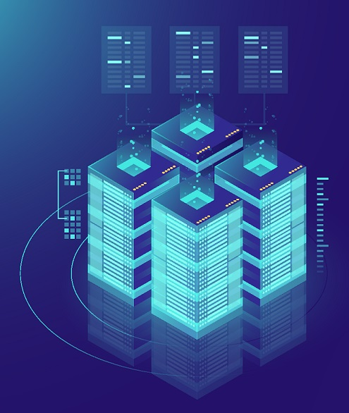
Encoding Trust in Land Registers
Susan Wells
301130235
November 27, 2018

Slide 2
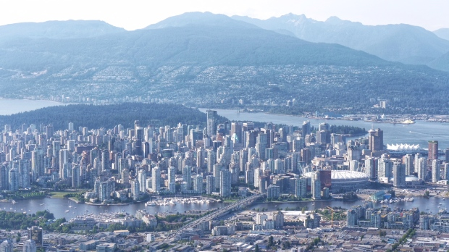
Gary Barndt, CTV Vancouver, July 25 2018

Slide 3

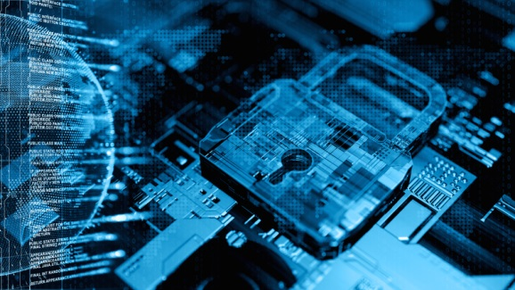
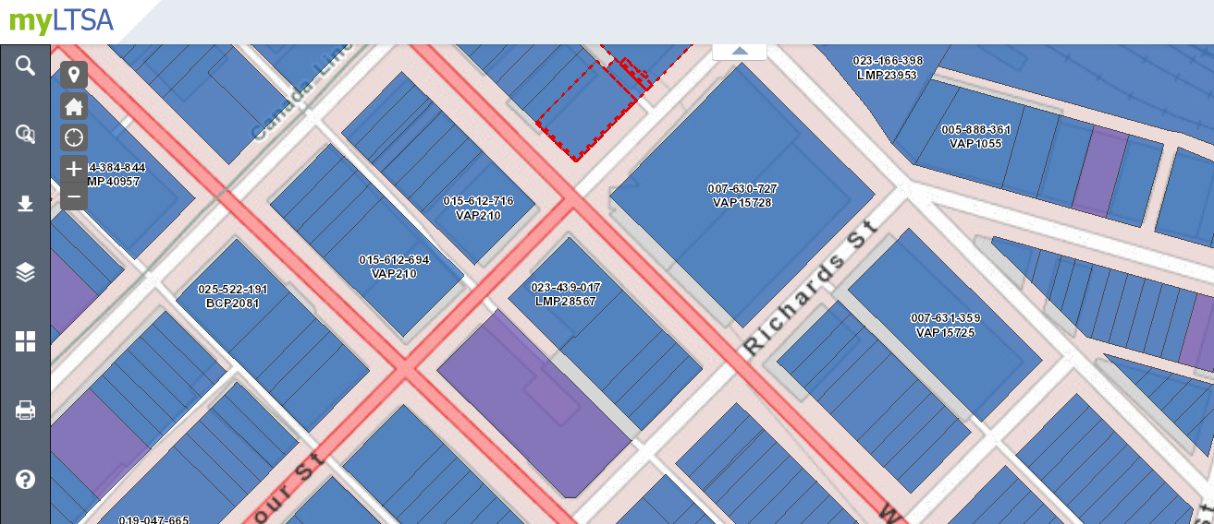
Exploring the Intersection of:
Trust
Land titles
Blockchain

Slide 4
What is Trust?
MAN: Show me and I will trust you.
GOD: Trust me and I will show you.
Old Testament, New Testament, Koran: ‘trust’ in God
13th century Middle English; possibly Scandinavian/Old Norse origin (traust) and/or Old English (treowe)
Foundation of human relationships / cornerstone of society and essential to its survival

Slide 5
3 Traits of Trustworthiness
Competence: do you have the skills, knowledge, and experience to do a particular role or task?
Reliability: are you consistent in doing what you say you’re going to do? Will you follow through?
Honesty: are your intentions aligned with mine? Do you show integrity?

Slide 6
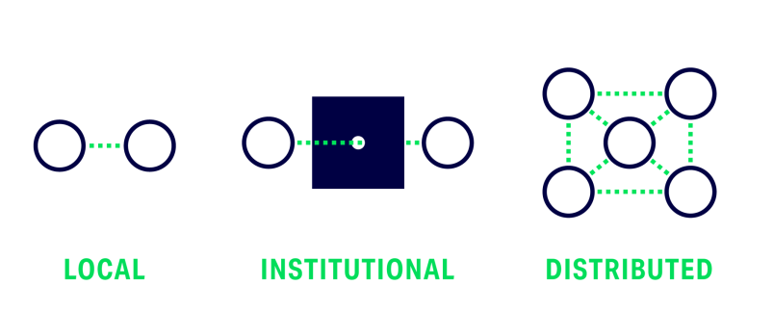
Evolution of Trust

Slide 7
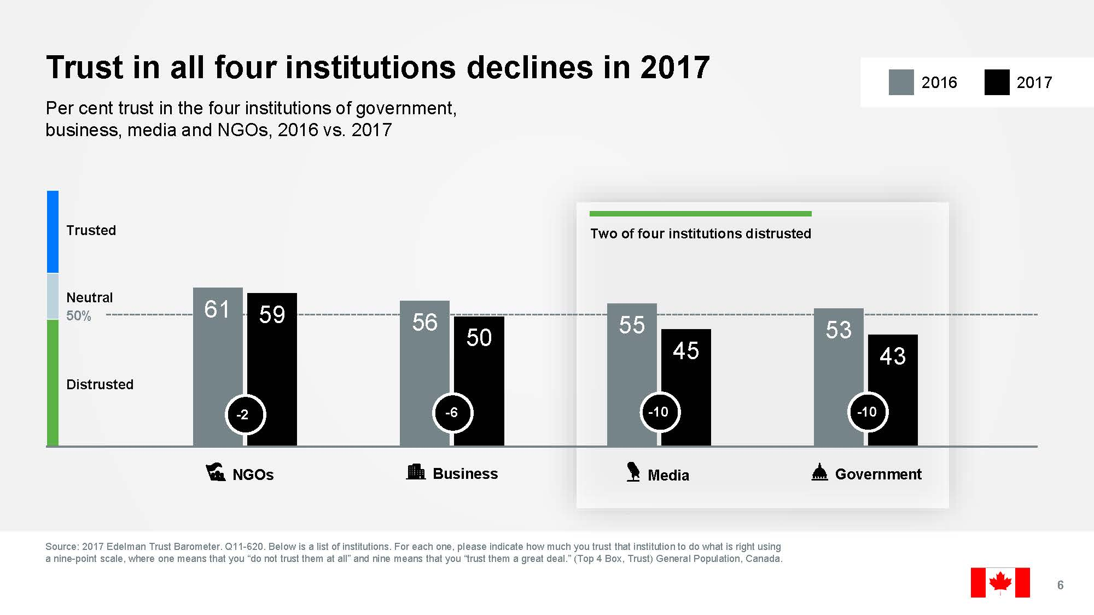
Institutional Trust in Crisis

Slide 8
Institutional Trust in Crisis
Gallup Research in US | 1970s | 2016
Overall confidence in major institutions | 70% | 32%
Government handling of international issues | 75% | 49%
Government handling of domestic issues | 70% | 44%
Supreme Court | 45% | 36%
Banks | 60% | 27%
Big Business | 26% | 18%
Church | 65% | 41%
Media/Newspapers | 39% | 20%

Slide 9
Why is Institutional Trust in Crisis?
Extent and rate of breakdown in trust between citizens/institutions and everyman/elites is unprecedented
For institutions to retain credibility and our confidence, there must be penalties—loss of power or position, fines, etc—when they break the rules or rules become meaningless
People are feeling let down and left behind
2008 Financial Crisis was only the tip of the iceberg

Slide 10
Purpose of Land Title Systems
No country can sustain stability within its boundaries, or economic development with the wider world, unless it has a system of registering private property rights that promotes internal confidence between its people, its commercial enterprises and its government.
Beyond the physical value of land and improvements, land titles transform property into a fungible asset that can be transferred/exchanged. Clear title has potential to generate surplus value by enabling owners to borrow against it and initiate additional production.
It is estimated there is $9.3 trillion dead capital in developing world because no title system in place to unlock the wealth potential of capital.

Slide 11
Bundle of Rights
Formal property records and titles represent our shared concept of what is economically meaningful about any asset. They capture and organize all the relevant information required to conceptualize the potential value of an asset and allow us to control it. Property is the realm where we identify and explore assets, combine them, and link them to other assets.
Real property rights are defined and protected by government (Torrens system)
Real property rights have a legal dimension
Real property rights have a physical dimension
Real property rights have an economic dimension; real property is a store of value

Slide 12
Public Expectations
“The power to identify and isolate with precision every asset and every particular interest on that asset”
A simple, understandable procedure for recognizing rights
Effective, secure documentation of rights
Protection against infringement of rights by others
Public record of rights so everyone knows
Record of complete and incontrovertible proof
Convenient methods for transferring rights
Effective procedures for preserving written record

Slide 13
2 Primary Land Title Systems Today
DEEDS | TORRENS
Common in Latin cultures in Europe (France, Spain, Italy), in South America, and in parts of Asia and Africa; founding system and common in United States | Introduced in South Australia in 1858; common in Australia, New Zealand, some states in US, most provinces in Canada, and some countries in Caribbean, Asia and Africa
Essentially ties record to person (subject) | Essentially ties record to land (object)
No government analysis / verification beyond basic review of signatures, witnesses, acknowledgements and taxes; receives and indexes the document, and returns to holder | Full government analysis / verify validity of title; guarantees person(s) named as owners on certificate of title have indefeasible title (but don’t guarantee boundaries)
Chain of title required from private market; legal and insurance specialists required to perform title search and title examination | 3 guarantees: Mirror: register reflects current status of title Curtain: register is sole source of title information and that no other source needs to be consulted to determine ownership, encumbrances, etc Indemnity: persons will be reimbursed if suffer any loss caused by errors, omissions, or misfeasance of Registrars.
Rapid recording | Easy to use/understand
Challenge: little government scrutiny; burden on private sector to determine rights holders; chain of title for 40-50 yrs required; title insurance necessary | Challenge: longer to register due to high scrutiny required

Slide 14
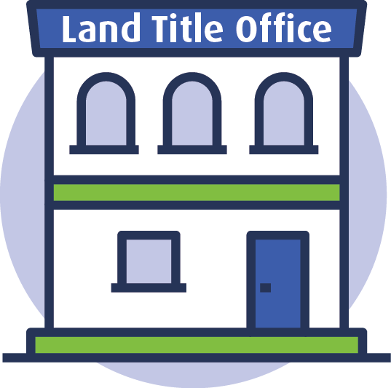
Land Titles Ecosystem
Property Owner / Seller
Agents
Provincial Govt
Financial Institution
Buyer
Lawyer / Legal Professionals
Other Smaller Parties

Slide 15
Impact of Eroding Institutional Trust
Single source of truth no longer as effective:
Increasing cyber risks / attacks
Susceptible to fraud
Trust in peers / strangers compromise role of intermediaries
Aging technology architected to store information; does not handle increasingly complex transactions and collaboration as easily
RISK: further loss of public trust and inability to adapt to trend toward distributed trust

Slide 16
Enter Blockchain
Beyond records, a P2P collaborative ecosystem
Immutable; secure, reliable and less susceptible to fraud
Owner-less (distributed ledger owned by all)
Permission-less (accessible to everyone)
Trust-less (not reliant on expensive intermediaries)
P2P sharing of authoritative data to validate identity, property information and complete due diligence
Faster close of transactions with less risks/gaps

Slide 17
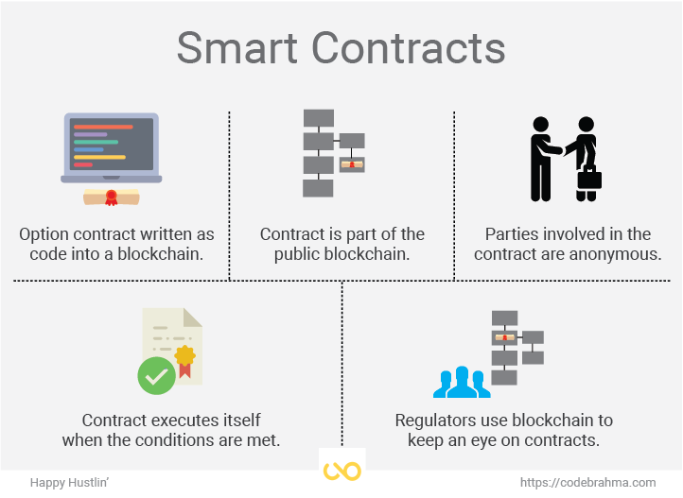
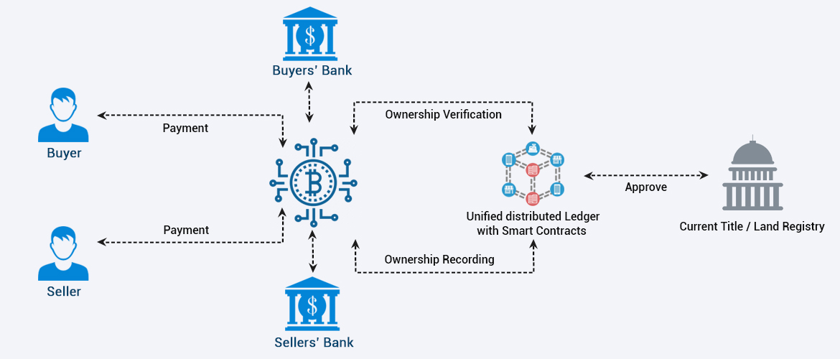
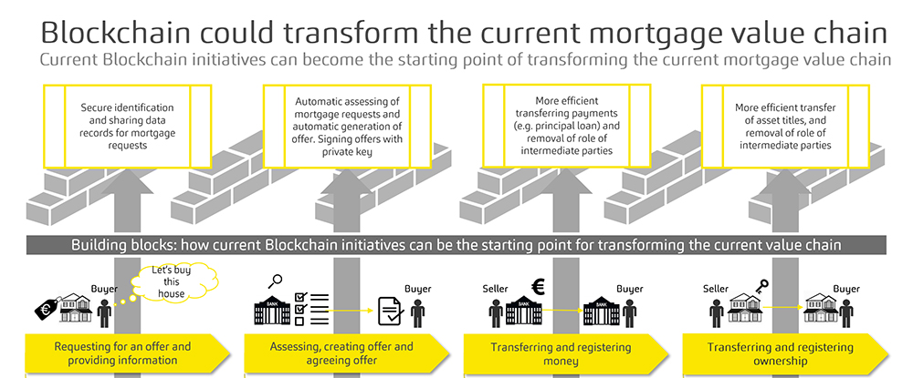
Enter Blockchain

Slide 18
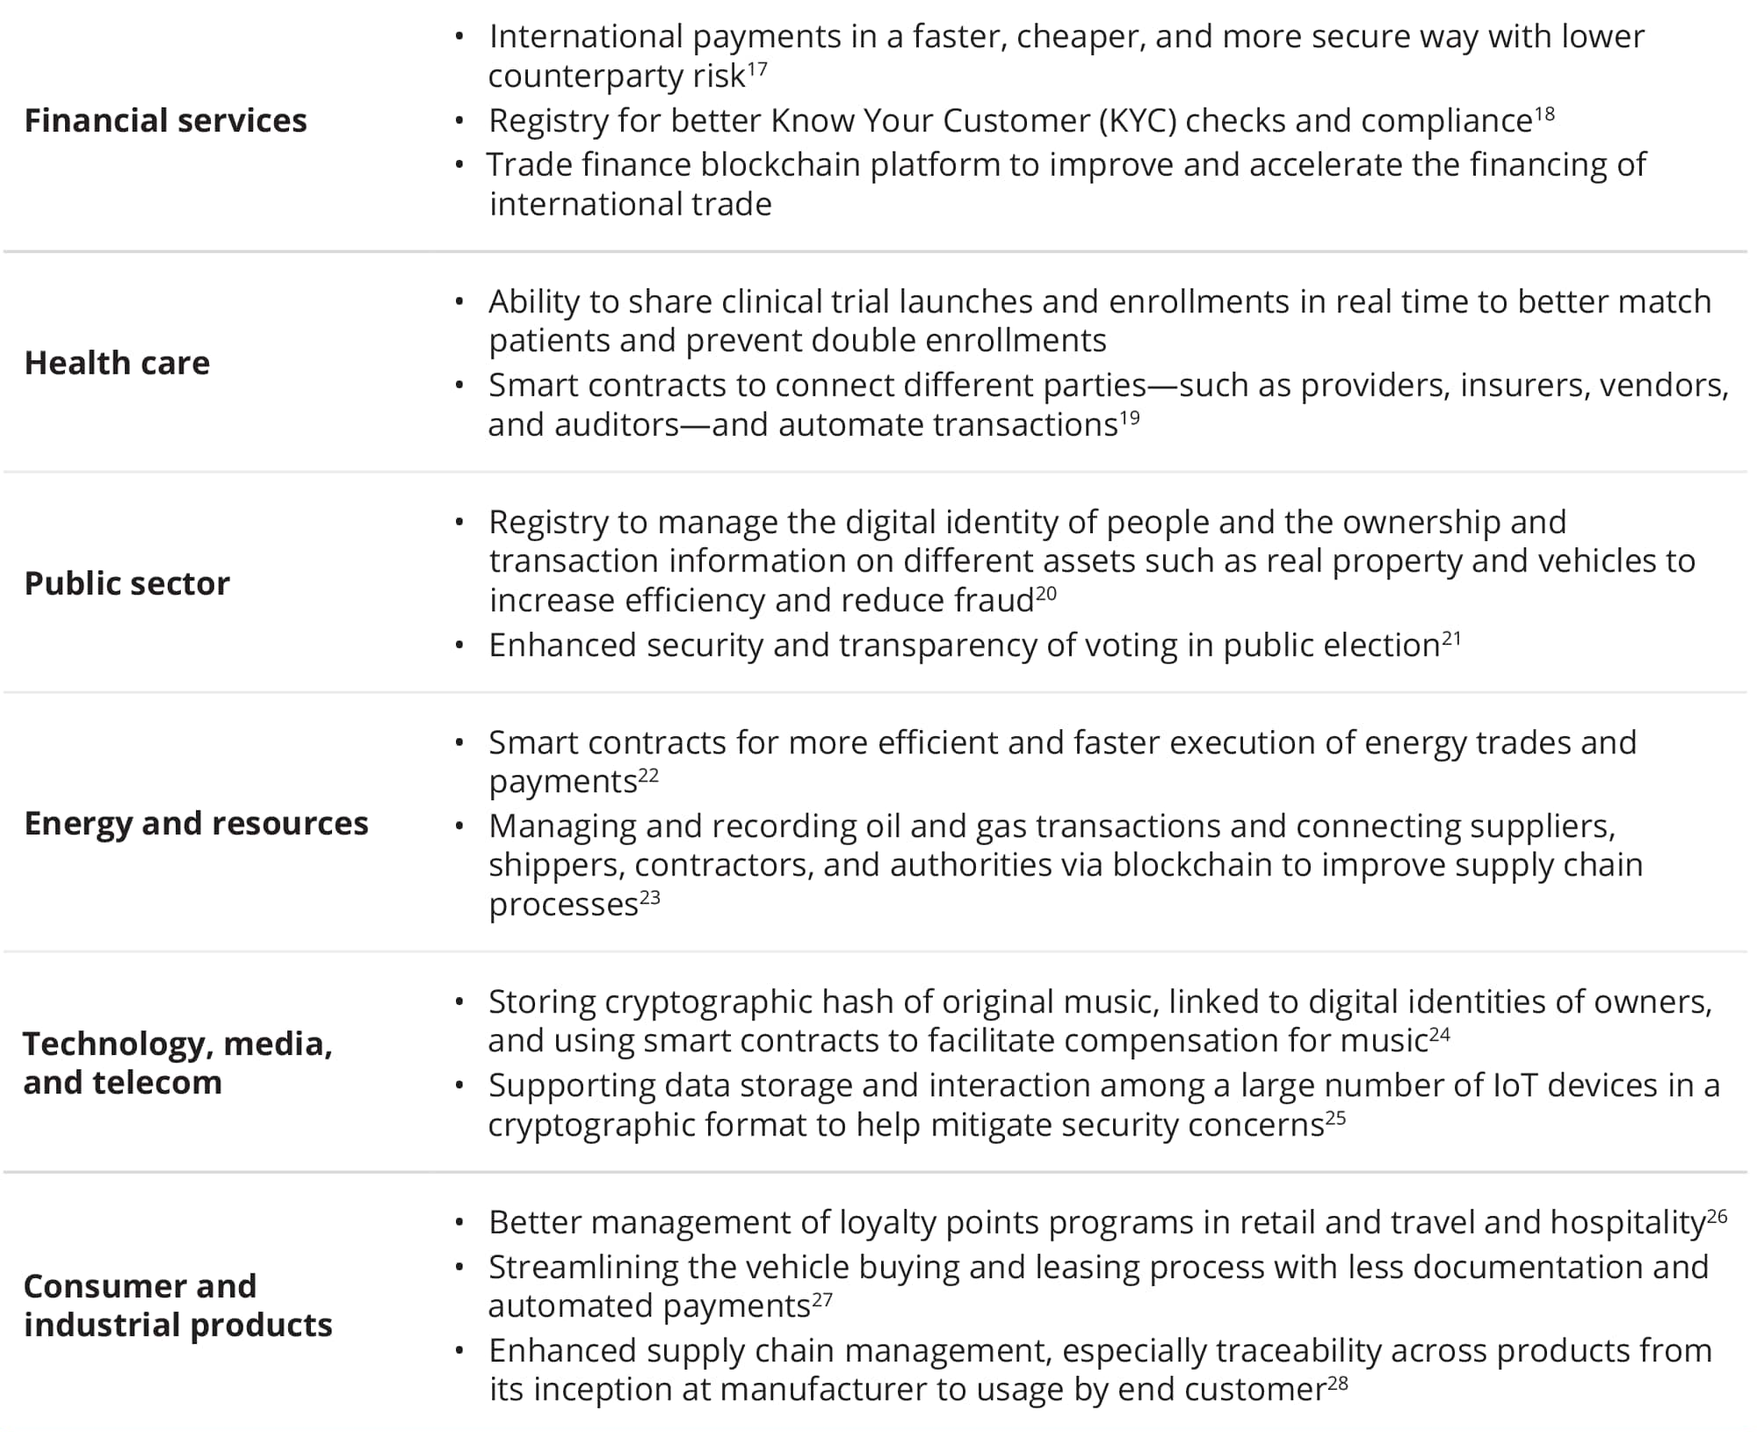
Additional Possibilities
Deloitte Insights | deloitte.com/insights

Slide 19
Why Not Blockchain?
Technology is merely a tool
Most registers are built on ‘new’ technology
May still require central authority to set up and maintain oversight
Requires ‘everyone’ to participate to be of value
Expensive to implement; no motivation/will to change
Not as safe / fraud-resistant as advertised; intermediaries still play a role

Slide 20

REMEMBER: Trust
People are trusting other people through technology.
The interplay of vulnerability and expectation, trust is a confident relationship with the unknown.

Slide 21
Summary
Trust is at the foundation of all human relationships.
Institutional trust is in crisis.
A trusted land system is critical to unlocking social and economic benefits; core reason why capitalism succeeds in the West.
Land title registers risk losing public trust and are unable to deal with erosion of institutional trust.
Blockchain offers opportunity to encode trust and make ecosystem more efficient, effective and sustainable.

Slide 22
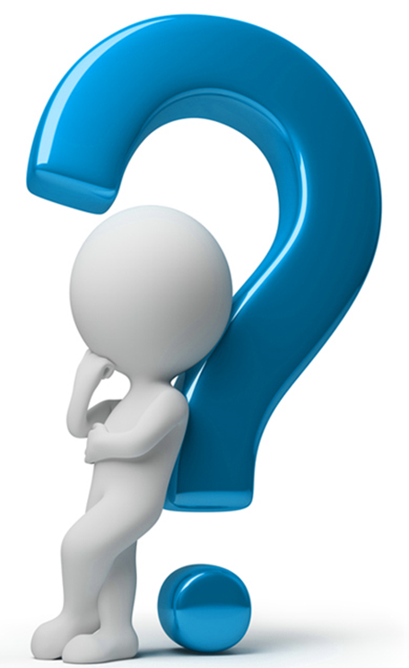
Thank You – Questions?

Slide 23
Links
https://www.kellogg.northwestern.edu/trust-project/videos/goldberg-ep-2.aspx
https://www.edelman.com/research/2017-edelman-trust-barometer
https://www.dailymaverick.co.za/article/2018-09-06-title-deeds-are-simply-a-means-to-an-end-security-of-property-rights/
http://www.pria.us/files/public/News/Presentations/2009/Winter_Symposium/LandRegistratonSystemsAroundTheWorld.pdf
www.libertystory.net/LSBIGSTORIESROMANPROPERTYLAW.htm
http://mitsloan.mit.edu/ideas-made-to-matter/blockchain-explained

Slide 24
References
Botsman, R. (2017). Who Can You Trust? Great Britain: Portfolio Penguin.
Casey, M.J. and Vigna, P. (2018). The Truth Machine: The Blockchain and the Future of Everything. New York: St. Martin’s Press.
De Soto, H. (2000). The Mystery of Capital: Why Capitalism Triumphs in the West and Fails Everywhere Else. New York: Basic Books.
Krier, J. E. (2008). The Evolution of Property Rights: A Synthetic Overview. University of Michigan Law School.

