Slide 1
Accused! Canada’s Human Rights Tribunals
An Innovation in Justice or Return of the Inquisition?
By Tim Hull
GLS 829
Notes:
Graduate Liberal Studies, Simon Fraser University
Dr. Geoffrey Poitras GLS 812
November 2018

Slide 2
An Inquiry
Into
The Procedures and Ethics of The Canadian Human Rights Tribunal

Slide 3
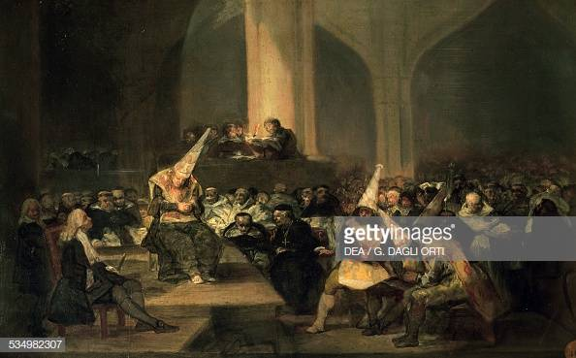
“The Inquisition Tribunal” Francisco de Goya
Notes:
Date: 1812-1819 * De Goya was twice summoned to the Inquisition for his art
The accused wearing dunce caps, coroza and frocks known as sanbenitos signifying personal details and offence

Slide 4
The Inquisitions
1184, Pope Innocent III, implemnts the 1st Inquisition in Southern France to quell the rise of the Cathars and Waldensians
The Inquisition would thrive for nearly four centuries in multiple iterations eg Medieval, Spanish, Portuguese, Papal, Roman…

Slide 5
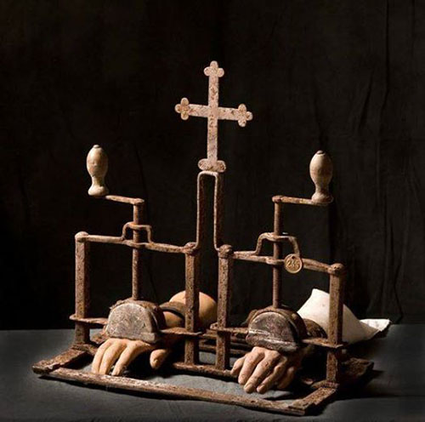
Hand Crusher with Cross

Slide 6
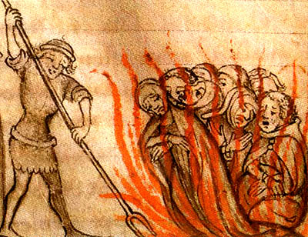
Would Christ have survived the Inquisition?
No one knows how many men women, children lost their lives
Conservative estimates: over 9,000,000 killed.
Notes:
http://www.badnewsaboutchristianity.com/gbg_inquisition.htm

Slide 7
Directorium Inquisition
"... for punishment does not take place primarily and per se for the correction and good of the person punished, but for the public good in order that others may become terrified and weaned away from the evils they would commit"
Nicholas Eymerich, Inquisitor General 1357-13-99
Notes:
Directorium Inquisitorum, edition of 1578, Book 3, pg. 137, column 1. Online in the Cornell University Collection; retrieved 2008-05-16.

Slide 8
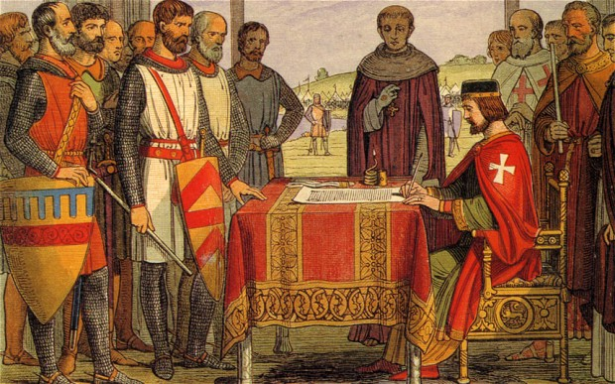
The Magna Carta 1215 England was the only Western Country to escape the Inquisition
Notes:
The Magna Carta at Runnymede, 1215
In 1215, Pope Innocent III was setting up the Inquisition. When he heard of Magna Carta, he wrote to the English clergy saying they had done something “abominable and illicit”.

Slide 9
Clause 39 of Magna Carta
No free man is to be arrested, or imprisoned, or disseised, or outlawed, or exiled, or in any other way ruined, nor will we go against him or send against him, except by the lawful judgment of his peers or by the law of the land.
Notes:
'The 1215 Magna Carta: Clause 39', The Magna Carta Project, trans. H. Summerson et al. [http://magnacarta.cmp.uea.ac.uk/read/magna_carta_1215/Clause_39 accessed 14 November 2018]

Slide 10
A radical and sudden shift
Formal > Informal
beginning of 13th Century
Accusatorial to Inquisitorial
On the grounds of a complaint or fama
From God as jury to Church appointed tribunals rendering verdicts
Inspired by Roman Law
Notes:
Levak, Brian P. The Witch Hunt in Early Modern Europe, 3rd Ed. Longman, London

Slide 11
What is a Tribunal? “Tribunals are less formal than the courts and people will often represent themselves without needing a solicitor. The tribunal chairman will usually take more time to explain the procedure and will ask more questions before making a decision”. This doesn’t happen in the courts. Very rarely will a judge intervene. Instead, they will listen to both sides and then make a decision based on the evidence they have heard.
Notes:
Insurance>David Walker, 7 AUGUST 2017
https://businessadvice.co.uk/insurance/liability-and-indemnity/the-difference-between-a-court-and-a-tribunal/

Slide 12

UNITED NATIONS – Universal Declaration of Human Rights – 1948

Slide 13
Article 8: Everyone has the right to an effective remedy by the competent national tribunals for acts violating the fundamental rights granted him by the constitution or by law. Article 10: Everyone is entitled in full equality to a fair and public hearing by an independent and impartial tribunal, in the determination of his rights and obligations and of any criminal charge against him.

Slide 14
The Path to Inquisitorial Justice in Canada The International Covenant on Civil and Political Rights (ICCPR) multilateral treaty adopted by the United Nations General Assembly through GA. Resolution 2200A (XXI) on 16 December 1966, and in force from 23 March 1976
Notes:
The ICCPR is monitored by the United Nations Human Rights Committee (a separate body to the United Nations Human Rights Council), which reviews regular reports of States parties on how the rights are being implemented. - wiki

Slide 15
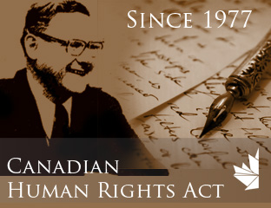
The Path to Inquisitorial Justice?
Notes:
The Canadian Human Rights Act would be come an integral part of the Charter of Rights and Freedoms which would be entrenched into the Constitution in 1982

Slide 16
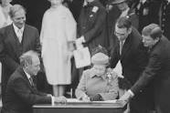
Charter of Rights & Freedoms Entrenched in the Constitution 1982
Notes:
As Prime Minister Pierre Trudeau (left) looks on, Queen Elizabeth II signs the Proclamation of the Constitution Act, 1982, in Ottawa on 17 April 1982. Her signature brought Canada's newly patriated Constitution \u2014 with the Charter of Rights and Freedoms \u2014 into force https://www.thecanadianencyclopedia.ca/en/article/constitution-act-1982

Slide 17
“To entrench the Charter in the Constitution seemed to be the only way to guarantee the judiciary would take it seriously, based on past experience with the Bill of Rights,”– Ian Greene, The Charter of Rights and Freedoms p.84 “The charter may transfer an important part of policy-making from the democratic process to the judiciary” (Greene, 85) Or did it give the UN an avenue into Canadian policy making and an instrument (outside of the courts) to enforce it through the Human Rights Tribunals?
Notes:
“Groups such as the Women’s Legal Education and Action Fund and the Canadian Civil Liberty Association are more likely to win a court challenge to a public policy they oppose than to win by working through the democratic process.” (Greene, 86)

Slide 18
Legal Rights in Canada Canada’s Bill of Rights (1960) vs. Charter of Rights & Freedoms (1982) Key Terms: ‘fundamental justice’ ‘fair hearing’ ‘fair tribunal’

Slide 19
Canadian Bill of Rights, 1960 (Federal Statute) Part 1 1. Recognition and declaration of rights and freedoms (a) the right of the individual to life, liberty, security of the person and enjoyment of property, and the right not to be deprived thereof except by due process of law. Construction of law 2 …no law of Canada shall be construed or applied so as to (e) deprive a person of the right to a fair hearing in accordance with the principles of fundamental justice for the determination of his rights and obligations;
Notes:
CONSOLIDATION Canadian Bill of Rights S.C. 1960, c. 44

Slide 20
The Charter of Rights & Freedoms, 1982 Legal Rights 7. Everyone has the right to life, liberty and security of the person and the right not to be deprived thereof except in accordance with the principles of fundamental justice 11. Any persons charged with an offence has the right (d) to be presumed innocent until proven guilty according to law in a fair and public hearing by an independent and impartial tribunal;

Slide 21
A Trudeau/Rawls connection? Trudeau on his 1968 Liberal Leadership Convention: “I based my campaign on the central theme of the just society. Achieving such a society would require promoting equality of opportunity and giving the most help to those who were disadvantaged.”

Slide 22
The Charter transformed the Courts into a supremely powerful institution, overnight “The Purposive Approach”
“Judges must shape the law to reflect reality and improve Society” - Bora Laskin, Chief Justice 1973-1984
Notes:
The Promise of Canada, pp 216,17, Gray,Charlotte, Simon & Shuster, Toronto, 2016

Slide 23
“The legislator sees law as a human artifact, created for a purpose, and many endeavor to use law not merely to rectify injustices but also to bring about a new social order in conformity with some ‘political morality.” - Roger Scruton
Notes:
Fools, Frauds and Firebrands, Thinkers of the New Left, p.55, Scruton, Roger, 2015, Bloomsbury, London

Slide 24
The Canadian Human Rights Tribunal The purpose of the Canadian Human Rights Act is to protect individuals from discrimination. It states that all Canadians have the right to equality, equal opportunity, fair treatment, and an environment free of discrimination. The Canadian Human Rights Tribunal (CHRT) applies these principles to cases that are referred to it by the Canadian Human Rights Commission (CHRC). The Tribunal is similar to a court of law, but is less formal and only hears cases relating to discrimination.
Notes:
From the Website https://www.chrt-tcdp.gc.ca/about/about-the-tribunal-en.html

Slide 25
CHRT Rules of Procedure 1 PURPOSE, INTERPRETATION Purpose 1(1) These Rules are enacted to ensure that a. all parties to an inquiry have the full and ample opportunity to be heard; b. arguments and evidence be disclosed and presented in a timely and efficient manner; and c. all proceedings before the Tribunal be conducted as informally and expeditiously as possible. …Dispensing with Rules abridgement or extension of time 1(4) The Panel may, on the motion of a party or on its own initiative, dispense with compliance with any Rule where to do so would advance the purposes set out in 1(1).

Slide 26
HUMAN RIGHTS CODE [RSBC 1996] CHAPTER 210 (BC Human Rights Tribunal Code)
Discrimination and intent
2. Discrimination in contravention of this Code does not require an intention to contravene this Code.

Slide 27
'I don't feel comfortable': Barber defends refusing haircut to woman. CTV News July 25, 2018
Notes:
CTVNews.ca Staff Published Wednesday, July 25, 2018 9:27PM EDT Last Updated Thursday, July 26, 2018 3:22PM EDT

Slide 28
An Ontario woman says she plans to file a human rights complaint against a barber who refused to cut her hair because of her gender. But Waterloo, Ont. barber Joe Cignelli says he’s never cut women’s hair and wouldn’t feel confident enough to properly perform the job. “It’s a men’s cut, pretty much. I’m not making no discrimination. If she got offended, I apologize to her. It’s all I can do – apologize,” he said. But human rights lawyer Cheronlyn Knapp says a person’s motivation has little impact on whether or not an incident can be deemed discriminatory.“The human rights code says that intent to discriminate is not the test. The test is the effect of the conduct. The effect on the person is what’s going to be looked at,” Knapp said. Croft was so upset by the experience, she plans to file a formal complaint with the Human Rights Tribunal of Ontario. The tribunal hears complaints and uses the Ontario Human Rights Code to determine if a person’s rights were infringed upon.

Slide 29
BCHRT Annual Report 2017 Tribunal Workload The Tribunal continued to have a significant workload. The caseload volume is at an all-time high. The number of active complaints at the Tribunal is 1,188, which represents a 20% increase over the previous year.

Slide 30
The Human Rights Act The Charter of Rights and Freedoms The Canadian Human Rights Tribunal The Canadian Human Rights Commission Provincial Human Rights Tribunals

Slide 31
Why? (if not a UN conspiracy) First Nations Influences 1. “The Inclusive Cirlce” 2. Dependence, Partnerships -John Ralston Saul
Notes:
A Fair Country, John Ralston Saul, 2008 Penguin Group, Canada

