Slide 1

An answer to the deep, philosophical question of why do we buy the stuff celebrities recommend?
Elaine Williamson
LS812
Apr. 2022

Slide 2
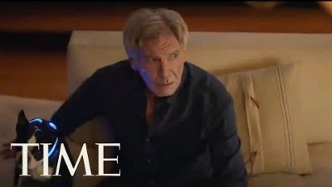
Count the number of celebrity endorsers
Notes:
2:48 – skip 1:30 – 2:00
2019 cost of a superbowl ad 30 sec = $5.2 million

Slide 3
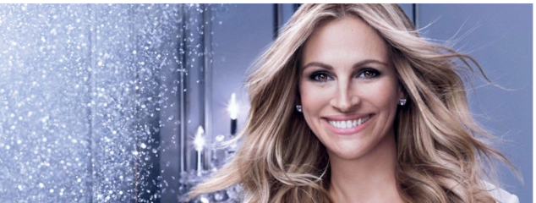
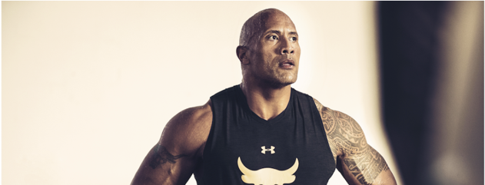
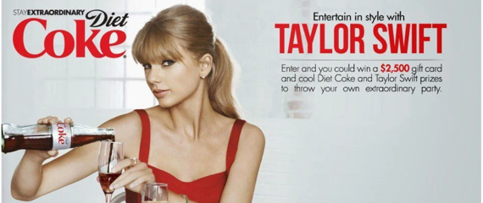
What is celebrity endorsement?
Consumers model their consumption based on a favourite celebrity’s preferences
Firms use celebrities to sell products to:
Gain attention from target customers
Improve brand credibility
Increase recall
Celebrity endorsements are more frequent with products with high margins and large customer base
Photo credit: https://blog.hollywoodbranded.com/top-10-celebrity-endorsements
Notes:
Celebrities can be excellent salesmen.
Offering consumers a familiar and recognizable face is considered to be the fastest and safest way for brands to develop an association and a bond in the mind of its consumers.

Slide 4
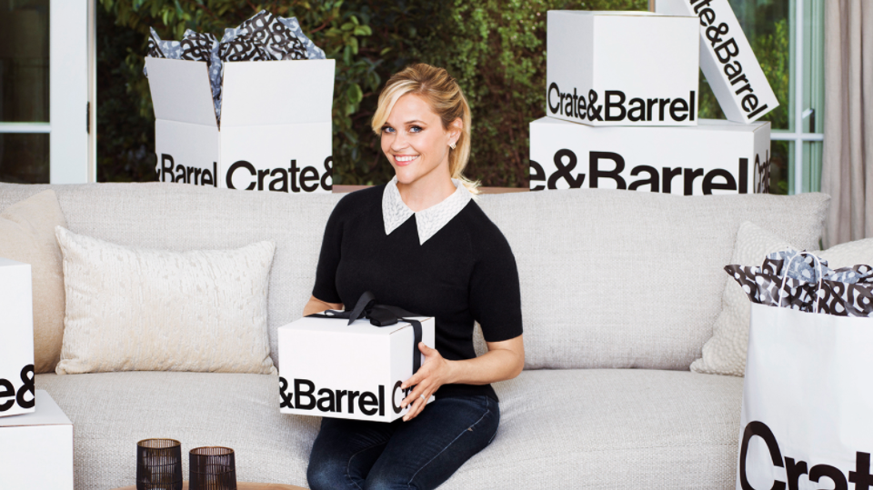
Celebrity endorsements can increase a company’s sales an average of 4%.
Notes:
celebrity endorsement increases a company’s sales an average of 4% relative to its competition, and also increases a company’s stock value by 0.25%, according to research by Harvard Business School professor Anita Elberse and Barclays Capital analyst Jeroen Verleun. For large companies—which are more likely to use celebrity endorsements—4% can be billions, justifying the exorbitant costs.

Slide 5
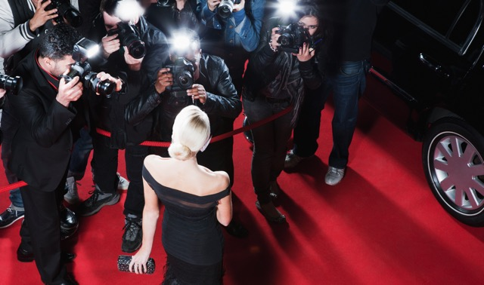
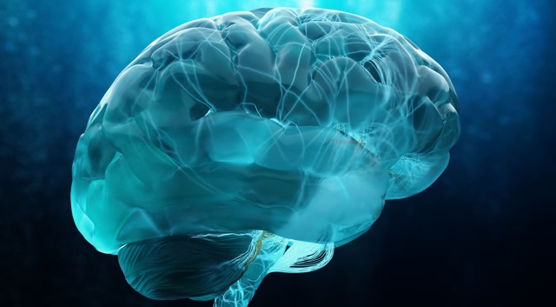
How does a celebrity endorsement work?
Your brain recognizes a familiar face.
Transitive properties kick in. If A=B and B=C, then A=C, therefore, Diet Coke must be good because Taylor Swift ❤️
Our emotions drive our decisions.
Notes:
The answer lies in the brain.
First, our minds do not do a good job of differentiating between real and make-believe, so celebrities become familiar to us.
When a familiar face promotes a product, it makes it seem as if the product itself is familiar, which makes people more likely to buy it.
Even though we’ve never met them, the brain regards familiar celebrities the same way it does people who are actually familiar and trustworthy to us in real life. And the brain loves familiar faces and lights up when we see one. The more familiar, such as your mom, the more the brain becomes active. Companies can’t, of course, get the endorsement of everyone’s moms, but they can find a celebrity that does the trick.
Because of the concept of familiarity, seeing a celebrity arouses our emotions. It connects us to the product and makes it memorable. Our emotions, more than any other thing, tend to drive our decisions
Similarly, through simple transitive properties, an endorsement by a high-quality person makes the product appear high quality. Endorsements give a product some credentials. We assume a beautiful celebrity knows more about beauty products than we do, an athlete knows more about thirst-quenching beverages, and we may even assume that an actor who plays a doctor on TV is knowledgeable about drugs.
Celebrity endorsed products makes consumers feel classy and glamorous
Consumers perceive celebrity-endorsed products as a symbol of status.
Consumers are more attracted towards celebrity endorsed advertisements than those without
Consumer brand recall improves with celebrity endorsements
Source:Investigating the marketing impact of consumers’ connectedness to celebrity endorsers

Slide 6
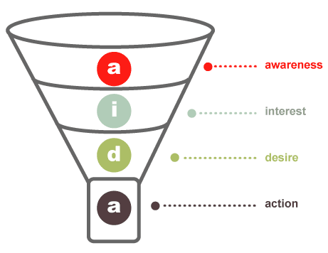
Neuromarketing: AIDA aka the hierarchy of effects model: Consumers move through a series of steps to make a purchase decision
think
feel
do
new customer
regular purchaser
loyal supporter
brand advocate
Notes:
Image credit: blog.hubspot.com
AIDA model: Promotion should move consumers toward action, like a funnel
Awareness: Get attention [THINK]
Do consumers know that Blendtec is a brand of blenders?
Memorable names and jingles, repetition
Interest: Get and maintain interest [FEEL]
Are consumers interested in Blendtec?
Desire: Generate “I want” or “I need” [FEEL]
Do consumers feel that they want or even need Blendtec blenders?
Action: Encourage action now (EX: BOGO) or in future (EX: Tiffany’s ad) [DO]
Action = purchase product, watch video, write blog, visit website, review on Yelp, etc.
Do consumers purchase Blendtec blenders?
The AIDA model is just one of a class of models known as hierarchy of effects models or hierarchical models, all of which imply that consumers move through a series of steps or stages when they make purchase decisions.
Cognition think Affect = feel (think) Beehaviou = do
The central concept of neuromarketing is strongly related to brain activities, understanding the consumers’ subconscious mind, explaining consumers’ preferences, motivations, and expectations, and predicting consumers’ behavior.
Then, going back to class #1, move people along the value chain
New customer: Get people to try it once
Regular purchaser: Get them to come back
Loyal supporter: Get them not to go elsewhere
Advocate: Get them to be a vocal champion – to friends, online, etc.
CLASS EX: Apply lessons in life (w/in or w/o marketing), major in marketing, etc.
JOB EX: video/resume grabs attention, maintains interest, makes desirable candidate, explains how to get you onboard quickly
Don’t be manipulative – maintain value orientation, may need to be selective (don’t get x, get y next time)
Not always a direct or quick link from a communication to an action
And consumers may not always do all steps, like impulse purchases

Slide 7
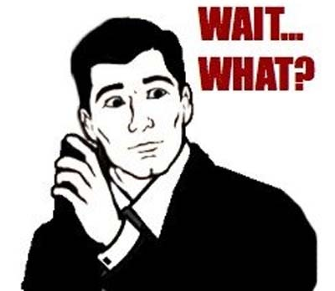
Our brains haven’t evolved for long enough to recognize that we don’t actually know the celebrity. We think they’re a friend. We become indoctrinated by products, the machinery of production…
This Photo by Unknown Author is licensed under CC BY-SA-NC

Slide 8
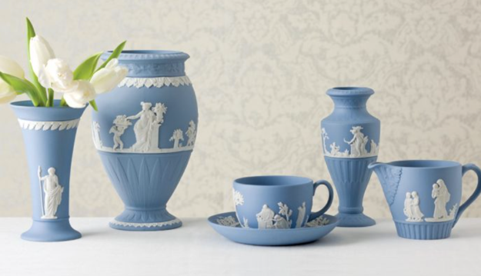
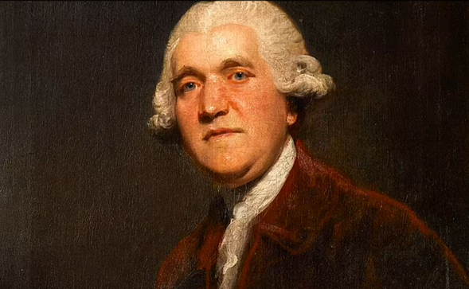
How long has this celebrities-selling-things been around?
1760 – Josiah Wedgwood
The monarchy
Notes:
he history of celebrity endorsement of products dates back to the 1760s. Josiah Wedgwood, the founder of the Wedgwood brand of pottery and chinaware, also called the father of the modern brand ';used royal endorsements and other marketing devices to create an aura around the name of his company that gave the brand a value far beyond the attributes of the product itself.⁴; A Mindshare Manifesto

Slide 9
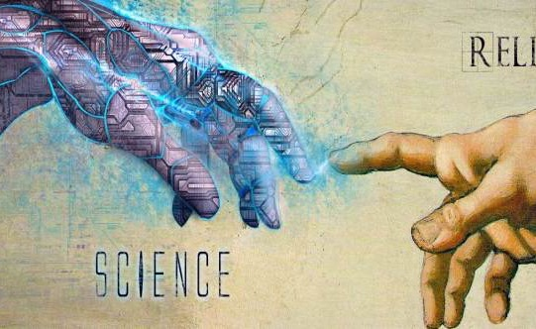
Hmm, this sounds pretty superficial. Isn’t this course on philosophy and business? Where’s the religion? The science?
A short primer on materialism

Slide 10
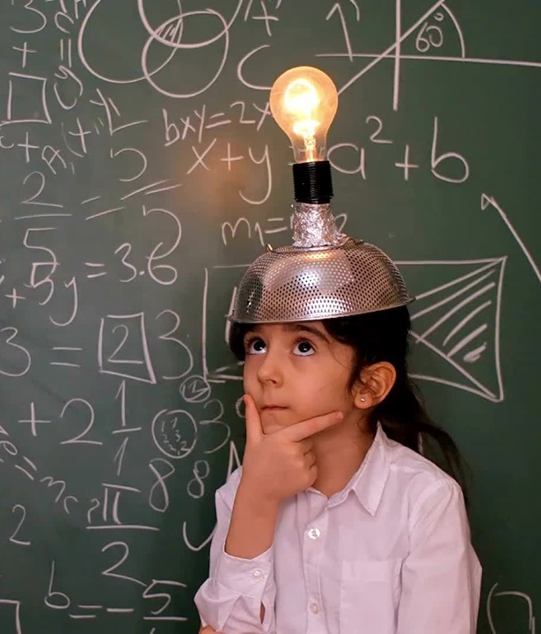
Popular materialism is the concept that nothing exists except matter and its movement – false consciousness
Although there are many philosophical schools, most fall into two primary categories, to answer the questions of ‘what reality consists of’ and ‘how it originates’:
Idealism – spirit or mind is primary
Materialism – matter is primary, mind is secondary
According to Constantin Gutberlet writing in Catholic Encyclopedia (1911), materialism, defined as "a philosophical system which regards matter as the only reality in the world…denies the existence of God and the soul."^{[50]}
In this view, materialism could be perceived incompatible with world religions that ascribe existence to immaterial objects.^{[51]}
Materialism may be conflated with atheism;^{[citation needed]} according to Friedrich A. Lange (1892), "Diderot has not always in the Encyclopædia expressed his own individual opinion, but it is just as true that at its commencement he had not yet got as far as Atheism and Materialism."^{[52]}
Notes:
Popular materialism is connected to ontological materialism (what is being all about) – being is completely described by objects. – reality is material not mental – no scope for intellectual or spritical substance
Kinda old – has been replaced by physicalism though – we might see things that aren’t exactly physical but they’re there – eg atoms, quarks - can’t see all parts of physical reality
Materialism a crude form of this – reality is about the things – accumulation of things
Joseph Smith, the founder of the Latter Day Saint movement, taught: "There is no such thing as immaterial matter. All spirit is matter, but it is more fine or pure, and can only be discerned by purer eyes; We cannot see it; but when our bodies are purified we shall see that it is all matter."^{[54]} This spirit element is believed to always have existed and to be co-eternal with God.^{[55]}
Mary Baker Eddy, the founder of the Christian Science movement, denied the existence of matter on the basis of the allness of Mind (which she regarded as a synonym for God).^{[56]}

Slide 11
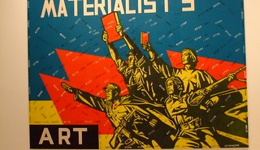
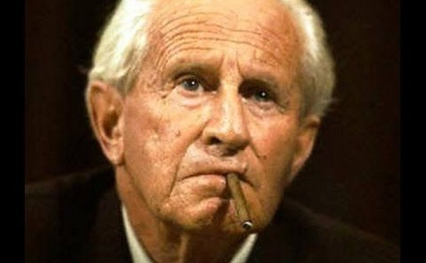
All About the Good Life: The Materialists, Marcuse and One-Dimensional Thought
The productive apparatus and the goods and services which it produces "sell" or impose the social system as a whole.
Products carry attitudes and habits, intellectual and emotional reactions, that tie consumers to producers
The products indoctrinate and manipulate, promoting a false consciousness
As products become available to more individuals in more social classes, the indoctrination they carry becomes a way of life.
Life is so much better ☺…and a pattern of one-dimensional thought and behavior in which ideas, aspirations, and objectives transcend the established universe of discourse are repelled or reduced to terms of this new universe.
This Photo by Unknown Author is licensed under CC BY-NC-ND

Slide 12
Discussion questions
Consumers are lazy. We like easy ways to remember things. Celebrity endorsements help with this. What’s the big deal?
Is a culture that overvalues celebrities, imbuing them with taste and insight, in danger of becoming one-dimensional?
Why aren’t we offended by Musk and Bezos? We almost glorify, don’t we? What would Marcuse say (one-dimensional thought)?

Slide 13
Works cited
Photo credit: https://blog.hollywoodbranded.com/top-10-celebrity-endorsements
Investigating the marketing impact of consumers’ connectedness to celebrity endorsers
https://www.eajournals.org/wp-content/uploads/Impact-of-Celebrity-Endorsement-on-Consumers-Buying-Behavior.pdf

