Slide 1
Understanding Populism
Notes:
1

Slide 2
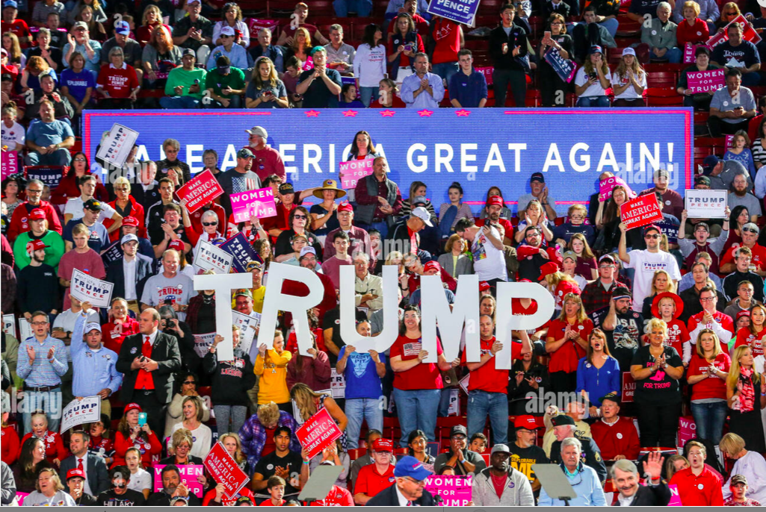

Slide 3
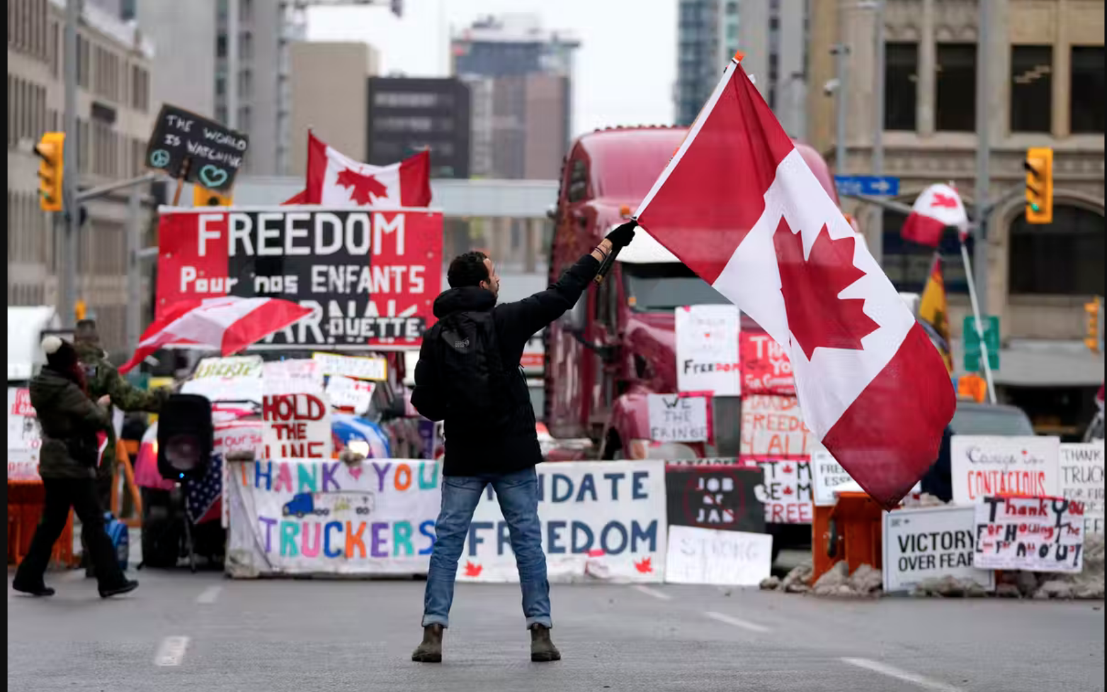

Slide 4
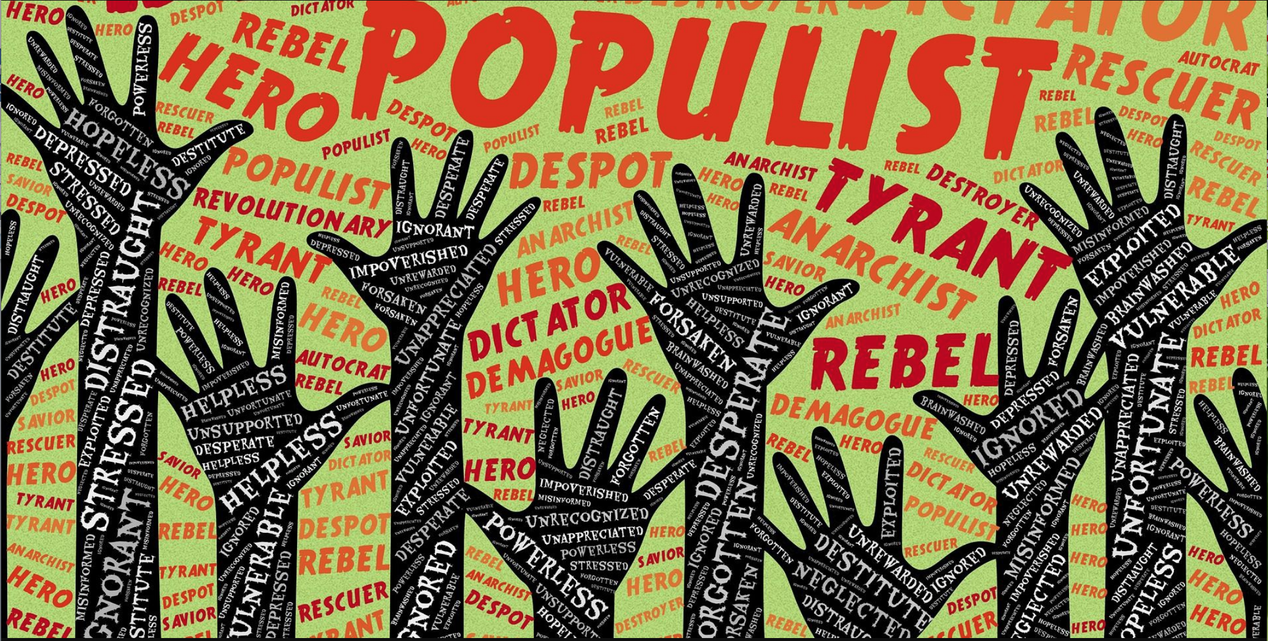

Slide 5
Definitions of Populism
Any political movement which seeks to mobilize the people… against a state which is either controlled by vested interests or too powerful in itself. - Oxford Dictionary of Sociology
A form of political expression that sets a supposedly unified people against elites who are somehow corrupt or morally inferior…an essentially anti-elite and anti-pluralist type of identity politics. – Muller, Jan-Werner (2016) What is Populism?, Penguin

Slide 6
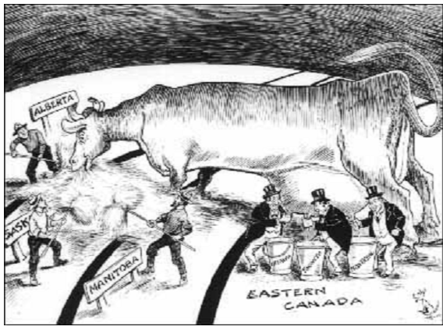

Slide 7
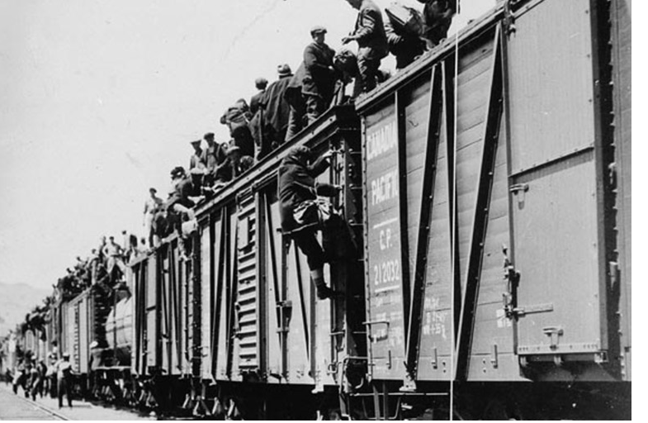

Slide 8
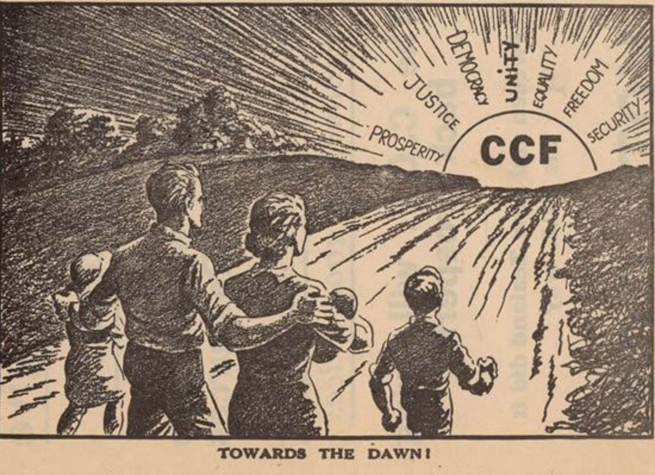

Slide 9
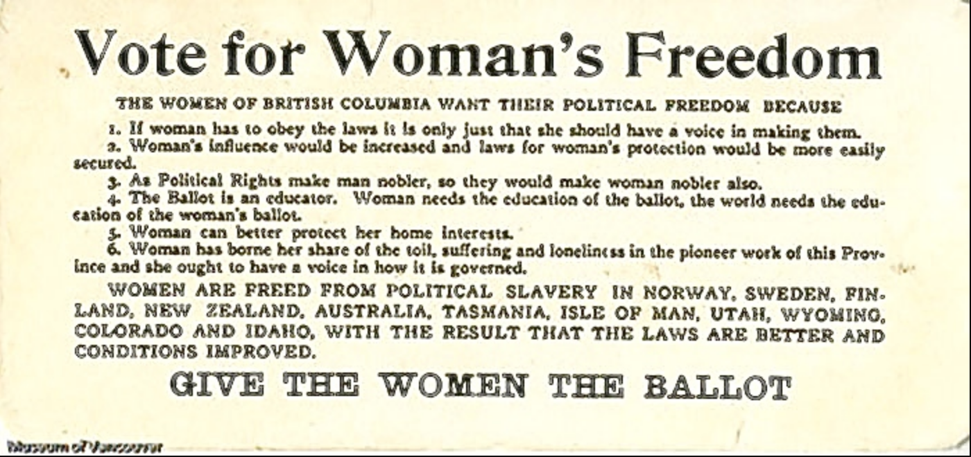
Notes:
I

Slide 10
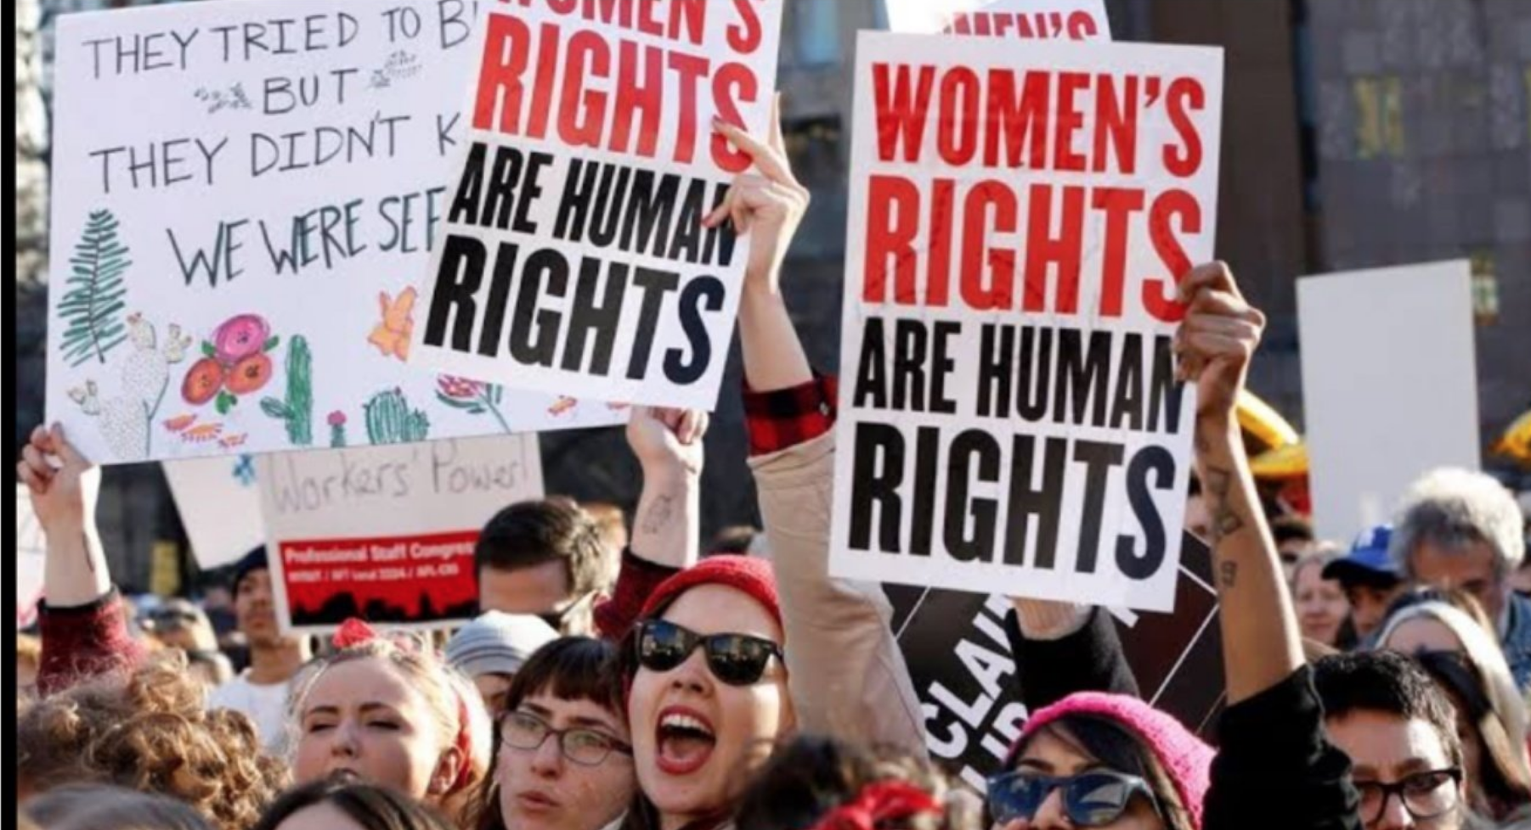

Slide 11
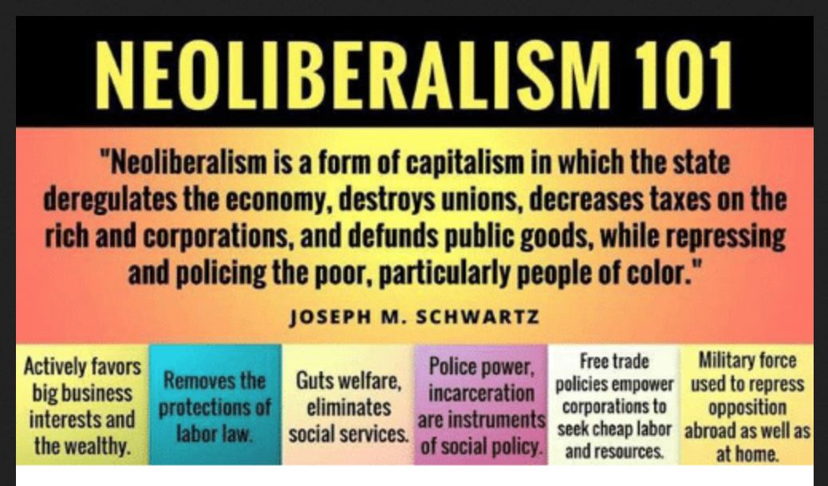

Slide 12
Impacts of Neoliberalism
Extreme wealth gap between rich and poor; wealth will ‘trickle down’ to enrich everyone
A collapse in intergenerational mobility
The unraveling of social legislation and economic oversight by governments. Eg. tax cuts for the wealthy; regulation minimized; public services privatized; ‘Dark money’ influencing elections
Collective bargaining/trade unions dismantled. Job loss a personal failure, not a system failure
Increased evidence of loneliness, depression, eating disorders, violence, anxiety

Slide 13
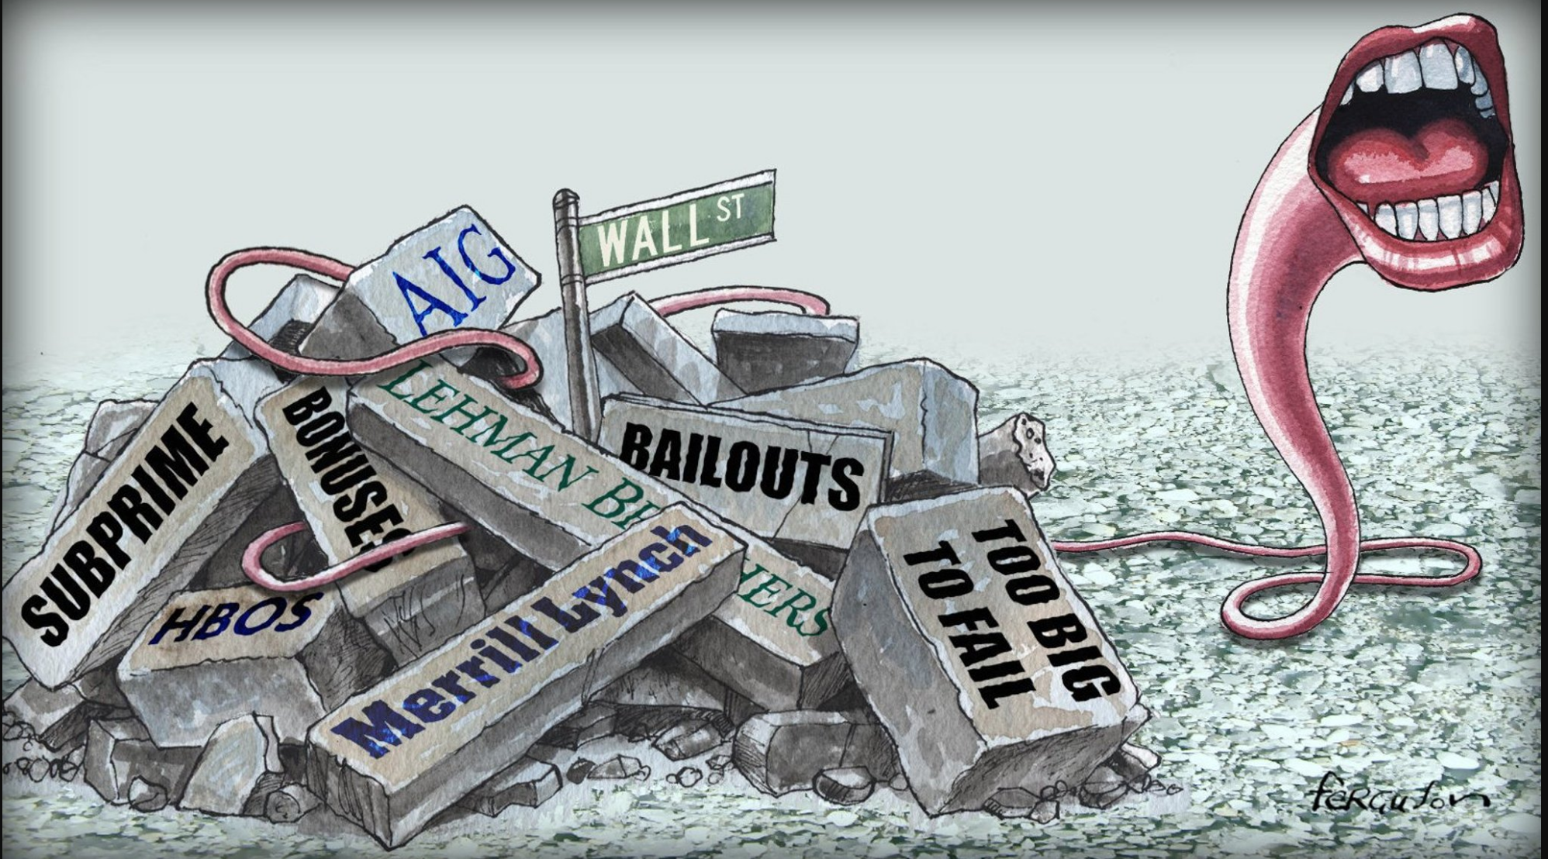

Slide 14
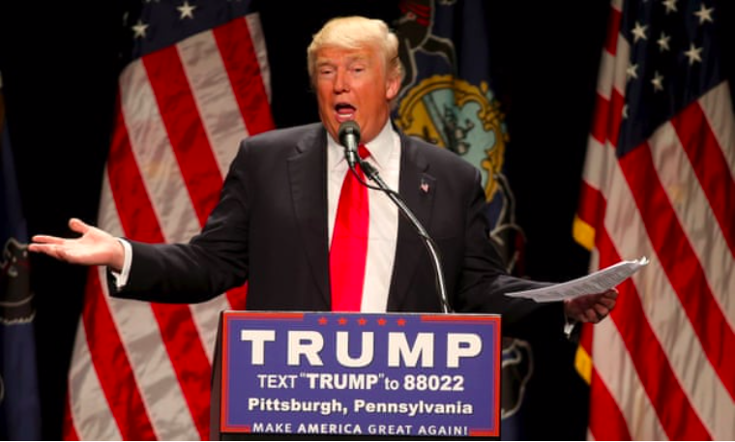

Slide 15
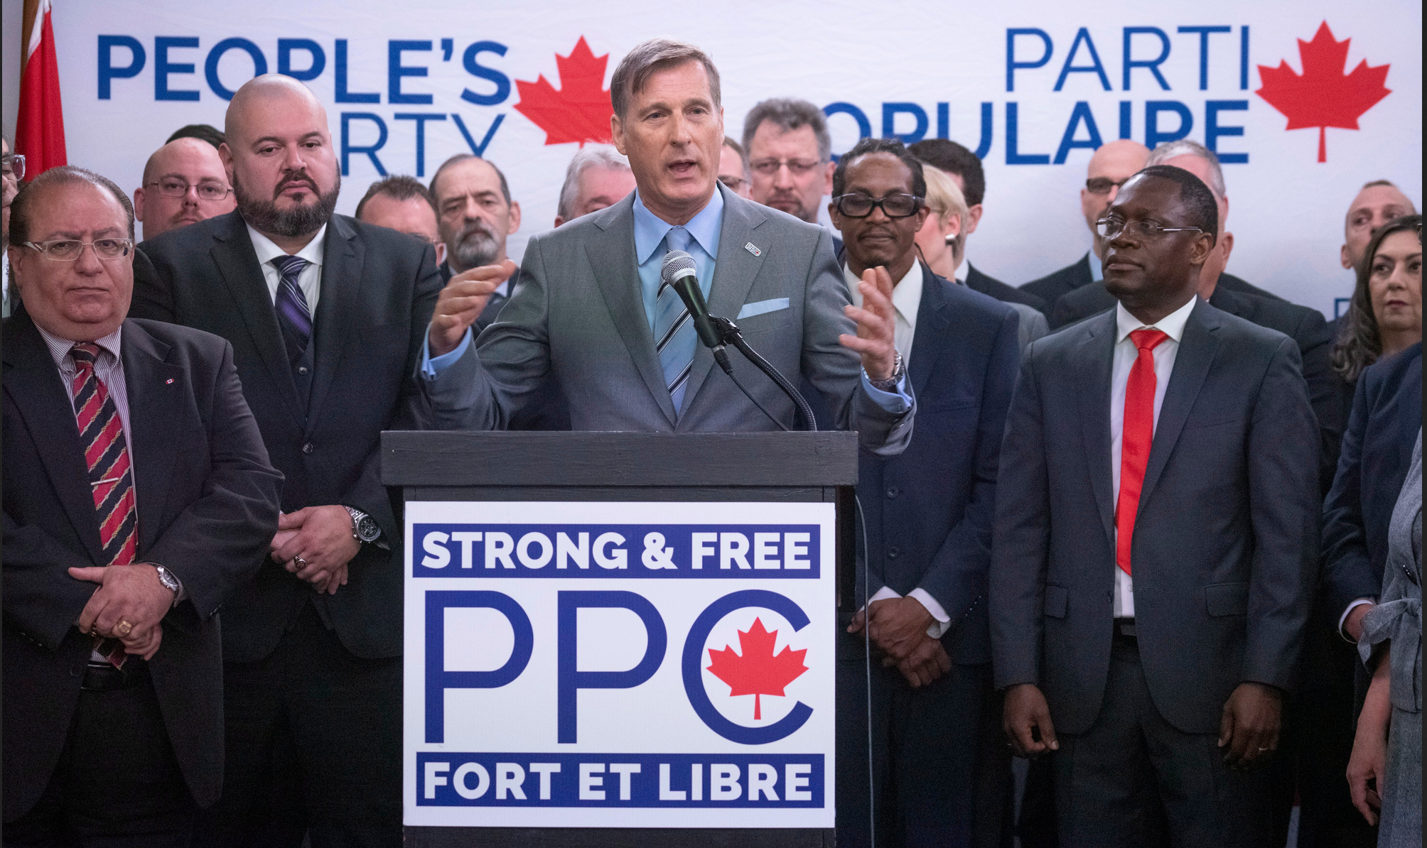

Slide 16
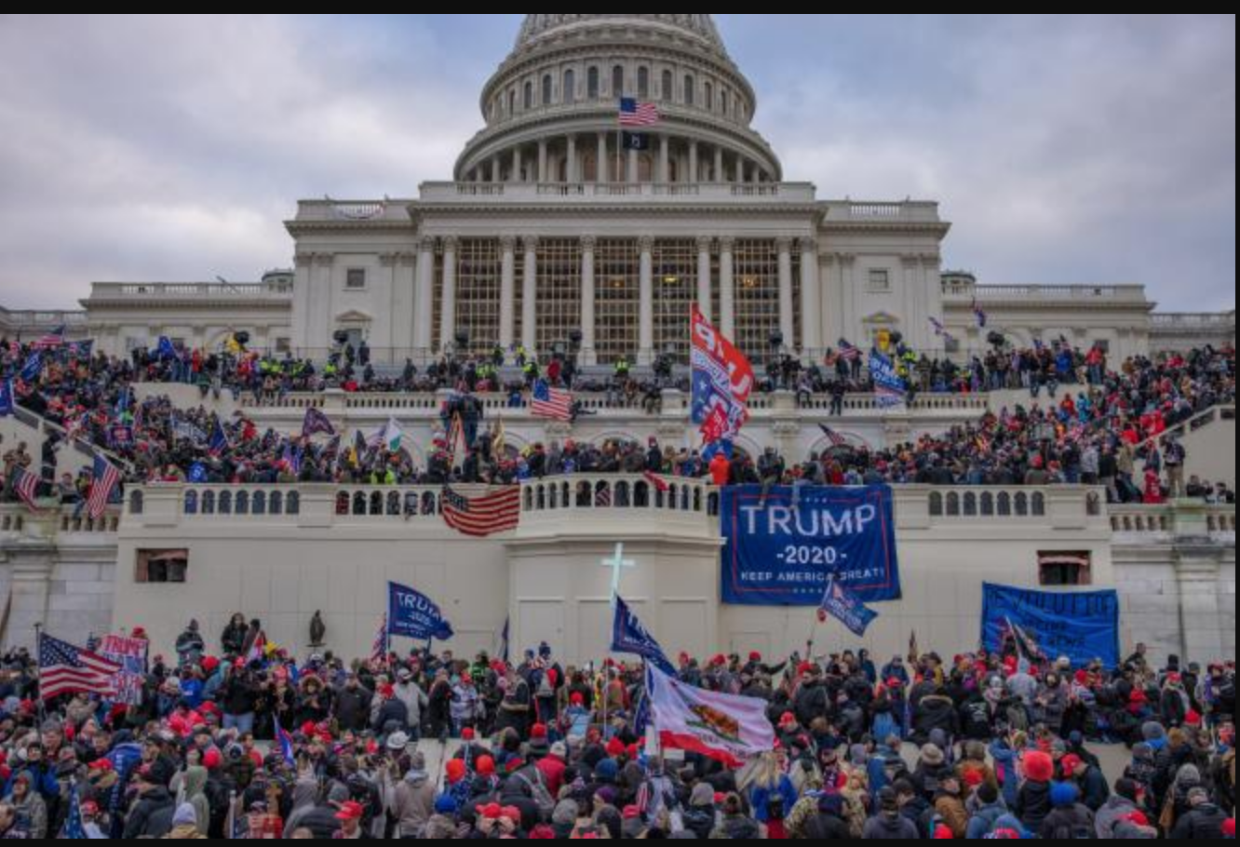

Slide 17
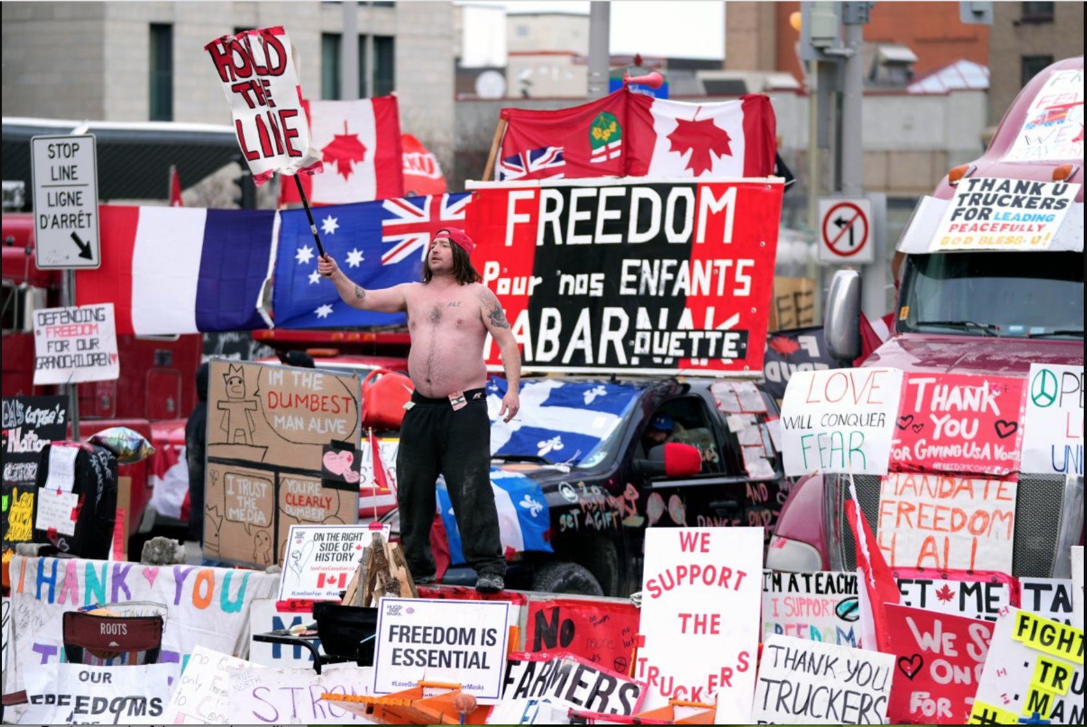

Slide 18
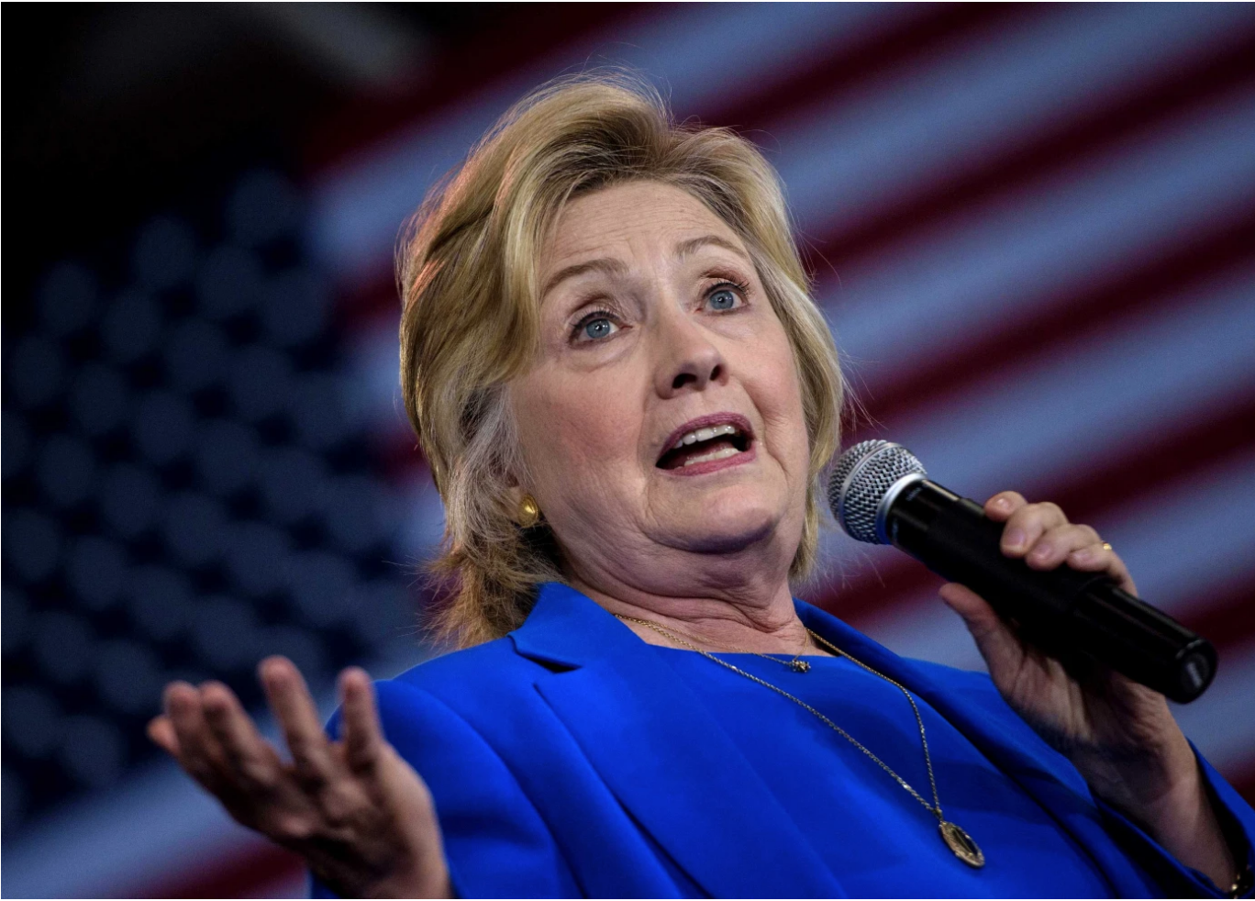
2016 Campaign
“You could put half of Trump supporters into what I call a basket of deplorables…they are racist, sexist, homophobic, xenophobic, Islamophobic..you name it”

Slide 19
Protzer & Summerville: Another Point of View
Populism stems from voters who think that the rules of society are unfairly rigged...these disenchanted citizens have reason to believe
that opportunity is not equal,
that economic rewards do not match contributions
That the much-cherished rules of meritocracy are broke
- Eric Protzer, & Paul Summerville, 2022 Reclaiming Populism: How Economic Fairness Can Win Back Disenchanted Voters,

Slide 20
Populism strikes when
Citizens are angered by economic unfairness
Being unfairly held back because opportunity is not equal
Reward is not according to contribution
Low social mobility because of unlucky start in life
Disadvantages due to factors outside their control (Gender, class, race, language)
Individual economic success depends on family wealth (a clear violation of economic fairness)
FAIR ECONOMIC OUTCOMES ARE NOT THE SAME AS EQUAL ECONOMIC OUTCOMES.

Slide 21
The Rise of Populism -Theories or Myths?
Cultural Variables
Immigration
Social Media
Intergenerational values
Economic Variables
Income and Wealth Inequality
Shocks from global trade
Fallout from the Global Financial Collapse
- Eric Protzer, & Paul Summerville, 2022 Reclaiming Populism: How Economic Fairness Can Win Back Disenchanted Voters,

Slide 22
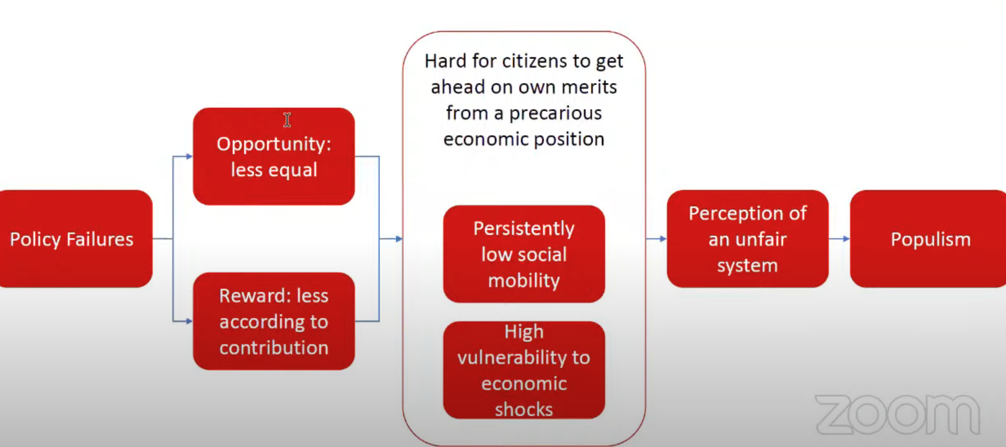

Slide 23
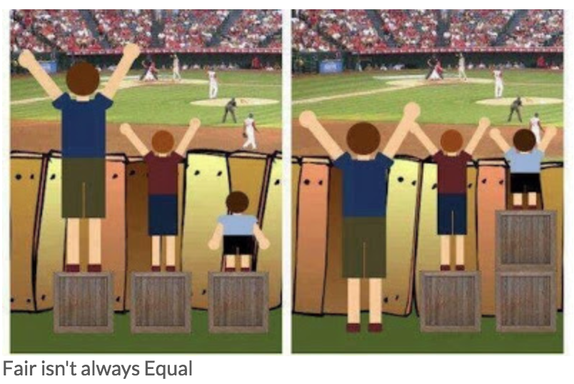

Slide 24
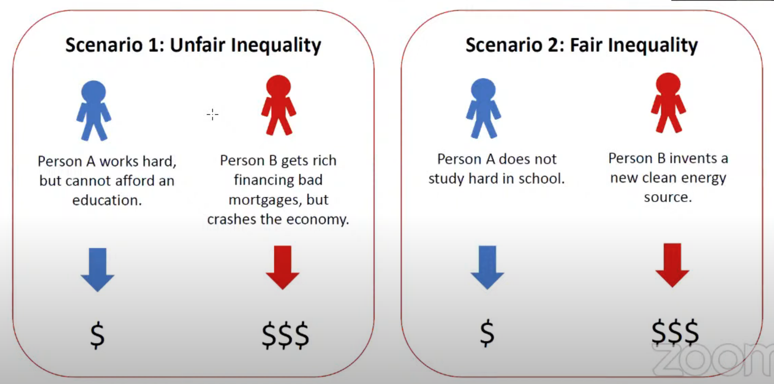
- Eric Protzer, & Paul Summerville, 2022 Reclaiming Populism: How Economic Fairness Can Win Back Disenchanted Voters

Slide 25
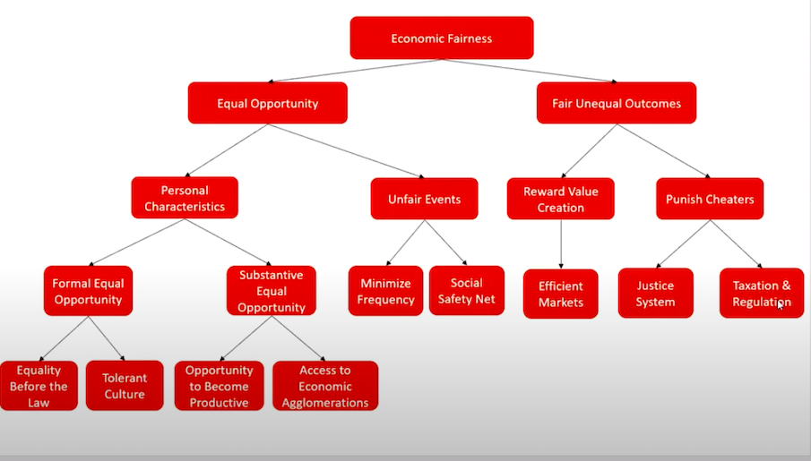

Slide 26
