Slide 1

SURROGACY
Baby Factories? Rent a Womb?
APRIL 14TH, 2022
LS812- Science and Human Values: Business, Science & Religion
Presented By: Nav Dhaliwal
Notes:
I have been down the deep rabbit hole of surrogacy these past few weeks. At the start of the term, I was interested in exploring the commodification of the body, this led me to think about surrogacy, which isn’t a short-term transaction, it’s one that involves priming the body for the gestation but also one that takes over a genetically born female body for approximately 9 months.
The question I’ve been asking myself is just because it can happen, and it’s a possibility doesn’t always mean it should happen. Is having a genetic child about the individual and what they believe is their right or is it about being a parent and having a family, then why not adopt. There are currently more than 147 million orphans in our world today!
And is it baby selling, as the baby is the commodity being traded for money.
Some also argue that free and informed consent cannot be given in case of surrogacy contract prior to the birth of the surrogate child because a surrogate cannot possibly know how she would feel after having carried the baby in her womb for nine months.
The removal of the act of childbearing from the idea of motherhood treats women as “objects of reproductive exchange” by effectively “renting” wombs and devaluing childbearing.
Surrogacy has been made available to us by the advancements in technology, but once we assign a dollar value, then surrogacy becomes a type of contract/ employment situation. What I’ve come to find is that it’s a highly unregulated industry and one that doesn’t have accurate numbers associated with it as there is no official tracking being done, so there are estimates as to how much the industry is worth and the numbers of babies born via these arrangements.
It has intersections with the presentations that have come before me on Day 1 of presentations.
Hannah questioned the meaning of work, are we now at a place where even the reproductive system is work and is compensated for, have all other alternatives run out? Jobs have working conditions associated with them, hours of work, overtime applying, this is more than full time job as once committed, it’s not something a surrogate can just quit. This begs the question what are the rights of a woman/surrogate?
Celebrities such as Kim Kardashian and Priyanka Chopra have shared, they welcomed babies through surrogacy, and although they are not endorsing a particular agency or product, the fact they are mentioning it, as Elaine stated in her presentation the human brain is influenced by this and it leads to more acceptance of it as a practice and puts its in the forefront.
Marja – exploitation, dark origins, child labour – no different here.

Slide 2
TABLE OF CONTENTS
01
02
03
04
WHAT IS SURROGACY?
RELIGION
Definition, Types and Recent History and Current Affairs
Christianity, Roman Catholics and Islam
SCIENCE
BUSINESS
Asisstive Reproductive Technology Evolution
Commercial: Fee for Service

Slide 3

01
WHAT IS SURROGACY?
Definition, Types, Recent History and Current Affairs

Slide 4


SURROGACY:
Traditional
or
Gestational
No Stance
Banned
Altruistic
Commercial
Notes:
“Surrogacy is often thought to be a ‘treatment’ option for the infertile or an alternative to adoption, and so to be celebrated in fulfilling people’s desires to be parents.” It has allowed same sex male couples to have genetically related children.
Surrogacy is where a woman becomes pregnant with the intention of handing over the child to someone else after giving birth. Generally, she carries the baby for a couple or parent who cannot conceive a child themselves - they are known as "intended parents".
There are two types of surrogacy.
In traditional surrogacy, the surrogate mother is artificially inseminated with the sperm of the intended father (or sperm donor) whereas
Gestational Surrogacy is the process of a woman carrying a child with no genetic ties to the child.
Thought quite often than not to be undertaken by a childless couple, however not necessarily true, it can be often that the couple already has a child, but then wants to have another (which begs the question are people being greedy and absorbed by accumulation?)
“However, surrogacy also brings a wealth of more complex ethical issues around gender, labour, payment, exploitation and inequality.”
A mixed bag. Countries have taken a stance and banned it or allow it commercially or they allow it only altruistically; or they have taken no stance.
Problem with it is that there is not enough data tracking to know how many surrogacy cases there are each year, the profit, etc.

Slide 5
GLOBAL AFFAIR
Estimated Valuation
6 Billion USD in 2018.
Expected to surpass 27.5 billion USD by 2025.
Notes:
The Surrogacy Industry in Ukraine has made recent headlines with the recent war as surrogate mothers' lives are endangered as well as the surrogate babies they are carrying or babies are being born into a warzone, in Kyiv, at least 21 babies born from surrogate mothers are being cared for in an underground bomb shelter. There are images and videos making their rounds on the internet and social media platforms showing these babies being cared for in a makeshift underground bunker as International Parents are unable to enter Ukraine to pick up their babies.
Prior to this Ukraine also made headlines as babies were unable to be picked up by their International Parents due to the COVID pandemic. Babies were situated in orphanages to be taken care of, now with the war orphanages have been emptied, and there is way to know where these babies have been taken to unless the surrogates are in direct contact with the parents, who they are being cared by, and are their International Parents ever going to be united with them.
In 2014, a Japanese Billionaire Businessman hired multiple Thai women to give birth to his 13 children. The reported reason he wanted all these children was he wanted a large family so he could leave his fortune to them. A court case ensued as Thai Officials were concerned what the motives of this man were to give birth to so many children, in 2018 this man was given sole custody of the children; however, most were around 4 years old at that time and in state custody once the final decision as reached and the court was satisfied the children would be well cared for.
In another case called the Baby Gammy case in 2014 in Thailand, another case made headlines where a surrogate gave birth two a twin boy and girl, the boy ended up having down syndrome as well as a heart condition and the Australian parents took only the girl home as a result. A media frenzy erupted which exposed the Australia father was a sex offender, the Thai mother petitioned to have the daughter returned. In the end it turned out the Thai mother had wanted to keep the boy and that’s why the girl was only taken,
Cases like these have caused governments to intervene and ban surrogacy arrangements to foreigners altogether or ban even for its own citizens it as a commercial process, and only allowing altruistic arrangements.
Countries/state where it is booming: California, Ukraine, Georgia, and Russia.
BANNED – ALL FORMS
EU - Austria, Belgium, Bulgaria, Croatia, Republic of Cyprus, Czech Republic, Denmark, Estonia, Finland, France, Germany, Greece, Hungary, Ireland, Italy, Latvia, Lithuania, Luxembourg, Malta, Netherlands, Poland, Portugal, Romania, Slovakia, Slovenia, Spain and Sweden
Their Charter of Rights and Freedoms – Article 3 (Right to integrity of the person) specifically states 2. c) In the fields of medicine and biology, the following must be respected in particular: the prohibition on making the human body and its parts as such a source of financial gain.
France
Germany
Italy
Spain
Portugal
Bulgaria
ALTRUISTIC ALLOWED
Canada
UK
Ireland
Denmark
Belgium
Australia
Thailand – Was previously allowed however all forms were banned effective 2015 – altruistic allowed in a specific capacity (The Baby Gammy Case – Australia and the Mitsutoki Shigeta - Japanese Case)
India was in favor of commercial surrogacy up until 2022 where now all commercial forms are banned, and only altruistic is allowed with certain conditions being met, the woman already has children of her own.
COMMERCIAL ALLOWED
Some states in the US
Ukraine – 2002
Russia – 1993 – bill banning foreigners.
Georgia

Slide 6

POWER OF CELEBRITY INFLUENCE
“Role Models”
Notes:
A surrogacy center’s website in California called all these celebrities role models and responsible for breakdown stigmas and making surrogacy more acceptable.
Kim Kardashian and Kanye West – used for 2 of four children – already had two children.
Nicole Kidman and Keith Urban – already had a daughter but wanted one more child.
Elton John and spouse – a same sex couple that wouldn’t have been able to have genetically related children.
Ricky Martin – gay man.
Sarah Jessica Parker and Matthew Broderick – already had a child, wanted more.
I think the perception is childless people get to have a baby but that isn’t always the case, it’s those who want more of what they already have.
“Money talks. If you have money, you’re going to have a baby. It’s sad, but it is the case,” is what one doctor of fertility clinic in LA said.
Now, a growing number of women are coming to Sahakian for “social” surrogacy: they want to have babies that are biologically their own, but don’t want to carry them. There is no medical reason for them to use a surrogate; they just choose not to be pregnant, so they conceive babies through IVF and then hire another woman to gestate and give birth to their baby. It is the ultimate in outsourced labour.
9 Celebrity Role Models for Surrogacy - Family Tree (familytreesurrogacy.com)
'Having a child doesn’t fit into these women's schedule': is this the future of surrogacy? | Surrogacy | The Guardian

Slide 7

RELIGION
02
Christianity, Roman Catholics and Islam

Slide 8
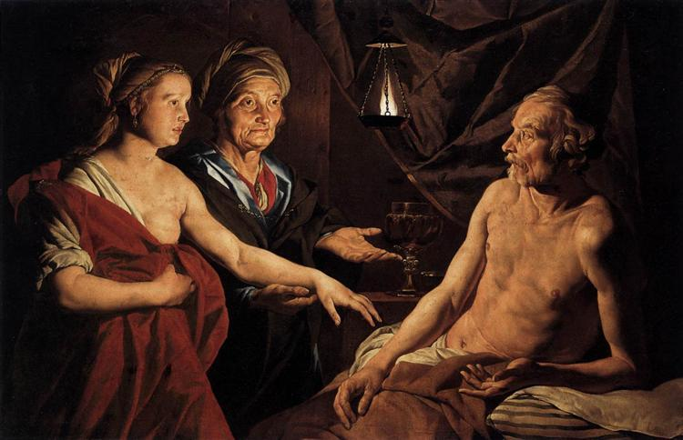
Notes:
“Biblical Times: The first mention of surrogacy can be found in “The Book of Genesis” in the story of Sarah and Abraham. Sarah and Abraham were married but could not conceive a child of their own, so Sarah turned to her servant Hagar to be the mother of Abraham’s child. This is a case of traditional surrogacy, where the surrogate uses her own egg in the child she’s carrying for intended parents. Even though Sarah was not biologically related to the baby, she and Abraham both claimed the child as their own. Up until about 30 years ago, traditional surrogacies like these were the only way intended parents could create a child through surrogacy. Traditional surrogacy remained a taboo topic up until the twentieth century due to the stigmas associated with infertility and “illegitimate” children. During this time, surrogate pregnancies would have been conceived naturally — which would be shameful for married couples.”
History of Surrogacy - From the Bible to Now | Surrogate.com

Slide 9

Roman Catholics - Donum Vitae
“Techniques for assisting fertility
12. With regard to the treatment of infertility, new medical techniques must respect three fundamental goods: a) the right to life and to physical integrity of every human being from conception to natural death; b) the unity of marriage, which means reciprocal respect for the right within marriage to become a father or mother only together with the other spouse; [19] c) the specifically human values of sexuality which require “that the procreation of a human person be brought about as the fruit of the conjugal act specific to the love between spouses”. [20] Techniques which assist procreation “are not to be rejected on the grounds that they are artificial. As such, they bear witness to the possibilities of the art of medicine. But they must be given a moral evaluation in reference to the dignity of the human person, who is called to realize his vocation from God to the gift of love and the gift of life”
Notes:
Instruction Dignitas Personae on Certain Bioethical Questions, Congregation for the Doctrine of the Faith (vatican.va)
Donum Vitae – produced on March 10, 1987, then reflected upon and brought up to date INSTRUCTION DIGNITAS PERSONAE ON CERTAIN BIOETHICAL QUESTIONS in 2008.
This document speaks to the Roman Catholic stance on surrogacy and essentially does not permit it:
“On March 10,1987, the Vatican responded to these recent developments in reproductive technologies by issuing a 40-page document called "Instruction on Respect for Human Life in Its Origin and on the Dignity of Procreation." This "instruction" was not only aimed at influencing the decisions of Roman Catholics, but also was intended to influence national legislation worldwide on biomedical issues.
What did the document say? It opposed all technological interventions into the process of human reproduction. More specifically, the document condemned artificial insemination and embryo transfer, in vitro fertilization, and surrogate motherhood under all circumstances. It also opposed experimentation on embryos when such experiments were not of direct therapeutic benefit to the fetus, and amniocentesis (a procedure used to detect fetal defects) when done for the purpose of deciding whether or not to abort the fetus.
The moral basis for these pronouncements is a familiar one in Roman Catholic moral teaching. Official Roman Catholic teaching maintains that human life begins at the moment of conception. From this claim follow the following moral judgments: a fetus or an embryo must be respected and treated as a human person with dignity and rights, including the right to life. Amniocentesis for the purpose of genetic screening is obviously morally objectionable because abortion is wrong. Similarly, the experimental use of embryos is condemned because it violates human dignity, reducing embryos to objects and instruments of scientific knowledge.
The moral argument underlying the Vatican condemnation of other practices is not so obvious. Why, for example, does the Church object to the artificial insemination of a childless woman with her husband's sperm? Such practices are opposed on the grounds that the sexual act has two purposes Ñ the unitive (emotional or spiritual) and the procreative (biological). Since these functions "by nature" belong together, it is always wrong to separate them. Artificial insemination, in vitro fertilization, and surrogate motherhood are immoral because they involve sexual acts that are procreative, but not unitive. And, rightful conception must respect the inseparability of the two meanings of the sexual act. In response to the suffering of infertile couples who want to have children, the document says that couples do not have a right to a child, claiming that such a right would make the child an "object of ownership." Childless couples that avail themselves of these reproductive techniques are said to violate a more important right of the childÑthe "right to be conceived, carried in the womb, brought into the world, and brought up within marriage."
Reproductive Technologies and the Roman Catholic Church (scu.edu)

Slide 10


Islam
Notes:
-In 1986 – Fiqh council of the Organization of Islamic Conference – surrogacy only permissible between married couples and under certain conditions.
-child created as a result of marriage.
-insemination into another woman’s womb is not permitted, unless the woman is his wife.
-first considered to be allowed between co-wives but then determined against.
-considered zina or adultery.
-” The child produced therefore has no lineage through legal marriage and will have to be considered as illegitimate. Therefore, if the product is haram, the means of acquiring the product (the surrogate’s renting of her womb) is also haram.”
-“the ayah (verse) in Surah al-Mujadalah (58: 2) where the Quran says:“…their mothers are only those who conceived them and gave birth to them (waladna hum).”
The Islamic Ruling on Surrogate Motherhood | IlmGate

Slide 11

Science
03
Assistive Reproductive Technology Evolution

Slide 12
SURROGACY: ORIGINS
1322
Dr. J Marion Sims
1884
Shannon Boff and Baby M
Father of Gynecology
Two landmark cases of the 80’s.
Arabs
Dr. William Pancoast
Artificial Insemination Successful Used on Mares
1866
First artificial insemination to result in live birth.
1985 and 1986
Notes:
“1322
Artificial insemination (referred to as AI) was first used successfully by the Arabs on mares.
1784
The first successful AI in a dog was reported by the scientist Lazzaro Spallanzani.
1790
AI was attempted on a human in the year 1790 by the English physician Dr. John Hunter after previously completing the procedure in moths. Dr. Hunter was known for pioneering research in venereal diseases and liked to experiment on himself, which was particularly unfortunate in regards to his research into syphilis and gonorrhea. When a young man desperate to have a child with his wife came to him in 1790, he was equipped with syringes and a prescription for frequent masturbation. He was told to collect his semen and inject it into his wife. We'll never know what type of 18th-century turkey-baster they used, but a single pregnancy was reported.”
1866
Dr. Marion Sims
1884
Dr. William Pancoast
That brings us to 1985 and 1986 where Shannon Boff and Baby M were the first successful surrogates in the US.
A Brief History of Donor Conception | Psychology Today
No More Test-Tube Babies, Surrogate Vows; Hospital Says It Was Misled | AP News
And Baby Makes Four: for the First Time a Surrogate Bears a Child Genetically Not Her Own | PEOPLE.com

Slide 13
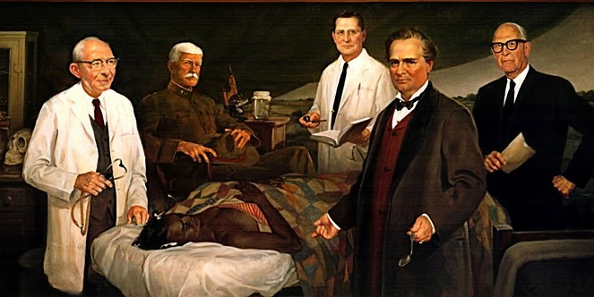
Notes:
Dr. Marion Sims was revered as The Father of modern gynecology.
He invented the vaginal speculum as well as a successful treatment for vesico-vaginal fistulas.
Although he made pioneering discoveries, he did so by practicing his surgicial techniques and procedures on black slave women, named Lucy, Anarcha, and Betsey amongst those known.
He performed 30 surgeries on Anarcha alone, all without anesthesia, as it was not yet widespread.
Ethical concerns with women who never really had a chance to agree to participate or not.

Slide 14

Notes:
In April 2018 amongst the disputes over US statues that commemorate controversial figures the statue of Dr. Marion Sims’ statue was removed from its location in Central Park across from the New York Academy of Medicine.
The statue was moved to Brooklyn Cemetery where the surgeon is buried, and a plaque mentioned his work on black slaves that he conducted research on.

Slide 15
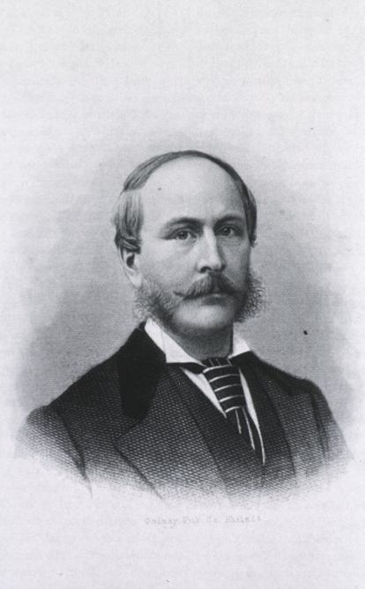
Dr. William Pancoast
1884
Notes:
The first artificial insemination to result in a live birth, as performed by the Philadelphia physician William Pancoast in 1884 however the story is filled with deceit. A 31-year-old woman and her husband a 41-year-old man came to see Dr. Pancoast, and initially Dr. Pancoast conducted tests on the woman thinking she may have fertility issues which he concluded she did not. Further testing on the husband lead him to conclude it was the husband who had the issues with low sperm count. He then proceeded to try to fix the husband’s issue with treatment for two months, which failed, and Dr. Pancoast realized the husband wouldn’t be able to impregnate his wife.
The doctor without informing either the husband or the wife of their issues and his conclusion, he invited his patient back to his clinic, put her out with chloroform and using a rubber syringe, inseminated her with the sperm of one his sex medical students that were present and witnessing the entire event. He particularly chose that medical student as he was the most attractive of the bunch.
Nine months later the woman gave birth to a baby boy, only at which time he proceeded to tell the husband the truth, and they both decided they would keep it a secret from his wife. So this whole time the wife is thinking it’s her husband’s child that she gave birth to.
In 1909 the true story was published in a medical journal by one of the six students present on the day of the procedure.
The First Artificial Insemination Was an Ethical Nightmare - The Atlantic

Slide 16
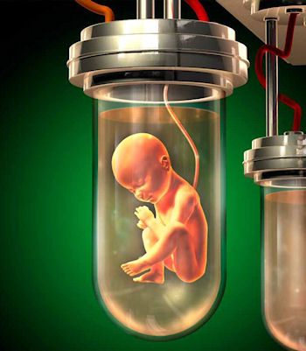

Shannon Boffo
Baby M
Notes:
Shannon Boffo – 1985
-a couple hired suburban Detroit housewife Shannon Boff to carry their baby.
-first time a woman carried and gave birth to a child that was not genetically hers.
-human incubator – “first fetal babysitter”. First test tube baby.
-paid $10,000.
-baby born on April 13, 1986.
-overall cost incurred by the intended parents was $32,000.
-in this case the surrogate told herself the baby wasn’t hers and needed to be given to the couple.
-Controversy – “Officials of the Ohio hospital that carried out the insemination said Wednesday the genetic parents failed to tell them that Mrs. Boff was getting $10,000 for her services. ″We cannot be party to a situation where we know a financial transaction is taking place,″ said Dr. Wulf Utian, obstetrics and gynecology director at Mount Sinai Medical Center in Cleveland.
Baby M
-New Jersey case
-Mary Beth Whitehead agreed to carry and give birth to a child for William Stern (Biochemist)
-Payment agreed to as $10,000.
-this case used Whitehead’s own egg and William Stern’s sperm, not his wife Elizabeth Stern’s egg.
-Child was genetically related to the surrogate.
-Gave birth on March 27, 1986.
-A week after birth the mother wanted to keep the baby.
-New Jersey court restored the rights of birth mother Whitehead, ruled the surrogacy contract was illegal. Whitehead received visitation rights and the Sterns kept custody.
“1984–1986: Perhaps the most famous case in surrogacy history is the “Baby M.” case, involving a traditional surrogacy. Bill and Betsy Stern hired Mary Beth Whitehead to be their surrogate in 1984, agreeing to pay her $10,000. Whitehead’s eggs were used in the artificial insemination process, making her the biological mother of the child. When the baby was born and it was time for Whitehead to sign over her parental rights, she refused and took custody of baby Melissa Stern (“Baby M.”) — starting a long custody battle in 1986. The results of the custody case played a key role in the development of some of the stricter surrogacy laws in the U.S. The New Jersey Supreme Court ruled that the surrogacy agreement between Whitehead and the Sterns was illegal and, therefore, restored Whitehead’s parental rights. Custody was granted to Bill Stern, with Whitehead receiving visitation rights. This case marked a huge turning point in the history of surrogacy, and, not surprisingly, many surrogacy professionals began to move toward the use of gestational surrogacy to avoid these legal entanglements.”
And Baby Makes Four: for the First Time a Surrogate Bears a Child Genetically Not Her Own | PEOPLE.com
No More Test-Tube Babies, Surrogate Vows; Hospital Says It Was Misled | AP News
History of Surrogacy - From the Bible to Now | Surrogate.com

Slide 17

04
BUSINESS
Commercial: Fee for Service

Slide 18
KEY PARTIES
AGENCY
GOVERNMENT
SURROGATE
INTENDED PARENTS
Notes:
Parents:
Parents are at risk of ill-treatment from surrogacy companies. Contracts state that surrogacy companies are not responsible for failed pregnancies, or any care after birth. Embryos go missing.
-In Canada –
-Agencies encourage surrogates to overinflate the receipts they are submitting, and any payment to the surrogate happens through the agency, resulting in parents paying more than they should or need to.
Agency:
-Ukraine – BioTexCom
One surrogate in Ukraine, Alina - had undergone open heart surgery a year prior to her pregnancy and BioTexCom did not ask for her medical history. She should not have been selected as a candidate for surrogacy.
“A couple from Argentina said that BioTexCom allowed their surrogate mother to travel while six months pregnant with twins and unwell. The surrogate went into labor during the trip and had no choice but to give birth in a small hospital which was ill-equipped to deal with the complexities of her labor. The premature babies were born in septic fluid.”
Put 4 women in a small apartment, a surrogate 32 weeks into her pregnancy forced to share a bed with another surrogate mother.
They required women to be home by 4pm, if they returned afterwards, they could be fined 100 euros. Threatened with fines as well if surrogates publicly criticized the company or communicated directly with biological parents or took any money or gifts from biological parents.
-India – Akanksha
-46 women share a bathroom in a facility where they are being housed.
-preys on women who make $96 a month – and have financial need. Women who slept on empty stomachs and now say at least I have something to eat as a result of being a surrogate.
-former surrogates are then recruited to bring more surrogates to the clinic, they get a referral fee ($269) for each surrogate they bring in.
Surrogate:
Ukraine
“It is the second time that I am pregnant by surrogacy. I'll do it a third and last time, I think. This way I will be able to give my two daughters good living conditions,” explains Olesya, a 41-year-old woman from Dnipro who worked in a metallurgical factory until she approached BioTexcom. She is a single mother and says her sister and mother support her in this decision. According to Olesya, she receives about 16,000 euros for each baby delivered. The couples that will keep the newborn pay between 39,900 and 64,900 euros, depending on whether they choose one, several or indefinite attempts at fertilization.”
Alina decided to become a surrogate mother in 2016 because she was struggling to make enough money as a hairdresser in her hometown of Donets, in Kharkiv.“It’s hard to find a well-paid job in Ukraine,” she said. “I wanted to renovate the house and set aside money for my son’s university fees – they’re very expensive. My mother never had the means to support me in that way, but I want my son to get a good education.” “We were treated like cattle and mocked by doctors.” She gave birth in a state hospital where the conditions were poor. “There was no hot water, we washed with plastic bottles over the toilet with water that was preheated in a kettle. I wanted to be transferred to a different hospital, but the staff threatened to not pay me at all if I complained” to the biological mother.
According to several international media reports, cases have been documented in which the clauses of the surrogacy contract demand certain requirements from pregnant women, such as not drinking coffee or using hair dyes.
In other cases, surrogates who miscarried or had a stillborn birth did not receive any payment.
India
“Instances of exploitation of surrogates are more in case of international commercial surrogacy where surrogates are from poor background and are often forced by their in-laws to consent to such procedure that can earn the livelihood for the whole family. This raises the question of whether they are really exercising free choice in the matter, or whether a lack of economic alternatives gives surrogates no other feasible option. Their lack of legal or medical knowledge and the fact they are being offered sums of money which to them seem huge, make it difficult for surrogates to have equal bargaining power against the comparatively wealthy and powerful clinics and commissioning parents they contract with.”
Governments:
Criticized for not regulating the surrogacy industry and for not allowing the practice. Proponents of commercial surrogacy say that banning it will further cause exploitation of women, giving rise to black market and underground industry.
Ukraine Hopes These Surrogate Babies Will Stir The Conscience Of The West (worldcrunch.com)
Ukraine’s ‘baby factories’: The human cost of surrogacy | Women's Rights | Al Jazeera
India's Commercial Surrogacy Ban Could Hurt Low-Income Women | Time

Slide 19
COST
 | PRICE
UKRAINE | $35,000 - $50,000 USD
RUSSIA | $35,000 - $55,000 USD
GEORGIA | $38,000 - $64,000 USD
USA (CALIFORNIA) | $110,000 to $170,000 USD
Notes:
“More than 2,000 children are born through surrogacy every year in Ukraine, the majority to foreign couples. The country has around 50 reproductive clinics and many agencies and middle-men who match couples - known as "intended parents" - to surrogates.
Ukraine is a popular choice because of the way its laws on surrogacy are written. In many European countries, including the UK, when a surrogate gives birth she is listed as the mother on the birth certificate. If she is married, her husband will be listed as the father. In Ukraine the intended parents are listed as mother and father. That means getting the baby a passport and bringing them home is much simpler.”
Surrogates receive a fraction of the cost in the east – Ukraine – some say around $11,000-$13,000 in Ukraine. In India - $8000 when the surrogacy costs anywhere the same as Ukraine.

Slide 20

DISCUSSION:
Do you think surrogacy should be:
Legal or Banned?
If allowed, then Commercial or Altruistic?
Is it possible to change the way life is created without conflicting with morality?
What happens if an expecting parent no long wants the child can they make the mother abort the baby or babies because they own the genetic material?

