Slide 1
Finance in the USSR
Riley Hill

Slide 2

Connection to the Course
Course started with evolution of business ideology.
Brought us to industrial capitalism during the 19th century.
I was interested in an example of a state trying to abandon our financial system and starting fresh.

Slide 3
How did the USSR build the ﬁrst post-capitalist ﬁnancial system?

Slide 4
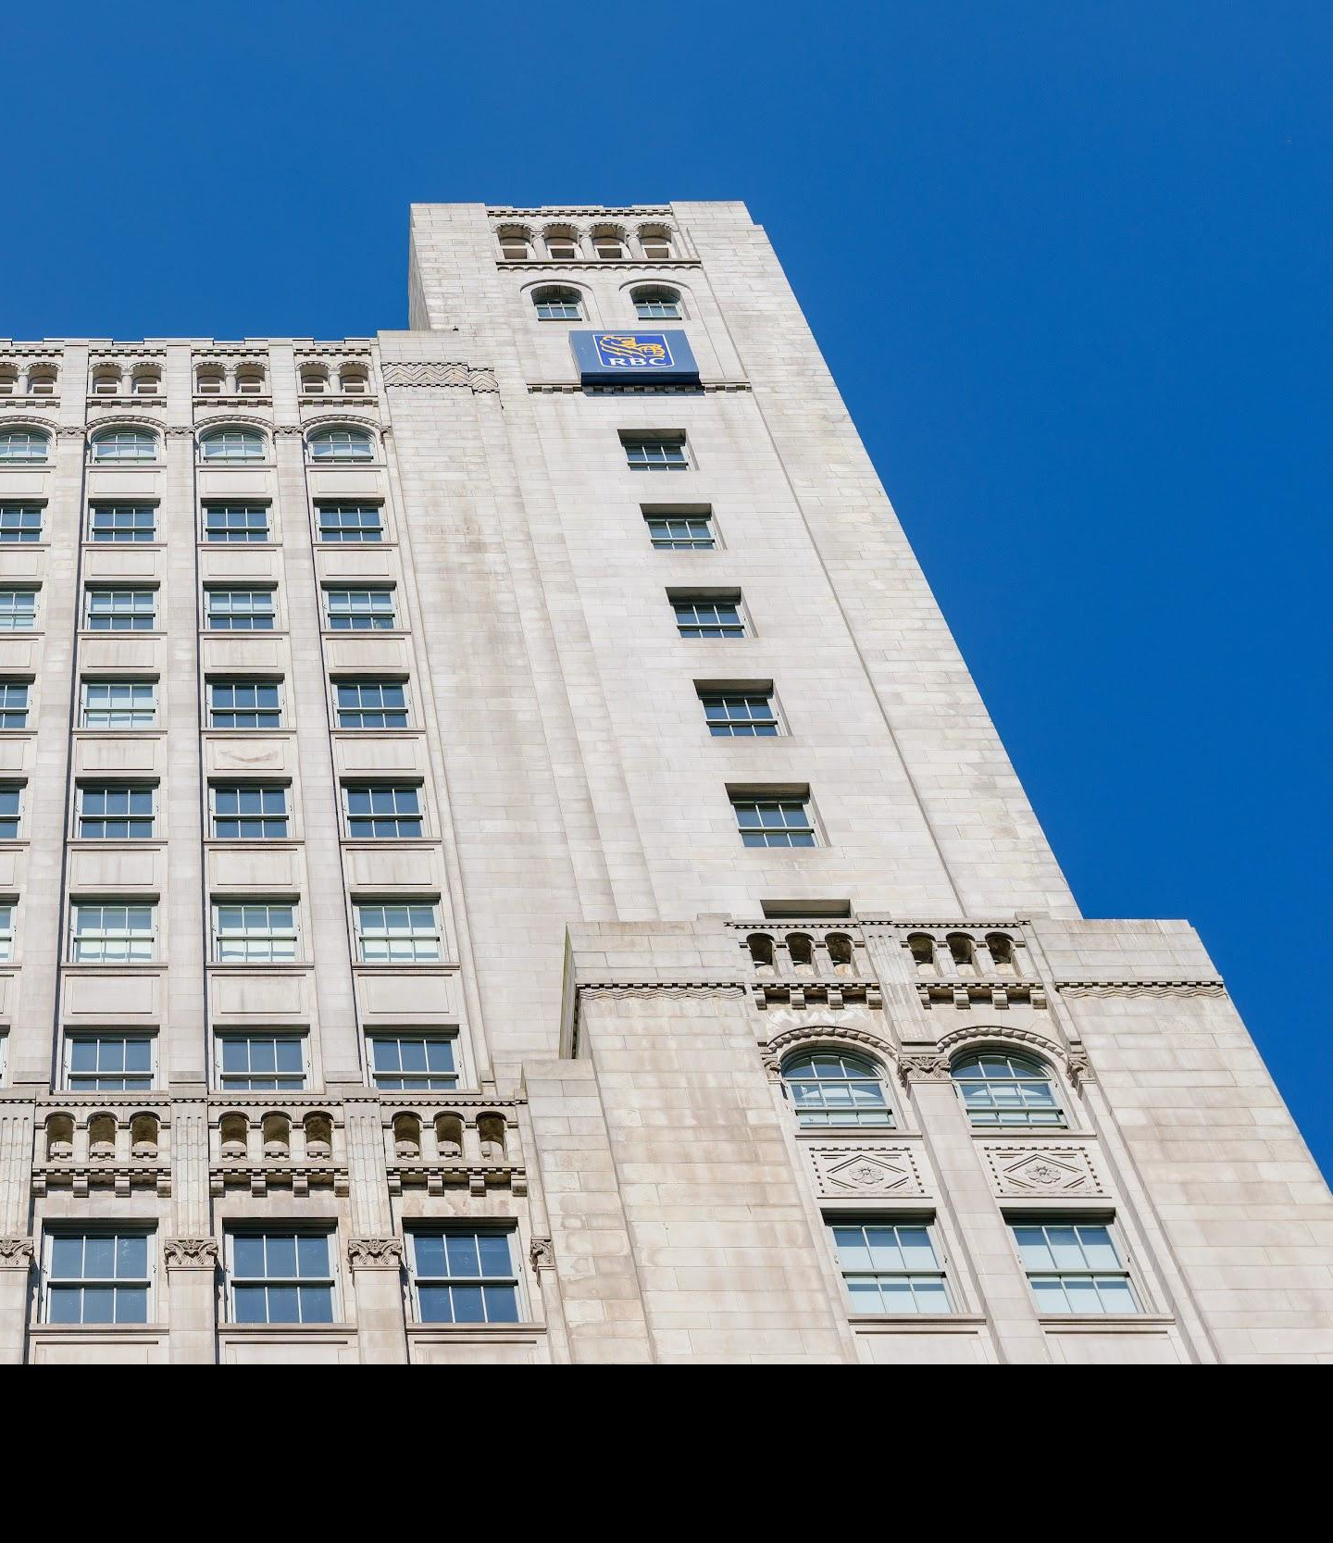
What is a ﬁnancial system?
The institutions and practices used to organize the distribution of capital.
The system used to facilitate the exchange of assets and debts between investors, lenders and borrowers participating in different markets.
Key institutions: Commercial/investment banks, central banks, stock and bond markets.

Slide 5
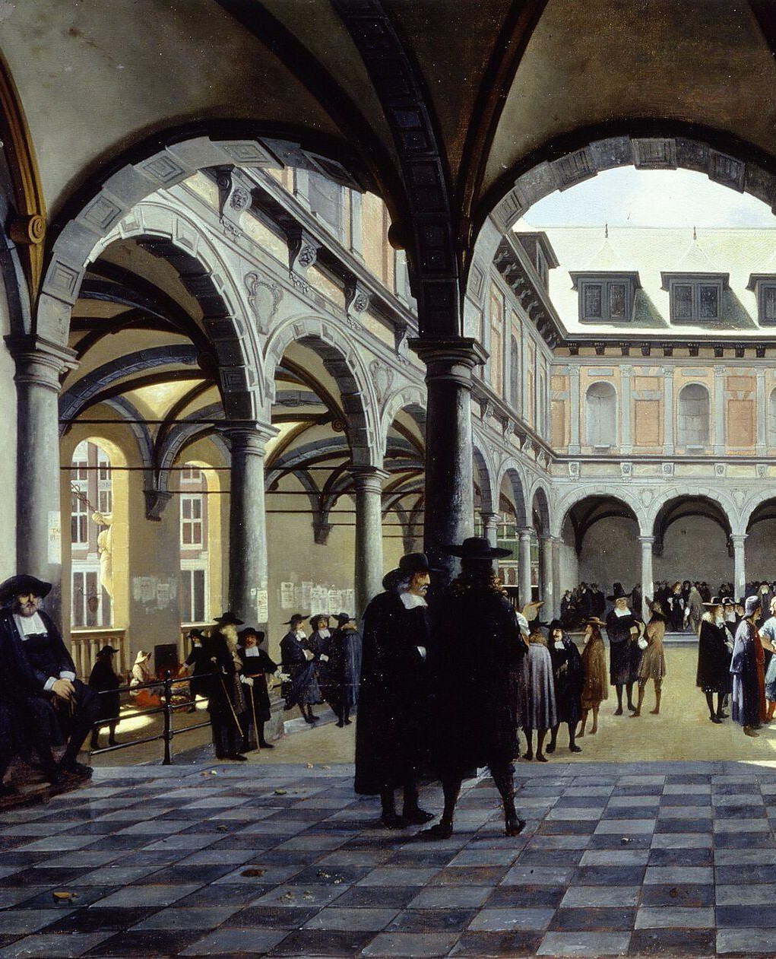
Europe by the 19th Century: Developments from Course
Lending of money at interest.
Birth of business schools.
Development of security markets.
Colonialism and joint-stock companies.
Development of the scientific method.

Slide 6
Industrial Capitalism in Europe
Growth of powerful industrial firms
Large domestic and international markets
Energy-intensive economies/urbanization
Great military powers

Slide 7
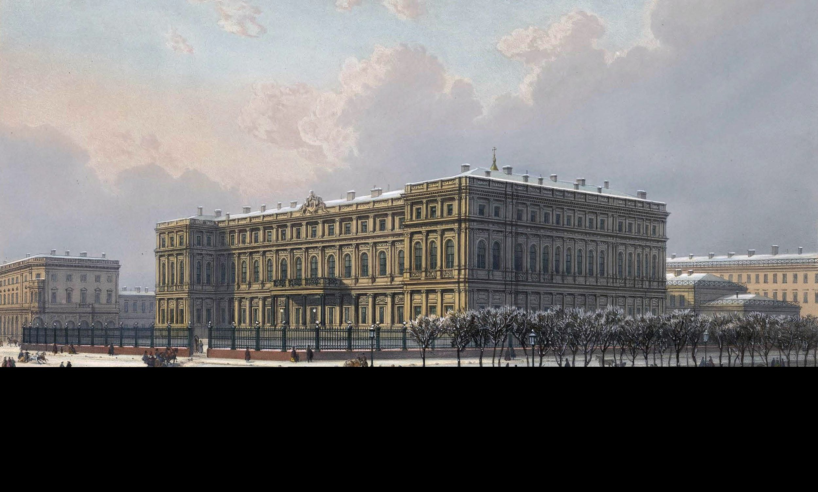
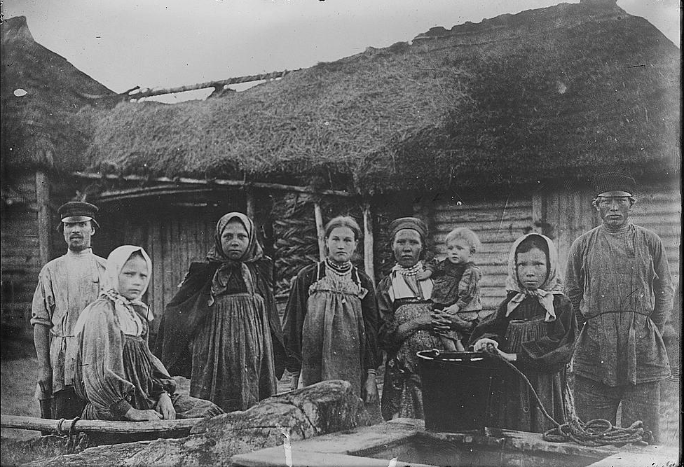
Russia in the 19th Century
Vast empire stretching east.
Rural society with urban elite.
Financial system, including monetary policy, dominated by state institutions.
Large and growing population.

Slide 8
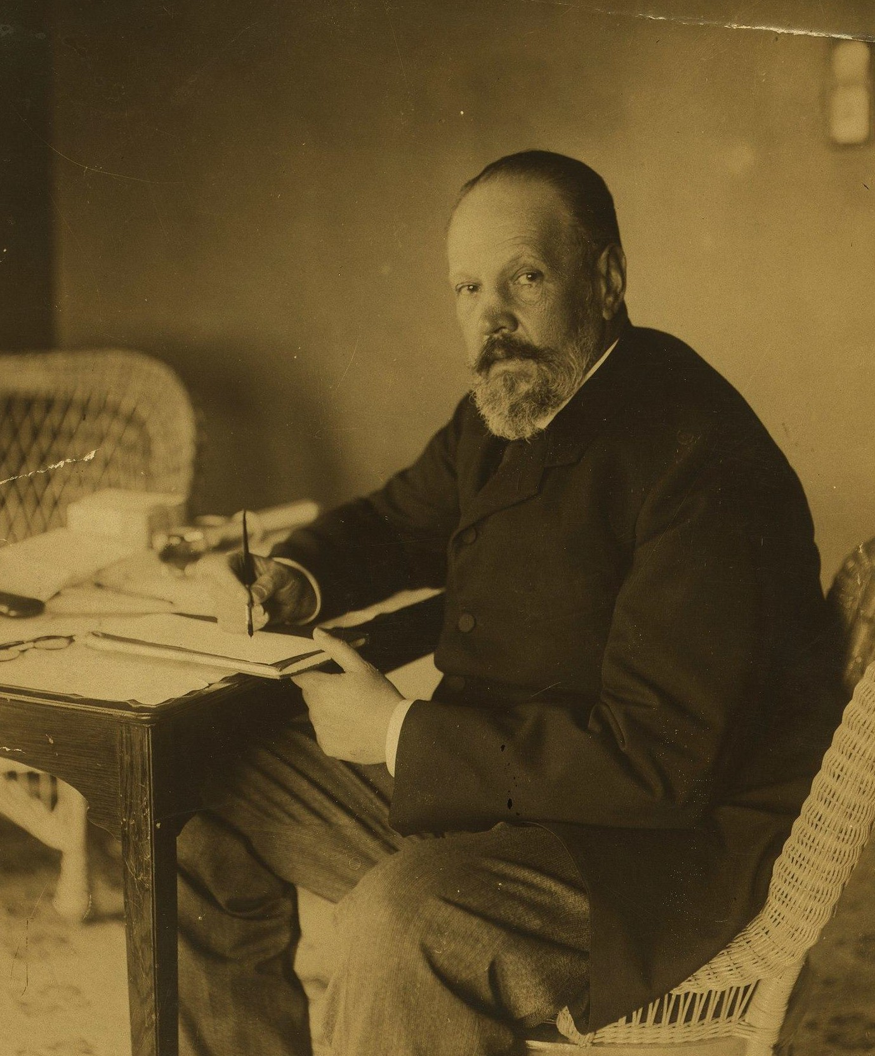
Industrialization and The Witte System
Finance Minister Sergei Witte was instrumental in Russian modernization.
Russian bonds traded heavily in Paris.
Growing connection and importance to European markets
Rapid economic growth.

Slide 9
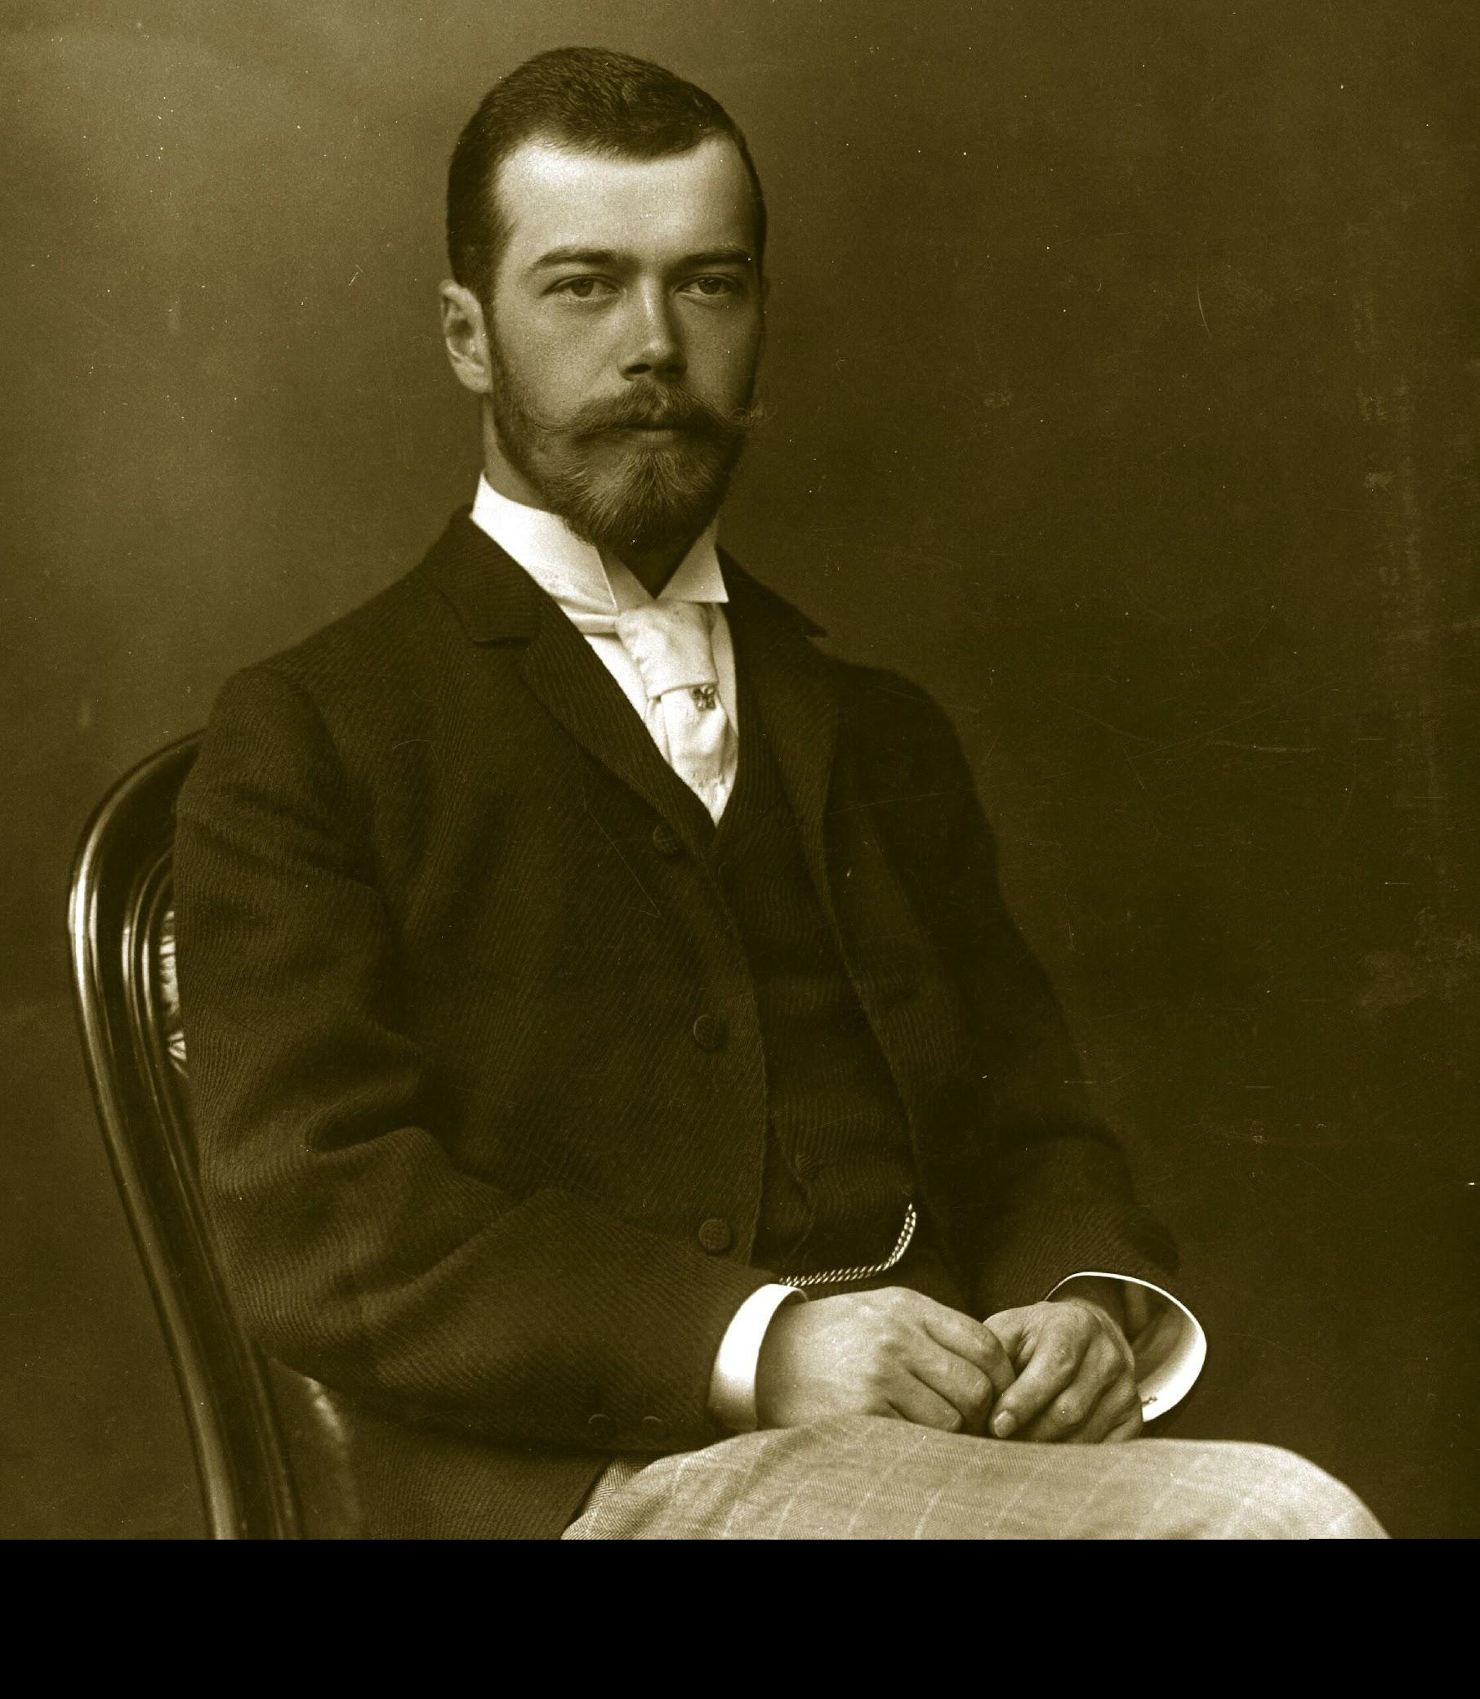
Political Crisis in Russia
Rule of Tsar Nicholas II marked by incompetence.
First World War puts massive strain on Russian economy.
Government collapses, Russia sees two revolutions.
Russian financial system nationalized.

Slide 10
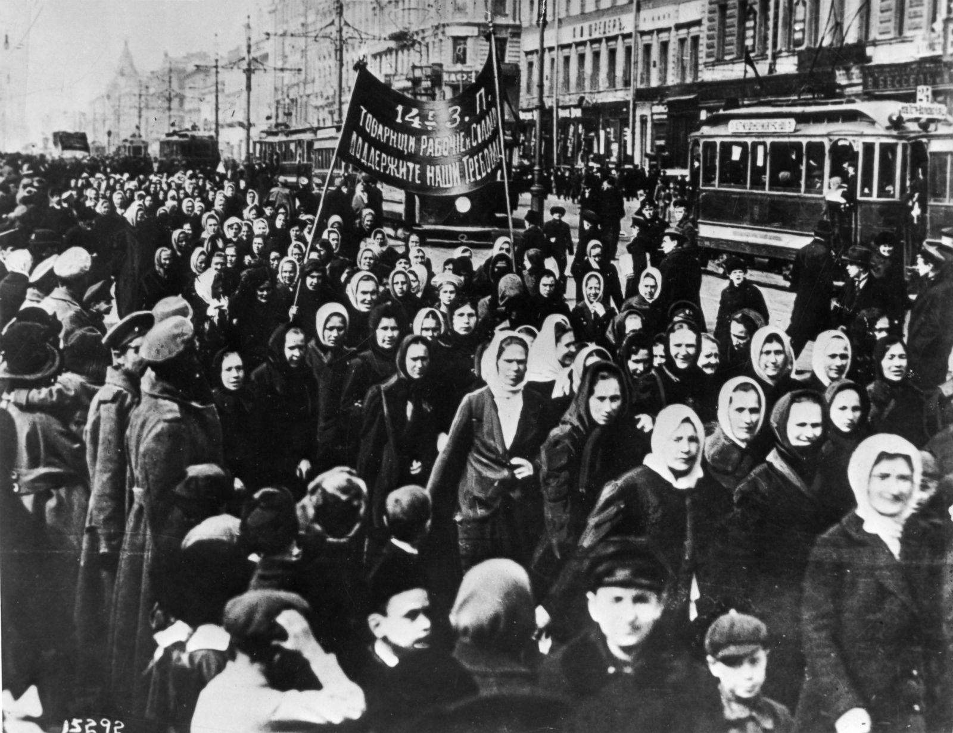

Slide 11
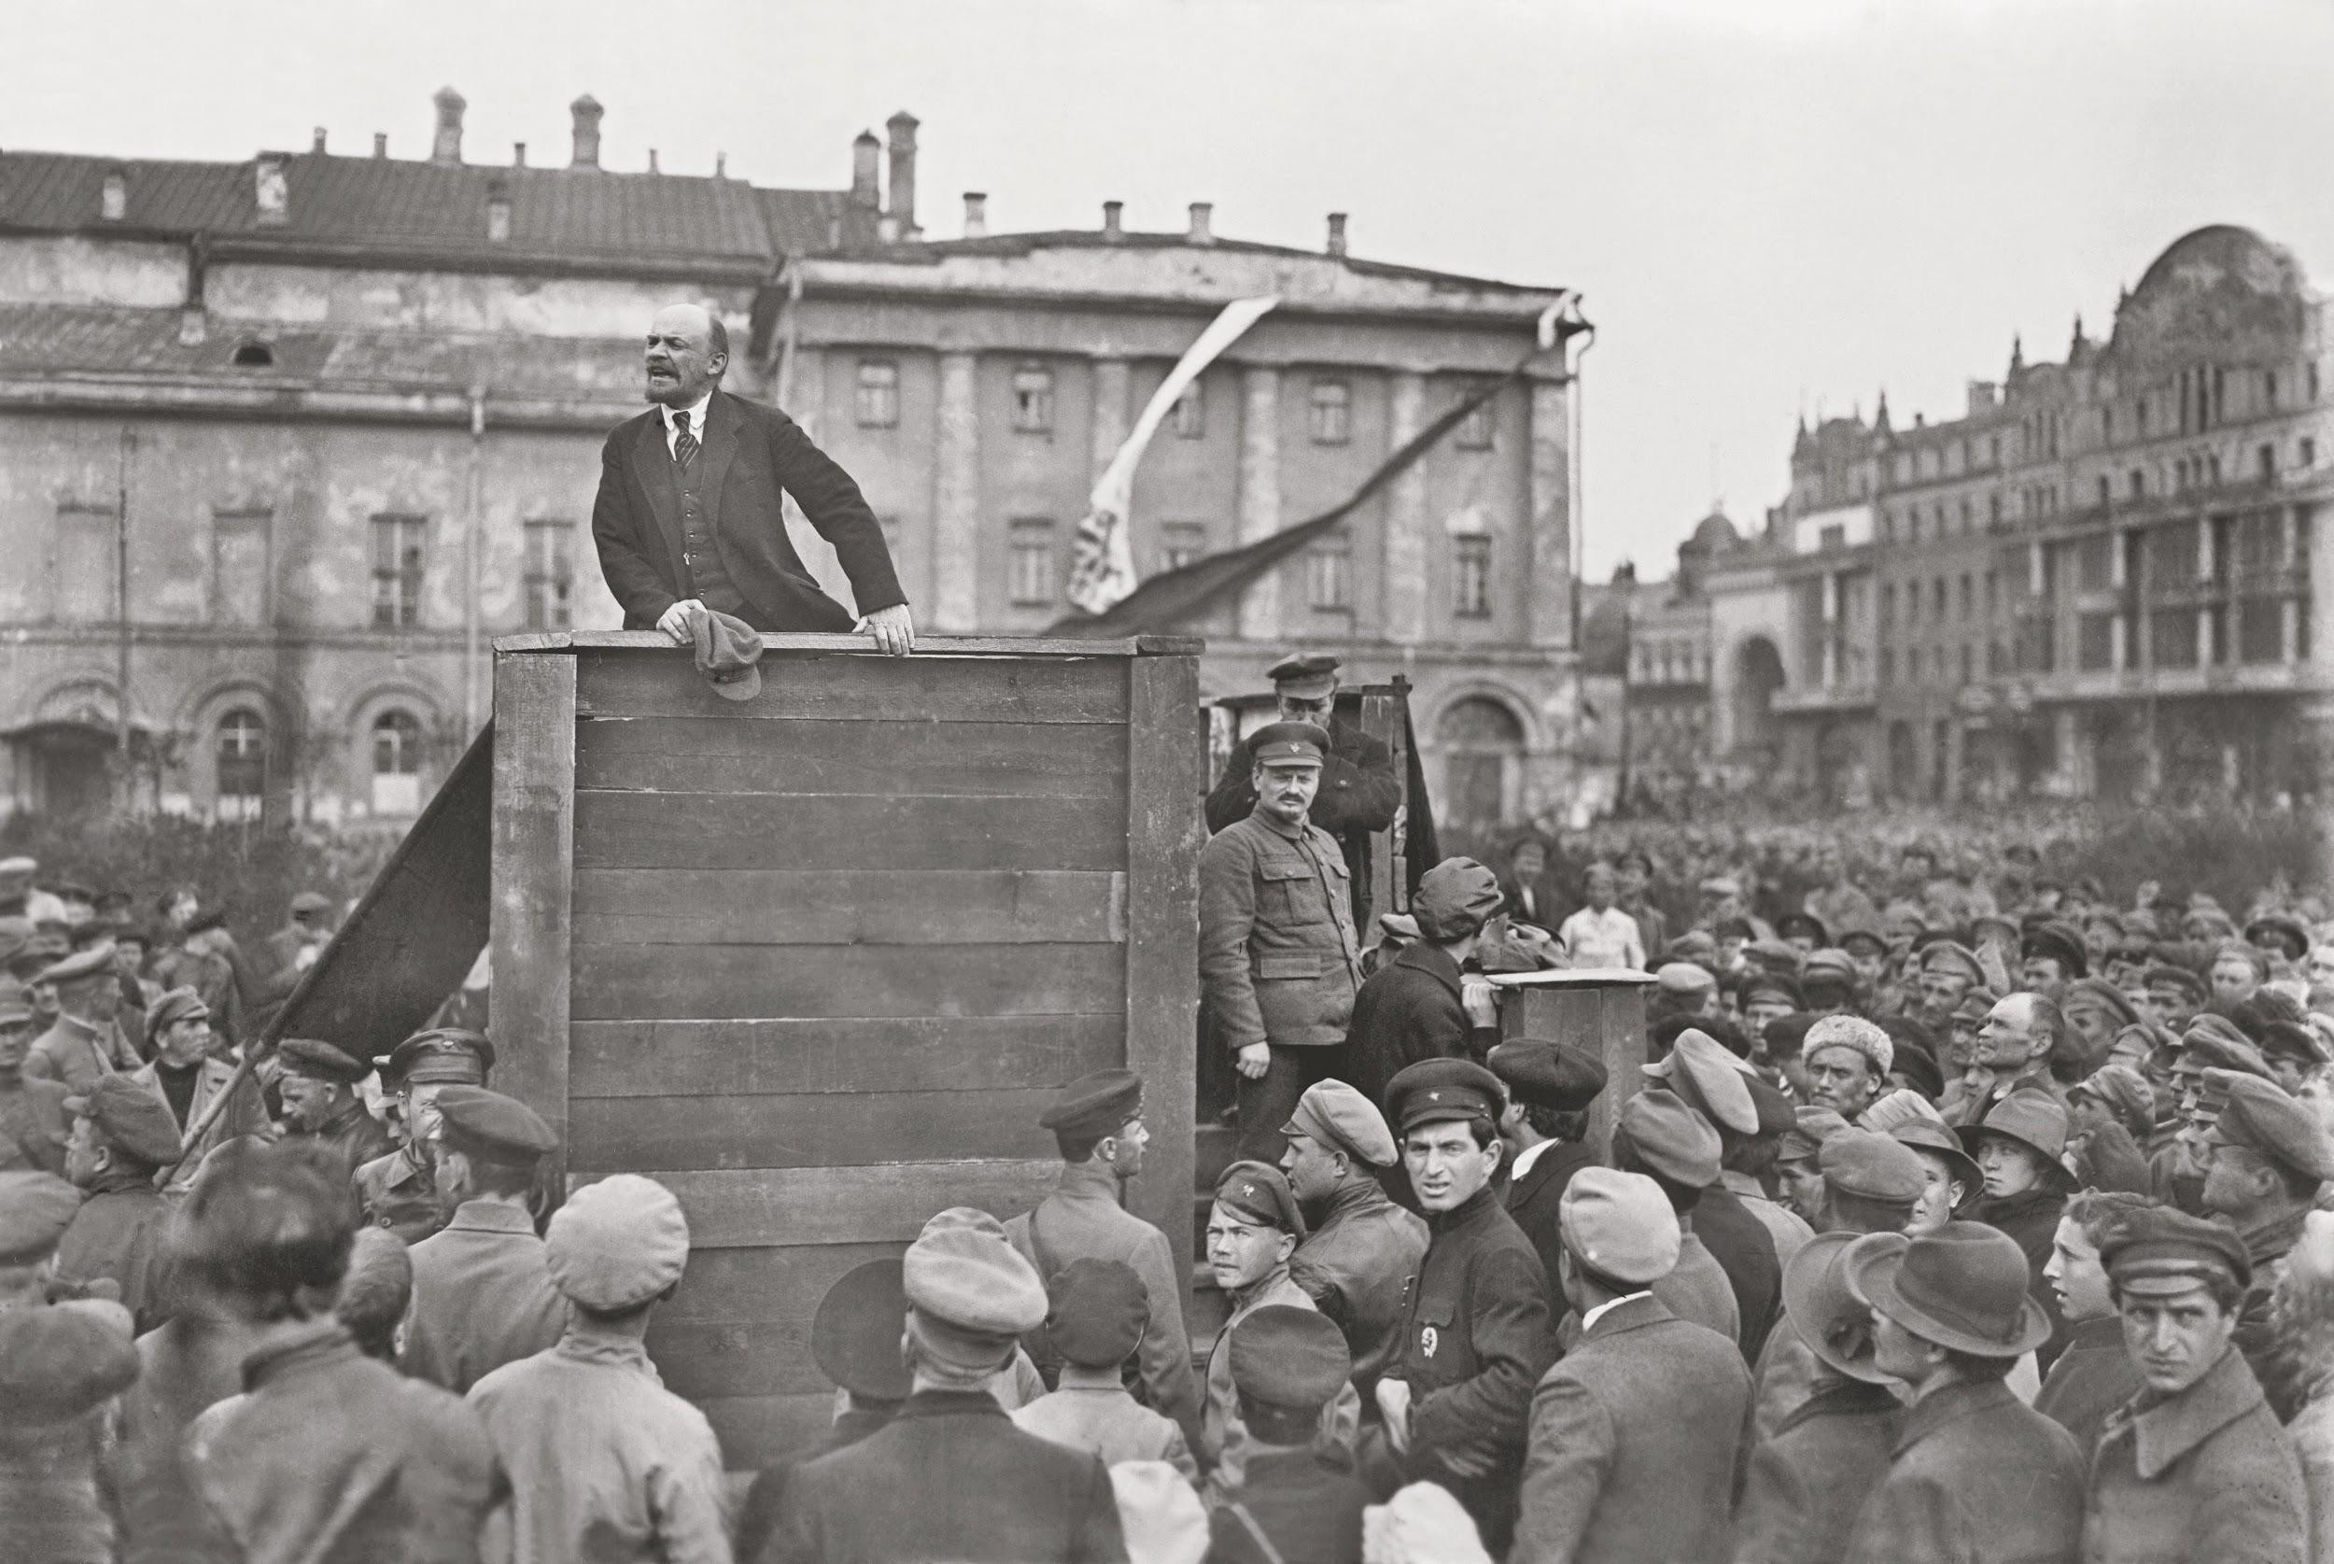

Slide 12
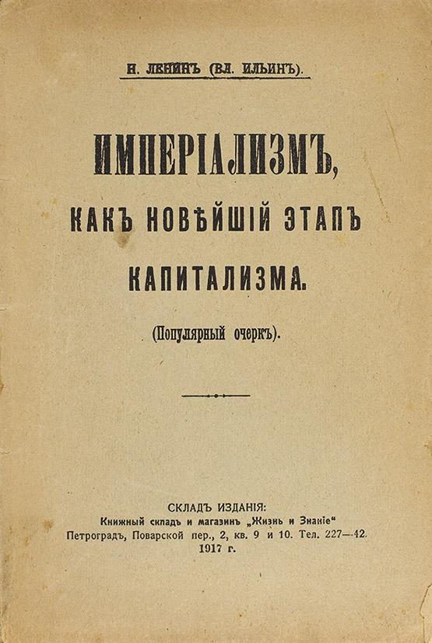
Lenin and Finance
Lenin, the head of the Bolsheviks, outlined his views on finance in Imperialism: The Highest Stage of Capitalism.
He believed financial firms in capitalist nations directed markets.
“Cartels come to an agreement on the terms of sale, dates of payment, etc.
They divide the markets among themselves. They fix the quantity of goods to be produced. They fix prices. They divide the profits among the various enterprises.” In this stage of development, “production becomes social, but appropriations remain private.” - Lenin in Imperialism
He thought the state should “socialize” this process with representatives for the working class in charge.

Slide 13
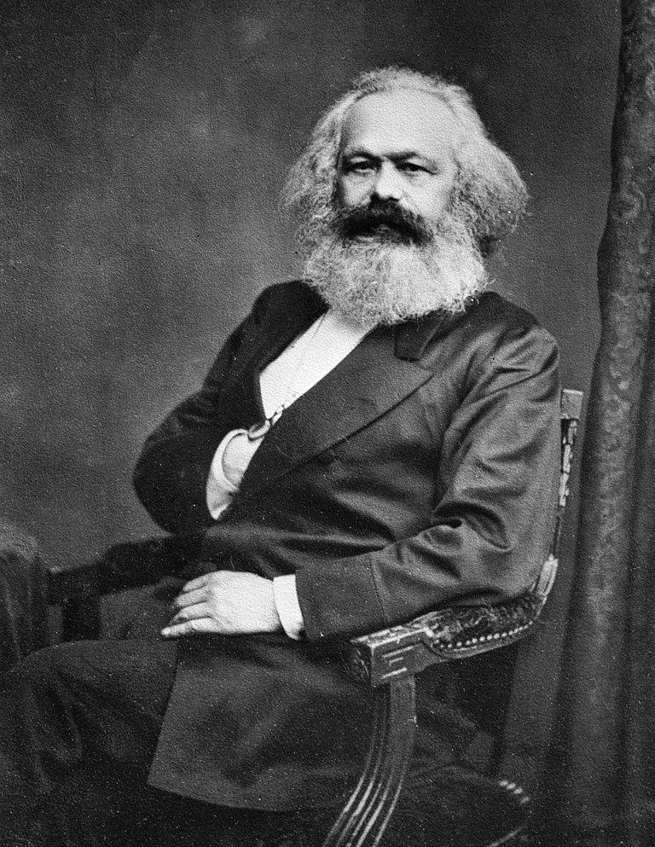
Marxist Context
Communist revolution supposed to involve the working class, seizing the means of production.
Financial system to be nationalized, centralized, and managed by political authority.
Bolsheviks viewed themselves at the sole legitimate representatives of the proletariat.
Bolshevik rule premised on the “dictatorship of the proletariat.”

Slide 14
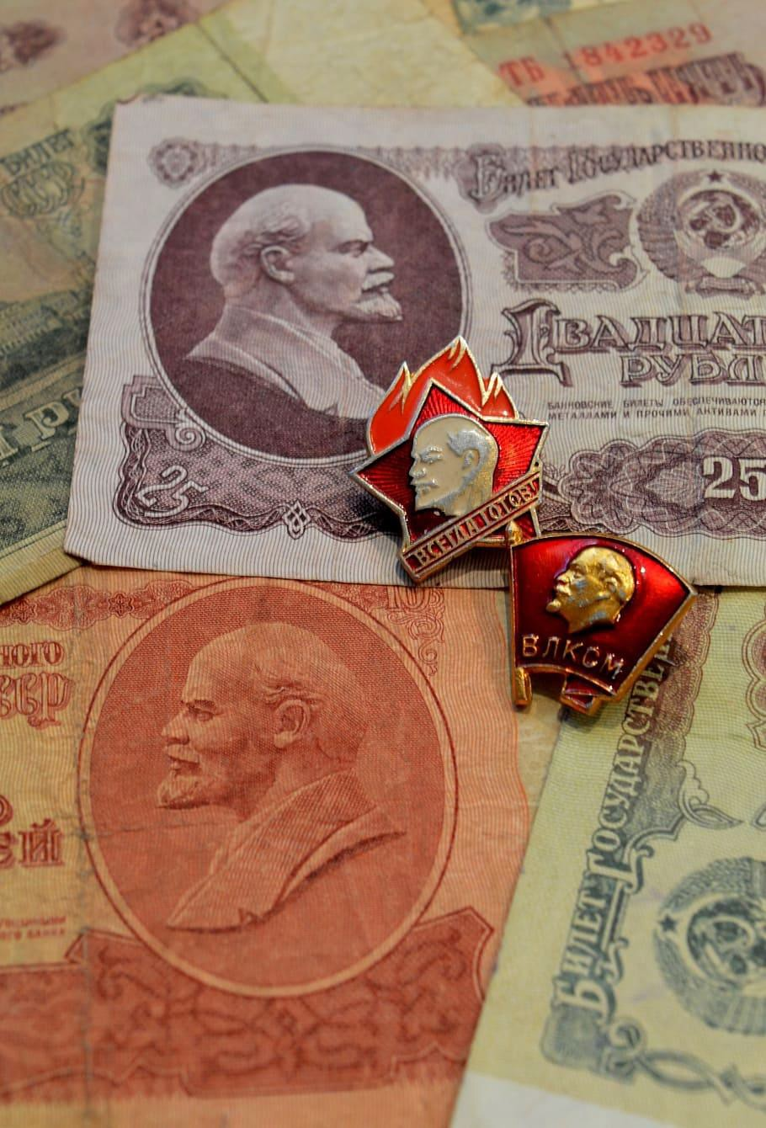
Finance in the USSR
Begins with nationalization of all financial institutions.
Assets are reorganized into a highly-centralized and bureaucratic state system.
Organization and allocation of capital became the responsibility of two state institutions, Gosplan and Gosbank.
Institutions subordinate to the Politburo

Slide 15
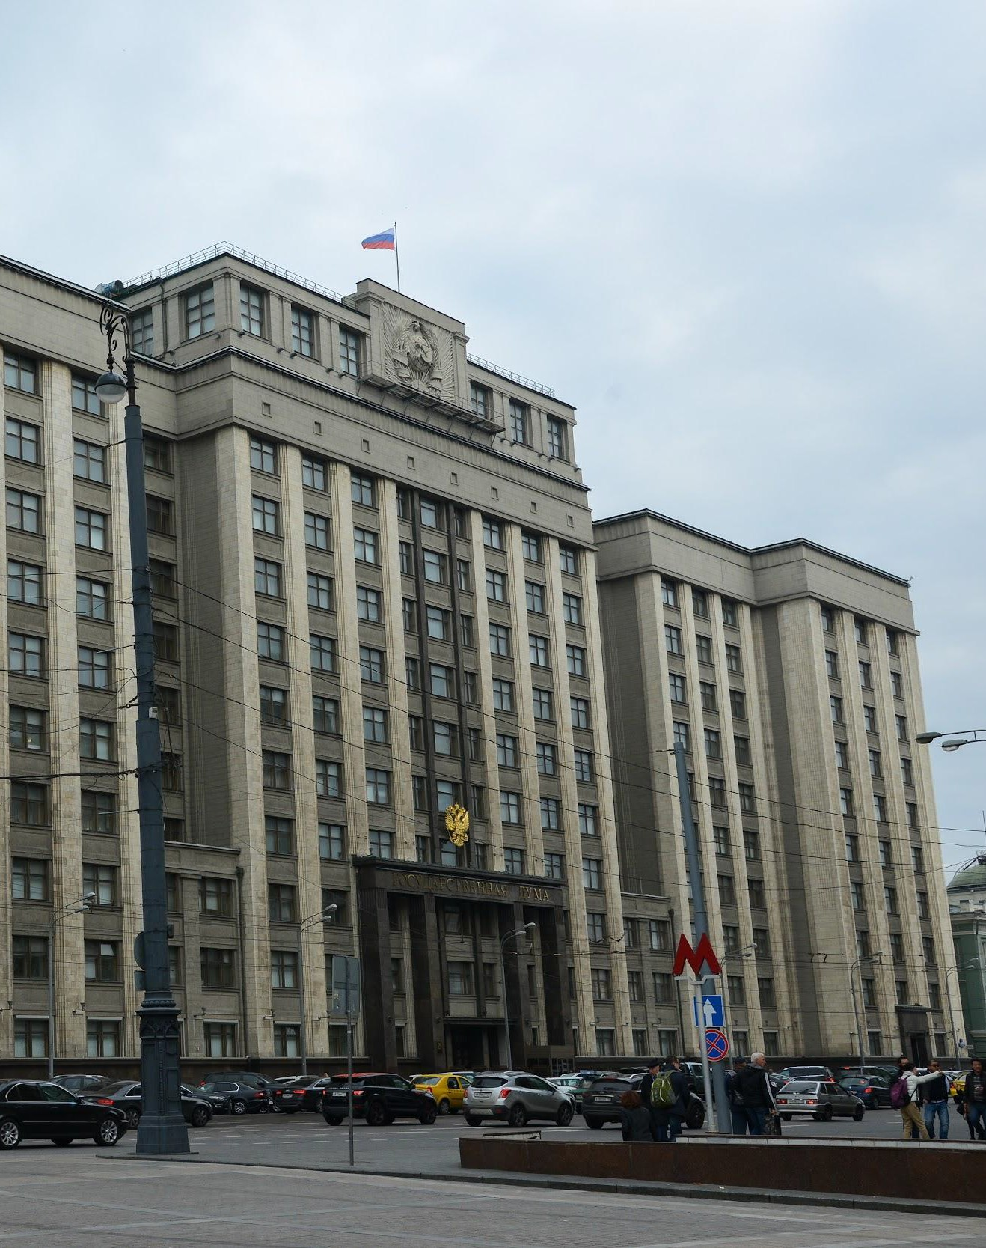
Economic Planning: Gosplan
In charge of investment and economic planning.
Started as an advisory organization. Became responsible for economic planning in 1928.
Top down command structure. Controls all points of investment, distribution, advertising and sales.

Slide 16
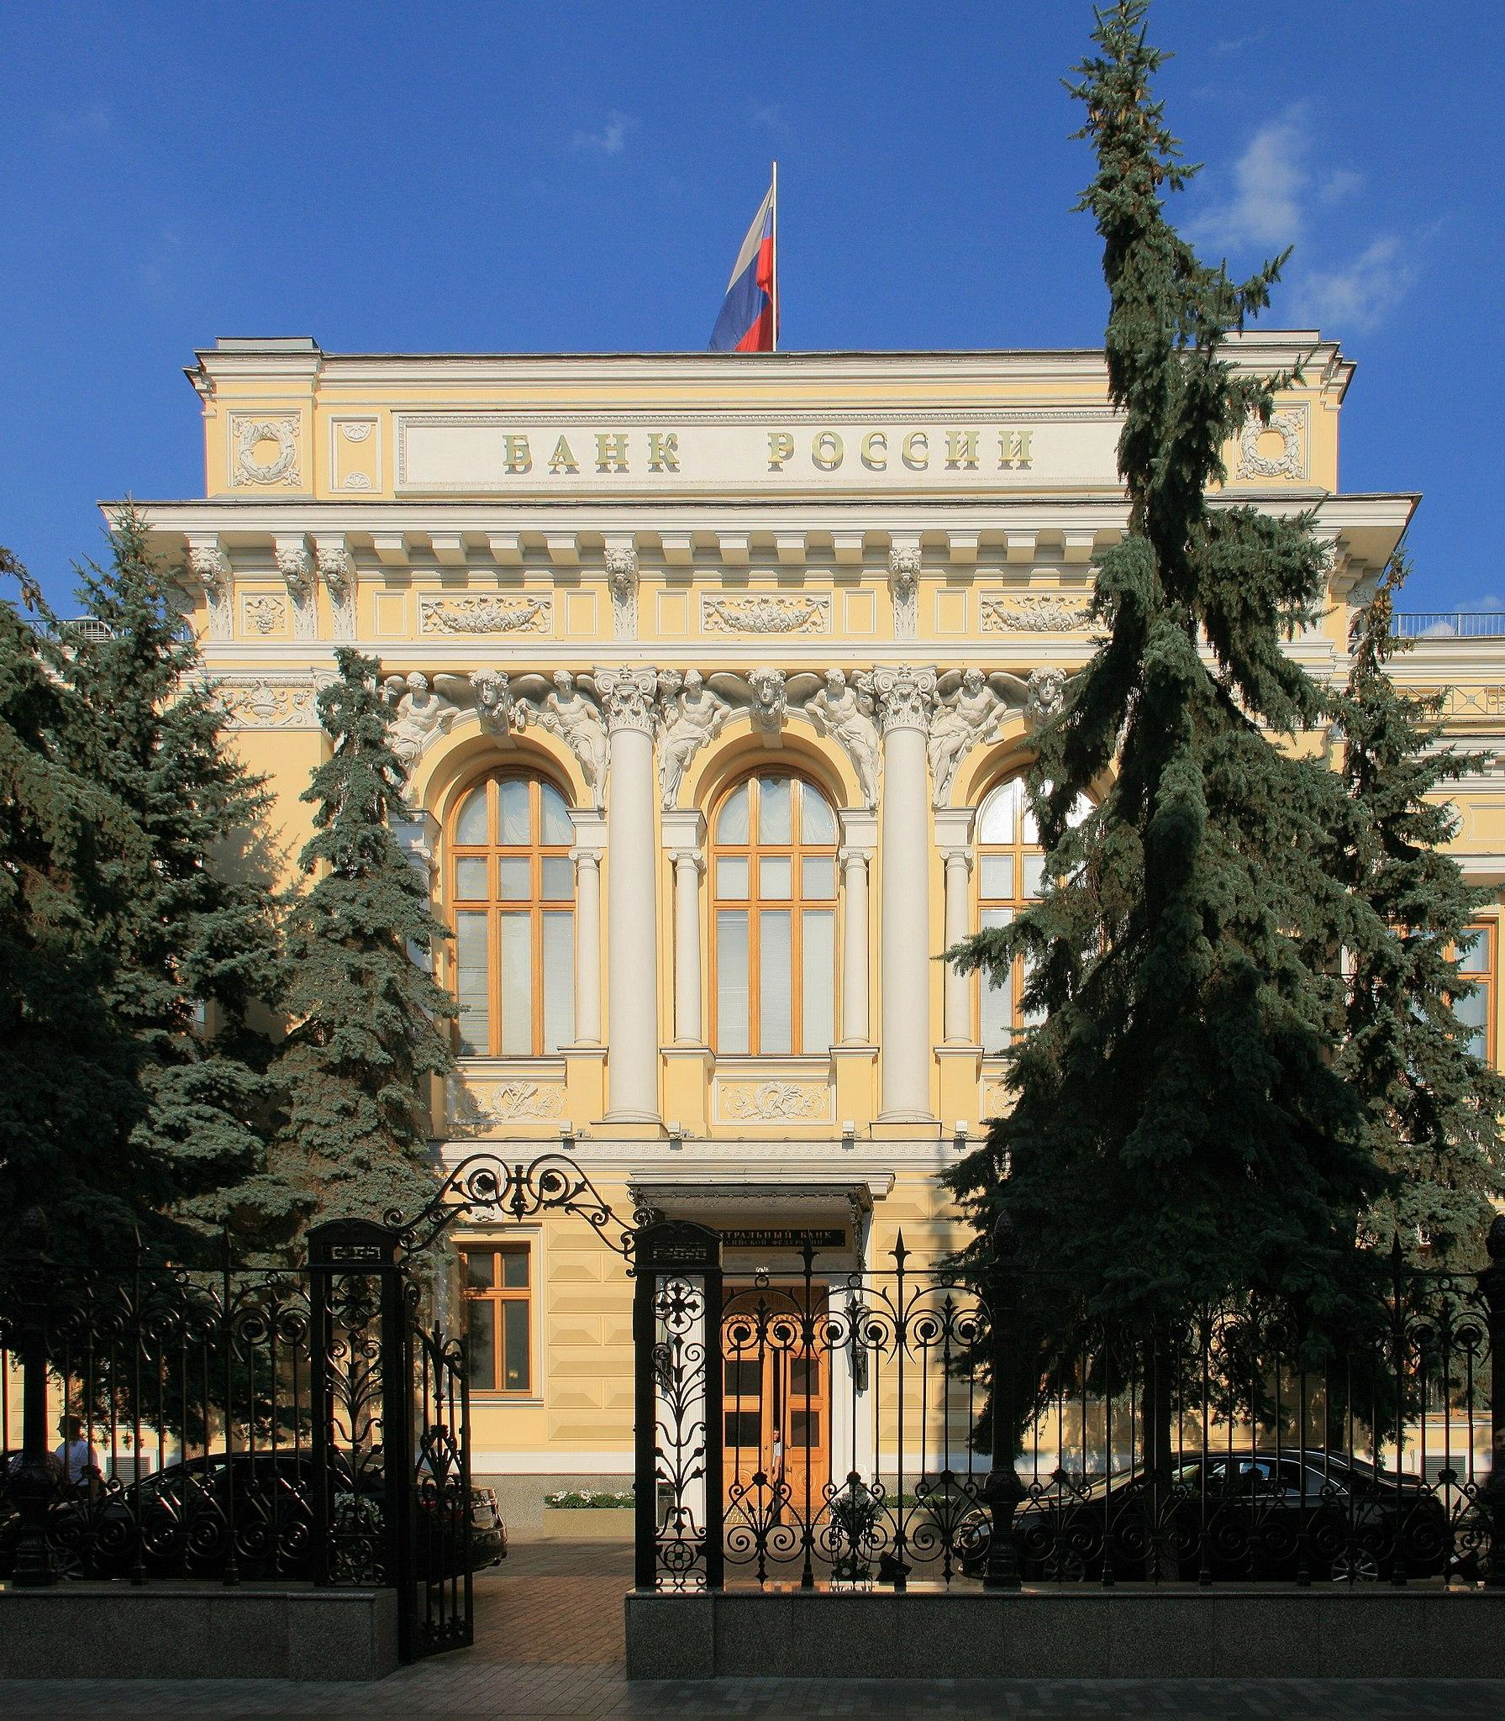
Financial Services: Gosbank
Only bank in the Soviet Union. Responsible for facilitating all exchange.
In charge of monetary policy.
Only institution that could buy and sell foreign currency.

Slide 17
Conclusion
The financial system in the USSR was highly centralized, and it developed out of the chaos of the Russian Revolution and civil war. Decisions about the allocation of capital were made by a single state planning agency. Exchange was facilitated by a single state bank, which was also responsible for monetary policy. Both institutions received orders from Russian leadership, which viewed itself as exercising power in the interest of the working class.

Slide 18
Discussion Questions (if we have time!)
In industrialized nations, are their alternatives to a market system or a command economy?
What do you think of Lenin’s analysis? Is Canada ruled by a financial elite?
●

