Slide 1

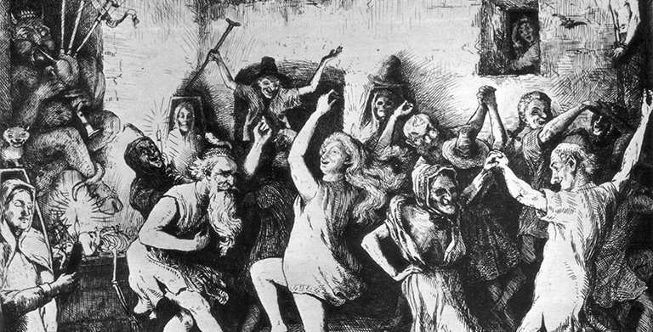
Witchcraft & Other Magical Beliefs in 16th to 17th Century England
Loren Catotal | LS 812 | April 7, 2022
Notes:
0:00 – 3:00 (including trivia)
Picture link: https://www.english-heritage.org.uk/learn/histories/journey-into-witchcraft-beliefs/
Reason for choosing topic – childhood fascination with magic due to pop culture, regarding witch hunts – disbelief that innocent people were killed for being a “witch”, disturbing.
Decision to focus on 16th – 17th century England. Although common in Europe in 16th and 17th century, difficult to generalize, so focusing on one country and this period. Intensity of witch-hunting was not consistent in European history (e.g., Germany – most severe). England’s was relatively mild everything considered, but still an interesting case.

Slide 2
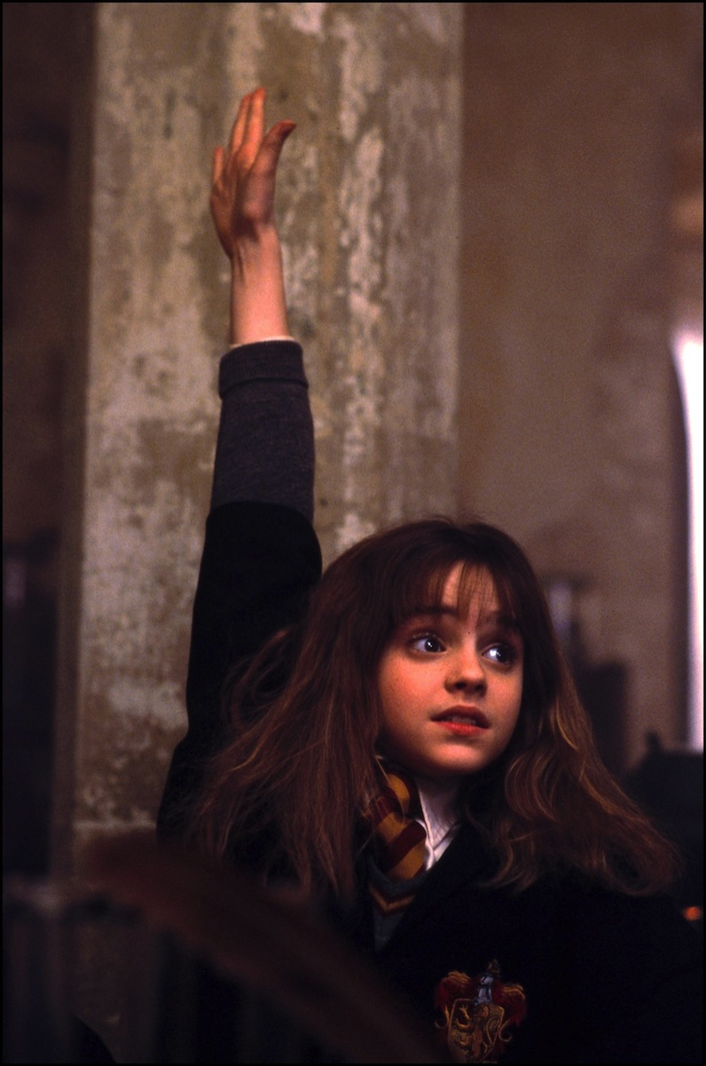
But first…. a Witch Quiz!

Slide 3
What do you call the book where witches keep magical incantations?

Slide 4
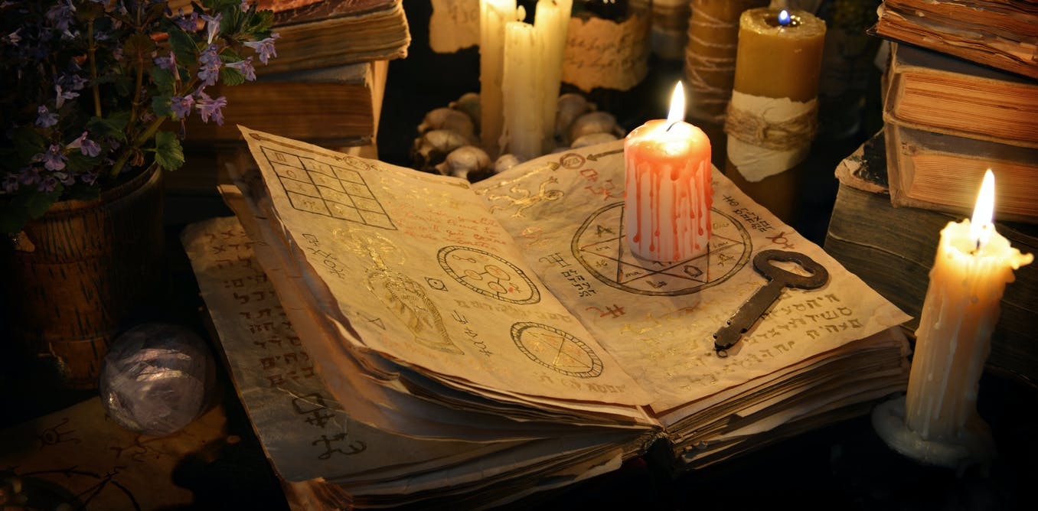
What do you call the book where witches keep magical incantations?
A grimoire

Slide 5
What do you call a group of witches?

Slide 6
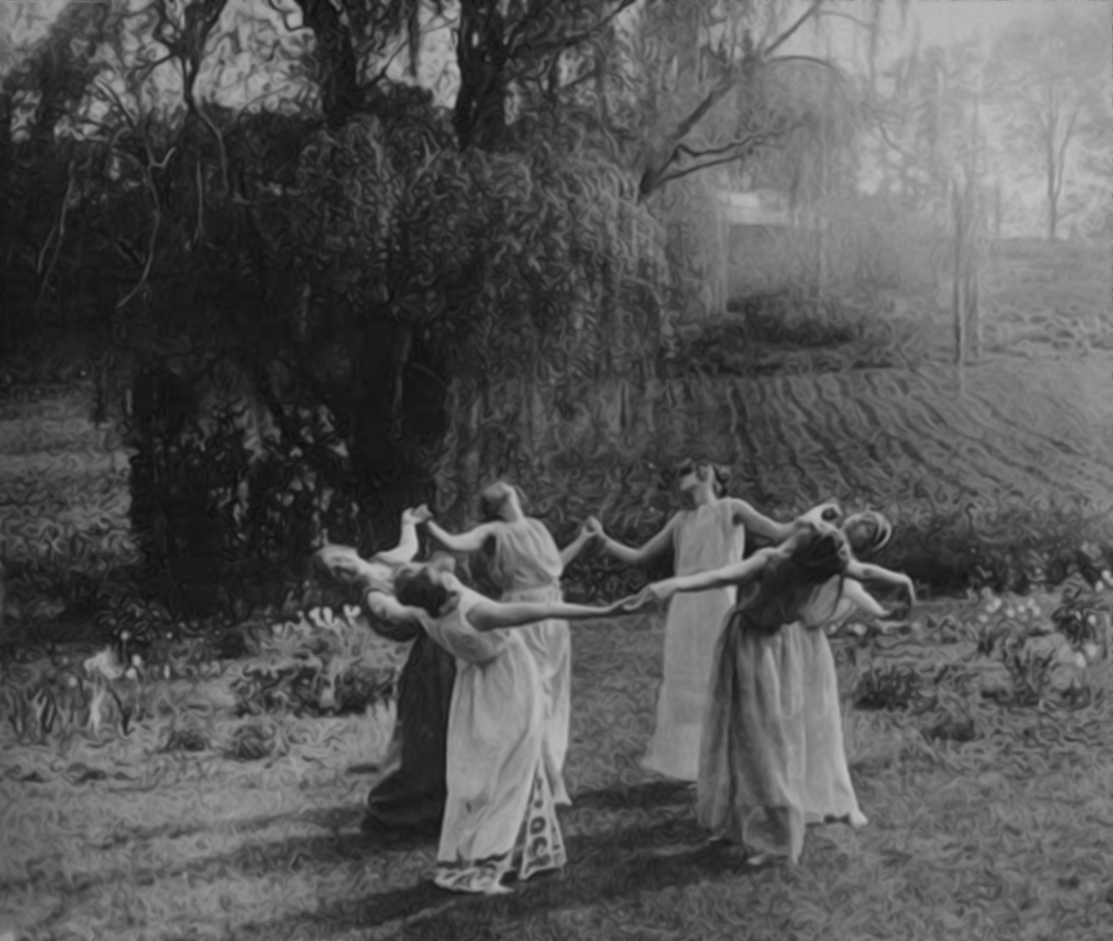
What do you call a group of witches?
A coven
Notes:
Coven. The formal organization and working unit of witches. The origin of the word coven is not clear. Most likely, it derives from the verb convene, which includes in its variant, convent, which once referred both to a religious meeting and the place of a religious meeting. Chaucer used the term coven in Canterbury Tales to refer to the meeting of 13 people. Basically the same as “Squad”. (Guiley, 2008, p. 75)

Slide 7
What do you call a witch’s pet?

Slide 8
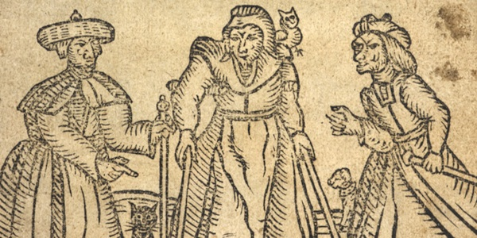
What do you call a witch’s pet?
A familiar
Notes:
Constant companion of witches for the purpose of carrying out spells. Usually cats, toads, owls, mice and dogs, also insects. Said to be given by the devil or bought from other witches. (Guiley, 2008, p. 122)

Slide 9
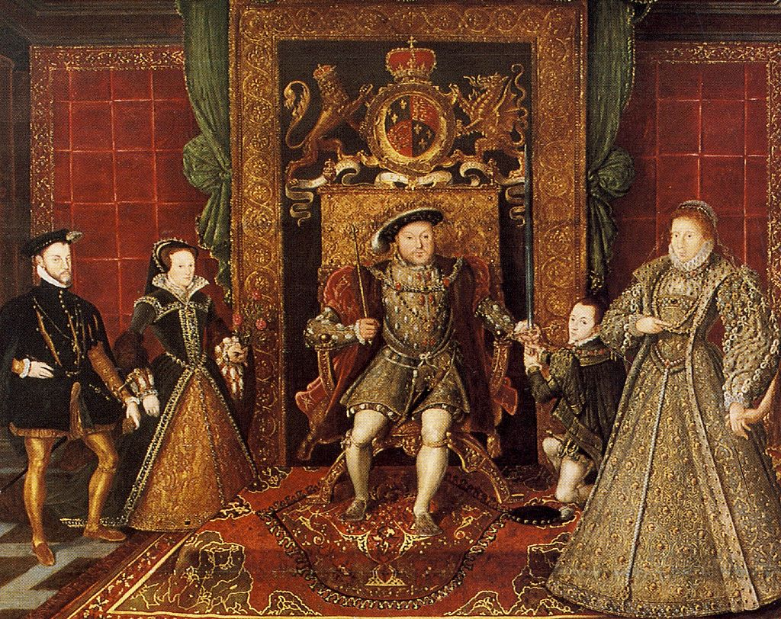
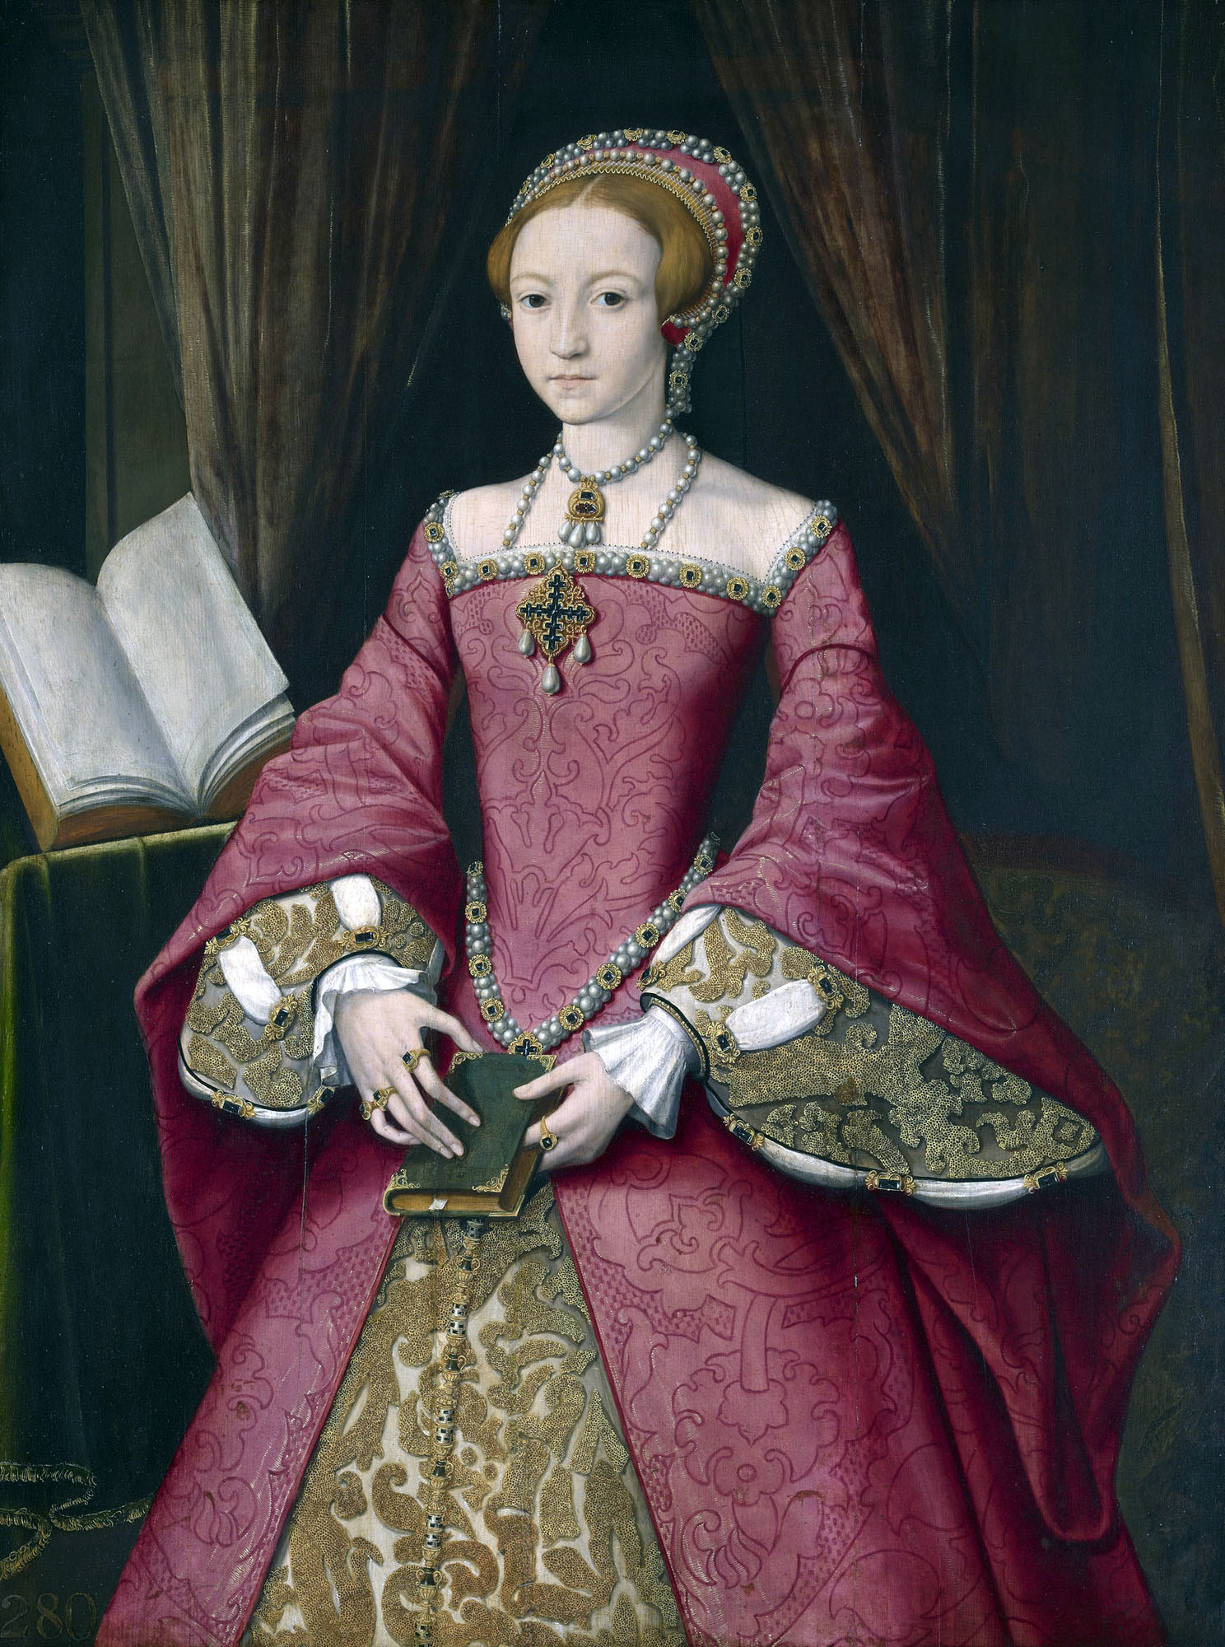
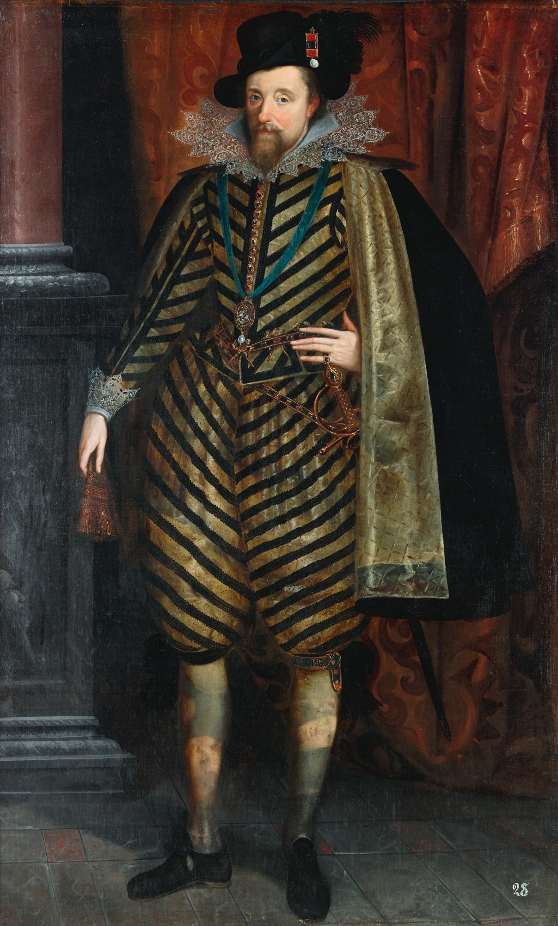
The Monarchs of 16th and 17th Century England
Notes:
3:00 – 4:00
House of Tudor (most popular monarch Henry VIII)
Elizabethan era: Elizabeth I (his daughter with Anne Boleyn)
House of Stuart: James I (pictured) and Charles I
https://www.salonprivemag.com/wp-content/uploads/2019/08/The-House-of-Tudors.jpg
https://smarthistory.org/wp-content/uploads/2020/07/329955-1350464449.jpg
https://sothebys-md.brightspotcdn.com/9a/18/601345504baab7e9c19104d74f8d/111l19037-b8jhp.jpg

Slide 10
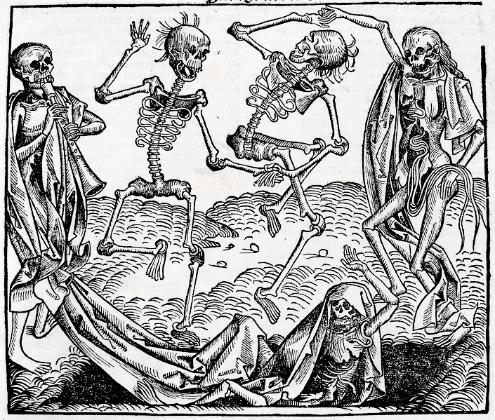
It was a time of poverty, illness, and disaster…..
Social Class
  Mostly fixed. 50% of the population were “decreasing the wealth of the kingdom”.
  Chronic underemployment. Poor living conditions.
  From bottom to top: Cottagers, paupers, labour people → Farmers, freeholders, tradesmen → rising professional groups of lawyers, clergymen, merchants → Elite landed gentry and nobility.
Life Expectancy
  Extremely low. Even aristocratic infants had high death rates.
  Low food supply. Most suffered from Vitamin A and D deficiencies. Sore eyes, urinary tract infections, tuberculosis, and rickets were common. Smallpox, the bubonic plague, and influenza killed thousands.
  Hygiene, sanitation, and antiseptics had not been studied. The poor could not afford physicians, so they consulted with herbalists and wise women instead.
  Outbreaks of fire were common.
  (Thomas, 1971, 23 – 37)
Notes:
4:00 – 6:00
Great Fire of London as well happened during this time.
Important to know to understand why people were open to magical beliefs. People were so hopeless and depressed…
https://www.theanneboleynfiles.com/wp-content/uploads/2013/12/Dance-of-Death.png

Slide 11
What exactly is Witchcraft?
A universal definition for witchcraft does not exist. A “witch” can mean different things depending on culture and period in history.
In general, there is both a positive and negative connotation associated with Witchcraft. “It is a form of sorcery, the magical manipulation of supernormal forces through the casting of SPELLS and the conjuring or invoking of spirits, for either good or bad purposes. MAGIC and sorcery have been used by mankind since prehistoric times in an effort to control the environment and enhance daily life.”
According to anthropologists, witchcraft can be done psychically without the use of ritual or charm. It also involves the use of supernatural abilities, such as invisibility, shape-shifting, clairvoyance, astral projection and flying for example.
(Guiley, 2008, p. 378)
Notes:
6:00 – 7:00

Slide 12
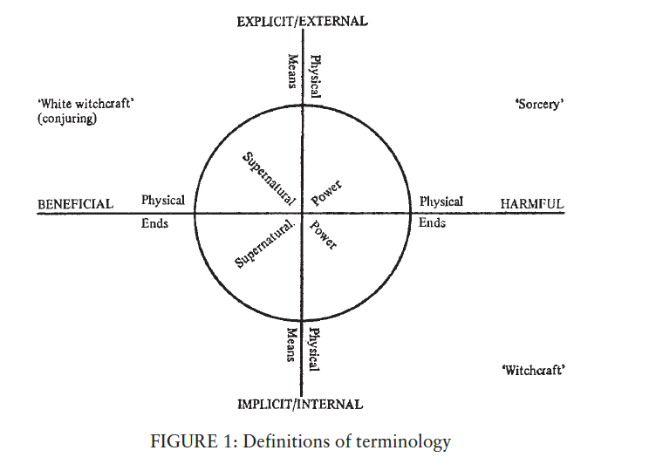
Distinguishing Between White Witchcraft, Sorcery, and Witchcraft in 16th century England
Notes:
7:00 – 9:00
White witchcraft – healing (cunning folk)
Sorcery – a sorcerer makes an image of his enemy in wax with the evil ends of witchcraft. He sticks pins into the image to cripple his victim.
Witchcraft – supernatural activity, result of power given by some external force (Devil) and to result in physical injury to the person or object attacked by it. Not necessarily any outward action or words on the part of the witch. (MacFarlane and Sharpe, 1999, p. 4) Harmful magic was called maleficium (Thomas, 1971, p. 443)
Generally speaking, the cunning folk and the maleficent witches were believed to be two separate species. But they did sometimes overlap, and there are many examples of village wizards and charmers who found themselves accused of maleficent witchcraft (Thomas, 1972, p. 444)

Slide 13
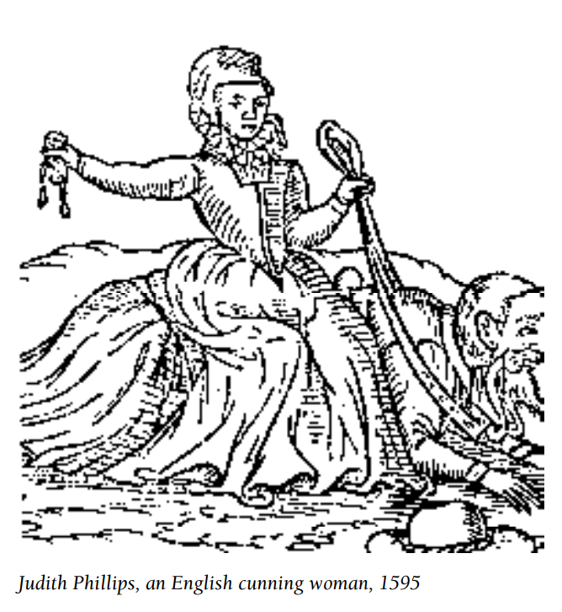
Cunning Folk
Village witch or healer who provides cures, remedies, charms, spells, and divination, usually in exchange for a fee or gift.
Acquired through heredity or through supernatural gifts from fairies, the dead, or divine intervention.
Practiced magic that was a home-made blend of Christian and Pagan material, folk magic, and occultism.
Served as unofficial police. Consulted for crimes.
Some were prosecuted for witchcraft during the Inquisition, but public support for them was strong. Cunning Folk were sought out by aristocrats for love. Some charged hefty fees, even annuities.
Practices live on through astrology, intuitive counselling, herbalism, and energy healing in modern times.
(Guiley, 2008, p. 86-87)
Motivated by desire for prestige and boasted of their “gift and power” (MacFarlane and Sharpe, 1999, p. 127)
Notes:
10:00 – 12:00
Not worshippers of the Devil. Not all magic is witchcraft.

Slide 14
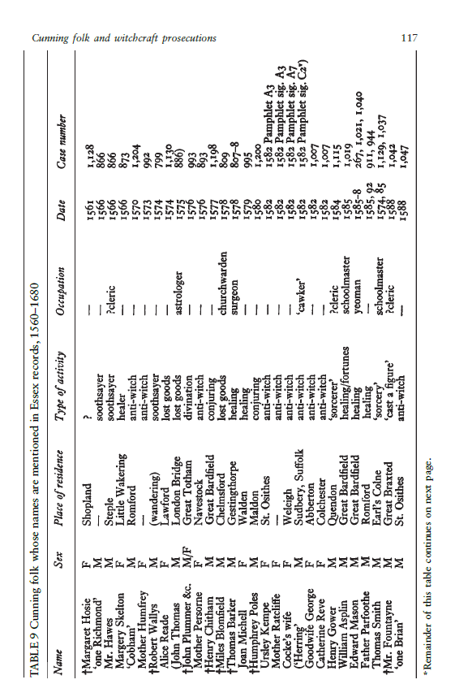
Notes:
12:00 – 13:00
List of cunning folk in Essex. Not a lot of cunning folk were brought to court because “men rather uphold them, and say, why should any man be questioned for doing good”.
Principal reasons for their popularity: 1) many of them received successful treatment, they charged less than physicians. 2) can also explain physical pain (e.g., could tell if someone was “bewitched”), dealt with both physical and mental needs, 3) also acted as information centres, know from gossip and rumours the names of local witches
(Macfarlane, p. 117)

Slide 15
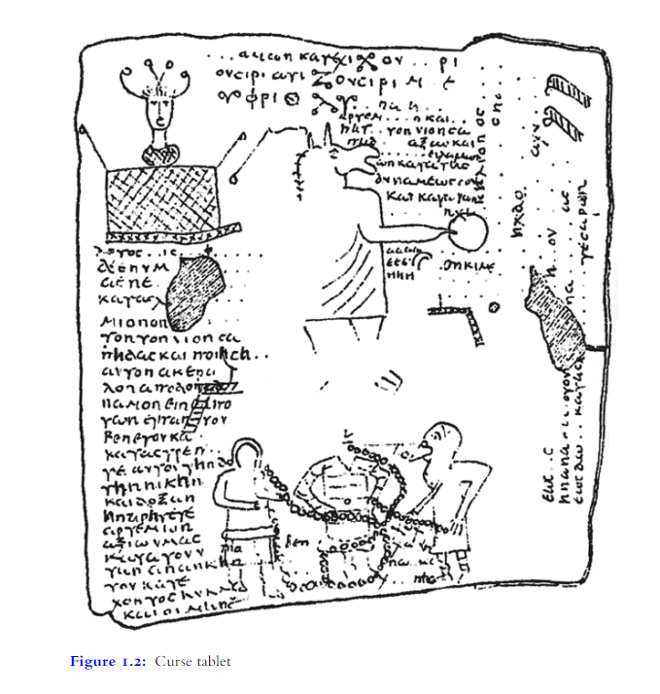
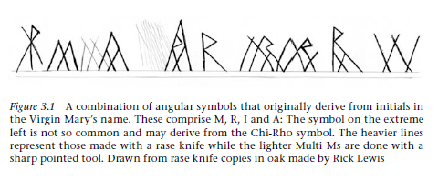
In reality, magic was widely practiced for centuries in Europe (pre-and-post-Witchcraze)
Notes:
13:00 – 15:00
Curse tablets – in the Greco-Roman world, there was a market for ritual curses and spells inscribed on thin sheets of lead or other materials. These tablets were deposited near the target (e.g., a well). Also put into graves when the agent was a deceased person. Generally purchased from professional scribes. There was an industry for it. Curses were used for centuries (e.g., business, winning a sport or a court case, love, etc). (Rampton, 2018, p. 57)
Apotropaic (evil-averting) symbols to protect buildings against misfortune. Practice was likely post-Witchcraze – 16th to 17th century. Christian magic was a thing. Symbols found in the county of Suffolk, but these types of symbols have been found everywhere in the UK, commonly in houses, barns, stables, churches. The common was the combination of letter that form MARIA (Virgin Mary). Many church doorways have scribed Ms on walls. Considered talismans. W is a variant of M. R for “Regina” – Queen of Heaven. (Hutton, 2015, p. 39 – 65)

Slide 16
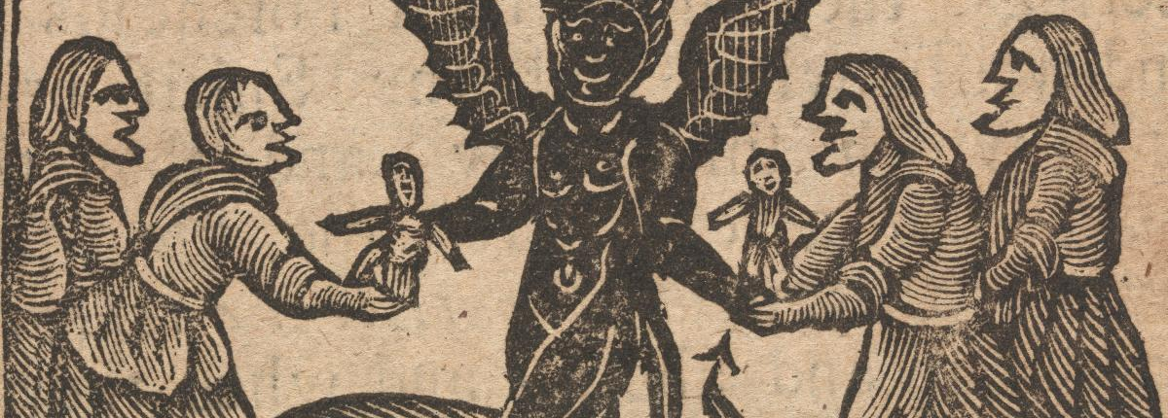
It was only in the late Middle Ages when witchcraft became almost synonymous to making a pact with the Devil
Notes:
15:00 – 16:00
Notion that the witch gained her powers because he or she made a pact with the Devil. In return, the Devil would give her supernatural powers.
Not about the damage to other people, but its heretical character --- devil worship (Thomas, 1972, p. 445). It didn’t matter whether the witch harmed other people. Witchcraft was the greatest sin because it involved the renunciation of God.

Slide 17
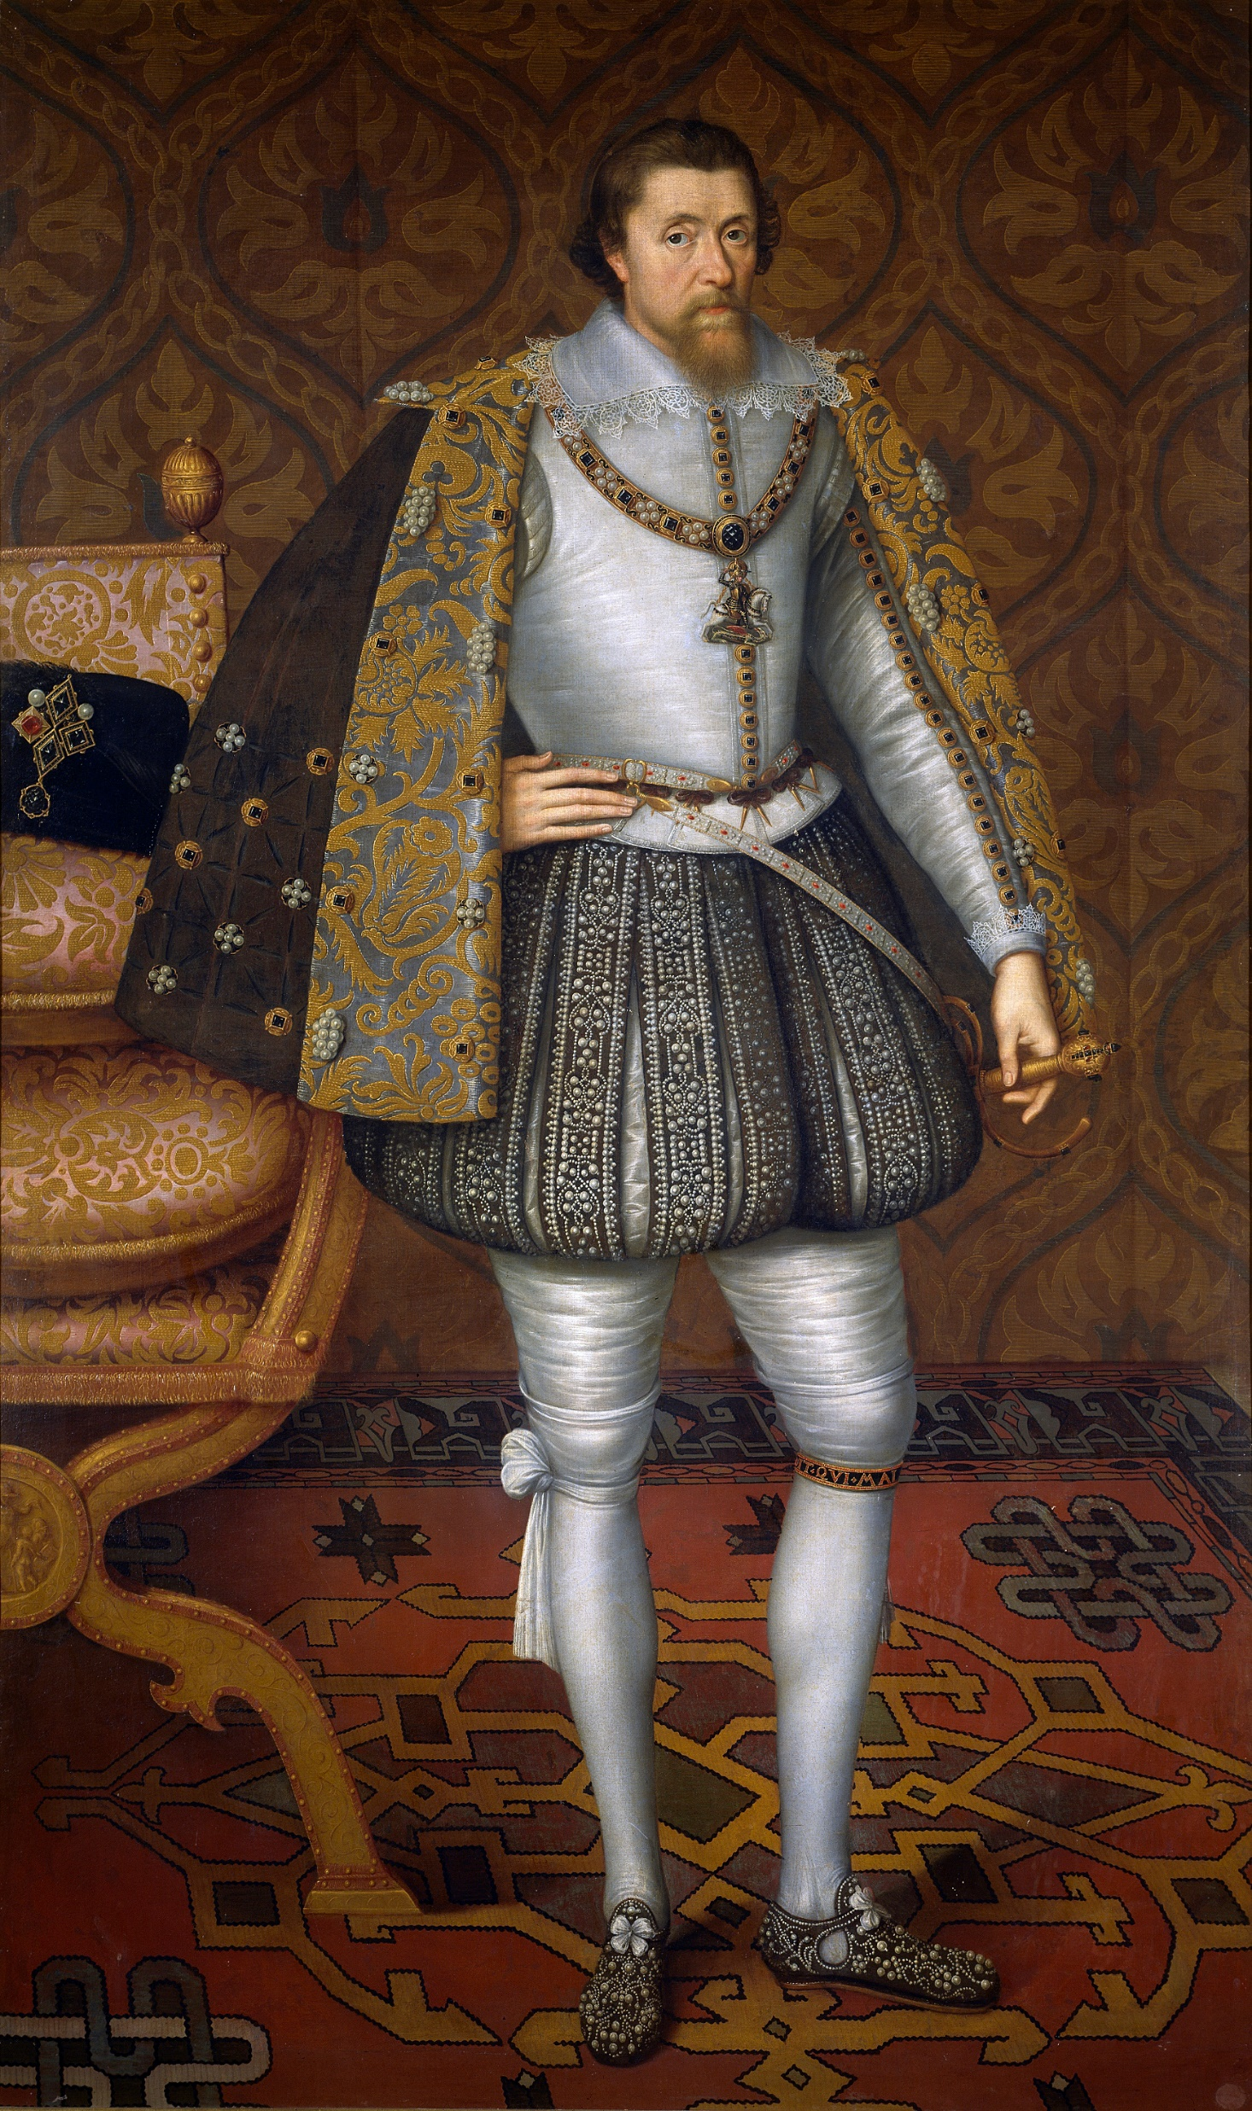
King James VI of Scotland (or James I of England)
Ruler of Scotland from 1567 – 1625 and became King of England in 1603
His Danish bride was almost killed by two storms at sea. This sparked his interest in witchcraft. He believed this was a personal attack on him and his bride by the North Berwick witches. He also attended their trials.
Personal crusade to fight Satan and even wrote a book called “Daemonologie” as a declaration of his mission to eradicate and punish witches in the form of a dialogue between Philomathes and Epistemon.
His main message: any type of magic is bad and must be punished.
(Rampton, 2018, p. 387 – 399)
Notes:
16:00 – 17:30
2 mins
Source of image: https://upload.wikimedia.org/wikipedia/commons/6/63/JamesIEngland.jpg

Slide 18
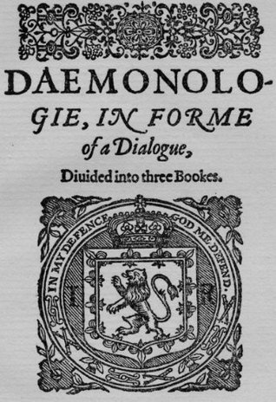
Notes:
17:30 – 18:00
Image source: https://i.gr-assets.com/images/S/compressed.photo.goodreads.com/books/1400357197l/22140586.jpg
Book talked about the evils of necromancy, herbalism, spells, stones (crystals?), astrology, divination, and fairies. (Rampton, 2018, p. 393 – 399). Even werewolves.

Slide 19
Witchcraft Acts in England
1542
First English Statute concerning witchcraft. Back then, it was treated as an example of heresy. Prosecutions were rare before then. Repealed in 1547, but then….
1563
Act against Conjurations, Enchantments, and Witchcraft was passed. Death penalty created.
1604
Punishments became more severe. New offence was added (i.e., taking out dead bodies from graves became illegal). Government concerned by false predictions, astrology, and amateur conjuring. Partially due to James I’s interest in demonology and witchcraft.
(MacFarlane and Sharpe, 1999, p. 14)
Notes:
18:00 – 19:00
Striking that there is no reference to demonic entities in the first two. More concern about maleficium. 1604 is different – evidence of relationship with evil spirits or familiars was technically sufficient to secure the judicial condemnation of an accused person, doesn’t matter if someone was harmed (Thomas, 1972, p. 448 – 450).

Slide 20
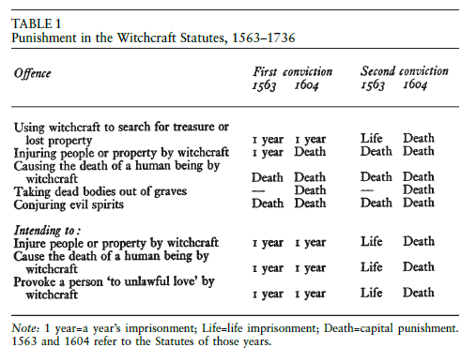
(MacFarlane and Sharpe, 1999, p. 14 -20)
Notes:
19:00 – 20:00
Least severe punishment was 1 year imprisonment. Death was through hanging unless it was “petty treason” (in this case, the convicted witch would be burnt). Popular belief that witches were burnt, but this was uncommon.

Slide 21
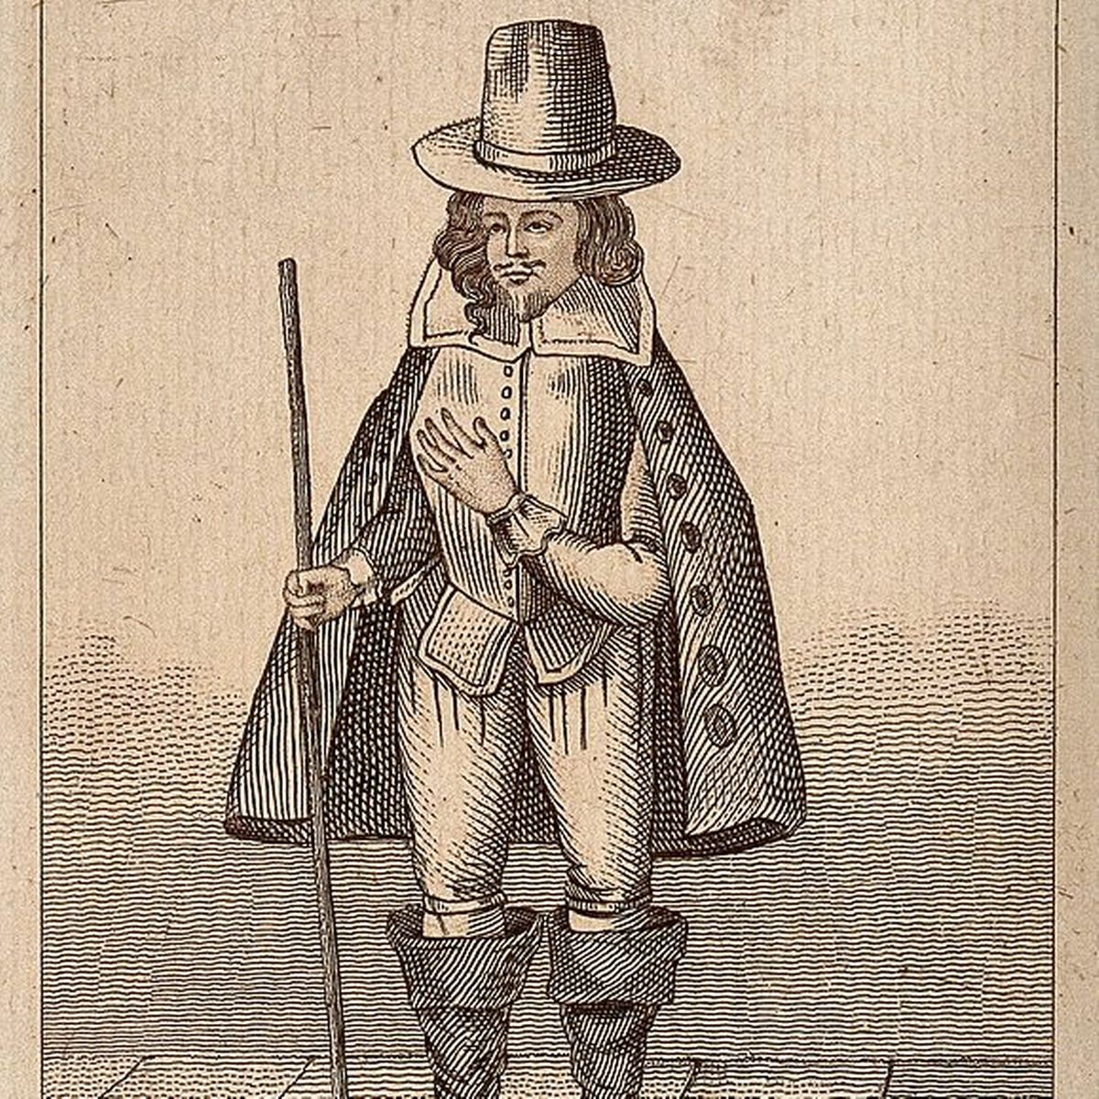
Witch Hunters – a new career!
Matthew Hopkins was a witch-hunter who was the leader of the most intense witch hunts in English history. He was active in the counties of Suffolk and Essex. Total execution count: 200+ victims. (Durrant & Bailey, 2012, p. 14)
For perspective, there were less than 500 executions in England throughout the early modern period (Durrant & Bailey, 2012, p. 72-73)
Denied the accused of sleep until his or her familiar had appeared (Thomas, 1971, p. 525)
Notes:
19:00 – 20:00
A new industry created!
Source: https://i2-prod.suffolklive.com/incoming/article5742452.ece/ALTERNATES/s1200c/2_581px-Matthew_Hopkins_Witchfinder_general.jpg

Slide 22
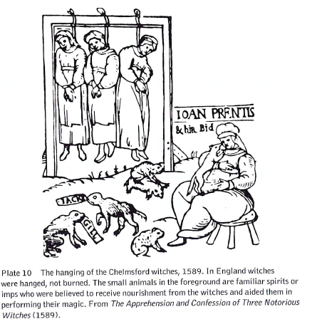
Witch Accusations, Confessions, and Torture
Accusers were not required to witness the actual act of witchcraft. After all, it was done in an “invisible way”. As such, half-proofs were considered evidence.
Degrees of evidence:
  A “strong presumption” (e.g., reputation of being a witch, injuring a person through cursing, malice followed by a misfortune, accusation by a “white witch”).
  “Sufficient proofs” (e.g., accusation by another witch, Witch’s mark allegedly caused by a familiar or the Devil, two people witnessing the accused of making a pact with Satan)
  Other “adequate evidences” (e.g., pictures or images of victim in the accused’s home, a corpse bleeding when touched by the accused, confession of the accused)
A confession was considered one of the few credible proofs of guilt. If the accused confessed, he or she became a powerful witness against other witches.
Physical and mental torture was only allowed if treason was involved. That being said, if the presumption was strong enough, the accused was kept awake for several nights, immersed in water, or constantly questioned.
(MacFarlane and Sharpe, 1999, p. 17-20)
Notes:
20:00 – 22:00
Picture Source: Levack reading

Slide 23
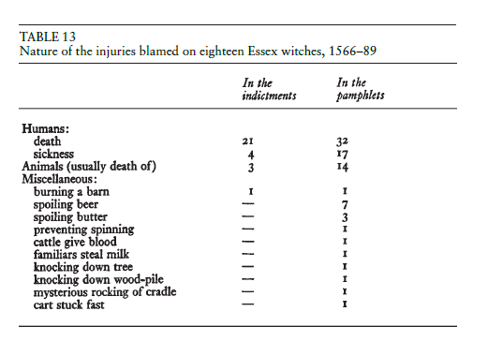
Prosecution and Economic Problems
Population
No correlation between population density and prosecutions at the village and county level.
Relationships between Accused vs. Accuser
The most serious accusations took place between people who knew each other, most of the time between neighbours. In fact, newcomers were not prosecuted. There is only one case of this in Essex. Sometimes, family members gave evidence against one another.
Social Class
Accused witches were poorer than their “victims”, but not by a lot. One explanation for this was that families who had decreasing wealth would have been more likely to be viewed as witches because they would have more reason to feel envious of those with more financial assets.
What did witches do?
Witches were blamed for deaths, loss of butter or beer, mysterious accidents, loss of animals and farm produce, etc.
(MacFarlane and Sharpe, 1999, p. 147 – 153, p. 170)
Notes:
23:00 – 25:00
Assumption that it’s because of population growth does not seem to be true.
Children gave evidence against their own parents.

Slide 24
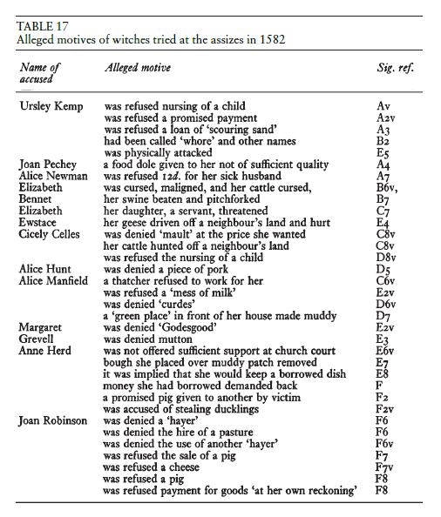
(MacFarlane and Sharpe, 1999, p. 173)
Notes:
25:00 – 26:00
Witches always had a reason for their actions. Usually, it was because of revenge caused by the mistreatment of their neighbours.

Slide 25
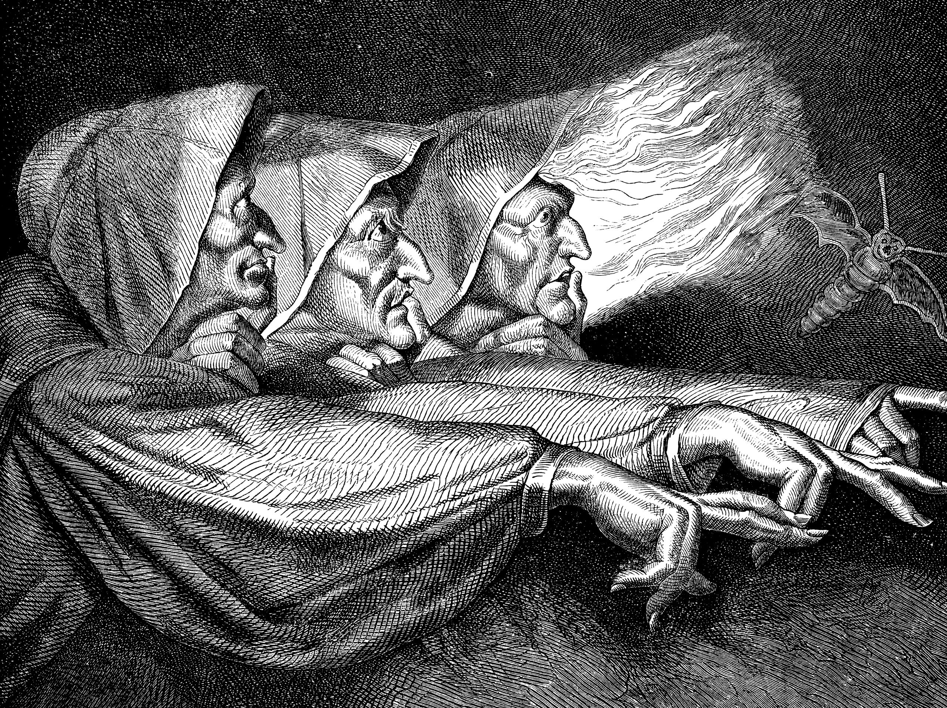
Characteristics of the Prosecuted
Attractiveness and Likeability
Personality was more of a determining criteria than physical attractiveness. People usually only became suspects after having “acted like a witch” (i.e., illiterate, lustful, or miserable). They would then be searched for a physical oddity or a witch’s mark.
Mostly Older Women
A belief that women were the weaker sex and more vulnerable to the Devil. Women were said to be “sooner entangled by the Devil’s illusion with this damnable art, then [sic] the man”.
Marriage Status
Almost always “wives and widows”, not unmarried women. Widowhood was especially a problem during the Elizabethan era.
Also mostly older women. Data from Essex shows the likeliest age for a witch was between 50 – 70 years old. It was believed that older witches were more powerful than younger ones. Their victims were usually younger adults.
(MacFarlane and Sharpe, 1999, p. 158 – 164)
Notes:
26:00 – 28:00
https://shorthand.uq.edu.au/small-change/women-as-witches/assets/3vgQm2X8Nx/gettyimages-170644277-2560x1913.jpeg

Slide 26
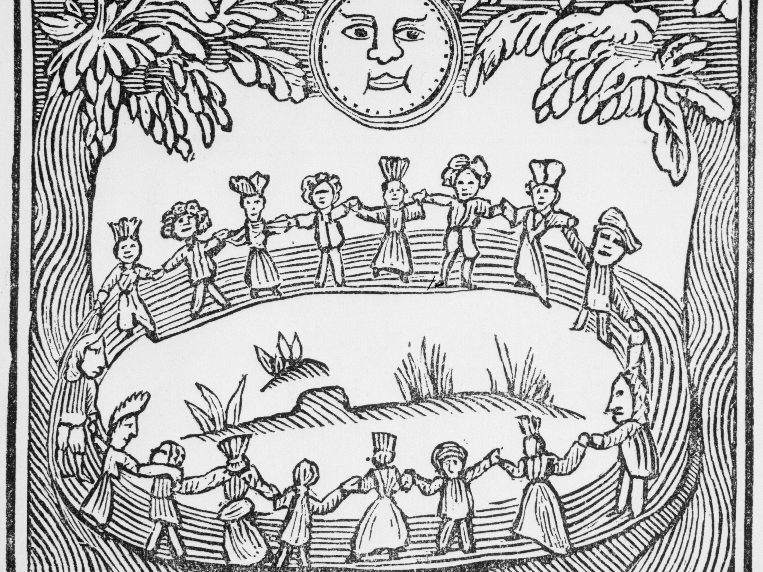
The Decline of Witch Beliefs
Two attitudes came about:
  1) The assumption that God or the Devil is unlikely to intervene on the order of the universe.
  2) The assumption that there was a natural explanation for mysterious events, such as the witch’s mark or the incubus.
By the late 17th century, most of the intellectuals and gentry became more skeptical of witchcraft.
Witchcraft Act repealed in 1736 finally.
(Thomas, 1972, p. 588 – 595)
Notes:
28:00 – 29:00
God conducts his affairs in an orderly way, working through natural causes accessible to human investigation. Considering God’s reasonableness, miracles or magic came to be seen as implausible. People became more skeptical of confessions of people seeing the Devil or witnessing curses.
Melancholy – could be a delusion. Incubus – could be a disease. Recognition that there should be a study of mental illness.
Picture Source: https://www.learnreligions.com/thmb/CGp5KjMiurZlxDzO4xL-J9DUj9E=/3858x2894/smart/filters:no_upscale()/illustration-of-a-witch-dance-517436262-5c65e43c46e0fb0001cec272.jpg

Slide 27
Discussion Questions
Is magic or witchcraft inherently bad?
What if it comes from a place of good intention?
On a social level, what can we learn from the witch hunts?

Slide 28
Works Cited
Durrant, J., & Bailey, M. D. Historical dictionary of witchcraft. Scarecrow Press, 2012.
Guiley, Rosemary. The encyclopedia of witches, witchcraft and wicca. Checkmark Books, 2008.
Hutton, Ronald. Physical Evidence for Ritual Acts, Sorcery and Witchcraft in Christian Britain: A Feeling for Magic. Basingstoke UK and New York: Palgrave Macmillan, 2015.
Levack, P. B. The Witch-Hunt in Early Modern Europe. London: Longman, 1995.
Macfarlane, Alan, and J. A. Sharpe. Witchcraft in Tudor and Stuart England : a Regional and Comparative Study / Alan Macfarlane. 2nd ed. / with an introduction by James Sharpe., Routledge, 1999.
Rampton, & Scholars Portal, distributor. European magic and witchcraft : a reader / edited by Martha Rampton. University of Toronto [Ontario] Press, 2018.
Thomas, Keith. Religion and the Decline of Magic / [by] Keith Thomas. -. Scribner, 1971.

