Slide 1
Network Intervention
By Thomas W. Valente
Yilin sun

Slide 2
Introduction
The research on social networks has shown that people can be influenced by their social networks to adopt new ideas that affect their personal lives.
Network interventions are purposeful efforts to use social networks or social network data to generate social influence, accelerate behavior change among individuals or communities.

Slide 3
Network Intervention Strategies
Identifying individuals
Segmentation
Induction
Alteration

Slide 4
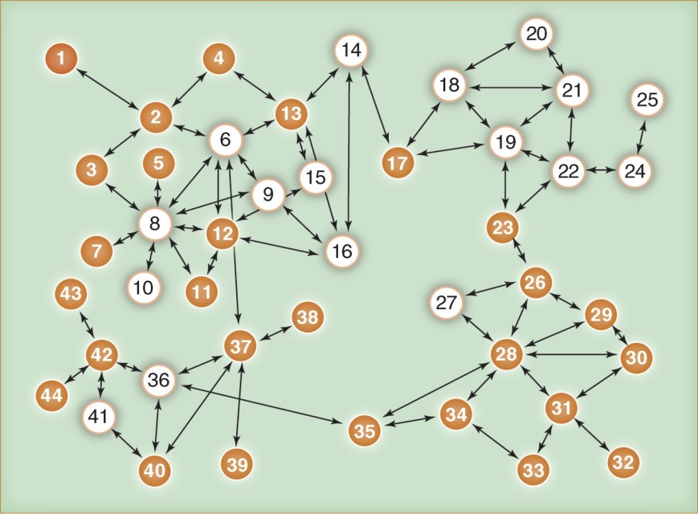
Individuals

Slide 5
Leader
Those who received the most nominations up to some threshold, the top 10 to 15%, were identified as leaders.
nodes 28, 8, 13, 37, 19, and 6
We use conception of centrality to count nominations.

Slide 6
Bridging Individuals
More easy to change and may be in a better position to change others.
Brokers (nodes 8, 28, 6, 37, 19, and 13) who have many connections to people who are not directly connected .
Bridges whose connections maximally increase network cohesion (nodes 14, 37, 24, 6, and 35).

Slide 7
Individuals

Slide 8
Low-threshold change agents
Those people should be recruited when the researcher wants to create early momentum for the change and accelerate the time to reach a critical mass or tipping point.
Low-threshold adopters are individuals willing to adopt a new idea earlier than their peers.

Slide 9
Isolate Nodes
People on the margins of the community or organization may also be identified by change programs, because they are potentially excluded from services or the positive supports derived from community participation, not for their ability to persuade others.
Peripheral individuals may be important to identify, as they are often the source of new ideas and innovations because they have contacts with other communities and/or are free from the social pressure to conform.

Slide 10
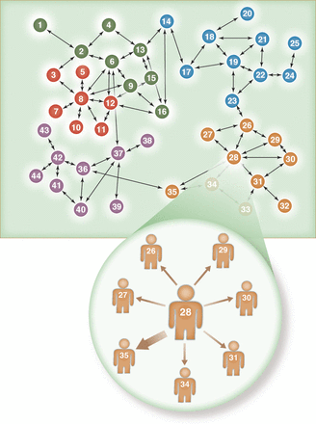
Segmentation

Slide 11
Induction
Induction interventions stimulate or force peer-to-peer interaction to create cascades in information/behavioral diffusion.
Word-of-mouth (WOM) interventions
In respondent-driven sampling (RDS)
Network outreach

Slide 12
World of Mouth
Word-of-mouth (WOM) interventions stimulate interpersonal communication to persuade others to adopt the new behavior.
The success of WOM is a function of the network position of initial adopters and the incentives they have to recruit others.

Slide 13
In Respondent-Driven Sampling (RDS)
Also known as “snowball methods”
In RDS, an initial set of people who are members of the community or population to be influenced are selected and identified as “seeds.” These seeds then recruit members of their social networks who subsequently encourage additional people to participate, and so on .

Slide 14
Network Outreach
The network seeds recruit members of their personal networks to participate in an intervention together, in which the behavior change messages can be delivered to the entire group.

Slide 15
Alteration
Adding/deleting nodes
Adding/deleting links
Rewiring existing links

Slide 16
Selecting an Intervention
Selecting an appropriate network intervention depends on many factors, including the type and character of available network data, the type of behavior change being promoted, and the environmental or situational context.
You have to choose the most validity and reliability data, and then choose an appropriate strategy.

Slide 17
Some Factors Influence Intervention
Geographic distance
Characteristics of the behavior
Interdependent behaviors
Prevalence
Perceived political support or acceptability of the new behavior

Slide 18
Conclusion
Existing evidence indicates that network interventions are quite effective. The options for network interventions have been dramatically enhanced by communication and information technologies , These electronic networks are often composed of friends (sometimes close friends), and much affective communication now occurs over electronic media.
The studies reviewed here indicate that networked interventions are more effective to achieve a goal than non-network alternatives.

