Slide 1
Social Influence Bias: A Randomized Experiment
Muchnik, Aral, Taylor
Present by Haiteng Sun

Slide 2
Introduction
our society is increasingly relying on the digitized, aggregated opinions of others to make our own decision

Slide 3
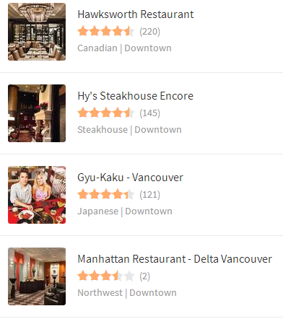
Question?
Do they produce useful, unbiased, aggregate information about the quality of the item being rated?

Slide 4
Herding Effects
Herding Behavior: describes how individuals in a group can act collectively without centralized direction.
Social influence on individuals’ perceptions of quality and value could create herding effects that lead to suboptimal market outcomes
rich-get-richer
A group think mentality

Slide 5
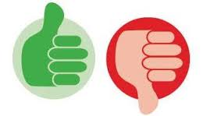
Experiment Design
A large-scale randomized experiment to quantify the effects of social influence on users’ ratings and discourse on a social news aggregation web site.
Step 1: writing comments
Step 2: others “up-vote” or “down-vote” these comments
aggregate current rating=# of up-votes - # of down-votes
the data provide a unique opportunity to comprehensively study social influence bias in rating behavior

Slide 6
Experiment
Data: 101,281 comments, over 5 months
Three Treatments:
Up-treated (4049): +1 rating
Down-treated (1942): -1 rating
The experiment comments were viewed more than 10 million times and rated 308,515 times by subsequent users.
Down-treated
Control
Up-treated

Slide 7
Result
Up-treated: 5.13%
Down-treated: 0.82%
Users did not tend to correct the upward manipulation
Negative social influence inspired users to correct manipulated ratings (down-votes 1.4%)

Slide 8
Result: Control Comments
Positive herding effects:
Politics
culture and society
business

Slide 9
Result: “Friends” V.S. “Enemies”

Slide 10
Result: Discourse

Slide 11
Other Findings
proportion of positive (or negative) votes
Changing opinions about comment quality
Four subgroup:
Positivity
The commenters’ quality
The frequency with which a rater rated a particular commenter
Whether raters were friends or enemies with commenters

Slide 12
Other Findings

Slide 13
Conclusion
positive social influence increased the likelihood of positive ratings
negative social influence inspired users to correct manipulated ratings

Slide 14
Thanks

