Slide 1
Body Composition
Refers to the absolute and relative amounts of the body constituents
Can be assessed on elemental (atomic), chemical, cellular and tissue / system levels
Many methods are restricted to lab applications, but often serve as the foundation for the simpler tests
Reasons to assess body composition
Strong association between obesity and chronic disease risk
correlation established with high chol, high BP and Alzheimer’s
Obese 74% inc risk of dementia, overweight 35% inc risk
Fit better able to maintain cognitive skills with age
Very low levels of fat also detrimental to health
establish optimal weight for health and performance in athletes
Formulation of dietary guidelines and exercise prescription for modifying body composition
Monitor changes in composition with growth, maturation, and aging to distinguish normal from diseased states

Slide 2
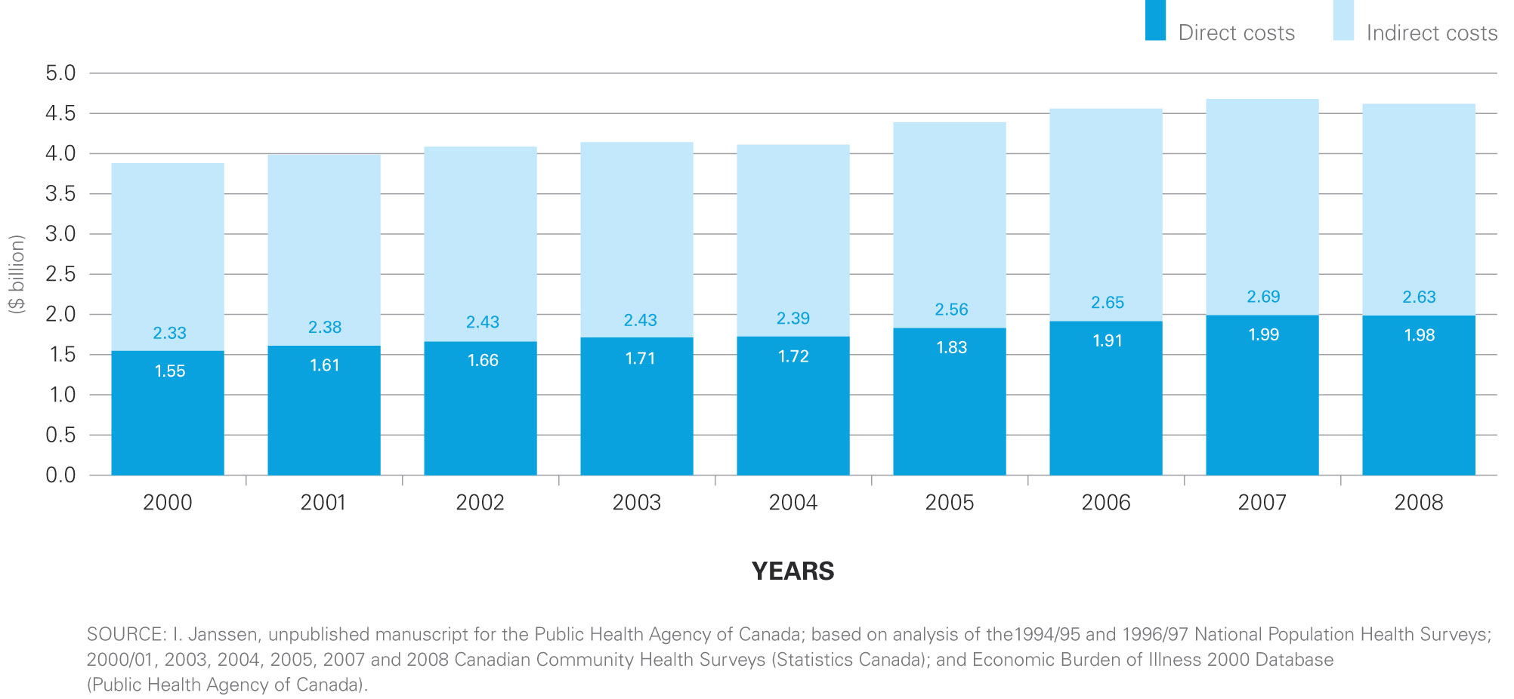
http://www.phac-aspc.gc.ca/hp-ps/hl-mvs/oic-oac/
Notes:
The Centers for Disease Control and Prevention estimated medical costs associated with obesity were $147 billion in 2008.
Canadian costs are estimated to be about 4.6-7 billion per year, split between direct and indirect costs.
http://www.theglobeandmail.com/life/health-and-fitness/health/conditions/obesity-costs-economy-up-to-7-billion-a-year/article583803/
http://www.phac-aspc.gc.ca/hp-ps/hl-mvs/oic-oac/

Slide 3
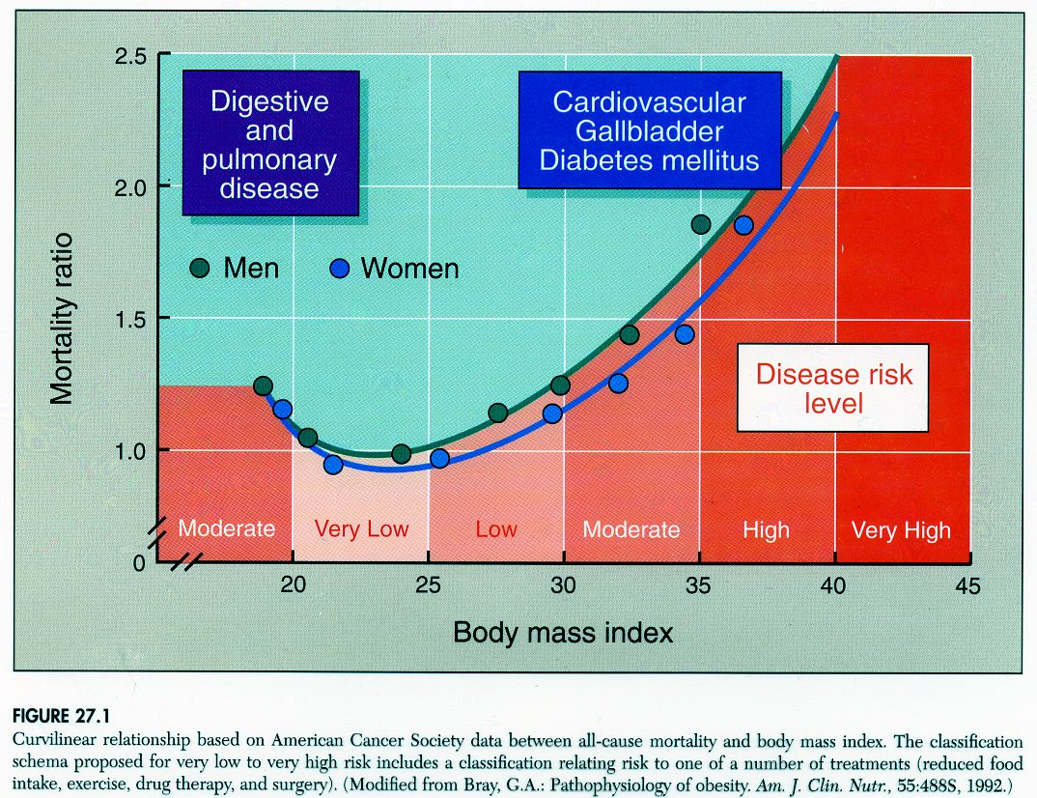

Slide 4
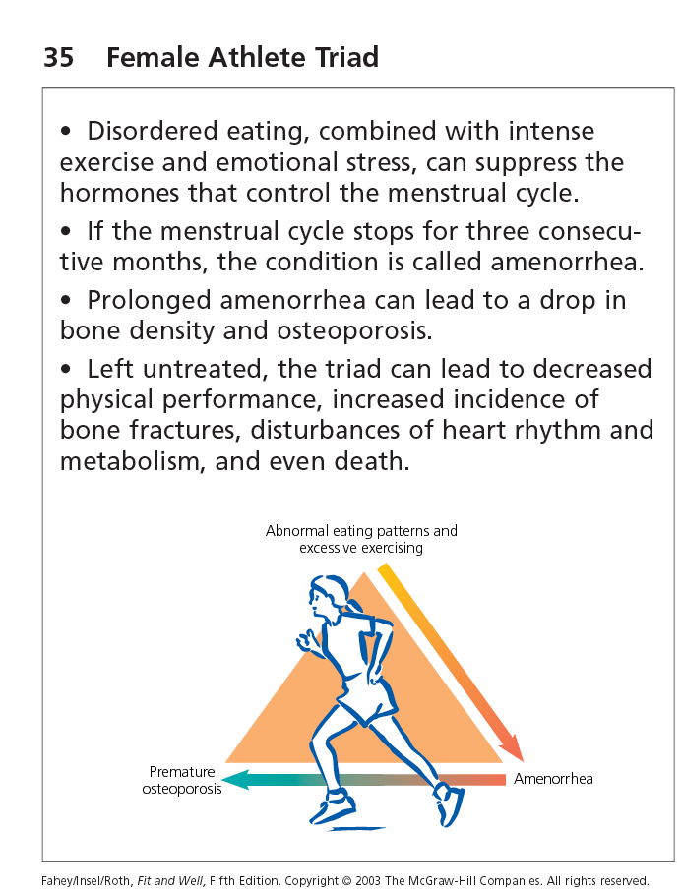

Slide 5
Two Compartment Model
Fat vs fat free mass (FFM)
FFM - bone, water, muscle, connective tissue, organ tissue, teeth
Essential fat - lipids in nerves, brain, heart, lungs, liver and mammary glands
men 3% - women 12 % - breasts, uterus
Non essential fat (storage) - fat cells
adipose tissue - subcutaneous and around organs
variable - gender, age, heredity, metabolism, diet, activity level
excess storage fat - consumption of more energy(food) that is expended

Slide 6
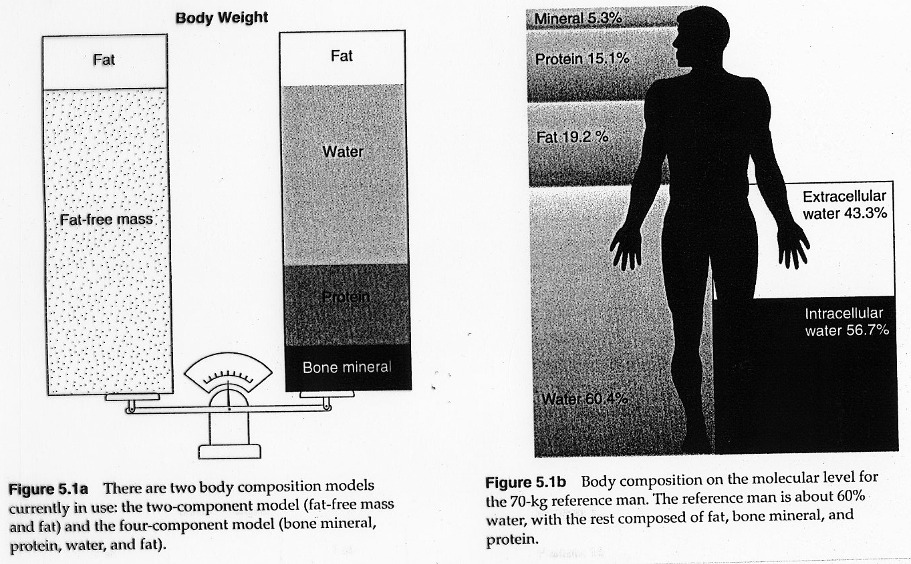

Slide 7
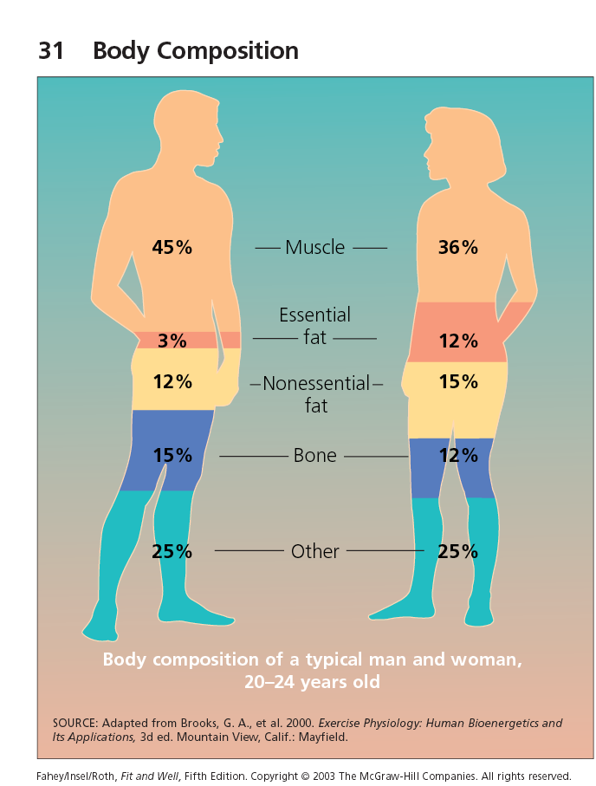

Slide 8
Fat Free Mass
Although body fat is often the focus with evaluation
Lean tissue mass and its components are at least as important
Low lean mass and loss of lean tissue contribute directly and indirectly to metabolic complications
Impaired capacity, decreased activity and energy expenditure - greater risk of fat gain
Sarcopenia - muscle wasting - decreased strength and capacity for routine activity - correlated to mortality
Low bone mass and density - primary predictors of osteoporotic fracture

Slide 9
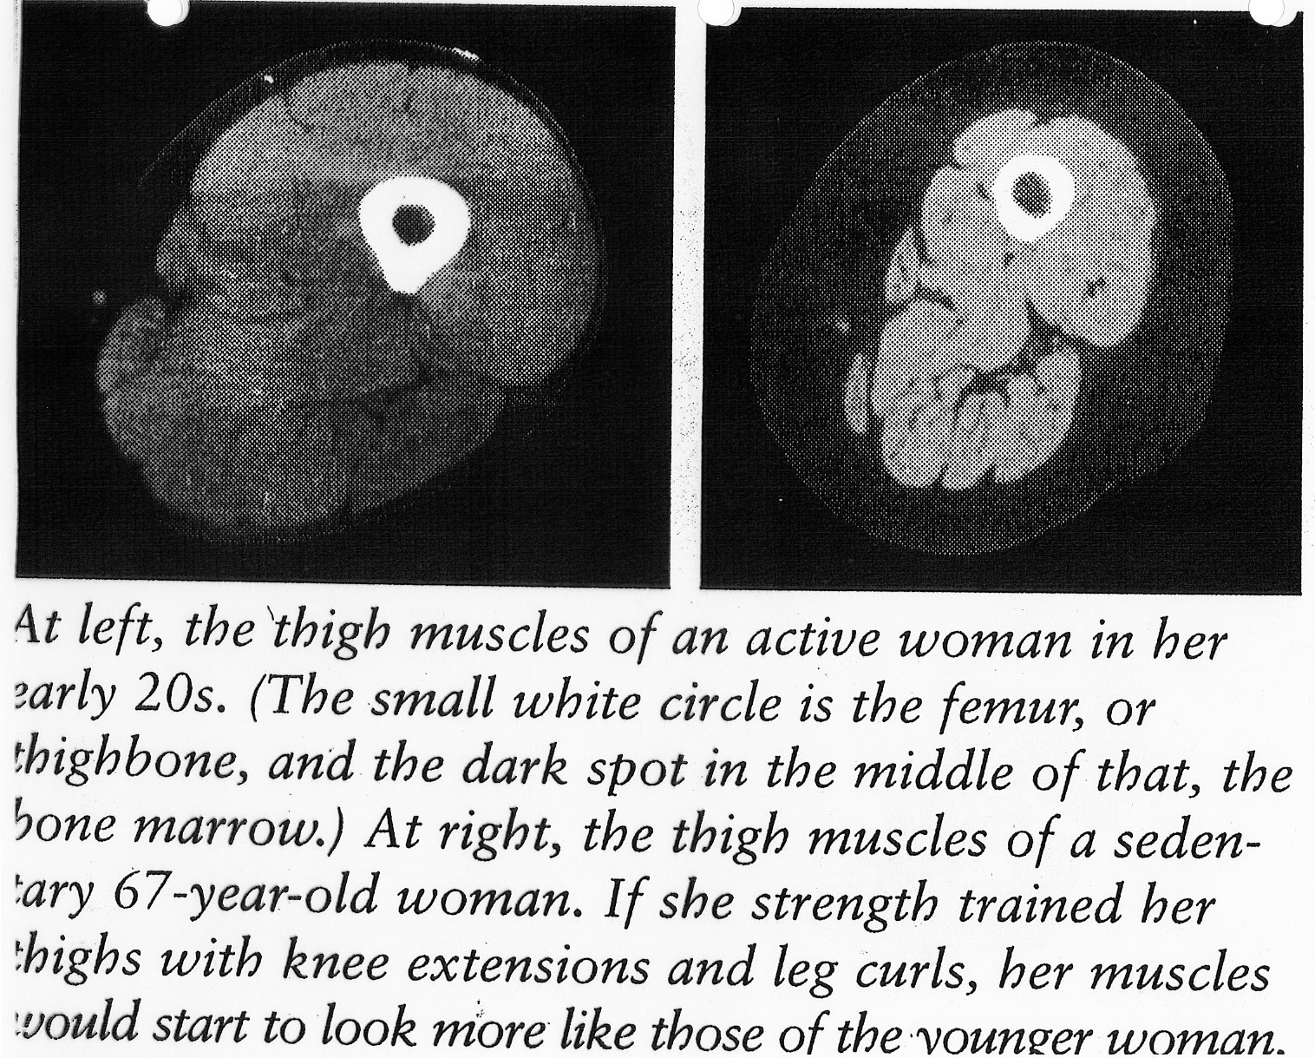

Slide 10
Assessment of Body Composition
Direct methodologies - cadaver studies
Important to provide data that are the foundation from which indirect methods are developed
Indirect methods
Property based - volume, isotope decay, impedance
Total body water using tritium dilution
Component based - depend on well established models
Ratios of measurable quantities (properties) to components that are assumed constant both in and between individuals
Use total body water to estimate FFM
Doubly Indirect - regression analysis to derive equations that relate a measured property to and estimated component
Skin fold and BIA equations
Errors or inaccurate assumptions are propagated
Most susceptible to inaccuracies

Slide 11
BIA - Bioelectrical Impedance Analysis
Rapid, non invasive, relatively inexpensive
May be advantageous as;
Does not require technical skill
More comfortable for client
Requires minimal cooperation
Interludes less on privacy
Single frequency (50kHz) low-level excitation current (500μA) measures whole body impedance
FFM - 73% water - good conductor
Fat - anhydrous - poor conductor
Total impedance reflects volumes of water and muscle compartments constituting FFM

Slide 12
BIA
Accuracy and precision is affected by;
Instruments used
results can vary between instruments and brands - calibrate, use same instrument with repeat assessment
Subject factors
Eating, drinking and exercise must be controlled
Hydration status, fluid distribution and temperature
Technical skill
Prediction equation
Equations available based on gender, age and ethnicity

Slide 13
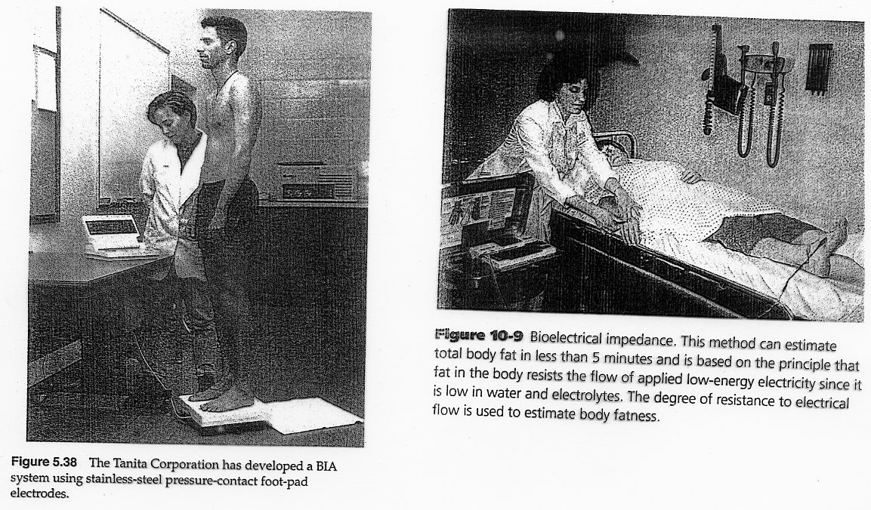

Slide 14
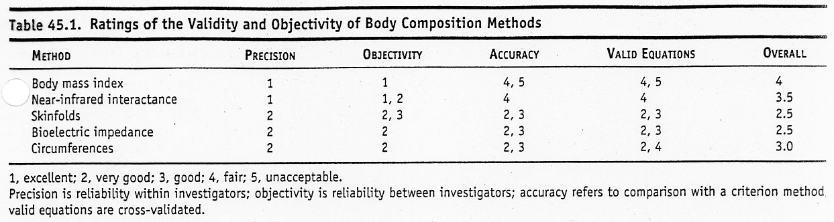
Anthropometry
Table 19.1 ACSM - validity and objectivity
Weight for height indices, skin fold thicknesses, limb and truck circumference and skeletal dimensions have been used to estimate body composition

Slide 15
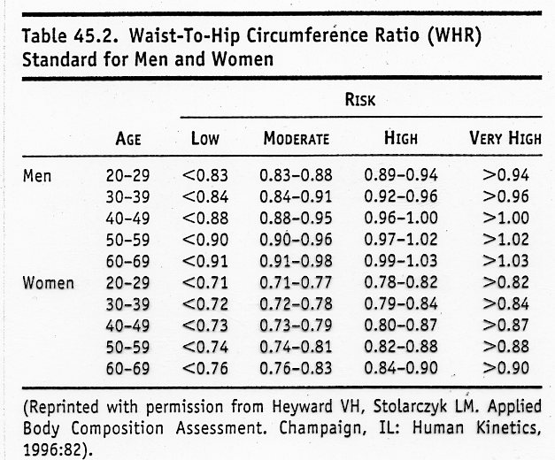
Anthropometry
Skin fold and circumference useful for assessing fat pattern
Subscapular vs tricep - reflect central vs peripheral fat pattern
WHR - waist to hip ratio - common index of upper vs lower body fat distribution
Table 45.2 ACSM(4th ed) - predictor of chronic disease risks

Slide 16
Reliability of Skin folds
Reliability of anthropometric techniques is affected by;
Skill of the measurer
Precise identification of the site of the skin fold
Formation of the skin fold
Alignment of the skin fold
Maintenance of the pressure of the skin fold when measurement is taken
Complete release of caliper jaws
Proper timing of measurement following release of caliper jaws
Type of caliper (pressure differences and consistency)
Slim Guide rated for professional use - also inexpensive
Subject factors
Compressibility of skin fold, edema, variability in fat pattern and distribution
Prediction equation - valuable only for population used to derive them - age, sex, race and level of physical activity

Slide 17
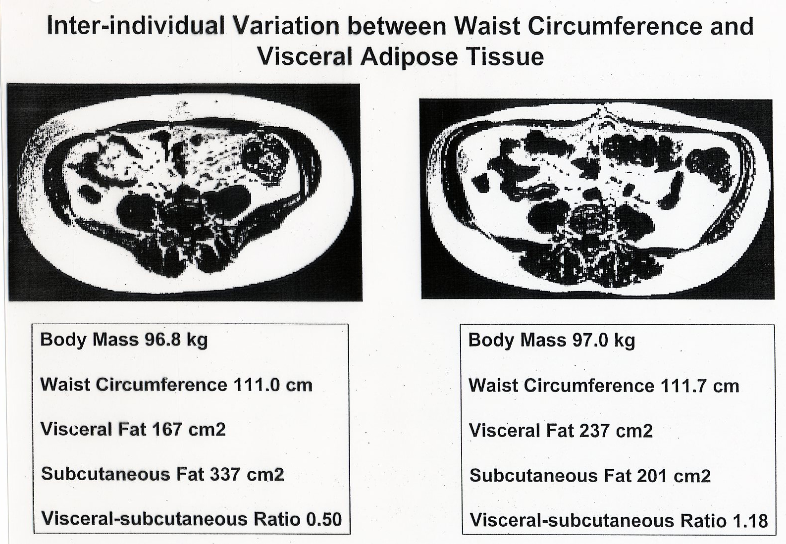

Slide 18
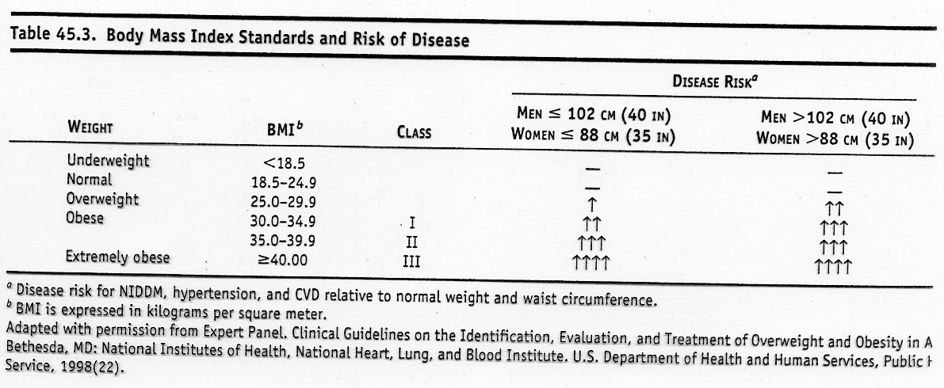
Body Mass Index - BMI
measure is fairly accurate for those who do not have an unusual amount of muscle
weight (Kg) / [ height(m) *height (m)]
Table 45.3 (ACSM 4th ed) relative risk of disease
overweight BMI > 25
obese BMI > 30, stage I, II and III associated with increasing risk for chronic disease
Risk increases when high BMI is combined with high waist girth (men >102cm; women >88cm)

Slide 19
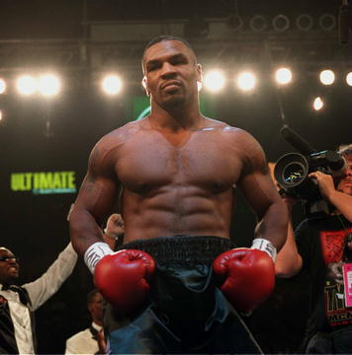
His BMI is over 30 - is he obese?

Slide 20
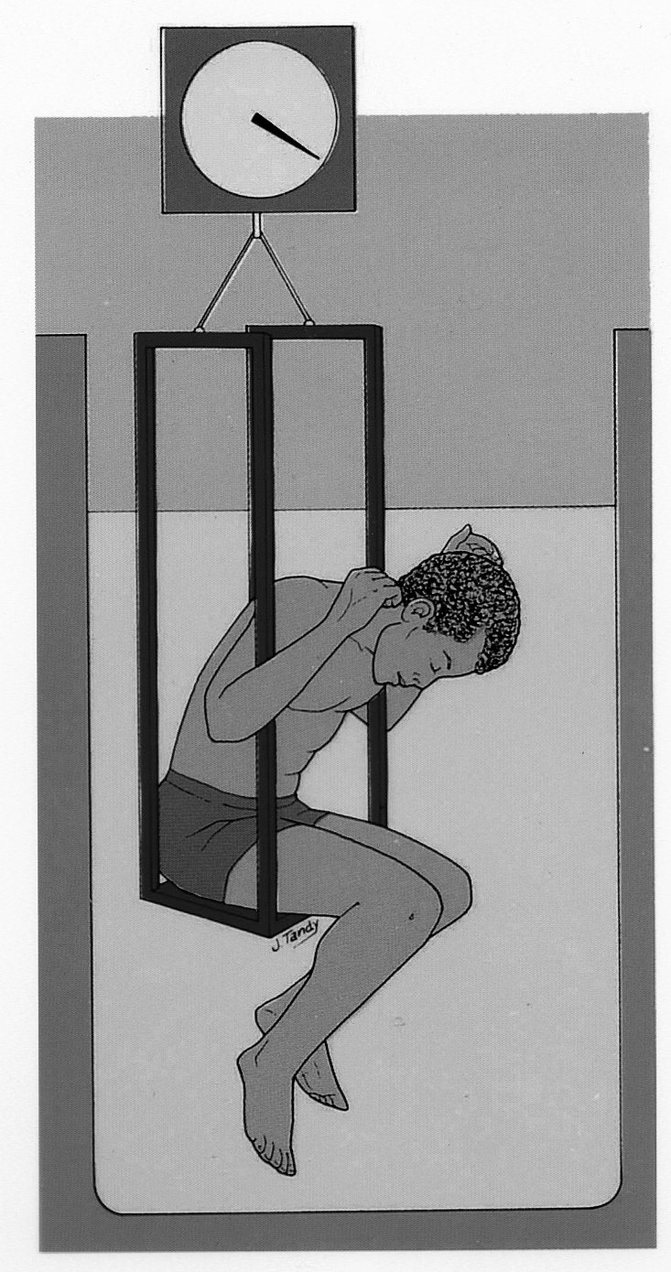
Underwater weighing
fat and fat free mass have different densities
fat .91 ; fat free 1.1 (g / cubic cm)
FFM varies slightly with ethnicity, gender and age

Slide 21
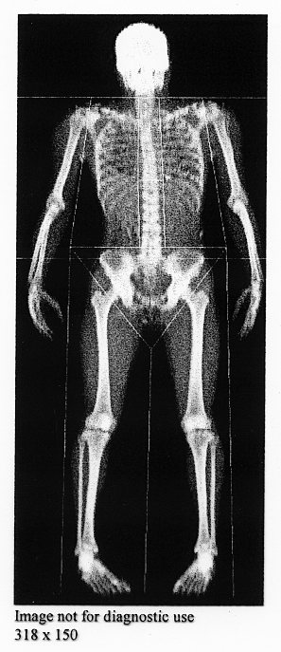
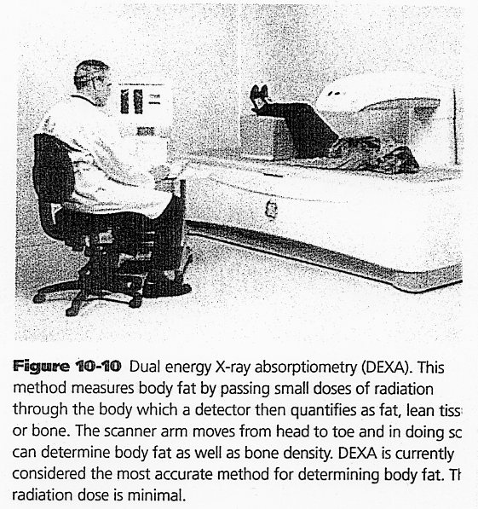
DEXA Scanning

Slide 22
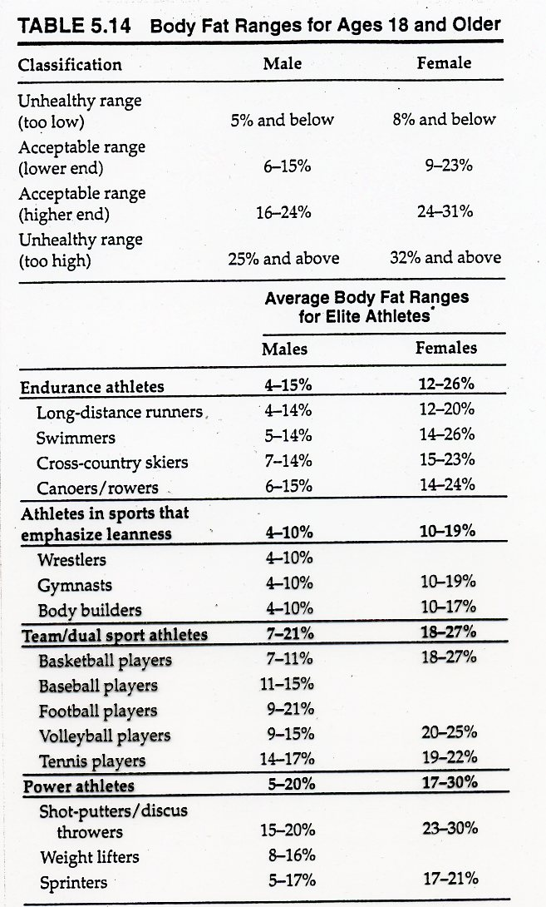
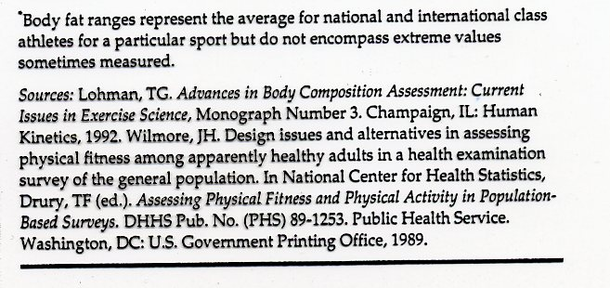

Slide 23
Overweight and Obesity
Affects more than 66% of adults in North America
Rates in Canada have doubled since 1980
Obesity - excessive enlargement of the body's total quantity of fat.
> 20% body fat for men
> 30% body fat for women
as high as 50 - 70% body fat in massively obese
Most experts believe that obesity results from an interaction among many factors.
Genetic psychological hormonal
social environmental
It is increasingly recognized that inheritance is a factor in obesity and regional fat distribution.
Weight reduction reduces health risks associated with chronic disease
blood lipids, blood pressure, risks for type 2 diabetes
10% reduction in weight encouraged for long term benefits
3-5% reduction will significantly improve health short term.
Notes:
Globe and Mail Sept 9 2013 – ambient temperature and brown fat activity – at 21 C very little energy needed to stay comfortable, many people now spend most of their lives in climate control. Japanese study 17C for 2 hours per day for six weeks – 58% increase in brown fat activity and 5.2 % decrease in fat (controls no change in either factor) – Netherlands 15-16C for six hours a day for 10 days, increased brown fat activity and subjects acclimated to environment. British study in 2011 noted that avg bedroom temp had risen by three degrees since the 1970’s.

Slide 24
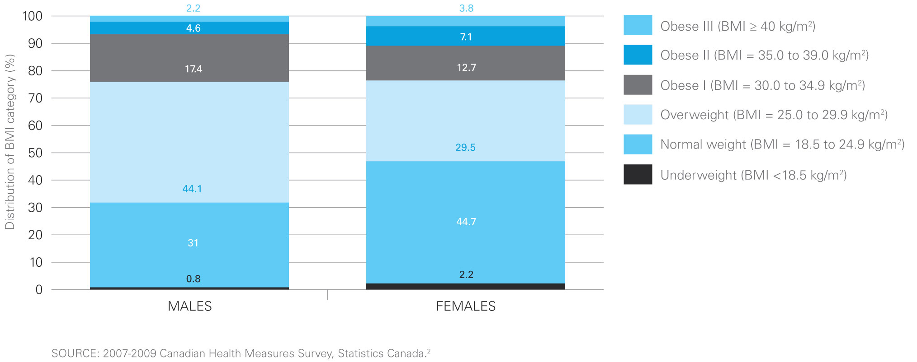
http://www.phac-aspc.gc.ca/hp-ps/hl-mvs/oic-oac/
Notes:
The Centers for Disease Control and Prevention estimated medical costs associated with obesity were $147 billion in 2008.
Canadian costs are estimated to be about 4.6-7 billion per year, split between direct and indirect costs.
http://www.theglobeandmail.com/life/health-and-fitness/health/conditions/obesity-costs-economy-up-to-7-billion-a-year/article583803/
http://www.phac-aspc.gc.ca/hp-ps/hl-mvs/oic-oac/

Slide 25
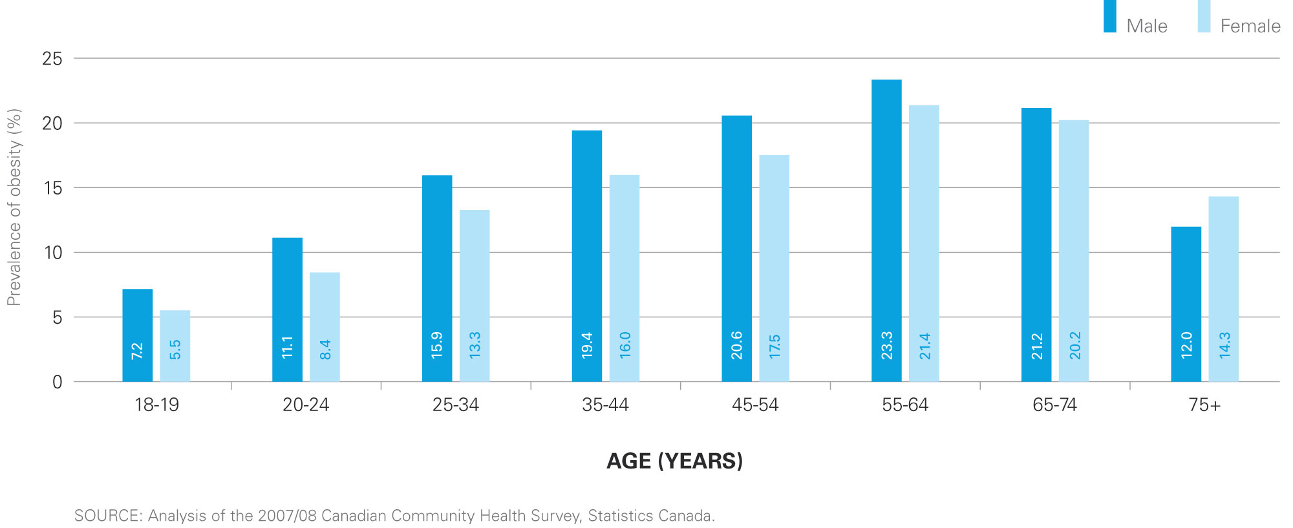
http://www.phac-aspc.gc.ca/hp-ps/hl-mvs/oic-oac/
Notes:
The Centers for Disease Control and Prevention estimated medical costs associated with obesity were $147 billion in 2008.
Canadian costs are estimated to be about 4.6-7 billion per year, split between direct and indirect costs.
http://www.theglobeandmail.com/life/health-and-fitness/health/conditions/obesity-costs-economy-up-to-7-billion-a-year/article583803/
http://www.phac-aspc.gc.ca/hp-ps/hl-mvs/oic-oac/

Slide 26
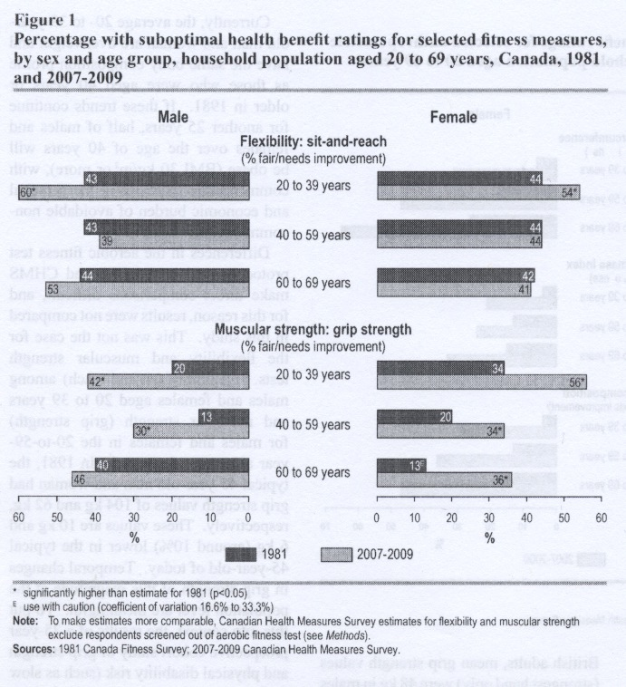
Canada fitness survey 2010

Slide 27
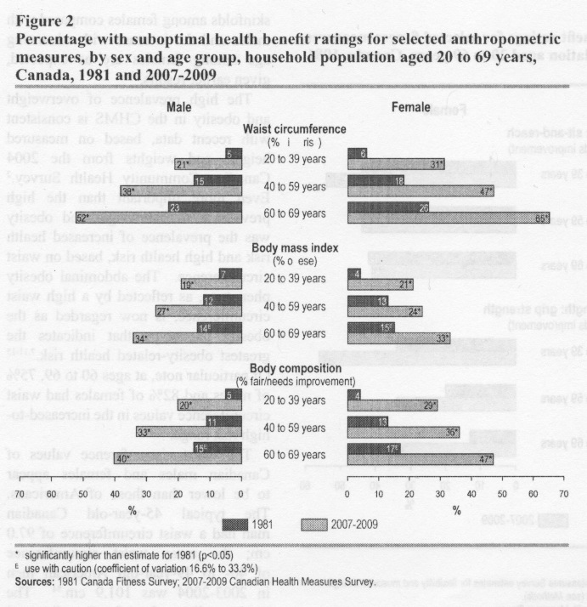
Canada fitness survey 2010

Slide 28
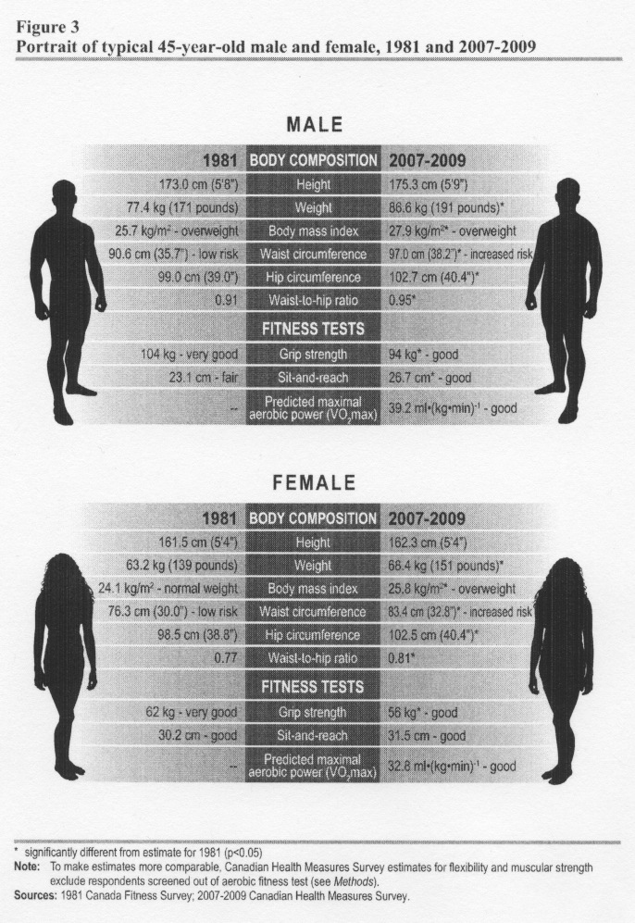
Canada fitness survey 2010

Slide 29
Fat Cell Size and Number
The body can increase its quantity of adipose tissue in two ways:
Fat cell hypertrophy - enlarging existing fat cells
Fat cell hyperplasia - increasing the total # of fat cells.
The major structural difference in adipose tissue mass between obese and non-obese people is in cell number.
Typical fat cell numbers are as follows:
Average, nonobese person - 25 - 30 billion
Moderately obese person - 60 - 100 billion
Massively obese person - up to 200 billion
Weight reduction in obese adults and children is accompanied by a decrease in the size of fat cells but no change in the # of cells.

Slide 30
There are 3 critical periods when the number of fat cells increase significantly:
1. during the last trimester of pregnancy
2. during the first year of infancy
3. during the adolescent growth spurt
Therefore it would seem prudent to prevent significant over-fatness during these periods of life if at all possible.
Healthy weight gain during pregnancy
Limit bottle feeding and delay introduction of solid foods - helps prevent overeating and poor habits
Regular physical activity and prudent caloric intake during growth stage

Slide 31
Set-Point Theory
The body has an internal control mechanism that drives the body to maintain a particular level of body fat.
Weight loss reduces resting energy (REE) expenditure slightly
When very low calorie diets (less than 800 kcal/day) are used, REE may be decreased by as much as 45 percent. This greatly conserves energy and causes the diet to become much less effective.
A person's set-point is probably the result of a number of hereditary and cultural factors - nicotine, amphetamines and exercise can also influence the set point
Genetics
A US and Sweden study found that genetics may account for 70% of the differences between individuals.
Other studies have reported values as low as 25%.

Slide 32
Weight Management Wisdom
44% of women (29% of men) are trying to lose weight
Only ~ 20% of those trying to lose weight are exercising > 150 min/week and reducing energy intake
Michael Pollan-”eat food, not too much, mostly plants.”
Dr. Freedhoff - “The only way a person is going to lose weight and keep it off, is to like the life they’re living while they’re actually losing.”
Quebec Family Study - short sleep duration, emotional eating patterns and low dietary calcium intake predicted the risk of obesity better than the amount of fat in the subjects’ diets or how much vigorous exercise they did.
*Poor sleep leads to rise in ghrelin and drop in leptin
- hunger and satiation hormones respectively.

Slide 33
Energy Balance Equation
Energy In - Energy Out = Weight Gain / Loss / Maintenance
Energy In:
Energy in is determined by the calorie content of the food eaten.
Energy out:
Thermic Effect of Food (5-15%)
your body expends energy digesting and absorbing food.
Basal Metabolic Rate (BMR) (55-75%)
is the minimal level of energy required to sustain the body's vital functions in the waking state.
Energy Expended in Physical Activity(10-40%)

Slide 34
Energy Expended in Physical Activity
difficult to estimate
Direct Calorimetry - direct measurement of heat production.
these techniques are impractical for most sports
Indirect Calorimetry - obtain an indirect estimate of energy.
production by measuring a person's oxygen consumption

Slide 35
Unbalancing the Energy Balance Equation:
From the standpoint of energy metabolism, obesity is the end result of a positive energy balance.
One pound of fat will be stored in the body when an excess of approximately 3500 kcal of energy has been consumed.
to lose weight an individual must increase energy output and/or decrease energy input.
Therefore, only three alternative methods are available for the reduction of weight:
1. decrease caloric intake and maintain a constant energy expenditure
2. increase energy expenditure maintain a constant caloric intake
3. combination of #1 and #2

Slide 36
Decrease Caloric Intake:
should not attempt to lose more than 2 lbs. of body fat per week.
Daily caloric intake should never be less that 1200 kcals.
Lose 10% of body weight, then maintain before further weight loss is attempted
Caloric intake should be distributed approximately as follows:
12-15 percent protein,
20-30 percent fat and
55-68 percent carbohydrate
Beware of diets that seriously distort this ratio.
Follow Canada Food Guide
Make small, targeted changes
The ideal weight loss diet is one that can be incorporated into one's lifestyle, and is fundamentally a change in one's eating habits for life.

Slide 37
Increase Energy Expenditure:
Continuous aerobic activity most effective
If a 70 kg man runs 10 km per day, he will expend an extra 700 kcal of energy per day.
in 5 days, he will expend 3500 kcal or 1.0 lb. of fat.
Effects of exercise are cumulative
Muscle is denser than fat so scale will not indicate body composition changes
Resistance Training alone is not associated with significant weight change
May see fat loss and gain of fat free mass
Benefit of reduction in some CVD risk factors
sweating off weight does not work
advise that clients do not weigh themselves too often, reevaluate body composition after enough time has been allowed for changes to occur
Notes:
Cris Slentz 2011 Am J Physiology - End and Met - AT was more effective than RT at improving visceral fat, liver to spleen ratio, total abdominal fat (all P<0.05) and trended towards a greater reduction in liver fat score (P<0.10). AT plus RT no different that AT alone.

Slide 38
Combination of diet and exercise
Significant advantages for long term weight loss and prevention of weight regain with combination.
Provides protection against the loss in lean tissue usually observed when weight loss is achieved by dieting alone.
By reducing stress, boredom and tension, exercise can considerably reduce the amount of food consumed in response to these influences.
Observe better dietary and body awareness, due to the health and lifestyle influences of exercise
Able to modify each element by smaller amount to effect the same change - less drastic impact on lifestyle
ACSM recommends at least 150min/wk of moderate-intensity Physical Activity to prevent significant weight gain and reduce associated chronic disease risk factors.
Greater weight loss and enhanced prevention of weight regained with Physical Activity doses of 250-300min/wk (~2000kcal/wk)

Slide 39
ACSM - Diet in weight management of overweight and obese
Initial weight loss goal to decrease body weight by 5-10% and to sustain new weight long term
Long rem health benefits could be maximized with sustained weight loss of > 10% body weight
Diet
Reduce energy intake by 500-1000 kcal / day ; 0.5 -0.9 kg per week for those with BMI over 25
Studies show loss of ~9 kg in first 16 – 26 weeks
Greater initial weight loss (21.5 kg in 26 weeks) with VLCD (< 800 kcal/day) but no difference in loss after one year
Our focus is on long term impact
Standard macronutrient ratios recommended
(< 30% fat, 20% protein, 50+% complex carbohydrates)

Slide 40
ACSM – Exercise in weight management of overweight and obese
Reduce Cardiovascular disease Risk
30 min of moderate (55-69% HR max) intensity exercise on most, preferably all, days of the week.
Minimum of 150 min of moderate intensity exercise per week
fitness benefits from including higher intensity exercise
Long term weight loss
progress to > 65 min per day associated with improvements in the maintenance of weight loss long-term
progress to > 200 min per week when possible to reduce risk of weight regain
No evidence yet that incorporating higher intensity exercise will have further benefits on weight management.
Resistance training adds no further benefit in terms of maintenance of FFM or long term weight loss
Benefit to overall fitness and performance of activities of daily living

Slide 41
Misconceptions Regarding the Role of Exercise in Weight Control:
Exercise Effects on Appetite
Many studies have shown that vigorous exercise of moderate duration does not markedly increase appetite and food intake.
Exercise Effects on Energy Expenditure
"It takes a ridiculous amount of physical activity to lose a pound of fat".
Effects of exercise are cumulative
Walking and running are both effective means of energy expenditure

Slide 42
Walking vs Running
The energy cost to run or walk a given distance increases with body weight
walking ~.75 kcal per kg per km
running ~ 1 kcal per kg per km
Although the energy cost for running is higher,
walking is a good exercise for burning calories and is more feasible for many people, especially the obese
The approximate caloric cost of running a distance is the same whether the speed is fast or slow
When time is limited, a higher intensity workout will burn more calories

Slide 43
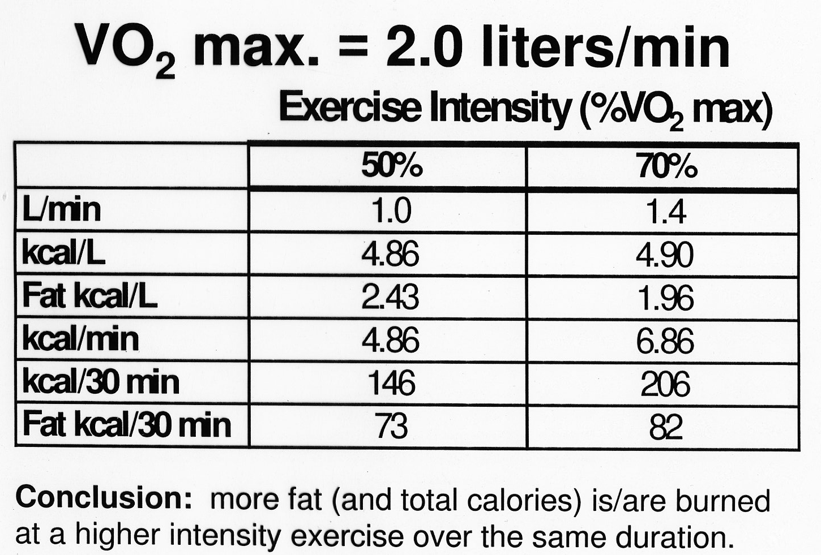

Slide 44
VO₂ and caloric cost calculations
Oxygen Cost - ml/kg/min
Walking VO₂= 3.5 +.1(speed) +1.8(speed)(grade)
Running VO₂= 3.5 +.2(speed) +.9(speed)(grade)
Leg Cycling VO₂= 3.5 + 3.5 +1.8(workload)/(body mass)
Stepping VO₂= 3.5 +.2(rate) +2.4(rate)(H)
Rate is in completer four-cycle steps per minute
H is height of step in meters
Net Caloric Cost of exercise
Remember to remove cost of rest from calculation of net effect of exercise (ie 3.5 ml/kg/min for rest)
Convert O₂ to L/min
5kcal/L oxygen expenditure
1MET(3.5 ml/kg/min) = 1 kcal/kg/min

