Slide 1
Exercise Prescription (Cardio)

Slide 2
Outline
Principles overview
General steps for program design
Cardiovascular Training
Methods
Adaptation
Prescription
FITTe
Measuring Intensity
Sample Case Study

Slide 3
Exercise Prescription
Resources :
ACSM - Guidelines for Exercise Testing and Prescription
CSEP - PATH
Basic Principles of Training Response (143)
Overload
Specificity
Reversibility
Individuality
Progressive overload
ASCM Recommendations : FITTe
Aerobic
Muscular
Weight Loss
Flexibility
Moderate program incorporating all components of fitness is better than intense program in only one

Slide 4
Healthy Adult Programming
Keep in mind that apparently healthy adults are just that -- apparently healthy
General steps for program design
Be cautious and perform health screening appropriately
Determine stage of change and recommendations
CSEP-PATH - SOC-Q
Ascertain purpose of fitness program for client
CSEP-PATH - Lifestyle needs evaluation
Determine individual activity preferences
CSEP-PATH - Activity inventory tool
Ascertain fitness levels through assessments for various components of fitness
Assist in the development of SMART goals
Assist in the development of program (FITTe)
Assist with suggestions for maintenance and variety

Slide 5
Components of a Cardio-respiratory Exercise Program
Warm-up and cool-down
Primary activity (FITTe)
Mode of exercise
Frequency
Duration
Intensity
Supportive conditioning
Cardio-respiratory goals
Progression plan
Safety and cautions
Notes:
Overheads on Warm-up and cool-down
Mode of exercise
Frequency
Duration
Intesity

Slide 6
Only about 10-11% of the Canadians adhere to an exercise regime of optimal intensity
Recommendations for CR fitness development
ACSM 1998-3-5 days/week; 40-85% VO₂ R; 20-60 min
CSEP – at least 150 min/week of moderate to vigorous aerobic activity in bouts of at least 10 min
ACSM 2010-at least 5 days/week at moderate intensity
3 days /week at vigorous intensity ( >59% VO₂R)
Volume - minimum of 1000kcal/wk, 2-4000kcal/wk optimal
Dose response relationship
Significant health benefits with small increase in physical activity level (Fig 52.2 ACSM)
Require greater volume for optimal health and fitness benefits
Fitness training requires more commitment and a structured exercise program than physical activity

Slide 7
Exercise Prescription
Determined from objective evaluation of Physical Fitness
HR, BP, Capacity for Exercise (ECG)
individual health history (orthopedic limitations)
risk factors, behaviour
Personal goals
preferences
Require flexibility in application of principles
Goal - behaviour change - aid in increasing their habitual physical activity

Slide 8
The FITTEness Formula
Fitness Level Low Average High
Frequency 3 3-4 5+
(days/week)
Intensity-THR* 50-80% 60-85% 70-90%
(% of max.HR)
Time (min.) 15-20 20-45 30-60
Type Any rhythmical activity: walking, cycling, stair machine, jogging, swimming, etc.
Enjoyment incorporate variety and choice of activities
*THR = target heart rate or training HR - start at lower end of range

Slide 9
Estimating Exercise Intensity
METS (see cardiovascular assessment lecture)
% of maximum HR (estimated or measured)
HRR (Heart Rate Reserve - Karvonen method)
Training HR = [(MHR-RHR) * %T_{INT}] + RHR
% Training_{INTENSITY} = (THR-RHR) / (MHR - RHR) * 100
Minimum 60% T_{INT} preferably 70% T_{INT}
VO₂R- Target VO2 = (% target)(VO₂max-3.5) + 3.5
=(.4)(26-3.5) +3.5 (for client with VO₂max of 26 exercising at 40%)
= 12.5 ml/kg/min
Perceived exertion (Borg scale)
Talk-test method
Volume can be measured with weekly caloric expenditure
does not distinguish between types of training
Recommend minimum 1000kcal/wk - 2-4000kcal/wk optimal
Notes:
Overhead on METs related to activity
Overhead on max heart rate related to % capacity
Karvonen method
(heart rate maximum reserve method)
Maximum heart rate - resting heart rate (percentage of this) thenadd back to resting heart rate

Slide 10
%HR max and %VO₂ max vs Workload

Slide 11
BORG Scales
Old BORG | RPE SCALE | New BORG | RPE SCALE | %HR Max | %VO₂ max
6 7 8 | Very,very light | .5 | Very,very weak
 |  | 1 | Very weak
9 10 | Very light | 2 | weak
 |  | 3 | moderate
11 12 | Fairly light | 4 | Somewhat strong | 52-66 | 31-50
 |  | 5 | Strong
13 14 | Somewhat hard | 6 |  | 61-85 | 51-75
15 16 | Hard | 7 | Very strong | 86-91 | 76-85
 |  | 8
17 18 | Very Hard | 9 |  | 92 | 85
19 | Very,Very Hard | 10 | Very Very Strong
 |  |  | Maximal

Slide 12
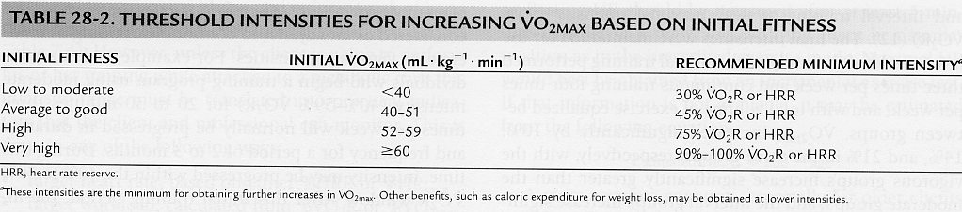
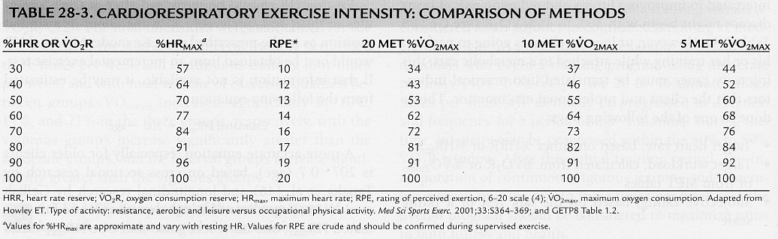

Slide 13
Aerobic Training Methods
Continuous Training
Intermediate vs Long Steady Distance
Interval Training
aerobic vs. anaerobic
Fartlek Training
Circuit Training
Aerobic Composite Training (cross training)

Slide 14
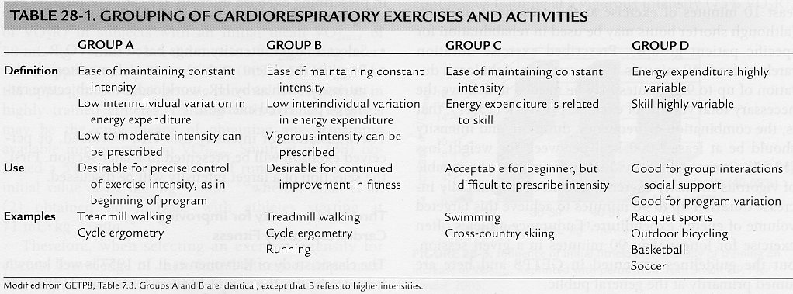

Slide 15
Increased VO₂max??
Increases depend on:
Age
Frequency of training
Intensity of training (motivation)
Duration
(training volume)

Slide 16
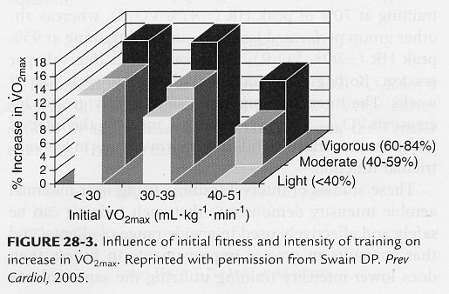
Increased Aerobic Capacity
For young and middle-aged adults
Usual improvement of 15-20% over 10-20 weeks of training
However, it can increase up to 45-50%
Intensity
%VO₂R

Slide 17
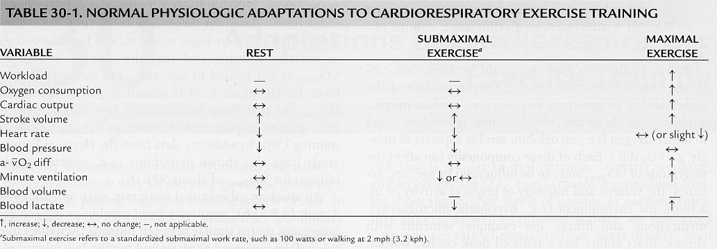
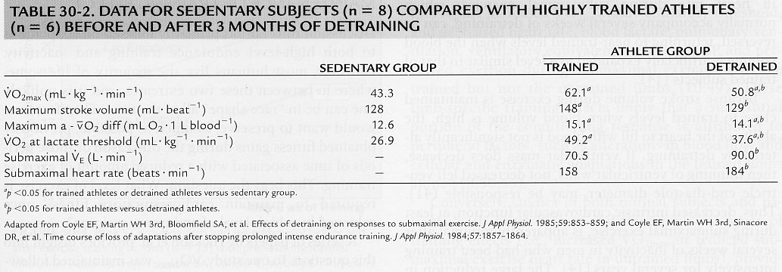

Slide 18
Progression and Maintenance
3 general stages - variable rates between clients
Initiation, Improvement, Maintenance
Initiation Conditioning Stage - allows time to begin adaptation process
lower intensity - 50 - 60 % HR max
shorter duration - 15 - 40 min
about 3-6 weeks
Improvement Conditioning Stage - progressive overload
Weight management - long duration lower intensity focus to begin, progress toward higher intensity to burn more calories/min and have greatest impact
Athletes - intensity and type most important factors
about 6 months

Slide 19
Progression
Increase only one component of FITT per week
Keep changes in overall volume slow and steady
No more than 10% increase in volume in any week
Adding 5-10 min per session every week is well tolerated
Allow body to adapt before overloading again
Measuring Progress and achievement of goals
time over a set distance
distance covered in set time (http://www.mapmyrun.com/)
http://www.strava.com/
perceived exertion (BORG) at treadmill setting
Re-appraisal of initial fitness evaluation (coopers test)

Slide 20
Maintenance Conditioning Stage
6 to 12 months
Diversification - rotate and reduce the stresses of continued training
maintain enjoyment and explore
Maintenance - intensity most important for VO₂ max - observe losses in endurance performance
may decrease frequency and duration - reduce overuse injuries
Enjoyment, surveillance and reappraisal
Warm up/down
modify according to needs - 50 % of workout effort
flexibility - sport specific

Slide 21
Maintenance
Behaviour that satisfies or reduces discomfort is likely to be maintained
Four Strategies
Monitoring and Feedback
Diary, physiological monitoring
Making the activity as satisfying as possible Reinforcement - very individualistic
Relapse prevention - and anticipation - decide what to do in event of relapse now
Making a formal commitment - Contract
Realistic and achievable, revised as necessary
Problem solving for goals not achieved

Slide 22
Adherence to Exercise
Many factors addressed in design of fitness program - goals, rewards, progression
Availability of programs- Time and location
Convenience - close to home, minimum preparation time, individualistic
Social support - programming should deal with family and significant others
Program characteristics
Qualified and enthusiastic personnel
Individual prescription and Variety
Training diary, periodic evaluation, avoiding too much too soon - higher drop out rate with higher intensity, frequency or duration
Patience - give them a chance to succeed - set realistic goals
Do not equate success with winning
Understand the benefits of regular physical activity - health rather than athletic competition
Self discipline - most difficult challenge is getting starting and persisting with activity

Slide 23
Hints for adherence
Show up for class or workout - Even if feeling low energy
benefits are long term and come through forming a new lifestyle habit - engage in a lower intensity alternative for session
test enjoyment - scale from 1-5 - modify routine if necessary
Planning suggestions
Carry exercise clothes in car
Leave exercise clothes out by the bed
Spend time with other exercisers
Park the car and walk
Suggestions for missed sessions
Admit responsibility
Develop restart plan
Call exercise ‘buddy’
Arrange reinforcement to prevent relapse- preplan alternatives for vacation, illness or injury - as well as return from these
Simplify or change regimen

Slide 24
Overuse syndromes
Growing number of people engaging in large volumes of exercise
Ensure goals are healthy and realistic
Muscle dysmorphia, Female Athlete triad
Training errors primary cause of overuse injuries
Sudden increase in training - return from layoff
Persistent high-intensity training
Excessive hill running
Single severe training run or race
Anatomical factors also predispose individuals for injury
Recall footwear and biomechanical discussions in first week or semester
Maintaining flexibility and strength is important
Upper respiratory tract infections
Risk lowers with moderate intensity - increased natural killer cell activity
Risk increases with very high intensity

Slide 25
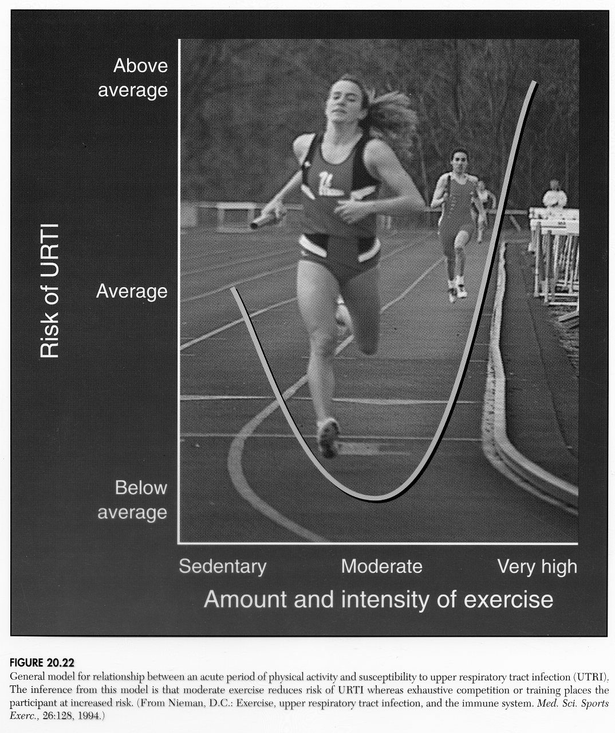

Slide 26
Overtraining
Tapering prior to competition will help performance
4 to 7 days
Allows for healing of minor injuries, optimal nutritional support and glycogen replenishment
Fatigue related to depletion of glycogen stores
Occurs with heavy training schedule without adequate recovery
1-2 days of rest or lighter activity
Carbohydrate loading prior to competitions can help
Applicable only to intense aerobic competition lasting longer than 60 minutes
Increased carbohydrates prior to and following training and with meals
Pre competition meal - 150-300g of carbohydrate 3 hours prior - intake of carbohydrates during long training sessions or competition

Slide 27
Overtraining Syndrome
Overload -
planned systematic and progressive increase in training with the goal of improving performance
Overreaching -
unplanned, excessive overload with inadequate rest. Poor performance is observed in training and competition. Recovery - days to weeks
Overtraining syndrome -
untreated overreaching that results in long-term decreased performance and impaired ability to train. May require medical attention.
Recovery may require weeks or months
Signs and symptoms - individual variability
Disturbed mood states - fatigue, depression, apathy, irritability and loss of competitive drive
Persistent muscle soreness and stiffness
Elevated resting pulse, painful muscles
Insomnia, loss of appetite, weight loss
Overuse injuries
Altered immune function

Slide 28
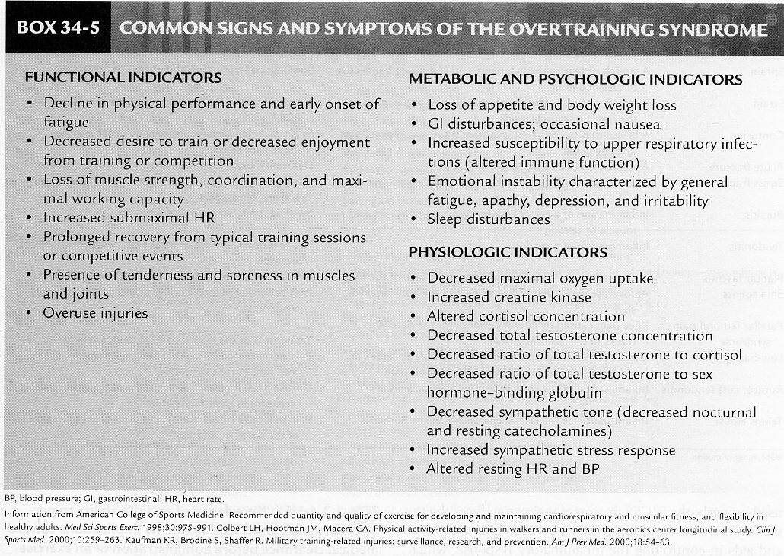

Slide 29
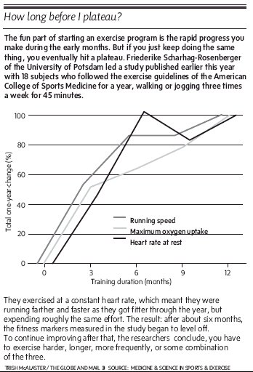

Slide 30
Interval Training
Alternating periods of intensity
both aerobic and anaerobic
high intensity intervals should only be used after a good base of aerobic fitness (2-3 months of moderate intensity training with progression)
Advantages
you can keep your average heart rate at threshold levels for entire workout
precise control of stress
easy to observe progress
develop a good sense of pace
Physiological benefits
maximize increases in VO₂ Max and tissue respiratory capacity
tolerance for high lactate levels and improved pathways for lactate removal
Increased ventilatory threshold
Improved time to exhaustion (performance)
Maximal body composition and metabolic adaptations

Slide 31
Interval training
Disadvantages
discomfort due to high lactate
higher chance of injury
requires more mental concentration
training may be less enjoyable
Structure
10 min warm up
Four to six intervals (more for very short distance sprint work)
Incorporate use of intervals into periodization (high intensity section)
Distance and Rate of Work interval
determine predominant energy system to target
ATP-PC 0-25 sec
ATP-PC-Lactate 30 - 80 sec
LA- O₂ 1.5-3 min
O₂ > 3 min

Slide 32
Determining work Intensity
Heart rate monitoring 90-95 % Max
Can workout be completed ?
Running speed method
eg. 400m intervals - 1-4 sec faster than 1/4 of best 1 mile time
computerized running tables
Number of Repetitions and sets
total distance of workout
short and middle distance athletes
2.5 - 3.5 km
middle and long distance
5 - 10 km
eg. 4 (reps) x 400m x 2 (sets) = 3.2 km

Slide 33
Relief Interval
Must consider duration and activity during relief interval
Rest relief - easy walking
work relief - moderate jogging
ATP-PC W/R ratio 1:3 -rest relief
LA W/R ratio 1:2 -work relief
O₂ W/R ratio 1:1-rest relief
exercise required to facilitate blood lactate recovery
Frequency of training
3 times / week for 8-10 weeks
low frequency at onset of season
peak near competition phase

Slide 34
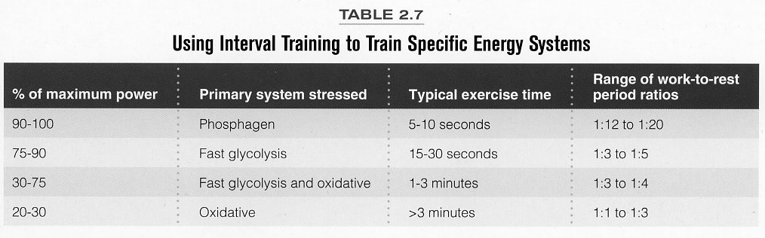
NSCA Essential of Strength Training and Conditioning, 2008

