Slide 1
Muscular Strength & Endurance (Training)
Notes:
Muscular strength and endurance are NOT totally separate. There is definite overlap in the response to training. However, optimal increases in strength and endurance are achieved by different programs.
Can test strength independent of endurance.
Can’t assess endurance independent of strength.

Slide 2
Strength Training Benefits
Inc muscle fiber size (hypertrophy) - after 6 -7 wks.
Increased muscle contractile strength
neural adaptations early in program
Increased bone and ligament tensile strength.
Manage stress
Prevent or treat osteoporosis
Promotes weight loss and maintenance
Improve dynamic stability
Maintain Activities of Daily Living (ADLs) and Recreational Activities
Prevent and/or rehabilitate injury
These changes improve our physical capacity, athletic performance, physical appearance, metabolic function and injury risk.
Notes:
physical capacity -- untrained men and women gain 2-4 pounds of muscle and 20-40 percent more strength after two months of training
Neurological adaptation.
Physical appearance -- leaner trimmer for the same weight. Reduce muscle loss with aging.
Metabolic Function -- muscle is a very active tissue. Even when asleep muscles are responsible for over 25% of our calorie use (BMR). Non-training adults loose 0.5% of BMR every year.
Injury Risk -- increase shock absorbing qualities and strength available for movements, avoid muscle imbalances in active individuals, 80% of low-back problems are muscular in nature and many would be preventable.

Slide 3
Strength Training Benefits
Initial training status influences rate and level of adaptation to resistance training
Untrained - no experience or several years off
Up to 40% increase in strength
Moderately trained - 6 months continuous
Approximately 20% increases
Advanced - years of training
Approximately 10% increase
Elite - years of training, high level of competition
2% increase
Above studies varied in duration from 4 wks to 2 yrs
Majority of strength increases occur in the first 4-8wks
Adaptations include neural function (recruitment and discharge rate) ms CSA, ms architecture and metabolites
Notes:
physical capacity -- untrained men and women gain 2-4 pounds of muscle and 20-40 percent more strength after two months of training
Neurological adaptation.
Physical appearance -- leaner trimmer for the same weight. Reduce muscle loss with aging.
Metabolic Function -- muscle is a very active tissue. Even when asleep muscles are responsible for over 25% of our calorie use (BMR). Non-training adults loose 0.5% of BMR every year.
Injury Risk -- increase shock absorbing qualities and strength available for movements, avoid muscle imbalances in active individuals, 80% of low-back problems are muscular in nature and many would be preventable.

Slide 4
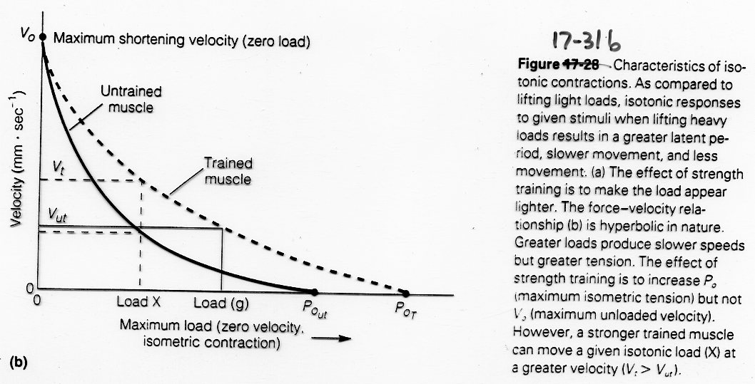

Slide 5
Development of Weight Training Programs
Determine the purpose of the program (strength, hypertrophy, endurance, health or elite athlete).
Be sure it fits your skill level and program needs.
Determine the type of program (i.e., dynamic, static, isokinetic, calisthenics).
Target the major muscle groups.
In addition to the main exercises for the upper and lower body, select exercises for additional muscle groups.
Adaptations depend on several variables
Ms actions, intensity, volume, ex selection and order, rest between sets, and frequency

Slide 6
Frequency
Varies with the type of program.
General guidelines are for 2 to 3 sessions per week. - Maintenance - with 1-2 days/wk
More sessions can be done using split routines, working different body parts on alternate days
Monday & Thursday - legs, back, biceps, abdominals; Tuesday & Friday - chest, shoulders, triceps
Must do each exercise 2 days per week in split routines (minimum)
Should allow one day recovery for each exercise
Advanced training - recommend 4-6 days/wk
Elite training (professional athletes) - multiple workouts/day
Important to ensure adequate recovery and minimization of overtraining
Notes:
Reason - greater work for each area, greater recovery time, greater variety of exercises which can be aimed at specific muscles and even parts of muscles.

Slide 7
Training Volume
Volume = sets x reps x resistance
Variation of volume (periodization) important
Sets
Both single and multi set programs are effective over short term (4 months)
Multiple set programs superior for strength, power, hypertrophy and high-intensity endurance and progression over long term
Intensity - reps x resistance
Train to fatigue (inability to continue with movement)
> 85% of 1RM increases likelihood of injury.
< 65% 1RM or less decreases strength gain stimulus.
Therefore, general recommendation is for training at 70-80% 1RM (8-12 repetitions to fatigue) for beginners

Slide 8
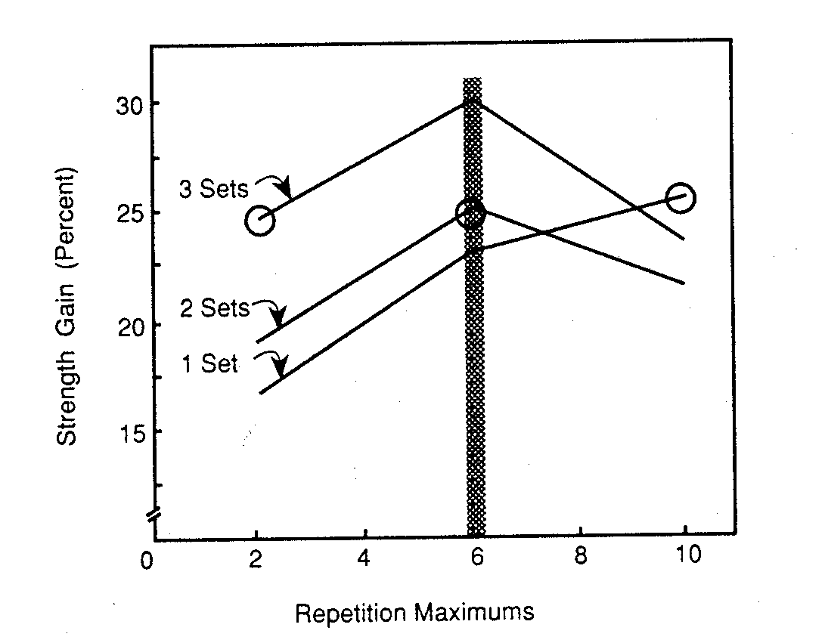

Slide 9
Sets and Reps (Heyward)
100% = 1-RM
95% = 2-RM
90% = 4-RM
85% = 6-RM
80% = 8-RM
75% = 10-RM
70% = 12-RM
65% = 14-RM
60% = 15- to 20-RM
The higher the repetition the less accurate the percentage.

Slide 10
Sets and Reps (Poliquin, 1986)
100% = 1-RM 72% = 11-RM
95% = 2-RM 70% = 12-RM
90% = 3-RM 69% = 13-RM
88% = 4-RM 68% = 14-RM
85% = 5-RM 66% = 15-RM
83% = 6-RM 65% = 16-RM
80% = 7-RM 64% = 17-RM
78% = 8-RM 63% = 18-RM
76% = 9-RM 62% = 19-RM
75% = 10-RM 60% = 20-RM

Slide 11
Rest Between Sets
primary determinant of overall intensity and metabolic stress
influences amount of resistance that can be used
Affects neuromuscular and metabolic demands
Short rests (<1 min) - greater anxiety and fatigue
Nausea and emesis - undesirable
Volume and length of workload and rest influences blood lactate response
Less rest appears to augment hypertrophy

Slide 12
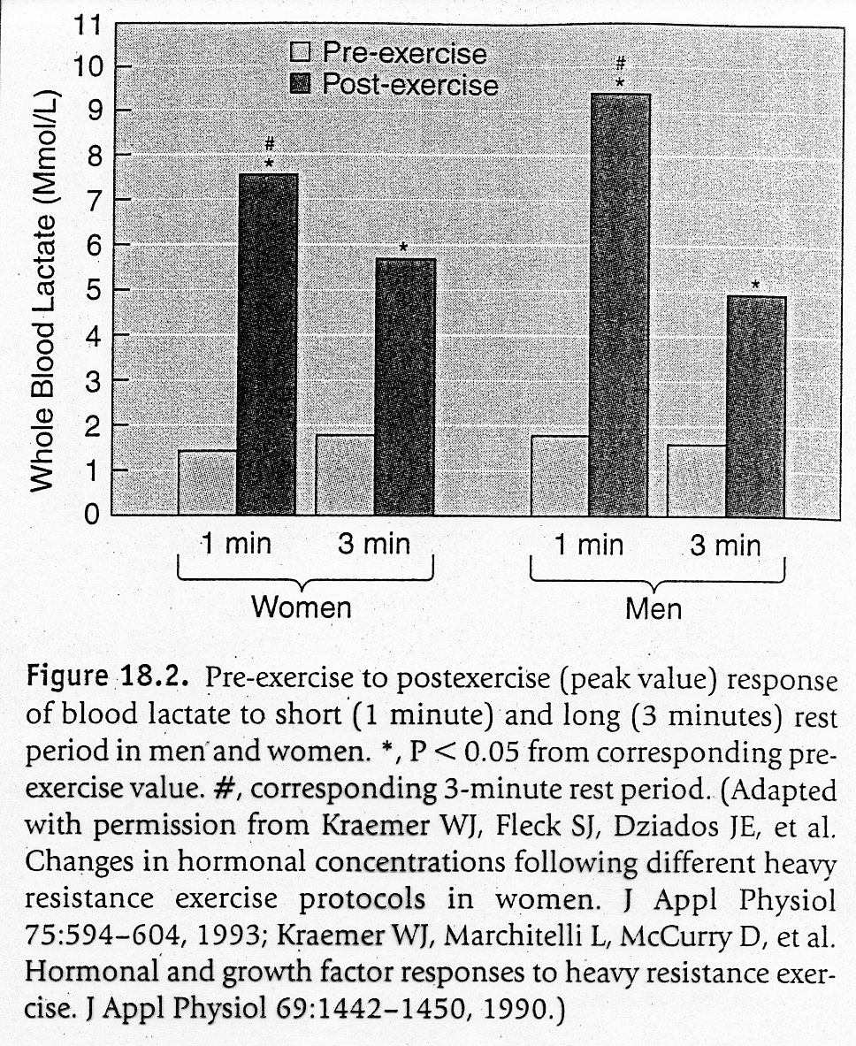

Slide 13
Speed of Movement
Exercise speed -- intermediate velocity (1-2 sec for concentric phase; 1-2 sec for eccentric phase) best to increase strength at all velocities
fast velocity (<1sec concentric), higher gains in strength for advanced training - try to match demands of sport - appropriate during selected phases of periodized training
Requires proper equipment choice for safety
Do not want to perform high speed reps at end of ROM
Protective reflex triggered to decelerate joint, must release mass to develop ability to accelerate through ROM
Plyometrics using medicine ball - require appropriate patterns of muscle activation

Slide 14
Order of Exercises
Order the exercises so that the same muscle group is not exercised consecutively.
Multi joint structural exercises first - bench press, squats/ leg press, lat pull down, military press
Isolated smaller muscle group exercises at end
Alternate lower and upper body
Alternate agonist / antagonist groups (push/pull)
Higher intensity before lower intensity exercises

Slide 15
Starting Out
As with any exercise regime the first few weeks are crucial and potentially the most risk-laden in terms of injury.
CSEP-PATH and ACMS suggest 2-3 session per week, one set of 8-12 reps to fatigue of 8-12 exercises. This should last for the first two weeks at least. ACSM recommends this for up to 3-4 months of training for beginners.
BCRPA suggest 12-15 reps would be more suitable for the first few sessions.
Large muscle groups appear to require a higher % of 1 RM to maintain strength RM zone (<6 reps)

Slide 16
Trial Starting Weights (Multiply factor by Body Weight)
Men | Women
.55 | .27 | Chest
.45 | .25 | Back
.4 | .25 | Shoulder
.25 | .15 | Biceps
.32 | .19 | Triceps
1.3 | 1 | Leg press

Slide 17
Basic Program - Universal Apparatus
1. Bench Press 1-3sets 8-12 reps*
2. Seated Row 1-3 8-12
3. Leg Press 1-3 8-12
4. Military (seated) Press 1-3 8-12
5. High Lat Pulldown 1-3 8-12
6. Leg Curl 1-3 8-12
7. Back Extension (ball) 1-3 10-20
8. Two-arm Curl 1-3 8-12
9. Bent Knee crunches (ball) 1-3 20
10. Tricep extensions 1-3 8-12
* Adjust weight so repetitions are to failure

Slide 18
Intermediate to Advanced Training
After 1-3 months, beginners may wish to alter program to continue to make improvements and keep their workout interesting
Program design should reflect goals in developing muscle strength, power, hypertrophy or endurance
Periodization in program design will optimize performance and recovery in rehabilitation, recreational and elite programs

Slide 19
Strength Training
Number of exercises: 1 - 2 per muscle group
Weight load: 85 - 95% 1RM
Sets: 2 - 4 sets per exercise
Repetitions: 2 - 6 repetitions per set
Rest between sets: 3 minute minimum

Slide 20
Hypertrophy (beginner / intermediate)
Number of exercises: 3 - 5 per muscle group
Weight load: 70 - 85% 1RM
Sets: 3 - 6 sets per exercise
Repetitions: 8 - 12 repetitions per set
Rest between sets: 1 - 2 minutes maximum

Slide 21
Hypertrophy (advanced)
Number of exercises: 3 - 5 per muscle group
Weight load: 70 - 100% 1RM
Sets: 3 - 6 sets per exercise
Repetitions: 1 - 12 repetitions per set
Periodized - majority in 6-12 range
Rest between sets: 1 - 2 minutes maximum
2-3minutes if high intensity phase

Slide 22
Power Training
Combine strength training with selected power (high velocity) exercises
Power clean, push press, loaded jump squat
Weight load: 30 - 60% 1RM at explosive velocity
Sets: 3 - 6 sets per exercise
Repetitions: 2 - 6 repetitions per set
Rest between sets: 3 minute minimum

Slide 23
Power
Weighted jump squats (30% IRM) resulted in greatest gains in the vertical jump (with and without counter movement)

Slide 24
Endurance
Number of exercises: 1 - 2 per muscle group
Weight load: 60 - 70% 1RM
Sets: 1 - 3 sets per exercise
Repetitions: 13 - 20 repetitions per set
Rest between sets: 1 minute maximum

Slide 25
Progression
Determine the appropriate starting loads for each exercise using variable repetition maximum test and slides 8 and 9.
Set guidelines to ensure progressive overload of each muscle group.
If failure occurs 2 reps past goal on 2 consecutive training days, increase weight ~2-10 % (2 for 2 rule)
2% for small ms groups, 10% for large ms groups and multi joint actions
Use periodization to reduce boredom and overtraining
Four week cycle of progression, followed by lighter cycle for recovery and optimization of training

Slide 26
Periodization
Thought now that an optimal combination of sets and reps likely does not exist
Variation in volume and intensity of training is important for optimal strength gain
Periodization - planned variation
Classical model - each phase 2-4 weeks
General pre-preparation phase (6-8 weeks) - low volume
Preparation phase - high volume - low intensity
Strength phase - technique and prog resistance
Power Phase - maximal effort - add plyometrics
Transition phase - active rest - few days to couple of weeks

Slide 27
Periodization
Planned variation in the volume and intensity of training - divides season into cycles or phases
Decrease volume and increase intensity as duration progresses
Selye’s general adaptation syndrome describes three phases of adaptation
Shock - occurs after initiation of novel stimulus
Develop syndromes of maladaptation - soreness, dec performance
Adaptation - occurs during repeated training exposure
Results in increased performance
Staleness - adaptation has occurred and same stimulus does not produce further adaptation - Performance may plateau
For further adaptation to occur a change in stimulus or rest must be imposed

Slide 28
Periodization (cont.)
Phases focus adaptive development so the athlete approaches peak performance at the most advantageous time in the competitive schedule
while diminishing the possibility of overtraining
Fig 52.3 ACSM
Periodization breaks training program into specific times
Macrocycle - ~ one year
Mesocycle - ~ 3-4 months
Microcycle - ~ 2-6 weeks
Each phase has specific goals and is planned as part of the total program

Slide 29
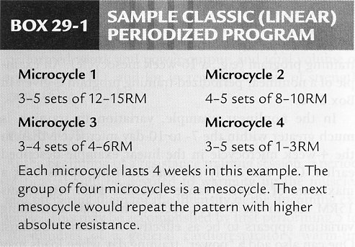
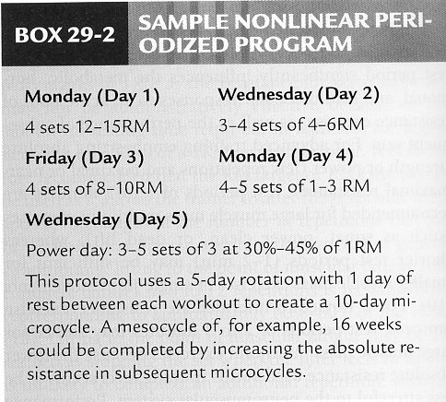

Slide 30
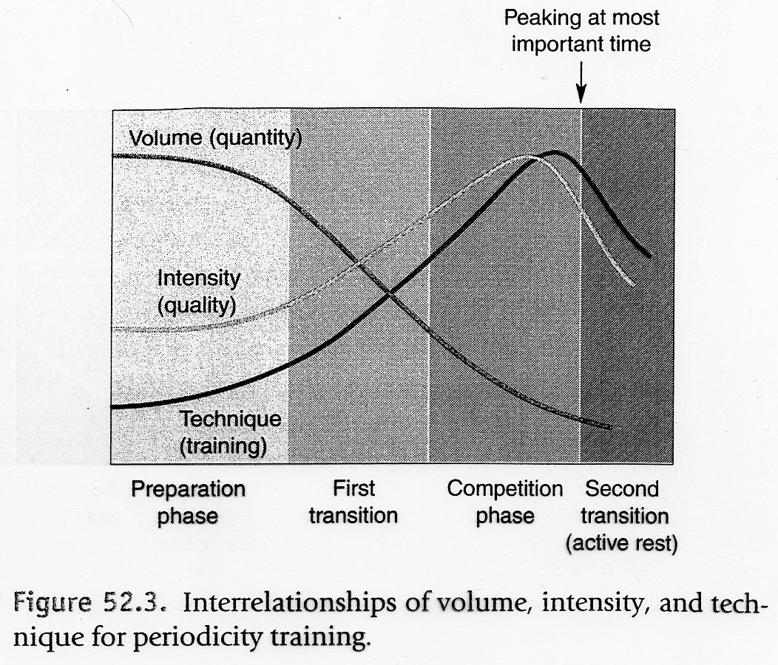

Slide 31
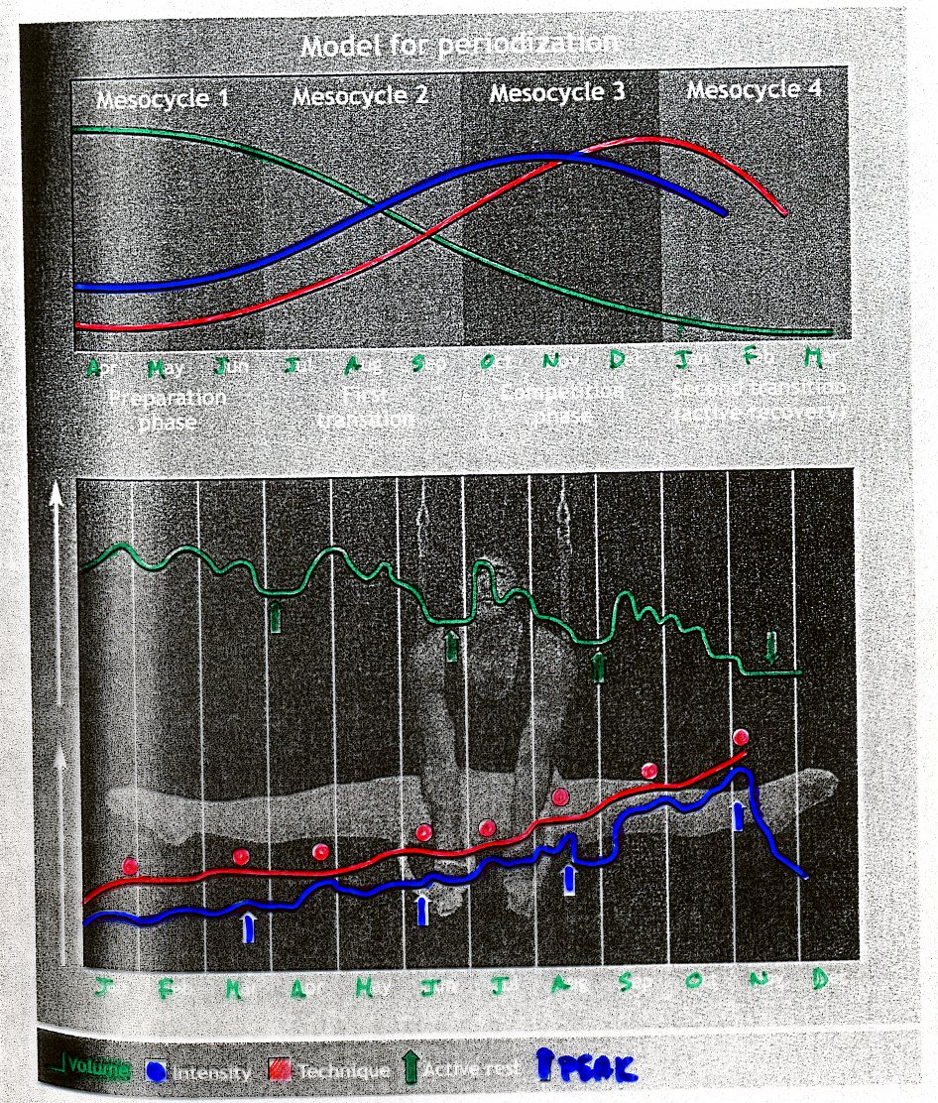

Slide 32
FITNESS / FATIGUE
The time course of the difference between fitness and fatigue represents the time course of predicted physical performance p(t), due to the training.
Thus fitness and fatigue grow and decay exponentially throughout a period of training.
During a taper period fatigue decays much faster than fitness, and the predicted performance increases.
Each period of training should be no longer than 28 days, followed by a taper lasting 7 to 14 days.
The response to a training program may be evaluated by an individual’s performance on a standard demanding physical task termed a criterion performance.

Slide 33
An effective training format is one that has an “on” stimulus of 28 days, in which the exercise has the proper intensity and duration to induce a positive exponential growth response in physiological and biochemical variables.
A 7 – 14 day taper at the end of the 28 day training program, will then allow fatigue to decay faster than fitness.
The end of the taper period provides a time when there is a maximal separation between fitness and fatigue, and performance reaches a peak.
Dr Eric Bannister
TRIMP - http://www.strava.com/

Slide 34
12 Week Training Program

Slide 35
Fitness/Fatigue Graph

Slide 36
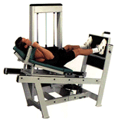
Machines vs. Free Weights
Machines are often safer and easier to use.
In some variable resistance machines, especially isokinetic ones, the strength gains may be better.
However, free weights offer a considerable advantage as they train stabilizers and develop skill better than machine exercises.
Free weights offer more variety and versatility, important for progression

Slide 37
Strength Training Misconceptions
Effects of Strength Training on Women
Speed of Movement
Marathon Workouts
Muscle Bound
Protein Supplements
Muscle Converts to Fat During Inactivity
Notes:
They do not increase muscle size as easily as men. One study showed a 44% increase in strength without any increase in muscle size. Even in strength gains beyond this 44%; as muscle is more dense than adipose tissue, any increase in muscle mass wouldn't necessarily increase body size (fat is often lost on good training programs).
Increasing the size and strength of a muscle increases the speed with which the muscle can contract against resistance. Absolutely, with no argument! If you have been told weight training slows you down, you have been misinformed.
Research and practical observations have shown that maximum strength gains can be achieved by performing only three workouts per week with each workout consuming 20-25 minutes or less. Look at what goes on during a two-hour marathon session with the boys; lots of talking, changing weights.
There is no evidence to show that increase strength has a detrimental effect on coordination, agility, mobility, and flexibility. In fact research has shown that strength training improves flexibility.
A balanced diet available in our society (which typically has about 12% protein content), is sufficient for any athletic training regime.
Impossible. Muscle breakdown will occur during de-training, but if dietary intake is reduced to reflect the decreased energy expenditure, no increase in body fat will occur. Body weight should decrease somewhat if you cease a weight training program.

Slide 38
Common Exercise Corrections
Breathe - exhale on effort for all exercise
Chest Press - seated
ensure low back is against support - use belt (seated) or bend knees (bench) to remove arch in back
Ensure hands at chest height - adjust seat height
Seated Row
Make sure knees are slightly flexed - reduce low back pressure
Keep torso erect - contract abs and low back ms
Pause at chest, return weight under control
Minimize upper torso movement - lighten weight if needed
Shoulder Press - seated
Keep back flat by contracting ab and low back muscles
Lower the weights under control until they just touch the other plates
adjust seat so that you are lowering to shoulder level

Slide 39
Common Exercise Corrections
Bicep curl - dumb bells
Stand with knees slightly flexed, torso erect, eyes forward
Fully extend elbows
Do not rock body and use momentum to move weight
Lower the weight carefully, do not hyperextend elbows
Tricep extensions
Space hands no more than 6 inches apart
Bar should begin at chest height, and not allowed to move higher than shoulders - returning bar slowly will help
Maintain upper torso stable, lighten load if necessary
Leg Press
Push with heels and balls of feet in contact with plate
Flex knees to 90 degrees
Do not lock knees in extension - control forward speed and stop before knees become locked out

Slide 40
Alternative methods
May not stimulate the same benefits for bone mineralization due to lower loads
Yoga - flexibility, relaxation, body awareness
Some endurance/strength training near end of ROM - isometric
Exercises provide training for most muscle groups - good overall body workout
Pilates
Work against body weight (Mat) or springs (Reformer, Wunda chair, Cadillac)
Develops strength/endurance
Individualized programming, based on postural and muscle imbalance analysis
Very good development of core musculature

Slide 41
Sample Circuit Training Program
Bench Press
Bent-knee sit-up
Leg extension
Lateral pull-down
Back extension
Standing press
Arm curl
Toe raise
Leg curl
Triceps extension
Leg press
Upright row
Intensity 40-55% 1-RM
Repetition: max in given time (30 s)
Rest: 15 s
Time/circuit: 9 min
Circuits/session: 3
Time/session: 27 min
Frequency: 3 per week
Duration: 8 weeks
Overload: adjust as 1-RM changes
Equipment: machines

Slide 42
Exercise Prescription and Aging
The principles of exercise prescription are the same
however caution must be taken with the elderly to decrease the risk of injury.
Elderly have more abnormal ECG’s during exercise.
Start slowly with walking or swimming - low impact
Running, racket-ball… only when fit
Problems with using estimates of Max HR for prescribing intensity - considerably variation in the elderly
(Max HR range : 105 - 200 for 60yr olds)
Principles
Progress carefully with intensity and duration
Warm up slowly and carefully
Cool down slowly - to less than 100bpm
Stretching - reduce DOMS

Slide 43
TABLE 1. ACSM/AHA physical activity recommendations for older adults.
150 min / wk of physical activity for health benefits, additional benefits occur with additional F, I, and T
- older adults should be as physically active as their abilities and conditions allow.
Frequency: moderate-intensity at least 30 or up to 60 (for greater benefit) min / day in bouts of at least 10 min each to total 150–300 minIwkj1,
at least 20–30 min / day or more of vigorous-intensity activities to total 75–150 min / wk, an equivalent combination of moderate and vigorous activity.
Intensity: On a 0 to 10 scale, 5 to 6 for moderate and 7 to 8 for vigorous
Duration: For moderate-intensity activities, accumulate at least 30 minIdj1 in bouts of at least 10 min each or at least 20 minIdj1 of continuous activity for vigorous-intensity activities.
Type: Any modality that does not impose excessive orthopedic stress; walking is the most common type of activity. Aquatic exercise and stationary cycle exercise may be advantageous for those with limited tolerance for weight bearing activity.

Slide 44
Resistance exercise for older adults:
Frequency: At least 2 days / wk
Intensity: Between moderate- (5–6) and vigorous- (7–8) intensity on a scale of 0 to 10.
Type: Progressive weight training program or weight bearing calisthenics (8–10 exercises involving the major muscle groups of 8–12 repetitions each), stair climbing, and other
strengthening activities that use the major muscle groups.
Flexibility exercise for older adults:
Frequency: At least 2 dIwkj1.
Intensity: Moderate (5–6) intensity on a scale of 0 to 10.
Type: Any activities that maintain or increase flexibility using sustained stretches for each major muscle group and static rather than ballistic movements.

Slide 45
Balance exercise for frequent fallers or individuals with mobility problems:
Because of a lack of adequate research evidence, there are currently no specific recommendations regarding specific frequency, intensity, or type of balance exercises for older adults.
ACSM recommends using activities that include the following:
1) progressively difficult postures that gradually reduce the base of support (e.g.,two-legged stand, semitandem stand, tandem stand, one-legged stand),
2) dynamic movements that perturb the center of gravity (e.g., tandem walk, circle turns), 3) stressing
postural muscle groups (e.g., heel stands, toe stands), or 4) reducing sensory input (e.g., standing with eyes closed).

Slide 46
The ACSM/AHA Guidelines recommend the following special considerations for older adults.
- The intensity and duration of physical activity should be low at the outset for older adults who are highly de-conditioned, functionally limited, or have chronic conditions that affect their ability to perform physical tasks.
- The progression of activities should be individual and tailored to tolerance and preference; a conservative approach may be necessary for the most de-conditioned and physically limited older adults.
- Muscle strengthening activities and/or balance training may need to precede aerobic training activities among very frail individuals.
- Older adults should exceed the recommended minimums if they desire to improve their fitness.
- If chronic conditions preclude activity at the recommended
minimum amount, older adults should perform physical activities as tolerated so as to avoid being sedentary.

Slide 47
