Slide 1
Special Populations

Slide 2
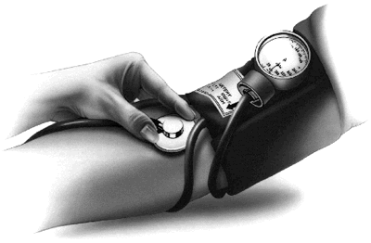
Special Populations
Modifications in assessment and programming may be required for a client with a specific health status
We will briefly address
Children
Pregnant women
CHD (CAD)
Hypertension
Diabetes (metabolic syndrome)
Disability

Slide 3
Special Populations: What You Need to Know
Anatomy and physiology of condition
Specialized screening procedure
Benefits of exercise
Cautions / observations (e.g. drug effects)
Contraindications
Modified exercise plans
cardio, strength, flexibility
weight loss?

Slide 4
Children and Youth
CSEP-PATH C4
Children - 5-11 years of age
Youth - 12-17 years of age
46% of kids get 3 hours or less of active play per week
Kids get only 24 min of moderate to vigorous physical activity out of a possible 4 hours at lunch and after school
Proportion of kids who play outside after school dropped 14% in the last decade
Safety concerns may result in more structured play and screen time, and academic study

Slide 5
Children and Youth
CSEP-PATH C4
Canadian Sport for Life
Active Healthy Kids Canada
2013 report card
Regular Physical Activity affects brain development
Cerebral capillary growth, blood flow, O2, neurotrophins, growth of hippocampus, neurotransmitters, nerve connection and network density, and brain volume
Improved attention, information processing, coping skills, positive affect and reduced cravings and pain.

Slide 6
Children and Youth
CSEP-PATH C4
Sedentary Behaviour
Independent health risk factor
Less active transportation
only 28% of kids walk to school, 78% of their parents did
Only 7% of kids attain the 60 minutes per day of moderate to vigorous physical activity recommended
Recommended to limit recreational screen time to < two hours per day
Inactivity increases risk for
Weak bones, metabolic disorders, obesity(rates have tripled in last 30 years),
Leads to increased risk of diabetes, high blood pressure, high cholesterol, asthma, arthritis, and poor health status

Slide 7
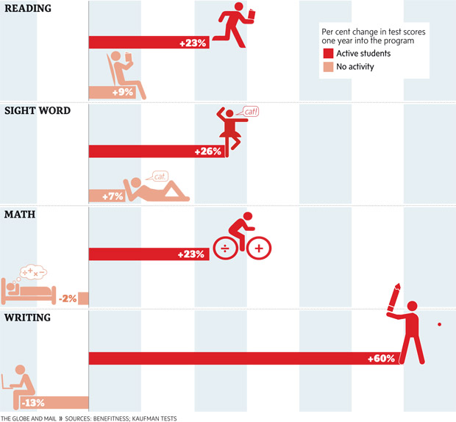
Active students improve test scores after one year
A comparison between Grade 9 at-risk students who did and did not participate in a thrice-weekly 20-minute workout at City Park Collegiate Institute in Saskatoon. Those who exercised consistently outperformed those who did not do any physical activity.

Slide 8
Children and Youth
Resistance training now thought to be safe and effective if children have
good motor skills and
an ability to accept and follow instructions
Pre-pubescent achieve strength gains through neuromuscular adaptation
Important not to have excessive resistance and to not work to failure
Recommend 8-15 reps, progress by adding reps before adding weight
No more than 2 days per week
Focus on multi-joint exercises to facilitate the development of functional strength
Perform push / pull pairing for balanced development

Slide 9
Push pull exercise combinations
 | Push | Pull
Legs | Leg press | Leg curl
Chest, back | Bench press | Row
Shoulder, back | Military press | Lat-pull down
Arms | Tricep | Bicep
trunk | Back ext | Abdominals

Slide 10
Pregnant Women
Moderate intensity exercise training during pregnancy improves maternal and fetal wellness in many areas
CV function, weight management, digestion, low back pain, blood pressure, attitude, labor, birth weight, and recovery
enhance newborn neurological development
Light to moderate activity (60% VO₂max, 20-30 min) recommended for women who have no previously been active.
Avoid starting an intense program during pregnancy
Stop or change program if;
Swelling of hands, face or ankles
Acute illness
Decreased fetal movement
Vaginal bleeding
Nausea
Chest pain
Rapid onset of abdominal or pelvic pain
Proper Hydration and avoiding supine position is important to maintain blood flow to fetus
Recommend not exceeding 150 bpm (RPE 13-14) as high HR may reduce blood flow to fetus
Notes:
Ellemberg – University of Montreal

Slide 11
Pregnant Women
Proper resistance training enhances level of muscular fitness which may help compensate for the postural adjustments and demands
Limited evidence indicating little risk to mother or infant - with the following exceptions
Table 53.4 ACSM - ACOG contraindications for aerobic ex
Women who have not weight trained before
Avoid ballistic exercises, and heavy resistance
Do 12-15 reps without pushing to failure
Discontinue specific exercises that cause pain or discomfort
Consult physician if any of the following occur - vaginal bleeding, abdominal pain, ruptured membranes, elevated BP or HR, lack of fetal movement
Limitations and risks for Flexibility training discussed in Flexibility lecture
Do not exceed moderate intensity
Hormone relaxin - increases joint laxity

Slide 12
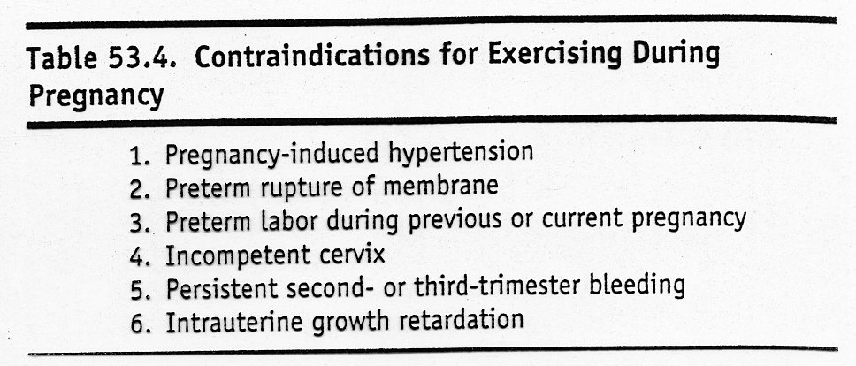

Slide 13
Disability
CSEP-PATH C3
“Physiological impairment or environmental barriers result in a functional limitation”
Persons with a disability have similar needs, interests and concerns regarding physical activity – more likely to encounter environmental barriers.
Gathering of pertinent information from client will assist in development of an appropriate program with the assistance of the client
AAL-Q
Identify barriers that may be the indirect result of the disability
lack of facilities, experience, knowledge
Fear, time, availability of support, perceived limit of options

Slide 14
Disability
CSEP-PATH C3
Wide range of impacts that a disability may have include;
Mobility
Object manipulation
Behavioural and Social Skills
Cognitive function
Communication and perception
Hearing impairments
Speech impairments
CSEP-PATH online toolkit includes
A way with words
Sign language for Exercise Professionals
Tips for conducting the CSEP-PATH fitness assessment for clients with a disability

Slide 15
Chronic Disease
Cardiac Rehabilitation
restore CAD patient to full and productive life
multifaceted - lifestyle overhaul
high variability - progression and manifestation
adjustments with medications
Establish risk based on prognosis and functional capacity (Bruce)
Angina Pectoris
stable angina, angina threshold (4 MET or greater)
10 - 15 bpm below angina threshold
prolonged warm up/down - ROM
whole body exercise - circuit training

Slide 16
Chronic Disease
Pacemakers
requires extensive evaluation of response to exercise
HR and exercise ?
Variable with type of pacemaker - some respond others do not
testing - low functional capacity
Increase by only 1 MET per 2-3 min stage

Slide 17
Medications
Beta Blockers - decreased resting and exercise HR and BP
inc. Angina threshold
case by case - dose specific
Nitrates - decreased after load and preload - increased angina threshold
no change in HR response
hypotension post exercise
Calcium Channel Blockers
vasodilator - increased O₂ to heart
reduce angina - dose specific
B blockers, Ca channel blockers and vasodilators may cause post exercise hypotension - cool down important

Slide 18
Special Populations
Consideration of underlying condition - physiologically
variability even within special populations
risk / benefit ratio
reassessment with changes in status - new goals...
COPD - emphysema, Bronchitis
low level testing - .5 MET’s per stage
may only see reduction in symptoms, anxiety, depression

Slide 19
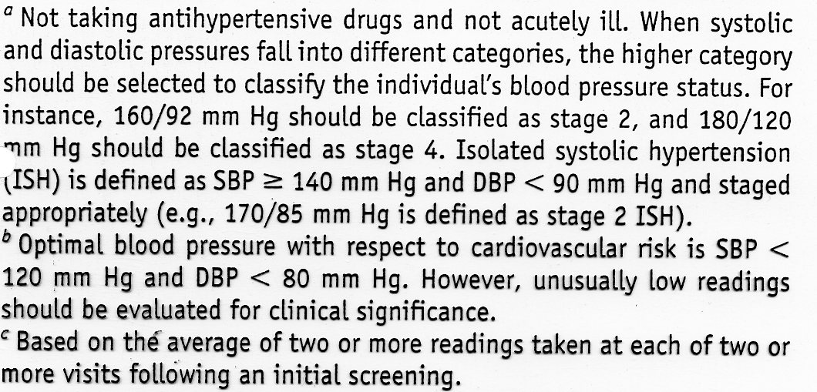
Classification of Blood Pressure for Adults
Classification | Systolic (mmHg) | Diastolic (mmHg)
Normal | < 120 | < 80
Pre Hypertension | 120 - 130 | 80 - 89
Stage 1 | 140 - 159 | 90 - 99
Stage 2 | > 160 | > 100
Risk of CVD, beginning at 115 / 75 mmHg, doubles with each increment of 20 / 10 mmHg

Slide 20
Hypertension
Primary (essential) Hypertension
95% of cases
unknown cause (idiopathic)
Secondary Hypertension
due to endocrine or renal structural disorder
Hypertension
increases probability of stroke, CAD and Left Ventricular Hypertrophy
Sedentary have 20-50% increased risk for developing hypertension
Exercise will reduce the age related increase in BP for those at high risk genetically
Exercise - greater increase in Q, SBP and DBP
Higher frequency and duration at lower intensity (40-65%)

Slide 21
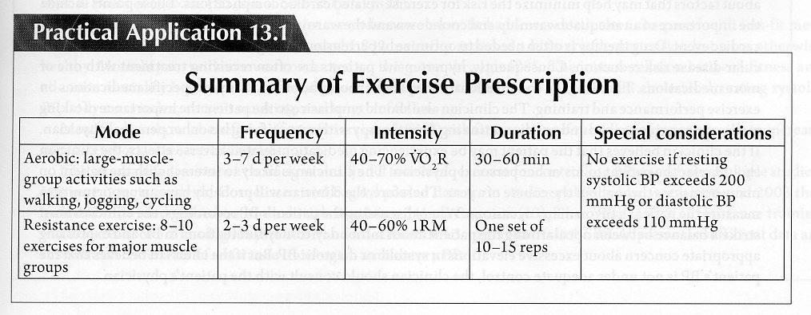
Exercise Prescription for Hypertensive Patients
Clinical Exercise Physiology 2nd ed, Human Kinetics, 2009

Slide 22
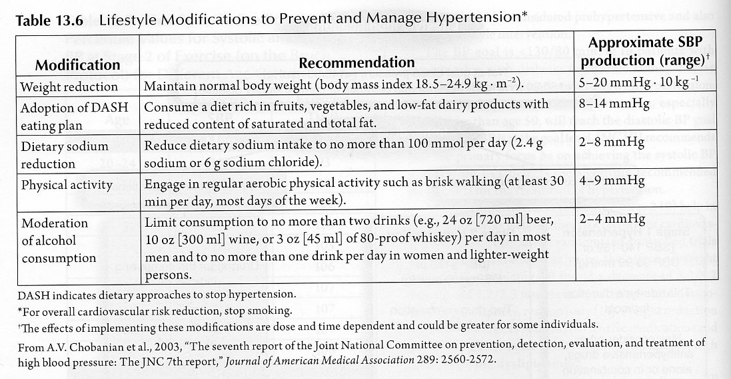
Impact of Lifestyle interventions on Hypertension
Clinical Exercise Physiology 2nd ed, Human Kinetics, 2009

Slide 23
Metabolic Syndrome
Definition - group of risk factors that increase risk of CHD, Type 11 Diabetes, and kidney disease
Diagnosis - for a person to be diagnosed as having the metabolic syndrome they must have:
Central Obesity
> 94 cm for Europid men
> 80 cm for Europid women (other ethnic specific values available)
And two of the following four factors:
Raised TG level : > 150mg/dL (1.7 mmol/L) or specific treatment of this lipid abnormality
Reduced HDL cholesterol: < 40 mg/dL in males < 50 mg/dL in females, or specific treatment of this lipid abnormality
Raised blood pressure: SBP > 130 or DBP > 85; or treatment of previously diagnosed hypertension
Raised fasting plasma glucose (FPG) > 100mg/dL (5.6 mmol/L or previously diagnosed type 2 diabetes

Slide 24
Diabetes
Exercise is an accepted adjunctive therapy in management of diabetes and metabolic syndrome
Diet, insulin and exercise are the three cornerstones of diabetes care
Exercise appears to be beneficial in controlling blood glucose in non-insulin dependent diabetes mellitus (NIDDM, type II, age onset)
Exercise can be made safe for individuals with IDDM (insulin dependant, type I) and may reduce the risk of CVD
Type I and II are distinct and separate diseases
Table 31.1 ACSM - characteristics of type I and II

Slide 25
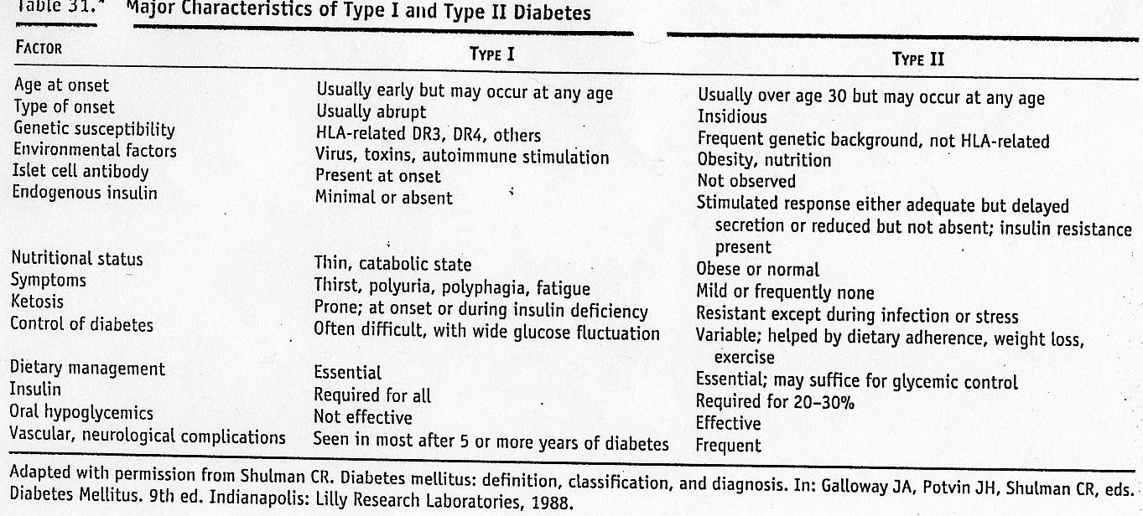
Table 37-1 ACSM

Slide 26
Type I Diabetes
Primary abnormality is insulin deficiency
Exercise improves glycemic control, though it is not well documented
People with type I are prone to hypoglycemia during and after exercise
Tend to eat more or reduce insulin to decrease the risk of hypoglycemia with exercise - Table 1 - CJDC
Increase carbohydrates tends to negate the benefits of exercise on glycosylated Hb
Glycosylated Hb - covalent links between glucose and Hb; [ ] increases with bld glucose, used as retrospective index of glucose control over time
Table 31.4 general guidelines for avoiding hypoglycemia

Slide 27
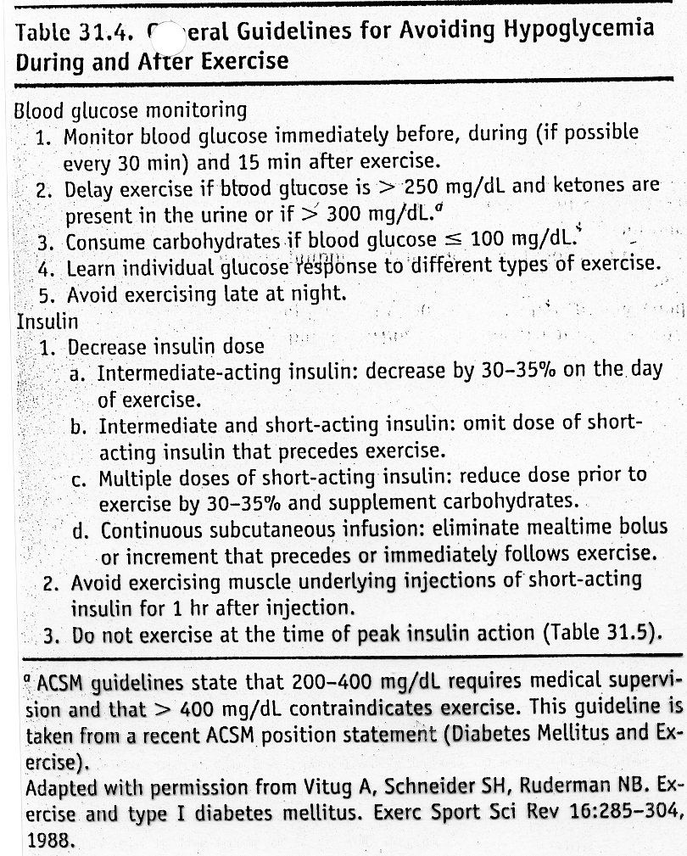

Slide 28
Type I Diabetes
Balance of insulin, glucagon and catecholamines largely controls the availability and use of metabolic fuels
Acute exercise increases glucose use which requires inc glucose production to maintain normal glucose
With diabetes the inc glucose production is compromised the the presence of insulin (injected) and / or inability to inc glucose due to abnormal hormone response (Table 31.5 activity characteristics of insulin)
Regular exercise does improve insulin sensitivity, glucose metabolism and CVD risk
Table 31.2 ACSM benefits of ex for type I
Table 31.3 ACSM general exercise recommendations

Slide 29
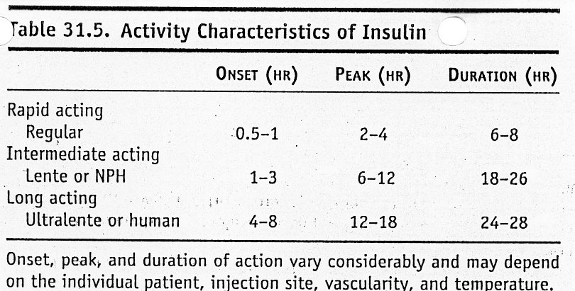
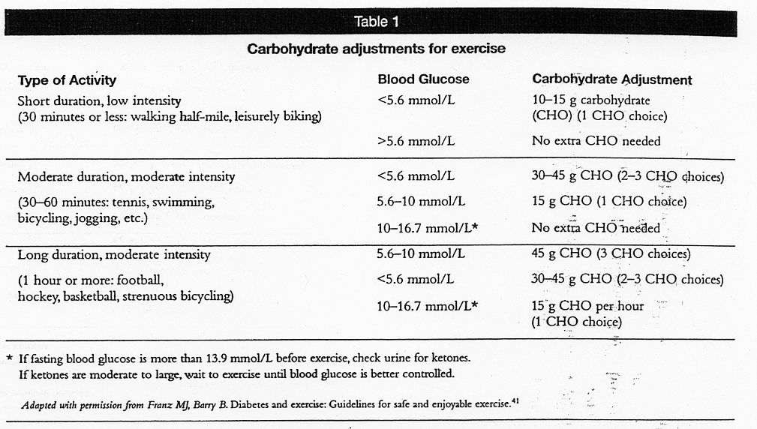

Slide 30
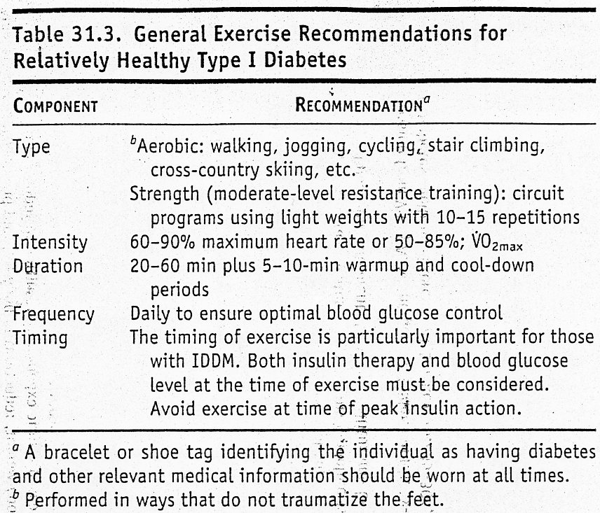
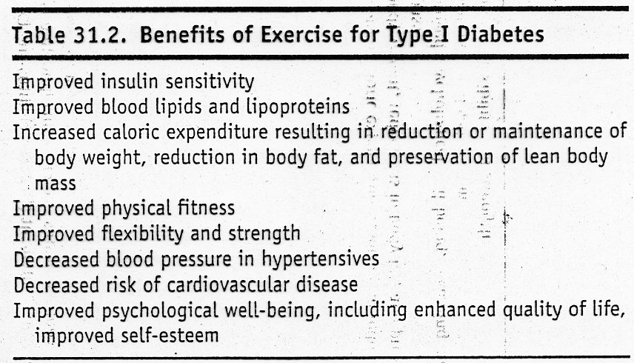

Slide 31
Type II Diabetes
Series of events caused by insulin resistance leads to stages of disease, including further insulin resistance and insulin and glucose abnormalities
Treatment usually includes weight loss and oral hypoglycemic agents to help restore peripheral insulin receptor sensitivity and stimulate pancreatic insulin release
Table 31.6 ACSM benefits of exercise
Regular physical activity is a recommendation of ADA for type II diabetes - prevention and treatment
Diabetes is found less often in active rural populations
Higher prevalence in sedentary individuals independent of body mass
Table 31.7 exercise recommendations for Type II
Dose response relationship - DC Wright
Most benefits coming form moderate to high intensity exercise

Slide 32
