Slide 1
Exploring Social Justice:
Does the Parliament of Canada Represent the Population of Canada?

Slide 2
Exploring Visible Minorities
Statistics Canada defines visible minorities as “persons who are non-Caucasian in race or non-white in colour and who do not report being Aboriginal.”

Slide 6
Exploring Demographics of Aboriginal People
Notes:
4% Aboriginal,
Only 4% Inuit

Slide 7
Exploring Representation of Aboriginal People
Notes:
2% Aboriginal people in parliament
3/7 are Inuit/Innu

Slide 8
Exploring Gender of MPs

Slide 9
Exploring Gender of MPs

Slide 10
Exploring Occupations

Slide 11
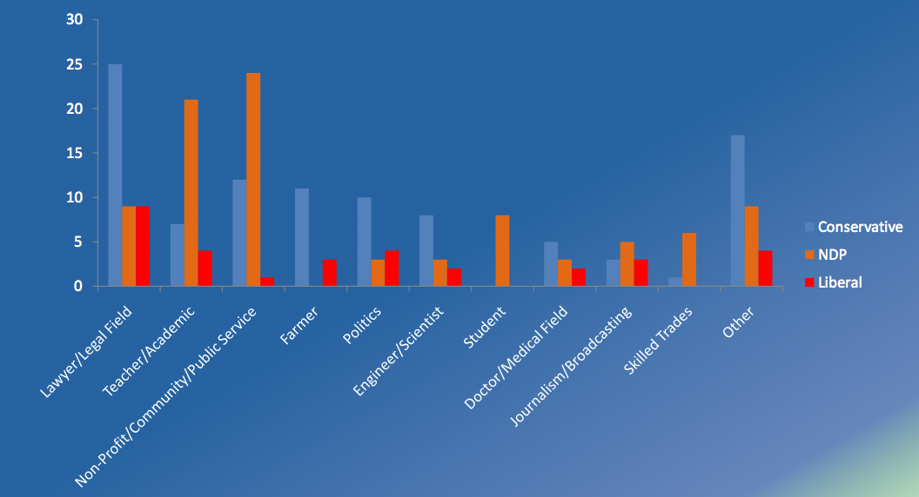
Occupation Breakdown by Party
Public Policy Forum. (2011). Edging Towards Diversity. Retrieved from http://www.ppforum.ca/sites/default/files/edging_towards_diversity_final.pdf

