Slide 1
Engaging mathematics problems
Sean Chorney sbc7@sfu.ca
FOR THE DISSECTION WORKSHEET YOU’LL HAVE TO EMAIL ME, THANK YOU
NorthWest Conference 54
October 23, 2015

Slide 2
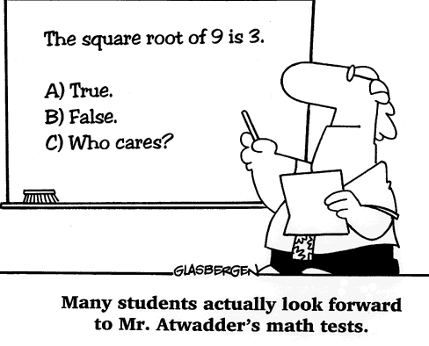

Slide 3
Selected Resouces
Thinking Mathematically J. Mason, L. Burton, K. Stacey
Aha! Gotcha: Paradoxes to puzzle and delight Martin Gardner
Mindtrap game
Mathematical Activites: A resource book for teachers Brian Bolt
Pi in the sky, Vector
peterliljedahl.com –numeracy tasks or problem of the week

Slide 4
How I use problems in class
Have a problem on projector at beginning of every class
attendance, scan class get a feel of energy, take an opportunity to talk to students
Warm up, students won’t be late
Opportunity to change things up, introduce technolgoy
Having fun
Not necessarily curricular based

Slide 5
Engaging problem
Not about the answer
Challenge students to readjust the problem, reformulate, extend, when students get to know how I deal with problems it’s like their worst nightmare b/c problem never ends!
Pose questions
extend

Slide 6
Cards
The problem is to deal cards onto the table in alternating colour from the deck. The challenge is that you must deal in a special order: place the top card under the deck, deal the next card to table, then repeat.

Slide 7
Classical problem
The host at a party turned to a guest and said, “I have three daughters and I will tell you how old they are. The product of their ages is 72. The sum of their ages is my house number. How old is each? The guest rushed to the door, looked at the house number and informed the host that he needed more information. The host then added, “Oh, the oldest likes strawberry pudding.” The guest then announced the ages of the three girls. What are the ages of the three girls?
Let us imagine that the earth is an ideal sphere. There is a wire wound around the equator. In one place we break the wire and extend it by one metre. Then we raise the wire everywhere equally above the ground. Could a cat creep under the wire? (Earth’s radius given as 6537 km)

Slide 8
More Classical problems
A new school has ben completed. There are 1000 lockers in the school numbered from 1 to 1000. At the beginning of the school year: the first student walked in and opened all the locker doors, the second student closed all the even numbered doors, the third reversed the state of all the doors numbered with multiples of three, the fourth reversed the state of all doors that were multiples of 4 and so on…After 1000 students entered the school, which locker doors were open?
A camel must travel 1000 miles across a desert to the nearest city. She has 3000 bananas but can only carry 1000 at a time. For every mile she walks, she needs to eat a banana. What is the maximum number of bananas she can transport to the city?

Slide 9
Chess board
How many squares on a chessboard?
Notes:
How many rectangles on a chessboard?

Slide 10
Fermi problems
Give a ratio of water to air on earth
How many words have you spoken in your life?
On average, how many people’s names appear in an edition of the Vancouver Sun?
How many number of watermelons would fit in churchill high school?
How many different states of the Rubrik’s cube are there?
How many people are unemployed in BC?

Slide 11
Open ended problems
How many golf balls will fit in a suitcase?
Which is better fit: a square peg in a round hole or a round peg in a round hole?
A number is rounded to 5.8. What might the number be?

Slide 12

Finger counting

Slide 13
Cutting a cube
Dangle a cube from a vertex using a string. Now make a horizontal cut through the cube halfway between the top and bottom. What shape is created from the cut surface?
Notes:
Look at different ways of solving this? Overhead, iphone flashlight,
Slicing – what other cross sectional shapes

Slide 14
Dissection
What other cross sectional shapes can you get by slicing a cube?
Can you cut a hole in a cube such that a larger cube can fit through it?

Slide 15
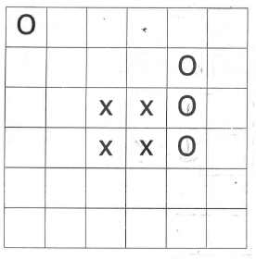
Dissection problems
Handout
Using all the squares in the figure below, create 4 congruent shapes each consisting of an ‘O’ and an ‘X’

Slide 16
Dartboard
My friend Sarah has built a new dartboard for her son. The board has two regions: the centre circle, valued at 9 points, and the outside circle, valued at 4 points. What is the largest number that cannot be achieved as a score in this game? (Assume that you can continue the game as long as you wish, and that you can stop whenever you wish.)

Slide 17
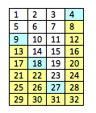
An easy way to solve this is to do it graphically by filling in colours. Because we are dealing with multiples of 4 and 9, it is best to set up in columns of 4 or 9. Since 4 is smaller, we will use that instead of 9. Once we colour in a square, we can fill in all the colour below because we just keep adding 4’s. We also colour in all the squares that are multiples of 9. Once we have a complete row, it means we can generate all the scores that are higher.
We can see that the highest uncoloured square is 23. So that is the highest score that cannot be achieved.

Slide 18
Fibonocci?
___ ___ ___ ___ ___
In the 5 spaces above put numbers in the first two spots, write their sum in the 3rd spot. The sum of the 2nd and 3rd spots goes in the 4th, similarly the sum of the 3rd and 4th goes in the 5th. 100 should be the 5th number.

Slide 19
Disruption
What’s the largest number less than 5?
How many times can you subtract 7 from 35?
How can you put 18 cubes of sugar in a cup of coffee so that there is an odd number of cubes in each cup?

Slide 20
Factory Worker
To get to the factory where he works Fred takes the train everyday, when he gets off the train a chauffeur picks him up and drives the rest of the way. One day he decided to catch a train that arrives 1 hour earlier and walk partway to the factory. On his way walking to the factory the chauffeur picks him up and drives him straight there. Fred arrives 30 mins earlier than usual.
How long did he walk?

Slide 21
Goldfish
A boy has the hobby of breeding goldfish. He decides to sell all his fish. He does this in four steps:
1) He sells one half of his fish plus half a fish.
2) He sells a third of what remains, plus one third of a fish.
3) He sells a fourth of what remains, plus one fourth of a fish.
4) He sells a fifth of what remains, plus one fifth of a fish.
He now has 11 goldfish left.
Of course, no fish is divided or injured in any way. How many did he start with? See if you can work it out.

Slide 22
Farm Animals
A cow costs $10, a pig $3, and a sheep 50 cents. A farmer buys 100 animals and at least one animal of each kind spending a total of $100. How much of each did he buy?

Slide 23
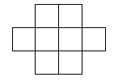
Number puzzles
Place the digits 1-8 into the boxes so that no consecutive numbers are touching (including diagonals).

Slide 24
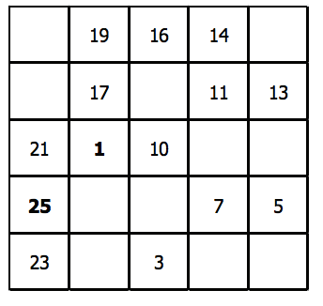
Hidato
Make a chain from 1 to 25 connecting the squares
Notes:
Susan milner univ fraser valley
http://media.pims.math.ca/pi_in_sky/pi18.pdf

Slide 25
Table
A circular table has four holes. In each hole is a wine glass that is either upside down or upright. You are not able to see the wine glasses in the holes. You may put one or both of your hands in the holes and change the orientation of one, both or neither glasses. As soon as you remove your hands the table spins a random number of times and the four holes are in different positions. When all four glasses match positioning, a buzzer will sound so you know you are finished.
Objective: To place all wine glasses either up or down.
Question: Is there a finite number of times in which the objective can be accomplished? If so, how many?

Slide 26
Triangles
Using 12 rods of varying lengths how many different triangles can you make?
What types of triangles can you make? Can you make a triangle with any three rods? What about 2, 3, and 5 or 2, 2 and 3?

Slide 27
Tax Collector
Start with a collection of paychecks, from $1 to $12. You can choose any paycheck to keep. Once you choose, the tax collector gets all paychecks remaining that are factors of the number you chose. The tax collector must receive payment after every move. If you have no moves that give the tax collector a paycheck, then the game is over and the tax collector gets all the remaining paychecks. The goal is to beat the tax collector.

Slide 28
Shoe Sale
You decide to take advantage of a buy 2 pair get 1 pair of equal or lesser value for free sale at the local shoe store. The problem is that you only want to get two pairs of shoes. So, you bring your best friend with you to the store. After much deliberation you settle on two pairs of shoes – a sporty red pair for $20 and a dressy black pair for $55. You friend finds a practical cross trainer for $35. When you proceed to the check out desk the cashier tells you that your bill is $90 plus tax (the $20 pair are for free). How much should each of you pay? Justify your decision.

Slide 29
Probability kings
What is the probability of drawing a king from a deck of cards?
What if you pick a card, don’t look at it, and set it off to the side, what is the probability now of drawing a king with the remaining cards?
What if you pick two card, don’t look at them, and set them off to the side, what is the probability now of drawing a king with the remaining cards?

Slide 30
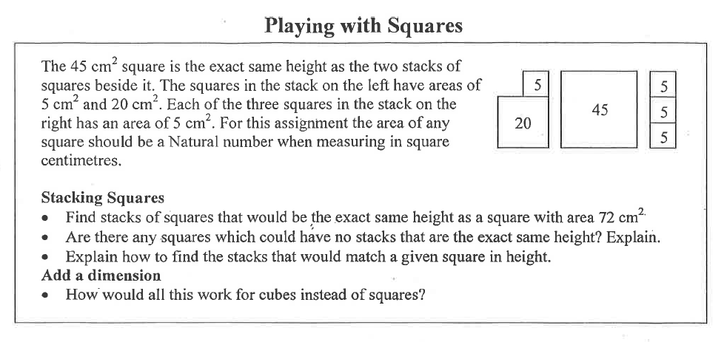
Summing squares

Slide 31
1001 coins
1001 Coins
On a table there are 1001 pennies lined up in a row.
I come along and replace every second coin with a nickel.
Then I replace every third coin with a dime.
Finally, I replace every fourth coin with a quarter.
How much is on the table now?

Slide 32
Number problem
What is the number which when added separately to 100 and 164 will make them both perfect square numbers?

Slide 33
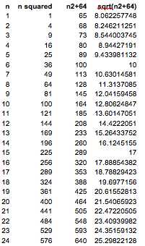

Slide 34
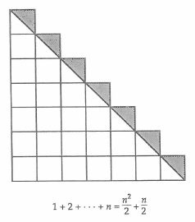
Diagrams prompt questions

Slide 35
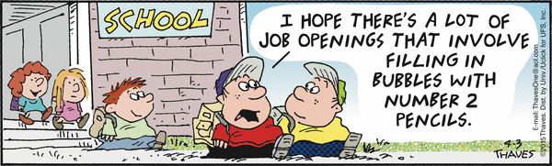

Slide 36
Egg Drop
You are given two eggs, and access to a 100-storey building. Both eggs are identical. The aim is to find out the highest floor from which an egg will not break when dropped out of a window from that floor. If an egg is dropped and does not break, it is undamaged and can be dropped again. However, once an egg is broken, that’s it for that egg.

