Slide 1
07
IAT 102 Graphic Design

Slide 2
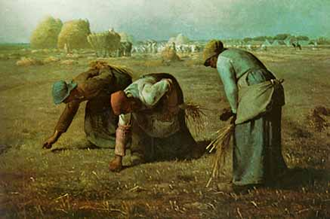
Pre- Victorian Era
Agrarian society (agriculture) that relied on animal and human power for energy

Slide 3
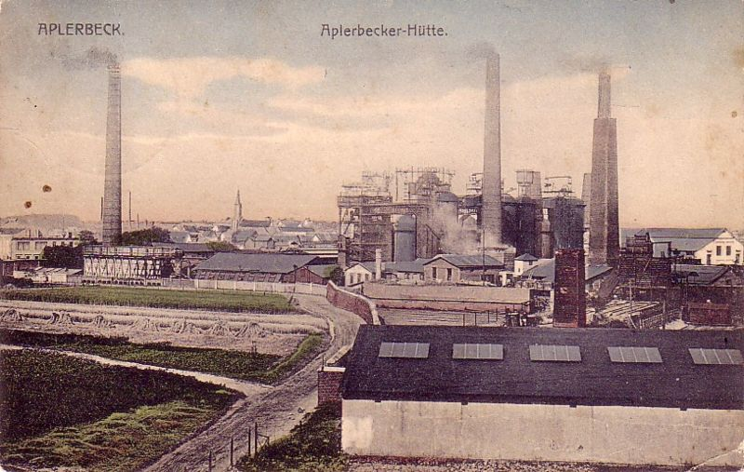
the industrial revolution between 1760 - 1840
Shift from agricultural society to an industrial society powered by the steam engine
Notes:
To steam engine – power increased 100 fold.
City grew, populations, new classes.
Power shifted from those who owned land to those that produced goods – merchant class – and even a middle class.
Conditions often depressing and unstable – overall living conditions improved.
These new technologies could produce goods cheaply & more people could afford them.

Slide 4
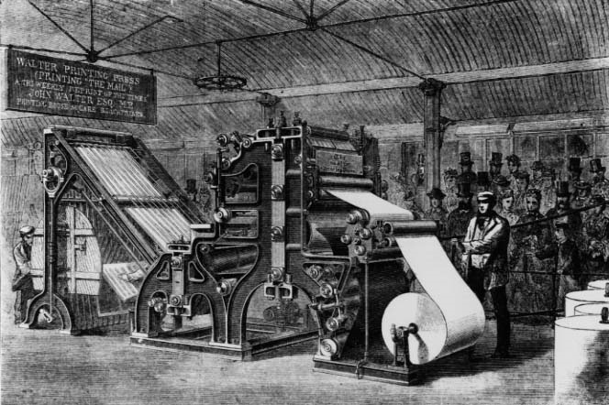
introduced machine into everyday life
Increase mass production
production of large amounts of standardized products

Slide 5
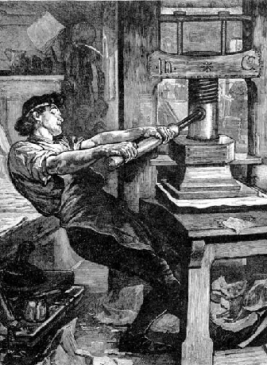
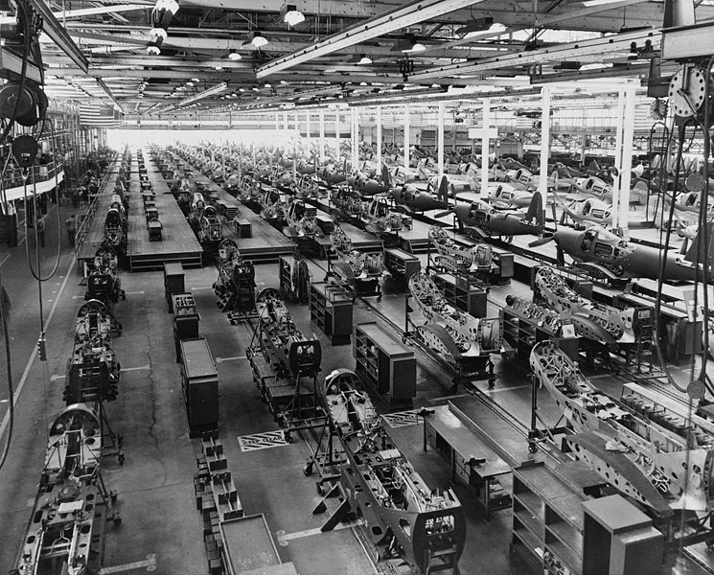
Past:
Limited production
Hand-written
Machine operated by humans
20th century
Publications were produced in massive quantities

Slide 6
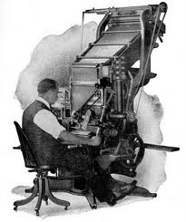
Linotype gave skilled typesetters the ability to create four to seven lines of type a minute.

Slide 7
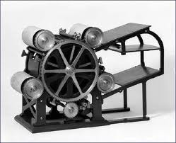
Rotary steam presses (steam 1814, rotary 1868) replaced hand- operated ones, doing the same job in 16 per cent of the time; photo-engraving took over from handmade printing plates.
Notes:
A rotary printing press is a printing press in which the images to be printed are curved around a cylinder. Printing can be done on large number of substrates, including paper, cardboard, and plastic. Substrates can be sheet feed or unwound on a continuous roll through the press to be printed and further modified if required (e.g. die cut, overprint varnished, embossed). Printing presses that use continuous rolls are sometimes referred to as "web presses". Rotary drum printing was invented by Richard March Hoe in 1843, perfected in 1846,^{[1]} and patented in 1847. (Note - Some sources describe Parisian 'Hippolyte Auguste Marinoni', (1823, 7 January 1904) as the inventor of the Rotary printing press.^{[2]})^{[clarification needed]}

Slide 8
The age of mass communication had arrived.

Slide 9
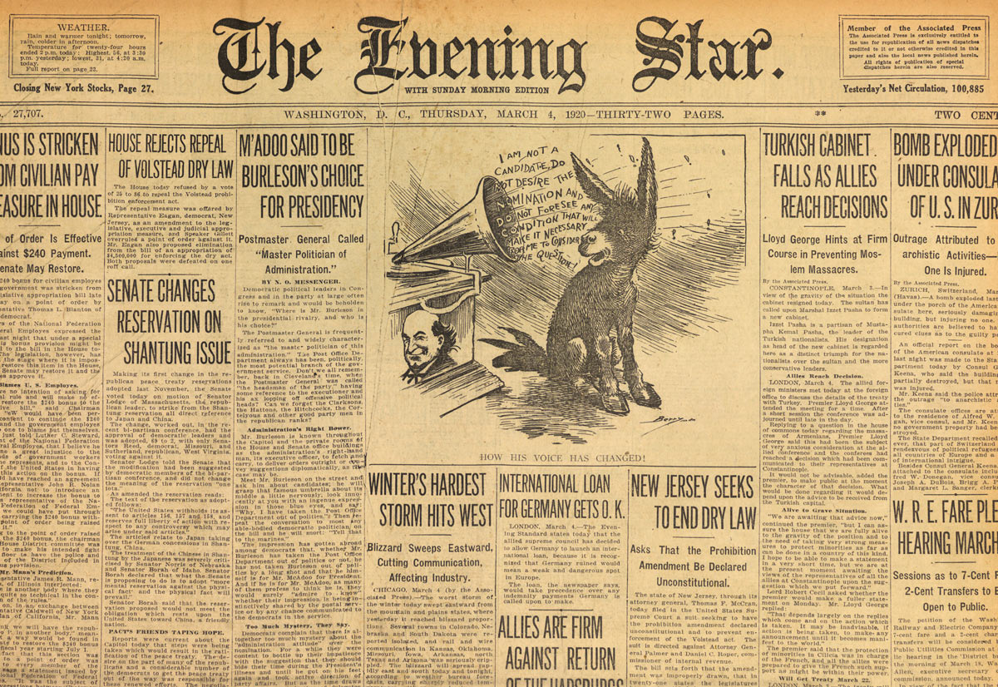
magazines and newspapers and other periodic publications required a standard - quick layouts

Slide 10
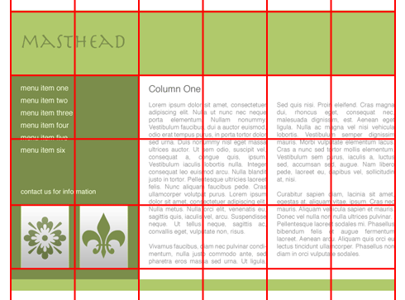
need for a layout system
Produce content quickly
Grids used for structure

Slide 11
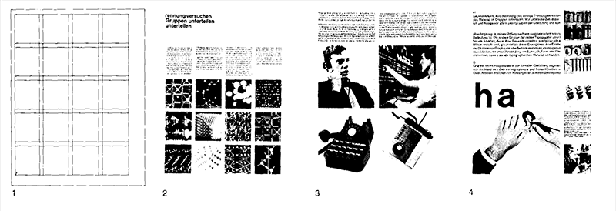
Grid as structure
Reusable system
Quick, generic layout
Organize content efficiently
saves time on layout

Slide 12
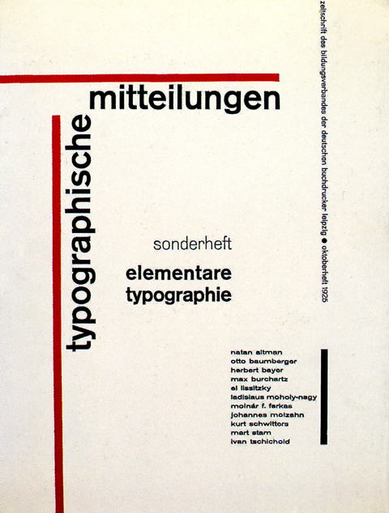
Typography grid
Asymmetrical layout
Clarity in reading direction
Logical order, hierarchy

Slide 13
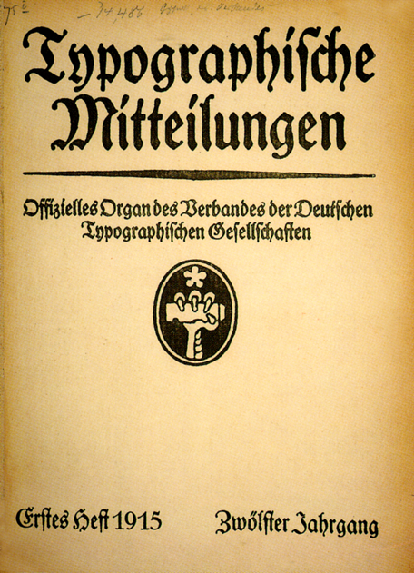
Classical layout was abandoned
Centralized format
Symmetrical
Ornamental typefaces

Slide 14
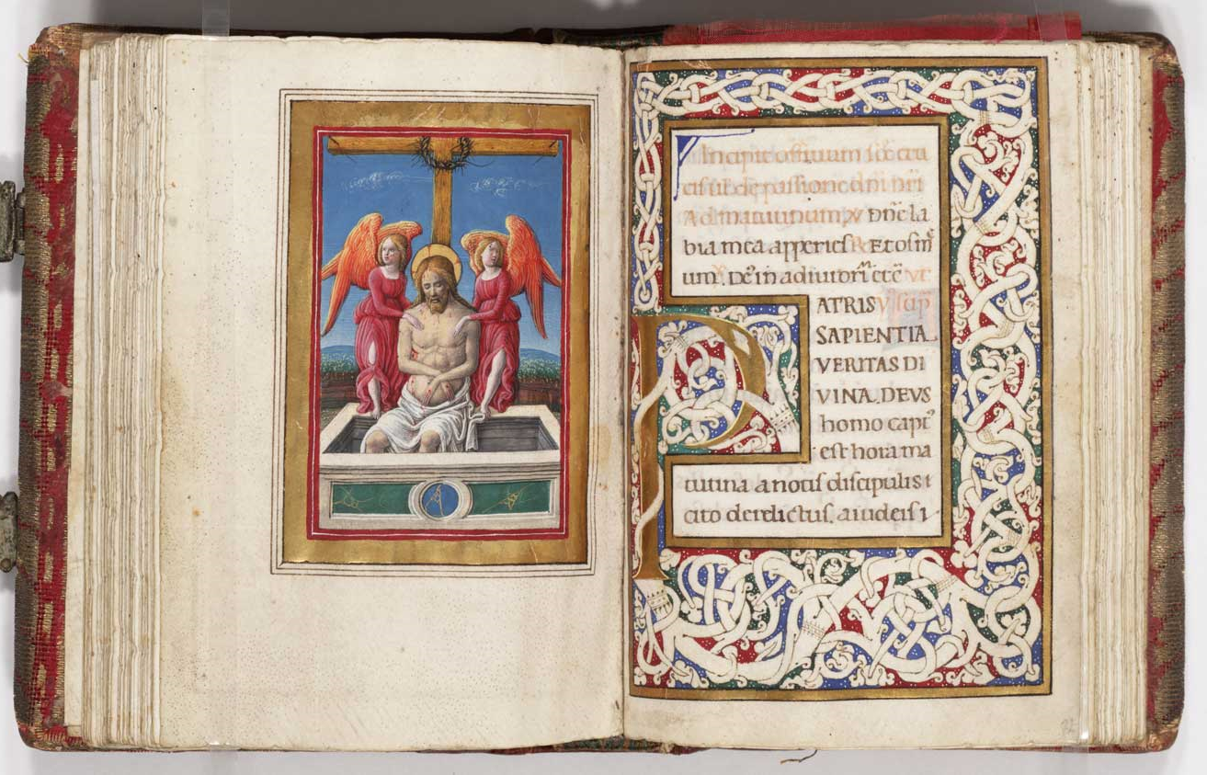
Page layouts
Medieval ages – 18th century

Slide 15
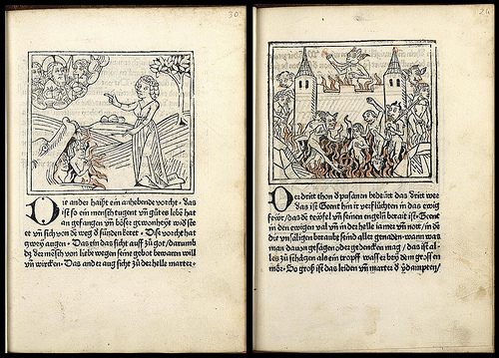
Simple grid
Centralized composition

Slide 16
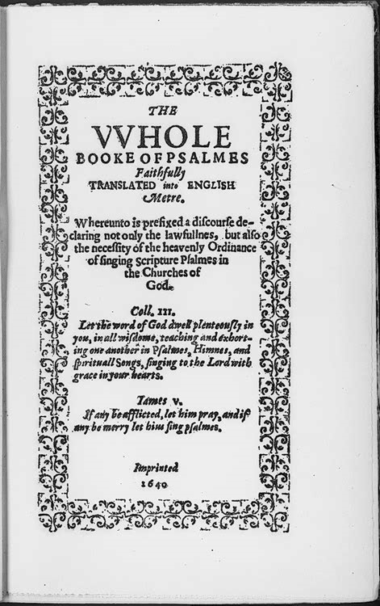
Decorative frames

Slide 17
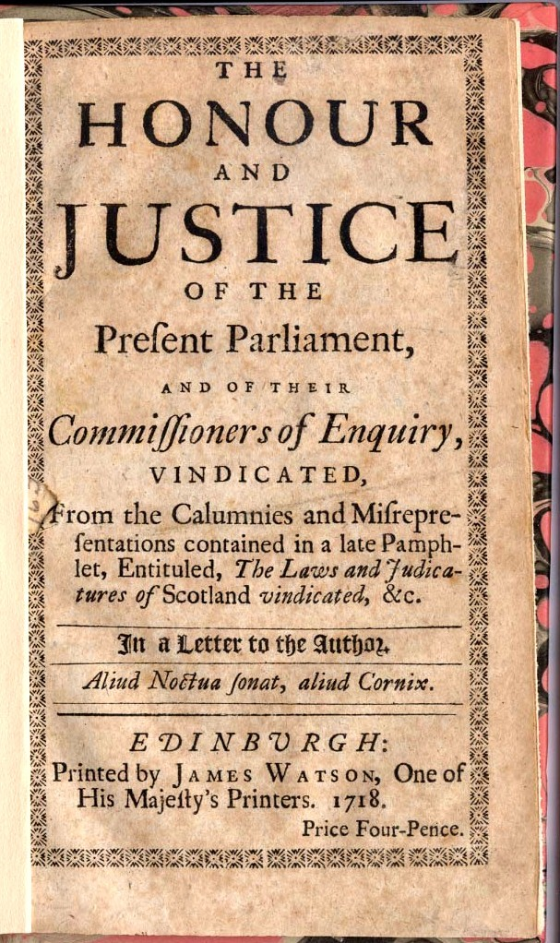
Centralized format
Ornamentation by:
  various typefaces
  Sizes

Slide 18
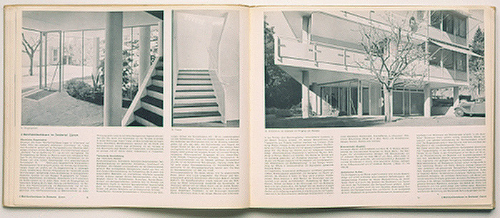
Grid uses in Composition:
Balance + order + consistency

Slide 19
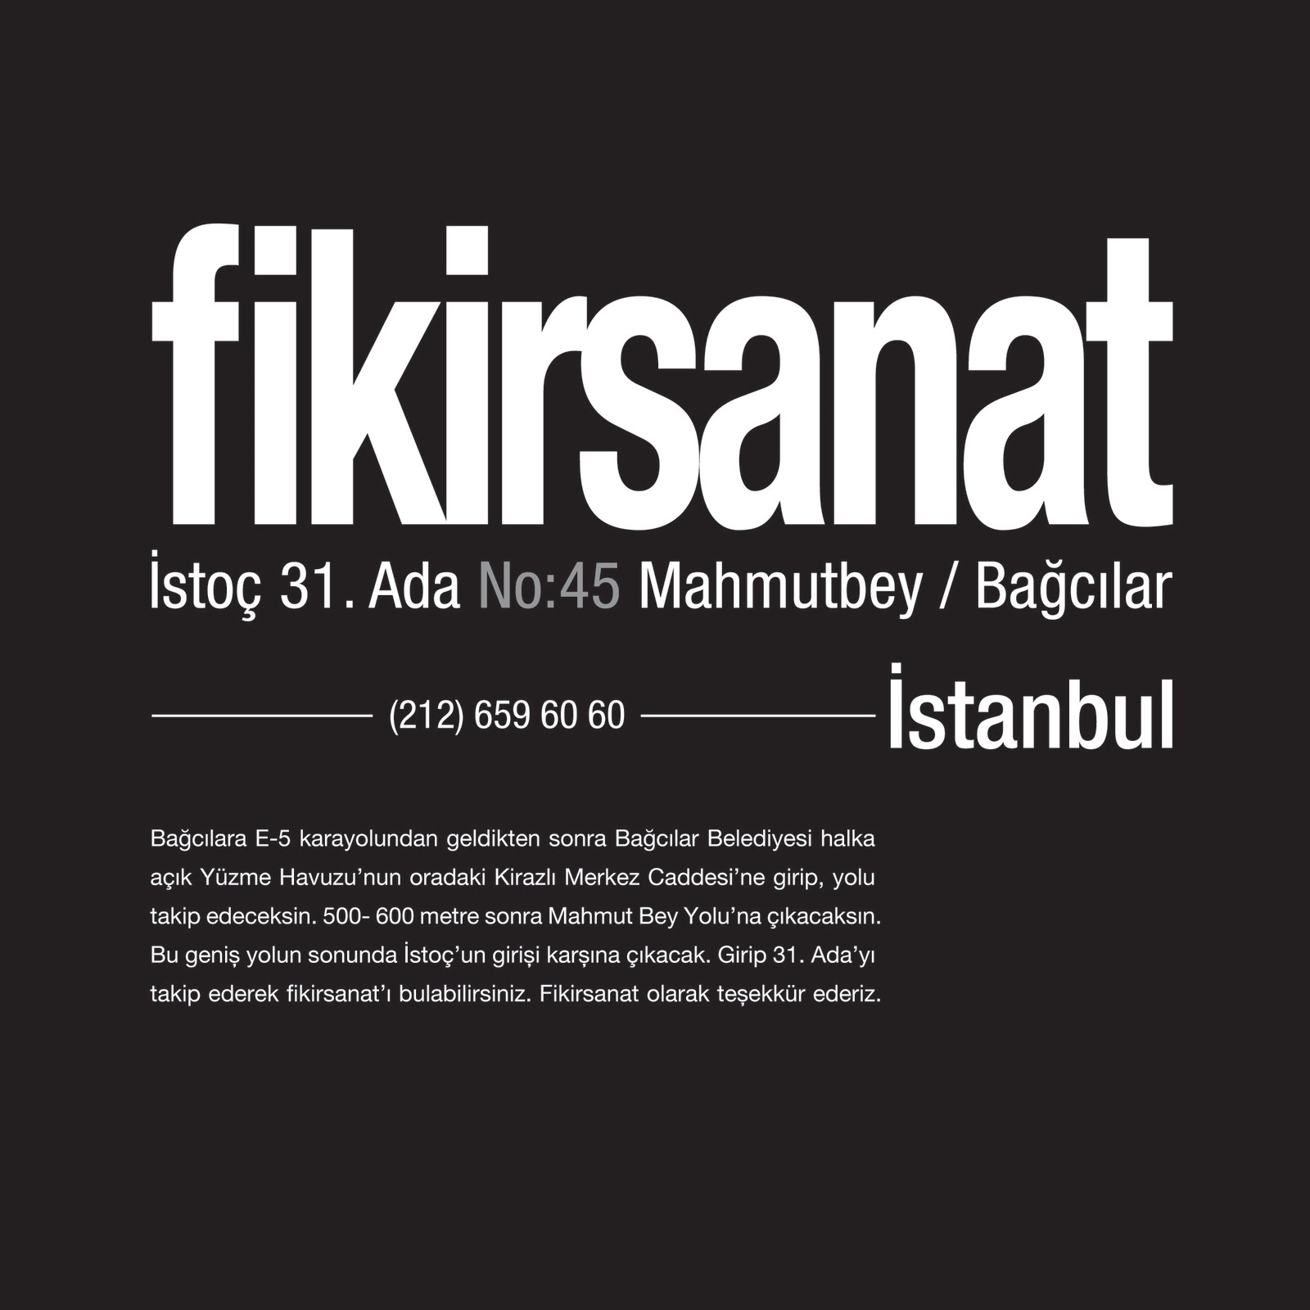
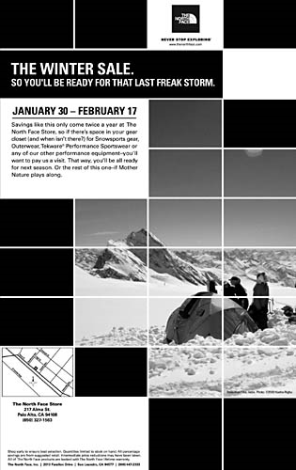
Grid in presenting information
Arranges content in Clear + logical hierarchy
Makes it easy to read + understand

Slide 20
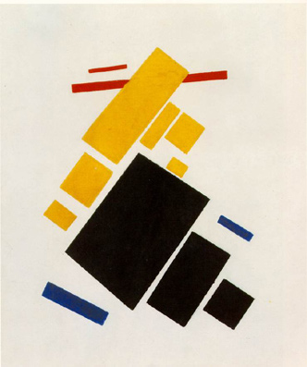
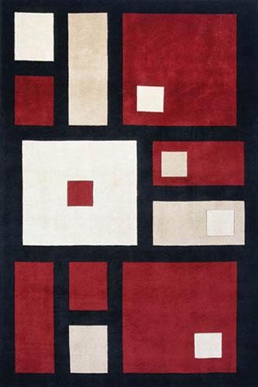
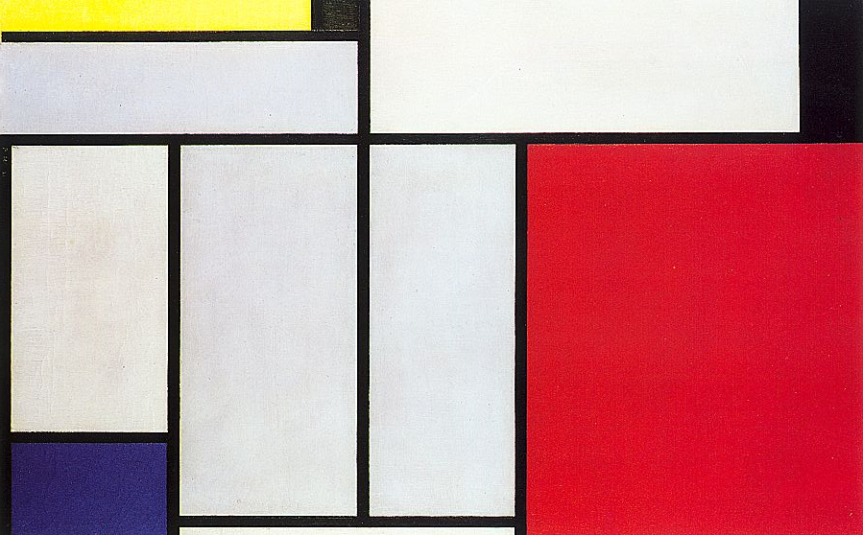
Grid influenced art movements

Slide 21
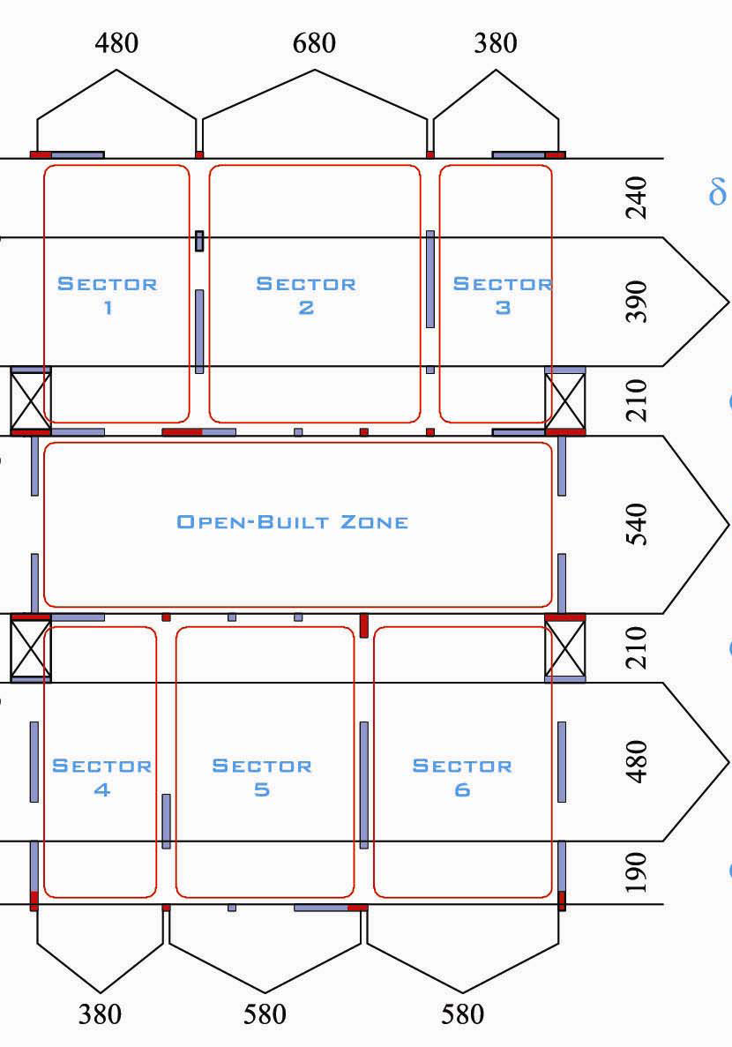
Modular grid used in architecture:
produce quick, generic layouts
Mass-housing for people after WW2

Slide 22
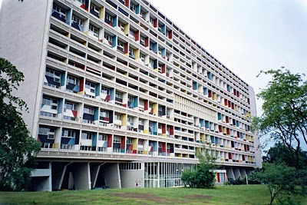
Prefabricated blocks
Fast layout like lego houses

Slide 23
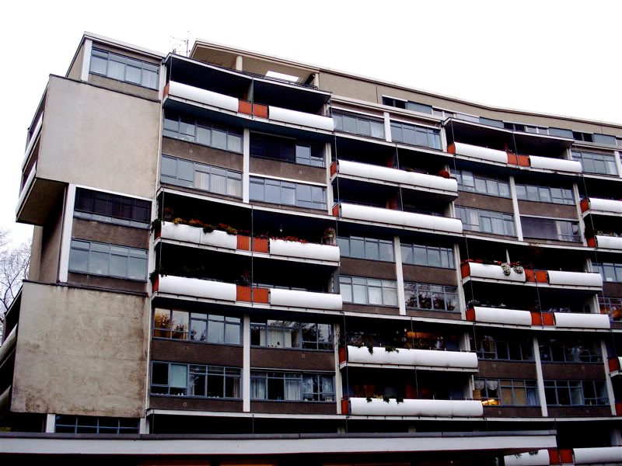
Problems
Very generic
Repetitive
Didn’t consider varying human needs

Slide 24
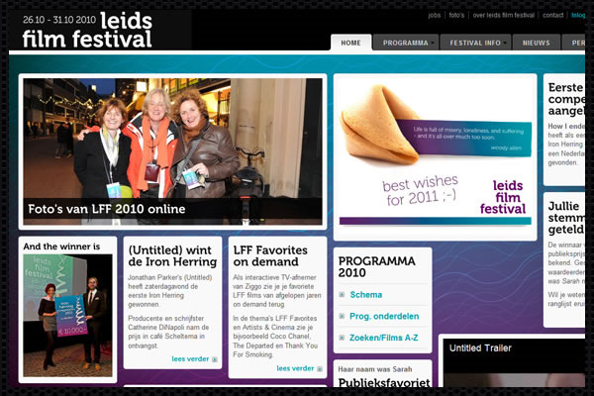
Grid in web design

Slide 25
Grid types

Slide 26
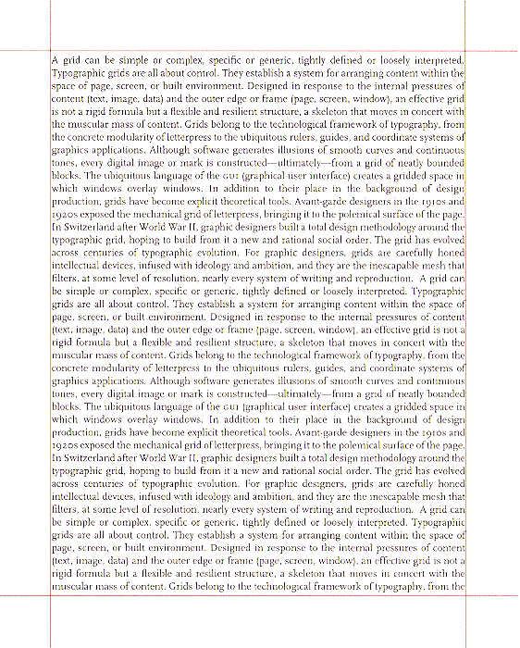
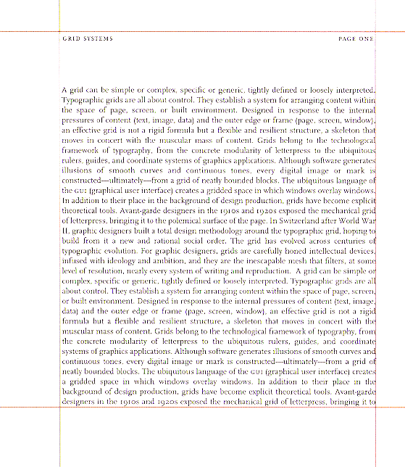
1. single-column grid
Most common page design: letters, books
Default layout in current word processors
Notes:
Single page even margins
Square wider inside margins

Slide 27
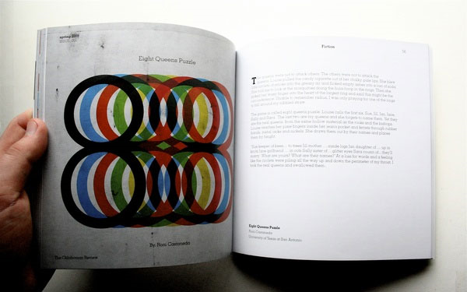
Single-column grid in books

Slide 28
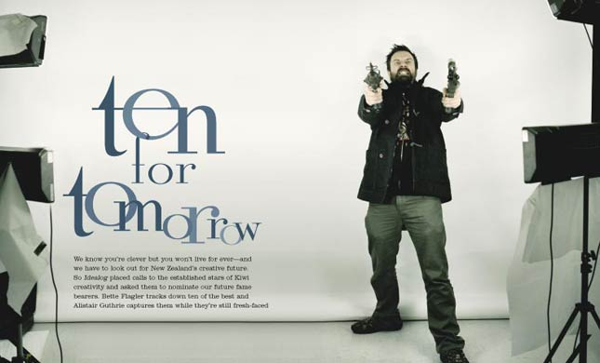

Slide 29
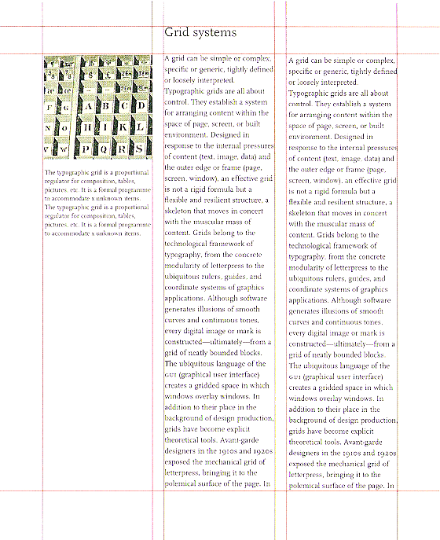
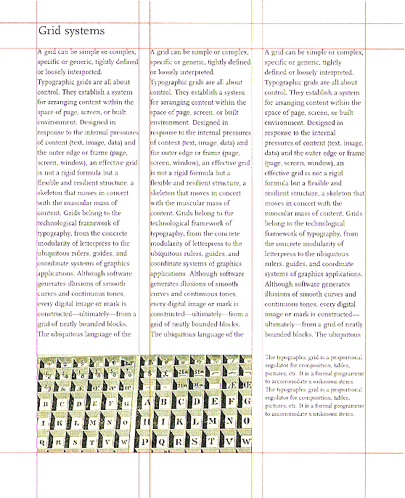
2. multi-column grid
Divide space into vertical bands.
Read text in a linear way from top to bottom
Notes:
More flexible
Not all the space has to be filled
Can span more then one column
One for captions & images
-one images & text share space

Slide 30
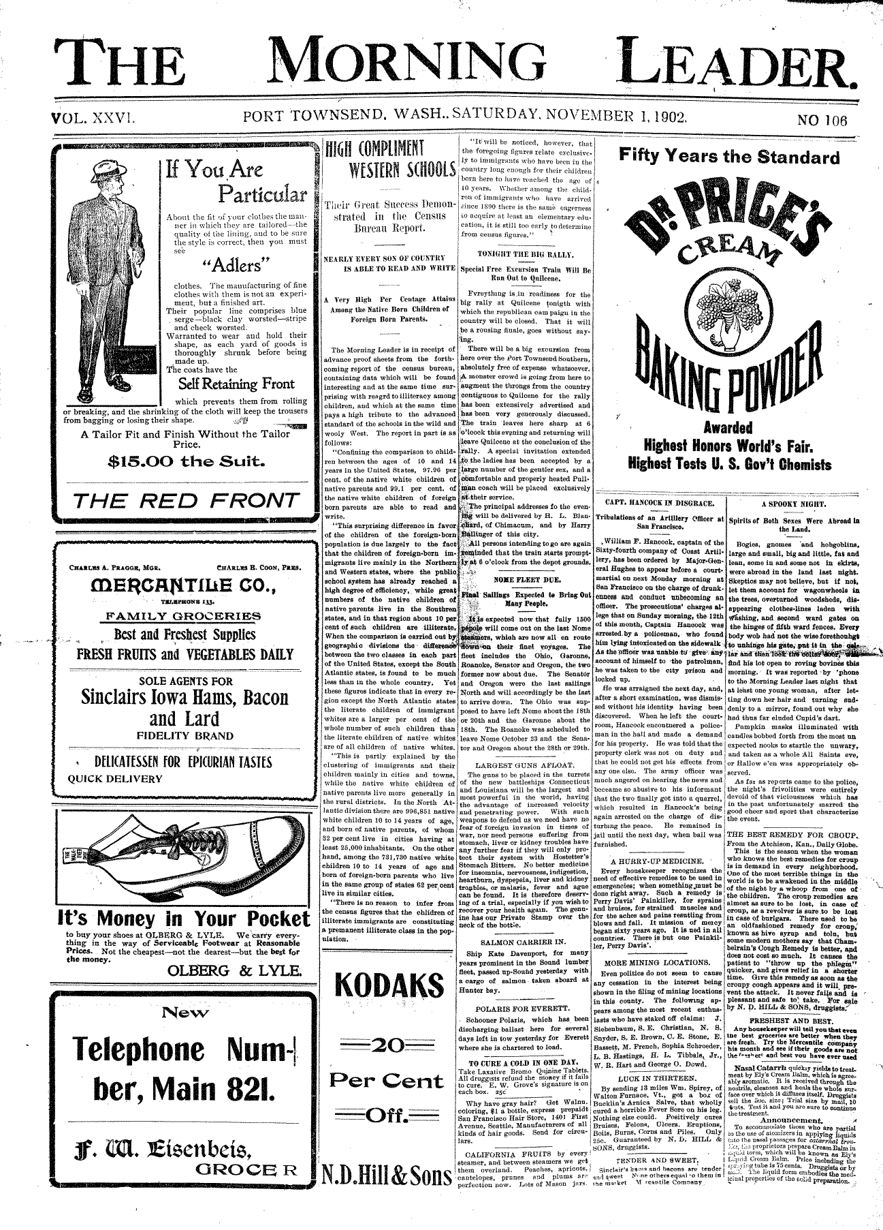
Most common in magazines and news papers.
Insert many elements (text, images, ads, etc)
Divide information into smaller chunks
Read in linear way from top to bottom

Slide 31
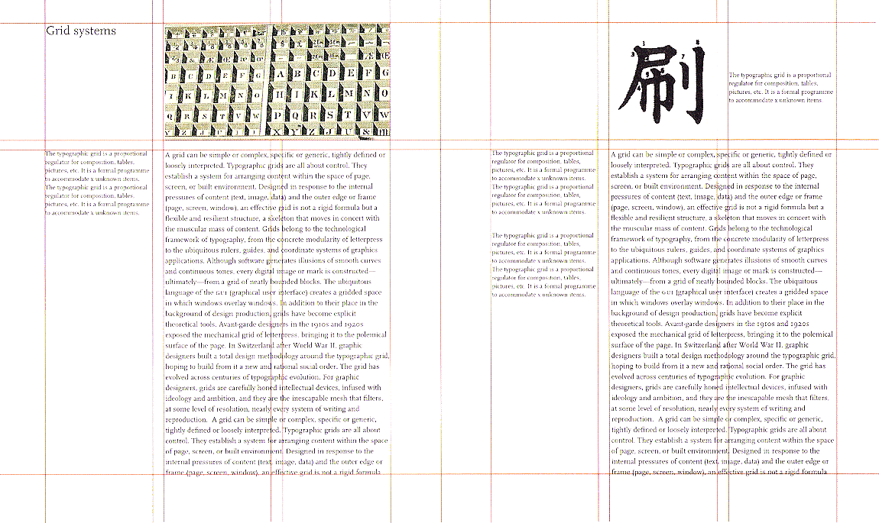
Inserting lateral divisions
Lateral divisions
occupied by specific content
i.e. images and captions

Slide 32
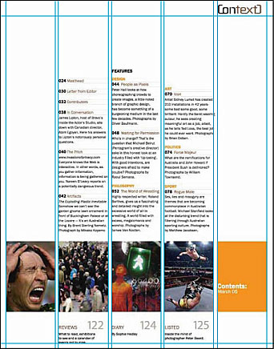
A lateral division is inserted for images at the bottom

Slide 33
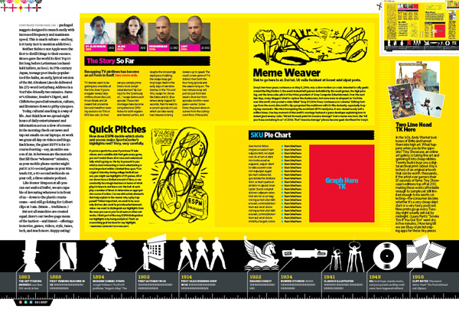
The lateral division at the bottom depicts the progress of time in this time-line

Slide 34
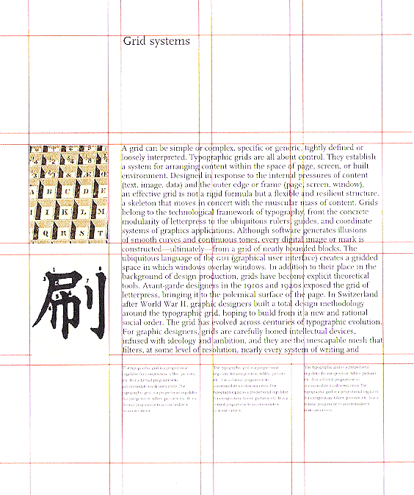
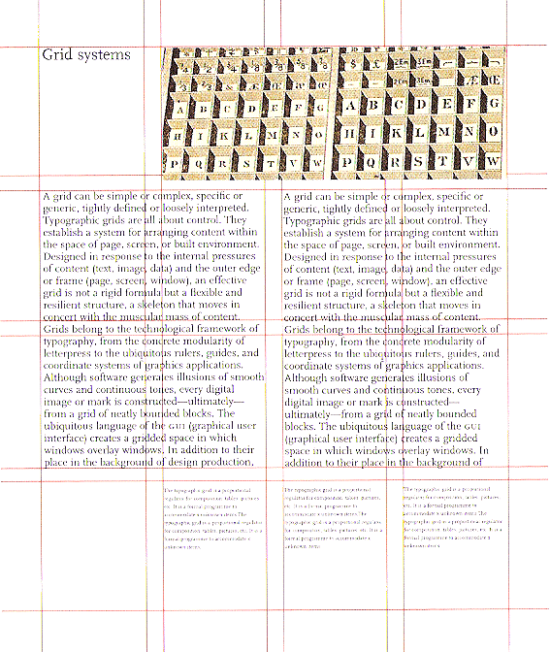
3. modular grid
uniform vertical and horizontal division
More complex layout
Allows content to be read in many different orders
Flexibility in layout

Slide 35
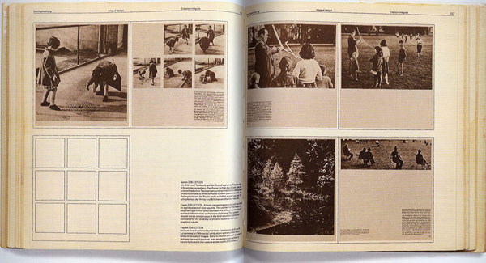
modular grid

Slide 36
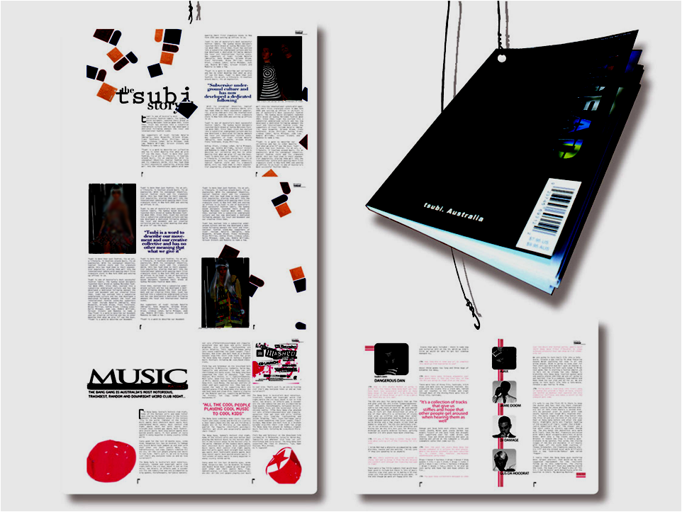
Breaks content into smaller segments

Slide 38
Segments visually separated by increasing gutter size
Wide gutter
Wide gutter
Wide gutter
Wide gutter
Wide gutter

Slide 39
Grid types

Slide 40
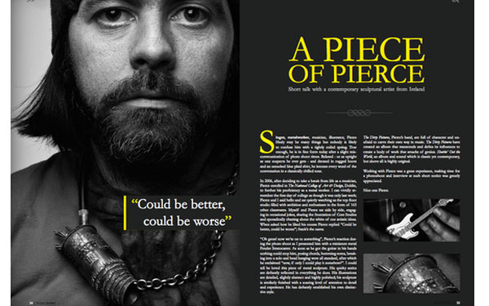

Slide 41
Inserting lateral divisions
Lateral divisions
occupied by specific content
i.e. images and captions

Slide 42
A lateral division is inserted for images at the bottom

Slide 43
The lateral division at the bottom depicts the progress of time in this time-line

Slide 44
3. modular grid
Allows content to be read in many different orders
Flexibility in layout
uniform vertical and horizontal division
More complex layout

Slide 45
modular grid

Slide 46
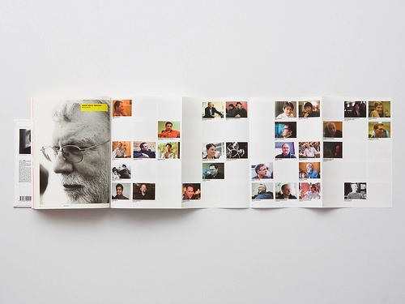

Slide 47
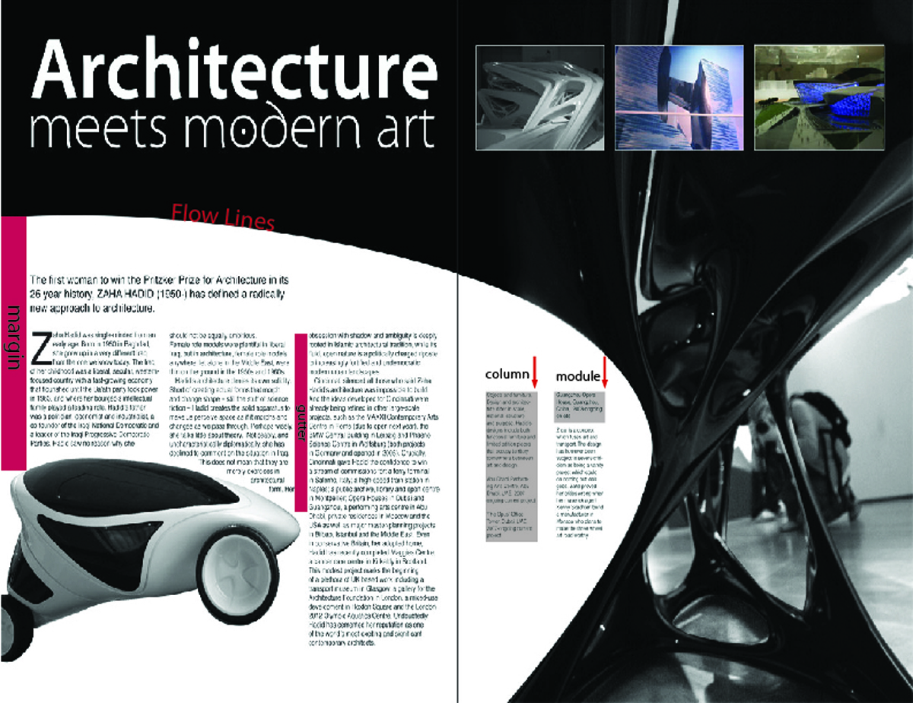

Slide 48
Assignment 2
  2 page magazine spread
  Use modular grid
  Asymmetrical layout
  Clear hierarchy, balance and consistency
  Style suits content
  You decide on magazine type.
  Images may be taken from the internet as long as they do not have any text or design elements (such as bars or lines).
  Images must be edited to seamlessly coordinate with overall design.

Slide 49
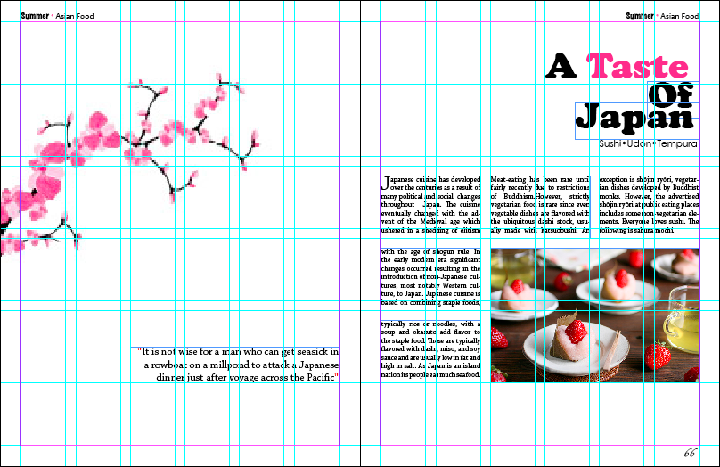

Slide 50
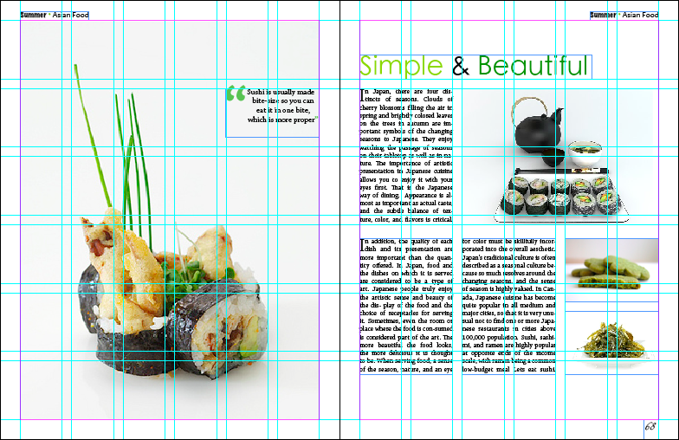

Slide 51
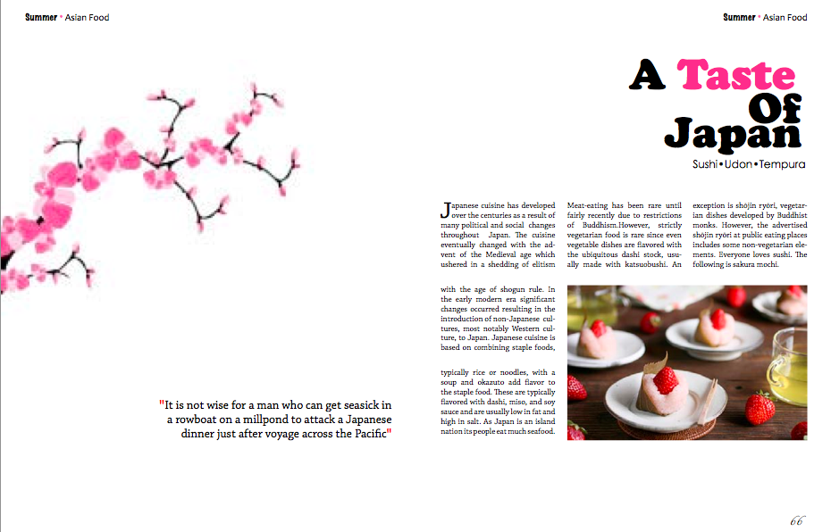

Slide 52
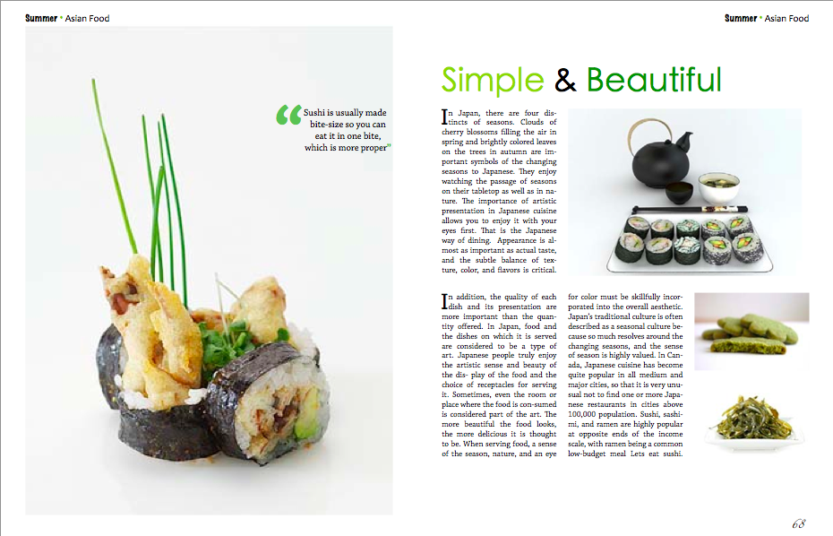

Slide 53
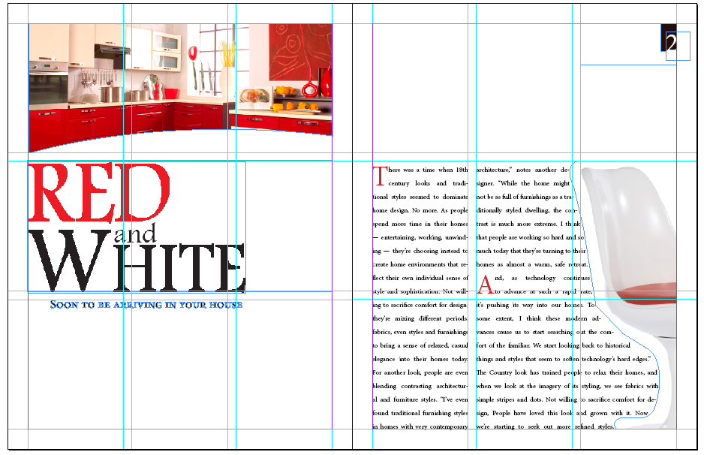
Final Draft

Slide 54
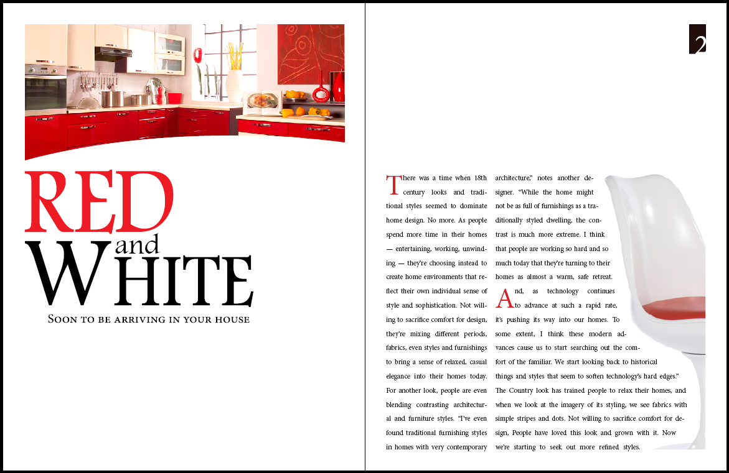

Slide 55
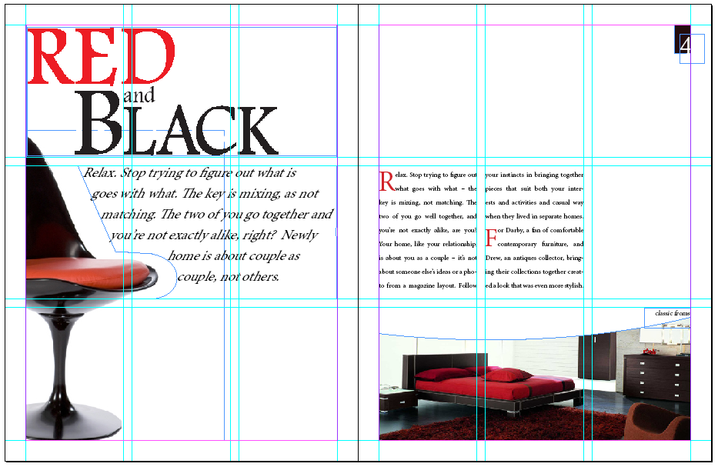
Final Draft

Slide 56


Slide 57



Final

Slide 58
fin

