Slide 1

IAT 202 New Media Images
week 11
Sequencing

Slide 2
reminders
Filming on Burnaby campus must fill out permission form http://www.sfu.ca/fs/Services/Burnaby/Filming-On-Campus.html
Final Lab will be in Theatre – exhibition of final videos. Be ready.

Slide 3
General Comments from last week storyboards
Lots of interesting concepts!
Too many locations
Too many plot points
Some neutral thinking in terms of camera (linear, no POV).
Some not clear on what you want the audience to “get out of it” or the experience you are creating for them.
Most had a good variation in shots but needed to think how the shots could help build the sequence.

Slide 4
Today
Review: framing & sequencing
Q+A patterns
Triangle system - review
Experiment! – construct the experience.

Slide 5
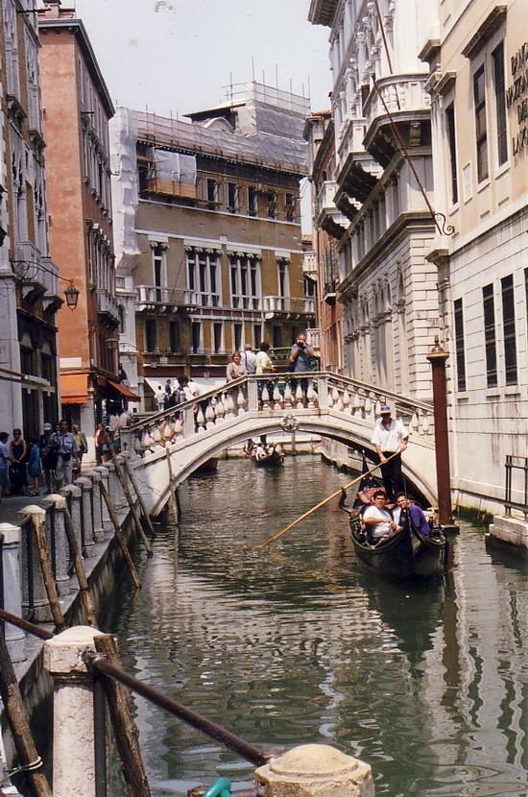
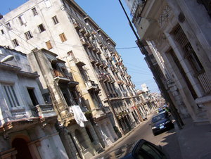
Storyboard Step 02: Clarify, intensify and interpret
informs
Dramatizes
Your Job: Clarify, intensify and interpret for your audience
Notes:
Guiding principle for turning mental pictures into creative work is clarify, intensify and interpret
Think of how you want the sequence to unfold – remember this is not a style of editing it could be continuity, it could be experimental approach, most films today do not stick to continuity editing. They are a mix.

Slide 6



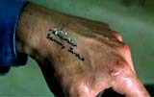
Inductive visual approach
Go from details to overview (sometimes provide overview)
Viewer uses psychological closure to explain the story
Influenced by television, music videos, new media
Faster pace for modern audience
Notes:
Show Weezer’s Pork and Beans
http://www.youtube.com/watch?v=muP9eH2p2PI
Discuss which approach is taken - deductive or inductive and why.

Slide 7
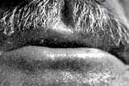
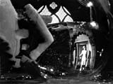
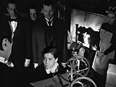
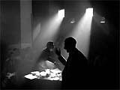
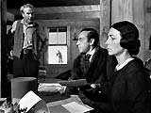
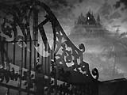
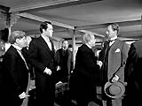
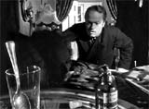
Citizen Kane (1941) – “jigsaw” editing to create a complex portrait
*close-up *strange camera angle *flash forward *high contrast lighting * optical transitions *low angle with view of ceiling * in camera matt shot
Notes:
This highly-rated classic masterpiece from director-star-producer Orson Welles brought together many cinematic and narrative techniques and experimental innovations (in photography, editing, and sound) to reconstruct the title character like building a jigsaw puzzle; the innovative, bold film is still an acknowledged milestone in the development of cinematic technique, although it 'shared' some of its techniques from many earlier films. Its components brought together the following aspects:
use of a subjective camera
unconventional lighting, including chiaroscuro, backlighting and high-contrast lighting, prefiguring the darkness and low-key lighting of future film noirs
inventive use of shadows and strange camera angles, following in the tradition of German Expressionists
deep-focus shots with incredible depth-of field and focus from extreme foreground to extreme background (also found in cinematographer Gregg Toland's earlier work in Dead End (1937), John Ford's The Long Voyage Home (1940), and Hitchcock's Rebecca (1940)) that emphasized mise-en-scene; deep-focus shots included the scene in Mrs. Kane's boarding house as young Kane played outdoors in the snow, Susan's music lesson, Kane's firing of Leland, and Susan's attempted suicide
low-angled shots revealing ceilings in sets (a technique possibly borrowed from John Ford's Stagecoach (1939) which Welles screened numerous times)
sparse use of revealing facial close-ups
elaborate camera movements
over-lapping, talk-over dialogue (exhibited earlier in Howard Hawks' His Girl Friday (1940)) and layered sound
the sound technique termed "lightning-mix" in which a complex montage sequence was linked by related sounds
a cast of characters that aged throughout the film
flashbacks, flashforwards, and non-linear story-telling (used in earlier films, including another rags-to-riches tale starring Spencer Tracy titled The Power and the Glory (1933) with a screenplay by Preston Sturges, and RKO's A Man to Remember (1938) from director Garson Kanin and screenwriter Dalton Trumbo); later adopted by many films including Pulp Fiction (1994) and Memento (2000)
the frequent use of transitionary dissolves or curtain wipes, as in the scene in which the camera ascended in the opera house into the rafters to show the workmen's disapproval of Mrs. Kane's operatic performance; also the famous 'breakfast' montage scene illustrating the disintegration of Kane's marriage in a brief time, or the dissolve when the camera passed down through the nightclub's roof coordinated with a lightning flash
the abrupt cut between the opening scene of Kane's death, and the beginning of the "News on the March" segment
long, uninterrupted shots or lengthy takes of sequences
continuity editing, such as the scene of Kane's anger by Susan's departure; also montage (or discontinuity) editing, such as Susan's opening night opera performance

Slide 8

Q&A Pattern
Notes:
Question and answers continuity:
Temporal connections – dropping a glass cut to it smashing.
Spatial – Wide shot of a house cut to detail
Logical connection: White house – president in an office (assume it is in the white house).
These are very simple spatial question – only used
However can be more complicated – know glass was poisoned. That he is sick. ….
Provoked into asking: who , what , when , where & why.
Eisenstein
Eisenstein’s dialectical shot pattern of thesis-antithesis-synthesis. “thesis-antithesis-synthesis” – first two shots ask a questions and the third answeres.
The triad is usually described in the following way:
The thesis is an intellectual proposition.
The antithesis is simply the negation of the thesis, a reaction to the proposition.

Slide 9
Question and Answer Editing
- storyboard refinement
Thinking in terms of how the larger sequence interacts rather then of the pictorial elements of a shot.
What does the audience need to know and when do they need to know it.
Question and answer patterns can be simple (2 shots) or take dozens of shots to play out.
Think in terms of an overlapping sequence of events rather then a connected group of shots.

Slide 10
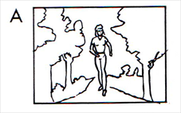
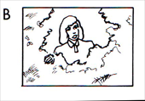
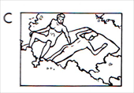
Q+A example one
Film directing Shot by Shot pg. 148
Shot A: Laura Enters woods. Q: Where is Tom?
Shot B: Laura stops a few yards from the clearing. Q: What has she found
Shot C: Tom and a girl lying naked on a blanket. Answer: Laura has found her brother.
Notes:
Straight forward. Viewer can anticipate outcome.

Slide 11
Q+A example two
Shot A: Laura Enters woods. Q: Where is Tom?
Shot C: Tom and a girl lying naked on a blanket. Answer: Tom is here. New question: Will Laura find Tom?
Shot B: Laura stops a few yards from the clearing. Answer: Laura has found tom.
Notes:
Prolong time to find, viewer and filmaker share a secrete (where Tom is). Hitchcock often used this to build tension (privileged information).

Slide 12
Q+A example three
Shot C: Tom and a girl lying naked on a blanket. Answer: Tom is here.
Shot A: A girl enters woods. Q: Is this Laura?
Shot B: Laura stops a few yards from the clearing. Answer: This is Laura
Notes:
Reveals Tom in a compromising situation, a suspenseful situation is created. Audience is in a privileged position (Hitchcock often did this).

Slide 13
Motivated Editing
Cause and effect
The reader is provoked into speculation by the order and the manner in which the plot is revealed even though the same basic events are being represented.
Question and answer is often set-up in a way that causes reader participation.
Question may be answered through the accumulation of information over several shots.

Slide 14
Q+A variations
Rhythm and timing of the patterns can be varied by with holding some or all of the expected narrative information for a few shots or for several scenes.
Question can be asked and then answer postponed.
Can be reversed. Show an event and then cut to “look”
Can create the question over several frames e.g.“who is this person” (several close-ups). The question could be a combined question “who are they and why are they there?”.
The question can build in complexity rather then be answered. For eample Who is this person, why is ink spilled on the flour, what is the drink glass, what were they reading…
Used by many directors (Berman, Kurosawa, Dreyer…) to implicate the viewer in the moral dilemmas of the character.

Slide 15




Expressive shots: Jump Cuts
An abrupt edit, cutting from one shot to another almost exactly like it. Very jarring to the viewer. (Sometimes this jarring quality is a deliberate choice on the part of the filmmaker; see the examples below.)

Slide 16
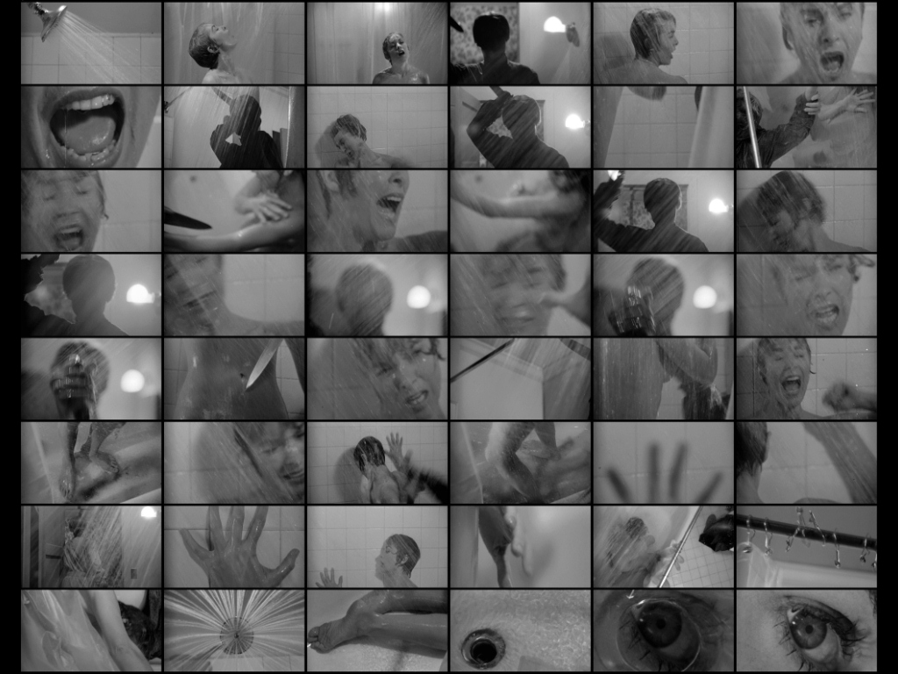
Expressive shots: Montage

Slide 17
Walter Murch: The Rule of Six
Emotion 51%
Story 23%
Rhythm 10%
Eye-Trace 7%
Two-dimensional plane of screen (stage line) 5%
Three-dimensional space of action 4%
“What they (the audience) finally remember is not the editing,
not the camerawork, not the performance, not even the story–
it’s how they felt”
-Walter Murch (p. 18)
Notes:
From: Walter Murch. In the Blink of an Eye: A Perspective on Film Editing (2nd edition). TR 899 M87 2001
The Rule of Six (pp. 17-20)
The two chapters from In the Blink of an Eye have been scanned and are available as PDF in files. Use as basis for discussion.

Slide 18
Student Examples

Slide 19
Short Films
Drift: http://www.bbc.co.uk/filmnetwork/films/p00bzm8g
    I drift, half awake, half asleep. Moving through the city I recall but have never been to.
A Jump From a Platform: http://www.bbc.co.uk/filmnetwork/films/p004r6xc
  A pause in an untouchable moment
Adjustment:http://www.bbc.co.uk/filmnetwork/films/p006dc5l
  A diarist searches for flickers of hope in a drama of emotional and technical obsession.
On Miles Platting Station:http://www.bbc.co.uk/filmnetwork/films/p005bq9z
  A mixed-media animated adaptation of Simon Armitage's poem 'On Miles Platting Station'.
Nachtmaschine :http://www.bbc.co.uk/filmnetwork/films/p004r6wj
  Night vs. light, music vs. motion, figuration vs. abstraction.
10000 photos of you
Notes:
I drift, half awake, half asleep. Moving through the city I recall but have never been to.
"Architecture is the simplest means of articulating time and space, of modulating reality, of engendering dreams" Ivan Chtcheglov
This film was made using a digital stills camera to create a stop motion animation.
"A Jump From a Platform" is part of personal research trying to touch feelings with an audiovisual medium. With a free association of sources, I tried to mix my personal story with a more universal feeling.

Slide 20
Short Films
http://www.emilyhenricks.com/
http://www.surfacefilm.com/
Everything Turns: http://www.bbc.co.uk/filmnetwork/films/p0056bjn
  Life makes your head spin, and before you know it, it's over. A very short film about time, life and death. Inspired by Durs Grünbein's poem Vertigo.
Snap: http://www.youtube.com/watch?v=NmxX2r-uD8I&feature=related
Ah Pook Is Here: Music from the album "William S. Burroughs - Dead City Radio" Track 4 - "Ah Pook The Destroyer / Brion Gysin's All-Purpose Bedtime Story" http://www.youtube.com/watch?v=2C5XuylNFLo
The Man with the Beautiful Eyes: Based on Charles Bukowski's poem, a group of children are attracted towards the dilapidated home of an outcast. http://www.youtube.com/watch?v=n9WI9Zn0lRs
http://www.1stavemachine.com/#/home

Slide 21
Short Films
http://www.oscars.org/awards/saa/index.html
http://www.niceshorts.com.au/ (elephant)
http://www.hillmancurtis.com/index.php?/film/view/short_films/

Slide 22

Q&A Analysis
http://vimeo.com/2554266

Slide 23
Student Examples
www.sfu.ca/iatwork/202

