Slide 1
Brain Storming
From reading “logo design love”

Slide 2
Mind-mapping
Mind-mapping is particularly useful in the design profession
because it’s very effective for working through these important
steps of the design process:
  Collecting your thoughts
  Generating ideas
  Getting into a creative groove
  Associating words with images

Slide 3
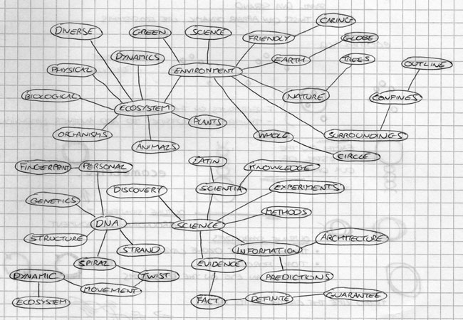
Don’t edit yourself put down all ideas. Highlight the good ones as you go.

Slide 4
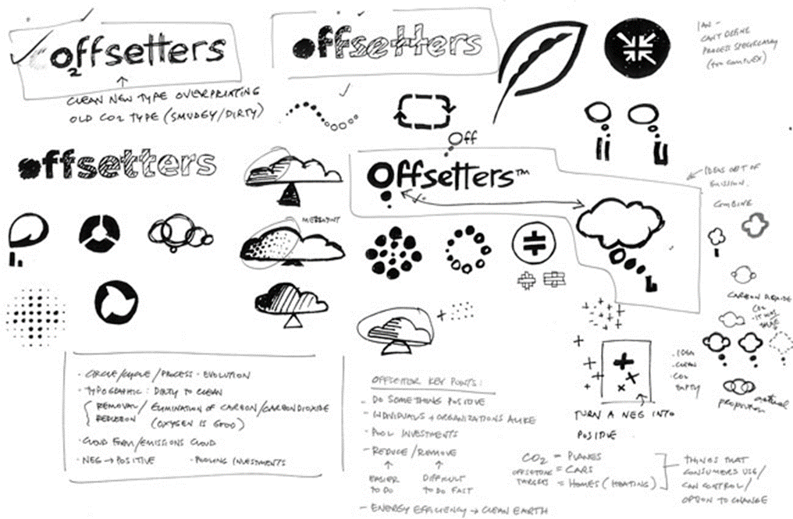
Sketch
Sketch out your ideas, even the far fetched ones. These should be quick, remember these are not finished works.

Slide 5
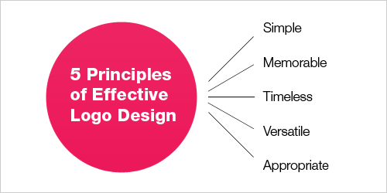
http://www.smashingmagazine.com/2009/08/26/vital-tips-for-effective-logo-design/

Slide 6
Ask yourself, is your logo still effective if it is printed…
In one color?
In reverse color (i.e. light logo on dark background)?
The size of a postage stamp?
As large as a billboard?
http://www.smashingmagazine.com/2009/08/26/vital-tips-for-effective-logo-design/

