Slide 1
Project 2: considerations

Slide 2
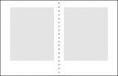
Margins – general rules
Don't use the same page margins on all sides
Make inside margins smaller than outside margins (half of outside margins VISUALLY) You may need more space to account for binding.
Use a larger bottom margin. Make the top margin half the size of the bottom margin.
Notes:
Designing with Margins Margins have several functions.
Visually, they keep the text and graphics from "falling off the page" by providing a buffer zone.
They give the eye a break or resting place, even in densely set type.
On the practical side, margins leave space for the reader to hold the material without obscuring the text with fingers or thumbs.
In manuals, workbooks, and textbooks, ample margins give the reader space for making notes.
They allow for binding the material with staples, three ring binders, or other methods.
In general, with books and ad layouts, the more space devoted to margins compared to the text and graphics, the more formal the design. Minimalist designs with little text, simple graphics, and generous margins can convey elegance, simplicity, or richness depending on other elements of the design.
Skimpy margins suggest "mass produced." These tight margins are found in paperback novels, newspapers, and phone books and came about due to cost restraints and the desire to get as much information as possible into a small amount of space. We've grown so accustomed to this format that more generous margins in similar publications might seem odd and disconcerting even if it did improve readability.

Slide 3
Margins – general rules
Make the top margin half the size of the bottom margin.
outside margin two-thirds bottom margin.
Inside one third of bottom
Bottom margin is double top margin
Tip 6pO (picas = 1 inch)
Notes:
Designing with Margins Margins have several functions.
Visually, they keep the text and graphics from "falling off the page" by providing a buffer zone.
They give the eye a break or resting place, even in densely set type.
On the practical side, margins leave space for the reader to hold the material without obscuring the text with fingers or thumbs.
In manuals, workbooks, and textbooks, ample margins give the reader space for making notes.
They allow for binding the material with staples, three ring binders, or other methods.
In general, with books and ad layouts, the more space devoted to margins compared to the text and graphics, the more formal the design. Minimalist designs with little text, simple graphics, and generous margins can convey elegance, simplicity, or richness depending on other elements of the design.
Skimpy margins suggest "mass produced." These tight margins are found in paperback novels, newspapers, and phone books and came about due to cost restraints and the desire to get as much information as possible into a small amount of space. We've grown so accustomed to this format that more generous margins in similar publications might seem odd and disconcerting even if it did improve readability.

Slide 4
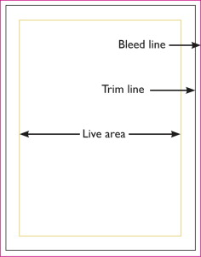
Margins – example
Notes:
Designing with Margins Margins have several functions.
Visually, they keep the text and graphics from "falling off the page" by providing a buffer zone.
They give the eye a break or resting place, even in densely set type.
On the practical side, margins leave space for the reader to hold the material without obscuring the text with fingers or thumbs.
In manuals, workbooks, and textbooks, ample margins give the reader space for making notes.
They allow for binding the material with staples, three ring binders, or other methods.
In general, with books and ad layouts, the more space devoted to margins compared to the text and graphics, the more formal the design. Minimalist designs with little text, simple graphics, and generous margins can convey elegance, simplicity, or richness depending on other elements of the design.
Skimpy margins suggest "mass produced." These tight margins are found in paperback novels, newspapers, and phone books and came about due to cost restraints and the desire to get as much information as possible into a small amount of space. We've grown so accustomed to this format that more generous margins in similar publications might seem odd and disconcerting even if it did improve readability.

Slide 5
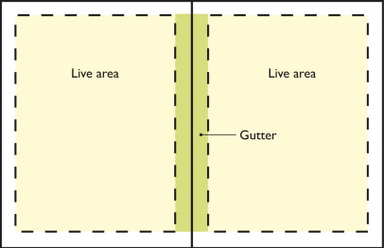
Margins – example
Notes:
Designing with Margins Margins have several functions.
Visually, they keep the text and graphics from "falling off the page" by providing a buffer zone.
They give the eye a break or resting place, even in densely set type.
On the practical side, margins leave space for the reader to hold the material without obscuring the text with fingers or thumbs.
In manuals, workbooks, and textbooks, ample margins give the reader space for making notes.
They allow for binding the material with staples, three ring binders, or other methods.
In general, with books and ad layouts, the more space devoted to margins compared to the text and graphics, the more formal the design. Minimalist designs with little text, simple graphics, and generous margins can convey elegance, simplicity, or richness depending on other elements of the design.
Skimpy margins suggest "mass produced." These tight margins are found in paperback novels, newspapers, and phone books and came about due to cost restraints and the desire to get as much information as possible into a small amount of space. We've grown so accustomed to this format that more generous margins in similar publications might seem odd and disconcerting even if it did improve readability.

Slide 6
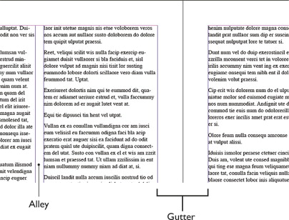
Margins – example
Notes:
Designing with Margins Margins have several functions.
Visually, they keep the text and graphics from "falling off the page" by providing a buffer zone.
They give the eye a break or resting place, even in densely set type.
On the practical side, margins leave space for the reader to hold the material without obscuring the text with fingers or thumbs.
In manuals, workbooks, and textbooks, ample margins give the reader space for making notes.
They allow for binding the material with staples, three ring binders, or other methods.
In general, with books and ad layouts, the more space devoted to margins compared to the text and graphics, the more formal the design. Minimalist designs with little text, simple graphics, and generous margins can convey elegance, simplicity, or richness depending on other elements of the design.
Skimpy margins suggest "mass produced." These tight margins are found in paperback novels, newspapers, and phone books and came about due to cost restraints and the desire to get as much information as possible into a small amount of space. We've grown so accustomed to this format that more generous margins in similar publications might seem odd and disconcerting even if it did improve readability.

Slide 7
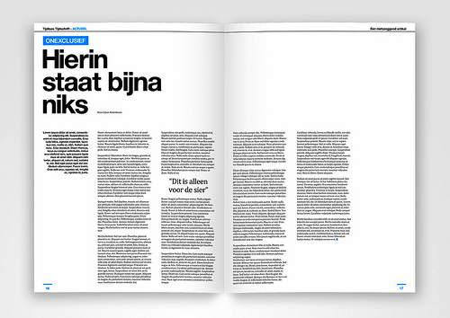
Margins – modern
Notes:
Designing with Margins Margins have several functions.
Visually, they keep the text and graphics from "falling off the page" by providing a buffer zone.
They give the eye a break or resting place, even in densely set type.
On the practical side, margins leave space for the reader to hold the material without obscuring the text with fingers or thumbs.
In manuals, workbooks, and textbooks, ample margins give the reader space for making notes.
They allow for binding the material with staples, three ring binders, or other methods.
In general, with books and ad layouts, the more space devoted to margins compared to the text and graphics, the more formal the design. Minimalist designs with little text, simple graphics, and generous margins can convey elegance, simplicity, or richness depending on other elements of the design.
Skimpy margins suggest "mass produced." These tight margins are found in paperback novels, newspapers, and phone books and came about due to cost restraints and the desire to get as much information as possible into a small amount of space. We've grown so accustomed to this format that more generous margins in similar publications might seem odd and disconcerting even if it did improve readability.

Slide 8
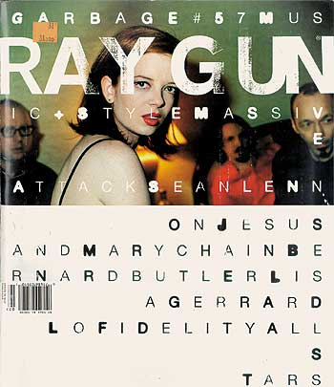
Margins – bleed image
Notes:
Designing with Margins Margins have several functions.
Visually, they keep the text and graphics from "falling off the page" by providing a buffer zone.
They give the eye a break or resting place, even in densely set type.
On the practical side, margins leave space for the reader to hold the material without obscuring the text with fingers or thumbs.
In manuals, workbooks, and textbooks, ample margins give the reader space for making notes.
They allow for binding the material with staples, three ring binders, or other methods.
In general, with books and ad layouts, the more space devoted to margins compared to the text and graphics, the more formal the design. Minimalist designs with little text, simple graphics, and generous margins can convey elegance, simplicity, or richness depending on other elements of the design.
Skimpy margins suggest "mass produced." These tight margins are found in paperback novels, newspapers, and phone books and came about due to cost restraints and the desire to get as much information as possible into a small amount of space. We've grown so accustomed to this format that more generous margins in similar publications might seem odd and disconcerting even if it did improve readability.

Slide 9

Alignment - classical

Slide 10
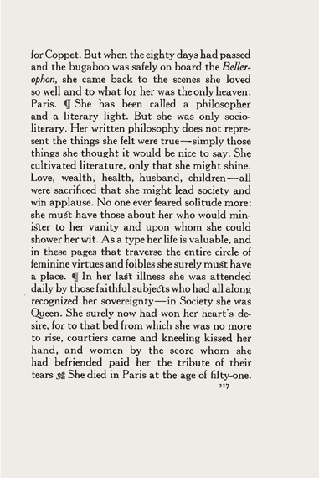
Alignment – justified

Slide 11
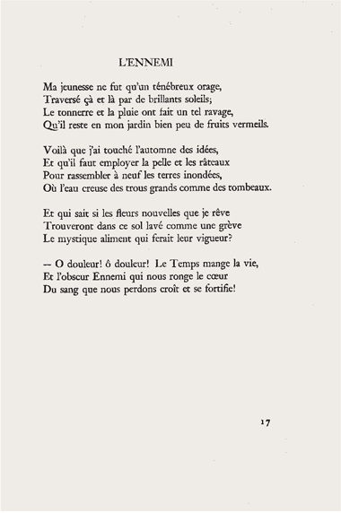
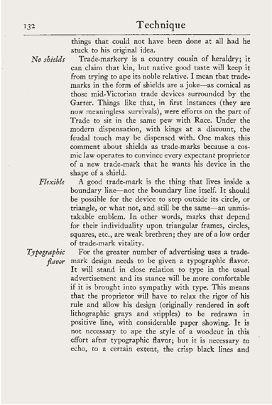
left & right justified

Slide 12
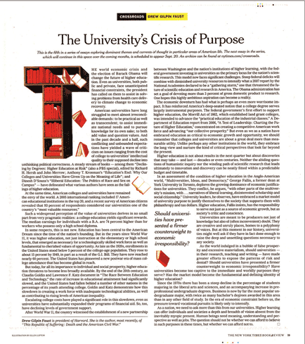
Drop Capital

Slide 13
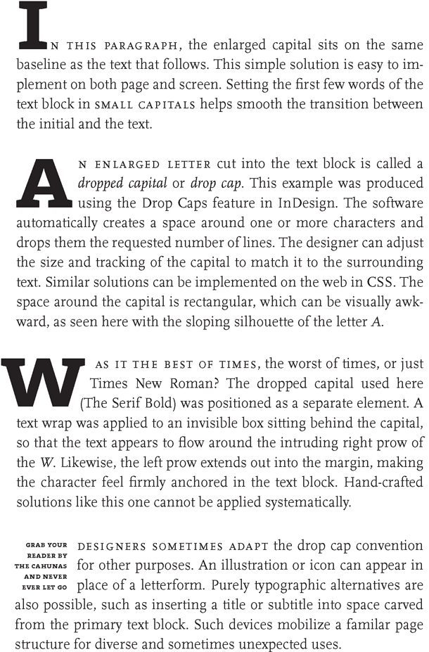

Slide 14
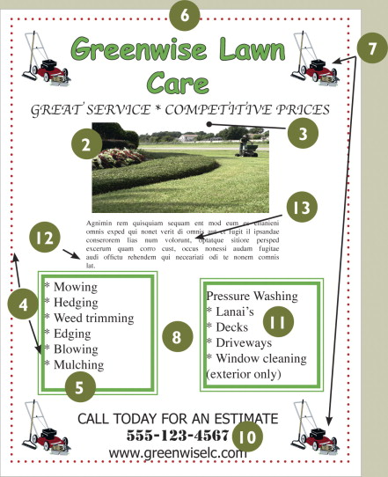
1. Things That Blink. Incessantly.
2. Warped Photos
3. Naked Photos
4. Bulky Borders & Boxes
5. Cheated Margins
6. Centering Everything
7. 4 Corners & Clutter
8. Trapped Negative Space
9. Busy Backgrounds
10. Tacky Type Emphasis
11. Bad Bullets
12. Widows & Orphans
13. Justified Rivers
White Space is Not Your Enemy
A Beginner's Guide to Communicating Visually through Graphic,
Web and Multimedia Design
Notes:
. Things That Blink. Incessantly. Keep animated repetition to a minimum.2. Warped Photos Keep photographs proportionate.3. Naked Photos Use hairline rules to border photos that have ambiguous edges.4. Bulky Borders & Boxes Use negative space to group or separate things. If you must use a border or box, choose an understated one.5. Cheated Margins Be generous with margins, including inset and offset for text and picture boxes.6. Centering Everything Avoid centered layouts.7. 4 Corners & Clutter Clutter: Bad. Clumping: Good.
Full-size image (92K) View Within Chapter
8. Trapped Negative Space Push extra negative space to the outside edges of your layout.9. Busy Backgrounds Design backgrounds as negative space. Save tiling for the bathroom.10. Tacky Type Emphasis Think twice about reversing, stroking, using all caps or underlining.11. Bad Bullets Use real bullets for lists, and use hanging indents to properly align lists.12. Widows & Orphans Avoid inelegant breaks at the bottoms and tops of legs of type.13. Justified Rivers Avoid unsightly rivers of negative space flowing through legs of justified type.

Slide 15
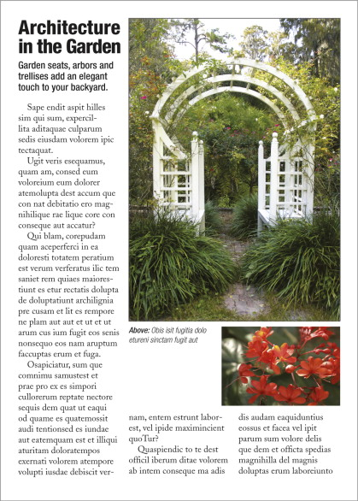
Sin No. 8: Trapped Negative Space

Slide 16
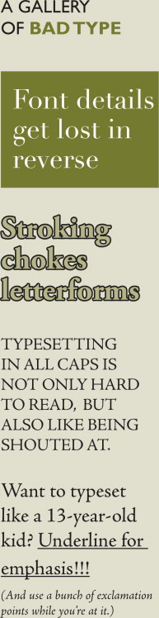
Tacky Type Emphasis: Reversing, Stroking, Using All Caps & Underlining

Slide 17
Final Considerations
Asymmetrical Balance
Rule of thirds / Golden Mean
White Space
Leave room between elements – don’t squish images or blocks of text
Alignment – follow your grid
Visual hierarchy.
Hint** course connection the principles of design were covered in IAT 100 project 1, these skills are transferable. Think of your design like a beautiful picture not isolated elements.

