Slide 1
Notes:
intro slide

Slide 2
Notes:
examples

Slide 3
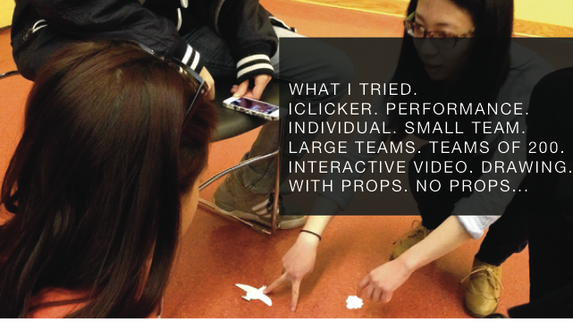
Notes:
review of core concepts

Slide 4


Slide 5
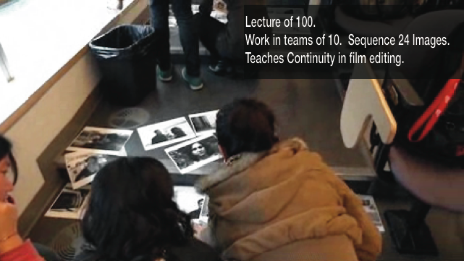

Slide 7


Slide 8
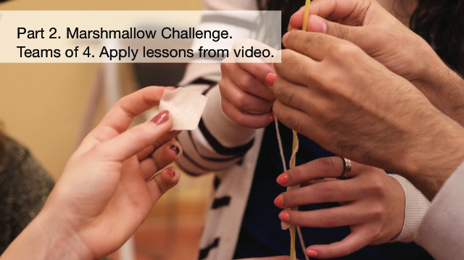

Slide 9
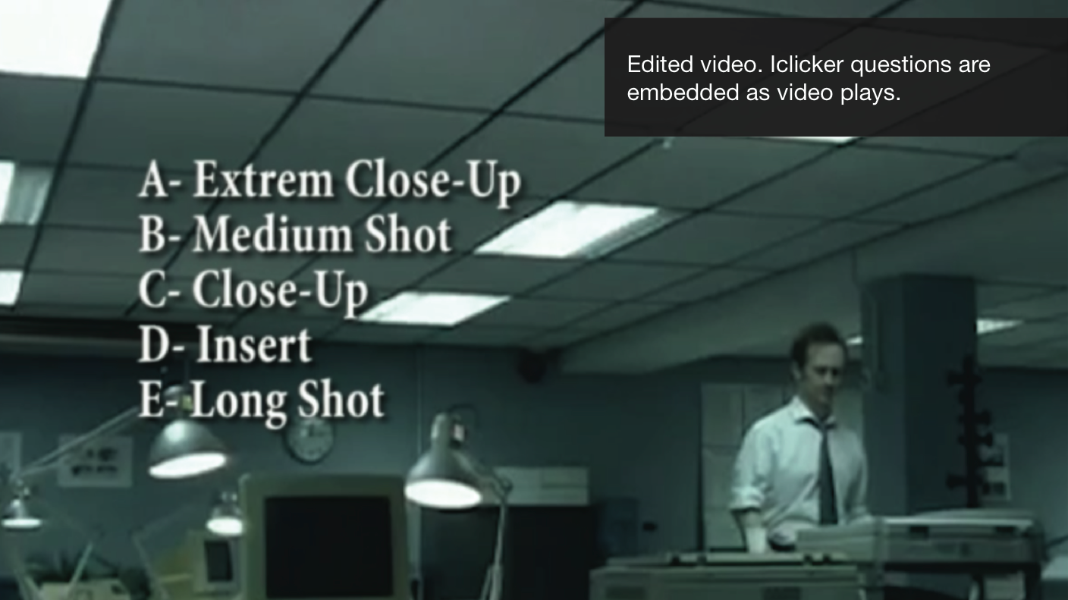

Slide 10


Slide 12
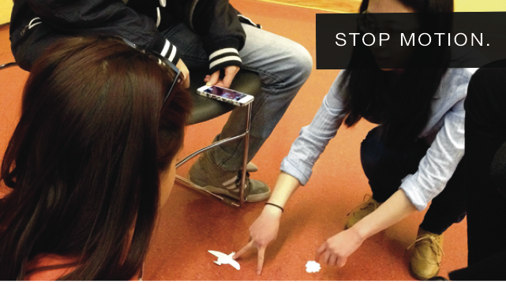

Slide 13


Slide 14


Slide 15


Slide 16


Slide 17


Slide 18


