Slide 1
Notes:
intro slide

Slide 2
Notes:
examples

Slide 3
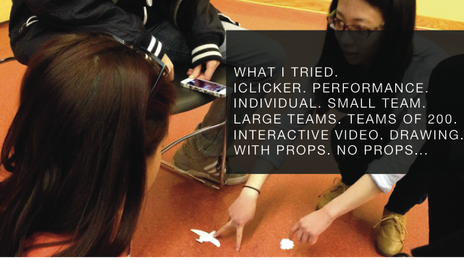
Notes:
review of core concepts

Slide 4


Slide 5
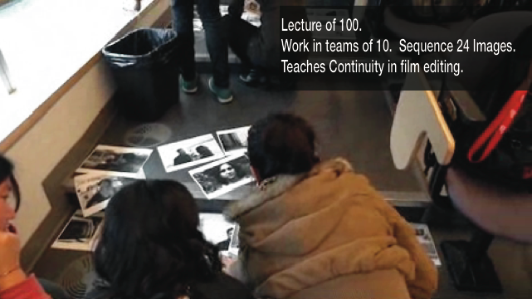

Slide 7


Slide 8
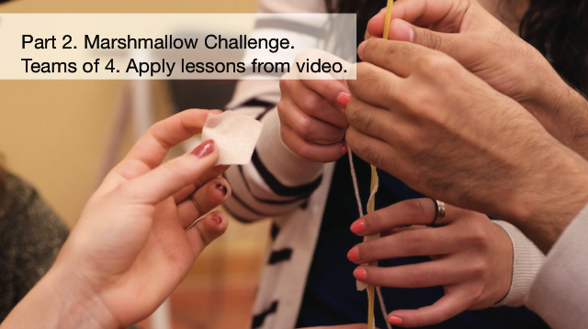

Slide 9
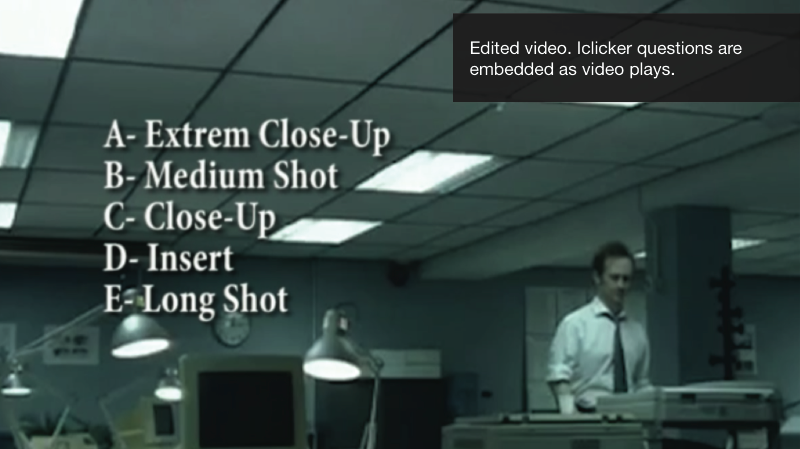

Slide 10


Slide 12
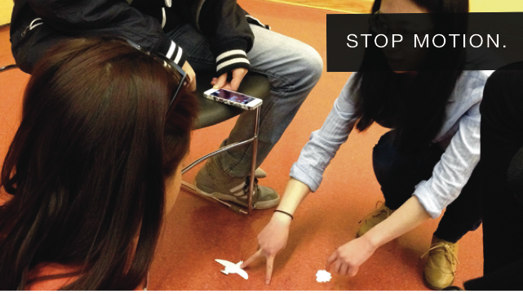

Slide 13


Slide 14
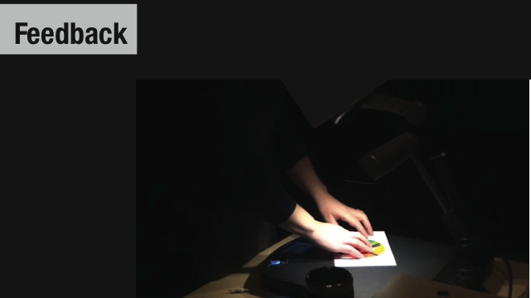

Slide 15


Slide 16


Slide 17


Slide 18
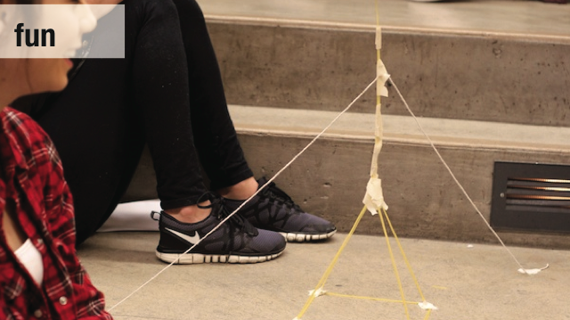

Slide 19
Notes:
Go through example from we

Slide 20
www.studiolecture.com

Slide 21
TRIGGER
Write down: What is missing for me?
Q.1
Notes:
This is the driver. What do you want to see happening in the class room. What is going to make it an exciting environment to teach in.

Slide 22
INSPIRATION
Write down: Is there somewhere in my teaching / learning
life/ that I can use as a model? .
Q.2
Notes:
Is there something in your field you can model as practice? For me, I came out of small group critique based teaching of art and design education. This cannot be reproduced in a group of 200 however aspects of engagement could. So what is it that I wanted: lively, perceptual (see it, hear it, evaluate it), problem based, invested in what was happening.

Slide 23
PICK
Write down: Identify a course, a class, and a moment in
that class.
Q.3
Notes:
What am I saying, what do I expect them to do with this information,

Slide 24
RESOURCES
Write down: 1) Space and configuration, 2) people (who can help),
3) Time
Q.4
Notes:
Started with

Slide 25
ACTIVITY
Write down: 1) Your idea. 2) What knowledge do students need to come in with. 3) Is it a team activity 4) Tell your idea to the person next to you.
Q.5
Notes:
Started with

Slide 26
MATERIALS
Write down: 1) What materials will you need? 2) Who will be responsible for providing them?
Q.6
Notes:
Started with

Slide 27
FEEDBACK
Write down: 1) How will you provide feedback?
Q.7
Notes:
Started with

Slide 28
SHARE
Share ideas with the group.
C. 1
Notes:
Started with

Slide 29
SUMMARY
Fun
Provides feedback
Build Community
Varied
Use Props
C.2
C. 2
Notes:
Started with

Slide 30
GOAL
At the end of this session you should have worked through an idea for a lecture activity.
C.2
C. 3
Notes:
Started with

