Slide 1
IAT 355 Introduction to Visual Analytics
Chris Shaw, Ph.D.
shaw@sfu.ca

Slide 2
Introductions
Instructor
Chris Shaw
shaw@sfu.ca
Graphics
Visual Analytics
Bioinformatics Visualization
Two-Handed 3D interfaces
Scientific & Information Visualization
Virtual Reality Software

Slide 3
Introductions
TA
Ankit Gupta
aga53@sfu.ca

Slide 4
Topics
Information Visualization
Representation
Presentation
Interaction
Object-Oriented Programming
Computer Graphics

Slide 5
What You Will Do
Design and Build Visualizations
Assignments
Small Project
Exam

Slide 6
Course Information
Grading
Project (2 parts) 12.5% each --> 25%
Homeworks 35%
Final Exam 40%

Slide 7
Expected Audience
People in 3rd year
Some experience with design
Some experience with building software

Slide 8
Two Levels of Design
2 Levels of Designing things:
WHAT
HOW

Slide 9
WHAT
What is WHAT?
The first design task is to figure out WHAT to design
Talk to customers,
Dream up a great idea, etc
Refine an existing design

Slide 10
HOW
What is HOW?
As one becomes more clear about WHAT, You can start to figure out HOW to design/build it.
HOW follows WHAT
(Although they may co-evolve as you learn more about the problem)
What we do at SIAT is WHAT and HOW

Slide 11
Why?
We are in a new era of human history:
Since 1994 we have witnessed an information explosion. (duh)
Everyone can get all of the data that’s out there
News, sports, financial, purchases, etc...

Slide 12
Kegs of data
Between 1.8 zettabytes of unique data produced per year
1800000000000000000000 (10²¹) bytes
300 gig for every person
Printed documents only .003% of total
Lyman and Varian, 2000
Cal-Berkeley, Info Mgmt & Systems
www.sims.berkeley.edu/how-much-info
90 trillion emails sent on the Internet in 2009

Slide 13
Unlike Before…
Used to be (20 years ago), you had to go to a library
read the info, put it on some sort of storage device, take notes, run a specialized program
On a computer 1000 times slower than today
Now:
How do we make sense of the data?
How do we harness this data in decision making processes?
How do we avoid being overwhelmed?

Slide 14
The only reasonable solution
Computing + Human Vision
Highest bandwidth sense
Fast, parallel
Pattern recognition
Extends memory and cognitive capacity
Many People think visually

Slide 15
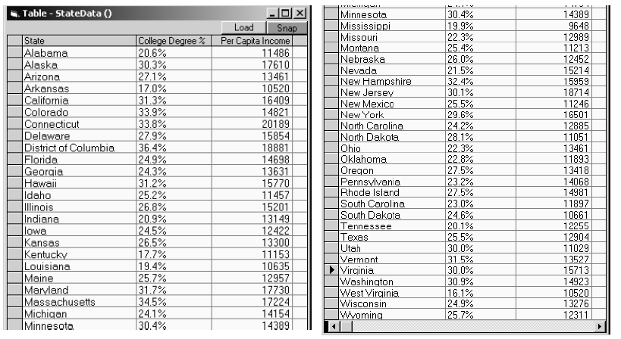
Questions:
Which state has the highest income?
Is there a relationship between income and education?
Are there any outliers?

Slide 16
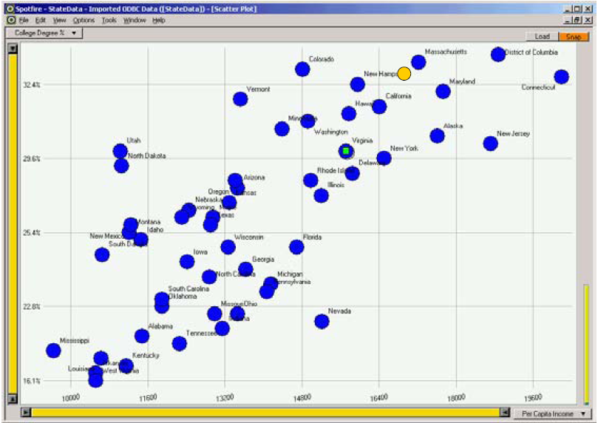
Spotfire: Visualize the data
College Degree %
Per Capita Income

Slide 17
Visualization
It’s tempting to think that Visualization is about pictures
Really, it’s a tool to help you think about a problem and learn something
A cognitive process helped by pictures
“The purpose of visualization is insight, not pictures”
Fred Brooks, quoting Claude Shannon
Insight: discovery, decision making, explanation

Slide 18
Main Idea
Visuals help us think
Provide a frame of reference, a temporary storage area
External cognition
Role of external world in thinking and reason

Slide 19
Information Visualization
What is “information”?
Items, entities, things which do not have a direct physical correspondence
Notion of abstractness of the entities is important too
Examples: baseball statistics, stock trends, connections between criminals, car attributes...

Slide 20
What is “Visualization”?
The use of computer-supported, interactive visual representations of data to amplify cognition.
From [Card, Mackinlay Shneiderman ‘98]

Slide 21
Scientific Visualization
This is a branch of Visualization that helps people understand things that have a built-in geometry.
Fluid flow past a ship hull
Volume rendering of human body
Weather in BC
Forces on a turbine blade

Slide 22
SciVis vs InfoVis
With SciVis: you have the geometry already
With InfoVis: Must create a mapping from Information to geometry
Map info to 2D or 3D space
Give the info a visual representation
Both: Enable interaction with the visual data

Slide 23
Domains of Info Vis
Text
Statistics
Financial/business data
Internet information
Linkages between various things
Software

