Slide 1
IAT 355 Introduction to Visual Analytics
Visualization Examples

Slide 2
Example Visualizations
Are these following static pictures information visualizations?
And if so, how good are they?

Slide 3
Excel

Slide 4
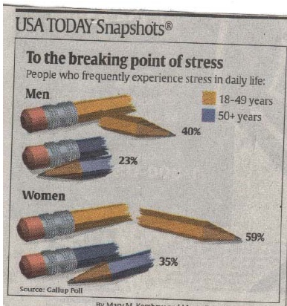
USA Today Graphics
What’s right/wrong with this pic?

Slide 5
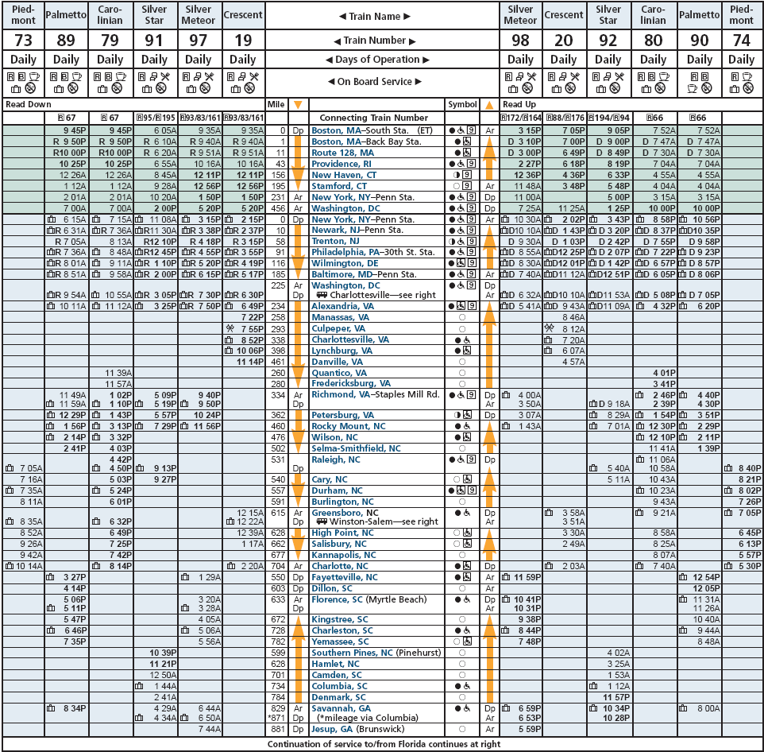
Train Schedule

Slide 6
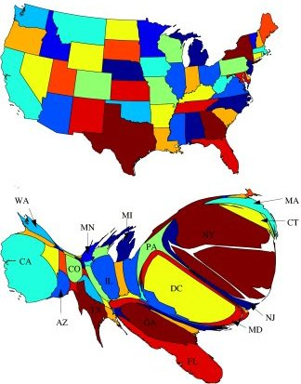
News Stories
Newman & Gastner, PNAS

Slide 7
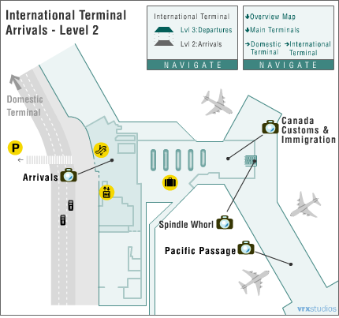
YVR
Flash Map:
Moves car!
cameras give 360 view

Slide 8
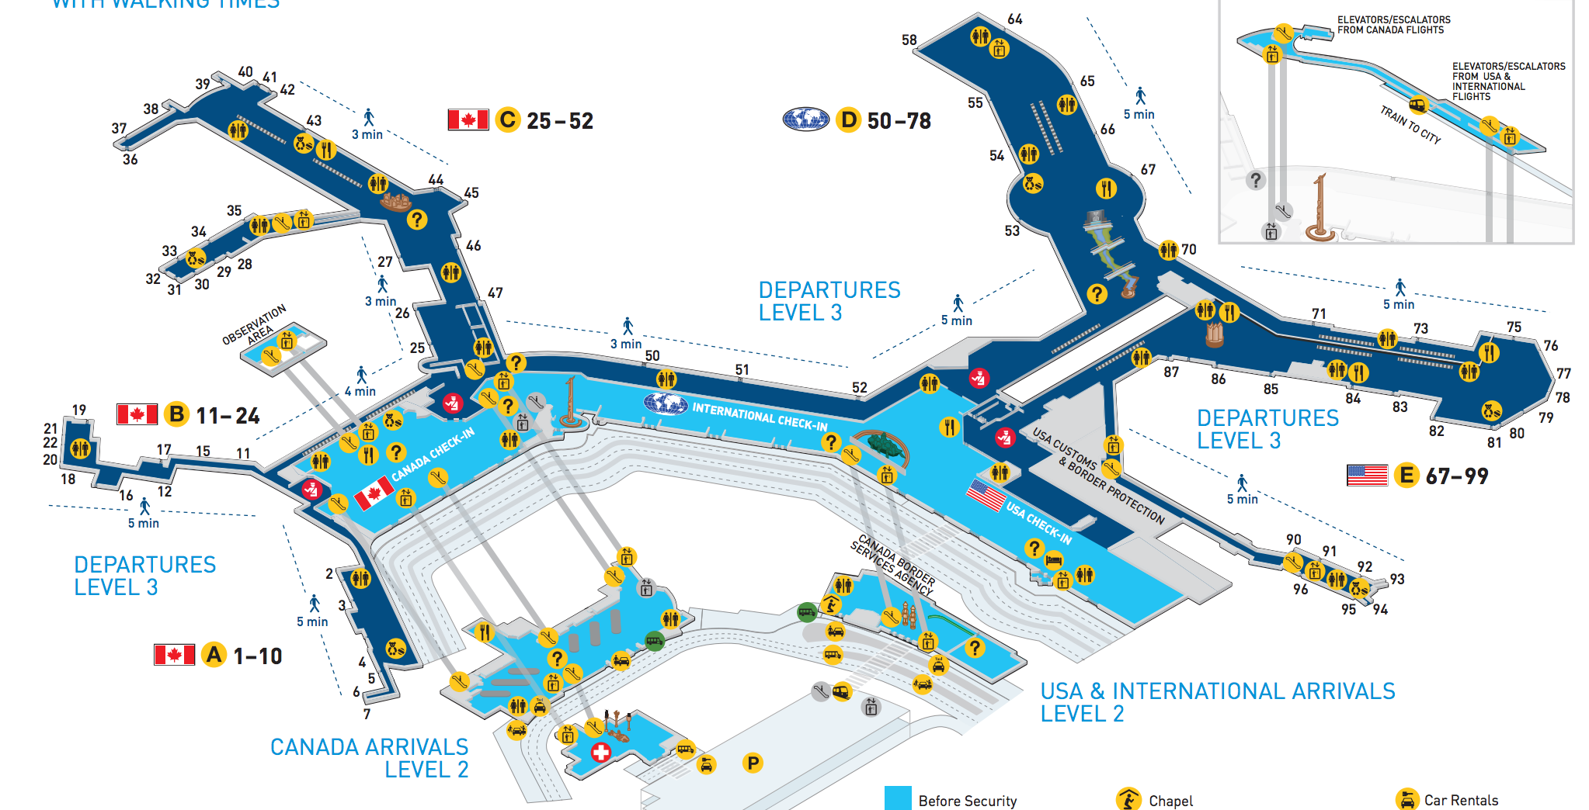
YVR Now

Slide 9
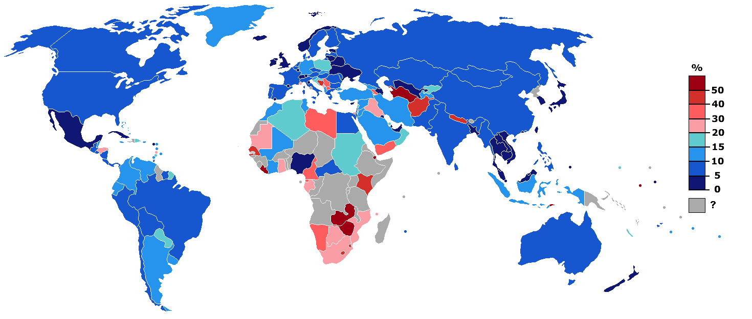
Unemployment rates

Slide 10
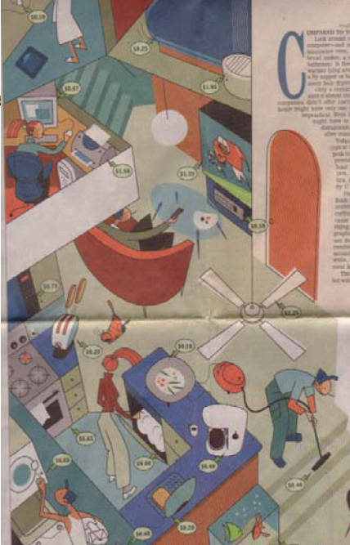
Power Costs
Average Monthly Power Costs
Wall Street Journal 2001

Slide 11
Ancient Europe
The Tabula Peutingeriana
Around 350AD (Shows Constantinople)
Shows road network of Roman Empire
Highly distorted

Slide 12
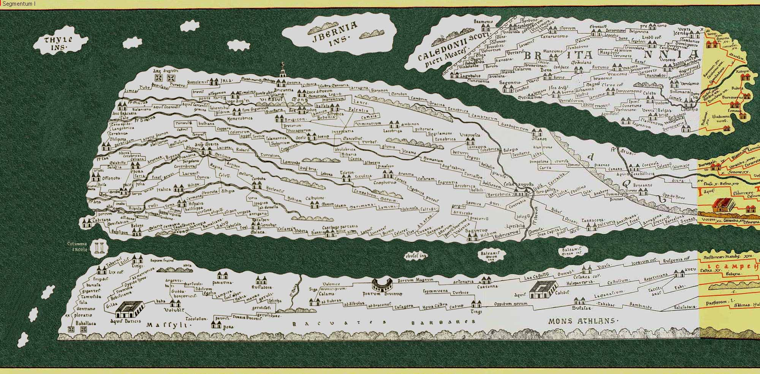
Ancient Europe

Slide 13
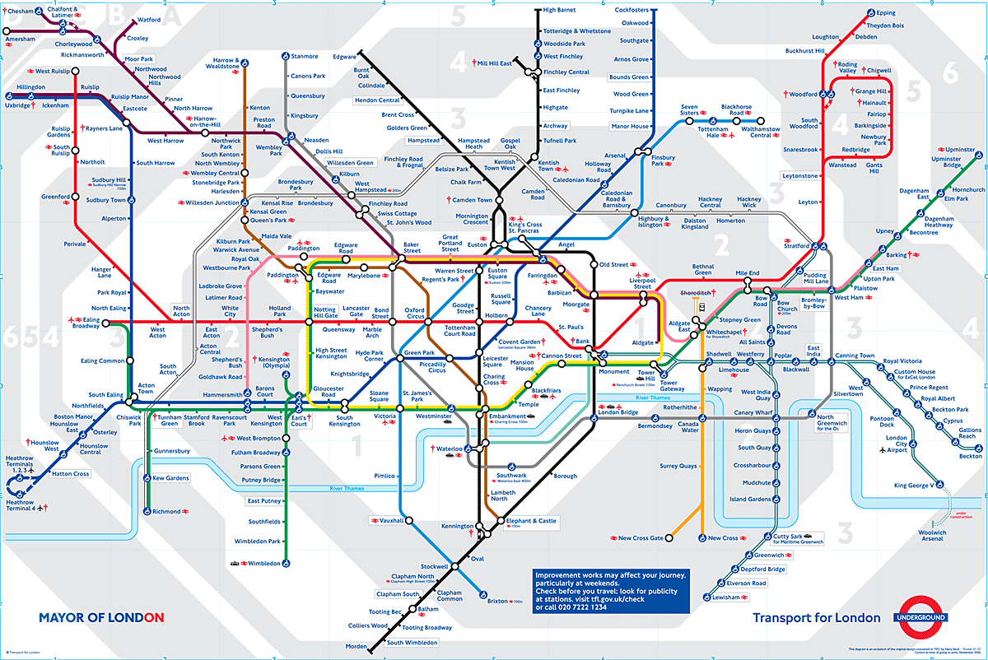
London Underground

Slide 14
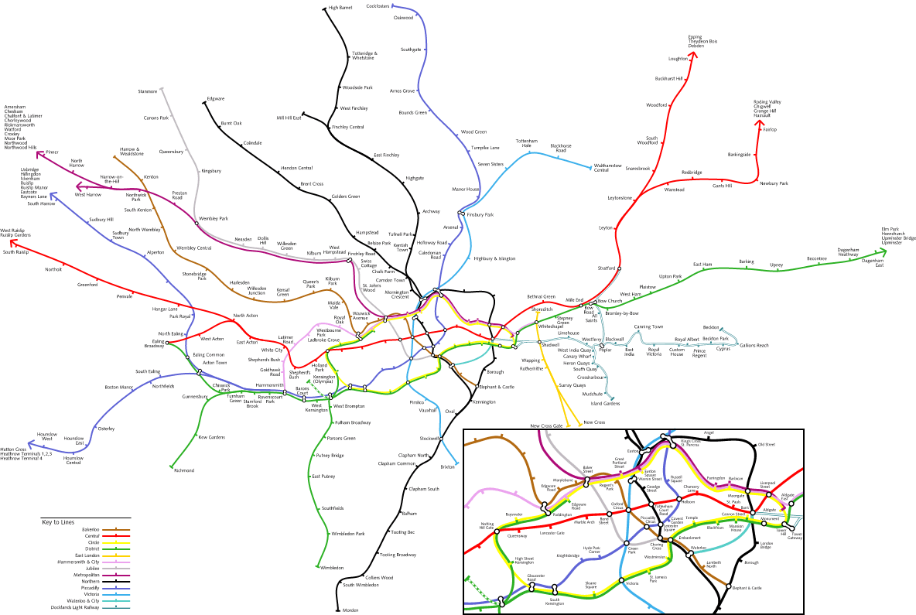
Actual Geography
www.kottke.org/plus/misc/images/tubegeo.gif

Slide 15
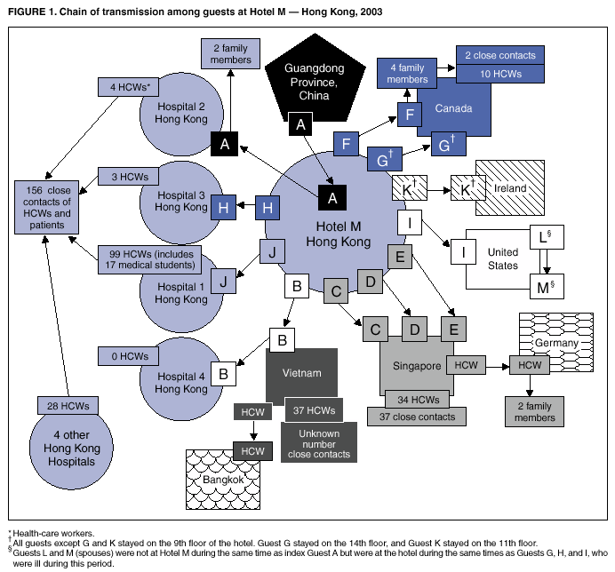
SARS 2002
www.cdc.gov/mmwr/preview/mmwrhtml/mm5212a1.htm

Slide 16
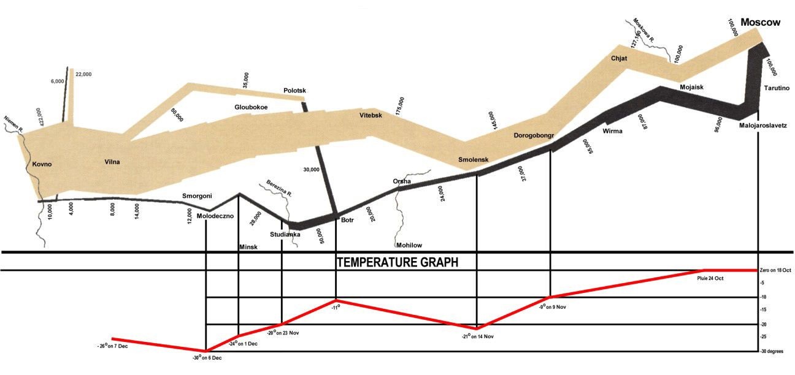
Napoleon’s Invasion of Russia
A redrawn version of Minard’s map showing some data more clearly than in the original
Source: http://www.napoleanic-literature.com, © John Schneider

Slide 17
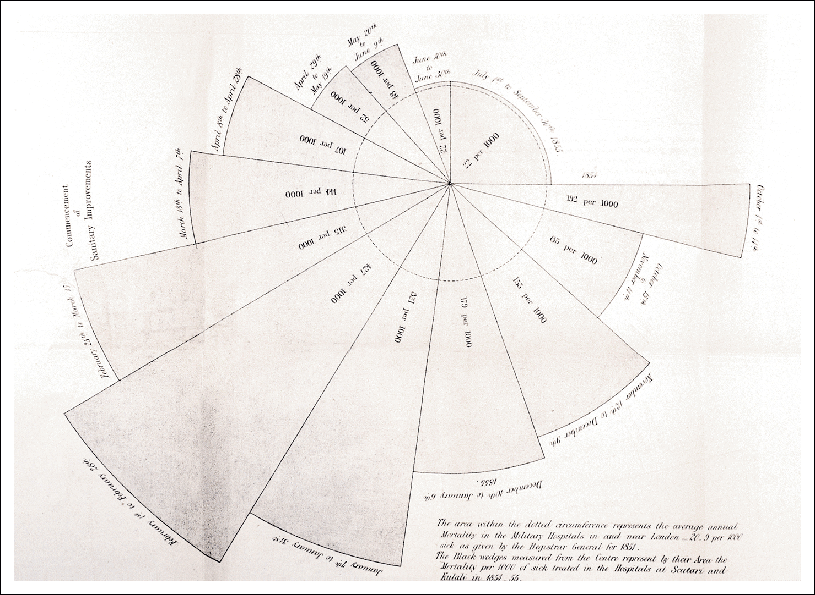
Florence Nightingale’s diagram showing the dramatic reduction in death rates in the hospitals of Scutari following the changes she introduced
Source: Nightingale (1858)

Slide 18
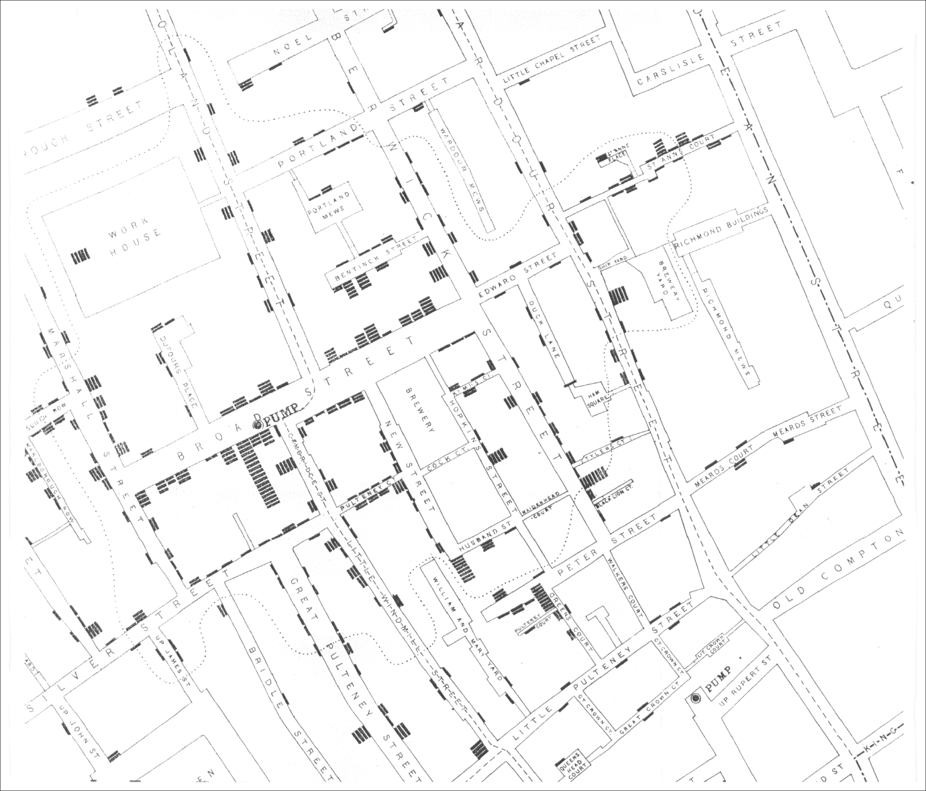
Figure 1.3 Part of John Snow’s original map in which each death from cholera is indicated by a black bar. The dotted line encloses the area that was closer to the Broad street pump (in walking distance) than to any other street pump
Source: Cholera Inquiry Committee, St. James parish. Report on the cholera outbreak in the parish of St. James, Westminster, during the autumn of 1854. London, J Churchill, 1855. Map 3. Thanks: Brock Craft

Slide 19
Figure 1.6 The process of information visualization. Graphically encoded data is viewed in order to form a mental model of that data

Slide 20
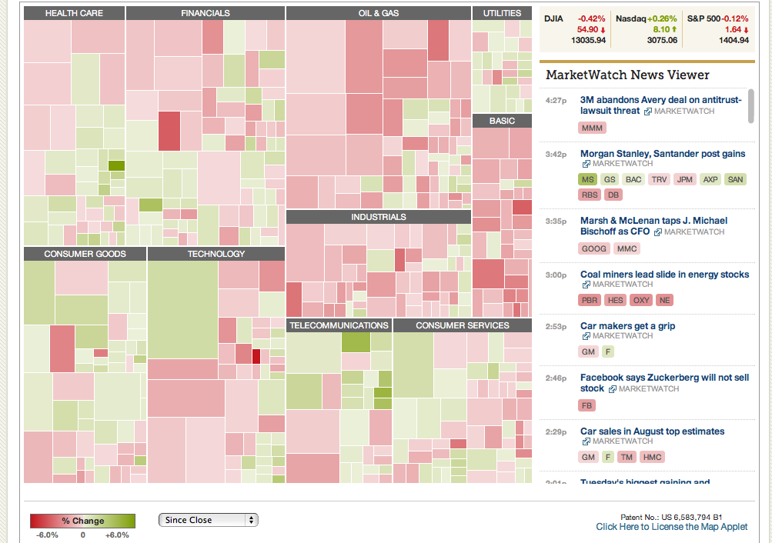
SmartMoney MarketMap
https://finviz.com/map.ashx

Slide 21
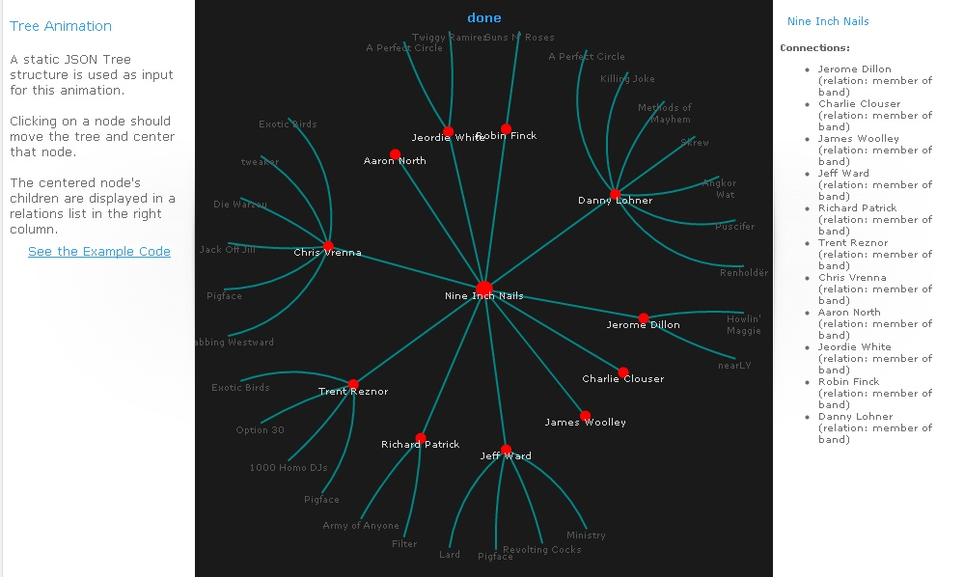
Inxight StarTree
Hyperbolic mapping of tree
http://thejit.org/static/v20/Jit/Examples/Hypertree/example1.html

Slide 22
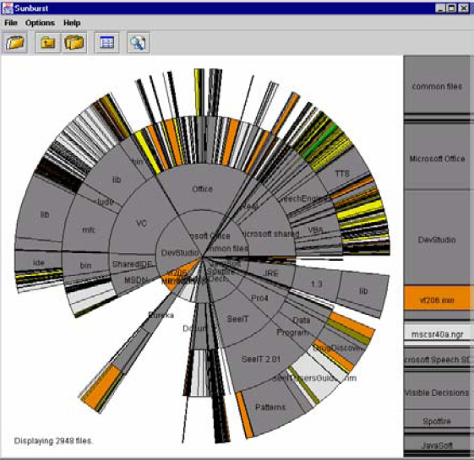
Sunburst File Browser
http://www.cc.gatech.edu/gvu/ii/sunburst/

Slide 23
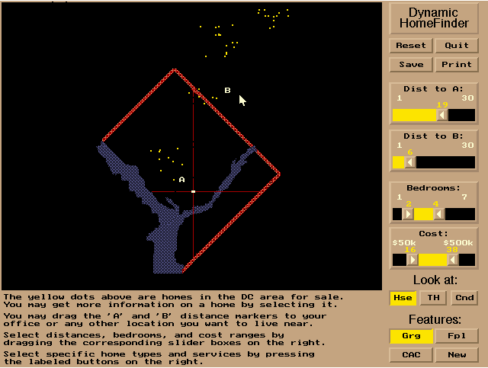
HomeFinder HCIL U Maryland

Slide 24




Data too large for paper & pencil
(a)
Figure 1.7(a) A table associated with the exploration of potentially useful drugs may involve many rows corresponding to compounds and fourteen columns associated with specific properties. Gaining insight into such a table is difficult

Slide 25
Knowledge Seeking Tasks
Search
Were is the local White Spot?
What is Bob’s phone number?
Browsing
Who was Augustus Caesar…Ancient Rome… Roman Baths…. Where can I visit one on my next trip to Europe… Maybe I can see the real copy of that ancient map…
Who wrote the recommendation letter, and what are her research papers and how good are they?
Maybe I’ll read a few

Slide 26
Tasks in InfoVis
Analysis
Comparison, difference, similarity
Find Patterns, relationships, regularities
Find Outliers, Extremes
Assimilation
Monitoring
Awareness

Slide 27
Other goal Taxonomies
What is the user thinking?
Analysis
Monitoring
Planning
Communication
Tufte:
Description
Exploration
Tabulation
Decoration
What’s the purpose of the vis?
Aid to thinking
Problem solving/Decision making
Insight
Clarifying
Entertainment / Art

Slide 28
Another way to approach it
Answer this: Do you know the answer?
If yes,
Presentation, communication, education
If no,
Exploration, analysis
Problem solving, planning,
Aid to thinking, reasoning
Answer this: Are you the creator or the viewer of the information?
Often there is a loop between analysis and presentation
Stone & Zellweger

Slide 29
Homework
Find an interesting InfoVis Out There
Report to class on Thursday:
Be ready with a URL
Here are two*
The Onion: http://www.theonion.com/content/video/breaking_news_series_of
Hans Rosling, Gapminder TED 2008 http://www.youtube.com/watch?v=RUwS1uAdUcI

