Slide 1
IAT 355
Data + Multivariate Visualization
______________________________________________________________________________________ SCHOOL OF INTERACTIVE ARTS + TECHNOLOGY [SIAT] | WWW.SIAT.SFU.CA

Slide 2
Agenda
Data forms and representations
Basic representation techniques
Multivariate (>3) techniques

Slide 3
Data Sets
Data comes in many different forms
Typically, not in the way you want it
How is stored (in the raw)?

Slide 4
Example
Cars
make
model
year
miles per gallon
cost
number of cylinders
weights
...

Slide 5
Data Tables
Often, we take raw data and transform it into a form that is more workable
Main idea:
Individual items are called cases
Cases have variables(attributes)

Slide 6
Data Table Format
Dimensions
 | Variable1 | Variable2 | Variable3
Case1 | Value11 | Value12 | Value13
Case2 | Value21 | Value22 | Value23
Case3 | Value31 | Value32 | Value33
Think of it as a function
F(Case1) = <Val11, Val12,…>

Slide 7
Example student data
Name | Student Num | Age | Entered SFU | GPA
Mary | 65432101 | 20 | Sep 2010 | 4.0
Tom | 98765651 | 22 | Sep 2013 | 2.3
Louise | 89846251 | 19 | Jan 2012 | 3.1

Slide 8
Variable Types
Three main types of variables
N - Nominal (equal or not equal to other values)
Example: gender
O - Ordinal (obeys < relation, ordered set)
Example: mild, medium, hot, suicide
Q - Quantitative (can do math on them)
Example: age

Slide 9
Metadata
Descriptive information about the data
Might be something as simple as the type of a variable, or could be more complex
For times when the table itself just isn’t enough
Example: if variable1 is “l”, then variable3 can only be 3, 7 or 16
Mary | 65432101 | 20 | Sep 2010 | 4.0
Tom | 98765651 | 22 | Sep 2013 | 2.3
Louise | 89846251 | 19 | Jan 2012 | 3.1

Slide 10
How Many Variables?
Data sets of dimensions 1, 2, 3 are common
Number of variables per class
1 - Univariate data
2 - Bivariate data
3 - Trivariate data
>3 - Hypervariate data

Slide 11
Representation
What’s a common way of visually representing multivariate data sets?
Graphs! (not the vertex-edge ones)

Slide 12
Basic Symbolic Displays
Graphs
Charts
Maps
Diagrams

Slide 13
Graphs

Slide 14
Graphs
Visual display that illustrates one or more relationships among entities
Shorthand way to present information
Allows a trend, pattern or comparison to be easily comprehended

Slide 15
Issues
Critical to focus on task
Why do you need a graph?
What questions are being answered?
What data is needed to answer those questions?
Who is the audience?

Slide 16
Graph Components
Framework
Measurement types, scale
Geometric Metadata
Content
Marks, lines, points
Data
Labels
Title, axes, ticks
Nominal Metadata

Slide 17
Chart
Structure is important, relates entities to each other
Primarily uses lines, enclosure, position to link entities
Flow charts, family tree, organization chart
A
B
C

Slide 18
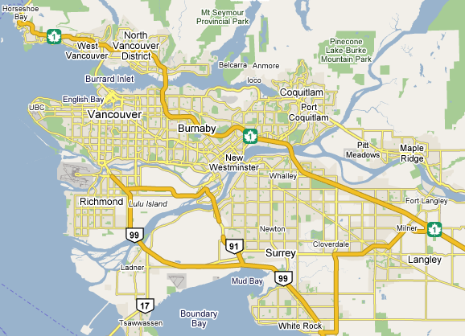
Map
Represents spatial relations
Locations identified by labels
Nominal metadata

Slide 19
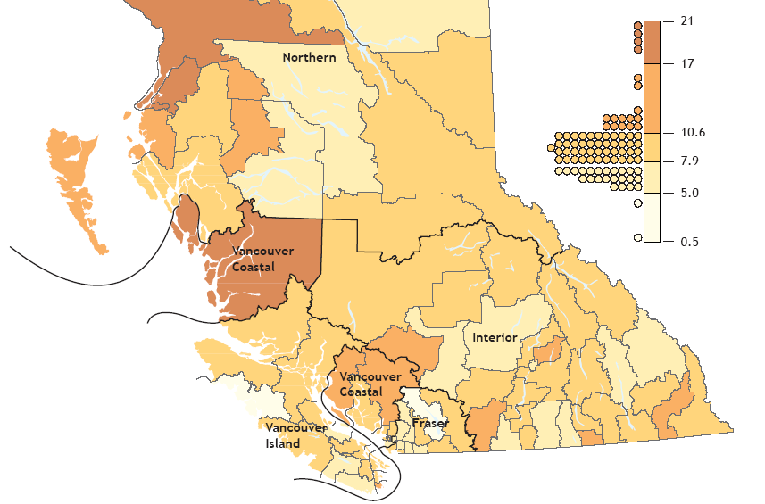
Choropleth Map
Areas are filled and colored differently to indicate some attribute of that region

Slide 20
Cartography
Cartographers and map-makers have a wealth of knowledge about the design and creation of visual information artifacts
Labeling, color, layout, …

Slide 21
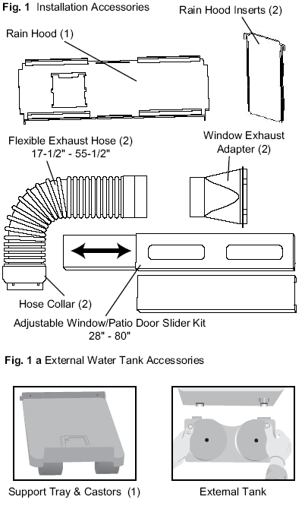
Diagram
Schematic picture of object or entity
Parts are symbolic
Examples: figures, steps in a manual, illustrations …

Slide 22
Details
What are the constituent pieces of these four symbolic displays?
What are the building blocks?

Slide 23
Visual Structures
Composed of
Spatial substrate
Marks
Graphical properties of marks

Slide 24
Space
Often put axes on space to assist perception of space
Use techniques of
composition, alignment, folding, recursion, overloading to
1) increase use of space
2) do data encodings

Slide 25
Marks
Things that occur in space
Points
Lines
Areas
Volumes

Slide 26
Graphical Properties
Size, shape, color, orientation...
 | Spatial Properties | Object Properties
Expressing Extent | Position, Size | Greyscale
Differentiating Marks | Orientation | Color, Shape, Texture

Slide 27
Data
Number of variables per class
1 - Univariate data
2 - Bivariate data
3 - Trivariate data
>3 - Hypervariate data

Slide 28
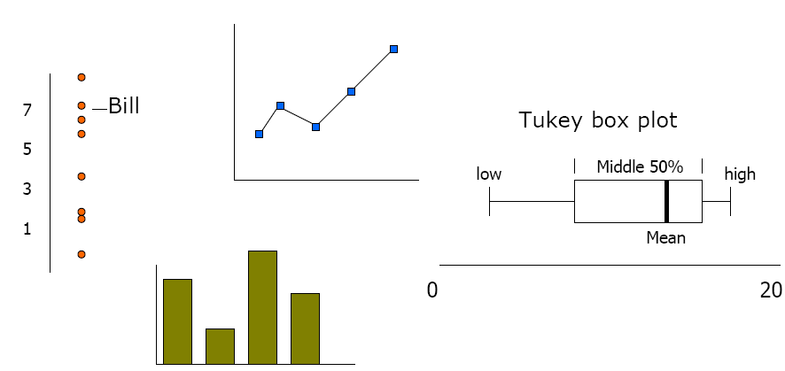
Univariate Data

Slide 29
What goes where
In univariate representations, we often think of the data case as being shown along one dimension, and the value in another
Y Axis is quantitative
Graph shows change in Y over continuous range X
Y Axis is quantitative
Graph shows value of Y for 4 cases

Slide 30
Or…
We may think of graph as representing independent (data case) and dependent (value) variables
Guideline:
Independent vs. dependent variables
Put independent on x-axis
See resultant dependent variables along y-axis

Slide 31
Bivariate Data
Price
Representations
Scatter plot
Each mark is a data case
Want to see relationship between two variables
What is the pattern?
Mileage

Slide 32
Trivariate Data
Horsepower
Price
3D scatter plot may work
Must have 3D cues
3D blobs
motion parallax
stereoscopy
Mileage

Slide 33
Scatter Plot
Use mark attribute for another variable
Price
Price
Mileage
Mileage

Slide 34
Alternative 3D
Represent each variable on its own line

Slide 35
Hypervariate Data
Number of well-known visualization techniques exist for data sets of 1-3 dimensions
line graphs, bar graphs, scatter plots OK
We see a 3-D world (4-D with time)
What about data sets with more than 3 variables?
Often the interesting, challenging ones

Slide 36
Multiple Views
Each variable on its own line
1
 | A | B | C | D
1 | 1 | 6 | 7 | 9
2 | 9 | 12 | 9 | 12
3 | 6 | 8 | 6 | 7
4 | 8 | 6 | 6 | 8
2
3
4
A
B
C
D

Slide 37
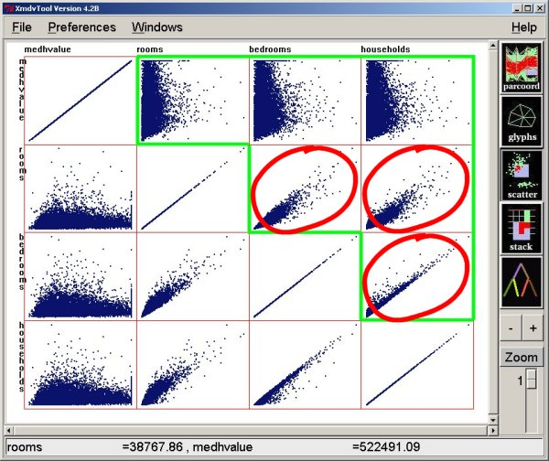
Scatterplot Matrix aka Splom
Represent each possible pair of variables in their own 2-D scatterplot
Useful for what?
Misses what?

Slide 38
Much More than 3D
Fundamentally, we have 2 display dimensions
For data sets with >2 variables, we must project data down to 2D
Come up with visual mapping that locates each dimension into 2D plane
Computer graphics 3D->2D projections

Slide 39
Spreadsheets
Tables allocate a unique space per value
Case + Variable
1 case per row
1 variable per column

Slide 40
Parallel Coordinates
V1 V2 V3 V4 V5
10
9
8
7
6
5
4
3
2
1
Case 1
V1 V2 V3 V4 V5
9 6 7 3 5

Slide 41
Parallel Coordinates
V1 V2 V3 V4 V5
10
9
8
7
6
5
4
3
2
1
Case 2
V1 V2 V3 V4 V5
7 8 9 7 3

Slide 42
Parallel Coordinates
Each column of space is assigned a variable
Vertical Scale to left
Each data case is a polyline that puts a vertex on each column at its corresponding data value

Slide 43
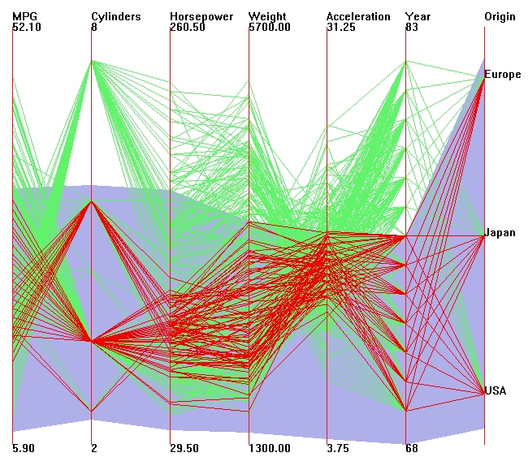
Parallel Coords Example

Slide 44
Issues
The range of each variable can be different:
Must rescale to the vertical space available
Each variable rescales independently
Hard to read parallel coord plot as a static picture
Interaction required

Slide 45
Example Problem
VLSI chip manufacture
Want high quality chips (high speed) and a high yield batch (% of useful chips)
Able to track defects
Hypothesis: No defects gives desired chip types
473 batches of data
A. Inselberg, “Multidimensional Detective” InfoVis 1997.

Slide 46
The Data
16 variables
X1 - yield
X2 - quality
X3-X12 - # defects (inverted)
X13-X16 - physical parameters

Slide 47
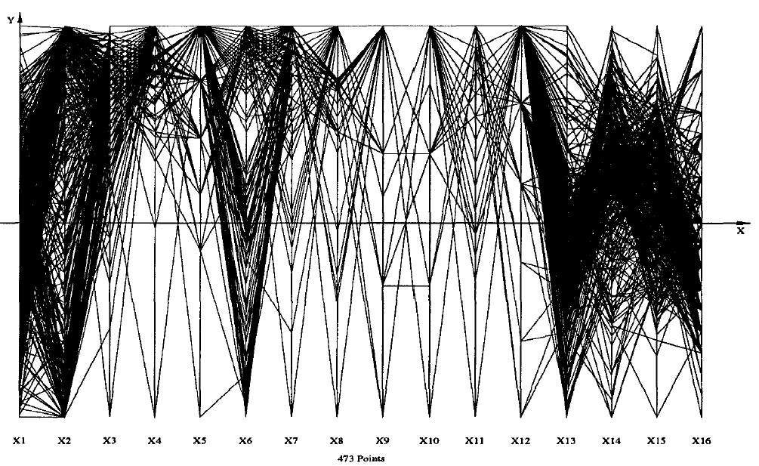
Yield
Quality Defects Parameters
Distributions
Yield: Normal
Quality: Bimodal

Slide 48
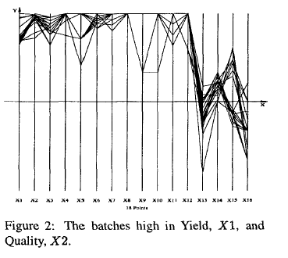
Top Yield & Quality
Split in parameters
Split

Slide 49
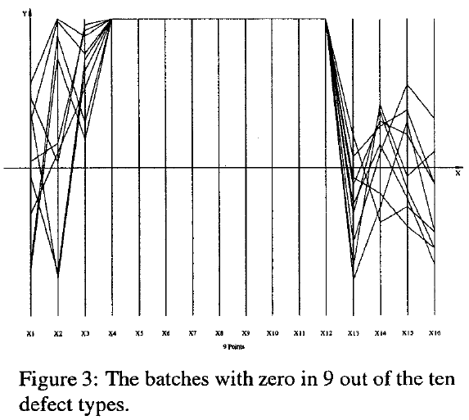
Minimal Defects
Not best yield & quality

Slide 50
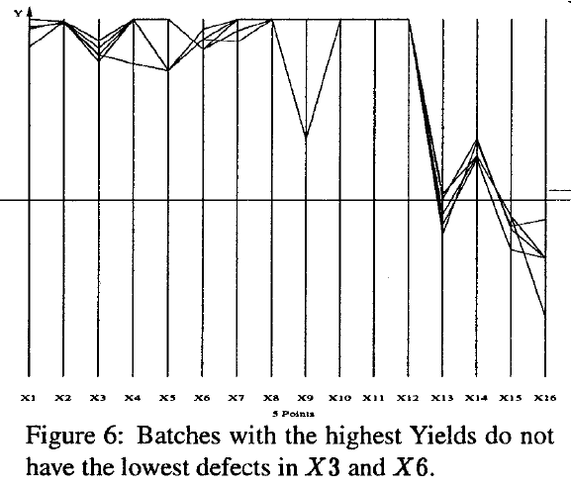
Best Yields
Parameters that give best yields cause 2 types of defects

Slide 51
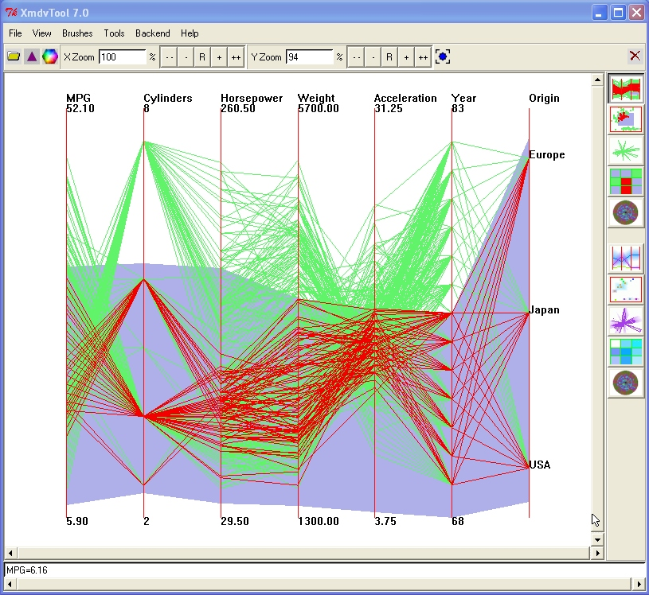
XmdvTool
Matt Ward, WPI
Does Parallel Coords

Slide 52
Dimensional Reordering
Which Dimensions are most alike?
Sort dimensions according to similarity

Slide 53
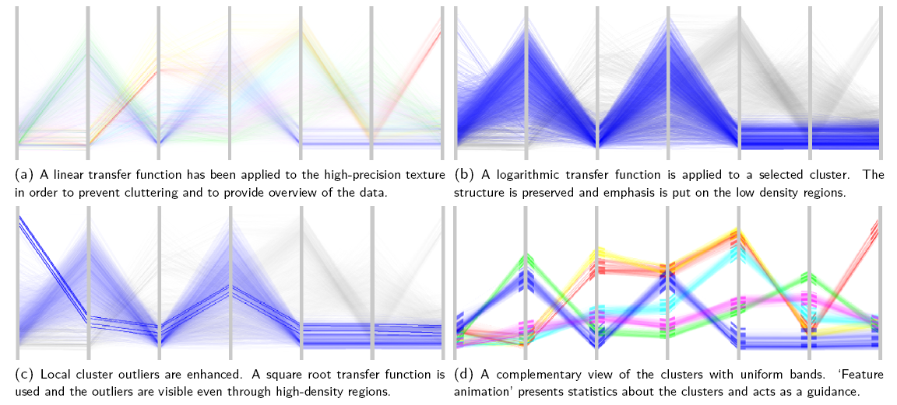
Advanced Graphics
Johanson et al InfoVis 2005

Slide 54
Use texture mapping
Pre-process data into clusters
Render each cluster to texture
Blend textures

Slide 55
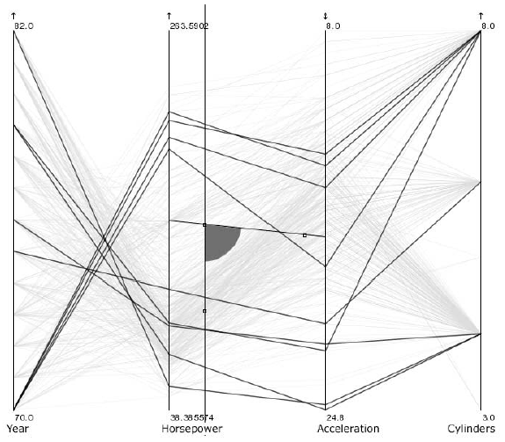
Interaction with Parallel Coords
Angular Query
Query the difference
Hauser et al InfoVis 2002

Slide 56
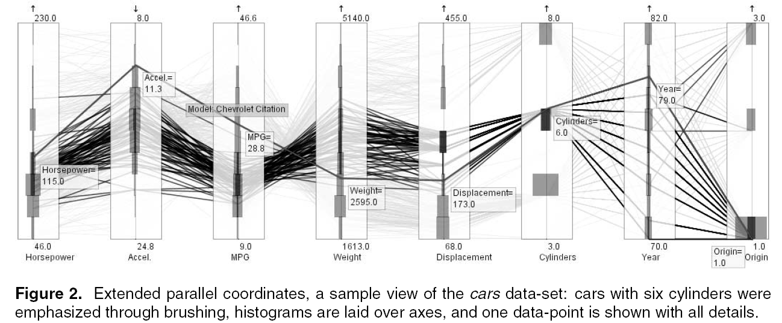
Further elaboration
Brush individual ranges
Display histogram per dimension

Slide 57
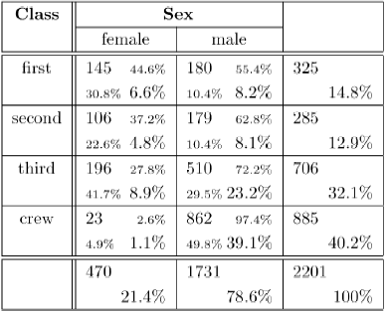
Visualizing Categories
Titanic Disaster
Bendix et al InfoVis 2005

Slide 58
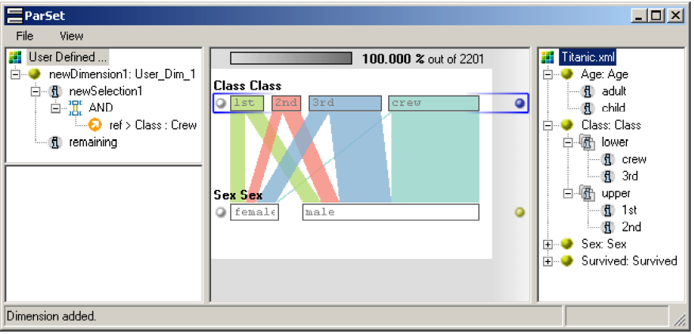
Parallel coordinates layout
Continuous axes replaced with boxes
Uses frequency based representation

Slide 59
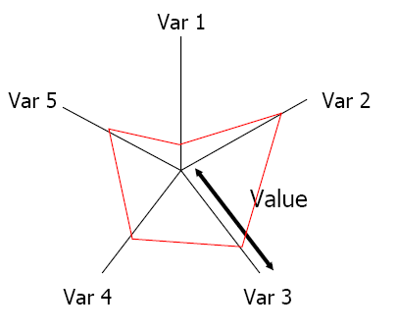
Star Plots
Space out the n variables at equal angles around a circle
Each “spoke” encodes a variable’s value
Data point is now a “shape”

Slide 60
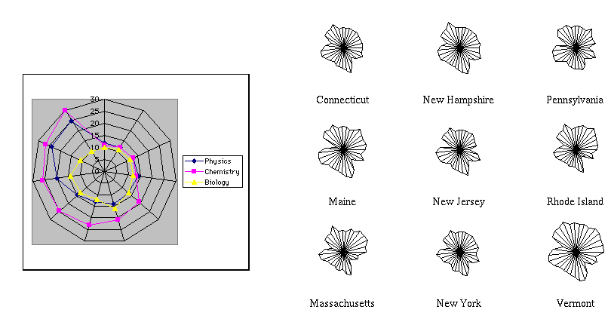
Star Plot Examples

