Slide 1
IAT 355
Cognition Models
Task Models

Slide 2
Cognition Summary
Visualization Helps Cognition
Aids the user by:
  Helping Knowledge creation process
  Helping with knowledge seeking tasks
Models:
  Process models
  Task taxonomies

Slide 3
Basic Premise
Understanding (the cognitive aspects) is the crucial part of InfoVis
Visualization is simply a tool useful for aiding comprehension and understanding

Slide 4
How Are Graphics Used?
Larkin & Simon ‘87 investigated usefulness of graphical displays
Graphical visualization could support more efficient task performance by:
  Allowing substitution of rapid perceptual influences for difficult logical inferences
  Reducing search for information required for task completion
(Sometimes text is better, however)

Slide 5
Understanding
People utilize an internal model that is generated based on what is observed
B. Tversky calls the internal model a cognitive map
  Think about that term

Slide 6
Example
You’re taking the SkyTrain to get to ScienceWorld
You have some existing internal model of the system, stops, how to get there
  On train, you glance at map for help
  Refines your internal model, clarifying items and extending it
  Note that it’s still not perfect, no internal model ever is

Slide 7
Question
Which direction do you drive to get from Windsor, Ontario to Detroit, Michigan?

Slide 8
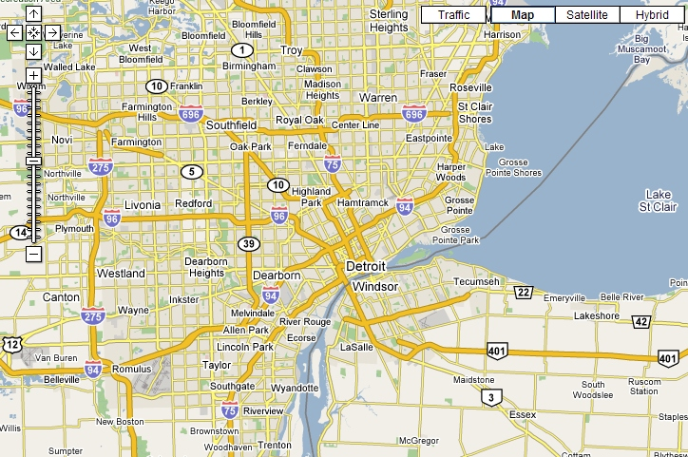
Answer: North
Which direction do you drive to get from Windsor, Ontario to Detroit, Michigan?

Slide 9
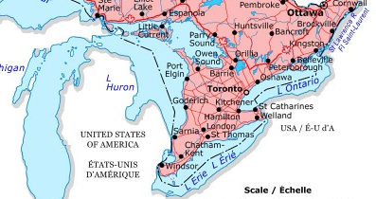
Windsor/Detroit
If you answered West, you likely used this mental map:
  “Michigan is West of Ontario, thus Detroit is west of Windsor”
If you answered South, likely you reasoned that Ontario/Canada is North of Michigan/USA

Slide 10
Cognitive Map
Just don’t have one big one
Have large number of these for all different kinds of things
Collection of cognitive maps -->
  Cognitive collage

Slide 11
Cognitive Collage
A visualization system should clarify a part of your cognitive map of the world
Correct and re-establish details when necessary
Details on demand

Slide 12
Process Models
Process by which a person looks at a graphic and makes some use of it
A number of substeps probably exist
  Can you describe process?

Slide 13
Don Norman’s Action Cycle
Two “Gulfs” to be bridged by cognitive activity
Gulf of Execution
  What do I do to change the display?
Gulf of Evaluation
  How do I interpret the display?

Slide 14
Process Model
Robert Spence
Navigation- Creation and interpretation of an internal mental model

Slide 15
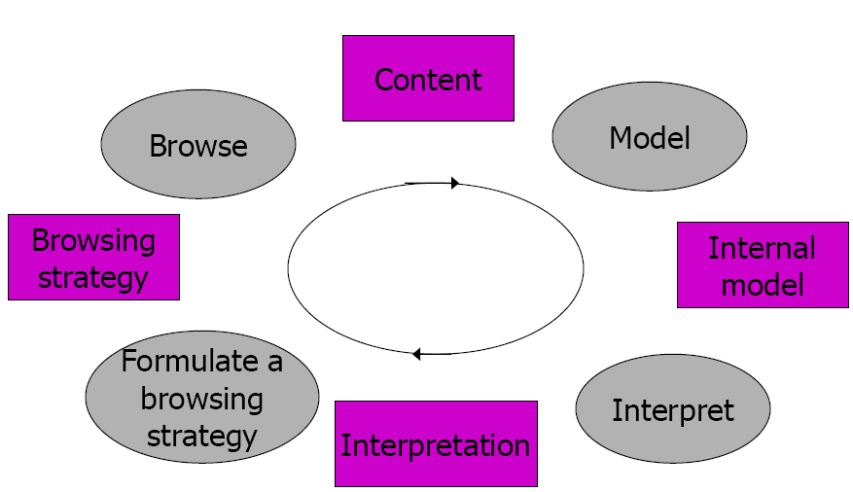
Navigation

Slide 16
Interpretation
Content is the display on screen
  Modeling of that pattern results in cognitive map
  Interpretation (ah, variables x and y are related) leads to new view, that generates an idea for a new browsing strategy
  Look at the display again with that idea in mind

Slide 17
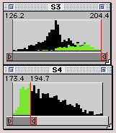
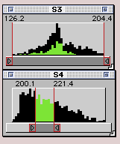
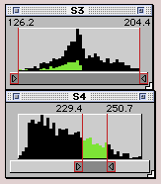
Example
(a)
(b)
(c)
Figure 5.15 As the range of S4 is moved to higher values, the corresponding values of S3 move to lower values, indicating a trade-off

Slide 18
Example Video
v5attributeexplorer

Slide 20
Process Model 2
Card, Mackinlay, Shneiderman book
Knowledge crystallization task
  Gather info for some purpose, make sense of it by constructing a representational framework, and package it into a form for communication or action

Slide 21
Knowledge Crystallization
Information foraging
Search for schema (representation)
Instantiate schema
Problem solve to trade off features
Search for a new schema that reduces problem to a simple trade-off
Package the patterns found in some output product

Slide 22
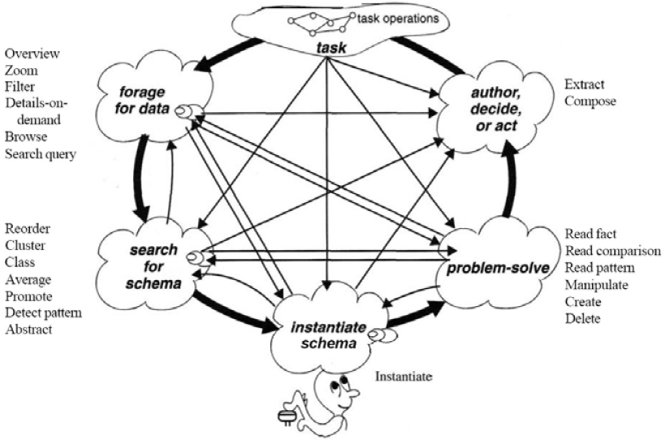
Knowledge Crystallization – Cognitive Process

Slide 23
How Vis Amplifies Cognition
Increasing memory and processing resources available
  External cognition. More room to work with
Reducing Data – dimensions or observations
Reducing search for information
Enhancing the recognition of patterns (pattern understanding, matching, differentiation)
Enabling perceptual inference operations
Using perceptual attention mechanisms for monitoring
Encoding info in a manipulable medium

Slide 24
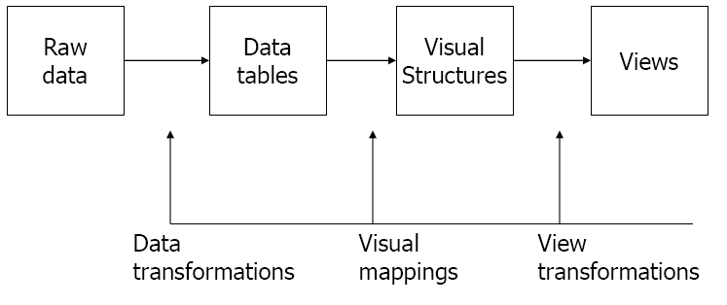
Process
Task

Slide 25
User Tasks
What things will people want to accomplish using information visualizations?
Search vs. Browsing
  Appears that information visualization may have more to offer to browsing
  But…browsing is a softer, fuzzier activity
  When is browsing useful?

Slide 26
Browsing
Useful when
  Good underlying structure so that items close to one another can be inferred to be similar
    Search engine results, library shelves
  Users are unfamiliar with collection contents
  Users have limited understanding of how system is organized and prefer less cognitively loaded method of exploration
  Users have difficulty verbalizing underlying information need
  Information is easier to recognize than describe

Slide 27
Tasks in More Detail
There are a number of Task Taxonomies
Each focuses on a different aspect of InfoVis
  Creating an artifact
  Human tasks
  Tasks using visualization system

Slide 28
User Tasks
Amar & Stasko created a taxonomy of user tasks in visualization environments
10 basic actions
Retrieve Value, Filter, Compute Derived Value, Find Extremum, Sort, Determine Range, Characterize Distribution, Find Anomalies, Cluster, Correlate

Slide 29
1. Retrieve Value
General Description:
  Given a set of specific cases, find attributes of those cases.
Examples:
  What is the mileage per gallon of the Audi TT?
  How long is the movie Gone with the Wind?

Slide 30
2. Filter
General Description:
  Given some concrete conditions on attribute values, find data cases satisfying those conditions.
Examples:
  What Kellogg's cereals have high fiber?
  What comedies have won awards?
  Which funds underperformed the S&P-500?

Slide 31
3. Compute Derived Value
General Description:
  Given a set of data cases, compute an aggregate numeric representation of those data cases.
Examples:
  What is the gross income of all stores combined?
  How many manufacturers of cars are there?
  What is the average calorie content of Post cereals?

Slide 32
4. Find Extremum
General Description:
  Find data cases possessing an extreme value of an attribute over its range within the data set.
Examples:
  What is the car with the highest MPG?
  What director/film has won the most awards?
  What Robin Williams film has the most recent release date?

Slide 33
5. Sort
General Description:
  Given a set of data cases, rank them according to some ordinal metric.
Examples:
  Order the cars by weight.
  Rank the cereals by calories.

Slide 34
6. Determine Range
General Description:
  Given a set of data cases and an attribute of interest, find the span of values within the set.
Examples:
  What is the range of film lengths?
  What is the range of car horsepowers?
  What actresses are in the data set?

Slide 35
7. Characterize Distribution
General Description:
  Given a set of data cases and a quantitative attribute of interest, characterize the distribution of that attribute values over the set.
Examples:
  What is the distribution of carbohydrates in cereals?
  What is the age distribution of shoppers?

Slide 36
8. Find Anomalies
General Description:
  Identify any anomalies within a given set of data cases with respect to a given relationship or expectation, e.g. statistical outliers.
Examples:
  Are there any cereals that have high calories but low sugar?
  Are there exceptions to the relationship between horsepower and acceleration?

Slide 37
9. Cluster
General Description:
  Given a set of data cases, find clusters of similar attribute values.
Examples:
  Are there groups of cereals w/ similar fat/calories/sugar?
  Are all comedies the same length?

Slide 38
10. Correlate
General Description:
  Given a set of data cases and two attributes, determine useful relationships between the values of those attributes.
Examples:
  Is there a correlation between carbohydrates and fat?
  Is there a correlation between country of origin and MPG?
  Do different genders have a preferred payment method?
  Is there a trend of increasing film length over the years?

Slide 39
Discussion
Compound tasks
  “Sort the cereal manufacturers by average fat content”
    Compute derived value; Sort
  “Which actors have co-starred with Julia Roberts?”
    Filter; Retrieve value

Slide 40
What was left out?
Basic math
  “Which cereal has more sugar, Cheerios or Special K?”
  “Compare the average MPG of American and Japanese cars.”
Uncertain criteria
  “Does cereal (X, Y, Z…) sound tasty?”
  “What are the characteristics of the most valued customers?”
Higher-level tasks
  “How do mutual funds get rated?”
  “Are there car aspects that Toyota has concentrated on?”
More qualitative comparison
  “How does the Toyota RAV4 compare to the Honda CRV?”
  “What other cereals are most similar to Trix?”

Slide 41
Cognition Summary
Visualization Helps Cognition
Aids the user by:
  Helping Knowledge creation process
  Helping with knowledge seeking tasks
Models:
  Process models
  Task taxonomies

