Slide 1
IAT 355
Trees
______________________________________________________________________________________ SCHOOL OF INTERACTIVE ARTS + TECHNOLOGY [SIAT] | WWW.SIAT.SFU.CA

Slide 2
Hierarchies
Definition
Data repository in which cases are related to subcases
Can be thought of as imposing an ordering in which cases are parents or ancestors of other cases

Slide 3
Hierarchies in the World
Examples
Family histories, ancestries
File/directory systems on computers
Organization charts
Animal kingdom: Phylum,…, genus,…

Slide 4
Trees
Hierarchies often represented as trees
Directed, acyclic graph
Two main representation schemes
Node-link
Space-filling

Slide 5
Task
Learn the structure of the hierarchy
Example Structure questions
Who has the most descendants?
What family tends to have the most children?
Example Search question
Who is Bob’s paternal grandfather?

Slide 6
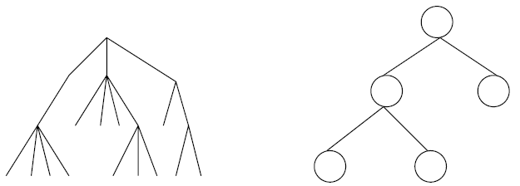
Node-Link Diagrams
Root at top, leaves at bottom is very common

Slide 7
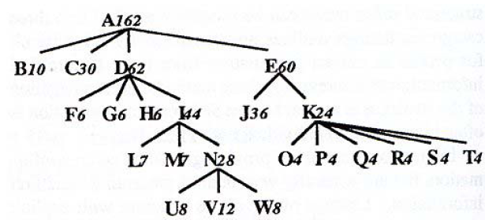
Sample Representation
From Johnson &Shneiderman 1991

Slide 8
Example
Layout
Tree level indicated by X→
Unique item per Y slot
Takes advantage of reading order
Good for?
Search
Bad for?
Understanding Structure
1 folder per row pushes large structures away

Slide 9
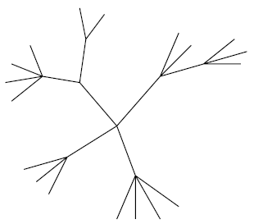
Why Put Root at Top?
Root can be at center with levels growing outward too
Can any node be the root?

Slide 10
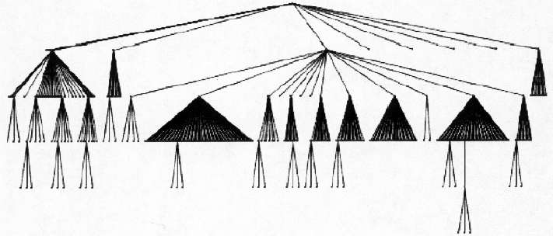
Drawing a Tree
Show more structure by allocating space differently
1 horizontal slice per level
How wide should it be?

Slide 11
Drawing a Tree
How to draw this?
Depth-First Search
Propagate size requirements upward from leaves

Slide 12
Potential Problems
For top-down, width of fan-out uses up horizontal real estate very quickly
At level n, there are 2n nodes
Tree might grow a lot along one particular branch
Hard to draw it well in view without knowing how it will branch

Slide 13
InfoVis Solutions
Techniques developed in Information Visualization largely try to assist the problems identified in the last slide
Alternatively, Information Visualization techniques attempt to show more attributes of data cases in hierarchy or focus on particular applications of trees

Slide 14
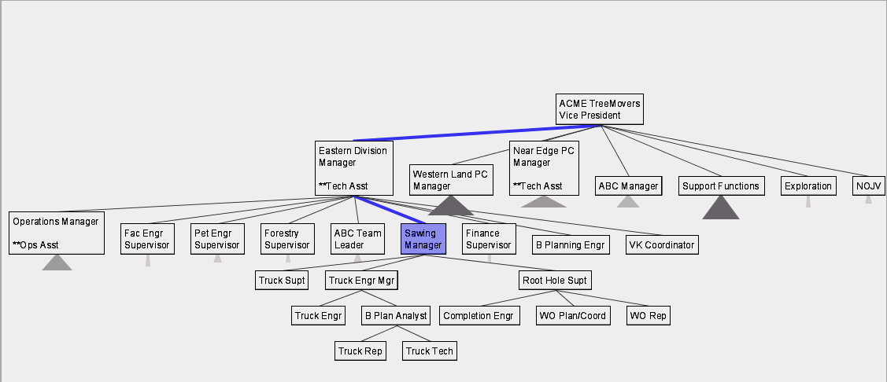
SpaceTree
Uses conventional 2D layout techniques
What are its unique features?
Grosjean, Plaisant, Bederson InfoVis ‘02

Slide 15
SpaceTree Characteristics
Vertical or horizontal
Subtrees are triangles
Size indicates depth
Shading indicates number of nodes inside
Navigate by clicking on nodes
Strongly restrict zooming
Lectures/SpaceTreeOrgchart.avi

Slide 16
SpaceTree Design Features
Make labels readable
Maximize number of levels opened
Decompose tree animation
Use landmarks
Use overview and dynamic filtering

Slide 17
3D Approaches
Add a third dimension into which layout can go
Compromise of top-down and centered techniques mentioned earlier
Children of a node are laid out in a cylinder “below” the parent
Siblings live in one of the 2D planes

Slide 18
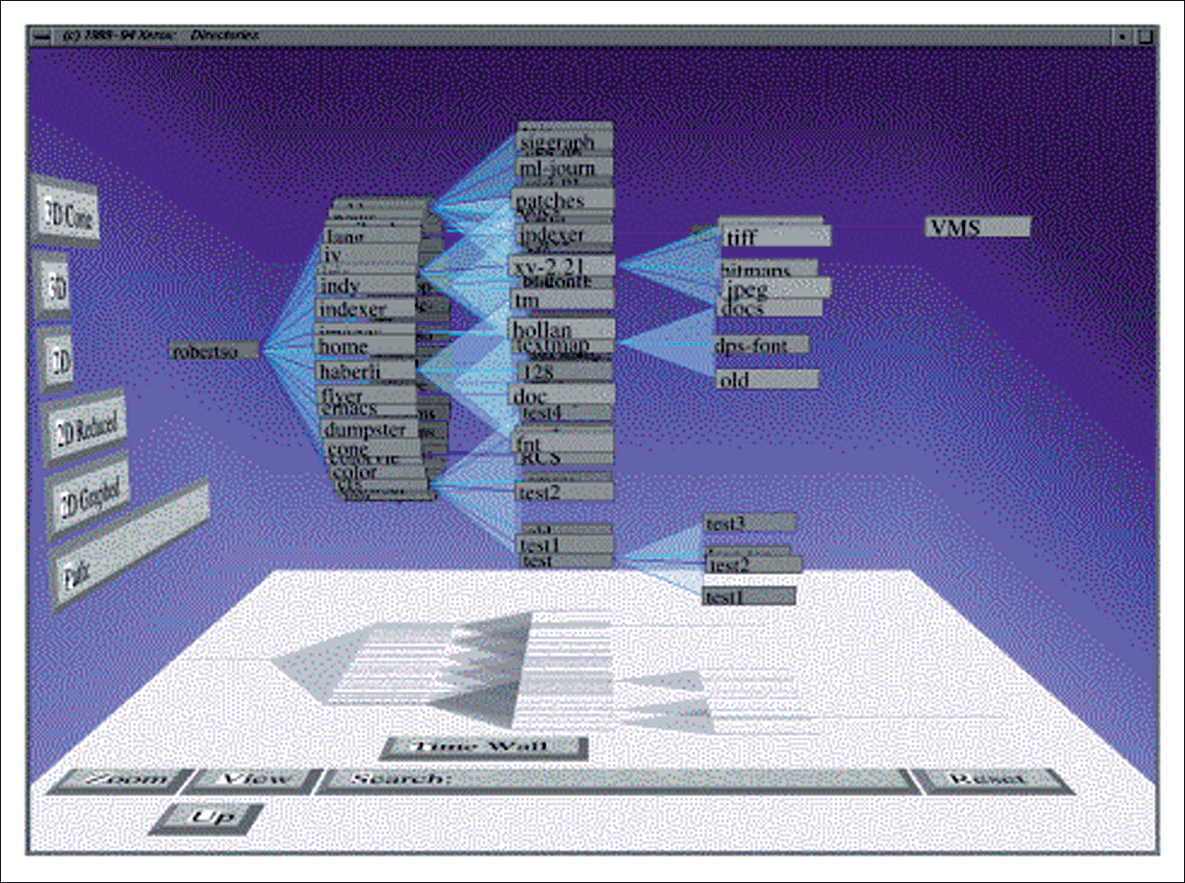
ConeTree
Interactive tree viewer
Clicking on node rotates it to front
Occlusion makes stuff hard to pick
Lectures/v9conetree.mov

Slide 19
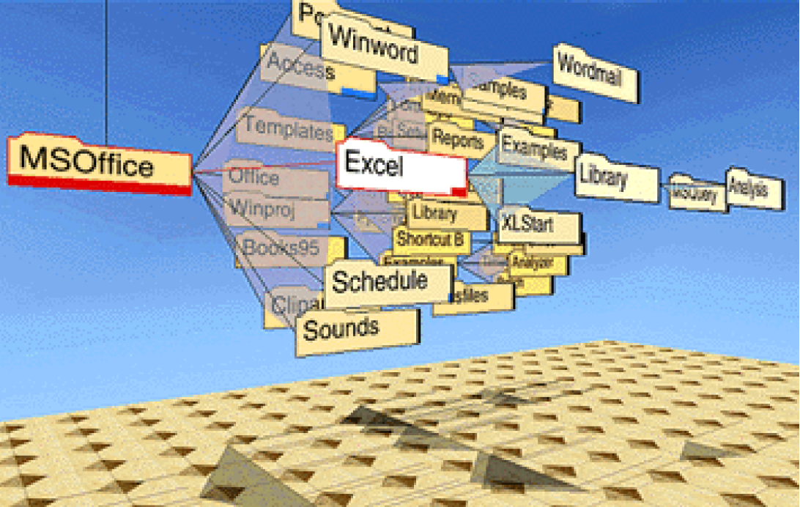
Alternative View

Slide 20
Cone Trees
Positive
More effective area (volume) to lay out tree
Use of smooth animation to help person track updates
Aesthetically pleasing
Negative
Occlusion obscures some nodes
Requires some graphics horsepower

Slide 21
Alternative Solutions
Change the geometry
Apply a hyperbolic transformation to the space
Root is at center, subordinates around
Apply idea recursively, distance decreases between parent and child as you move farther from center, children go in wedge rather than circle

Slide 22
Hyperbolic Browser
Focus + Context Technique
Detailed view blended with a global view
First lay out the hierarchy on the hyperbolic plane
Then map this plane to a disk
Start with the tree’s root at the center
Use animation to navigate along this representation of the plane

Slide 23
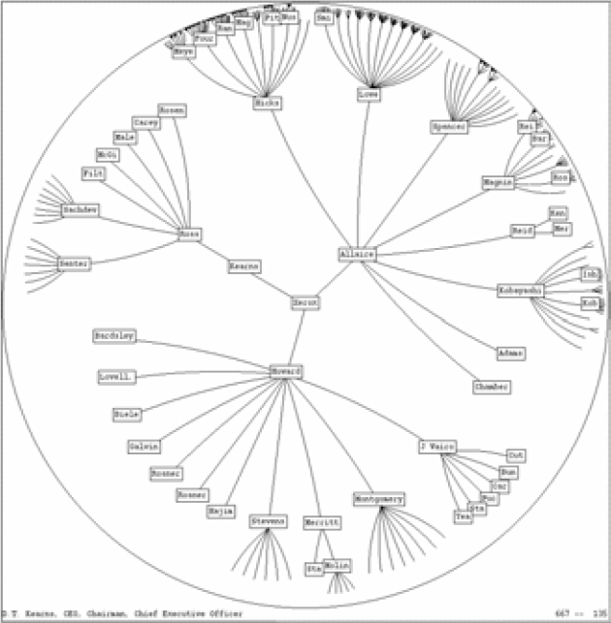
2D Hyperbolic Browser
Approach: Lay out the hierarchy on the hyperbolic plane and map this plane onto a display region.
Comparison
A standard 2D browser: 100 nodes (w/3 character text strings)
Hyperbolic browser: 1000 nodes, about 50 nearest the focus can show from 3 to dozens of characters
YouTube User “Treerao”

Slide 24
Hyperbolic Key Attributes
Natural magnification (fisheye) in center
Layout depends only on 2-3 generations from current node
Smooth animation for change in focus
Don’t draw objects when far enough from root (simplify rendering)
Problems
Watching the view can be disorienting
When a node is moved, its children don’t keep their relative orientation to it as in Euclidean plane, they rotate
Not as symmetric and regular as Euclidean techniques
Makes visual search more difficult

