Slide 1
IAT 355
Trees2
______________________________________________________________________________________ SCHOOL OF INTERACTIVE ARTS + TECHNOLOGY [SIAT] | WWW.SIAT.SFU.CA

Slide 2
Hierarchies
Definition
Data repository in which cases are related to subcases
Can be thought of as imposing an ordering in which cases are parents or ancestors of other cases

Slide 3
Trees
Hierarchies often represented as trees
Directed, acyclic graph
Two main representation schemes
Node-link
Space-filling

Slide 4
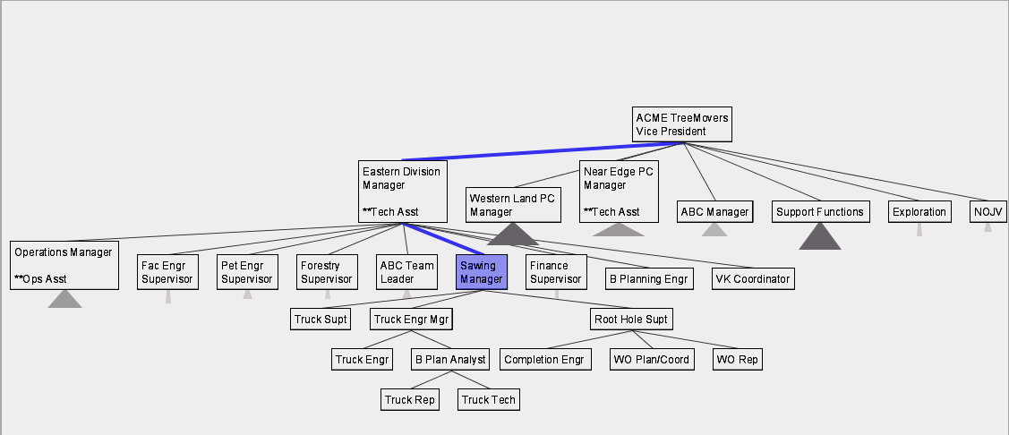
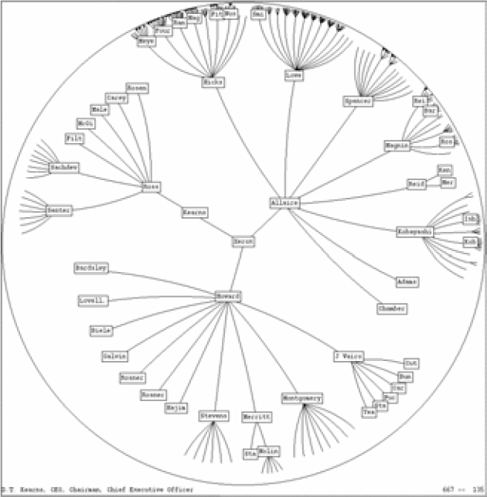
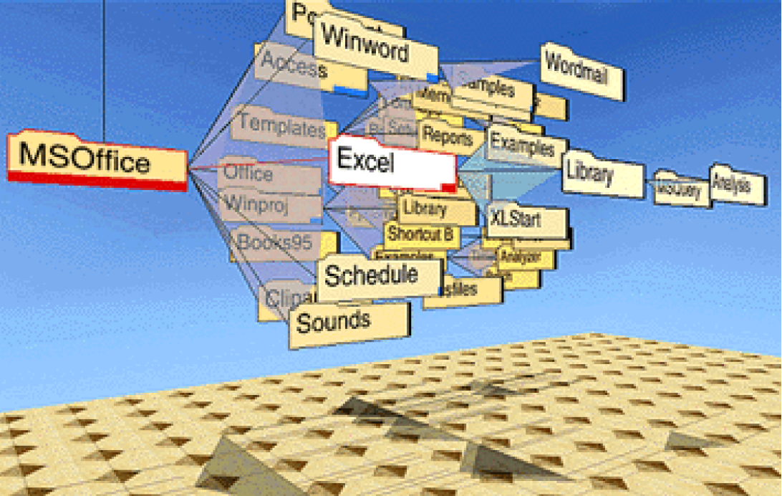
Node-Link Examples
SpaceTree
Hyperbolic Tree
ConeTree

Slide 5
Node-link Shortcoming
Difficult to encode more variables of data cases (nodes)
Shape
Color
Size
…but all quickly clash with basic node-link structure

Slide 6
Space-Filling Representation
Each item occupies an area
Children are “contained” under parent
Example shows each horizontal slice corresponding to a tree level
Width of box displays node size

Slide 7
Treemap
Space-filling representation developed by Shneiderman and Johnson, Vis ‘91
Children are drawn inside their parent
Alternate horizontal and vertical slicing at each successive level
Use area to encode other variable of data items

Slide 8
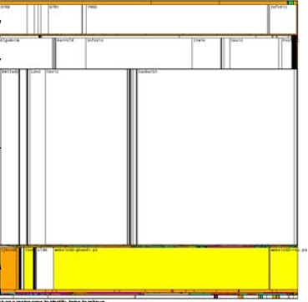
Treemap
Example
Folders

Slide 9
TreeMap Demo

Slide 10
Treemap Algorithm
Draw()
{
Change orientation from parent (horiz/vert)
Read all files and directories at this level
Make rectangle for each, scaled to size
Draw rectangles using appropriate size and color
For each directory
Make recursive call using its rectangle as focus
}

Slide 11
Nested vs. Non-nested
Non-nested Nested

Slide 12
Applications
Can use Treemap idea for a variety of domains
File/directory structures
Basketball statistics
Software diagrams
Useful where there is a size query

Slide 13
Software Visualization App
SeeSys: Software Metrics Visualizing System
Uses treemap-like visualization to present different software metrics
Displays:
Size
Recent development
High fix-on-fix rates
History and growth

Slide 14
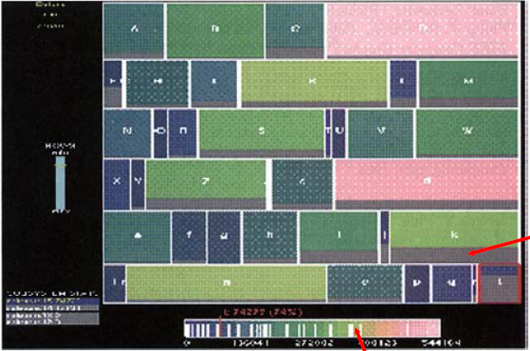
SeeSys sample
Subsystems in a software system. Each rectangle represents the non-comment source code in a subsystem. Area means size
New Code in this release
Size

Slide 15
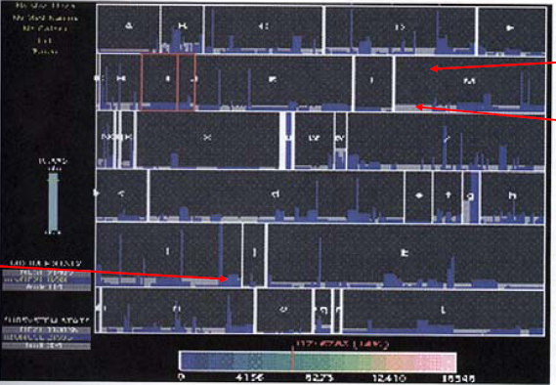
SeeSys sample 2
Bug Rates by Subsystem and Directory
New Code in this release
Added
Funtionality
Bug Fixes
Bars represent individual directories in the subsystem

Slide 16
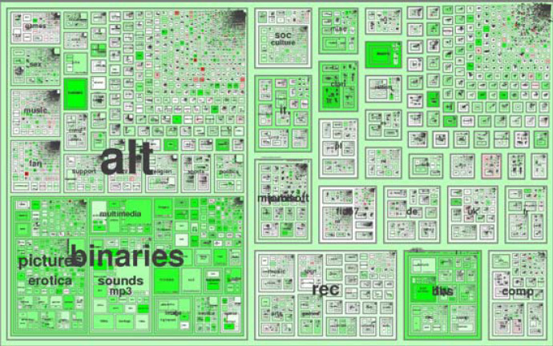
Internet News Groups
NetScan

Slide 17
Treemap Affordances
Good representation of two attributes beyond node-link: color and area
Not as good at representing structure
What happens if it’s a perfectly balanced tree of items all the same size?
Also can get long-thin aspect ratios
Borders help on smaller trees, but take up too much area on large, deep ones

Slide 18
Aspect ratios
Long thin rectangles hard to use
Hard to estimate area
Which one is bigger?

Slide 19
More squareness!
Can we force a rectangle to be “more square”?
Problem is that other rectangles have to change shape
NP Hard problem (Optimization, bin packing..)

Slide 20
Variation: “Cluster” Treemap
Finviz Map of the Market
Illustrates stock movements
“Compromises” treemap algorithm to avoid bad aspect ratios
Basic algorithm (divide and conquer) with some hand tweaking
Takes advantage of shallow hierarchy
https://finviz.com/map.ashx?t=sec_all

Slide 21
MarketWatch Map of the market

Slide 22
dd

Slide 23
Market Map Review
Dynamic user interface operations add to impact

Slide 24
Square Algorithm Problems
Small changes in data values can cause dramatic changes in layout
Order of items in a group may be important

Slide 25
Showing Structure
Regular borderless treemap makes it challenging to discern structure of hierarchy, particularly large ones
Supplement Treemap view
Change rectangles to other forms

Slide 26
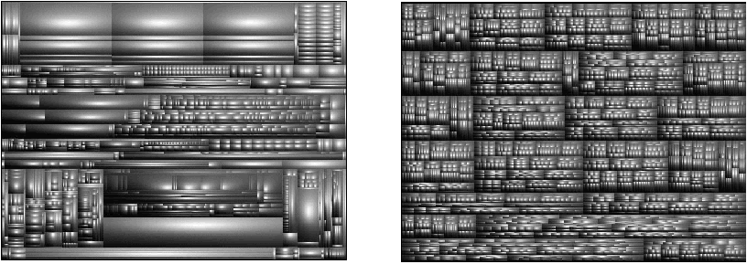
Variation: Cushion Treemap
Add shading and texture to convey structure of hierarchy

Slide 27
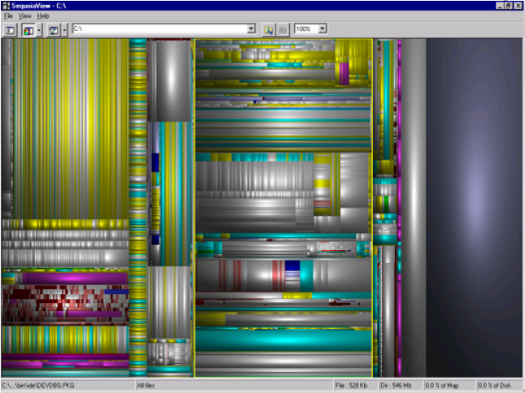
SequoiaView
File visualizer using cushion treemap
www.win.tue.nl/sequoiaview/

Slide 28
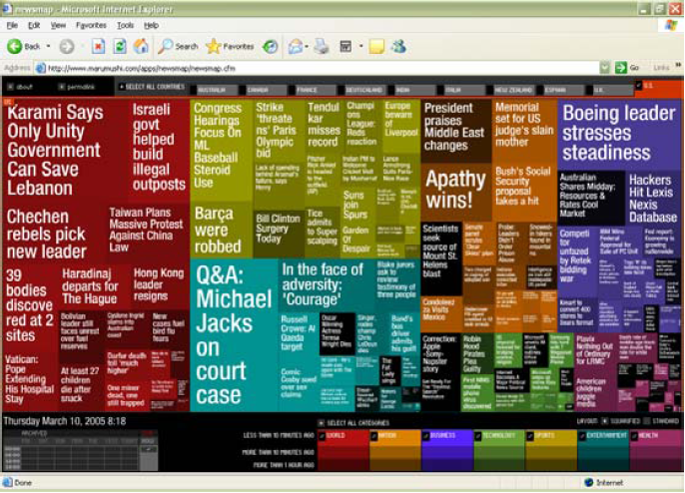
News Stories
newsmap.jp

Slide 29
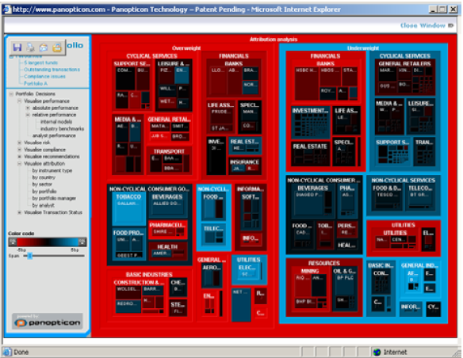
Investment Portfolios
www.panopticon.com

Slide 30
Another Problem
What if nodes with zero value (mapped to area) are very important?
Example: Stock or mutual fund portfolios: Funds you don’t currently hold have zero value in your portfolio, but you want to see them to potentially buy them

Slide 31
FundExplorer
Show mutual fund portfolios, including funds not currently held
Area maps to your relative investment in fund
Want to help the user with portfolio diversification as well
If I add fund X, how does that overlap with my current fund holdings?

Slide 32
Solution
Context Treemap – Treemap with small distortion
Give zero-valued items (all together) some constant proportion of screen area
Provide dynamic query capabilities to enhance exploration leading to portfolio diversification

Slide 33
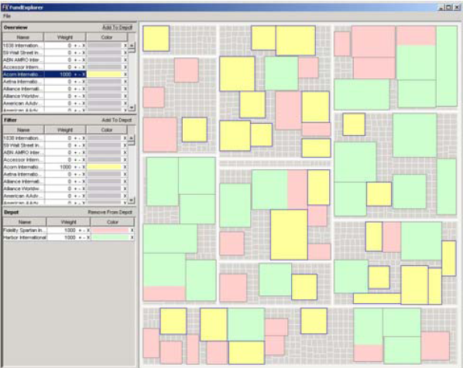
FundExplorer

Slide 34
What about Radial Space filling?
What if we used a radial rather than a rectangular space-filling technique?
We saw node-link trees with root in center and growing outward already...
Make pie-tree with root in center and children growing outward
Radial angle now corresponds to a variables rather than area

Slide 35
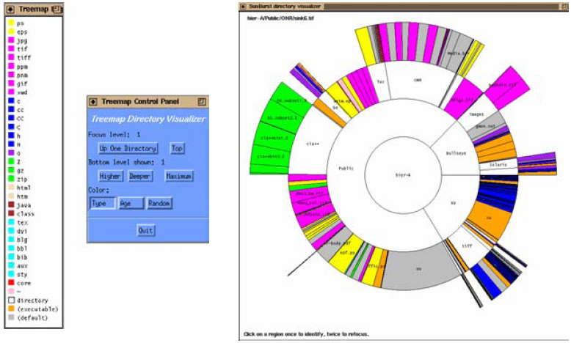
SunBurst
Stasko et al 2000

Slide 36
SunBurst
Root directory at center, each successive level drawn farther out from center
Sweep angle of item corresponds to size
Color maps to file type or age
Interactive controls for moving deeper in hierarchy, changing the root, etc.
Double-click on directory makes it new root

Slide 37
SunBurst Negative
In large hierarchies, files at the periphery are usually tiny and very difficult to distinguish

Slide 38
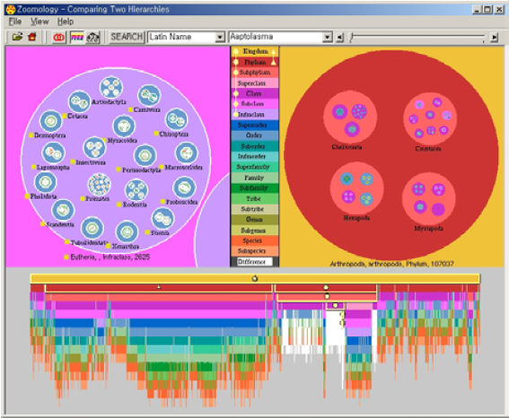
Zoomology
Not quite space filling
Circles within circles
Alternative structure view
Highly Interactive

Slide 39
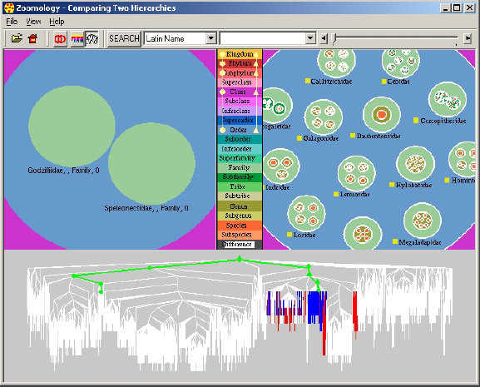
Zoomology
Coordinated structure views

Slide 40
Zoomology
Allows comparison of a pair of trees
This shows how the tree on the left has less stuff than the right

Slide 41
Space-Filling Representation
Good for trees with
Size attribute
Shallow hierarchy
Not so good
Showing structure
Showing links other than parent-child
Supporting visual search for a single item

