Slide 1

IAT 355
Interaction
______________________________________________________________________________________ SCHOOL OF INTERACTIVE ARTS + TECHNOLOGY [SIAT] | WWW.SIAT.SFU.CA

Slide 2
Interaction
Two main components in an infovis
Representation
Interaction
Representation gets all the attention
Interaction is where the action is (no pun intended)

Slide 3
Analysis through Interaction
Very challenging to come up with innovative, new visual representations
But can do interesting work with how user interacts with the view or views
It’s what distinguishes infovis from static visual representations on paper
Analysis is a process, often iterative with branches and side bars

Slide 4
Interaction Levels
Response Time
0.1 sec
animation, visual continuity, sliders
1.0 sec
system response, conversation break
10. sec
cognitive response

Slide 5
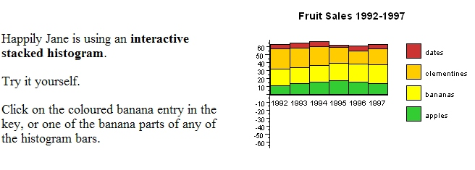
Example
Even simple interaction can be quite powerful
Stacked histogram
http://www.hiraeth.com/alan/topics/vis/hist.html
http://www.meandeviation.com/dancing-histograms/

Slide 6
Interaction Types
Dix and Ellis (AVI ’98) propose
Highlighting and focus
Accessing extra info – drill down and hyperlinks
Overview and context – zooming and fisheyes
Same representation, changing parameters
Linking representations – temporal fusion

Slide 7
Interaction Types
Daniel Keim’s taxonomy (IEEE TVCG 2002) includes
Projection
Filtering
Zooming
Distortion
Linking and brushing

Slide 8
Selection
Using pointer (typically) to select or identify an element
Often leads to drill-down for more details

Slide 9
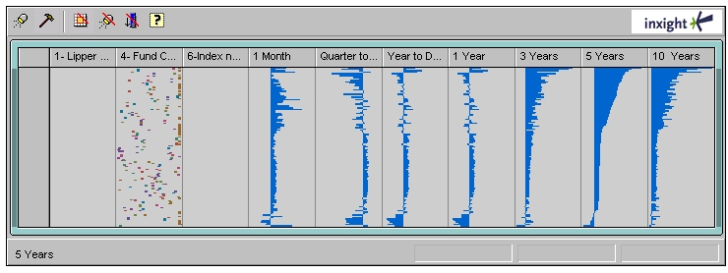
Pop-up tooltips
Hovering mouse cursor brings up details of item
TableLens www.inxight.com
http://www.youtube.com/watch?v=qWqTrRAC52U

Slide 10
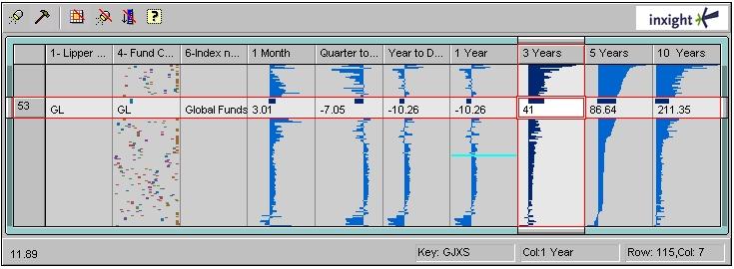
Selection
More details are displayed upon selection

Slide 11
Details-on-Demand
Term used in infovis when providing viewer with more information/details about data case or cases
May just be more info about a case
May be moving from aggregation view to individual view
May not be showing all the data due to scale problem
May be showing some abstraction of groups of elements
Expand set of data to show more details, perhaps individual cases

Slide 12
Hyperlinks
Linkages between cases
Exploring one may lead to another case
Example:
Following hyperlinks on web pages

Slide 13
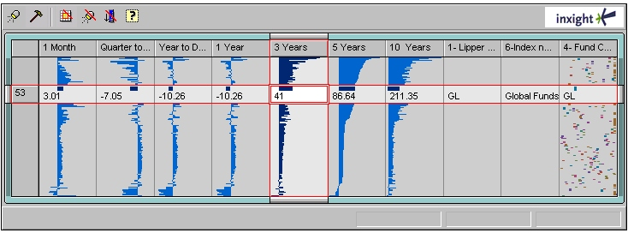
Rearrange View
Keep same fundamental representation and what data is being shown, but rearrange elements
Alter positioning
Sort

Slide 14
Changing Representation
May interactively change entire data representation
Looking for new perspective
Limited screen real estate may force change

Slide 15
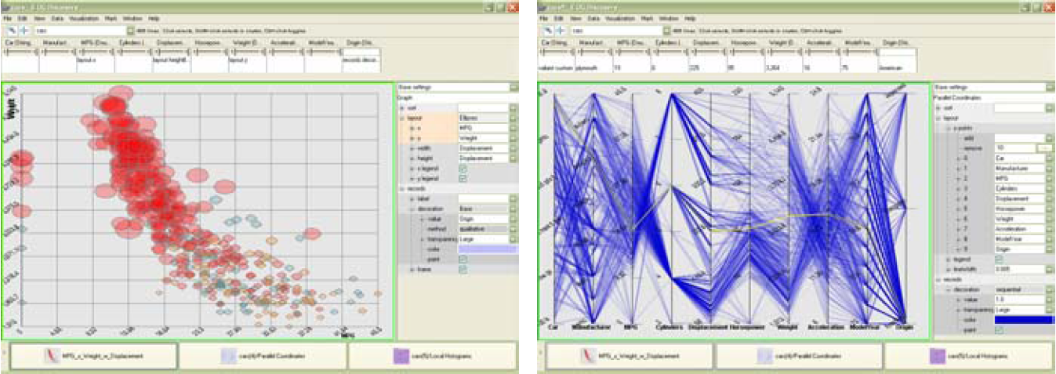
Example
Selecting different representation from options at bottom

Slide 16
Highlighting Connections
Viewer may wish to examine different attributes of a data case simultaneously
Alternatively, viewer may wish to view data case under different perspectives or representations
But need to keep straight where the data case is

Slide 17
Brushing
Applies when you have multiple views of the same data
Selecting or highlighting a case in one view highlights the case in the other views
Very common technique in InfoVis

Slide 18
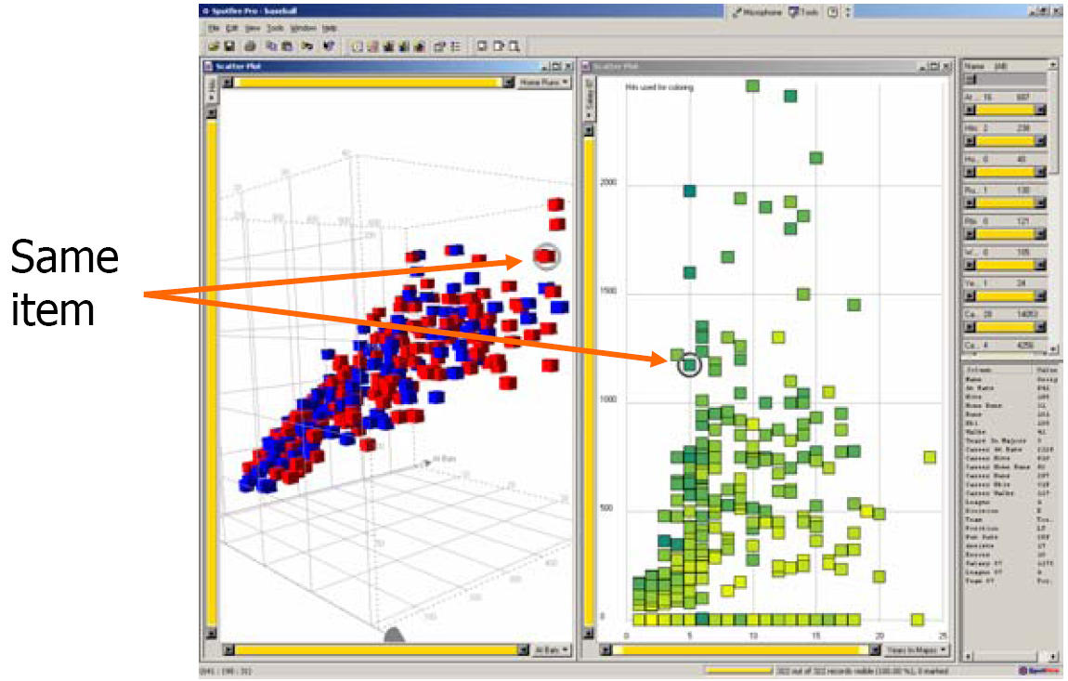
Brushing

Slide 19
Filtering/Limiting
Fundamental interactive operation in infovis is changing the set of data cases being presented
Focusing
Narrowing/widening

Slide 20
Zooming/Panning
Many infovis systems provide zooming and panning capabilities on display
Pure geometric zoom
Semantic zoom
More in later lecture

Slide 21
Dynamic Query
Probably best-known and one of most useful infovis techniques
Compare: Database query
Query language
Select house-address
From van-realty-db
Where price >= 400,000 and
price <= 800,000 and
bathrooms >= 3 and
garage == 2 and
bedrooms >= 4

Slide 22
Typical Query Response
124 hits found
1. 748 Oak St. - a beautiful …
2. 623 Pine Ave. -
…
0 hits found

Slide 23
Problems
Must learn language
Only shows exact matches
Don’t know magnitude of results
No helpful context is shown
Reformulating to a new query can be slow

Slide 24
Dynamic Query
Specifying a query brings immediate display of results
Responsive interaction (< .1 sec) with data, concurrent presentation of solution
“Fly through the data”, promote exploration, make it a much more “live” experience
Change response time from 10s to 0.1s

Slide 25
Dynamic Query Constituents
Visual representation of world of action including both the objects and actions
Rapid, incremental and reversible actions
Selection by pointing (not typing)
Immediate and continuous display of results

Slide 26
Imperfection
Idea at heart of Dynamic Query
There often simply isn’t one perfect response to a query
Want to understand a set of tradeoffs and choose some “best” compromise
You may learn more about your problem as you explore
Example: https://www.padmapper.com/

Slide 27
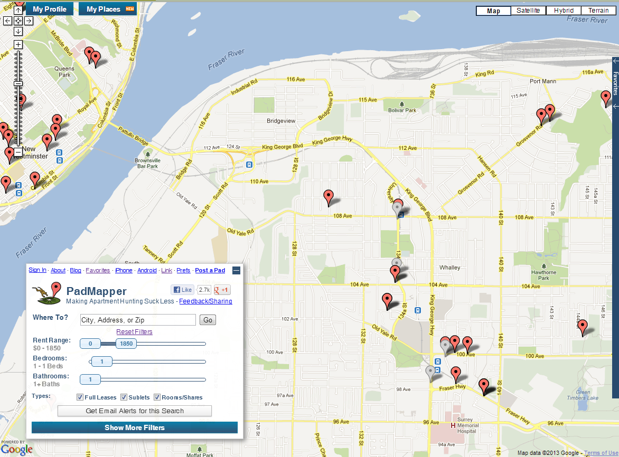
Padmapper.com

Slide 28
Query Controls
Variable types
Binary nominal - Buttons
Nominal with low cardinality - Radio buttons
Sort columns
Missing: Ordinal, quantitative - sliders

Slide 29
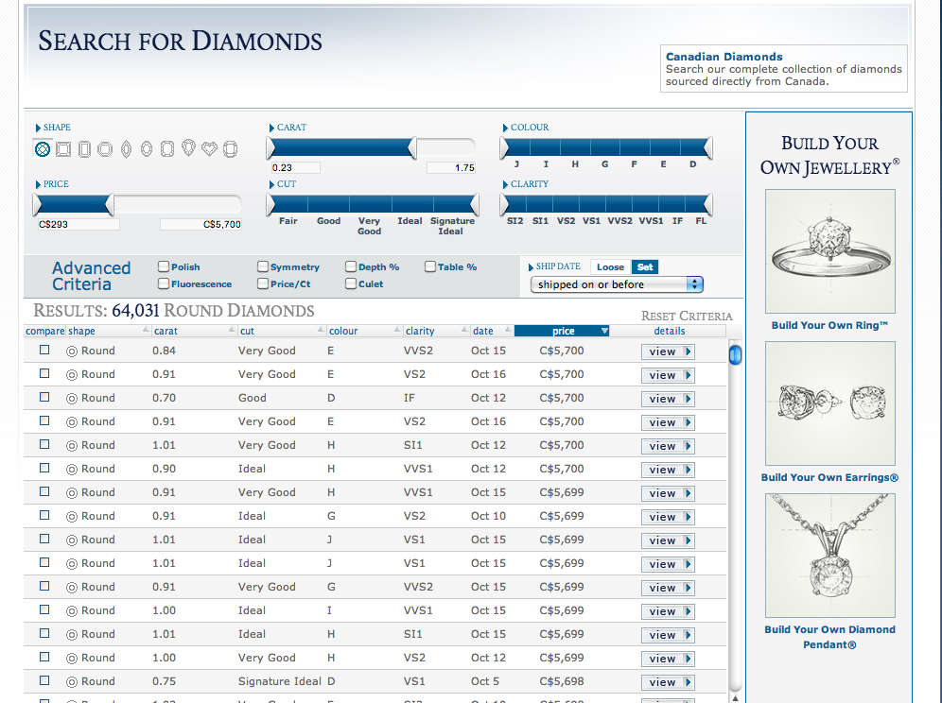
Search for Diamonds
www.bluenile.com/diamond-search

Slide 30
Dynamic Query Qualities
Strengths
Work is faster
Promote reversing, undo, exploration
Very natural interaction
Shows the data
Weaknesses
Operations are fundamentally conjunctive
Can you formulate an arbitrary boolean expression? !(A1 V A2) ^ A3 V (A4 V A5 ^ A6)
Controls are global in scope
Controls must be fixed in advance
Data must be prepared for instant access

Slide 31
Dynamic Query Weakness
Controls take space!
Put data in controls...
Lower Range Upper Range
Thumb Data Distribution Thumb

Slide 32
Dynamic Query Problem
As data set gets larger, real-time interaction becomes increasingly difficult
Storage - Data structures
linear array
grid file
quad, k-d trees
bit vectors

Slide 33
Attribute Exploration
Seen in Spence Chapter 3
Change range to narrow query
Pick histogram colums to select non-contiguous ranges

Slide 34
Summary Interactive Tasks
Highlighting and focus
Accessing extra info – drill down and hyperlinks
Filtering
Overview and context – zooming and fisheyes
Same representation, changing parameters
Linking representations – temporal fusion

