Slide 1

IAT 355
Overview + Detail
Focus + Context
______________________________________________________________________________________ SCHOOL OF INTERACTIVE ARTS + TECHNOLOGY [SIAT] | WWW.SIAT.SFU.CA

Slide 2
Fundamental Problem
Scale - Many data sets are too large to visualize on one screen
May simply be too many cases
May be too many variables
May only be able to highlight particular cases or particular variables, but viewer’s focus may change from time to time

Slide 3
Large Scale
One of the fundamental challenges in information visualization
How to allow user to navigate through, and analyze a data set that is too large to fit in the display
Potential solutions lie in
Representation
Interaction
Eventually you will run out of pixels!

Slide 4
The “Overview” Concept
Providing an overview of the data set can be extremely valuable
Helps present overall patterns
Assists user with navigation and search
Orients activities
Generally start with overview

Slide 5
Details
Viewers also will want to examine details, individual cases and variables
How to allow user to find and focus on details of interest?
Generally provide details on demand

Slide 6
Overview + Detail
Overview + Detail displays can be combined via either time or space
Time - Alternate between overview and details sequentially in same place
Space - Use different portions of screen to show overview and details
Develop visualization and interface techniques to allow flexible alternation

Slide 7
Common Solution- Scroll/Pan
Provide a larger, virtual screen by allowing user to move to different areas
Requires one or more of
Dedicated mouse button/wheel
Peripheral scroll bars
Takes screen space
Requires mouse move
Only get to see one piece

Slide 8
Worthy Objective
Allow viewer to examine cases and/or variables in detail while still maintaining context of those details in the larger whole
Concession
You simply can’t show everything at once
Be flexible, facilitate a variety of user tasks
Visualization + Navigation

Slide 9
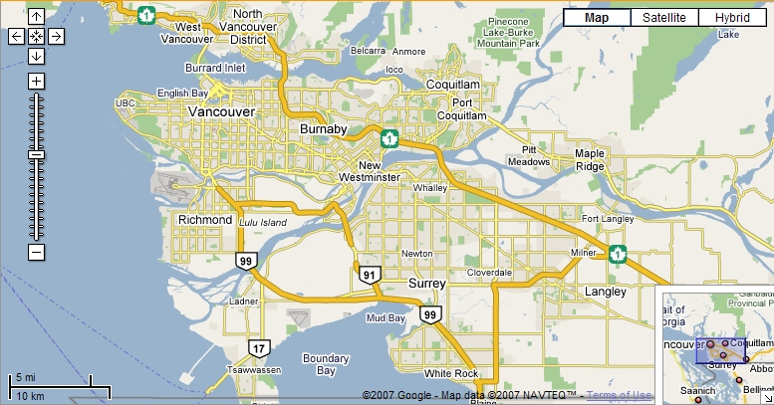
Example

Slide 10
Managing detail
Single window with horizontal and vertical panning
Works only when image/space is not too much larger than the window

Slide 11
Single Window
Single view with Selectable Zoom area
Selected zone is new view
Magnification and adjustment can follow
Context switch disorienting

Slide 12
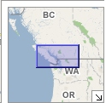
Single Window
Main + mini-map
Sometimes the Overview gets the most space
Depends on the user’s familiarity with the object of interest
Panning in one affects the other
Could be extended to 3 or more levels
Issue: How big are different views and where do they go?

Slide 13
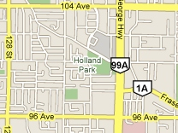
Lens Technique
Enlarged image floats over the overview
Neighbor objects obscured by the detail view

Slide 14
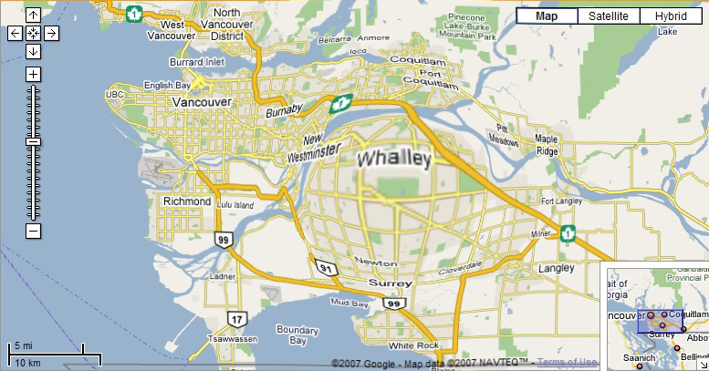
Fish-eye view
Focus is at high magnification, periphery at low magnification
All in one view
Distortion can be disorienting

Slide 15
Tasks
Image generation: overview is important, but most of time is spent at detail level
Example: CAD
Open-ended exploration: overview not always complete; navigation must be fluent and easily mastered
Example: Interactive Map
Diagnostic: high detail, fluent panning and complete image coverage
Example: Circuit Design, Map directions

Slide 16
Tasks
Navigation: global view with increased magnification detail areas; panning and zooming less important
Example: Geographic Information System
Monitoring: Global view with multiple detailed views for local troubleshooting; window management is critical
Example: Network management

Slide 17
Overviews
How to deal with approximate view?
Reduce the data elements
Eliminate
Sample
Aggregate
Reduce the visual representation
Need to render to sub-pixel resolution
Accumulate visual contributions per pixel

Slide 18
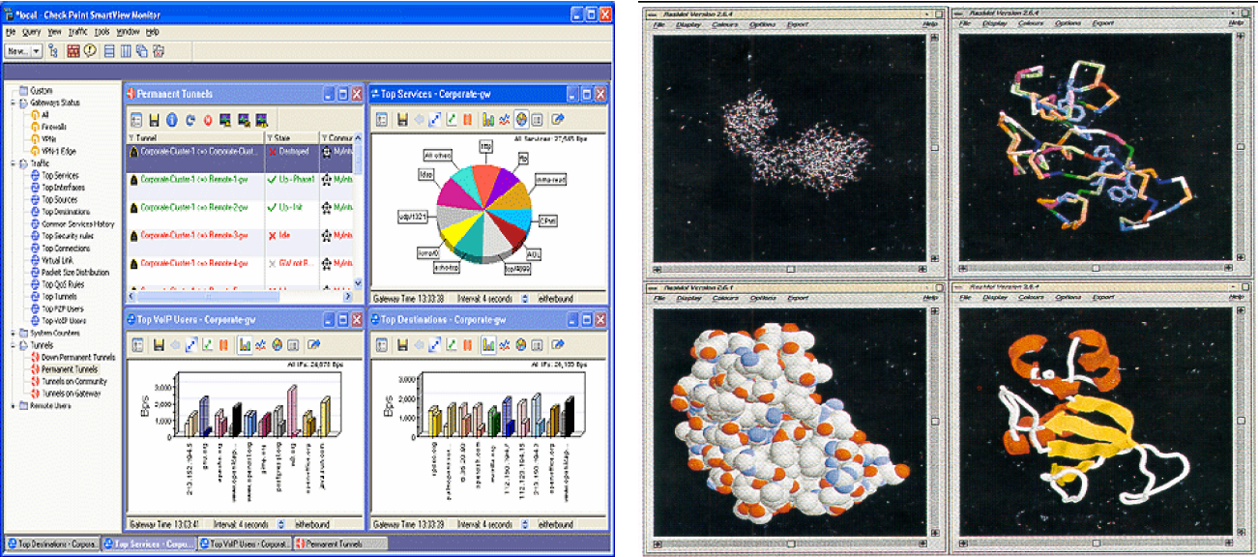
Multiple Views
“Guidelines for Using Multiple Views in Information Visualization”
Baldonado, Woodruff and Kichinsky AVI 00

Slide 19
Multiple Views: 8 Guidelines
Rule of Diversity:
Use multiple views when there is a diversity of attributes
Rule of Complementarity:
Multiple views should bring out correlations and/or disparities
Rule of Decomposition: “Divide and conquer”.
Help users visualize relevant chunks of complex data
Rule of Parsimony:
Use multiple views minimally

Slide 20
8 Guidelines Cont’d
Rule of Space/Time Resource
Optimization: Balance spatial and temporal benefits of presenting and using the views
Rule of Self Evidence:
Use cues to make relationships apparent.
Rule of Consistency:
Keep views and state of multiple views consistent
Rule of attention management:
Use perceptual techniques to focus user attention

Slide 21
Focus + Context
How is this different from Overview + Detail?
Focus + Context is an InfoVis term:
Present the Detail and the overview in the same window

Slide 22
Focus + Context Methods
Filtering
Selective aggregation
Micro-macro readings
Highlighting
Distortion

Slide 23
Prototype example
Bifocal Display – Spence & Apperley, 1980
Fisheye View - George Furnas, 1981

Slide 24
Definition
Fisheye View
Magnify an area of interest without obscuring its neighboring unmagnified imagery
Why fisheye?
The fisheye camera lens

Slide 25
Fisheye Terminology
Focal point
Distance from focus
Level of detail
Degree of interest function

Slide 26

Level of Detail
A number the determines the quantity of visual info you are going to draw for one data element
In maps: The quantity of imagery that fits in X pixels

Slide 27
Degree of Interest
Function that determines how items in display are drawn
DOI = Level of Detail – Distance From Focus
DOI = Level of Detail / Distance From Focus
1.0, 1.0
Query Position
0.4, 0.7
Focal Point
0.8, 0.1

Slide 28
DoI Function
Can take on various forms
Continuous - Smooth interpolation away from focus
Filtering - Past a certain point, objects disappear
Step - Levels or regions dictating rendering 0<x<.3 all same, .3<x<.6 all same
Semantic changes - Objects change rendering at different levels

Slide 29
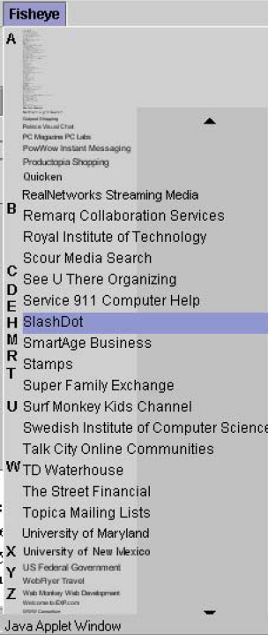
Examples
Fisheye Menus – Bederson
Dynamically change size of menu item & provide focus area around the pointer
Items near cursor displayed at full size
Items further away on either side are smaller
Uses a distortion function so items will always fill menu
Efficient mechanism for long menus
Need to “Lock Focus” to hit nearby targets (on right)

Slide 30
Panning and Zooming
Panning
Smooth movement of camera across scene (or scene moves and camera stays still)
Zooming
Increasing or decreasing the magnification of the objects in a scene
Useful for changing focal point

Slide 31
Paper
“Space-Scale Diagrams: Understanding Multiscale Interfaces” George Furnas – Fisheye Benjamin Bederson - Pad ++ CHI 1995

Slide 32
Important Concepts
Portals
Lenses
Sticky objects
Semantic zooming

Slide 33
Portals
Views onto another place in the world
Implemented typically as separate rectangular region
Zooming, panning, I/O all work independently in there
Can be used to create overviews or focus regions

Slide 34
Lenses
Rectangular regions/objects that can be moved around on display
Objects that alter the appearance and behavior of objects seen through them

Slide 35
Sticky Objects
Objects in the world that do not respond to the basic zoom/pan interface physics
Objects are “stuck” to the display
They never change position
They never change size

Slide 36
Semantic Zooming
Zooming that is not simply a change in size or scale like simple magnification
Objects change fundamental appearance/presence at different zoom levels
Zooming is like step function with boundaries where a semantic transition takes place

Slide 37
Efficiency Measures
Spatial indexing
Hierarchy of objects based on bounding boxes
Clustering
Restructure hierarchy to maintain a balanced tree, speed for indexing
Level of detail
Render items depending on how large they are on screen, don’t draw small ones

