Slide 1
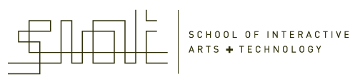
IAT 355
Time
______________________________________________________________________________________
SCHOOL OF INTERACTIVE ARTS + TECHNOLOGY [SIAT] | WWW.SIAT.SFU.CA

Slide 2
Time Series Data
Fundamental chronological component to the data set
Random sample of 4000 graphics from 15 of world’s newspapers and magazines from ’74-’80 found that 75% of graphics published were time series
  Tufte, Vol 1

Slide 3
Data Sets
Each data case is likely an event of some kind
One of the variables can be the date and time of the event
Ex: sunspot activity, hockey games, medicines taken, cities visited, stock prices, etc.

Slide 4
Meta Level
Consider multiple stocks being examined
Is each stock a data case, or is a price on a particular day a case, with the stock name as one of the other variables?
Conflation of data entity with data cases

Slide 5
Data Mining
Data mining domain has techniques for algorithmically examining time series data, looking for patterns, etc.
Good when objective is known a priori
But what if not?
  Which questions should I be asking?
  InfoVis better for that

Slide 6
Time Series Tasks
Examples
  When was something greatest/least?
  Is there a pattern?
  Are two series similar?
  Do any of the series match a pattern?
  Provide simple, fast access to the series

Slide 7
More Time Tasks
Does data element exist at time t ?
When does a data element exist?
How long does a data element exist?
How often does a data element occur?
How fast are data elements changing?
In what order do data elements appear?
Do data elements exist together?
        Muller & Schumann 03, citing MacEachern ‘95

Slide 8
Taxonomy
Discrete points vs. interval points
Linear time vs. cyclic time
Ordinal time vs. continuous time
Ordered time vs. branching time vs. time with multiple perspectives
        Muller & Schumann ’03 citing Frank ‘98

Slide 9
Fundamental Tradeoff
Is the visualization time-dependent, ie, changing over time (beyond just being interactive)
  Static
    Shows history, multiple perspectives, allows comparison
  Dynamic (animation)
    Gives feel for process & changes over time, has more space to work with

Slide 10
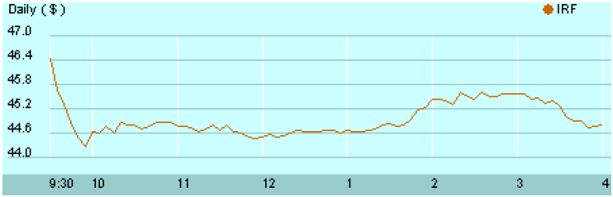
Standard Presentation
Present time data as a 2D line graph with time on x-axis and some other variable on y-axis

Slide 11
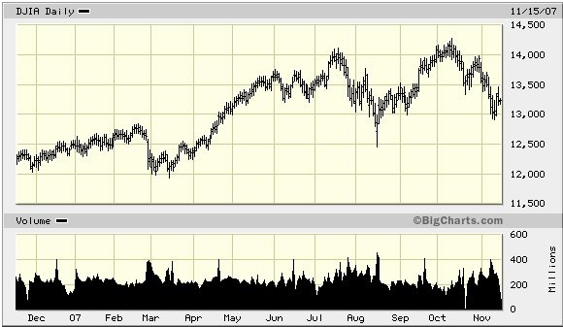

Slide 12
Today’s Focus
Examination of a number of case studies
Learn from some of the different visualization ideas that have been created
Can you generalize these techniques into classes or categories?

Slide 13
Example 1
Calendar visualization
Present series of events in context of calendar
Tasks
  See commonly available times for group of people
  Show both details and broader context

Slide 14
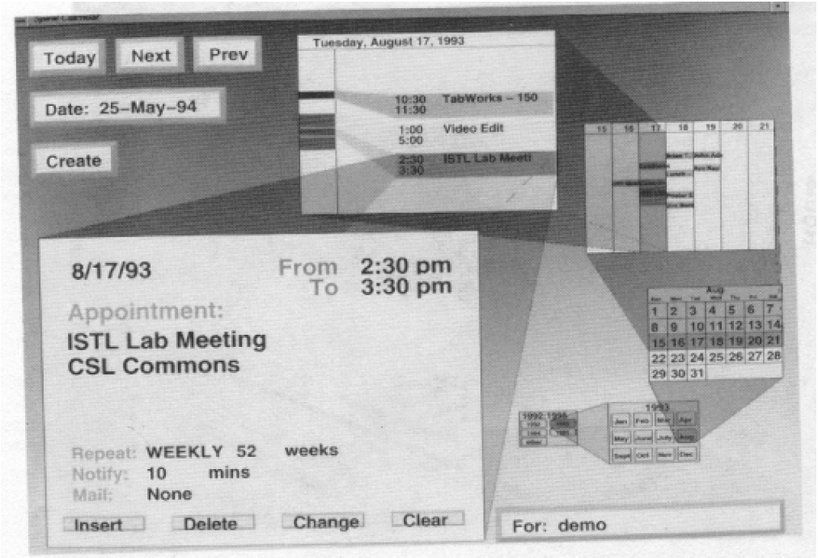
Spiral Calendar
Mackinlay, Robertson & DeLine
UIST ‘94

Slide 15
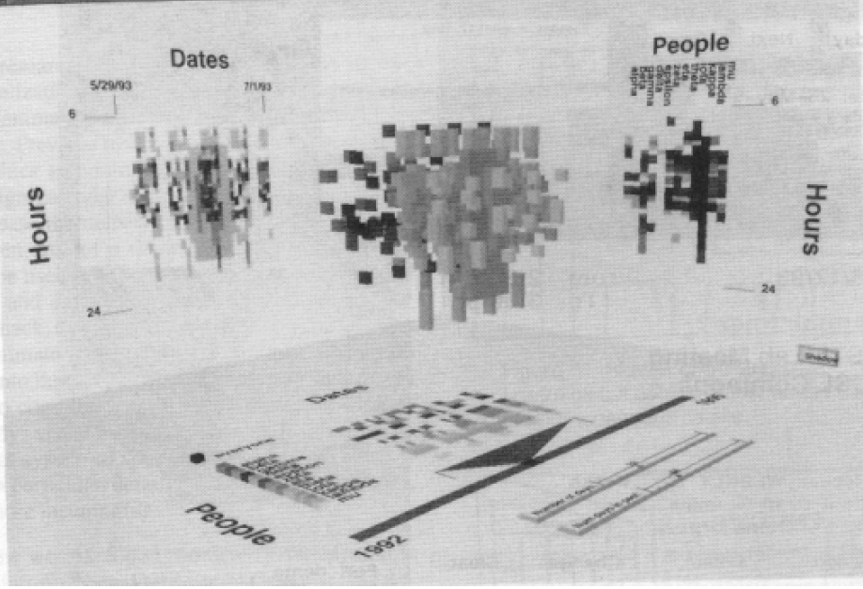
Time Lattice
Project “Shadows” on walls
x - days
y - hours
z - people

Slide 16
Example 2
Personal histories
  Consider a chronological series of events in someone’s life
  Present an overview of the events
Examples
  Medical history
  Educational background
  Criminal history

Slide 17
Tasks
Put together complete story
Garner information for decision-making
Notice trends
Gain an overview of the events to grasp the big picture

Slide 18
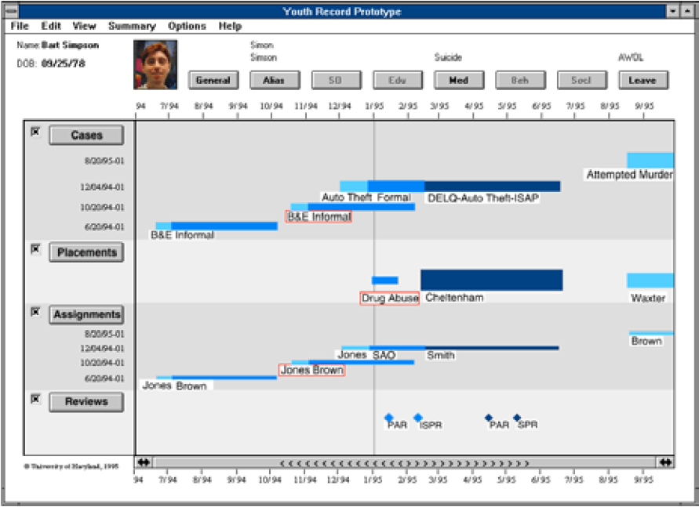
Lifelines Project
Visualize personal
history in some
domain
Plaisant et al
CHI ‘96

Slide 19
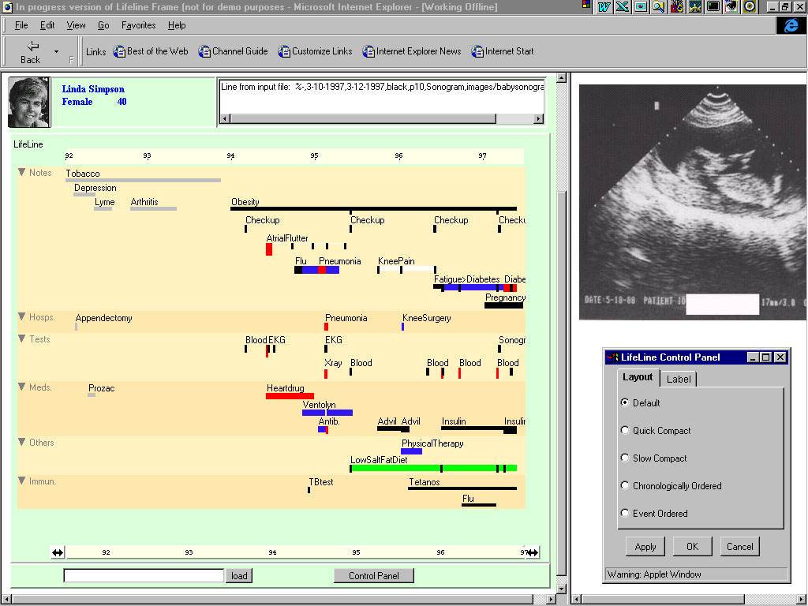

Slide 20
Lifelines Features
Different colors for different event types
Line thickness can correspond to another variable
Interaction: Clicking on an event produces more details
Certainly could also incorporate some dynamic query capabilities

Slide 21
Benefits + Challenges
Benefits
  Reduce chances of missing information
  Facilitate spotting trends or anomalies
  Streamline access to details
  Remain simple and tailorable to various applications
Challenges
  Scalability
  Can multiple records be visualized in parallel well?

Slide 22
Example 3
People’s presence/movements in some space
  Eg. Halo2 average health on a level
Situation:
  Workers punch in and punch out of a factory
  Want to understand the presence patterns over a calendar year

Slide 23
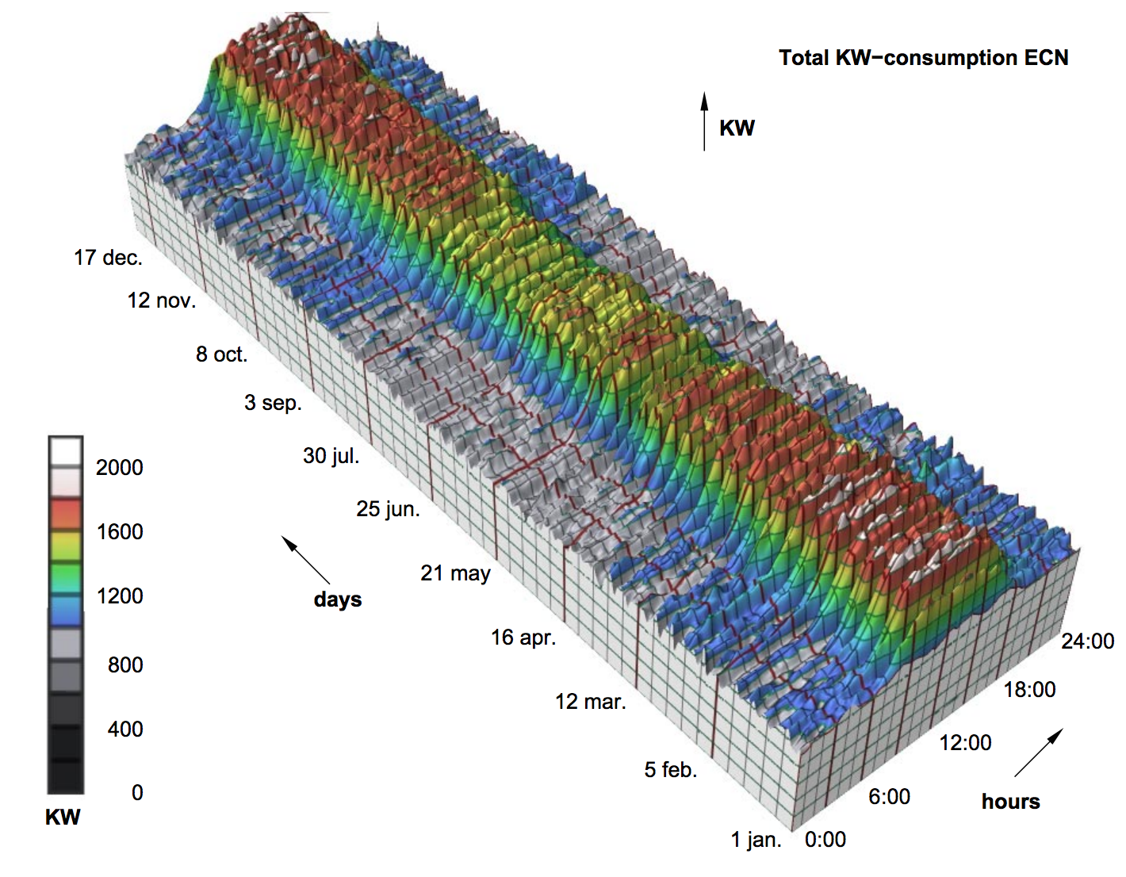
3D Plot of Time vs Power
Good
Typical daily pattern
Seasonal trends
Bad
Weekly pattern
Details
van Wijk & van Selow
InfoVis ‘99

Slide 24
Another Approach
Cluster analysis
  Find two most similar days, make into one new composite
  Keep repeating until some preset number left or some condition met
How can this be visualized?

Slide 25
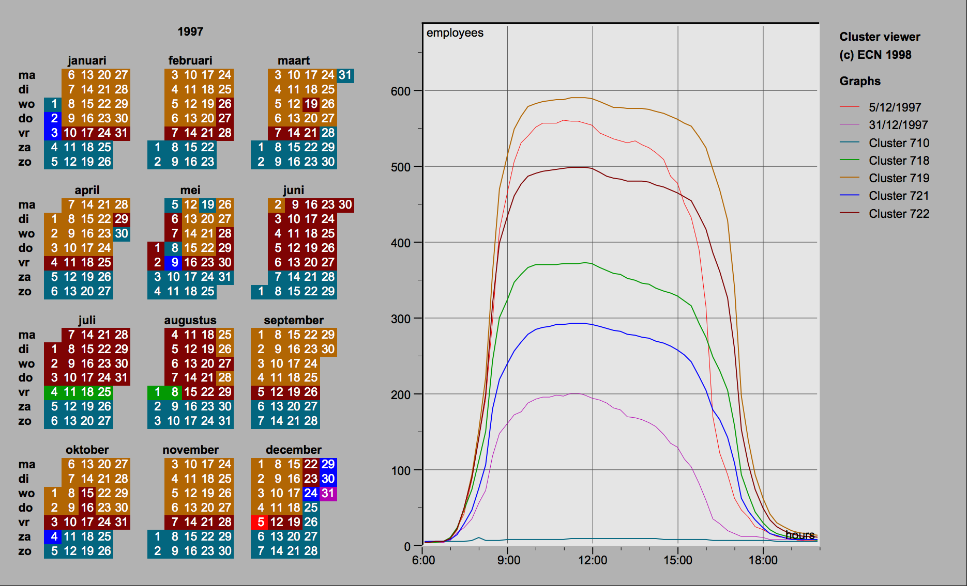
Display

Slide 26
Interaction
Click on day, see its graph
Select a day, see similar ones
Add/remove clusters

Slide 27
Insights
Traditional office hours followed
Most employees present in late morning
Fewer people are present on summer Fridays
Just a few people work holidays
When were the holidays
  School vacations occurred May 3-11, Oct 11-19, Dec 21- 31
Many people take off day after holiday
Many people leave at 4pm on December 5

Slide 28
Example 4
Consider a set of speeches or documents over time
Can you represent the flow of ideas and concepts in such a collection?

Slide 29
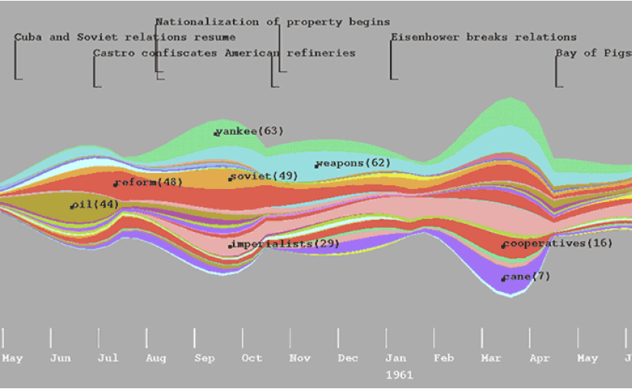
ThemeRiver
Havre et al
InfoVis ‘00

Slide 30
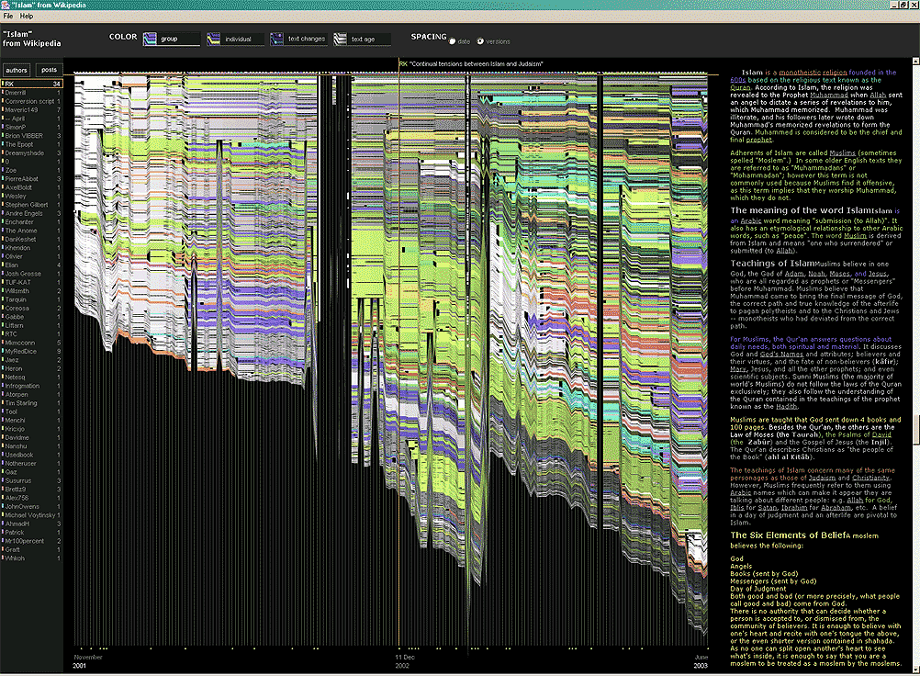
Example 5
http://researchweb.watson.ibm.com/history/
Flow of
changes
across
electronic
documents

Slide 31
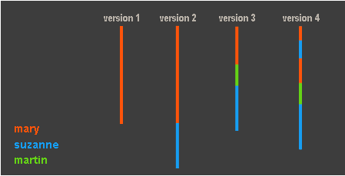
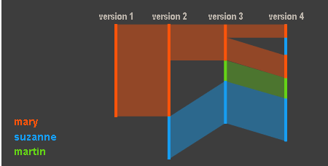
Technique
Length – how much text
Make
connections

Slide 32
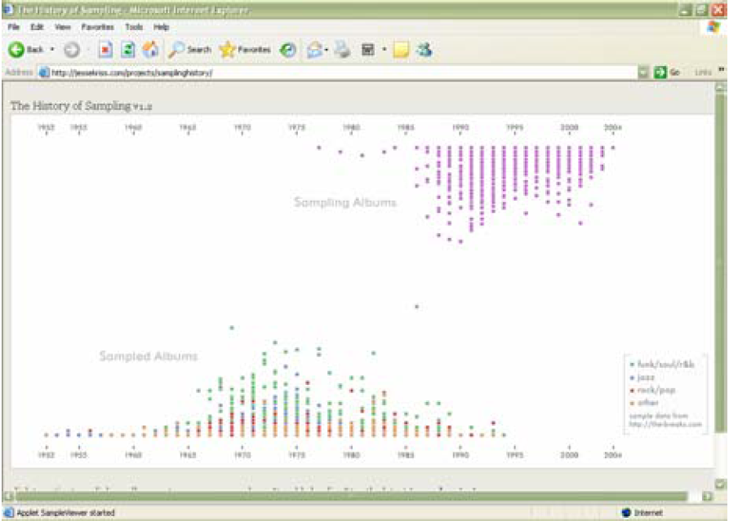
Example 6
http://jessekriss.com/projects/samplinghistory/
History of Sampling

Slide 33
Interaction
Note key role interaction plays in previous example
Common theme in time-series visualization

Slide 34
Example 7
Computer system logs
Potentially huge amount of data
  Tedious to examine the text
Looking for unusual circumstances, patterns, etc.
MieLog
  System to help computer systems administrators examine log files
  Interesting characteristics
  Takada & Koike LISA ‘02

Slide 35
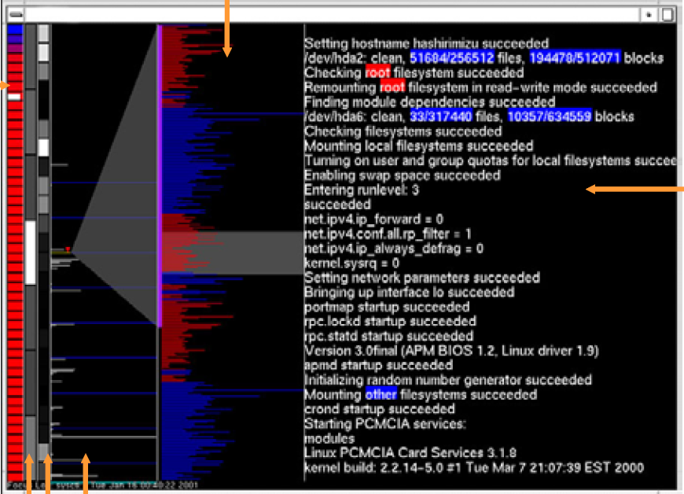
Outline Area
Pixel per character
Tag area
block for
each unique
tag, with
color
representing
frequency
(blue-high,
red-low)
Message area
actual log
messages
(red – predefined
keywords
blue – low
frequency
words)
Time area days, hours, &
frequency histogram
(grayscale, white-high)

Slide 36
Interactions
Tag area
  Click on tag shows only those messages
Time area
  Click on tiles to show those times
  Can put line on histogram to filter on values above/below
Outline area
  Can filter based on message length
  Just highlight messages to show them in text
Message area
  Can filter on specific words

Slide 37
Example 8
TimeFinder
Dynamically query elements in the display
Create query rectangles that highlight items passing through them

Slide 38
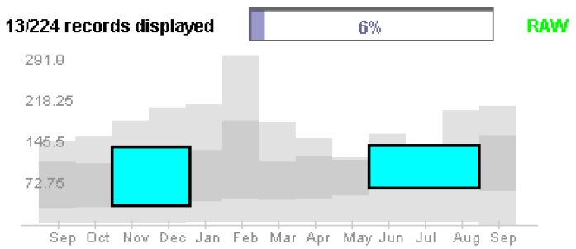
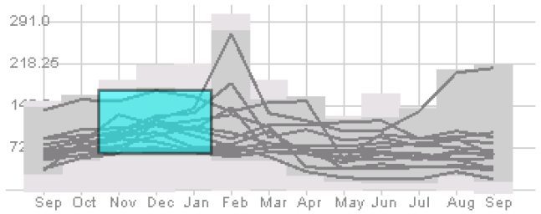
TimeSearcher
Light gray is all data’s extent
Darker grayed region is data envelope that shows extreme values of queries matching criteria
        Hochheiser & Shneiderman Info Vis’04
        http://www.cs.umd.edu/hcil/timesearcher/

Slide 39
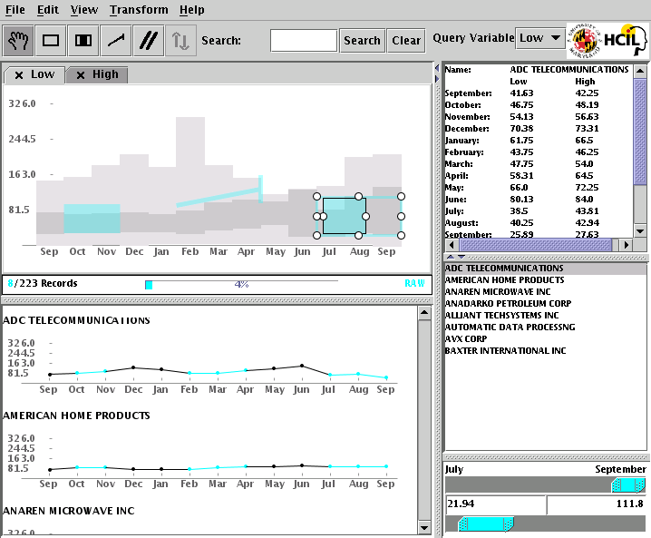
TimeSearcher
Angular Queries

Slide 40
Serial Periodic Data
Data that exhibits both serial and periodic properties
Time continues serially, but weeks, months, and years are periods that recur
Two types
  Pure serial periodic data
  Event-anchored serial periodic data

Slide 41
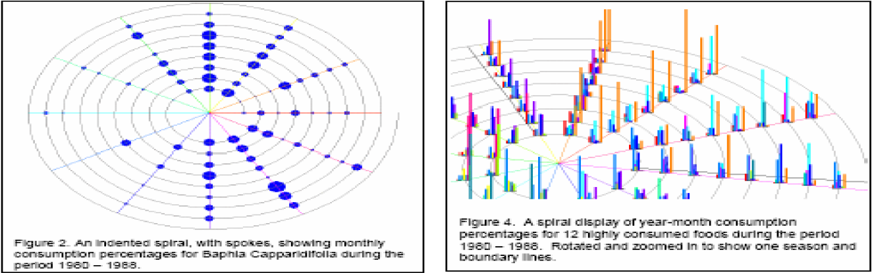
Why A Spiral?
Simultaneous exploration of the serial and periodic attributes of serial periodic data.
Allows for events to be shown over time.
        Carlis, Konstan UIST ’98

Slide 42
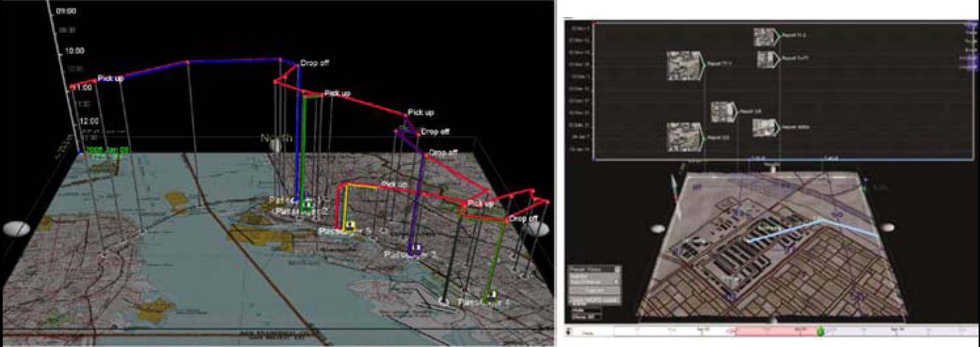
GeoTime
https://www-prev.uncharted.software//
Objective: visualize spatial interconnectedness of information over time and geography with interactive 3-D view

Slide 43
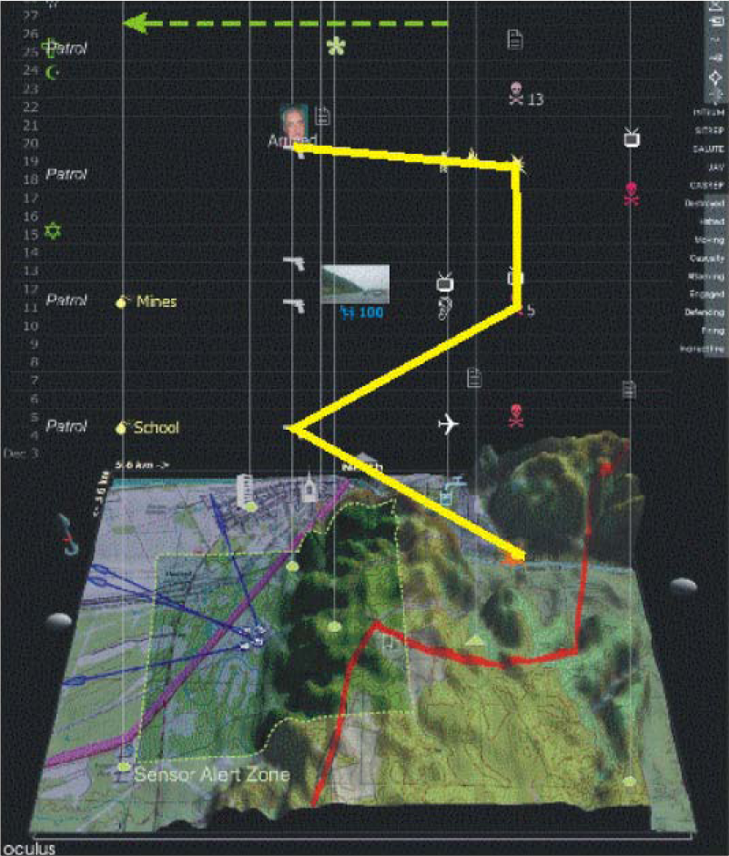
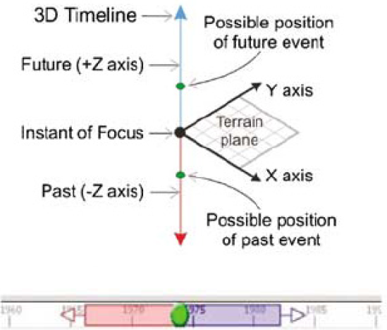
Spatial timelines
  3-D Z-axis
  3-D viewer facing
  Linked time chart

Slide 44
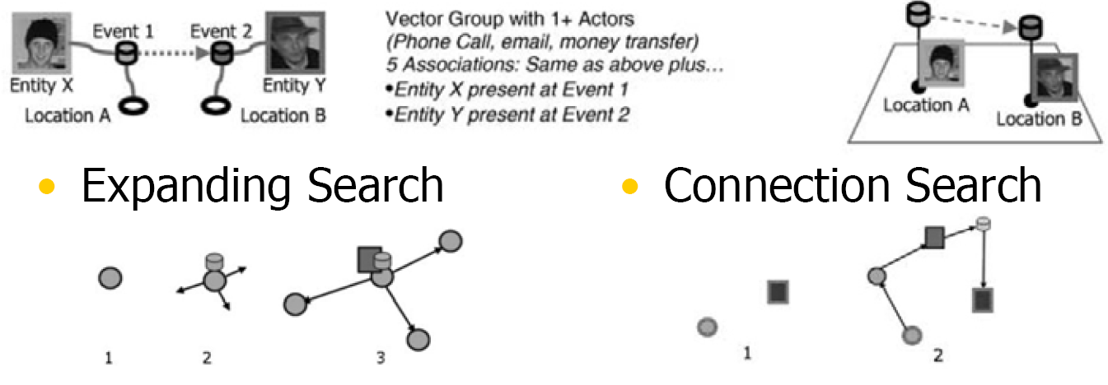
GeoTime Information model
Entities (people or things)
Locations (geospatial or conceptual)
Events (occurrences or discovered facts)
  Combined into groups using Associations

Slide 45
Thanks
John Stasko, Georgia Tech

