Slide 1

IAT 355
Scent, or
Interaction & Navigation
______________________________________________________________________________________
SCHOOL OF INTERACTIVE ARTS + TECHNOLOGY [SIAT] | WWW.SIAT.SFU.CA
IAT 355
1

Slide 2
Interaction
In discrete information spaces, need ability to move from current to new view
Discrete Info space?
  Situations where there are discrete queries
    Web
    Between moves in dynamic query
IAT 355
2

Slide 3
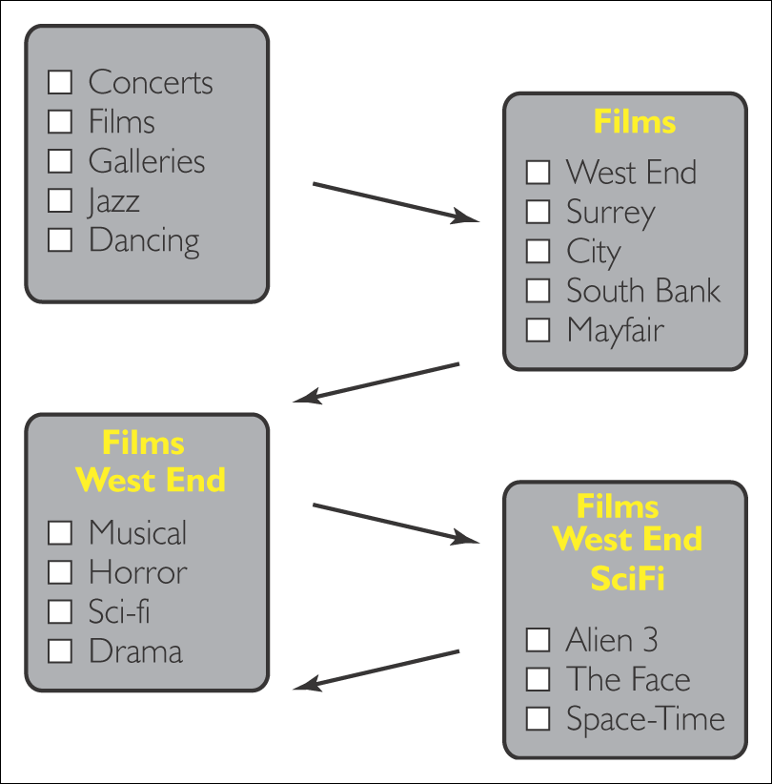
Discrete information space
Stepped interaction
Figure 5.2

Slide 4
Figure 5.3
Discrete information space
Continuous interaction
Responsive system

Slide 5
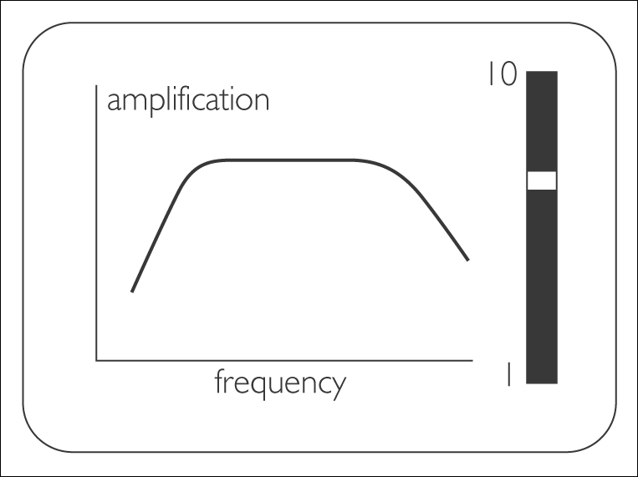
Figure 5.5
Continuous interaction
Continuous relation
Immediate response
Preliminary calculation may be needed

Slide 6
Figure 5.6 Two classes of information space

Slide 7
Figure 5.7 Information spaces, interaction modes and examples of their combination

Slide 8
Norman’s Action Cycle
Figure 5.8 Norman’s Action Cycle

Slide 9
Perceive-Think-Act
In small-scale visualizations, this is easy
  Select variable to map to X
  Select color of Honda Cars
In large-scale info spaces, the volume of data is too large
Must be selected, or Navigated through
  WWW

Slide 10
Navigation Questions
Where am I?
Where can I go?
How do I get there?
What lies beyond?
Where can I usefully go?
Where have I been?

Slide 11
Sensitivity
A movement in information space and the interaction required to achieve it
SM – Sensitivity Movement
  Visible cues to future locations
    Labeled hyperlinks on web
    Signs, labeled doors in real life
SI – Sensitivity Interaction
  Actions you can take to change location
    Click on a button
    pass through door

Slide 12
SM, SI
SM: Black bars indicate that only one attribute does not satisfy
SI: Range sliders under each histogram
Black encoding of houses that fail one attribute limit provides sensitivity information

Slide 13
SM, SI
SM: Yellow range shows “populated” region of parameter
SI: Arrowheads
Figure 5.22 In a limit positioning tool colour coding indicates that selection will be unaffected while the lower limit stays within the white region. When a limit moves into the yellow region selection will be affected

Slide 14
Where can I go?
Often answered by displaying possibilities
In InfoVis case, showing what is in and/or beyond current range
  Outlook: Preview email content
  Google: Show context or search terms
  Dynamic Query: next slide

Slide 15
Figure 5.24 A possible modification to the Dynamic Queries interface. Houses violating only one limit are identified, so that sensitivity is explicit rather than having to be discovered by manual movement of the limits

Slide 16
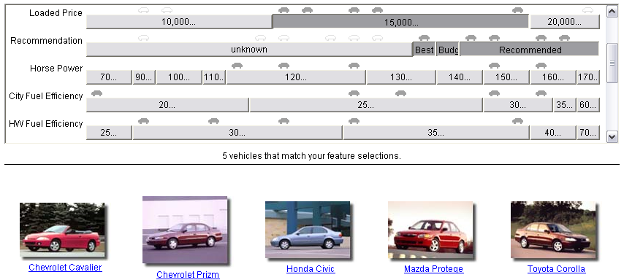
Figure 5.25 In the EZChooser outline cars are those that satisfy all requirements except one. Selection of the range immediately underneath an outline car ensures that the car then satisfies all requirements

Slide 17
Figure 5.49 Limits placed on the four stresses S1 to S4 have been brushed into the parameter histograms, with red designs indicating those which satisfy all limits on S1, S2, S3 and S4

Slide 18
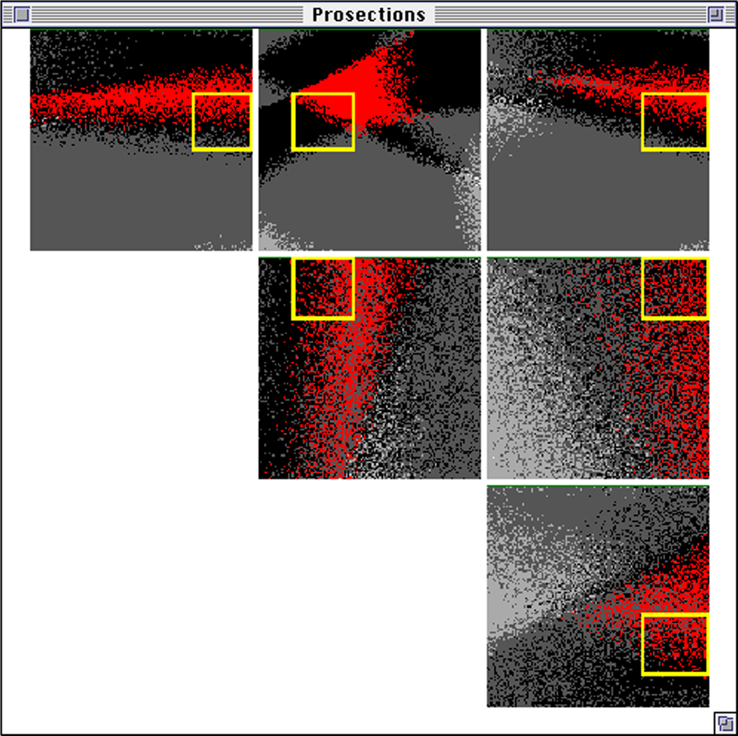
Figure 5.50 A prosection matrix associated with a design involving four parameters. Red indicates the location of designs that satisfy all performance limits. Yellow defines the regions within which the designs of a mass-produced design will lie as a result of manufacturing tolerances on the parameters

Slide 19
Residue
An indication of distant content in SM encoding

Slide 20
Scent
Scent: The perceived benefit associated with a movement in information space, evaluated as one interprets one or more cues
Where can I usefully go from here?

Slide 21
remote content
Residue
(= cue encoding
remote content)
sensitivity cues
SM and SI
encoding
human interpretation
Interpreted
sensitivity cues
and residues
scent
human evaluation
of the benefit of
available SMs
Figure 5.31 The relation between sensitivity, residue and scent

Slide 22
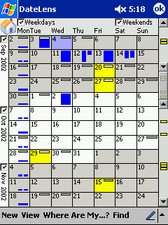
DateLens
Search for HCIL: Highlight yellow
Yellow highlights extend beyond visible region in scrollbar

Slide 23
Where am I?
Navigational aids

Slide 24
Figure 5.39 Available paths from the current location in discrete information space

Slide 25
Figure 5.40 Location breadcrumbs (red) provide an awareness of the structure of a site within which the current location resides

Slide 26
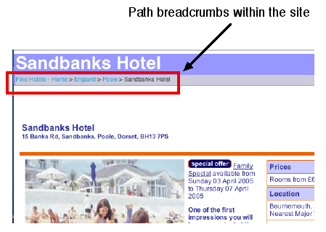
Figure 5.41 An example of path breadcrumbs within a website

