Slide 1
Computer Graphics Overview
Color
Displays
Drawing Pipeline

Slide 2
Color
Light in range 400-780 nm
Tristimulus theory allows color to be reproduced by 3 color components
Subtractive: Cyan, Magenta, Yellow CMY - Used in printing
Additive: Red, Green, Blue -- RGB

Slide 3
Perception
Eye has light sensitive cells on the retina:
Cones - 3 Types
“Red”, “Green”, and Blue
Spectral Response Curves
Rods - “monochrome”

Slide 4
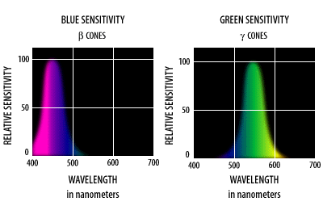
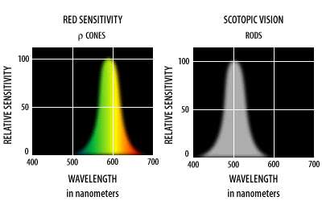
Color Perception

Slide 5
Additive Color
Additive: Red, Green, Blue -- RGB
Red + Blue + Green light added together = White
Basis of Color LCD
1
2
3
4

Slide 6
Displays
Color LCD contains rectangular array of colored dots - Pixels
RGB Triads
R, G, and B controlled separately per pixel
8 bits for each R, G and B

Slide 7
Frame Buffer
Stores image to be refreshed on Display
Dual port: Refresh port + Random-access port
Video RAM
Random-Access port used to load frame buffer with images

Slide 8
How do we turn on pixels?
We use the Standard Graphics Pipeline
We start with geometric items to draw
Each item is passed down the pipeline to the frame buffer.
Start with polygons
End with filled pixels

Slide 9
Programmer’s Model
Data → Application → Graphics Library → Hardware → Screen
Data: Info you want to draw
Application: (Rockets + Asteroids)
Graphics Library: (Processing, OpenGL)
Hardware: GPU (ATI / nVidia)
Screen: GPU’s frame buffer memory

Slide 10
Drawing Pipeline
Standard drawing process uses a pipeline of computations
Starts with: Collection of polygons
Ends with: Image stored in frame buffer
(Desired result)

Slide 11
Pipeline
Input device ->
Model traversal ->
Model transform ->
Viewing transform ->
Clipping ->
Project & Map to Viewport ->
Lighting ->
Shading ->
Rasterization -> Display

Slide 12
Pipeline:Model Traversal
Data structure of Polygons
Each polygon in own coordinate system
List:
0
1
2
3

Slide 13
Pipeline: Modeling Transform
Move each polygon to its desired location
Operations: Translate, Scale, Rotate
y
0
1
2
3
x

Slide 14
Pipeline: Viewing Transform
Transform the geometry of the scene into the coordinate space of the camera
The model truck going up a hill– the camera pans out
y
x

Slide 15
Clipping
Viewport is area of Frame Buffer where new image is to appear
Clipping eliminates geometry outside the viewport
Resulting
Polygon
Clipping
Viewport

Slide 16
Rasterization
Find which pixels are covered by polygon:
Plane Sweep: For each polygon
go line-by-line from min to max
go from left boundary to right boundary pixel by pixel
Fill each pixel
2D Process

Slide 17
Data Representation
2D Objects: (x, y) a 2D Vector
3D Objects: (x, y, z) a 3D Vector
2D Scale: (Sx, Sy) a 2x2 Matrix
2D Rotate (R theta)
2D Translate (Tx, Ty)
(
)
(
)
(
)
(
)
Sx 0 2 0 x 4 = 8
0 Sy 0 3 5 15

Slide 18
Matrix
A Matrix is a rectangular array of numbers
A single Matrix can be labelled by a single variable
Geometric operations can be represented by a matrix:
Multiply the matrix times vector to get new vector:
Vnew = M x Vold

Slide 19
Scale
(
)
(
)
(
)
(
)
(
)
Sx 0 2 0 x 4 = 2 x 4 + 0 x 5 = 8
0 Sy 0 3 5 0 x 4 + 3 x 5 = 15

Slide 20
2D Rotation
(
)
(
)
(
)
cos θ -sin θ 0 -1 x 3 = -4
sin θ cos θ 1 0 4 3
θ
x
x

Slide 21
Homogeneous coordinates
Translate(Tx, Ty, Tz)
X’ = X + Tx
Y’ = Y + Ty
Z’ = Z + Tz
y
y
x' = x + 3
y' = y + 2
x
x

Slide 22
Homogeneous Coordinates
Add a 4th value to a 3D vector
(x/w, y/w, z/w) <-> (x, y, z, w)
1 | 0 | 0 | Tx |  | X |  | X+Tx
0 | 1 | 0 | Ty | * | Y | = | Y+Tz
0 | 0 | 1 | Tz |  | Z |  | Z+Tz
0 | 0 | 0 | 1 |  | 1 |  | 1

Slide 23
3D Graphics

Slide 24
Project & Map to Viewport
Viewport is area of Frame Buffer where new image is to appear
Projection takes 3D data and flattens it to 2D
Eye
Projection Plane
(Screen)

Slide 25
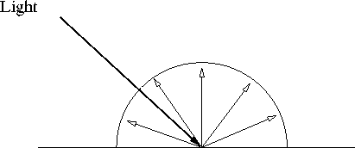
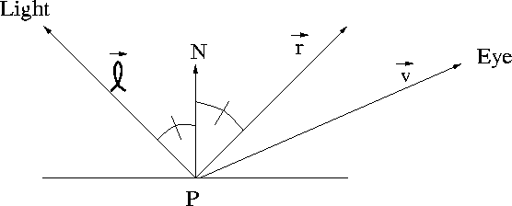
Lighting
Simulate effects of light on surface of objects
Each polygon gets some light independent of other objects
Diffuse (Lambertian)
Specular

Slide 26
Shading
Lighting could be calculated for each pixel, but that’s expensive
Shading is an approximation:
Gouraud shading: Light each vertex
Interpolate color across pixels

Slide 27
Rendering Pipeline
Input device ->
Model traversal ->
Model transform ->
Viewing transform ->
Clipping ->
Project & Map to Viewport ->
Lighting ->
Shading ->
Rasterization -> Display

