Slide 1
IAT 355
Scene Graphs

Slide 2
Scene Graphs
A data structure that stores information about a graphics scene
Each node has information that structures the interpretation of child nodes

Slide 3
Computer Graphics
In Processing we use immediate mode graphics
When we define a geometric object:
Call its drawing code
glPushMatrix()
glBegin( GL_TRIANGLES );
glVertex3f( 1.0, 2.0, 3.0 ); ...
glEnd();
glPopMatrix();

Slide 4
Immediate Mode
Graphics objects are not retained once they are drawn
To redraw the scene, must reexecute the code
Makes sense, because the screen needs redrawing when new info arrives

Slide 5
OpenGL and Objects
OpenGL has a weak notion of objects
Eg. Consider a red cube
Model the cube with squares
Color is determined by OpenGL state (current color, current lighting)
Not really an object

Slide 6
Imperative Programming Model
Example: rotate the cube
Application sends cube data to the graphics subsystem
The graphics subsystem maintains state
Current rotation, translation...
The rotate function must know how the cube us represented
Vertex list
Edge list

Slide 7
Object Oriented Graphics
In OO graphics, the representation is stored with the model
The application sends updates to the cube model, which stores state such as transformation, color
The object contains functions that allow it to transform itself

Slide 8
Java
The obvious means to do this is to store objects in instances of classes
Methods do transformation and trigger drawing calls

Slide 9
Cube object
Create an object that allows us to store rotation, translation, color...
Cube myCube ;
myCube.color[0] = 1.0 ;
myCube.color[1] = 0.0 ; ...
myCube.matrix [0][0] = 1.0 ; ....

Slide 10
Cube object functions
Also want common functions to act on the cube’s data:
myCube.translate( tx, ty, tz );
myCube.rotate( r, 1.0, 0.0, 0.0 );
myCube.setColor( r, g, b);
Draw it!
myCube.render();

Slide 11
class cube {
public:
float color [3] ;
float matrix[4][4] ;
private:
//implementation
}

Slide 12
The Implementation
Can choose any old way of representing the cube
Vertex list, polygons...
Private stuff accesses the public piece
Render method makes OpenGL calls

Slide 13
Other Objects
Other types of objects are:
3D Cameras
3D Lights
Also non-geometric things
Materials, colors
Matrices (storing geometric transformations)

Slide 14
Application
cube myCube ;
material plastic ;
myCube.setMaterial( plastic );
camera frontView;
frontView.position( x, y, z );

Slide 15
Scene Descriptions
If you can represent all scene elements as objects
Cameras
Lights
Material
Geometry
Put it all in a tree and traverse the tree
Render scene by traversal

Slide 16
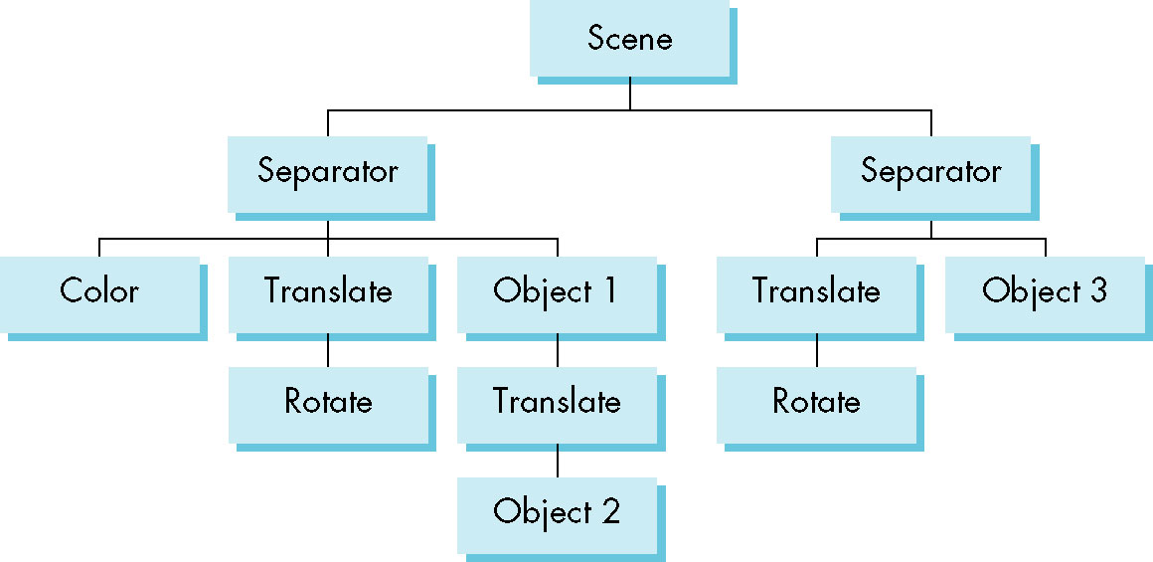
Scene Graph

Slide 17
Scene Graph
glPushAttrib
glPushMatrix
glColor
glTranslate
glRotate
Object1
glTranslate
Object2
glPopMatrix
glPopAttrib
...

Slide 18
Scene Graph Traversal
Similar to preorder traversal of binary tree
Visit a node
“Activate” the node -- pushMatrix/Attrib
Vist all children in child order
“UNActivate” node -- popMatrix/Attrib

Slide 19
Separator nodes
Necessary to mark places where attribute changes take place
Where the OpenGL push/pop live
Advantage:
You can write a universal traversal algorithm
Traversal order must be predictable
In OpenGL, state changes stick around
Setting color sticks until the next color change

Slide 20
Scene Graphs
There is a very important strategy:
Transform Code into a Data Structure
What was previously a bunch of OpenGL calls is now:
Graph nodes of various kinds
Each node type has well-defined rules

Slide 21
Scene Graph Hierarchy
Changes to Parent nodes affect all children
Translate of a sub-tree moves all of its nodes
Specify this large-scale change in one place
The scene graph rules handle the rest

