Slide 1
IAT 355
Text
______________________________________________________________________________________ SCHOOL OF INTERACTIVE ARTS + TECHNOLOGY [SIAT] | WWW.SIAT.SFU.CA
IAT 355
1

Slide 2
Text is Everywhere
We use documents as primary information artifact in our lives
Our access to documents has grown tremendously in recent years due to networking infrastructure
IAT 355
2

Slide 3
How Can InfoVis Help?
Example Specific Tasks
Which documents contain text on topic XYZ?
Which documents are of interest to me?
Are there other documents that might be close enough to be worthwhile?
What are the main themes of a document?
How are certain words or themes distributed through a document?
IAT 355
3

Slide 4
Related Fields
Information Retrieval
Active search process that brings back particular entities
InfoVis
Perhaps not sure precisely what you’re looking for
Browsing task more than search
IAT 355
4

Slide 5
Challenge
Text is nominal data
Does not seem to map to geometric presentation as easily as ordinal and quantitative data
The “Raw data --> Data Table” mapping now becomes more important
IAT 355
5

Slide 6
Document Collections
How to present document themes or contents without reading docs?
Who cares?
Researchers
News people
CSIS
Market researchers
IAT 355
6

Slide 7
Vector Space Analysis
How does one compare the similarity of two documents?
One model
Make list of each unique word in document
Throw out common words (a, an, the, …)
Make different forms the same (bake, bakes, baked)
Store count of how many times each word appeared
Alphabetize, make into a vector
IAT 355
7

Slide 8
Vectors, Inner Products
A The quick brown fox jumped over the lazy dog
B The fox found his way into the henhouse
C The fox and the henhouse are both words
Vector A l Vector B = 1 VectorB l VectorC = 2
Thus B and C are most similar
 | quick | brown | fox | jump | lazy | dog | find | his | way | henhouse | both | word | SUM
A | 1 | 1 | 1 | 1 | 1 | 1
B |  |  | 1 |  |  |  | 1 | 1 | 1 | 1
A.B |  |  | 1 |  |  |  |  |  |  |  |  |  | 1
C |  |  | 1 |  |  |  |  |  |  | 1 | 1 | 1
B.C |  |  | 1 |  |  |  |  |  |  | 1 |  |  | 2
IAT 355
8
Notes:
Here are 3 example sentences.
The table shows the corresponding word vectors A, B, and C, plus the results
A.B and B.C

Slide 9
Vector Space Analysis
Model (continued)
Want to see how closely two vectors go in same direction, inner product
Can get similarity of each document to every other one
Use a mass-spring layout algorithm to position representations of each document
Similar to how search engines work
IAT 355
9

Slide 10
Some adjustments
Not all terms or words are equally useful
Often apply TF/IDF
Term Frequency / Inverse Document Frequency
Weight of a word goes up if it appears often in a document, but not often in the collection
IAT 355
10

Slide 11
Process
IAT 355
11

Slide 12
Smart System
Uses vector space model for documents
May break document into chapters and sections and deal with those as atoms
Plot document atoms on circumference of circle
Draw line between items if their similarity exceeds some threshold value
Salton et al Science ‘95
IAT 355
12

Slide 13
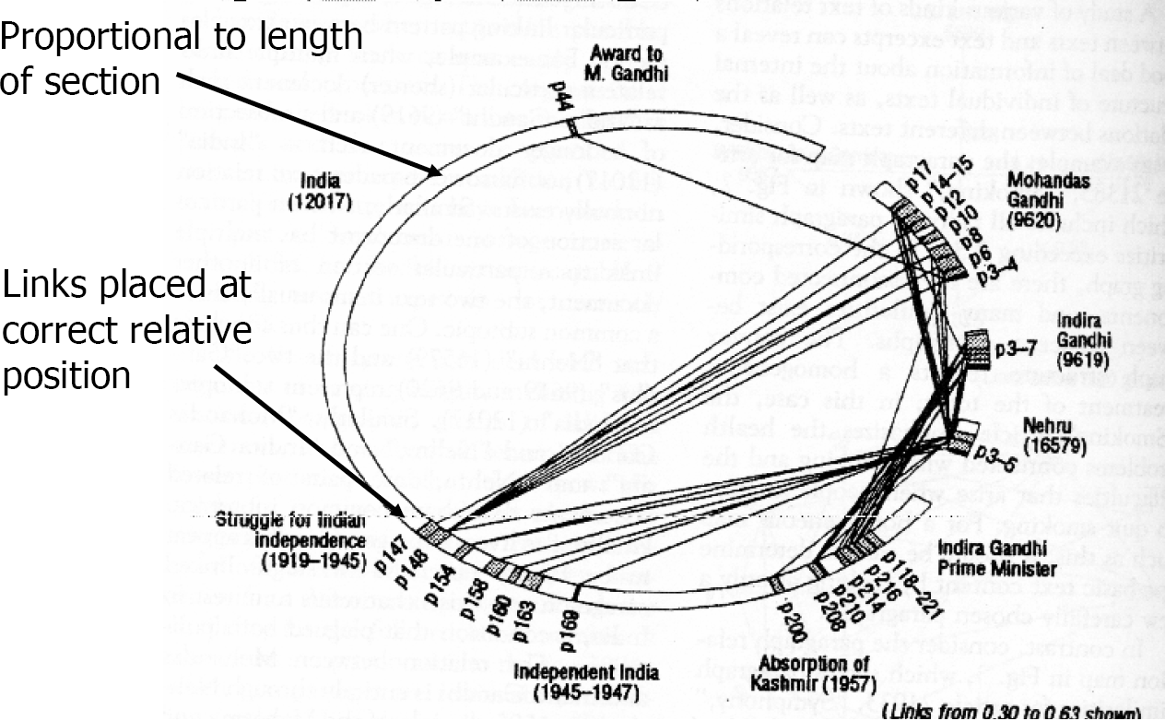
Nov 20, Fall 2007
IAT 355
13

Slide 14
Text Relation Maps
Label on line can indicate similarity value
Items spaced by length of section
IAT 355
14

Slide 15
Text Themes
Look for sets of regions in a document (or sets of documents) that all have common theme
Closely related to each other, but different from rest
Need to run clustering process
IAT 355
15

Slide 16
VIBE System
Smaller sets of documents than whole library
Example: Set of 100 documents retrieved from a web search
Idea is to understand contents of documents relate to each other
Olsen et al Info Process & Mgmt ‘93
IAT 355
16

Slide 17
Focus
Points of Interest
Terms or keywords that are of interest to user
Example: cooking, pies, apples
Want to visualize a document collection where each document’s relation to points of interest is shown
Also visualize how documents are similar or different
IAT 355
17

Slide 18
Technique
Represent points of interest as vertices on convex polygon
Documents are small points inside the polygon
How close a point is to a vertex represents how strong that term is within the document
Term1
Term3
Term2
IAT 355
18

Slide 19
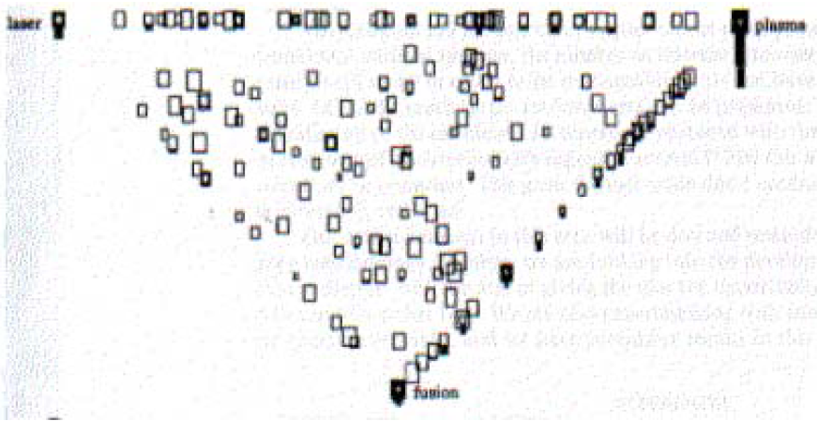
Example Visualization
laser
plasma
fusion
IAT 355
19

Slide 20
VIBE Pro’s and Con’s
Effectively communicates relationships
Straightforward methodology and vis are easy to follow
Can show relatively large collections
Not showing much about a document
Single items lose “detail” in the presentation
Starts to break down with large number of terms (eg. 8 terms: octagon)
IAT 355
20

Slide 21
InSpire
Clusters Documents by word vectors
K-means Clustering method:
Select K random docs (cluster centers)
For Each remaining document:
Assign it to the closest of the above K docs
(Creates K clusters)
For each cluster, compute “average” cluster center
Repeat 2 and 3 until every doc stops moving from cluster to cluster

Slide 22
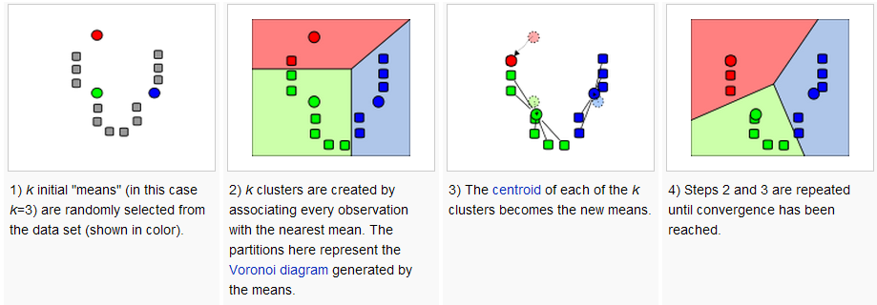
K-means
Thanks, Wikipedia!

Slide 23
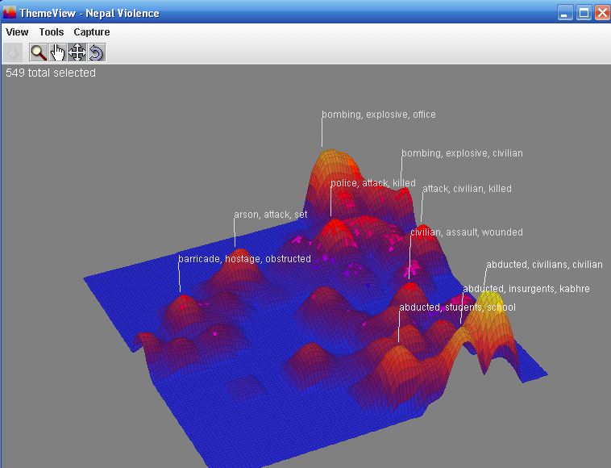
InSpire

Slide 24
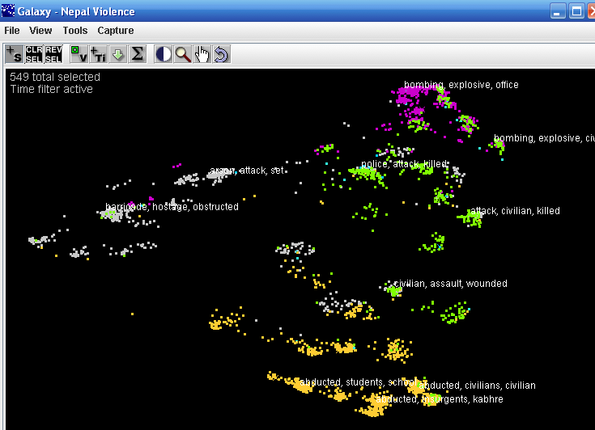
InSpire

Slide 25
InSpire
Clusters docs, then reports the most common TF/IDF words
Presents docs in “Galaxy” display
Projects from high-dimensional space to 2D

Slide 26
Thanks: John Stasko
IAT 355
26

