Slide 1
Representing Data with Patterns
Slides from Lyn Bartram
Mar 2, 2017

Slide 2
Introduction
Finding patterns is key to information visualization.
Expert knowledge is about understanding patterns (Flynn effect)
Example Queries: We think by making pattern queries on the world
Patterns showing groups?
Patterns showing structure?
When are patterns similar?
How should we organize information on the screen?
Notes:
enty-three years ago, an American philosophy professor named James Flynn discovered a remarkable trend: Average IQ scores in every industrialized country on the planet had been increasing steadily for decades. Despite concerns about the dumbing-down of society - the failing schools, the garbage on TV, the decline of reading - the overall population was getting smarter. And the climb has continued, with more recent studies showing that the rate of IQ increase is accelerating. Next to global warming and Moore's law, the so-called Flynn effect may be the most revealing line on the increasingly crowded chart of modern life - and it's an especially hopeful one. We still have plenty of problems to solve, but at least there's one consolation: Our brains are getting better at problem-solving.

Slide 3
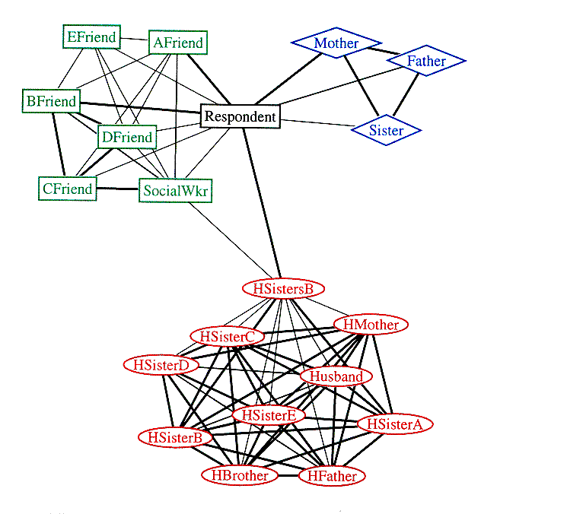
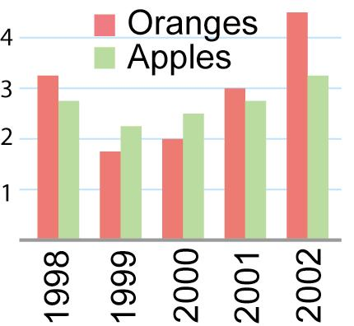
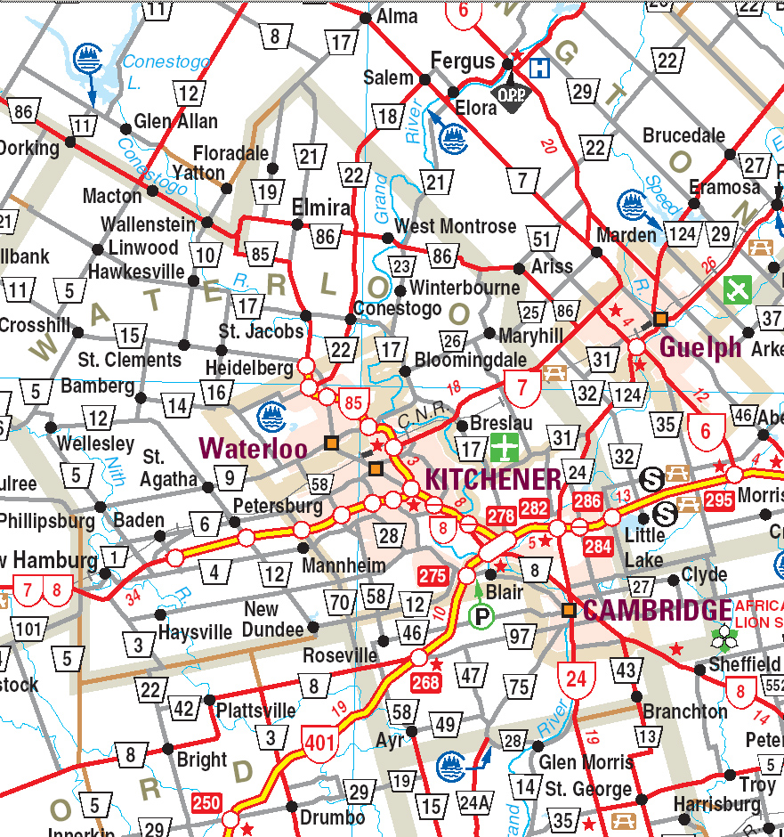
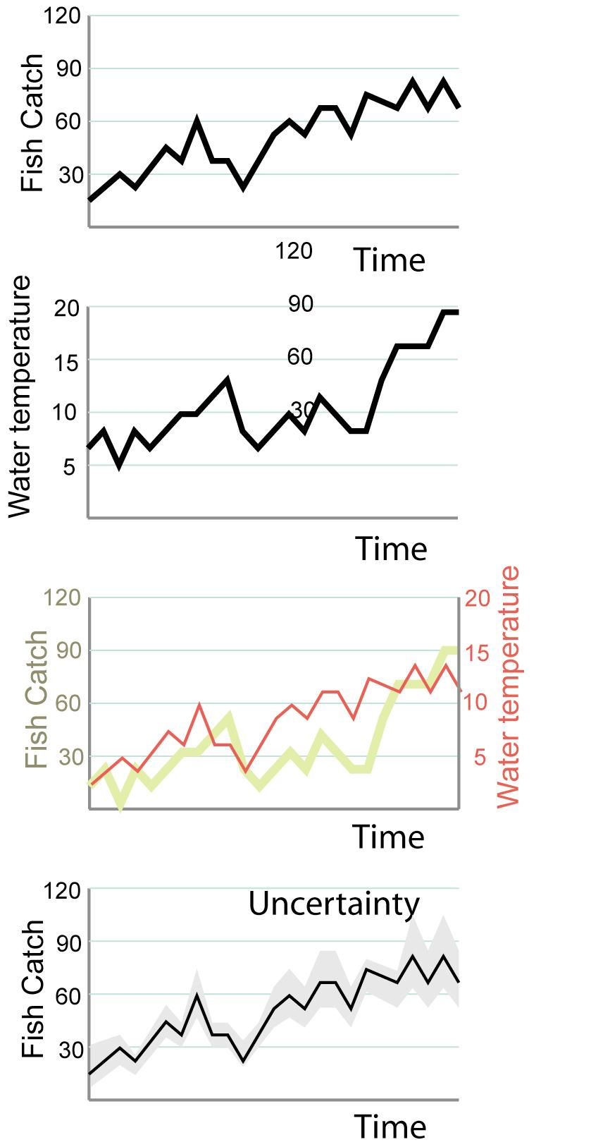

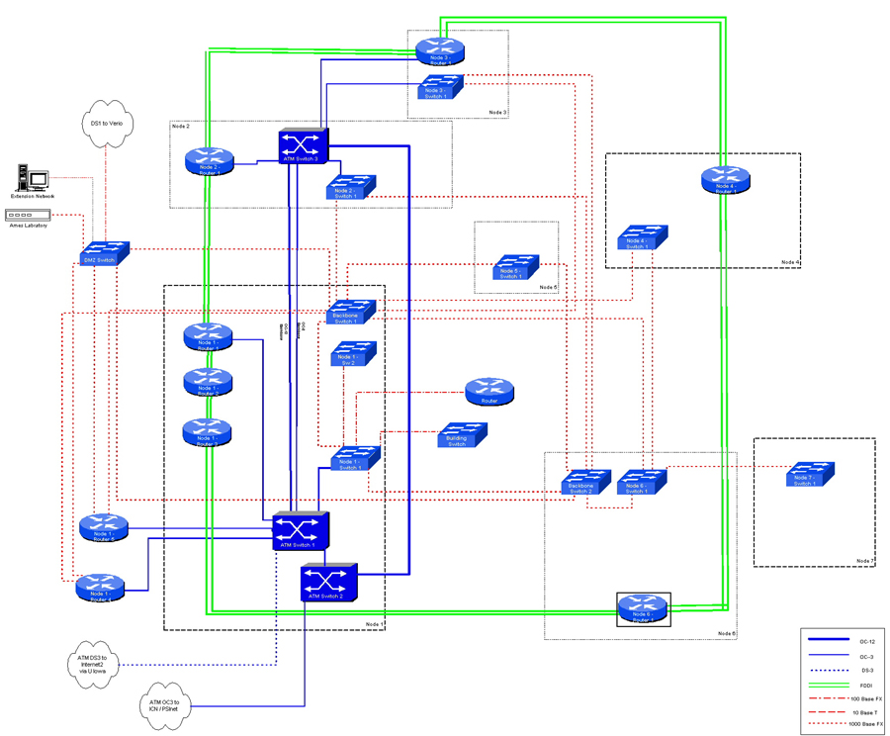

Slide 4
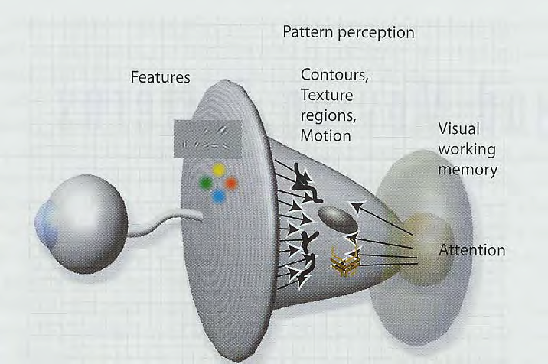
Figure 6.1 Pattern perception forms a middle ground where the bottom-up processes of feature processing meet the requirements of active attention.
Notes:
Early stages ==> feature abstraction, form, motion, colour, sterescopic depth
Middle stages ==> 2D pattern perception , contours are discovered and the woprld is segmented into distinct regions , based on texture, colour, motion and contour
Next ==> structures of objects and scenes
Finally ==> objects and significant patterns pulled out by attentional processes (high-level attentional processes
Pattern perception happens “in the middle”

Slide 5
Pattern perception
In the early stages, massively parallel processing of the entire image occurs.
This drives perception from the bottom up.
Object and visual search recognition is driven from the top down through active attention, meeting the requirements of visual thinking.
Pattern perception is the flexible middle ground where objects are extracted from patterns of features

Slide 6
Pattern perception
Understanding pattern perception provides abstract design rules on how to organise data so important structures are perceived
If we can map information structures to readily perceived patterns then those structures will be more easily interpreted
Learning is important
Priming: once we have seen a pattern we identify it much more easily
Long-term learning: takes place over thousands of occurrences, but some patterns are much easier to learn (quicker) than others

Slide 7
Gestalt psychology
The first serious attempt to understand pattern perception (1912) was the Gestalt school of psychology.
[Max Westheimer, Kurt Koffka, and Wolfgang Kohler (1912)]
The word gestalt simply means pattern in German.
Idea: forms or patterns transcend the stimuli used to create them.
Why do patterns emerge?
Under what circumstances?
They produced a set of Gestalt principles of pattern perception.
Original proposed mechanisms turned out to be wrong
Rules themselves are still useful

Slide 8
The Gestalt laws
The core laws
Proximity
Similarity
Connectedness
Continuity
Symmetry
Closure
Relative Size
Common fate
Principal effects
Figure - ground
Prägnanz : the “organising principle”

Slide 9
Proximity
Spatial proximity is a powerful perceptual organizing principle and one of the most useful in design.
Things that are close together are perceptually grouped together.
Application to display design:
the simplest and most powerful way to emphasize the relationships between different data entities is to place them in proximity in display.

Slide 10
Proximity

Slide 11
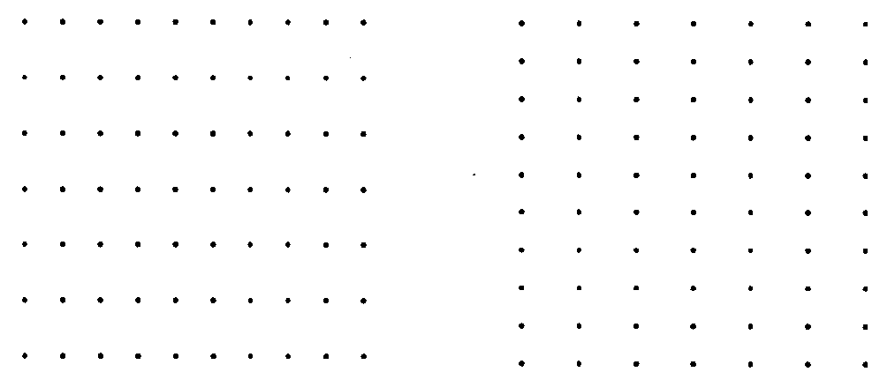
Proximity
rows
columns
Notes:
Because of proximity relationships we see rows on the left and columns on the right

Slide 12

Proximity
We are more likely to associate the lines which are close together than those which are further apart. In this example we tend to see three pairs of lines which are fairly close together (and a lonely line on the far right) rather than three pairs of lines which are further apart (and a lonely line on the far left).

Slide 13
Proximity and density
Principle of spatial concentration.
a
b
We perceptually group regions of similar density
X
Dot x is perceived as part of group a rather than group b although it is equidistant
Notes:
Dot x is perceived as part of group a rather than group b although it is equidistant

Slide 14
Proximity: design implications
a
Emphasize relationship by proximity
Emphasize relationship by spatial density

Slide 15
Similarity
The shapes of individual pattern elements can also determine how they are grouped
Similar elements tend to be grouped together

Slide 16
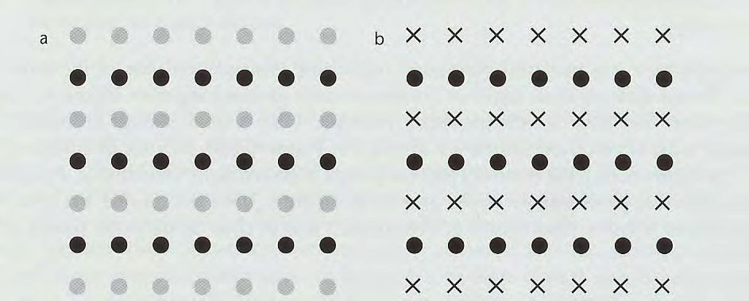
Similarity
Similarity between the elements in alternate rows causes the row percept to dominate

Slide 17
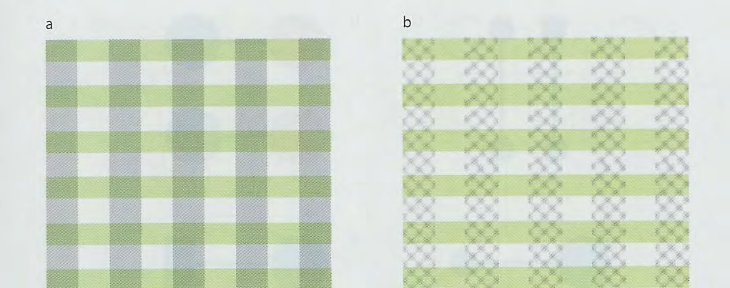
Similarity and integral dimensions
Integral dimensions (colour and grayscale) are used to delineate rows and columns
Separable dimensions (colour and texture) make it easier to attend separately to either the rows or the columns

Slide 18
Similarity and integral dimensions
separable
integral
A: separable dimensions allow both groupings to be perceived – but not simultaneously
B: with integral dimensions we can see both to construct a grid
Notes:
We can have ambiguity. In the case of a) seperable dimensions allow both groupings to be perceived - but not simultaneously
In the case of b) we construct a grid

Slide 19
Continuity
The Gestalt principle of continuity states that we are more likely to construct visual entities out of objects that are smooth and continuous, rather than those that contain abrupt changes in direction.
We see a-b crossing c-d
not a-d or b-c
A
A
D
D
C
B

Slide 20
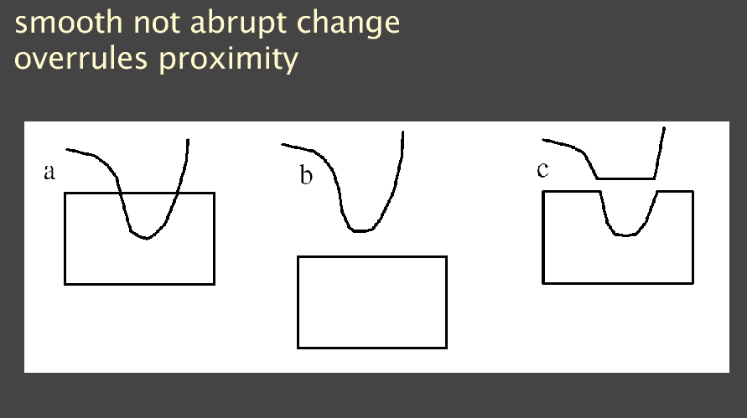
Continuity

Slide 21
Continuity in Diagrams
Connections using smooth or abrupt lines
Which is easier to follow?
Notes:
Studies show that smooth lines are easier to follow

Slide 22
Connectedness
Connectedness can over-rule proximity, colour, size or shape

Slide 23
Connectedness
Connecting graphical objects by a line is a very powerful way of expressing that there is a relationship between them
Basis of node-link diagrams
Most common method of indicating relationships

Slide 24
Symmetry
Symmetry creates visual whole
Powerful organising principle
b and c are seen as figures/objects, where a is a pair of parallel lines
We construct objects in the world
(a) (b) ( c )

Slide 25
Symmetry
Symmetry creates visual whole
Powerful organising principle
Outlines and filled shapes
We see a cross in front of a rectangle not the second option

Slide 26
Symmetry
Possible application is in tasks where data analysts are looking for similar patterns (e.g. in time-series data).
Detect asymmetries effectively

Slide 27
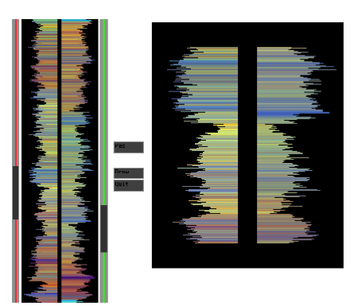
Symmetry (cont.)

Slide 28
Closure
Over-rules proximity
A closed contour tends to be seen as an object
The Gestalt psychologists argued that there is a perceptual tendency to close contours that have gaps
a circle behind a rectangle as in (a), not a broken ring as in (b).

Slide 29
Closure (cont.)
Closed contours to show set relationship
An Euler diagram. This diagram tells us (among other things) that entities can simultaneously be members of sets A and C but not of A, B, and C.
Also, anything that is a member of both B and C is also a member of D.
These rather difficult concepts are clearly expressed and understood by means of closed contours.

Slide 30
Closure
Wherever a closed contour is seen, there is a very strong perceptual tendency to divide regions of space into “inside” or “outside” the contour.
A region enclosed by a contour becomes a common region [Palmer (1992)].
Common region is a much stronger organising principle than simple proximity
This is presumably the reason why Venn-Euler diagrams are such a powerful device for displaying associations among sets of data.

Slide 31
Extending the Euler diagram
Notes:
Closed contours are essential for monitor and window systems
We can use texture and colour as well to emphasise regions and overlap
Closed rectangular contours strongly segment the visual scene

Slide 32
Closure
Rectangular contours strongly segment the visual field.
Creating frame of reference
Position of objects judged based on enclosing frame
Where is this critical?
Notes:
Window systems and monitor arrangements!

Slide 33
Relative Size
Smaller components tend to be perceived as objects
prefer horizontal and vertical orientations

Slide 34
Gestalt organising principles
Figure and ground
Subjective contour
Prägnanz

Slide 35
Figure and Ground
Confronted by a visual image, we seem to need to separate a dominant shape (a 'figure' with a definite contour) from what our current concerns relegate to 'background' (or 'ground')
Symmetry, white space, and closed contour contribute to perception of figure.
The perception of figure as opposed to ground can be thought of as the fundamental perceptual act of identifying objects.

Slide 36
Figures and Grounds
Rubin’s Vase
Competing recognition processes trying to construct objects from the pattern
One basis of trompe l’oeil

Slide 37
Subjective Contour
We construct an object from pieces

Slide 38
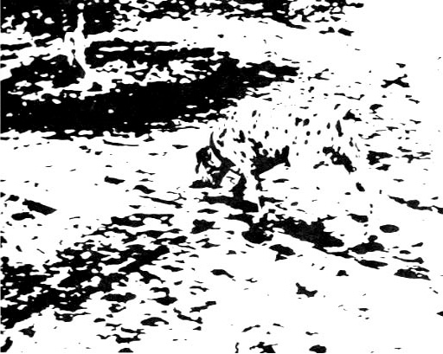
Emergence
(Kosara)
Holistic perception of image

Slide 39
Prägnanz
The law of “good form”
Overarching principle that the simplest and most stable interpretations are preferred
“What the Gestalt principles of perceptual organization suggest is that we may be predisposed towards interpreting ambiguous images in one way rather than another by universal principles…The Gestalt principles can be seen as reinforcing the notion that the world is not simply and objectively 'out there’ but is constructed in the process of perception.”
--Daniel Chandler
http://www.aber.ac.uk/media/Modules/MC10220/visper07.html

Slide 40

Prägnanz
A stimulus will be organized into as good a figure as possible. Here, good means symmetrical, simple, and regular.
here we see a square overlapping a triangle, not a combination of several complicated shapes.

Slide 41
Design example

Slide 42
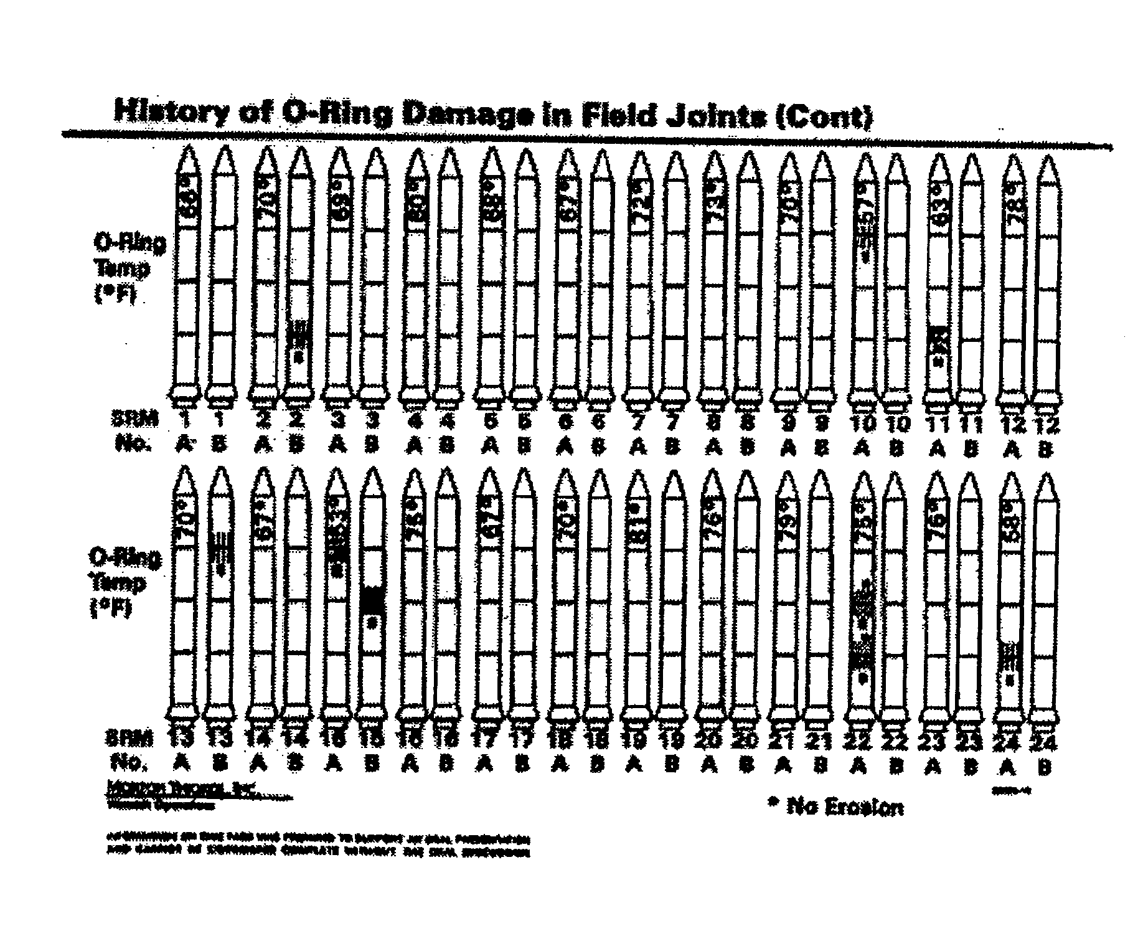
Does this point out relationships?

Slide 43
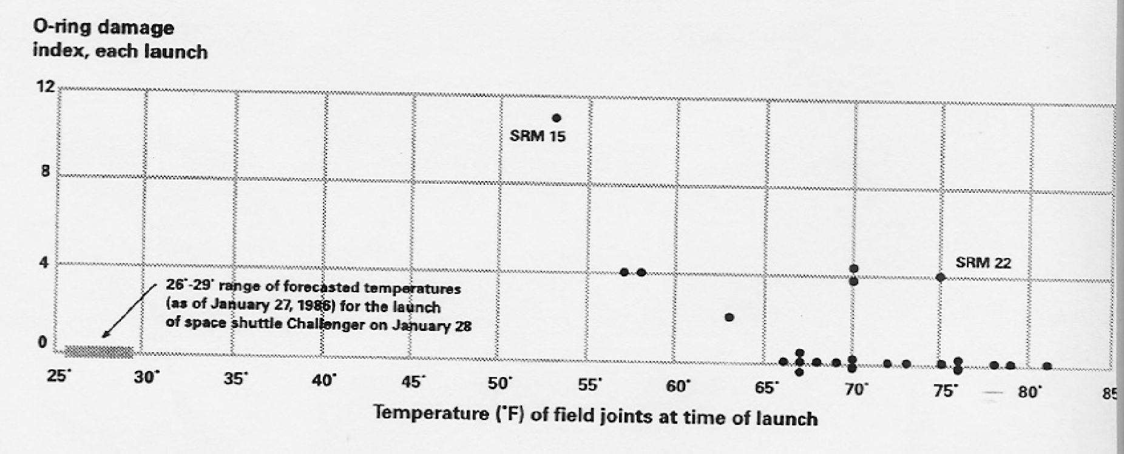
Same Data – Different Plot

