Slide 1
(In)Attention and Attention IAT355
Mar 3, 2017
Slides by Lyn Bartram

Slide 2
This is a useful topic
Understand why you can get students to shut their devices in class ☺
Complaints about inattentive and distracting behaviour
Talking
Texting
Surfing and gaming on laptops
More fundamentally, inform us on limited and realistic expectations

Slide 3
What is Attention ?
"Everyone knows what attention is. It is the taking possession by the mind in clear and vivid form, of one out of what seem several simultaneously possible objects or trains of thought...It implies withdrawal from some things in order to deal effectively with others, and is a condition which has a real opposite in the confused, dazed, scatterbrained state."
William James (1890, p. 403)

Slide 4
What is attention?
the process whereby a person concentrates on some features of the environment to the (relative) exclusion of others
The concentration of mental effort on sensory or mental events
The ability to “pay” attention at both a low and high level is fundamental to how we manage to process information and control external tools and machines in the world.

Slide 5
Bottom-up attention
Some features are processed efficiently, possibly in parallel, across the visual field.
These basic features include color, orientation, shapes, motion.
Search for items based on single features leads to efficient search.
The items "pop out" of the surrounding distractors.
“Preattentive” from Lecture 5
Search for conjunction of features is inefficient.
An example would be searching for a red square among blue squares and red triangles.
We must examine each item individually to find the target.

Slide 6
What this tells us
Inefficient searches show that we are not aware of everything in the entire scene at the same time.
We constantly shift our gaze and our attention to look at different parts of the scene and examine them in detail.
We think we see the scene in detail, but we don't.

Slide 7
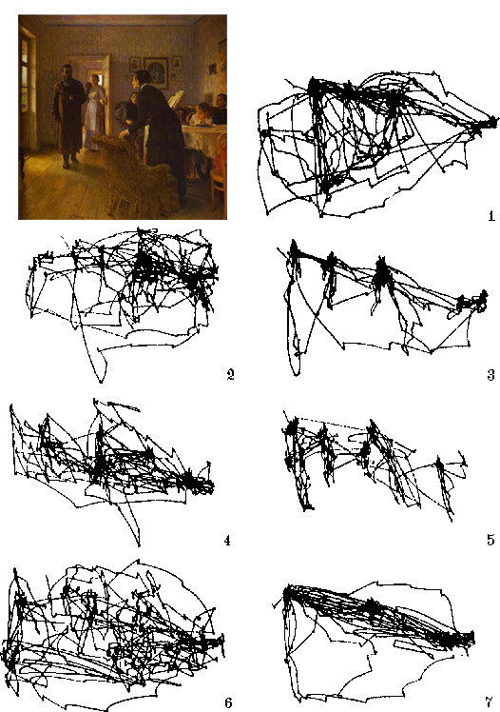
Task-driven
Yarbus (1967) recorded observers’ fixations and saccades while answering specific questions given to them about the scene they were viewing.
Saccadic patterns produced were dependent on the question that had been asked.
Implication [Ward 07]– if we don’t perceive parts of the scene what’s the point rendering it to such a high level of fidelity?!

Slide 8
A Game
Two teams: white and black shirts
Each team passes a ball
Count how many times the black-shirt team passes
You need to be very focused to get it right.

Slide 9
http://www.simonslab.com/videos.html
Discussion: what are the practical implications of this for everyday life?

Slide 10
Inattentional blindness
Phenomena of inability to perceive features in a visual scene if they are not being attended to.
Are there only some kinds of things we see when we are not attending?
What is the relationship between attention and perception?
How much, if anything, of our (visual) world do we perceive when we are not attending to it?
Notes:
Can’t attend to everyhting!

Slide 11
Attention
Determines
What information makes it “in” through perception
How that information is cognitively processed
How we subsequently act or interact
In all modalities you are faster and more accurate when you consciously attend to a task
Attention has a limited capacity
Notes:
It reall is PAYING atention

Slide 12
Early and late selection
Early selection:
Low level features determine what gets through, or cues
Volume
Motion
Brightness
“onset”
Attentional “grab”
Late selection
Everything gets through perceptual filter
Selection is based on importance of recognised percept
Problems with determining complexity of single channel switching.
Notes:
To pdown and bottom up models of attention

Slide 13
Main models in attention research
Selective attention (focused):
Whether we become aware of sensory information
Non-random selection
Stream/bottleneck model
Divided Attention (multitasking)
Attention can be split between multiple tasks
Allocation approach
Is what some of you are doing right now
Control and Automaticity
Notes:
Cocktail party effect

Slide 14
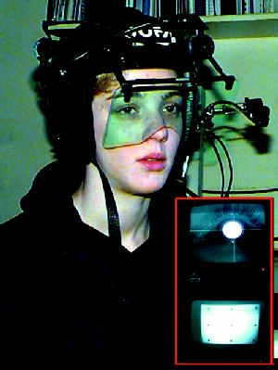
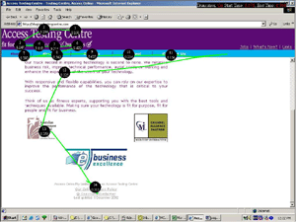
Selective Attention
Spotlight model
Eye movements/fixation

Slide 15
Divided attention
More recent models of attention as a resource that is allocated between processes
Top-down, consciously driven “spotlight” set: focus of attention
How many foci can we maintain?
What kinds of tasks demand more resources than others?
Bottom-up, stimulus driven “demand” events
Involuntary response to perceptual cue
Flashing light or alarm bell
How much can we attend to? No well-established capacity
Notes:
Change blindness demo

Slide 16
Conscious attention and restricted awareness
Can we be conscious of things without attending to them?
Are there only some kinds of things we see when we are not attending?
If we don’t have a highly salient cue of some kind, we will miss changes in the world
Motion
Sound
Sensation
Notes:
Can’t attend to everyhting!

Slide 17
Demo http://www2.psych.ubc.ca/~rensink/flicker/download/

Slide 18
We are constantly making rapid eye movements, known as saccades, as we scan a scene.
Vision is suppressed during saccades.
People fail to notice large changes in the scene if the change occurs during a saccade. (McConkie, Grimes, Ballard and others).
People also fail to notice large changes in the scene if they occur during a brief disruption (e.g. short blank period).
This is known as change blindness. (Rensink et al., 1996)

Slide 19
Blindness galore!
A cut between scenes, with a change in camera angle, can also induce change blindness. Simons and Levin showed this in a series of experiments.
Can you detect the changes?
Movie Perception Test – Conversation
http://www.youtube.com/watch?v=6JONMYxaZ_s
Only 1 in 10 people detected a change.
Change blindness occurs even for objects that are the center of attention:
http://www.youtube.com/watch?v=wBoMjORwA-4
Only 33% of 40 people noticed the main change.
Disruptions in real life can also lead to change blindness:
http://www.youtube.com/watch?v=FWSxSQsspiQ

Slide 20
What’s going on?
What causes change blindness?
We don't see the entire scene in detail.
Only the region attended to is seen in detail.
We constantly shift our eyes to see other parts of the scene in detail.
Only attended regions get into short term memory.
Briefly presented pictures are quickly forgotten (Intraub, 1981; Potter, 1976)
We must serially scan the picture, item by item, to find the one that is changing.
Attention is not enough.
Change in actors show that attention is not enough.
We must intentionally process the details in order to detect the changes.

Slide 21
Automatic and controlled processing
Automatic processing (automaticity):
Highly familiar and learned/known tasks
Do not require conscious attention
Occur without intention
Not available for conscious inspection
Well practiced responses
Unaffected by capacity
Fast
Difficult to modify
Driving a car and listening to the radio
Reading and (not) listening to your partner
Controlled attention
Require conscious attention
Takes resources
Limited capacity
Not well practiced
Slow
Driving on the other side of the road
Reading unfamiliar/rare words
Listening to lyn lecture
Notes:
Can we attend to things “unconsciously”?

Slide 22
Automaticity: the Stroop Effect
blue green red yellow
blue green red yellow
..
blue green red yellow
Notes:
Saying the colour of each word in the last line is more difficult and slower than any of the proceedings lines
Reading is an automatic process and it conflicts with naming the colour of the word

Slide 23
Selective Attention (Visual)
classic Stroop task (1935):
slower to name color when word says a different color than to name the color of an colored square
why does this happen?
reading is an automatic process
color naming is a controlled process
automatic process of reading interferes with our ability to selectively attend to ink color

Slide 24
There’s never enough of it to go around
“What information consumes is rather obvious: it consumes the attention of its recipients. Hence a wealth of information creates a poverty of attention, and a need to allocate efficiently among the overabundance of information sources that might consume it.”
--Herbert Simon, The Sciences of the Artificial
Notes:
How to design for attention …..
So imagine, if you will, what using your laptopis doing to youright jnow and what it is doing to others

Slide 25
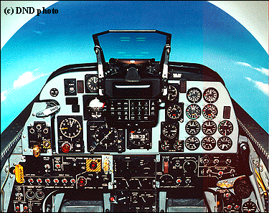
The real-life nature of the issue
CF-5 cockpit

Slide 26
The cell phone study
Cell phone use in driving has been linked to 400% increase in accidents
Assumptions: issue is interference due to handling the cell phone
BUT
No reduction in accidents for those who used hands’ free models.
Why??

Slide 27
The cell phone study conclusion
Cell phone use is an automatic process
During normal car conversations there will be lulls when the driver stops responding/talking because the road conditions require more attention
The passenger is aware of the change in conditions and simply waits for the conversation to continue…
A cell phone caller will increase the demands on the driver, “Hello? Are you still there? Can you hear me now?

Slide 28
Factors affecting attention
Stress
Environmental stressors
Noise, heat, light
Physical conditions
Fatigue, impairment (e.g. blurred vision)
Psychological factors
Fear, anger, boredom, excitement
Optimal level of arousal
Performance deteriorates after it is reached
Current level of demand
It’s not an unlimited resource!

Slide 29
Designing for attention
Two basic goals
Provide relevant information without overloading the user
Attract and engage the user’s attention appropriately
Situation awareness

Slide 30
How to best represent information in a display so that a user finds relevant information?
How best to avoid distraction?
Salience (how perceptually efficient and attractive it is)
Expectation (what and where I expect to see it)
Value/Pertinence (relates to emphasis)
Effort (how much work do I have to put in to find/see/decode it?)

Slide 31
Three Specific Tasks
Supervisory Control Sampling
Target Search/Sampling
Structured Visual Search

Slide 32
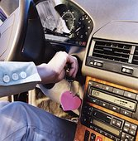
1. Visual supervisory control

Slide 33
Design Principles
Visual scanning in info displays - monitoring (vigilance)
Situation awareness
Build on mental models
Consider direction of scanning and group components
Provide sampling reminders
Create expectation via preview
Reminders during failure
Do not use highly salient cues for low-priority events

Slide 34
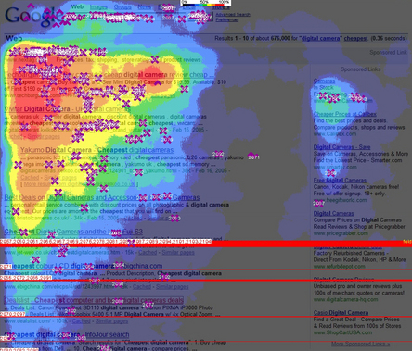
2. Visual Target Detection

Slide 35
Design Strategies
Serial vs parallel search?
Order and conflation of dimensions
Guidelines for Target properties which will induce faster search

Slide 36
Target Properties Inducing Parallel Search
Discriminability from background elements
color, size, brightness, and motion
Simplicity
Defined only by one dimension
No conjunctive search (look for the red square)
Automaticity:
highly familiar

Slide 37
Design Principles
Visual target search in info displays
1. Leverage or train expectation
2. Use salience
3. Combine display & conceptually driven cues
Avoid singletons
Avoid edges
4. Consider effects of aging

Slide 38
3. Structured Visual Search
Design structure of search
Menus
Minimize time to frequent targets
Top down
Linear search
Avoid similarity
Speed is proportional to distance from top

Slide 39
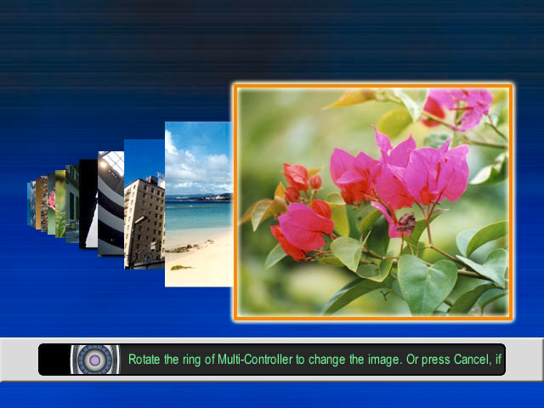
Rapid Serial Visual Presentation

Slide 40
NASA TLX

Slide 41
Divided & Focused Attentions (Reconsider)
We’re bad multitaskers
Unless one task is automatic
Less effect for different modalities

Slide 42
Summary
Attention determines perception
General factors
Three tasks and task-specific factors
Principles for design

