Slide 1
IAT 355
Graphs
______________________________________________________________________________________ SCHOOL OF INTERACTIVE ARTS + TECHNOLOGY [SIAT] | WWW.SIAT.SFU.CA

Slide 2
Graphs
Definition
Mathematical structures used to model pairwise relations between objects
Example relations
Airline Flights
Train stops
Circles of friends of MyFace

Slide 3
What is a Graph?
 | 1 | 2 | 3
1 | 0 | 1 | 0
2 | 1 | 0 | 1
3 | 0 | 1 | 0
Vertices (nodes) connected by
Edges (links)
Adjacency Matrix
1 2 3 | 2 1,3 2
1
3
2
Adjacency List

Slide 4
Graph Terminology
6
1
4
3
2
7
5
Graphs can have cycles
Graph edges can be directed or undirected
The degree of a vertex is the number of edges connected to it
In-degree and out-degree for directed graphs
Graph edges can have values (weights) on them (nominal, ordinal or quantitative)

Slide 5
Trees
Subcase of general graph
No cycles
Typically directed edges
Special designated root vertex

Slide 6
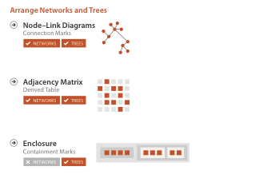
Arrange Networks

Slide 7
Graph Uses
In Information Visualization, any number of data sets can be modeled as a graph
Telephone system
World Wide Web
Distribution network for on-line retailer
Call graph of a large software system
Semantic map in an AI algorithm
Set of connected friends

Slide 8
Graph Uses
Facilitate understanding of complex socioeconomic patterns
Social Science visualization gallery (Lothar Krempel)
Next slide: Krempel & Plumper’s study of World Trade between OECD countries, 1981 and 1992
http://www.mpi-fg-koeln.mpg.de/~lk/netvis/trade/WorldTrade.html

Slide 9
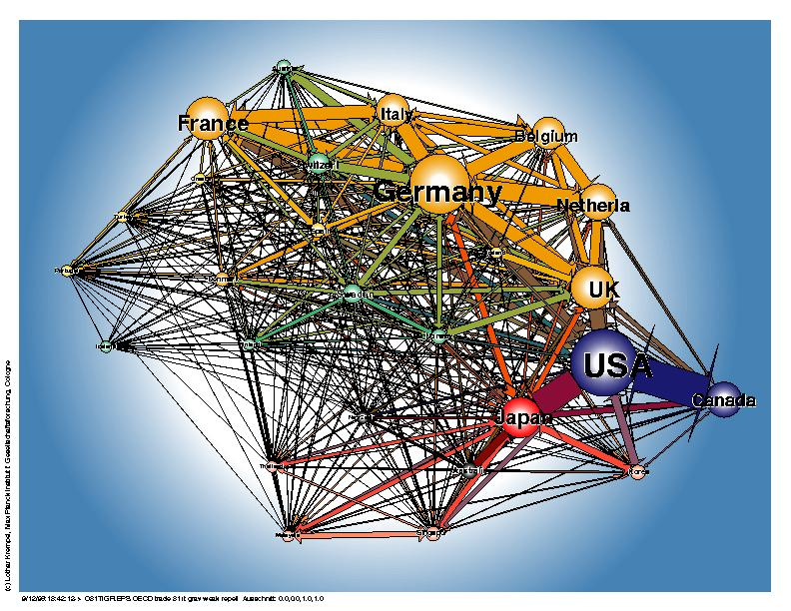
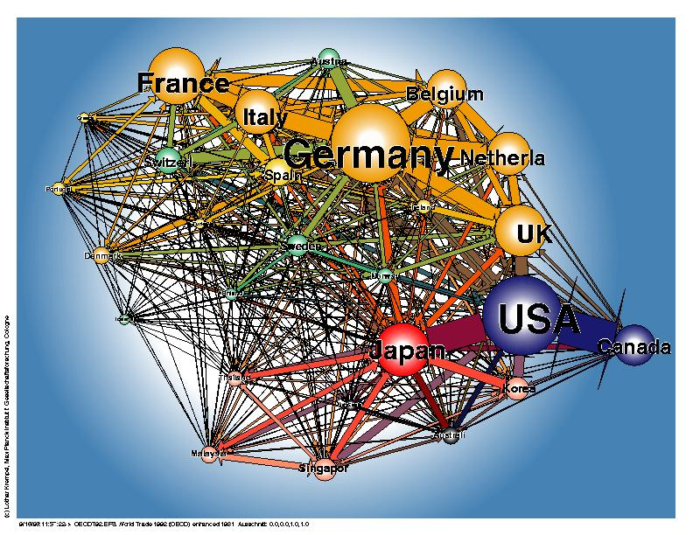
1981 1992
http://www.mpi-fg-koeln.mpg.de/~lk/netvis/trade/WorldTrade.html

Slide 10
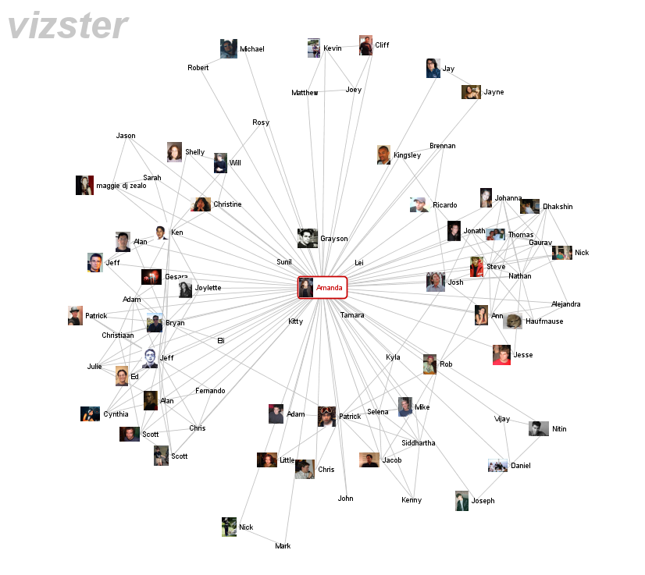
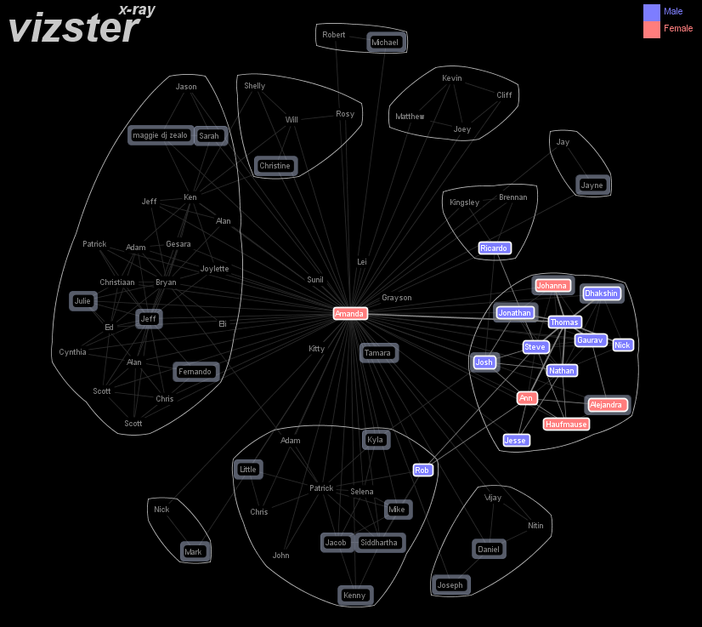
Vizster
Social Network Visualization
Video http://jheer.org/vizster/

Slide 11
Cytoscape
Visualization of protein-protien interaction networks

Slide 12
Graph Uses
Facilitate understanding of network flows, relations
Even information with a ‘geographical’ content can best appear as a ‘network’ rail maps
Geographic landmarks largely suppressed on maps, except water (rivers in Paris, London)

Slide 13
Case Study
AT&T long distance phone network
110 Nodes (switches)
Geographical location
Connected by 12,000 links
Directed, almost completely connected
Data every 5 minutes
EARTHQUAKE
Oct. 17, 1989

Slide 14
Questions
Where are the overloads?
Which links are carrying most traffic?
Was there network damage?
Is there underutilized capacity?
Are calls getting in to affected area or are there bottlenecks?
Is overload increasing or decreasing?

Slide 15
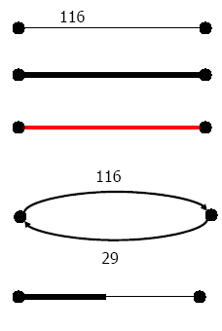
Edge Drawing Strategies
Label
Thickness
Color
Directed

Slide 16
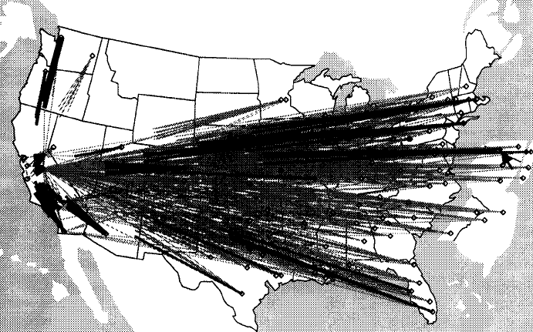

Slide 17
Problems
Too many lines!
Occlusion
Long lines become “more important”
Can’t see what happens in Midwest
Solutions
Use half/half technique out/out
Draw most important last
Use thickness & color for traffic

Slide 19
More Help
Shorten all lines so as to de-emphasize transcontinental links

Slide 20
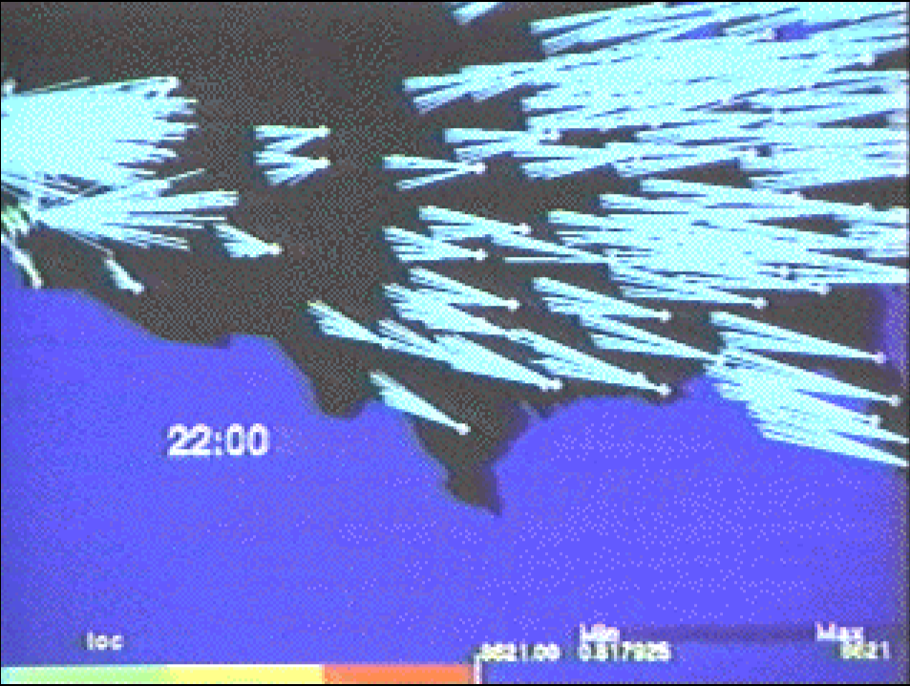

Slide 21
TouchGraph
Facebook Friends graph
http://www.youtube.com/watch?v=YOsbWWvWdjA

Slide 22
Focus of Graph
Particular node may be focus, often placed in center for circular layout
How does one build an interactive system that allows changes in focus?
Use animation
Maintain constancy of shape, link crossings

Slide 23
Graph Layout Idiom: Force Directed
Visual Encoding
link connection marks, node point marks
Considerations
Spatial position: no meaning directly encoded
left free to minimize crossings
Proximity semantics?
sometimes meaningful
sometimes arbitrary, artifact of layout algorithm
tension with length
long edges more visually salient than short

Slide 24
Force Directed Layout
Tasks
explore topology; locate paths, clusters
Scalability
Node/Edge density E < 4N
https://bl.ocks.org/mbostock/4062045

Slide 25
Graph Visualization Problems
Graph layout and positioning
Make a concrete rendering of abstract graph
Scale
Not too much of a problem for small graphs, but large ones are much tougher
Navigation/Interaction
How to support user changing focus and moving around the graph

Slide 26
Graph Layout
Vary hard problem, since graph nodes can have any degree
Good references:
Tutorial (talk slides)
www.cs.brown.edu/people/rt/papers/gd-tutorial/gd-constraints.pdf
G. diBattista, P. Eades, R. Tamassia, and I. Tollis, Graph Drawing: Algorithms for the Visualization of Graphs, Prentice Hall, 1999.
Herman et al, IEEE TVCG 2000

Slide 27
Vertex Issues
Shape
Color
Size
Location
Label

Slide 28
Edge Issues
Color
Size
Label
Form
Polyline, straight line, orthogonal, grid, curved, planar, upward/downward, ...

Slide 29
Complexity Considerations
Crossings-- minimize towards planar
Total Edge Length-- minimize towards proper scale
Area-- minimize towards efficient use of space
Maximum Edge Length-- minimize longest edge
Uniform Edge Lengths-- minimize variances
Total Bends– minimize orthogonal towards straight-line

Slide 30
Which Matters?
Various studies examined which of the complexity factors matter most and/or what kinds of layout/vis techniques look best
Purchase, Graph Drawing ’97
Ware et al, Info Vis1(2), June ’02
Ghoniem et al, Info Vis 4(2), Summer ’05
Results mixed: Edge crossings seem most important

Slide 31
Layout Heuristics
Layout algorithms can be
planar
grid-based
orthogonal
curved lines
hierarchies
circular

Slide 32
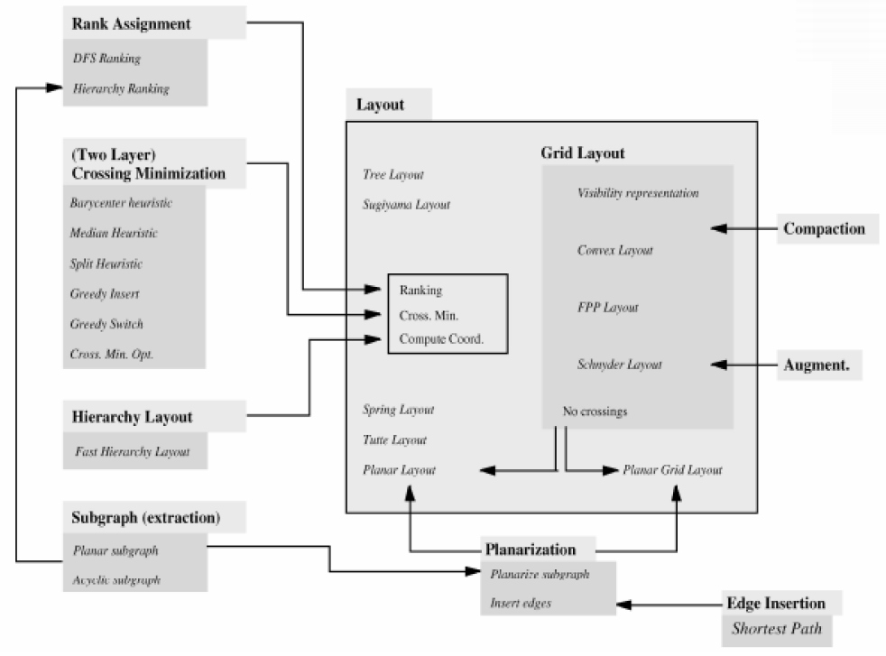
Types of Layout Algorithms
From P Mutzel et al Graph Drawing ‘97

Slide 33
Layout Types
Grid Layout
Put nodes on a grid
Tree Layout
Force Directed Layout
Model graph as set of masses connected by springs
Planar Layout
Detect part of graph that can be laid out without edge crossings

Slide 34
Layout Subproblems
Rank Assignment
Compute which nodes have large degree, put those at center of clusters
Crossing Minimization
Swap nodes to rearrange edges
Subgraph Extraction
Pull out cluster of nodes
Planarization
Pull out a set of nodes that can lay out on plane

Slide 35
Scale Challenge
May run out of space for vertices and edges (turns into “ball of string”)
Can really slow down algorithm
Often use clustering to help
Extract highly connected sets of vertices
Collapse some vertices together

Slide 36
Navigation/Interaction Issues
How do we allow a user to query, visit, or move around a graph?
Changing focus may entail a different rendering

Slide 37
Design Exercise
 | A | B | C | D | E | F
A | 0 | 1 | 2 | 0 | 4 | 5
B | 1 | 0 | 1 | 0 | 1 | 0
C | 3 | 1 | 0 | 3 | 1 | 1
D | 0 | 0 | 3 | 0 | 4 | 5
E | 4 | 1 | 1 | 0 | 0 | 5
F | 5 | 0 | 1 | 1 | 1 | 0
Relationship | Value
Knows | 1
Likes | 2
Dislikes | 3
Hates | 4
Loves | 5
Row Loves Column

