Slide 1
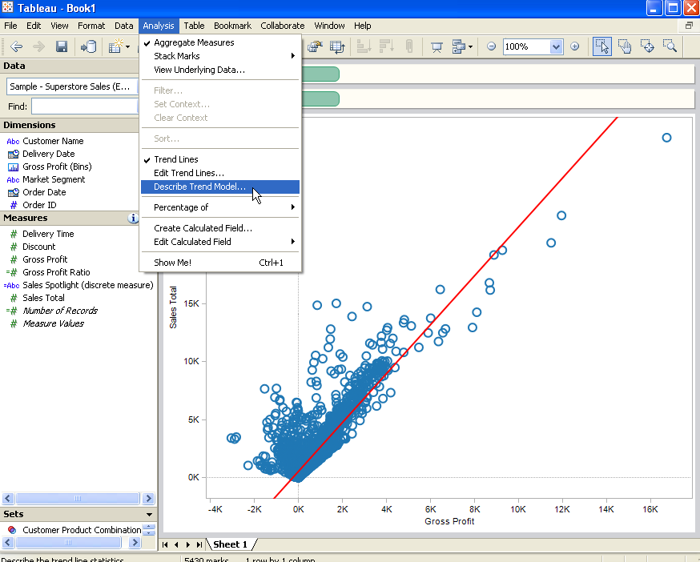
IAT 355 Visual Analytics
It’s all about the numbers:
Data and Statistical Models
Lyn Bartram

Slide 2
Data and more...
Raw data
Metadata
Data about the data
Frequency data
“more than half the respondents smoked before 16”
clustering
Derived data
Summaries, observations, inferences, predictions
“the odds of you getting ill from this pizza were 5 to 1”

Slide 3
Data analysis
Qualitative
Descriptive. Used to describe the distribution of a single variable or the relationship between two nominal variables (mean, frequencies, cross-tabulation)
Inferential (Used to establish relationships among variables; assumes random sampling and a normal distribution)
Nonparametric (Used to establish causation for small samples or data sets that are not normally distributed)

Slide 4
Simplest descriptive: Min, Max, Range
(73, 66, 69, 67, 49, 60, 81, 71, 78, 62, 53, 87, 74, 65, 74, 50, 85, 45, 63, 100)
Range
Difference between minimum and maximum values in a data set
Larger range usually (but not always) indicates a large spread or deviation in the values of the data set.

Slide 5
Frequency analyses
basic type of descriptive statistic
Frequency Distribution presents the counts of observations grouped within pre-specified groups
Relative Frequency Distribution presents the corresponding proportions within the groups
40% of respondents are male.
The mean level of income was $35,000
60% of younger voters cast their vote for Trudeau compared to 52% of voters over 50.

Slide 6
Understanding data: descriptive statistics
calculate the “average”
mean
Central tendency measures
median
mode
calculate the “spread”
range
Dispersion
measures
variance
Standard deviation

Slide 7
Understanding data: descriptive statistics
calculate the “average”
mean
Measures of centrality allow us to summarize the dataset based on a central tendency
Central tendency measures
median
mode
calculate the “spread”
range
Dispersion
measures
variance
Standard deviation

Slide 8
The “Average” ???
The Average (Mean)
Sum of all values divided by the number of values in the data set.
One measure of central location in the data set.
Average=(73+66+69+67+49+60+81+71+78+62+53+87+74+65+74+50+85+45+63+100)/20 = 68.6
When might you not want to use the mean?

Slide 9
The mean is vulnerable to problems
The data may or may not be symmetrical around its average value
0
2.5
7.5
10
4.8
0
2.5
7.5
10
4.8

Slide 10
The Median
The middle value in a sorted data set. Half the values are greater and half are less than the median.
Another measure of central location in the data set.
(45, 49, 50, 53, 60, 62, 63, 65, 66, 67, 69, 71, 73, 74, 74, 78, 81, 85, 87, 100)
Median: 68
(1, 2, 4, 7, 8, 9, 9)

Slide 11
The Median
May or may not be close to the mean.
Combination of mean and median are used to define the skewness of a distribution.
0
2.5
7.5
10
6.25

Slide 12
The Mode
The most frequent occurring value.
Another measure of central location in the data set.
(45, 49, 50, 53, 60, 62, 63, 65, 66, 67, 69, 71, 73, 74, 74, 78, 81, 85, 87, 100)
Mode: 74
Generally not all that meaningful unless a larger percentage of the values are the same number
BUT useful for nominal (categorical) data!
Most common social media tool used by students is FB

Slide 13
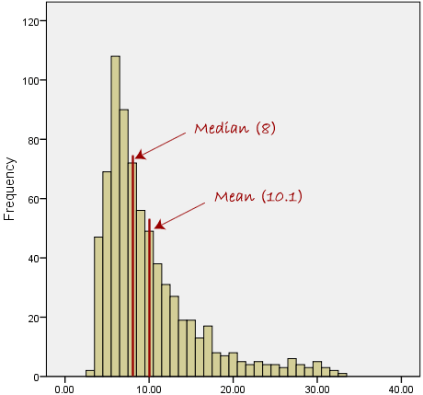
When do we use what?
Dependent on how the data are distributed
Note if mean=median=mode then the data are said to be symmetrical
Rule of thumb:
use mean if data are normally distributed and variance is within constraints
Use median to reduce effects of outliers

Slide 14
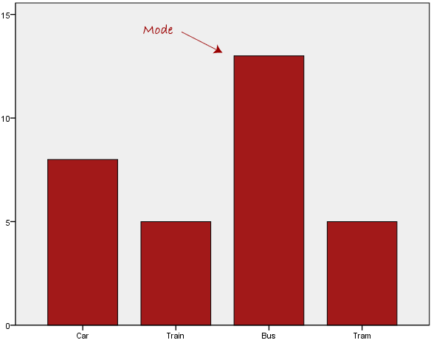
Mode for categorical frequency

Slide 15
Summary
http://statistics.laerd.com/statistical-guides/measures-central-tendency-mean-mode-median.php

Slide 16
Centrality
We can’t really tell much about this data set
Even Min and Max are hard to see
Notes:
The data can be presented such that more statistical info can be estimated from the chart (average, standard deviation).

Slide 17
Plot the distribution
Determine a frequency table (bins, buckets)
A histogram is a column chart of the frequencies
Category Labels | Frequency
0-50 | 3
51-60 | 2
61-70 | 6
71-80 | 5
81-90 | 3
>90 | 1

Slide 18
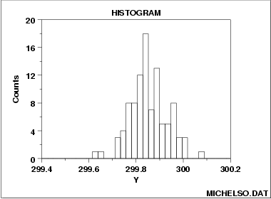
Histogram
Q → Q’ → N,O
Most common form: split data range into equal-sized bins and count the number of points from the data set that fall into the bin.
Vertical axis: Frequency (i.e., counts )
Horizontal axis: binned variable
Often use ordered bins
Notes:
Remember we talked about modes? These are just modes where we usethe bin as a mode. In essence we are turning the data into discrete categories

Slide 19
Histogram
The histogram graphically shows the following:
Centrality (i.e., the location) of the data;
spread (i.e., the scale) of the data;
skewness of the data;
outliers; and
multiple modes in the data.
Notes:
Most common form: split data range into equal-sized bins Then for each bin, count the number of points from the data set that fall into the bin.
Vertical axis: Frequency (i.e., counts for each bin)
Horizontal axis: Response variable

Slide 20
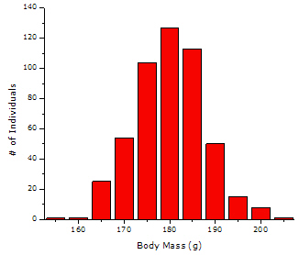
Discovering centrality
Visualization can indicate which centrality measure to use( mean, median)
Unimodal (one main central point
Symmetric data
Use the mean
http://www.sciencebuddies.org/science-fair-projects/project_data_analysis_summarizing_data.shtml

Slide 21
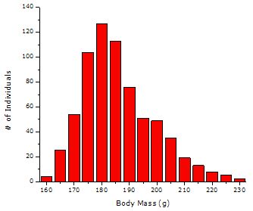
Discovering centrality
Visualization can indicate which centrality measure to use( mean, median)
Unimodal (one main central point)
Skewed data
Use the median
http://www.sciencebuddies.org/science-fair-projects/project_data_analysis_summarizing_data.shtml

Slide 22
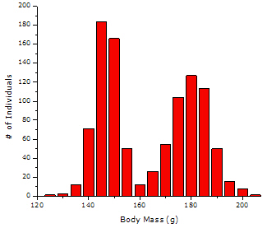
Histograms quickly show distribution clusters
Bimodal distribution
two clusters/groups, each with its own separate central tendency.
Don’t use centrality, or at least not for overall data set
http://www.sciencebuddies.org/science-fair-projects/project_data_analysis_summarizing_data.shtml

Slide 23
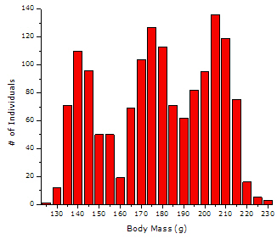
Histograms quickly show distribution clusters
Multimodal data
No separate central tendency.
Can’t assume centrality tendencies
http://www.sciencebuddies.org/science-fair-projects/project_data_analysis_summarizing_data.shtml

Slide 24
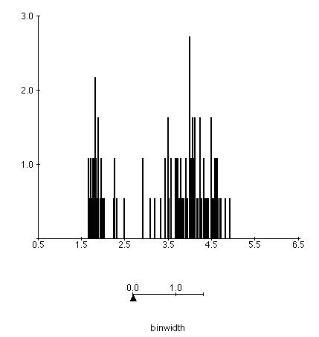
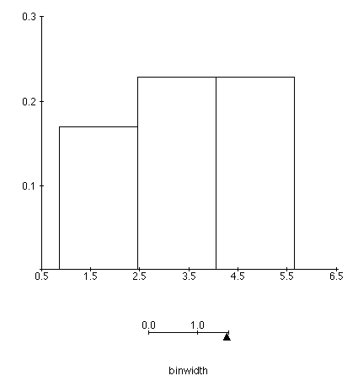
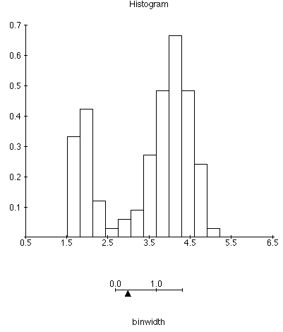
Bin size matters

Slide 25
Issues with Histograms
For small data sets, histograms can be misleading. Small changes in the data or to the bin boundaries can result in very different histograms.
Interactive bin-width example (online applet)
http://www.stat.sc.edu/~west/javahtml/Histogram.html
For large data sets, histograms can be quite effective at illustrating general properties of the distribution.
Histograms effectively only work with 1 variable at a time
Difficult to extend to 2 dimensions, not possible for >2
So histograms tell us nothing about the relationships among variables

Slide 26
Understanding data distribution
calculate the “average”
mean
Central tendency measures
median
median
Measures of dispersion characterise how spread out the distribution is, i.e., how variable the data are
calculate the “spread”
range
Dispersion
measures
variance
Standard deviation
quartiles
Notes:
Measures of dispersion characterise how spread out the distribution is, i.e., how variable the data are.
Commonly used measures of dispersion include:
Range
Variance & Standard deviation
Coefficient of Variation (or relative standard deviation)
Inter-quartile range

Slide 27
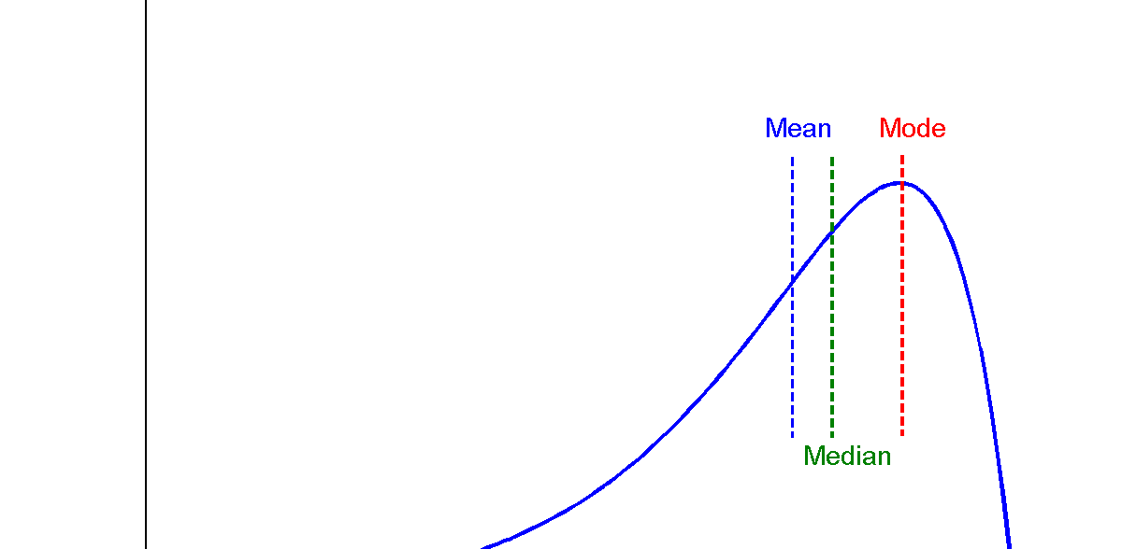
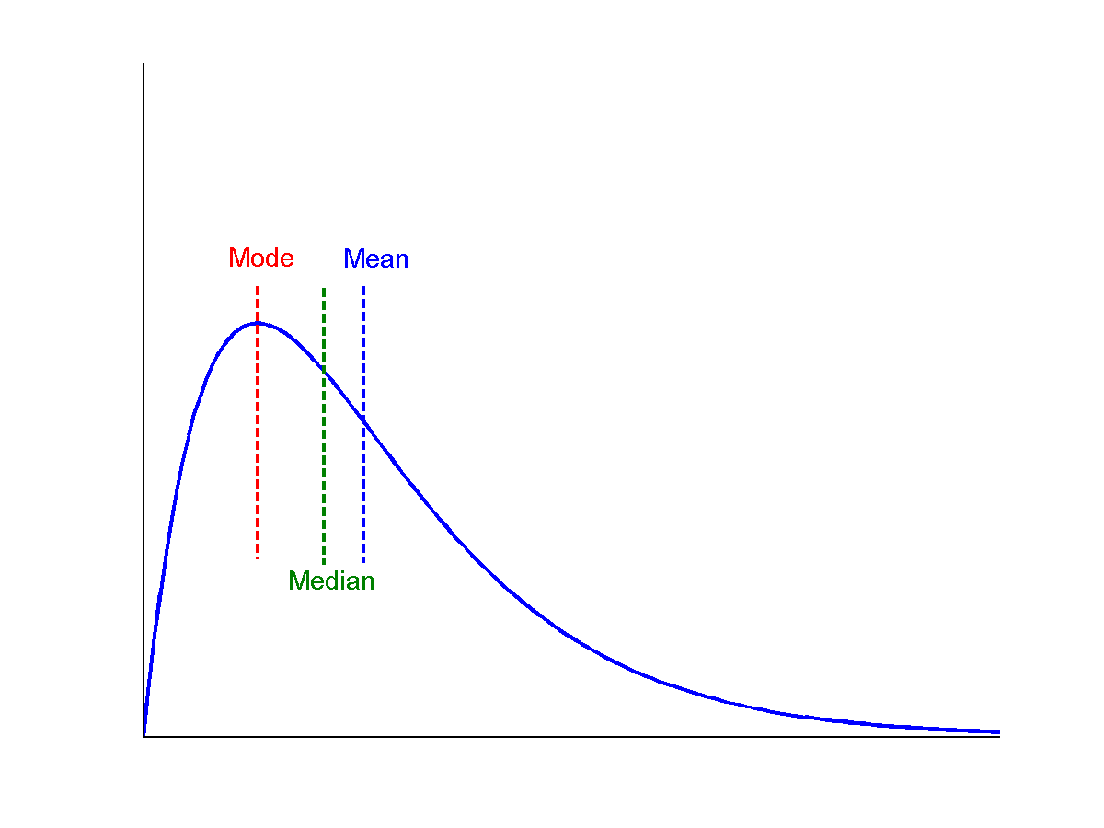
Distribution and symmetry
symmetric
Median, mean and mode of symmetric, positively and negatively skewed data
positively skewed
negatively skewed
Adapted from Han, Kamber and Pei 2013

Slide 28
Dispersion
data set 1: 3, 4, 4, 5, 6, 8
data set 2: 1, 2, 4, 5, 7, 11
mean: 5
Mean: 5
Dispersion: how scattered (far from the mean) the data are
Proportional to scale of scatter
Independent of data set size
Notes:
t would be useful to have a measure of scatter that has the following properties:
The measure should be proportional to the scatter of the data (small when the data are clustered together, and large when the data are widely scattered).
The measure should be independent of the number of values in the data set (otherwise, simply by taking more measurements the value would increase even if the scatter of the measurements was not increasing).
The measure should be independent of the mean (since now we are only interested in the spread of the data, not its central tendency).

Slide 29

Measures of variance
Variance
How far each value in the data set is from the mean
Standard Deviation
Commonest measure
Square root of the variance
Variance and SD are critical in analysing your data distribution and determining how “meaningful” is the chosen average
http://www.sciencebuddies.org/science-fair-projects/project_data_analysis_variance_std_deviation.shtml
Notes:
t would be useful to have a measure of scatter that has the following properties:
The measure should be proportional to the scatter of the data (small when the data are clustered together, and large when the data are widely scattered).
The measure should be independent of the number of values in the data set (otherwise, simply by taking more measurements the value would increase even if the scatter of the measurements was not increasing).
The measure should be independent of the mean (since now we are only interested in the spread of the data, not its central tendency).

Slide 30
Normal Distribution
The normal (distribution) curve
1 std dev: contains about 68% of the measurements
2 std dev: contains about 95% of it
3 std dev: contains about 99.7% of it
1
2
3

Slide 31
Inter-quartile range
The Median divides a distribution into two halves.
The first and third quartiles (denoted Q₁ and Q₃) are defined as follows:
25% of the data lie below Q₁ (and 75% is above Q₁),
25% of the data lie above Q₃ (and 75% is below Q₃)
The inter-quartile range (IQR) is the difference between the first and third quartiles, i.e. IQR = Q₃- Q₁

Slide 32
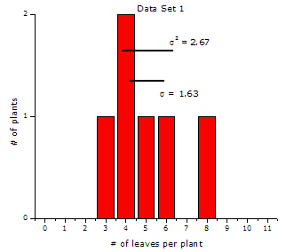
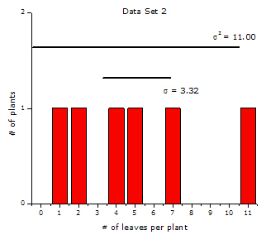
Can we see the magnitude of the spread?
Small scatter
SD = 1.63
Big scatter
SD = 3.32
Notes:
Clearly histograms can show us that there is a variance but not be the best to understand the relative size of that variance between datasets

Slide 33
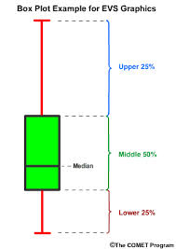
Box-plots
A box-plot is a visual description of the distribution based on
Minimum
Q1
Median
Q3
Maximum
Useful for comparing large sets of data
Notes:
Boxplots are very useful because they show us:
Range
Median
Mean
Min, Max

Slide 34
Outliers
An outlier is data that does not appear to belong with the other data
Outliers can arise because of a measurement or recording error or because of equipment failure during an experiment, etc.
An outlier might be indicative of a sub-population, e.g. an abnormally low or high value in a medical test could indicate presence of an illness in the patient.

Slide 35
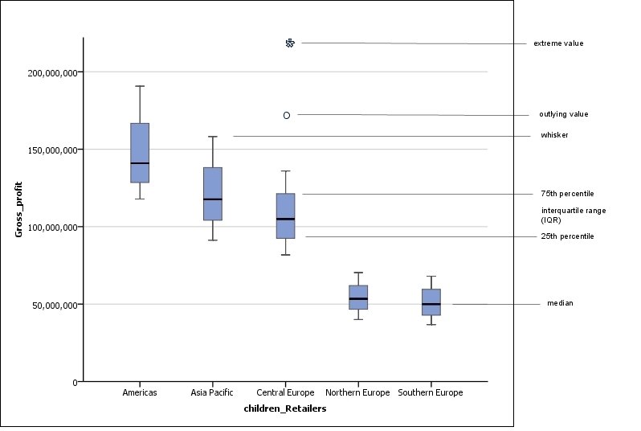
Box plots are useful for comparing dimensions as well as seeing outliers
IBM Cognos Business Intelligence User Guide
Notes:
The spacings between the different parts of the boxplot indicate the degree of dispersion (spread) and skewness in the data and identify outliers.
The line in the middle of the boxes is the median. Half of the cases have a value greater than the median, and half have a value lower. Like the mean, the median is a measure of central tendency. Unlike the mean, it is less influenced by cases with extreme values.
The bottom of the box indicates the 25th percentile. Twenty-five percent of cases have values below the 25th percentile. The top of the box represents the 75th percentile. Twenty-five percent of case have values above the 75th percentile. This means that 50% of the cases lie within the box.
The interquartile range (IQR) is the difference between the 75th and 25th percentiles and corresponds to the length of the box.
The T-bars that extend from the boxes are named inner fences or whiskers. These extend to the minimum and maximum value that is equal to or less than 1.5 times the IQR from the end of a box.
If the data is distributed normally, approximately 95% of the data is expected to lie between the inner fences.
A boxplot may contain outlying values marked as circles, and extreme values marked as asterisks.
Outlying values are values between 1.5 IQRs and 3 IQRs from the end of a box.
Extreme values are more than 3 IQRs from the end of a box.
Note: Outlying values can cause the mean to be different than the median.

Slide 36
Recap: Distribution is important for understanding aggregate measures
Visualization helps us see relations – or the trends of them - as visual patterns
a lot of what we visualize are the descriptive statistics
Example: mean income vs median income
Need to ensure that the univariate units of visualization are legit
Rule: check your core units /variables.
If they are summative/centrality-based, look at the distribution

Slide 37
Measuring the Dispersion of Data
Quartiles, centrality and outliers
Quartiles: Q₁ (25th percentile), Q₃ (75th percentile)
Inter-quartile range: IQR = Q₃ – Q₁
Five number summary: min, Q₁, median, Q₃, max
Boxplot: ends of the box are the quartiles; median is marked; add whiskers, and plot outliers individually
Outlier: usually, a value higher/lower than 1.5 x IQR
Variance and standard deviation (sample: s, population: σ)
Measure of how spread out the numbers are
Adapted from Han, Kamber and Pei 2013

Slide 38
Graphic Displays of Basic Statistical Descriptions
Histogram: x-axis are values, y-axis repres. Frequencies
Bar charts
Boxplot: graphic display of five-number summary
Line chart: slope of line shows trend over continous x-variable, y-value
Quantile-quantile (q-q) plot: graphs the quantiles of one univariant distribution against the corresponding quantiles of another
Scatter plot: each pair of values is a pair of coordinates and plotted as points in the plane
Adapted from Han, Kamber and Pei 2013
Notes:
JH: Maybe we can remove Loess curve

Slide 39
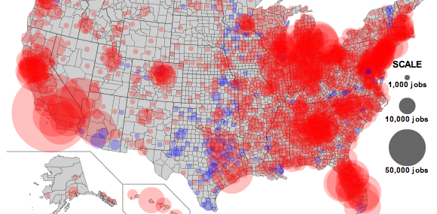
Example: job losses in US over time
Notes:
What do we think we are seeing here?
We see the biggest circles always in California, along the Eastern seaboard and in the lake region. This is true pretty much 90% of the time. What we are seeing is the distribution of population across the U.S.
What we are not seeing is how job losses affect different regions on the right scale.
The bubbles in California are almost always larger than those in the Midwest because there are more people in California.

Slide 40
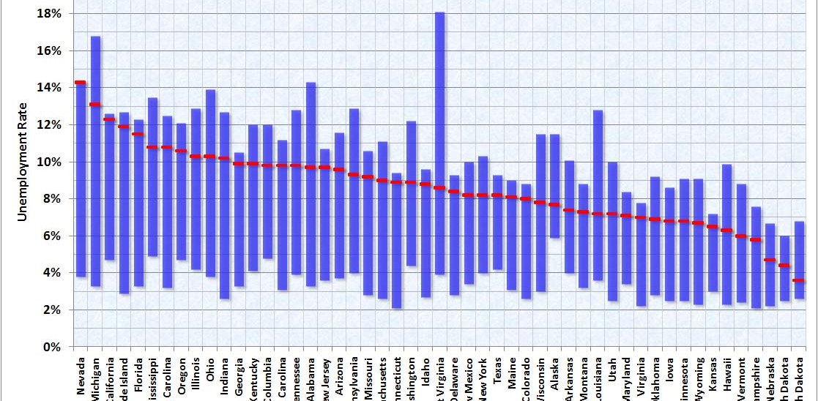
Example: job losses in US over time
Notes:
this designer collapsed both the time and geography dimensions. Time is partially present inside the boxes, as the maximum, minimum and current unemployment levels being plotted correspond to certain years in the past. The max and min are picked from data stretching back to 1976, a much longer period than the Slate chart. Geography is at the state level, rather than the county level (even though county-level data is available.) The states are sorted by the current level (July 2010) of unemployment.
The purpose of this designer is much easier to identify. For states like Nevada and California, the current situation is at the historical worst while for the Dakotas, they have seen much worse before.
A problem with using the range (maximum and minimum) is outliers. The maximum or minimum values could be outliers. Put differently, the blue boxes shown above, while containing all unemployment rates going back to 1976, may not tell us much about the typical unemployment rate

Slide 41
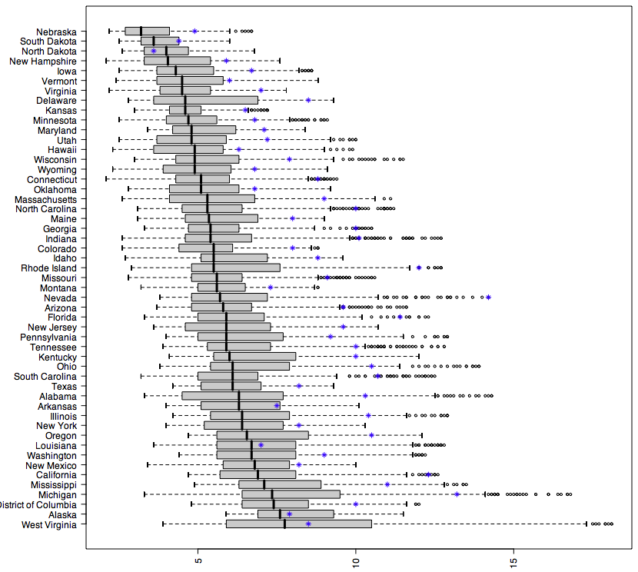
Notes:
A problem with using the range (maximum and minimum) is outliers. The maximum or minimum values could be outliers. Put differently, the blue boxes shown above, while containing all unemployment rates going back to 1976, may not tell us much about the typical unemployment rate. What we might want to know is what the unemployment rate is like for most years. a boxplot, the box (gray area) contains half of the historical data. So if you look at DC (third from the bottom), unemployment in most years are narrowly constrained to about 6 to 8 percent although the max-min range is from under 5 to above 12.
For this chart, I sorted the states by median unemployment (black line inside the box) and the blue asterisks indicate the current level of unemployment (June 2010).

Slide 42
Histograms Often Tell More than Boxplots
The two histograms shown in the left may have the same boxplot representation
The same values for: min, Q1, median, Q3, max
But they have rather different data distributions

Slide 43
Inferential statistics
Trends, correlations, patterns
Not a description within dimensions but relations and patterns across them

Slide 44
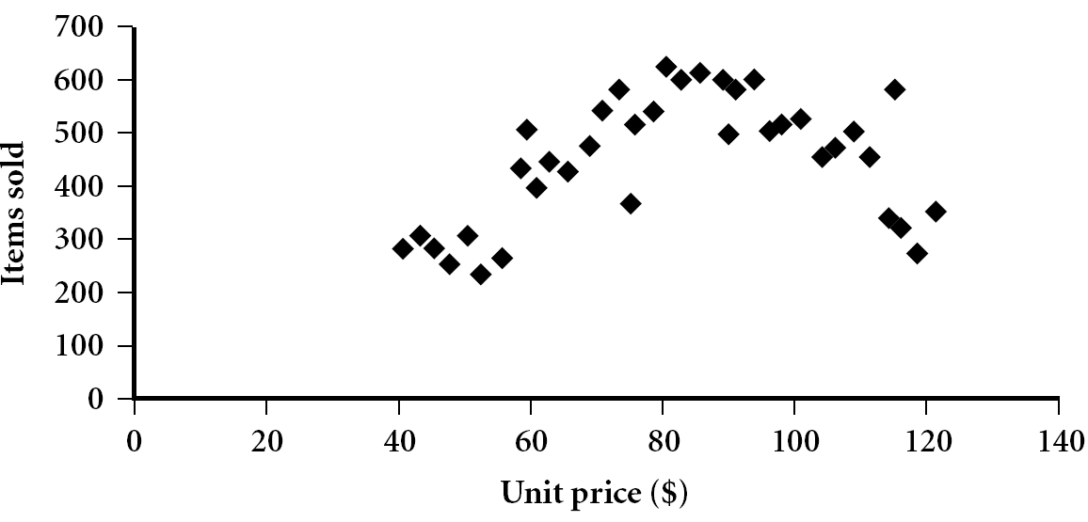
Scatter plot
Provides a first look at bivariate data to see clusters of points, outliers, etc
Each pair of values is treated as a pair of coordinates and plotted as points in the plane
Notes:
Need a better and more MEANINGFUL scatter plot! –JH.

Slide 45
Positively and Negatively Correlated Data
Positive correlation: as x increases, y tends to increase
Negative correlation: as x increases, y tends to decrease

Slide 46
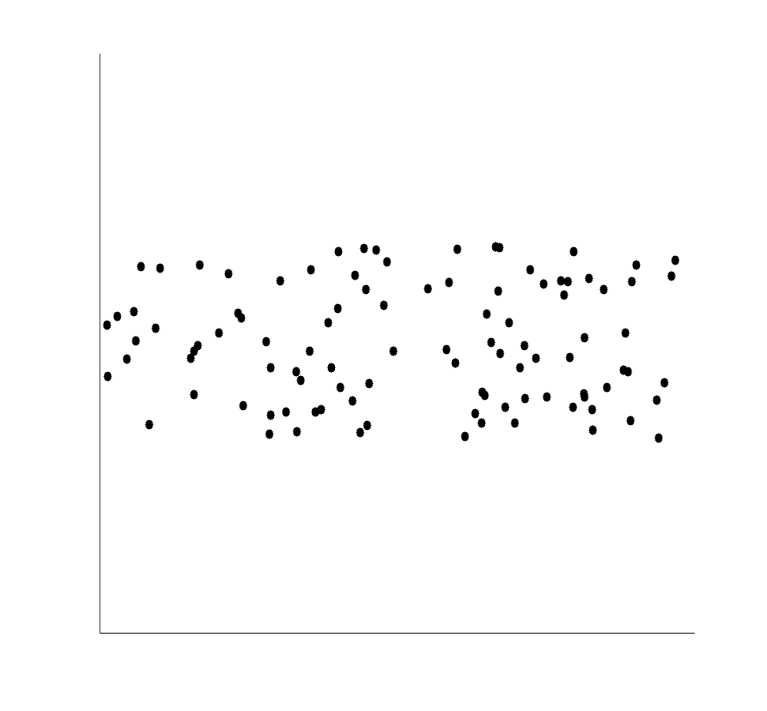
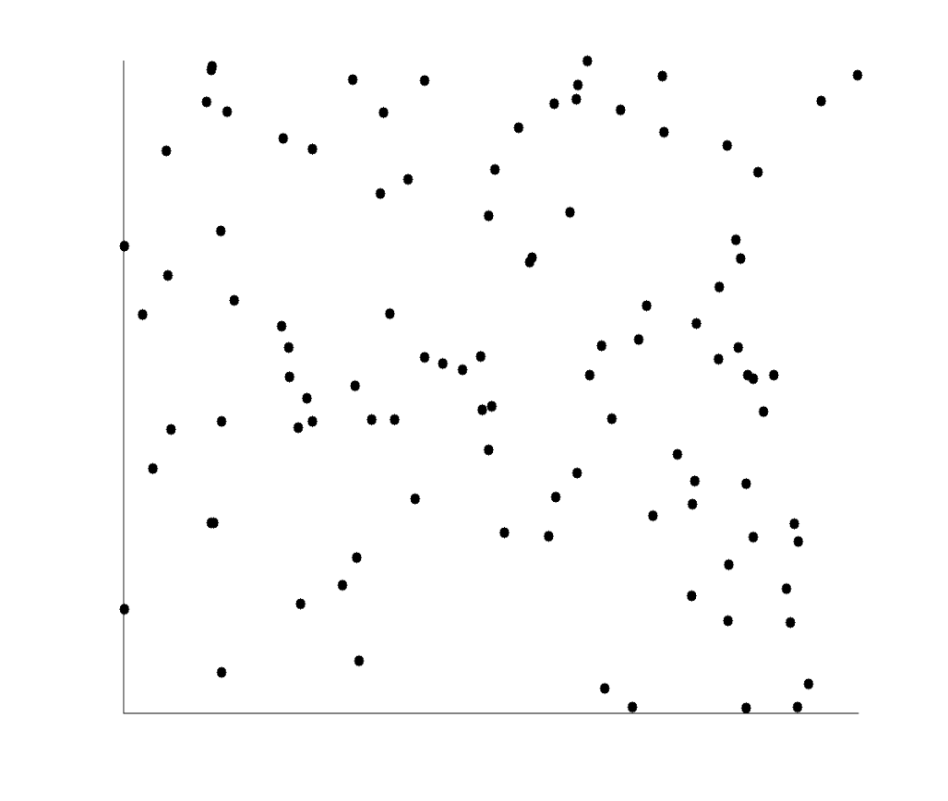
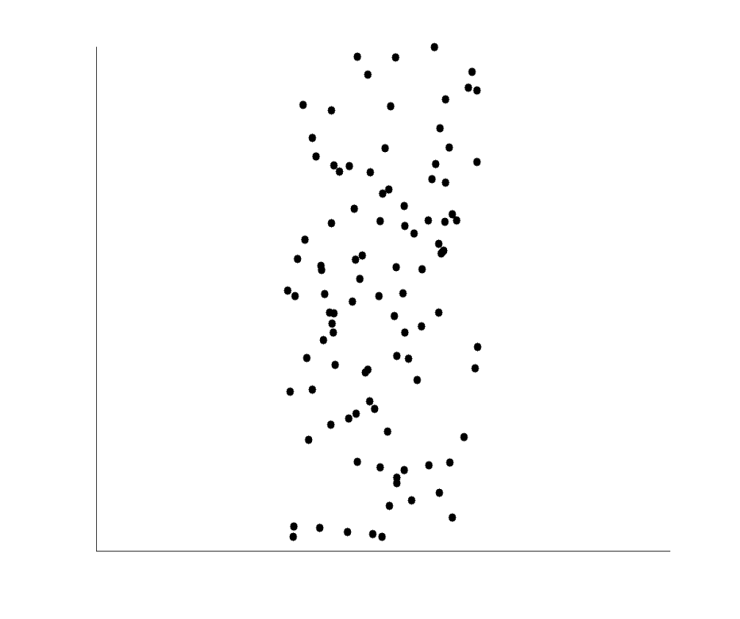
Uncorrelated Data

Slide 47
Correlation
A correlation exists between two variables when one of them is related to the other in some way.
A scatterplot is a graph in which the paired (x,y) sample data are plotted on a graph.
The linear correlation coefficient r measures the strength of the linear relationship.
Also called the Pearson correlation coefficient.
Ranges from -1 to 1.
r = 1 represents a perfect positive correlation.
r = 0 represents no correlation
r = -1 represents a perfect negative correlation
DOES NOT MEAN CAUSATION

Slide 48
Perfect positive Strong positive Positive
correlation r = 1 correlation r = 0.99 correlation r = 0.80
Strong negative No Correlation Non-linear
correlation r = -0.98 r = 0.16 relationship

Slide 49
Meanings
r² represents the proportion of the variation in y that is explained by the linear relationship between x and y.
Example: Using the heights and weights for a group of people, you find the correlation coefficient to be:
r = 0.796, so r² = 0.634.
So we conclude that about 63.4% of the peoples’ weight can be explained by the relationship between height and weight. This suggests that 36.6% of the variation in weights cannot be explained by height.

Slide 50
r² in Tableau

Slide 51
Relationship between Tree Circumference and Height
Outliers can strongly influence the graph of the regression line and inflate the correlation coefficient. Removing the outlier drops the correlation coefficient from
r = 0.828 to r = 0.678.

Slide 52
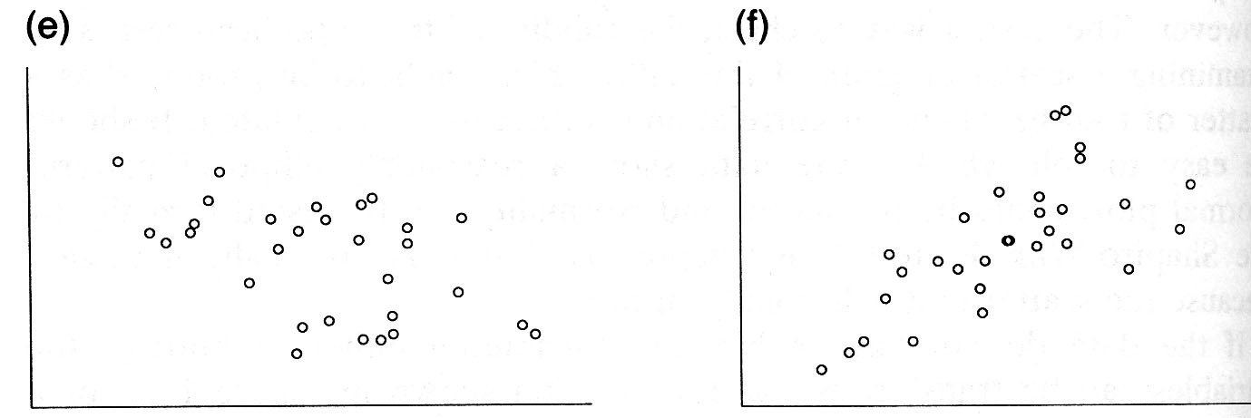
Correlation
Correlation Coefficient 0
Correlation Coefficient .3
Source: Altman. Practical Statistics for Medical Research

Slide 53
Correlation
Correlation Coefficient -.5
Correlation Coefficient .7
Source: Altman. Practical Statistics for Medical Research

Slide 54
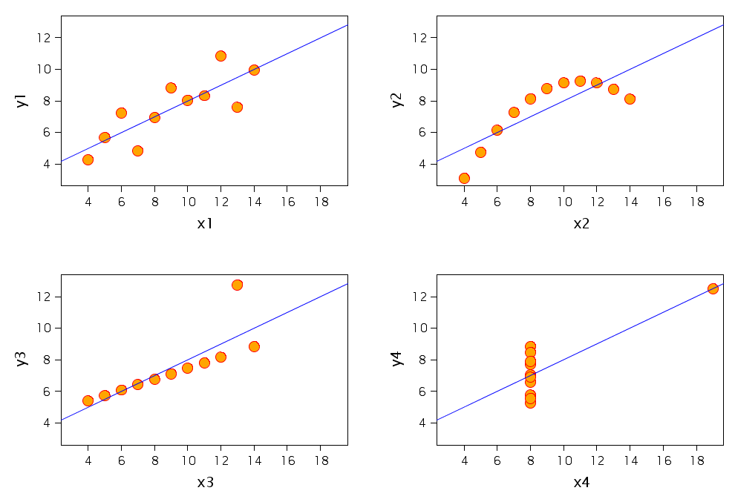
Four sets of data with the same correlation of 0.816 !!

Slide 55
Summary
Statistical models serve to inspect and categorise the nature of trends and relations between variables and fators (effects)
Distribution is a critical element in deciding what statistical measures to use, should be the lens by which you determine the appropriate metric
“eyeballing” your distribution is a first step in forming your next queries

