Slide 1





Chapter 3 Title Slide
Introductory Slides:
Business 478: Strategy Course & Delivery
PART 0 Help with Strategy
Essential Intro. Slides 1/16
© 2015, 2017, 2019, 2023 Jerry Sheppard. All rights reserved. May not be copied, scanned, or duplicated, in whole or in part, except
for use as permitted in a license distributed with a certain product or service or otherwise on a website for classroom use.
Presentation design by Jerry Sheppard.

Slide 2


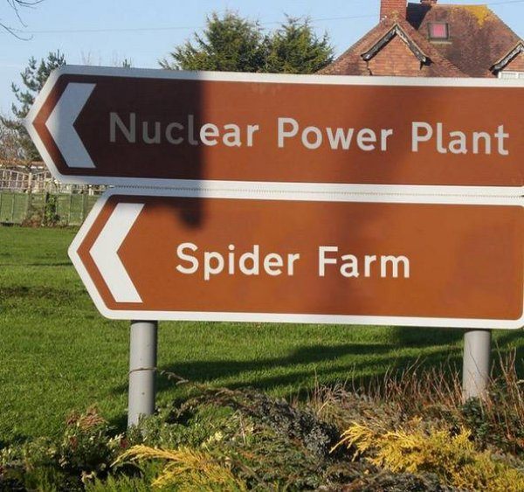


Learning Objectives
Learning Objectives
Studying this material should provide you with the strategic management knowledge needed to:
Know how to pass this class.
Know how to find the resources to perform an acceptable strategic analysis in this class.
Know that you could maybe not possibly ask for more!
Course Introduction

Slide 3
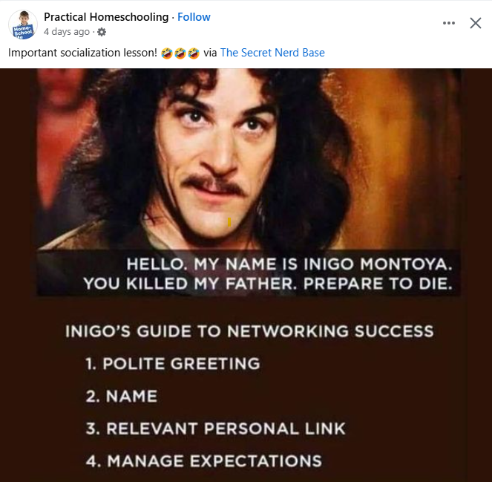
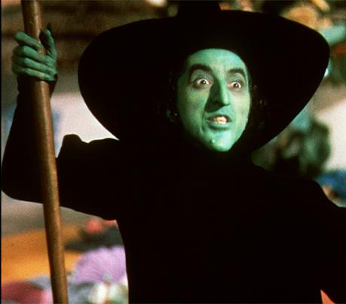





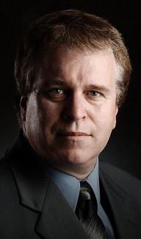






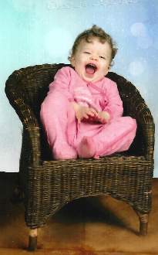
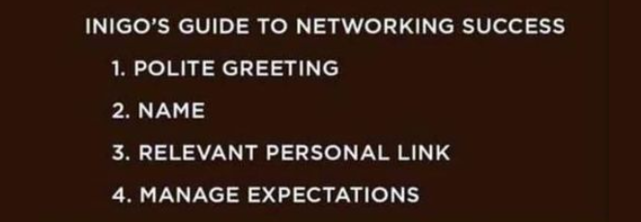
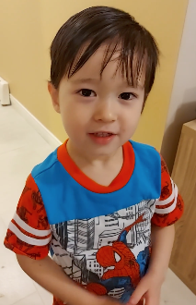




Intro. to Bus. 478: Strategy / 2025 D4700 Tue. Spring (1251)
Prerequisites: Bus. 207, 312, 343, 360 & 374 or 381 & 90 credits.
INSTRUCTOR:
Jerry Sheppard
CONTACTS: 778-782-4918 : Sheppard@sfu.ca
OFFICE: WMC 4387
HOURS: Mon. 12:45-2:20, Tue. 1:40-2:20 & by Appt.
For an appointment contact me in person,
by phone or E-mail & we’ll set-up an appt.
Canvas includes cases & exercises.
Course Introduction

Slide 4


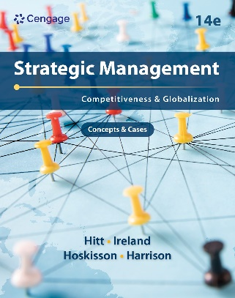
Course Description & Text
Course Description:
Provide an introduction to Strategy.
Goal: enhance your ability to insightfully develop, articulate, implement a strategy.
Coverage: strategic mgmt. process:
i.e., strategy formulation and implementation.
Short lectures, case studies and classroom exercises will support lecture & discussion of course topics.
Text:
Hitt, Ireland, & Hoskisson
Strategic Management: Competitiveness & Globalization, Concepts, 12th or later Ed.
Text & Course Description

Slide 5








Grading (more on this when I get to grade sheets )
Individual Grade (72%)
Written Component
16% Formulation Analysis.
16% Integrate, Recommend,
and Implement.
16% Executive Summary.
is the individual written case
Participation Component
11% Individual Participation.
7% Presentation Performance.
6% Peer Evaluated Group Contribution.
Grades & Grading

Slide 6


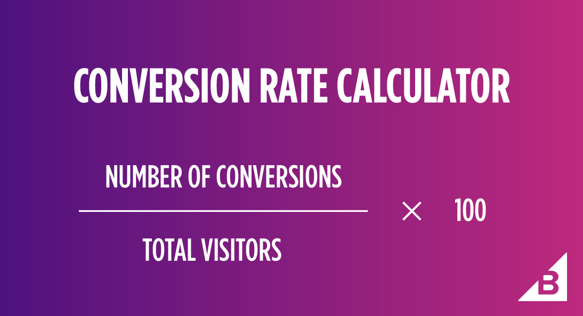
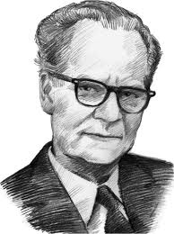
Grading (more on this when I get to grade sheets )
Group Grade (28%)
Final Group Case
8% Written Case Synopsis
10% Case Presentation
10% Written Executive Summary
These folks look WAY too happy!
GPA ~ % Conversion
GPA Grade = [ % Grade / 25 ]
% Grade = [ GPA scale * 25 ]
Ethical - Not doing your own work on individual assignments,
plagiarism or insufficient citation may get you a zero.
- You’ll need to mention AI use in your notes.
L.J.K.
Grades & Grading

Slide 7










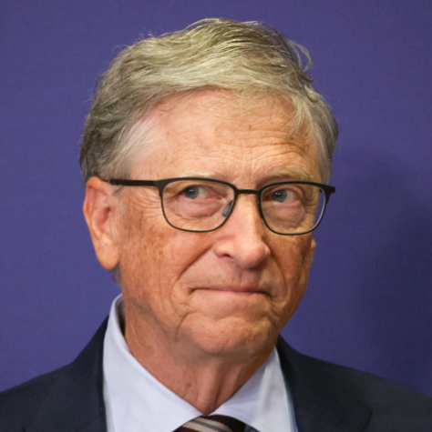
Group Selection Form
Name
Student ID #
Title
Concentration
You need to find a group & a company to analyze by Jan. 17.
I’ll put you in a group if you can not find one.
Steve Jobs
20311-1234
CEO
Marketing
Andy Grove
20302-1415
COO
Mgmt. Science
Phillip Kives
20210-1234
CMO
Marketing
Mike Milkin
20311-5678
CFO
Finance
Richard Branson
20102-1234
CHR
D. Technology
Bill Gates
20302-4321
C I O
D. Law
If you are your groups’ CEO you have no real power.
You’re just the first among equals.
Assuming he was still around
YOU ARE NOT BRUCE SPRINGSTEEN
Group
Selection

Slide 8
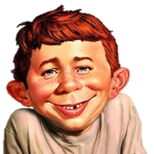


Class Assignments: The Basics .
Remember to tell them the password!
Remember to tell them the password!
Date | Topic | Class Details | Readings
Tue. Jan. 07 | Strategic Mgmt. | Strategic Mgmt. & Cases | Ch. 1, Case Pwr. Pt.s
Tue. Jan. 14 | Ex- & Internal Enviro. | Enviro, & the IMI Case | Ch. 2 & 3 & The IMI Case
Fri. Jan. 17
Tue. Jan. 21 | Business & Corp. Level Strategies | Bus. & Corp. Level Strat.s & Exercises A & B | Chapters 4 and 6 & Exercises A & B
Tue. Jan. 28 | Competitive Rivalry | & Dynamics at Home | Ch. 5 & Format Pwr. Pt.s
Tue. Feb. 04 | International Strategy | International Strat. & Toms | Ch. 8 & The Toms Case
Tue. Feb. 11 | Cooperative Strategy | Cooperative Strat. & The Carlsberg Case & Slides | Chapter 9 & the Carlsberg Case & Slides
Fri. Feb. 14
Tue. Feb. 18 | FAMILY | WEEK | No Class
Tue. Feb. 25 | Organizational Structure & Control | Structure and Control & The Deepwater Horizon | Chapter 11 & The Deepwater Horizon Case
G R O U P L I S T S D U E
Individual Formulation Analysis Due on Pandora
Class
Assignments

Slide 9
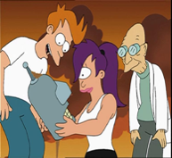

Class Assignments: Applications & Ends
Date | Topic | Class Details | Readings
Tue. Mar. 04 | Restructuring | Restructuring & Exercise C | Chapter 7 & Exercise C
Fri. Mar. 07
Tue. Mar. 11 | Corp. Governance & Leadership | Corp. Governance, Leadership & Exercise D | Chapters 10 & 12 & Exercise D
Fri. Mar. 14
Tue. Mar. 18 | Strat. Entrepreneurs & the Future | Strategic Entrepreneurship, the Future & Exercise E | Ch. 13, Being a futurist & Exercise E
Fri. Mar. 21
Tue. Mar. 25 | Case Presentations (Group Exec. Sum. due Mar. 27)
Tue. Apr. 01 | Case Presentations (Group Exec. Sum. due Apr. 03)
Tue. Apr. 08 | Case Presentations (Group Exec. Sum. due Apr. 10)
Individual Integration Recommendation
and Implementation Analysis on Pandora
Individual Executive Summary Due on Pandora
G r o u p C a s e S y n o p s i s D u e
Class
Assignments

Slide 10



Grade for Formulation Analysis
Section of report Grade range is 0.0 – 4.3
Form
Content
SUBHEADINGS!
1
2
3
4
Mission, Objectives, Goals, Stakeholders
3.0 3.3 Include Corp. Philosophy and stakeholder analysis.
General & Industry Environment
3.0 3.4 General External Environment, Porter’s 5 Forces, Competitor Analysis & Dynamics.
Resources, Capabilities & Core Competencies
3.3 3.3 Subheadings. Including explaining the firm’s core competences (VRIO).
Bus., Corp., Co-op. & International Strategies
3.3 3.4 Subheadings include Business, Corp., International & Co-op. Strategies.
Average
3.25 Average
Form
Strategic Analysis

Slide 11

Grade for Integration, Rec. & Impl.
Section of report Grade range is 0.0 – 4.3
Form
Content
SUBHEADINGS!
SWOT & Synthesis
3.5 3.3 SWOT & how Strengths match Opportunities & how Weaknesses exacerbate Threats.
Criteria, recommend target, evaluate,
3.5 3.5 Create criteria for a recommendation,
recommend, set targets, evaluate.
Implementation
3.3 3.4 State an action plan, timeline, needed structural & control changes required.
Remaining Considerations
3.5 3.4 Cover, reference, figures, tables.
Average
3.35 Average
Equal Weighting & pretty much as described.
Strategic Analysis

Slide 12

Grade for Executive Summary
-------------------- https://www.inc.com/guides/2010/09/how-to-write-an-executive-summary.html ---------------
First Paragraph Introduction:
If asked to read a big paper, you’d want to know why.
Explains what a firm does & compels further reading.
If you’ve a compelling A-Ha! moment, or identified a market segment not adequately served, you might start there.
Think about your core strengths.
Use bullet points to present your ideas more concisely.
What attributes does your firm have that make it special?
Strategic Analysis

Slide 13
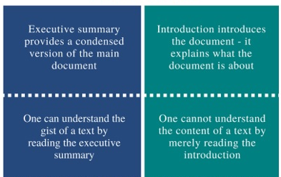
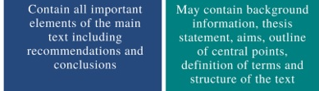

Grade for Executive Summary
Then tell me: • The Problem • Your Solution • Why Now
Problems include threats, opportunities &/or limitations.
Solutions should address what you want to do & when.
Why Now is important since it makes a summary timely.
Do NOT leave a reader thinking there's plenty of time to act.
If there’s no urgency to a summary, the plans won't get read.
EXECUTIVE SUMMARY ^{versus} INTRODUCTION
Strategic Analysis

Slide 14

Group Peer Evaluations
Peer Evaluation
3.7 OK
3.5 So-So
3.8 Good!
1.4 zzzzzz Don’t be the free rider!
You get a higher grade by not filling this out !
This is due Apr. 10, 2025
Group Peer Evaluations

Slide 15

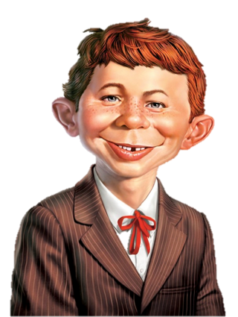



Sundry Material
Sessions average 33% short lecture, 67% strategy exercise or case analysis.
On-line lectures are from concepts chapters.
A rose means Uber-Text notes
Power Point Audio Lectures are available at: Canvas & http://www.sfu.ca/~sheppard/478index.html
All power point presentations include:
A star means an important point
There’s also some material on the bottom of the slide so you know how much longer the prof. is going to ramble on.
For fun, this guy, Alfred E. Neuman will be in every slide presentation at least once!
S O U N D
Sound
Unsound
Self Evaluation
& Sundry

Slide 16



Break
You mean to tell me that not everyone at the door is trying to kill us all?

