Slide 1








Quasi Synchronous Delivery:
____QUASI
Business 478: Strategy
Notes with Audio
Asynchronous Synchronous Quasi synchronous
Adapted from Pedrola, O., Rumley, S., Careglio, D., Klinkowski, M., Pedroso, P., Solé-Pareta, J., & Gaumier, C. (2009, June). A performance survey on
dection routing techniques for OBS networks. In 2009 11th International Conference on Transparent Optical Networks (pp. 1-6). IEEE.
Quasi Synchronous Delivery Slides 1/3
© 2020, Jerry Sheppard. All rights reserved. May not be copied, scanned, or duplicated, in whole or in part, except
for use as permitted in a license distributed with a certain product or service or otherwise on a website for classroom use.
Presentation design by Jerry Sheppard.

Slide 2


What to know about how we’ll do Quasi Synchronous Delivery
Before the week’s scheduled class time
When the instructor gets the material.
When the material is published to Canvas.
Download your Group’s Assignment & Exercise Slides
Instructor Comments on & grades the material
Student reviews documents
Your group addresses the issues noted in the slide
Leave room for a summary statement at the bottom
Synchronous (Optional)
Instructor Merges documents
More Less
Individuals may come to class an hour late (after reviewing the materials) & make constructive comments about other group’s content ‘live’
Individuals may make constructive comments about other group’s content at “Case work Discussion” and/or “Exercise Discussion” on Canvas
Group adds a short Audio part to go with the summary
(It can simply be a summary of the summary point)
Documents are published on to Canvas
Submit the Assignment and Exercise
After class, individual students make their document comments on Week in review
You’ve done most of this.
You’ve seen this.
Then what?
Then what?
Either come to class to discuss or
Terminator
(for flow
Charts!)
Process
Document
Summing Junction
Display
Decision
Alternate Process
leave some constructive comments on the discussion (make sure you note what group you are directing the comments toward).
The yellow parts are something new

Slide 3
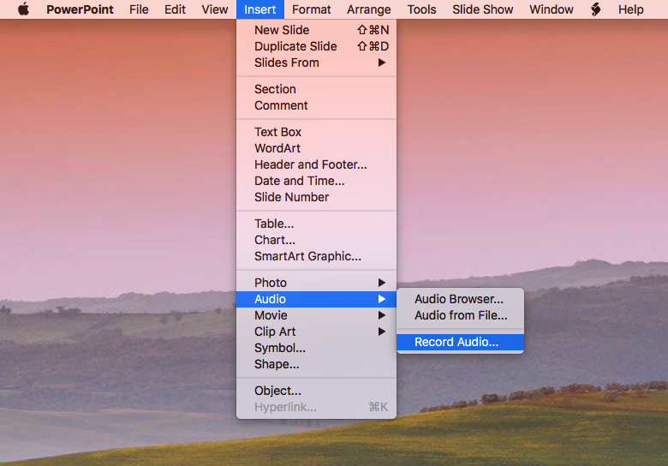
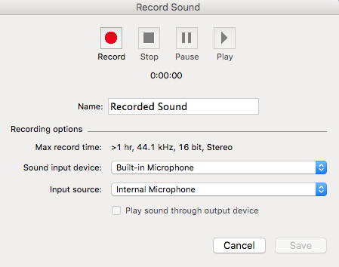

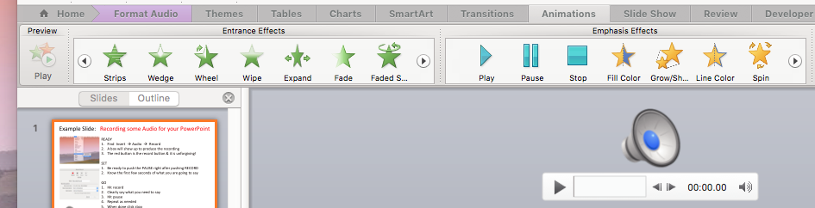

Example Slide: Recording Audio for your Group’s PowerPoints
READY . .
SET . . . . .
GO . . . . .
USE . . . .
Find Insert → Audio → Record
A box will show up to produce the recording.
The red button is the record button & it is unforgiving!
Be ready to push the PAUSE right after pushing RECORD.
Know the first few seconds of what you are going to say.
1
Hit RECORD.
Clearly say a bit of what you need to say and hit PAUSE.
Hit PAUSE again and speak a bit more.
Hit PAUSE again!
Repeat steps 2, 3 and 4 as needed.
When done click stop.
Click Save and a speaker appears.
7
2
To play the audio in the presentation you need to find PLAY under Animations when you click on the speaker.
To hide the speaker (the one in this presentation is behind the header).
A
SUMMARY STATEMENT

This is one of those things that looks straightforward but can be hard to get right & NEVER try to coordinate visuals and audio of what you’re presenting.

