Slide 1






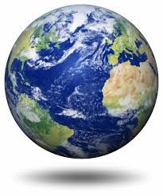
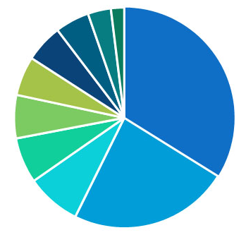
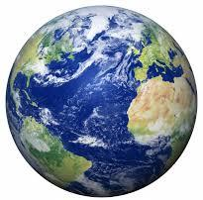
General Environment

Slide 2
Impacts from the Global Environment on the Industry.
Notes:
On top, tell us what’s happening in the world. On bottom, tell us how it impacts the industry. Adjust the text box size as needed.

Slide 3
Impacts from Demographics on the Industry.
Notes:
On top, tell us what’s happening in the world. On bottom, tell us how it impacts the industry. Adjust the text box size as needed.

Slide 4
Impacts from the Physical Environment on the Industry.
Notes:
On top, tell us what’s happening in the world. On bottom, tell us how it impacts the industry. Adjust the text box size as needed.

Slide 5
Impacts from the Political / Legal Environment on the Industry.
Notes:
On top, tell us what’s happening in the world. On bottom, tell us how it impacts the industry. Adjust the text box size as needed.

Slide 6
Impacts from the Economic Environment on the Industry.
Notes:
On top, tell us what’s happening in the world. On bottom, tell us how it impacts the industry. Adjust the text box size as needed.

Slide 7
Impacts from the Socio-Cultural Environment on the Industry.
Notes:
On top, tell us what’s happening in the world. On bottom, tell us how it impacts the industry. Adjust the text box size as needed.

Slide 8
Impacts from the Technogical Environment on the Industry.
Notes:
On top, tell us what’s happening in the world. On bottom, tell us how it impacts the industry. Adjust the text box size as needed.

