Slide 1








Cases Title Slide
Case Slides:
Strategy Case Analysis /
Preparing an Effective Case Analysis
Notes with Audio
PART 0 Help with Strategy
Audio Case Slides 1/21
© 2015, 2017, 2019, 2023 Jerry Sheppard. All rights reserved. May not be copied, scanned, or duplicated, in whole or in part, except
for use as permitted in a license distributed with a certain product or service or otherwise on a website for classroom use.
Presentation design by Jerry Sheppard.

Slide 2


Learning Objectives
Studying this material should provide you with
the strategic management knowledge needed to:
Discuss why we use cases.
Describe the process of preparing a case.
Study the product of the analysis: the report.
Discuss, generally, what’s involved with the synopsis.
Note the requirements for the analysis paper.
Note the analysis presentation requirements.
Audio Case Slides 2/21
© 2015 , 2017, 2019, 2023 Jerry Sheppard. All rights reserved. May not be copied, scanned, or duplicated, in whole or in part, except
for use as permitted in a license distributed with a certain product or service or otherwise on a website for classroom use.
Presentation design by Jerry Sheppard.

Slide 3


The Strategic Management Process
Analysis
Chapter 2:
The External Environment
Chapter 3:
The Internal Organization
Above Average Returns
Chapter X1:
Strategy Case Analysis
Chapter X2:
Strategic Performance
Chapter X1:
Strategy Case Analysis
Vision & Mission
Chapter 10:
Corporate Governance
Ch. 11: Org. Structure & Controls
Chapter 4:
Bus.-Level Strategy
Implementing for Performance
Chapter 5:
Competitive Dynamics
Chapter 6:
Corp.-Level Strategy
Chapter 12:
Strategic Leadership
Chapter 7:
Acquisition & Restructuring
Chapter 8:
International Strategy
Chapter 13:
Strategic Entrepreneurship
Strategies
Chapter 9:
Cooperative Strategy
Strategic Competitive-ness
Audio Case Slides 3/21
© 2015 , 2017, 2019, 2023 Jerry Sheppard. All rights reserved. May not be copied, scanned, or duplicated, in whole or in part, except
for use as permitted in a license distributed with a certain product or service or otherwise on a website for classroom use.
Presentation design by Jerry Sheppard.

Slide 4

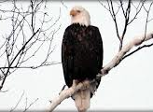


Why use Cases?
+ Results of Case Method Involvement:
Preparing for case discussion, case analysis makes you practice important managerial skills:
Diagnosing.
Making decisions.
Observing.
Listening & persuading.
Cases require you to:
Relate analysis and action.
Develop realistic and concrete actions, despite complexity & partial knowledge.
You develop a general managerial point of view…
Where responsibility is sensitive to action in a diverse environmental context.
Why Use Cases?
Why Use Cases?

Slide 5


Why use Cases?
+ Results of Case Method Involvement:
You confront the intractability of reality:
The absence of needed information;
An imbalance between needs & resources;
Conflicts among competing objectives.
Communication skills will be honed by use of oral & written presentations of case analyses.
The primary responsibility for learning is yours.
The quality of discussion entails some mastery of case facts & some analysis.
The case method requires you read and think carefully about each case.
Try to read the case a day or two before the class. ★
Why Use Cases?
Why Use Cases?

Slide 6








Essentials in Preparing a Case
Essential elements include preparation:
Careful reading and thinking about case facts,
Reasoned analyses,
Development of alternative solutions to case problems.
Recommended alternatives should flow logically from core problems identified through study of the case.
Case Prep. Essentials

Slide 7



Preparing for a Case
1. Gaining Familiarity
In general, determine who, what, how, where & when (the critical facts in a case).
I.D. situation’s places, persons, activities, & contexts.
Recognize informational certainties & uncertainties.
2. Recognizing Symptoms
List all indicators (including stated “problems”) that something is not as expected or as desired.
Ensure symptoms are not assumed to be a problem (symptoms lead to identifying problems):
  You may want to correct symptoms, not true problems.
  True problems are states or situations requiring solution before firms’ or persons’ performance can improve.
Preparing
for a Case

Slide 8


Preparing for a Case
3. Identifying Goals
Identify critical statements by major parties.
List all goals of the major parties that exist or can be reasonably inferred.
4. Conducting the Analysis
Decide what ideas, models, theories are useful.
Apply these conceptual tools to the situation.
As new info. is revealed, go recycle back to ‘a.’
Preparing
for a Case

Slide 9


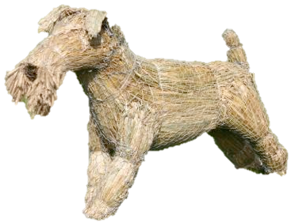

Preparing for a Case
5. Making the Diagnosis
Identify predicaments (goal inconsistencies).
Identify problems (goal performance divergence).
Prioritize problems by timing, importance, etc.
6. Doing the Action Planning
Specify & prioritize criteria used for alternatives.
Discover or invent feasible action alternatives.
Examine likely consequences of alternatives.
Recommend a course of action.
Design an implementation plan / schedule.
Create a plan to assess implemented actions.
Most items I’m talking about deal with writing-up the analysis for the few cases where you have to hand in a written analysis.
A “straw-dog” is something you set-up just so you can knock it down.
Preparing
for a Case

Slide 10
Producing a Good Case Analysis
1. Mission, Objective, Goals & Stakeholders
Updated Information
Current Mission / Goals & Objectives
Stakeholders & what they want
FORM
If the case info. needs updating, you should update it & bring the audience up to speed.
Provide what you think are the firm’s current Mission & some goals.
CONTENT
Provide a list of stakeholders & what you think they each desire from the firm.
Producing a Good Case Analysis

Slide 11
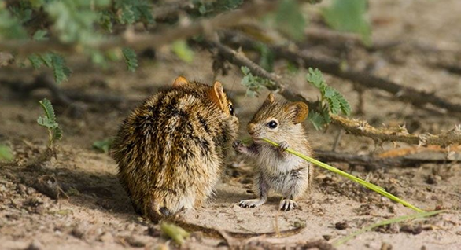
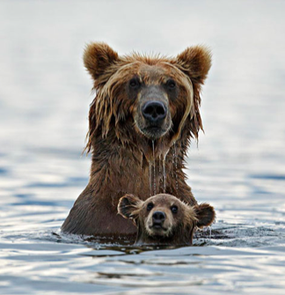

Producing a Good Case Analysis
2. External Environment: General, Industry & Competitive
General (Macro) Environment:
FORM
Demographics, Economy, etc.
Industry Environment:
Porter’s 5 forces.
Competitors:
Detail the top three.
Dynamics:
Likelihood of attack & response.
Clearly detail the above elements.
CONTENT
Producing a Good Case Analysis

Slide 12
Producing a Good Case Analysis
3. Internal Analysis:
Resources, Capabilities, Core Competencies
FORM
Resources
Tangible Intangible
Capabilities (by Functional Area).
Core Competencies (VRIO).
Financial Performance results.
Details will be needed.
(You might say “Their physical plant is the most modern and efficient in the industry. It allows them to…”
CONTENT
rather than just listing ‘Physical Plant’ under tangible resources).
Producing a Good Case Analysis

Slide 13
Producing a Good Case Analysis
4. Strategy
Business Level Strategy.
Corporate Level Strategy.
International Strategy.
Cooperative Strategy.
FORM
State the firm’s Generic Bus. level strategy (Cost Leadership, Differentiation, Focus)
State the firm’s Corp. level strategy (Conglomerate, Vert. Integration, Single bus.)
State the firm’s International Strategy (Global, Transnational, Multidomestic)
CONTENT
Say with whom they have cooperative arrangements & how they benefit the firm.
Producing a Good Case Analysis

Slide 14
Producing a Good Case Analysis
5. SWOT & Synthesis
SWOT Synthesis (with SWOT Matrix)
FORM
Strengths
Weaknesses
CONTENT
What strengths allow the firm to uniquely take advantage of opportunities
What weaknesses prevent the firm from taking advantage of opportunities
Opportunities
What strengths allow the firm to defend against threats.
What weaknesses exacerbate threats to the firm.
Threats
How does all that you have said so far fit together.
Producing a Good Case Analysis

Slide 15
Producing a Good Case Analysis
6. Criteria, Evaluations & Recommendations
Criteria for Evaluation of Recommendation.
FORM
Recommendation.
Targets and Goals.
Evaluation of Recommendation.
What are the criteria for a good recommendation.
Recommend a course of action.
Tell me what you seek to achieve through your recommendations.
CONTENT
Evaluate your recommendation based on the criteria.
Producing a Good Case Analysis

Slide 16
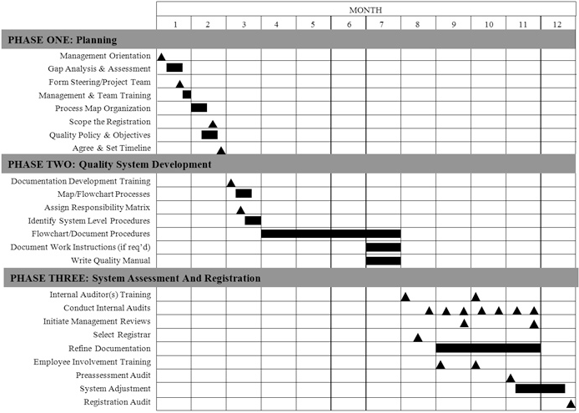

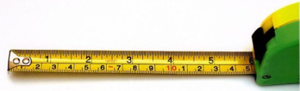
Producing a Good Case Analysis
7. Implementation
Plan of Action (What to do 1st, 2nd, etc.)?
FORM
Are new Organizational Structures & Controls needed (If so, What types?).
Criteria by which we Evaluate Changes.
Generate a list actions needed for change and explain your logic for them.
Evaluate whether new Organizational Controls are needed & if so what types.
CONTENT
Discuss how we will know whether the change has been effective.
Producing a Good Case Analysis

Slide 17


Writing Good Formulation & Integration- Recommendation-&-Implementation Analyses
The Individual Analyses:
The course outline says what individual analyses are & when they are due!
Fudging (verb): Present so as to conceal the truth or mislead.
Formatting:
  One and 1/2 spaced ( I will check ).
  Page limit is eight pages, excluding cover and citations.
  NO Table of Contents needed.
  Min. 12 point Times New Roman with max .3 compression.
  Minimum margins of 1 inch or 2.54 centimeters.
NO appendices allowed..
Tables:
  They save space (avoid cut & paste).
The Web Page has a blank analyses with very useful advice.
We remember the alphabet by putting it into 8 chunks
ABCD EFG HIJK LMNOP QRS TUV WX YZ
  Short term memory rule: 7 ± 2 for lists.
Citations / References:
  Any common consistent format; quotes, odd facts.
Grammar: No incompressible misspelled sentences.
, outside sources..
  Include an endnote on any use of AI..
Producing Good Analyses Papers

Slide 18

For a Good Executive Summary
INTRODUCTION
Explain what the firm does.
Give a compelling interest to read.
Notes the goals of the analysis.
Show a recommended strategy.
The Problem / Challenge
Opportunities / threats (competitor, industry & macro environment).
Strengths / limitations (resources, capabilities & core competencies).
The Solution
What do you want to the firm to do?
What steps need to be taken (logical & appropriate action plan).
How soon do we start; with what steps?
How will we measure success (criteria by which you evaluate).
Why Now
Explain external conditions driving change.
Note internal resources for recommendation.
Detail the need for why change now.
One page,11 pt., New Times Roman, ½-inch margins, 1.25 spacing
Producing Good Analyses Papers

Slide 19
Producing a Good Firm Synopsis
Groups will write a 5-8 page company synopsis.
This is a mini-case to familiarize the rest of the class with the firm your group will analyze.
  It will be posted on-line for everyone in class to read.
Your synopsis should cover:
Firm history.
Current situation.
Environment.
Main strategic challenges.
I will need a Word™ AND a pdf version of your groups’ synopsis e-mailed to me in good form.
  Without student ID numbers on the cover.
There is a link to previous terms synopses on the Groups page of the Business 478 Webpage.
Producing a Good Synopsis

Slide 20

For a Good Presentation
Over the Last Three Classes
Section of report Grade range is 0.0 – 4.3
Form
Content
A presentation should include all parts of an exec. summary.
Introduction
Evidence all analysis parts were done.
The Problem
Presentations should be about 30 minutes, & 10 min.s for ?s.
The Solution
Why now?
You all present, but its a group grade.
Consistent written look so it seems like the group coordinated what’s shown.
Average
Like these
Section of report Grade range is 0.0 – 4.3
Covered
Section of report Grade range is 0.0 – 4.3
Covered
This means the same typeface, same system of typeface sizes & bullets, etc.
Minimum 18 point type.
Spelling & Grammar count.
Mission, Objectives, Goals, Stakeholders
SWOT & Synthesis
✔
✔
✔
✔
✔
✔
✔
✔
General & Industry Environment
Criteria, Recommend. , Targets & Evaluation
Resources, Capabilities & Core Competencies
Implementation
The Word™ Exec. Summary is due two days after presenting.
Bus., Corp., Co-op. & International Strategies
Remaining Considerations
Producing a Good Presentation

Slide 21
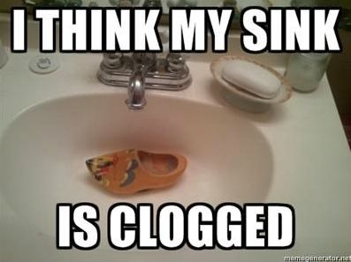
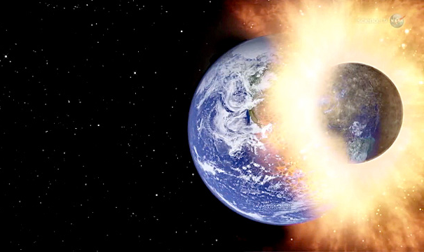

The Strategic Management Process
Analysis
Chapter 2:
The External Environment
Chapter 3:
The Internal Organization
Above Average Returns
Chapter X1:
Strategy Case Analysis
Chapter X2:
Strategic Performance
Chapter X1:
Strategy Case Analysis
THE END
Vision & Mission
Chapter 10:
Corporate Governance
Ch. 11: Org. Structure & Controls
Chapter 4:
Bus.-Level Strategy
Implementing for Performance
Chapter 5:
Competitive Dynamics
Chapter 6:
Corp.-Level Strategy
Chapter 12:
Strategic Leadership
Chapter 7:
Acquisition & Restructuring
Chapter 8:
International Strategy
Chapter 13:
Strategic Entrepreneurship
Strategies
Chapter 9:
Cooperative Strategy
Strategic Competitive-ness
Essential Case Slides 21/21
© 2015, 2017, 2019, 2023 Jerry Sheppard. All rights reserved. May not be copied, scanned, or duplicated, in whole or in part, except
for use as permitted in a license distributed with a certain product or service or otherwise on a website for classroom use.
Presentation design by Jerry Sheppard.

