Slide 1


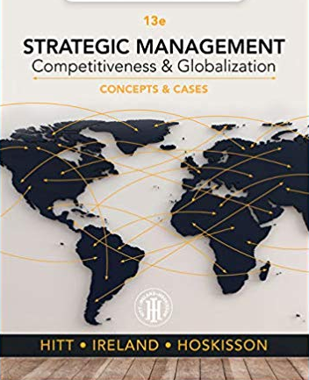




Business 478
Starter PowerPoint
Notes with Audio
PART -1 ! : We’re keeping a safer social distance
478 Start up 1/3
Presentation design by Jerry Sheppard.

Slide 2


Objectives .
This is intended to allow you to orient you to the online version of this course:
What to do.
This is just a placeholder file.
I’m still putting it all together.
It should be ready by September.
Etc.
Etc.
Etc.
Etc.
Introduction

Slide 3



The Strategic Management Process
Analysis
Chapter 2:
The External Environment
Chapter 3:
The Internal Organization
Above Average Returns
Chapter X1:
Strategy Case Analysis
Chapter X2:
Strategic Performance
Vision & Mission
Chapter 10:
Corporate Governance
Ch. 11: Org. Structure & Controls
Chapter 4:
Bus.-Level Strategy
Chapter 5:
Competitive Dynamics
Chapter 6:
Corp.-Level Strategy
Chapter 12:
Strategic Leadership
Implementing for Performance
Chapter 7:
Acquisition & Restructuring
Chapter 8:
International Strategy
Chapter 13:
Strategic Entrepreneurship
Strategies
Chapter 9:
Cooperative Strategy
Strategic Competitive-ness
478 Start up 3/3
Presentation design by Jerry Sheppard.

