Slide 1


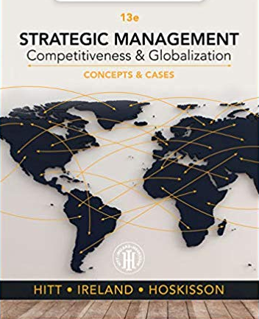





Chapter1: Title Slide
Chapter 1:
Strategic Management & Strategic Competitiveness
Notes with Audio
PART 1 STRATEGIC MANAGEMENT INPUTS
Audio Chapter 1 1/31
Audio Chapter 1 1/23
© 2015, 2017, 2019, 2020 Cengage Learning. All rights reserved. May not be copied, scanned, or duplicated, in whole or in part, except for use
as permitted in a license distributed with a certain product or service or otherwise on a password-protected website for classroom use.
Presentation design by Jerry Sheppard.
© 2015 2017 Cengage Learning. All rights reserved. May not be copied, scanned, or duplicated, in whole or in part, except for use as
permitted in a license distributed with a certain product or service or otherwise on a password-protected website for classroom use.

Slide 2


Learning Objectives
Learning Objectives
Studying this chapter should provide you with
the strategic management knowledge needed to:
Define strategic competitiveness, competitive advantage, and above-average returns.
Explain the strategic management process.
Describe the competitive landscape and explain how globalization and technological changes shape it.
Use the industrial organization (I/O) and resource-based models to explain how firms can earn above-average returns.
Describe vision and mission and discuss their value.
Define stakeholders & describe their ability to influence firms.
Audio Perform 2/23
© 2015, 2017, 2019, 2020 Cengage Learning. All rights reserved. May not be copied, scanned, or duplicated, in whole or in part, except for use
as permitted in a license distributed with a certain product or service or otherwise on a password-protected website for classroom use.
Presentation design by Jerry Sheppard.
Notes:
----- Meeting Notes (20-09-08 14:18) -----

Slide 3

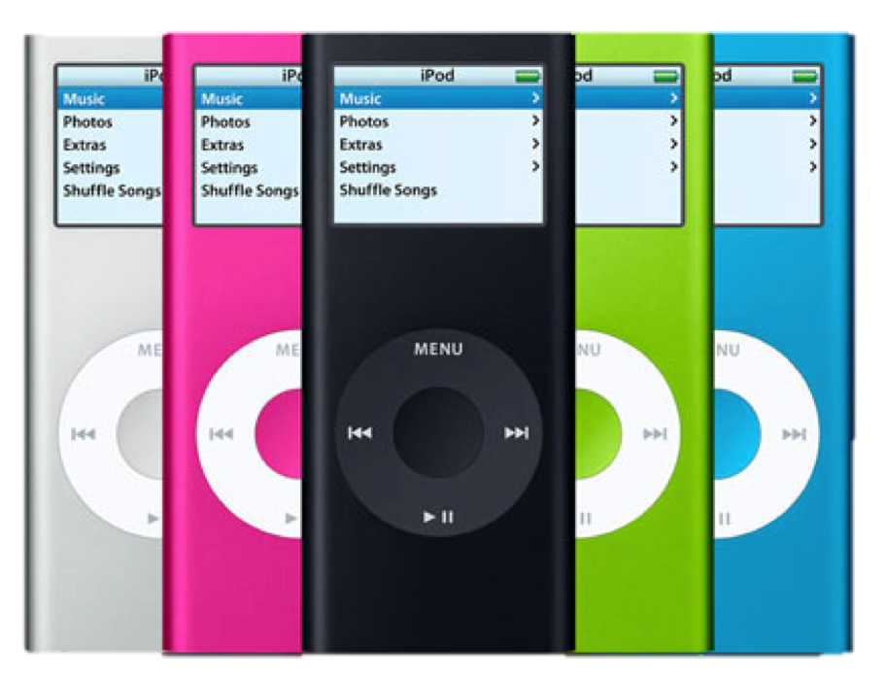

Strategic Competitiveness
Create advantages current and potential rivals aren’t able to duplicate
Firms develop a strategy rivals aren’t concurrently implementing
Formulation and implementation of
a superior value-creating strategy
Commitments and actions to achieve above-average performance and returns
What the firm will do
Competitive advantage
What the firm will not do
Basic
Definitions

Slide 4



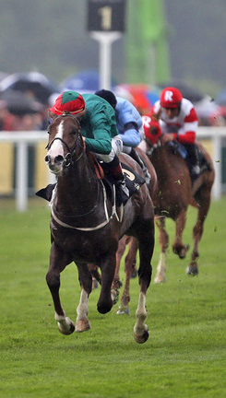



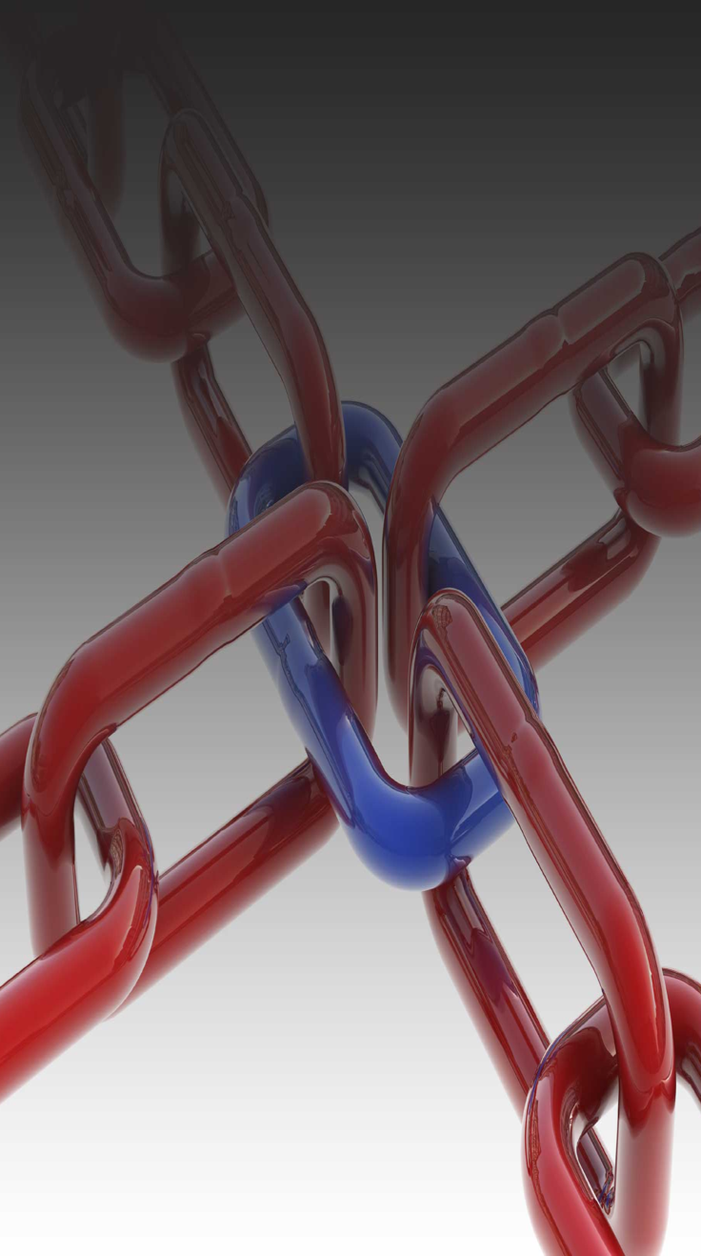





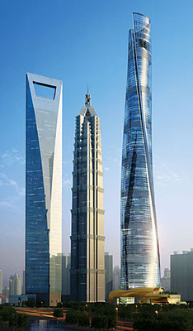
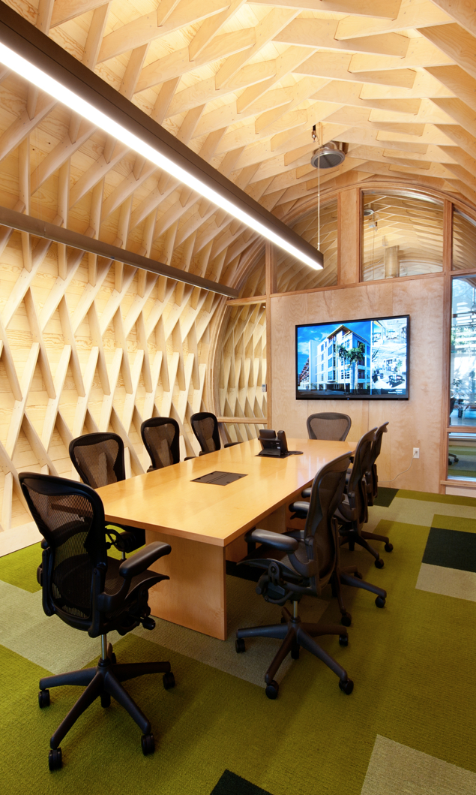
The Strategic Management Process .
We cover these details later when we go through these chapters.
Analysis, Strategies, & Performance
We cover these details later when we go through these chapters.
We cover these details later when we go through these chapters.
Analysis
Chapter 2:
The External Environment
Chapter 3:
The Internal Organization
Above Average Returns
Chapter X1:
Strategy Case Analysis
Chapter X2:
Strategic Performance
Vision & Mission
Chapter 10:
Corporate Governance
Chapter 10:
Corporate Governance
Chapter 10:
Corporate Governance
Chapter 4:
Bus.-Level Strategy
Chapter 4:
Bus.-Level Strategy
Ch. 11: Org. Structure & Controls
Chapter 4:
Bus.-Level Strategy
Ch. 11: Org. Structure & Controls
Ch. 11: Org. Structure & Controls
Chapter 5:
Competitive Dynamics
Chapter 5:
Competitive Dynamics
Chapter 6:
Corp.-Level Strategy
Chapter 5:
Competitive Dynamics
Chapter 6:
Corp.-Level Strategy
Chapter 6:
Corp.-Level Strategy
Implementing for Performance
Chapter 12:
Strategic Leadership
Chapter 12:
Strategic Leadership
Chapter 12:
Strategic Leadership
Chapter 7:
Acquisition & Restructuring
Chapter 7:
Acquisition & Restructuring
Chapter 8:
International Strategy
Chapter 7:
Acquisition & Restructuring
Chapter 8:
International Strategy
Chapter 8:
International Strategy
Chapter 13:
Strategic Entrepreneurship
Chapter 13:
Strategic Entrepreneurship
Chapter 13:
Strategic Entrepreneurship
Strategies
Chapter 9:
Cooperative Strategy
Chapter 9:
Cooperative Strategy
Chapter 9:
Cooperative Strategy
Strategic Competitive-ness
The Strategic Management Process

Slide 5
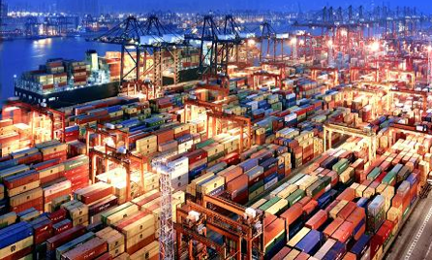
Twenty-First Century Competition
Today’s Competitive Markets
The global economy
Globalization
Rapid
technological change
Increasing importance of knowledge
and people
21st Century Landscape

Slide 6



The Global Competitive Landscape
Increasing
Market volatility and instability due to
the rapid pace of change in markets.
Need for flexibility, speed, innovation,
and integration in the use of technology.
Rising product quality standards.
Today’s Competitive Markets
The global economy
Rapid
technological change
Increasing importance of knowledge
and people
Globalization
Blurring of market boundaries.
Globalized flow of financial capital.
Strategic and operational complexity
of global-scale competition.
Decreasing
Traditional time for adapting to change.
Traditional sources of competitive advantage.
Traditional managerial mindset.
21st Century Landscape

Slide 7


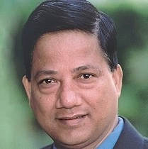
Hypercompetition
Strategic options in hypercompetitive environments
Today’s Competitive Markets
The global economy
Rapid
technological change
Increasing importance of knowledge
and people
Globalization
Global economy
Technology
What this means is:
Use of
price-quality positioning to build market presence
Creation of new know-how and use of first-mover advantage
Protection or invasion of established geographic or product markets
21st Century Landscape

Slide 8
Competitive Success Factors
Today’s Competitive Markets
The global economy
Rapid
technological change
Increasing importance of knowledge
and people
Globalization
Top Corporate Performers
Have an entrepreneurial /
opportunistic mindset
Make effective
use of valuable competencies
Offer new
and innovative products and services
Are market/ customer-needs oriented
21st Century Landscape

Slide 9



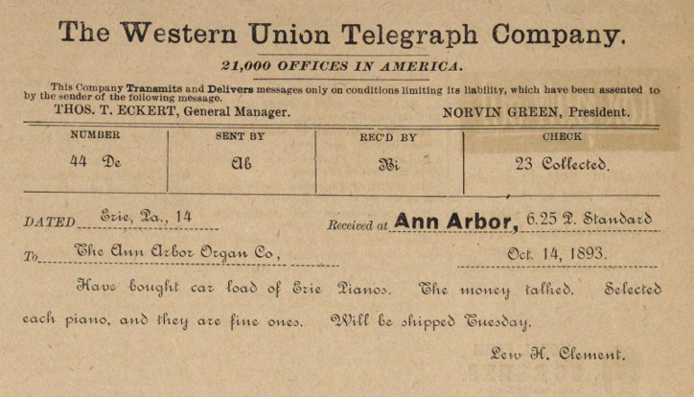
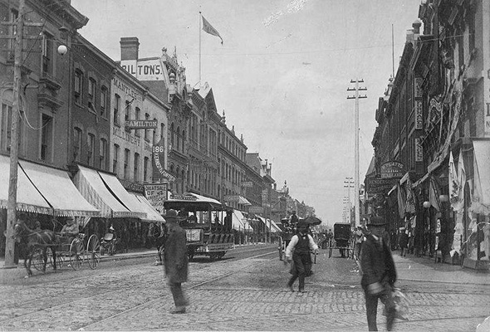

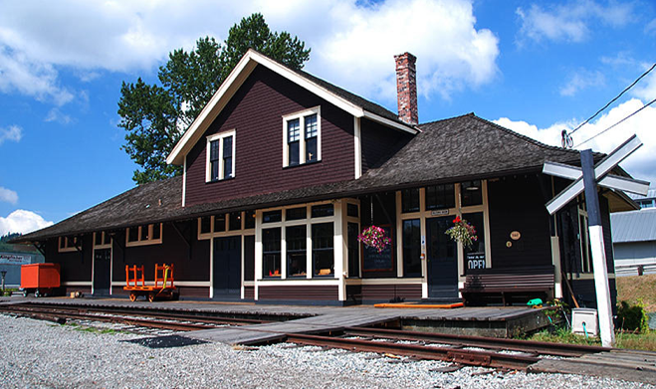

Technology & Technological Change
Technology trends impacting the global competitive environment
Increasing rate of technology diffusion and the emergence
of disruptive technologies
Today’s Competitive Markets
The global economy
Rapid
technological change
Increasing importance of knowledge
and people
Globalization
The information age: Internet and the global proliferation of low-cost computing power
Increasing knowledge intensity
as an intangible source of competitive advantage
21st Century Landscape

Slide 10
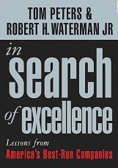

Strategic Flexibility
  Involves coping with the uncertainty and risks of hypercompetitive environments.
  Must first overcome built-up organizational inertia.
  Must take advantage of available organizational slack.
  Requires developing the capacity for continuous learning and applying the new and updated skills sets and competencies to the firm’s competitive advantage.
Today’s Competitive Markets
The global economy
Rapid
technological change
Increasing importance of knowledge
and people
Globalization
21st Century Landscape

Slide 11


Strategic Decision Making
Two Complementary Models
Industry Organization (I/O) Model
Resource-Based
View (RBV)
Competitive Strategy
Decision
Stresses the External Environment. The focus of Chapter 2.
Stresses the
Internal Organization. The focus of Chapter 3.
Complementary Models

Slide 12


Models of Above-Average Returns
I/O Model of Superior Returns
RBV Model of Superior Returns
Study the external environment, especially the industry environment.
External Environment
General, Industry and Competitive Environment
Resources
Inputs to a firm’s production process
ID firm resources. Study strengths / weaknesses relative to others.
Find an industry with a high potential for above-average returns.
An Attractive Industry
Whose structure suggests possible higher returns
Capability
Capacity for integrated resources to perform tasks
Determine what firm capabilities allow it to do better than rivals.
ID strategy called for by the industry to earn above-average returns.
Strategy Formulation
Selected strategy linked to higher industry returns
Competitive Advantage
Ability of a firm to outperform its rivals
ID how firm resources & capabilities create competitive advantage.
Develop or acquire as-sets & skills needed to implement the strategy.
Assets and Skills
Ones needed to implement a chosen strategy
An Attractive Industry
Opportunities exploitable by a firm’s core competencies
Locate an industry where you can exploit your competences.
Use the firm strengths (its assets or skills) to implement the strategy.
Implementation
Actions linked to effective implementation of strategy
Formulate & Implement
Actions taken to earn above-average returns
Select strategy to exploit resources and capabilities
Sustain strategy to out-perform industry rivals.
Superior Returns
Earn above-average returns
Superior Returns
Earn above-average returns
Sustain strategy to out-perform industry rivals.
Complementary Models

Slide 13
The I / O Model & Its Assumptions
Economies
of scale
Barriers to market entry
Diversification
Product differentiation
Industry concentration
Market
frictions
The Firm’s Strategic Choices
The Firm’s Strategic Choices
Thus the I/O model is very reliant on the Porter five forces model
The external environment imposes pressures and constraints that determine strategic choices.
Similarity in strategically relevant resources causes competitors to pursue similar strategies.
Resource differences among competitors are short-lived due to resource mobility across firms.
Strategic decision makers behave as rational profit optimizers.
Complementary Models

Slide 14
Five Forces Model & Its Assumptions
Potential Entrants
Suppliers
Industry Rivalry
Buyers
Substitutes
Industry profitability (rate of return on invested capital relative to cost of capital) is a function of interactions among the 5 forces.
Industry attractiveness equates to its profitability potential for earning above-average returns to:
  Produce standard goods or services at costs below rivals (cost leaders).
  Or produce differentiated goods or services for which customers are willing to pay a price premium (differentiation).
Complementary Models

Slide 15


The RBV Model & Its Assumptions
RBV Model of Above Average Returns
Resources As Core Competencies
Costly to imitate
V RI O T e s t
Building competitive advantage .
Core competence
A source of competitive advantage
How resources become core competencies
Capabilities
An integrated set of resources
Valuable
Rare
Resources
Physical, human, and organizational capital
(tangible and intangible)
Organized to be exploited
Non- substitutable
Organized to be exploited
Firms acquire different sets of resources.
Unique capabilities are based on how firms combine resources.
Resources and certain capabilities are not highly mobile across firms.
Differences in resources / capabilities are basis of competitive advantage and firm performance, not the industry’s structural characteristics.
Complementary Models

Slide 16
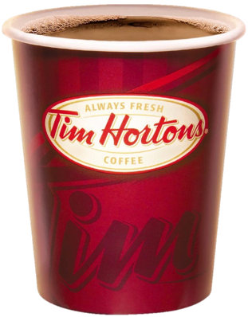
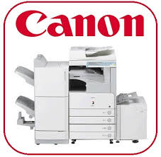



Vision Statement
A Successful Vision is:
  An enduring word picture of what the firm wants to be and expects to achieve in the future.
  One that stretches and challenges the firm’s people.
  One that reflects the firm’s values and aspirations.
  Most effective when its development includes all stakeholders.
  One which recognizes the firm’s internal organizational and external competitive environments.
  Supported by upper management decisions and actions.
“ Our vision is to be the quality leader in everything we do.”
Vision & Mission

Slide 17



Mission Statement
An Effective Mission:
  Specifies business or businesses in which the firm intends to compete & customers it intends to serve.
  Has a more concrete, near-term focus on current product markets and customers than the firm’s vision.
  Should be inspiring and relevant to all stakeholders.
“ Our guiding mission is to deliver superior quality products & services for our customers & communities through leadership, innovation & partnerships.”
Vision & Mission

Slide 18
Stakeholders
Can affect development of the firm’s vision and mission
Primary stakeholders
(individuals, groups, and organizations)
Are affected by the strategic outcomes achieved by the firm
Can have enforceable claims
on the firm’s performance
Are influential when in control
of critical or valued resources
Stakeholders

Slide 19



Classification of Stakeholders
Categories of stakeholders
Capital Market Stakeholders
Product Market Stakeholders
Organizational Stakeholders
Stock market / Investors
Primary Customers
Host Communities
Unions / Suppliers
Employees
Managers
Nonmanagers
Debt suppliers / Banks
Stakeholders

Slide 20
Capital Market Stakeholders
Capital Market Stakeholders
Stock market / Investors
Preservation
of investment
Debt suppliers / Banks
Conflicting expectations of shareholders and lenders
Influence
Risk/return
Enhanced wealth
Stakeholders

Slide 21
Product Market Stakeholders
Product Market Stakeholders
Primary Customers
Host Communities
Unions / Suppliers
Product market stakeholder concerns
Supplier Relationship Concerns
Customers Product Value Concerns
Host Community Tax Base / Jobs Concerns
Union Condition & Employment Concerns
Stakeholders

Slide 22
Organizational Stakeholders
Organizational Stakeholders
Employees
Managers
Nonmanagers
Responsibilities of strategic leaders for development and effective use of the firm’s human capital
Education
and skills of employees
Organizational culture and ethical work environment
Strategic goals and global standards
International assignments
Stakeholders

Slide 23





The Strategic Management Process .
BAD PUNS?
Analysis
Chapter 2:
The External Environment
Chapter 3:
The Internal Organization
Above Average Returns
Above Average Returns
Chater X1:
Strategy Case Analysis
Chapter X2:
Strategic Performance
Vision & Mission
Vision & Mission
Chapter 10:
Corporate Governance
Ch. 11: Org. Structure & Controls
Chapter 4:
Bus.-Level Strategy
Chapter 5:
Competitive Dynamics
Chapter 6:
Corp.-Level Strategy
Chapter 12:
Strategic Leadership
Implementing for performance
Chapter 7:
Acquisition & Restructuring
Chapter 8:
International Strategy
I’M A BIG FAN
Chapter 13:
Strategic Entrepreneurship
Strategies
Chapter 9:
Cooperative Strategy
Strategic
Competitive-
ness
Strategic Competitive-ness
Essential Ch. 1 23/23
© 2015, 2017, 2020, 2023 Cengage Learning. All rights reserved. May not be copied, scanned, or duplicated, in whole or in part, except for use
as permitted in a license distributed with a certain product or service or otherwise on a password-protected website for classroom use.
Presentation design by Jerry Sheppard.

