Slide 1








Chapter 3 Title Slide
Introduction Slides:
Business 478: Strategy
Notes with Audio
PART 0 Help with Strategy
Audio Intro. Slides 1/16
© 2015, 2017, 2019 , 2024 Jerry Sheppard. All rights reserved. May not be copied, scanned, or duplicated, in whole or in part, except
for use as permitted in a license distributed with a certain product or service or otherwise on a website for classroom use.
Presentation design by Jerry Sheppard.

Slide 2


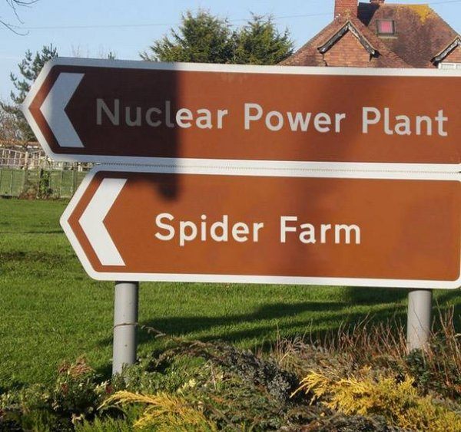



Learning Objectives
Learning Objectives
Studying this material should provide you with the strategic management knowledge needed to:
Know how to pass this class.
Know how to find the resources to perform an acceptable strategic analysis in this class.
Know that you could maybe not possibly ask for more!
Learning Objectives
Course Introduction

Slide 3
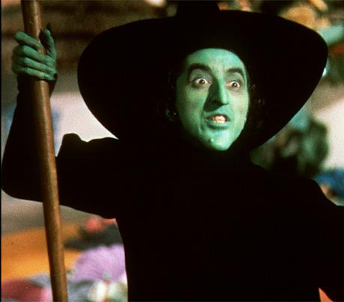


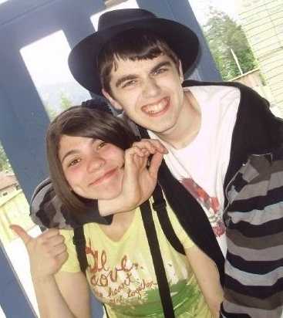


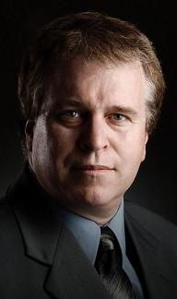
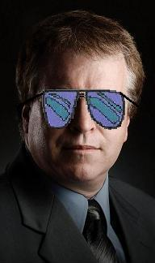



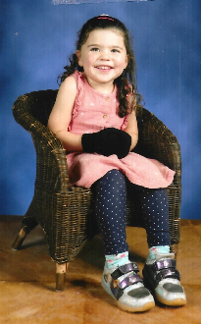
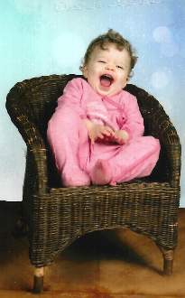


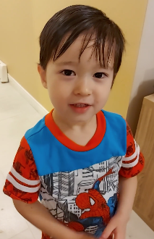


Intro. to Bus. 478: Strategy / ’24 D400 Thurs. Spr. (1241)
Prerequisites: Bus. 207, 312, 343, 360 & 374 or 381 & 90 credits.
INSTRUCTOR: Jerry Sheppard
CONTACTS: 778-782-4918 : Sheppard@sfu.ca
NOTES: http://www.sfu.ca/~sheppard/index.html
OFFICE: WMC 4387
HOURS: Tue. 15:40-16:20, Thurs. 10:40 -11:20 & by Appt.
For an appointment contact me in person,
by phone or E-mail & we’ll set-up an appt.
Canvas & my web page includes cases & exercises.
Course Introduction

Slide 4
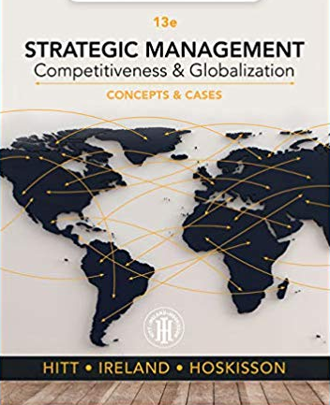

Course Description & Text
Course Description:
Provide you with an introduction to Strategy.
Goal: enhance your ability to insightfully develop, articulate, implement a strategy.
Coverage: strategic mgmt. process:
i.e. strategy formulation and implementation.
Short lectures, case studies and classroom exercises will support lecture & discussion of course topics.
See how I kept that to a minimum
Text:
Hitt, Ireland, & Hoskisson
Strategic Management: Competitiveness & Globalization, Concepts, 12th or later Ed.
Text & Course Description

Slide 5

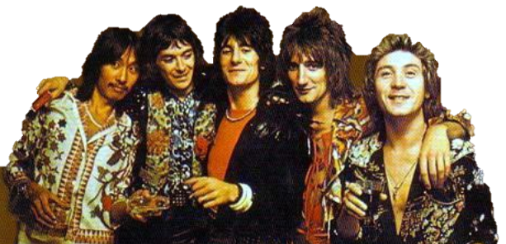






Grading (more on this when I get to grade sheets )
Individual Grade (72%)
Written Component
16% Formulation Analysis.
16% Integrate, Recommend,
and Implement.
16% Executive Summary.
D e n m a r k
is the individual written case
Participation Component
11% Individual Participation.
7% Presentation Performance.
6% Peer Evaluated Group Contribution.
Grades & Grading

Slide 6



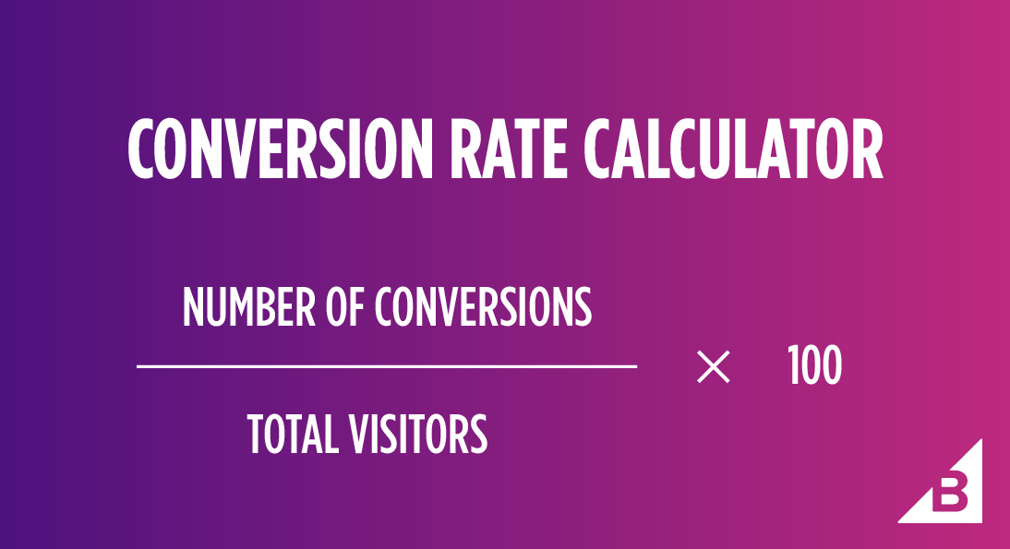
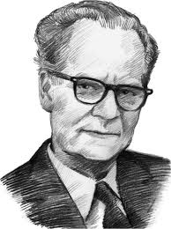

Grading (more on this when I get to grade sheets )
Group Grade (28%)
Final Group Case
8% Written Case Synopsis
10% Case Presentation
10% Written Executive Summary
These folks look WAY too happy!
GPA ~ % Conversion
GPA Grade = [ % Grade / 7 ]^{0.5}
% Grade = [ GPA grade ]² X 7
Ethical Not doing your own work on individual
assignments, plagiarism or insufficient
citation may get you a zero.
Sky Urban Solutions is the case for the first 3 papers
L.J.K.
Grades & Grading

Slide 7





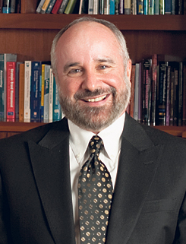




Group Selection Form
Name
Student ID #
Title
Concentration
You need to find a group in a company to analyze by Jan. 19.
I’ll put you in a group if you can’t find one.
Steve Jobs
20311-1234
CEO
Marketing
Andy Grove
20302-1415
COO
Mgmt. Science
Phillip Kives
20210-1234
CMO
Marketing
Mike Milkin
20311-5678
CFO
Finance
Mark Wexler
20102-1234
CHR
H.R.M.
Assuming he was still around
If you are your groups’ CEO you have no real power.
You’re just the first among equals.
YOU ARE NOT BRUCE SPRINGSTEEN
Group
Selection

Slide 8
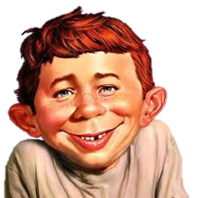

Class Assignments: The Basics .
Remember to tell them the password!
Remember to tell them the password!
Date | Topic | Class Details | Readings
Tue. Jan. 09 | Strategic Mgmt. | Strategic Mgmt. & Cases | Ch. 1, Case PowerPoints
Tue. Jan. 16 | External / Internal Environment | Enviro, & the IMI Case | Chapters 2 and 3 & The IMI Case
Fri. Jan. 19
Tue. Jan. 23 | Business & Corp. Level Strategies | Strategies & Exercises A & B | Chapters 4 and 6 & Exercises A & B
Tue. Jan. 30 | Competitive Rivalry & International Strat. | Rivalry, International & The Toms Case | Chapters 5 and 8 & The Toms Case
Tue. Feb. 06 | Cooperative Strategy | Cooperative Strat. & The Carlsberg Case & Slides | Chapter 9 & the Carlsberg Case and Slides
Thur. Feb. 08
Tue. Feb. 13 | Organizational Structure & Control | Structure and Control & The Deepwater Horizon | Chapter 11 & The Deepwater Horizon Case
G R O U P L I S T S D U E
Individual Formulation Analysis Due on Coop (Dk.)
Class
Assignments

Slide 9
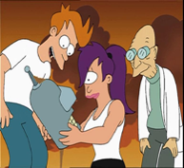

Class Assignments: Applications & Ends
Date | Topic | Class Details | Readings
Tue. Feb. 27 | Restructuring | Restructuring & Exercise C | Chapter 7 & Exercise C
Thur. Feb. 29
Tue. Mar. 05 | Corp. Governance | Corp. Governance, & Ex. D | Ch. 10 & Exercise D
Tue. Mar. 12 | Leadership | Leadership, & Vestas Case | Ch. 12 & Vestas Case
Thur. Mar. 14
Tue. Mar. 19 | Strat. Entrepreneurs & the Future | Strategic Entrepreneurship, the Future & Exercise E | Ch. 13, Being a futurist & Exercise E
Thur. Mar 21
Tue. Mar. 24 | Case Presentations (Group Exec. Sum. due Mar. 26)
Tue. Apr. 04 | Case Presentations (Group Exec. Sum. due Apr. 06)
Tue. Apr. 09 | Case Presentations (Group Exec. Sum. due Apr. 11)
Individual Integration Recommendation and
Implementation Analysis Due on Coop (Dk.)
Individual Executive Summary Due on Coop (Dk.)
G r o u p C a s e S y n o p s i s D u e
Class
Assignments

Slide 10



Grade for Formulation Analysis
Section of report Grade range is 0.0 – 4.3
Form
Content
SUBHEADINGS!
1
2
3
4
Mission, Objectives, Goals, Stakeholders
3.0 3.3 Include Corp. Philosophy and stakeholder analysis.
General & Industry Environment
3.0 3.4 General External Environment, Porter’s 5 Forces, Competitor Analysis & Dynamics.
Resources, Capabilities & Core Competencies
3.3 3.3 Subheadings. Including explaining the firm’s core competences (VRIO).
Bus., Corp., Co-op. & International Strategies
3.3 3.4 Subheadings include Business, Corp., International & Co-op. Strategies.
Average
3.25 Average
Form
Strategic Analysis

Slide 11

Grade for Integration, Rec. & Impl.
Section of report Grade range is 0.0 – 4.3
Form
Content
SUBHEADINGS!
SWOT & Synthesis
3.5 3.3 SWOT & how Strengths match Opportunities & how Weaknesses exacerbate Threats.
Criteria, recommend target, evaluate,
3.5 3.5 Create criteria for a recommendation,
recommend, set targets, evaluate.
Implementation
3.3 3.4 State an action plan, timeline, needed structural & control changes required.
Remaining Considerations
3.5 3.4 Cover, reference, figures, tables.
Average
3.35 Average
Equal Weighting & pretty much as described.
Strategic Analysis

Slide 12

Grade for Executive Summary
---------------- https://www.inc.com/guides/2010/09/how-to-write-an-executive-summary.html ------------
First Paragraph Introduction:
If asked to read a big paper, you’d want to know why.
Explains what a firm does & compels further reading.
If you’ve a compelling A-Ha! moment, or identified a market segment not adequately served, you might start there.
Think about the organization’s core strengths may be.
Use bullet points to present your ideas more concisely.
What attributes does your firm have that make it special?
Strategic Analysis

Slide 13

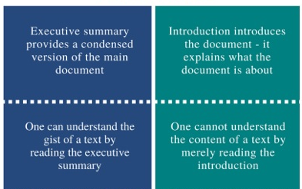
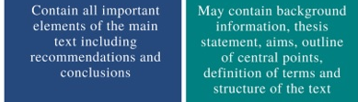
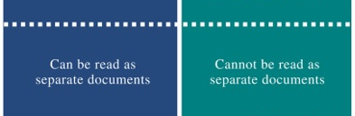
Grade for Executive Summary
Then tell me: • The Problem • Your Solution • Why Now
Problems include threats, opportunities &/or limitations.
Solutions should address what you want to do & when.
Why Now is important since it makes a summary timely.
Do NOT leave a reader thinking there's plenty of time to act.
If there’s no urgency to a summary, the plans won't get read.
Strategic Analysis

Slide 14
Group Peer Evaluations
Peer Evaluation
3.7 OK
3.5 So-So
3.8 Good!
1.4 zzzzzz Don’t be the free rider!
You get a higher grade by not filling this out !
This is due Apr. 13, 2024
.
Group Peer Evaluations

Slide 15

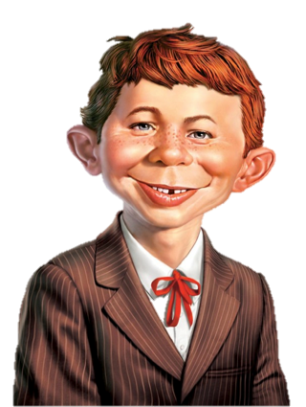


Sundry Material
Sessions will average 20% short lecture, 40% strategy exercise, 40% case analysis.
On-line lectures are from concepts chapters.
A rose means Uber-Text notes
Power Point Audio Lectures are available at: http://www.sfu.ca/~sheppard/478index.html
the Canvas modules (where I finally moved them).
All power point presentations include:
A star means an important point
There’s also some material on the bottom of the slide so you know how much longer the prof. is going to ramble on.
For fun, this guy, Alfred E. Neuman will be in every slide presentation at least once!
S O U N D
Sound
Unsound
Self Evaluation
& Sundry

Slide 16

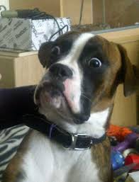

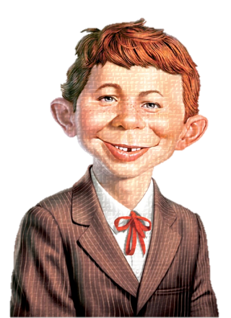
Break
You mean to tell me that not everyone at the door is trying to kill us all?

