Slide 1
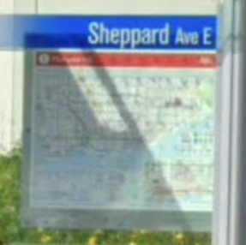

Bus 478 Sheppard
Grading your Presentations
Audio Presentations 1/7
© 2020, 2023 Jerry Sheppard. All rights reserved. May not be copied, scanned, or duplicated, in whole or in part, except for use as
permitted in a license distributed with a certain product or service or otherwise on a password-protected website for classroom use.
Next

Slide 2
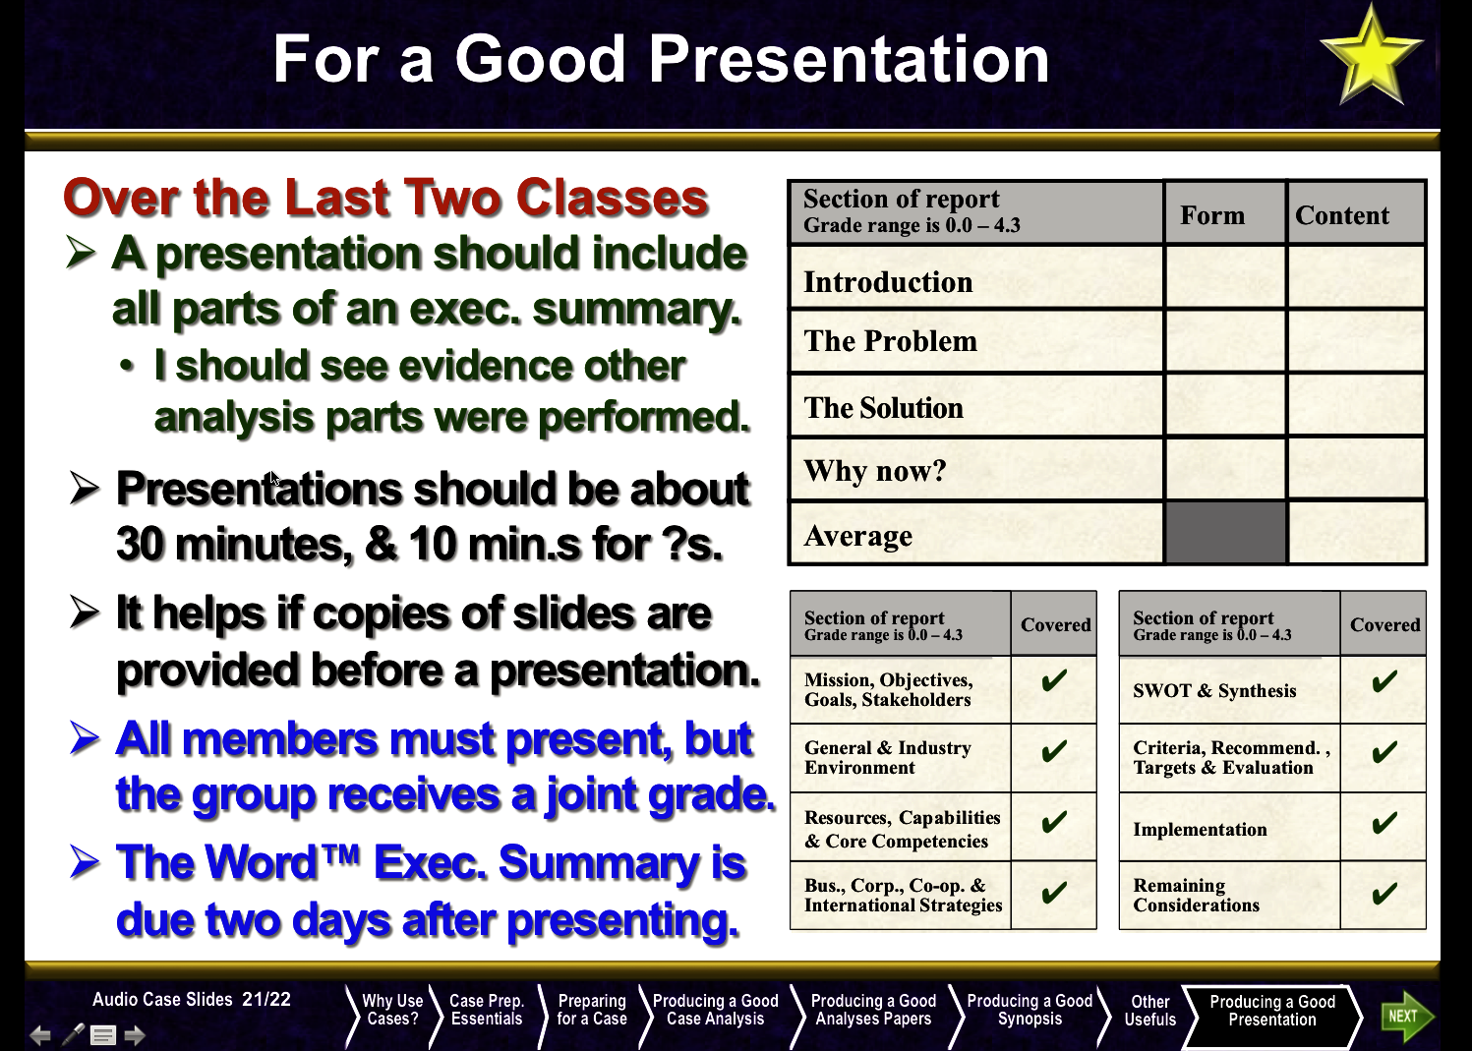
What I said I’d Grade
Audio Presentations 2/7
What I Said I’d Grade
Next

Slide 3
Good Form
 |  | Form | Content
Form
Form
This will deal with the slides and their ability to communicate your points.
Try not to make them too busy (as I am about to do).
Do not use anything less than 18 point font here.
Maintain a consistent appearance so it looks like your group coordinated what you all wrote.
Have the same typeface, the same system of type sizes and bullets, etc. under each heading.
Do not uncover all your points all at once.
I allowed this in the weekly material since it would have been too much to ask for a short assignment, but not here.
Sure spelling, grammar and no typos count.
Audio Presentations 3/7
Good Form
Next

Slide 4
Summary of the grading content
 | Sections | Form | Content
Introduction & Problem | 1. Describe the main challenges / problems for the organization.
 | 2. Show me an analysis backing how you arrived at the conclusion as to what the main challenges are to the organization.
 | 3. Tell me what resources & capabilities the organization has that help address the challenges/problems for the organization.
 | 4. Tell me what restraints the organization has to limit its actions.
Solutions, how & when | 5. Sum-up the above by telling what a good recommendation does.
 | 6. Make a recommendation that is clear and achievable.
 | 7. Explain an implementation schedule, showing a sense of urgency.
 | 8. Show me what things will look like when you are done (i.e. how will you measure success).
 | 9. Be able to address the questions raised.
Content
Introduction & Problem
Solutions, how & when
Audio Presentations 4/7
Summary of Grading Content
Next

Slide 5













Introduction & Problems
 | Sections | Form | Content
Introduction & Problem
1. Describe the main challenges / problems for the organization. Clear understanding of what the organization is trying to achieve.
2. Show an analysis as to how you arrived what the main challenges are to the firm. This is an analysis of the gen., ind. & competitive environment.
3. Tell me what resources / capabilities they have to help address their challenges. This shows me some evidence of an internal analysis.
4. Tell me what restraints the organization has to limit its actions. Basically some SWOT that is likely to emphasize weaknesses.
Section of report Grade range is 0.0 – 4.3
Covered
Section of report Grade range is 0.0 – 4.3
Covered
Section of report Grade range is 0.0 – 4.3
Covered
Mission, Objectives, Goals, Stakeholders
SWOT & Synthesis
SWOT & Synthesis
✔
✔
General & Industry Environment
Criteria, Recommend. , Targets & Evaluation
Criteria, Recommend. , Targets & Evaluation
✔
Resources, Capabilities & Core Competencies
Implementation
Implementation
✔
Bus., Corp., Co-op. & International Strategies
Remaining Considerations
Remaining Considerations
✔
Audio Presentations 5/7
Introduction & Problems
Next

Slide 6
Solutions, How and When
 | Sections | Form | Content
Solutions, how & when
5. Sum-up the above by telling what a good recommendation does. This is the criteria of what a good recommendation should do.
6. Make a recommendation that is clear and achievable. Here we see your recommendation and possibly some targets.
7. Explain an implementation schedule, showing a sense of urgency. This is your implementation and timeline.
8. Show me what things will look like (success measures). Remaining considerations.
9. Be able to address the questions raised. Remaining considerations.
Section of report Grade range is 0.0 – 4.3
Covered
Section of report Grade range is 0.0 – 4.3
Covered
Mission, Objectives, Goals, Stakeholders
SWOT & Synthesis
✔
✔
General & Industry Environment
Criteria, Recommend. , Targets & Evaluation
✔
✔
Resources, Capabilities & Core Competencies
Implementation
✔
✔
Bus., Corp., Co-op. & International Strategies
Remaining Considerations
✔
✔
Audio Presentations 6/7
Solutions, How & When
Next

Slide 7




Audio Presentations 7/7
© 2020, 2023 Jerry Sheppard. All rights reserved. May not be copied, scanned, or duplicated, in whole or in part, except for use as
permitted in a license distributed with a certain product or service or otherwise on a password-protected website for classroom use.
Presentation design by Jerry Sheppard.

