Slide 1






Chapter 3 Title Slide
Introductory Slides:
Bus. 478: Strategy Some Covid Info. First
PART -1 Covidocy
Essential Intro. Slides 1/20
© 2021 Jerry Sheppard. All rights reserved. May not be copied, scanned, or duplicated, in whole or in part, except
for use as permitted in a license distributed with a certain product or service or otherwise on a website for classroom use.
Presentation design by Jerry Sheppard.

Slide 2
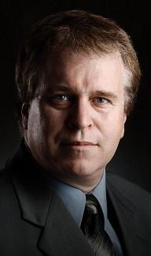

COVID: Here’s what they tell me
Your professor only has a Ph.D. not an M.D.
Essential Intro. Slides 2/20
© 2021 Jerry Sheppard. All rights reserved. May not be copied, scanned, or duplicated, in whole or in part, except
for use as permitted in a license distributed with a certain product or service or otherwise on a website for classroom use.
Presentation design by Jerry Sheppard.

Slide 3
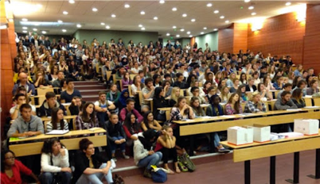
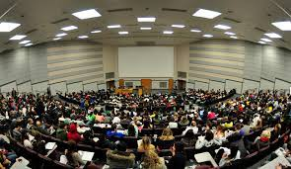

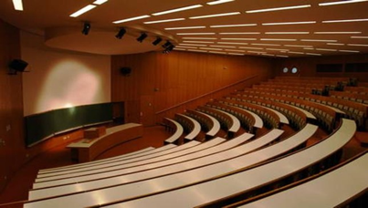
Generally, here’s what I was told
Provincial restrictions on gatherings do not apply to educational settings.
On-campus instruction can resume with classrooms at full capacity.
Physical distancing is not required in classrooms.
SFU will pivot to remote instruction if required by Public Health.
Essential Intro. Slides 3/20
© 2021 Jerry Sheppard. All rights reserved. May not be copied, scanned, or duplicated, in whole or in part, except
for use as permitted in a license distributed with a certain product or service or otherwise on a website for classroom use.
Presentation design by Jerry Sheppard.

Slide 4

COVID: Here’s what else they tell me
COVID-19 spreads by respiratory droplets an infected person produces when they breathe, cough, or sneeze.
If you are in contact with an infected person, the virus can enter your body if droplets get into your throat, nose, or eyes.
Contact
Public Health declares exposures and outbreaks, conducts contact tracing, and directs communication.
Only Public Health can confirm who is a close contact.
If you think you might have been in contact with a ‘case’ but you were not contacted by Public Health you are at no elevated risk.
If you’re a confirmed contact of someone who has tested positive & are at risk based on exposure criteria, Public Health will contact you and ask you to self-isolate or self-monitor as a precaution.
Essential Intro. Slides 4/20
© 2021 Jerry Sheppard. All rights reserved. May not be copied, scanned, or duplicated, in whole or in part, except
for use as permitted in a license distributed with a certain product or service or otherwise on a website for classroom use.
Presentation design by Jerry Sheppard.

Slide 5

To reduce COVID transmission it’s best to:
Get immunized !
Nesters Pharmacy (Burnaby) offers walk-in vaccinations (so I am told).
Stay home when sick !
Wear masks indoors:
Non-medical masks must be worn in indoor common areas & learning spaces;
Unless someone has an approved exemption.
Very few approved exceptions are anticipated;
If exempted, practice physical distancing where feasible.
• Practice cough / sneeze etiquette.
• Clean your hands often.
Essential Intro. Slides 5/20
© 2021 Jerry Sheppard. All rights reserved. May not be copied, scanned, or duplicated, in whole or in part, except
for use as permitted in a license distributed with a certain product or service or otherwise on a website for classroom use.
Presentation design by Jerry Sheppard.

Slide 6

The End
Essential Intro. Slides 6/20
© 2021 Jerry Sheppard. All rights reserved. May not be copied, scanned, or duplicated, in whole or in part, except
for use as permitted in a license distributed with a certain product or service or otherwise on a website for classroom use.
Presentation design by Jerry Sheppard.

