Slide 1

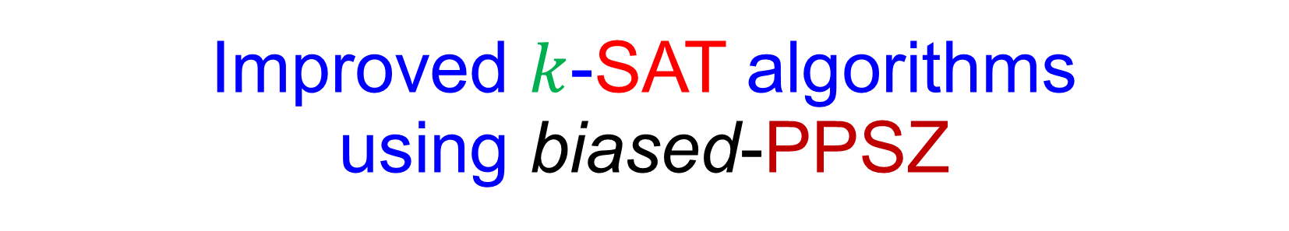



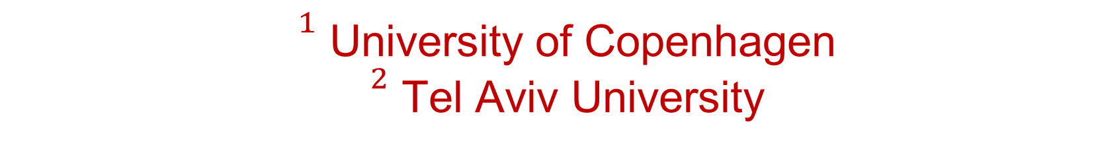
Thomas D. Hansen Haim Kaplan Or Zamir Uri Zwick
Improved $k$-SAT algorithms using biased-PPSZ
The algorithm of Paturi-Pudlak-Saks-Zane
$${}^{1}$$
$${}^{2}$$
$${}^{2}$$
$${}^{2}$$
${}^{1}$ University of Copenhagen ${}^{2}$ Tel Aviv University
SFU, September 30, 2019

Slide 2

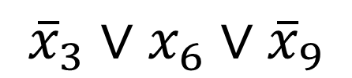

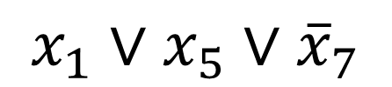
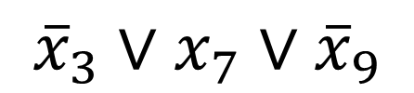
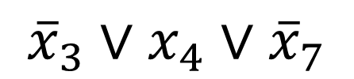
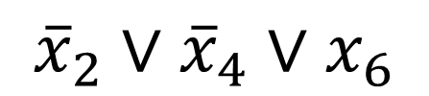
The 3-SAT problem
$$x_{1}∨x_{5}∨{\overline{x}}_{7}$$
$${\overline{x}}_{3}∨x_{6}∨{\overline{x}}_{9}$$
$${\overline{x}}_{2}∨{\overline{x}}_{4}∨x_{6}$$
$${\overline{x}}_{3}∨x_{4}∨{\overline{x}}_{7}$$
$${\overline{x}}_{3}∨x_{7}∨{\overline{x}}_{9}$$
$${\overline{x}}_{1}∨{\overline{x}}_{5}∨x_{8}$$
clause
$$⋯$$
literals
Is there a 0-1 satisfying assignment?
“The” NP-complete problem.
Naïve algorithm runs in $O^{∗}\left(2^{n}\right)$ time.

Slide 3
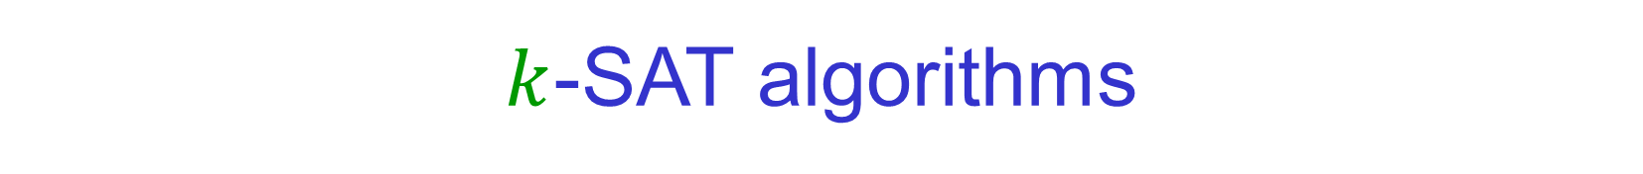
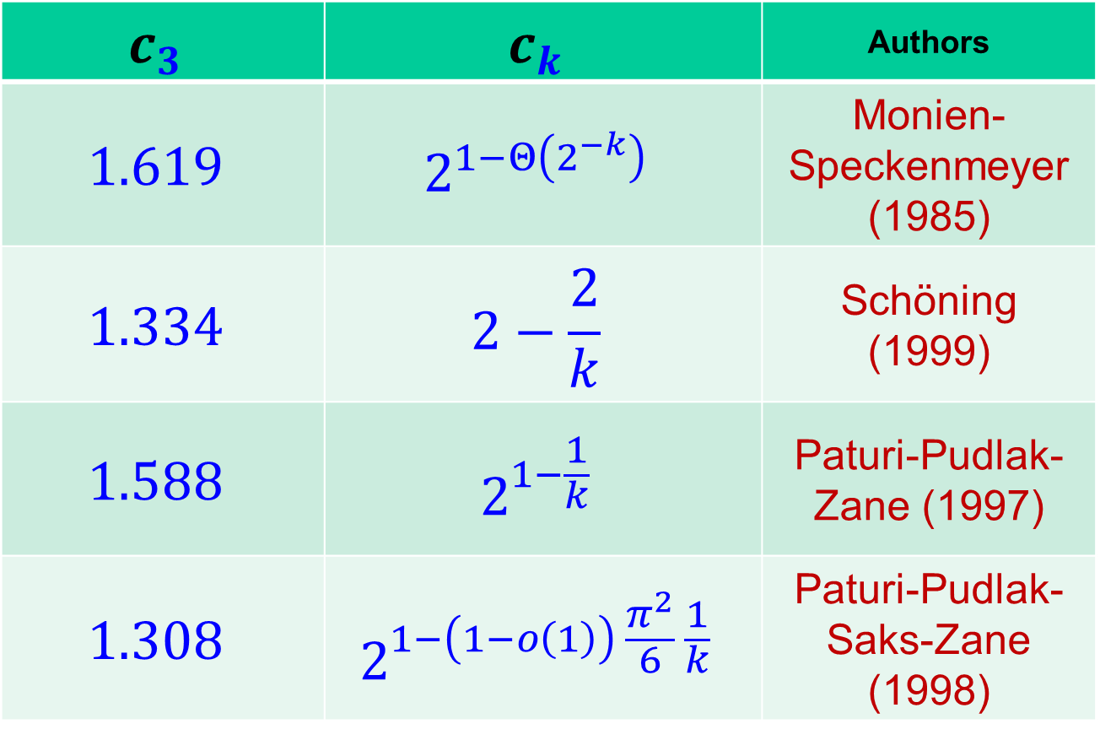
$k$-SAT algorithms
Complexity of known algorithm is ${\left(c_{k}\right)}^{n}$
$$c_{3}$$ | $$c_{k}$$ | Authors
$$1.619$$ | $$2^{1−Θ\left(2^{−k}\right)}$$ | Monien- Speckenmeyer (1985)
$$1.334$$ | $$2−\frac{2}{k}$$ | Schöning (1999)
$$1.588$$ | $$2^{1−\frac{1}{k}}$$ | Paturi-Pudlak- Zane (1997)
$$1.308$$ | $$2^{1−\left(1−o\left(1\right)\right) \frac{π^{2}}{6} \frac{1}{k}}$$ | Paturi-Pudlak- Saks-Zane (1998)
Deterministic branching algo.
Random Walk
*

Slide 4
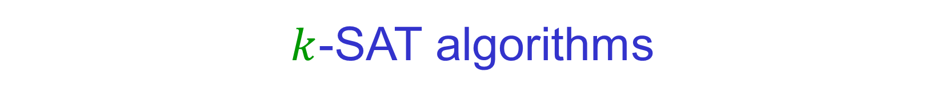
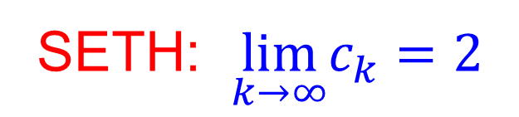
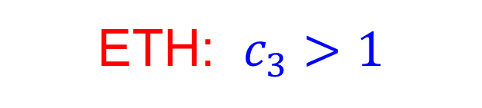
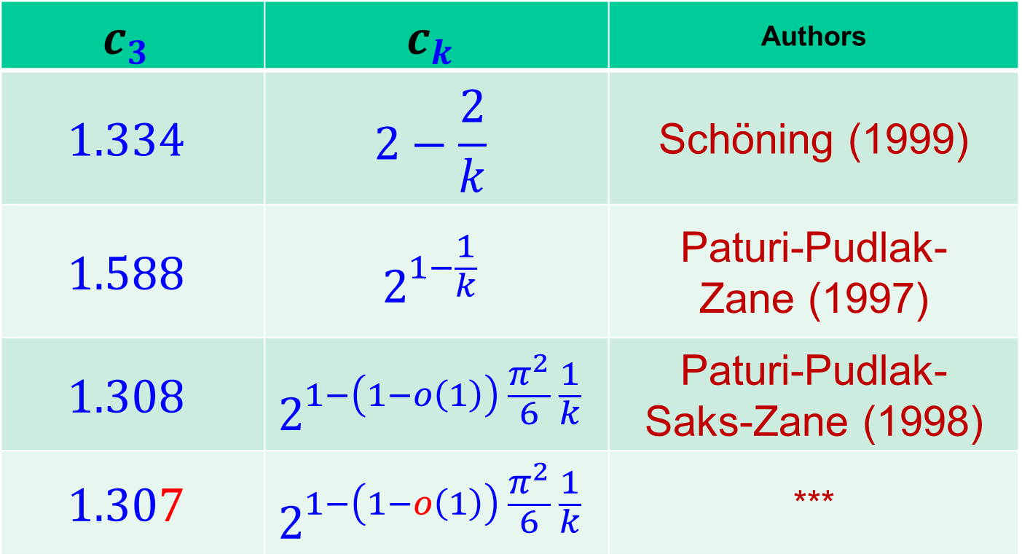
$k$-SAT algorithms
Complexity of known algorithms is $O^{∗}\left({\left(c_{k}\right)}^{n}\right)$
$$c_{3}$$ | $$c_{k}$$ | Authors
$$1.334$$ | $$2−\frac{2}{k}$$ | Schöning (1999)
$$1.588$$ | $$2^{1−\frac{1}{k}}$$ | Paturi-Pudlak- Zane (1997)
$$1.308$$ | $$2^{1−\left(1−o\left(1\right)\right) \frac{π^{2}}{6} \frac{1}{k}}$$ | Paturi-Pudlak- Saks-Zane (1998)
$$1.307$$ | $$2^{1−\left(1−o\left(1\right)\right) \frac{π^{2}}{6} \frac{1}{k}}$$ | ***
ETH: $c_{3}>1$
SETH: $\lim_{k→∞}c_{k}=2$
Notes:
MS: Deterministic branching algorithm
Schoening: Random Walk

Slide 5
ETH and SETH [ Impagliazzo & Paturi (1999) ]
Exponential Time Hypothesis
$$c_{3}>1$$
Strong Exponential Time Hypothesis
$$\lim_{k→∞}c_{k}=2$$
Stronger conjectures than $P≠NP$.

Slide 6

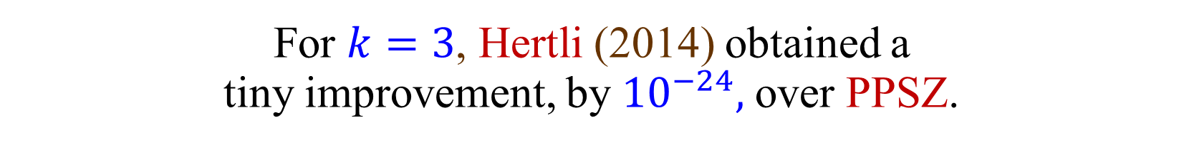
PPZ, PPSZ (and Hertli)
Unique $k$-SAT
Input formula has a unique satisfying assignment
* The PPSZ bounds in the table are for Unique $k$-SAT *
Hertli (2014) showed that the bounds hold without uniqueness.
For $k=3$, Hertli (2014) obtained a tiny improvement, by ${10}^{−24},$ over PPSZ.
Scheder-Steinberger (2017): An improvement over PPSZ for Unique $k$-SAT implies an improvement for $k$-SAT.

Slide 7
Our results
A biased version of the PPSZ algorithm
Improves over PPSZ for every $k≥3$
${1.307}^{n}$ for Unique 3-SAT
${1.305}^{n}$ for Unique NAE-3-SAT
(Improving on the existing ${1.308}^{n}$ algorithms)
A very natural approach
May hopefully lead to further improvements

Slide 8

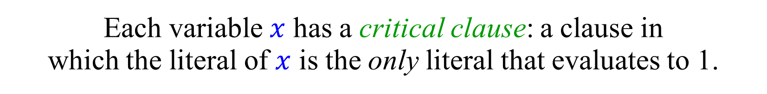
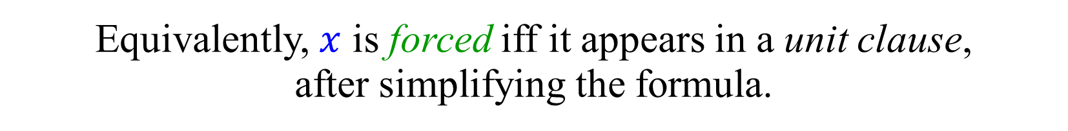
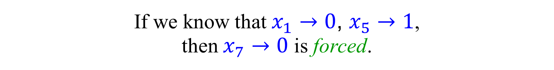
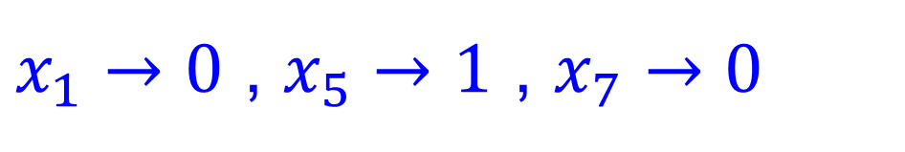
Uniqueness and Critical Clauses
Assume, at first, that the input formula has a unique satisfying assignment.
Each variable $x$ has a critical clause: a clause in which the literal of $x$ is the only literal that evaluates to 1.
$$x_{1}∨{\overline{x}}_{5}∨{\overline{x}}_{7}$$
$x_{1}→0$ , $x_{5}→1$ , $x_{7}→0$
If we know that $x_{1}→0$, $x_{5}→1$, then $x_{7}→0$ is forced.
Equivalently, $x$ is forced iff it appears in a unit clause, after simplifying the formula.

Slide 9
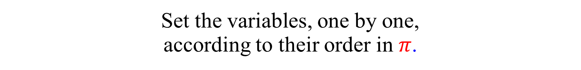
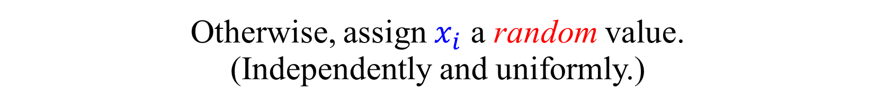
The PPZ algorithm
Choose a random permutation $π$ of the variables.
Set the variables, one by one, according to their order in $π$.
If $x_{i}$ is forced, set it accordingly.
Otherwise, assign $x_{i}$ a random value. (Independently and uniformly.)
If a satisfying assignment found → great.
Otherwise, repeat.
Give up after a certain number of iterations.

Slide 10
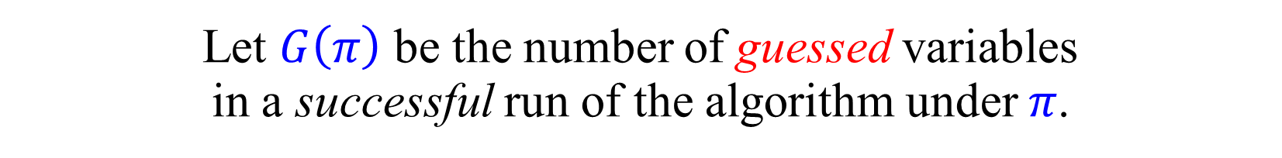
The PPZ algorithm - Analysis
Let $G\left(π\right)$ be the number of guessed variables in a successful run of the algorithm under $π$.
(Note: For a given $π$, this is not a random variable.)
Each variable has a critical clause.
With probability $\frac{1}{k}$ it is the last variable in this clause.
If previous values were set correctly, the variable is forced.
$𝔼_{π}\left[G\left(π\right)\right]≤\left(1−\frac{1}{k}\right)n$
Success probability (of one iteration):
$𝔼_{π}\left[2^{−G\left(π\right)}\right] ≥ 2^{−𝔼_{π}\left[G\left(π\right)\right]} ≥ 2^{−\left(1−\frac{1}{k}\right)n}$
Jensen’s inequality

Slide 11
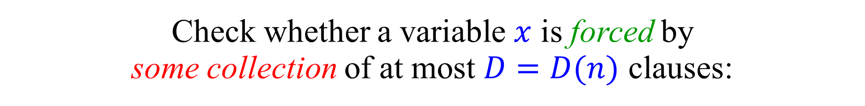
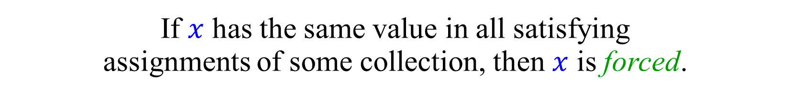
The PPSZ algorithm
Check whether a variable $x$ is forced by some collection of at most $D=D(n)$ clauses:
Enumerate over all collections of $D$ clauses.
Find all satisfying assignments of each collection.
If $x$ has the same value in all satisfying assignments of some collection, then $x$ is forced.
For $D=1$ this is exactly PPZ.
$\left({{\left(2n\right)}^{k} \atop D}\right) 2^{kD} =2^{o\left(n\right)}$ , if $D=o\left(\frac{n}{\log{n}}\right)$
This version is due to Hertli (2014). The original PPSZ algorithm uses bounded resolution.

Slide 12
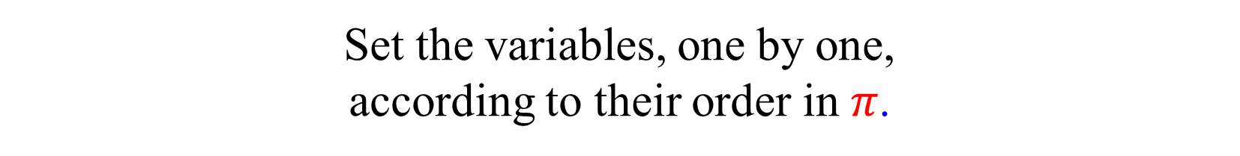
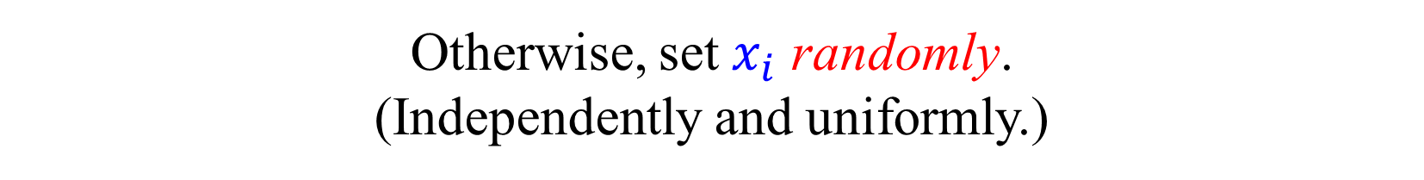
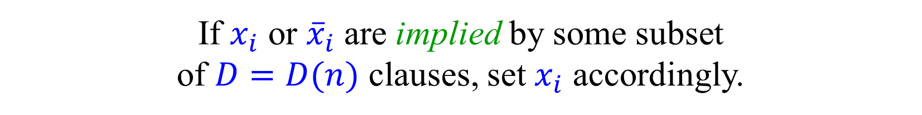
The PPSZ algorithm
Choose a random permutation $π$ of the variables.
Set the variables, one by one, according to their order in $π$.
If $x_{i}$ or ${\overline{x}}_{i}$ are implied by some subset of $D=D(n)$ clauses, set $x_{i}$ accordingly.
Otherwise, set $x_{i}$ randomly. (Independently and uniformly.)
Simplify the formula by eliminating $x_{i}$ and ${\overline{x}}_{i}$.
If a satisfying assignment not found, repeat.
Give up after a certain number of iterations.

Slide 13

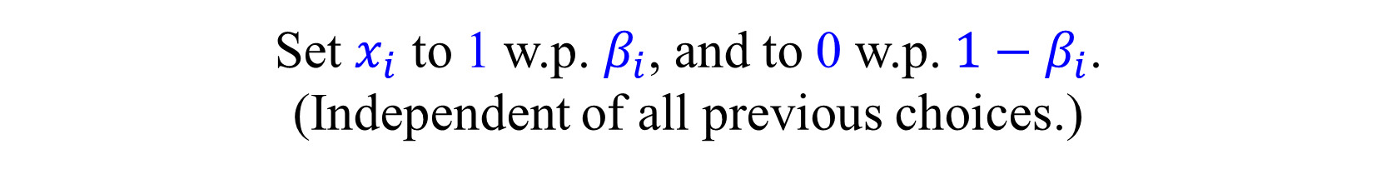
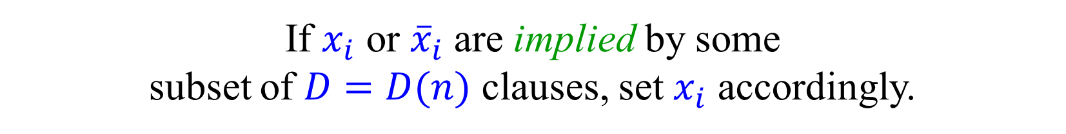
The biased-PPSZ algorithm
Choose a random permutation $π$ of the variables.
Set the variables, one by one, according to their order in $π$.
If $x_{i}$ or ${\overline{x}}_{i}$ are implied by some subset of $D=D(n)$ clauses, set $x_{i}$ accordingly.
Otherwise, compute a bias $β_{i}$.
Set $x_{i}$ to 1 w.p. $β_{i}$, and to 0 w.p. $1−β_{i}$. (Independent of all previous choices.)
Simplify the formula by eliminating $x_{i}$ and ${\overline{x}}_{i}$.

Slide 14

High-level Analysis of PPSZ
Let $G\left(π\right)$ be the number of guessed variables in a successful run of the algorithm under $π$.
(Note: For a given $π$, this is not a random variable.)
Assume $𝔼_{π}\left[G\left(π\right)\right]≤\left(1−μ\right)n$
Success probability (of one iteration):
$𝔼_{π}\left[2^{−G\left(π\right)}\right] ≥ 2^{−𝔼_{π}\left[G\left(π\right)\right]} ≥ 2^{−\left(1−μ\right)n}$
Jensen’s inequality
A variable that is not guessed is said to be forced.

Slide 15
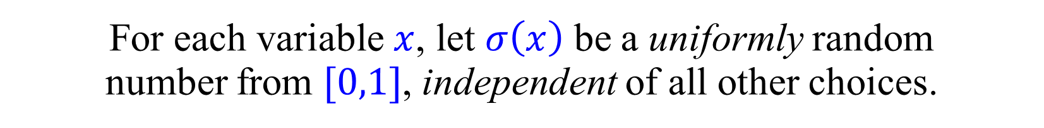
“Continuous” permutations
For each variable $x$, let $σ\left(x\right)$ be a uniformly random number from $[0,1]$, independent of all other choices.
Obtain a random permutation $π$, by sorting $σ$.
Simplifies the analysis, as all $σ(x)$’s are independent.

Slide 16
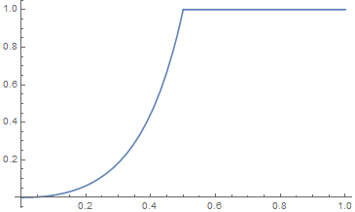
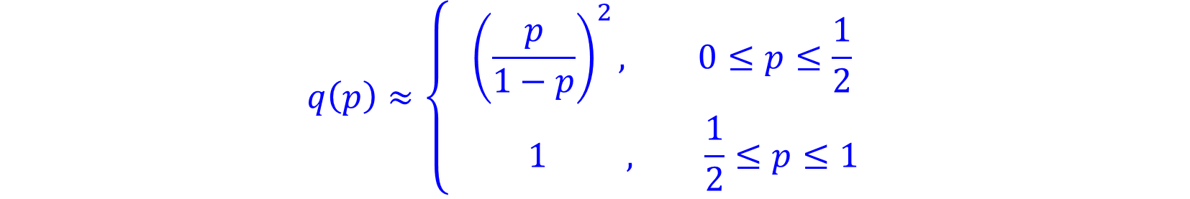
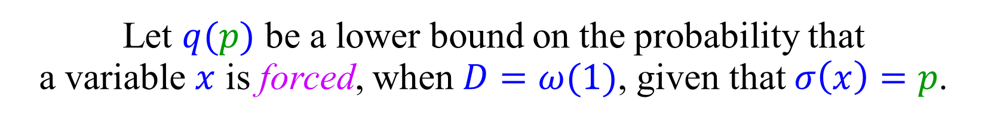
Forcing probabilities
Let $q(p)$ be a lower bound on the probability that a variable $x$ is forced, when $D=ω(1)$, given that $σ\left(x\right)=p$.
$$q\left(p\right)≈{\left(p+\left(1−p\right)q\left(p\right)\right)}^{2}$$
$$q\left(p\right)≈\left\{\begin{aligned}{\left(\frac{p}{1−p}\right)}^{2}, 0≤p≤\frac{1}{2} \\ 1 , \frac{1}{2}≤p≤1 \end{aligned}\right.$$

Slide 17
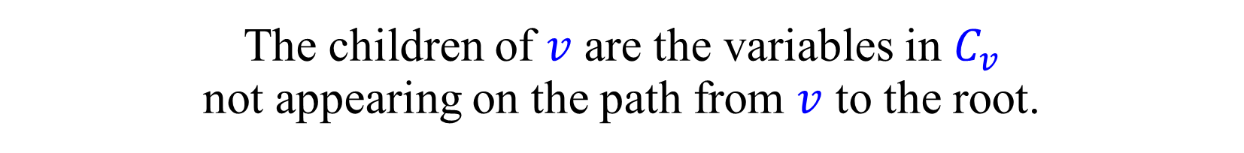
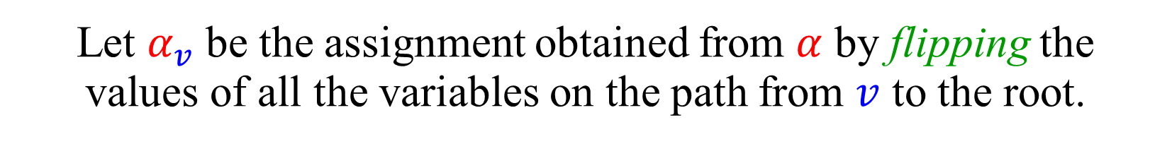
“Critical Clause” Trees (CCTs)
Let $α$ be the unique satisfying assignment.
For each variable $x$, construct a $\left(k−1\right)$-ary tree $T_{x}$:
Each node $v$ is assigned a variable $x_{v}$ and a clause $C_{v}$.
The variable assigned to the root is $x$.
Let $α_{v}$ be the assignment obtained from $α$ by flipping the values of all the variables on the path from $v$ to the root.
For every node $v$, the clause $C_{v}$ is not satisfied by $α_{v}$.
The children of $v$ are the variables in $C_{v}$ not appearing on the path from $v$ to the root.

Slide 18









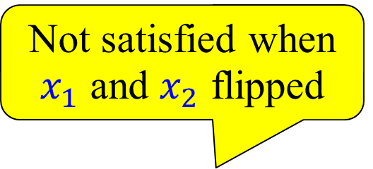



“Critical Clause” Trees (CCTs)
Assume that $α$, the unique satisfying assignment, is all-1.
Not satisfied when $x_{1}$ and $x_{2}$ flipped
$$x_{1}$$
$$x_{1}∨{\overline{x}}_{2}∨{\overline{x}}_{3}$$
Unary node
$$x_{2}∨{\overline{x}}_{4}∨{\overline{x}}_{5}$$
$$x_{2}$$
$$x_{3}$$
$$x_{1}∨x_{3}∨{\overline{x}}_{6}$$
$$x_{1}∨x_{2}∨x_{4}$$
$$x_{4}$$
$$x_{5}$$
$$x_{2}∨{\overline{x}}_{3}∨x_{5}$$
$$x_{6}$$
leaf
$$x_{3}$$

Slide 19














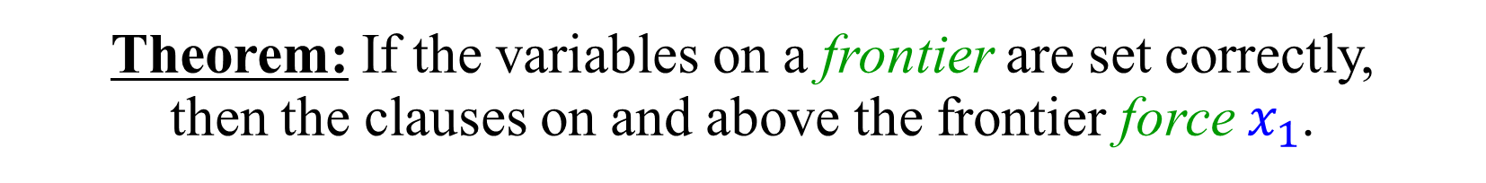
“Critical Clause” Trees (CCTs)
$$x_{1}$$
$$x_{1}∨{\overline{x}}_{2}∨{\overline{x}}_{3}$$
$$x_{2}∨{\overline{x}}_{4}∨{\overline{x}}_{5}$$
$$x_{2}$$
$$x_{3}$$
$$x_{1}∨x_{3}∨{\overline{x}}_{6}$$
$$x_{1}∨x_{2}∨x_{4}$$
$$x_{4}$$
$$x_{5}$$
$$x_{2}∨{\overline{x}}_{3}∨x_{5}$$
$$x_{6}$$
$$x_{6}∨{\overline{x}}_{7}∨{\overline{x}}_{8}$$
$$x_{3}∨{\overline{x}}_{7}∨{\overline{x}}_{8}$$
$$x_{3}$$
Theorem: If the variables on a frontier are set correctly, then the clauses on and above the frontier force $x_{1}$.

Slide 20

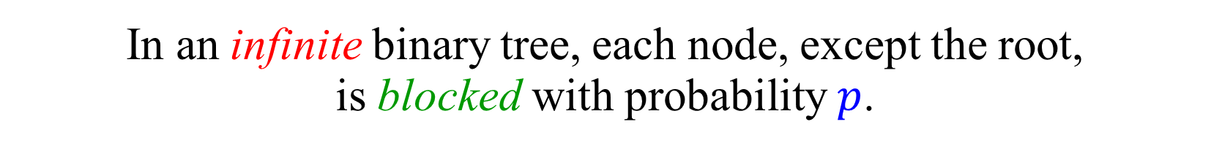
A percolation problem
In an infinite binary tree, each node, except the root, is blocked with probability $p$.
$$⋮$$

Slide 21
A percolation problem
In an infinite binary tree, each node, except the root, is blocked with probability $p$.
What is the probability $q\left(p\right)$ of having a finite frontier?
$$q\left(p\right)={\left(p+\left(1−p\right)q\left(p\right)\right)}^{2}$$
$$⋮$$

Slide 22
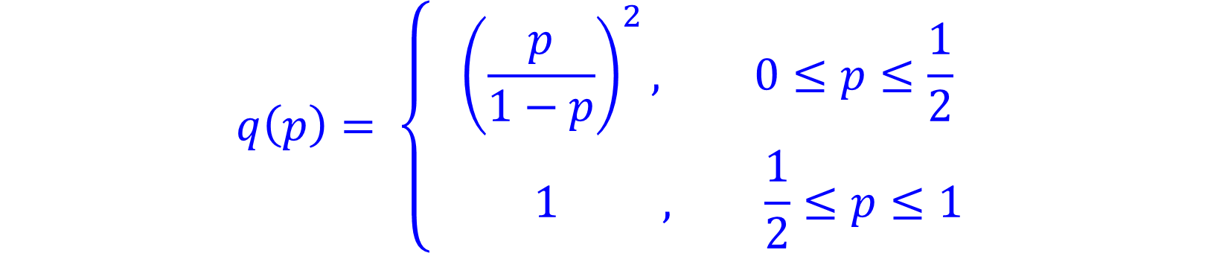

A percolation problem
In an infinite binary tree, each node, except the root, is blocked with probability $p$.
What is the probability $q\left(p\right)$ of having a finite frontier?
$$q\left(p\right)={\left(p+\left(1−p\right)q\left(p\right)\right)}^{2}$$
$$q\left(p\right)= \left\{\begin{aligned}{\left(\frac{p}{1−p}\right)}^{2}, 0≤p≤\frac{1}{2} \\ 1 , \frac{1}{2}≤p≤1 \end{aligned}\right.$$

Slide 23
CCTs vs. Percolation
A CCT is finite.
A CCT may have unary nodes.
Different nodes may be labeled by the same variable.
All work in our favor.
Correlations help due to the FKG inequality.
We want a frontier of size at most $D$.
Let $q_{D}\left(p\right)$ be the probability of a frontier of size $≤D$.
As $\lim_{D→∞}q_{D}\left(p\right)=q(p)$, having $D=ω\left(1\right)$ is enough.

Slide 24
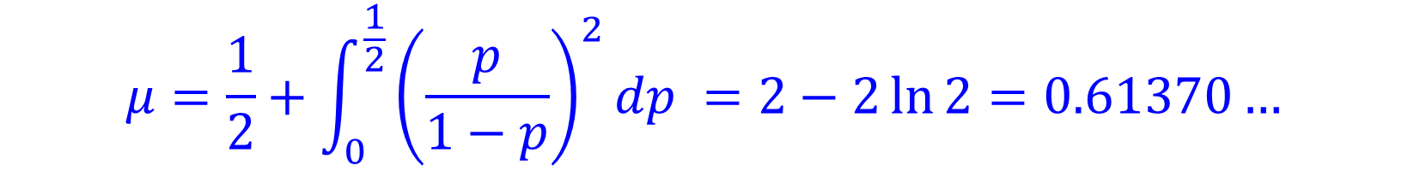
The PPSZ algorithm - Analysis
If $σ\left(x\right)≥1/2$, then $x$ is forced with probability 1.
If $σ\left(x\right)=p<1/2$, then $x$ is forced w.p. $≥{\left(\frac{p}{1−p}\right)}^{2}$.
The probability that $x$ is forced is:
$$μ=\frac{1}{2}+\int_{0}^{\frac{1}{2}}{{\left(\frac{p}{1−p}\right)}^{2}dp }=2−2\ln{2}=0.61370…$$
Success probability (of one iteration):
$𝔼_{π}\left[2^{−G\left(π\right)}\right] ≥ 2^{−𝔼_{π}\left[G\left(π\right)\right]} ≥ 2^{−\left(1−μ\right)n}≥{1.308}^{−n}$

Slide 25
Biased PPSZ
Suppose that $x$ is not forced.
Should we just ‘blindly’ guess it?
Maybe we should use bias in certain cases?
Using bias, in certain cases, provably helps.
Analysis is challenging.
We still understand fairly little.
“Toy” problem: NAE-3-SAT (Not-All-Equal-3-SAT)

Slide 26
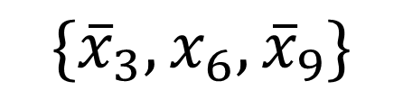

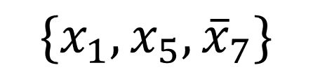
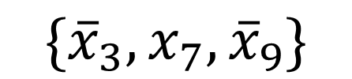
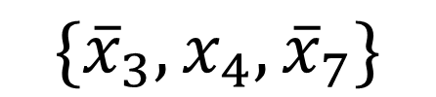

The NAE-3-SAT problem
$${\{x}_{1},x_{5},{\overline{x}}_{7}\}$$
$$\{{\overline{x}}_{3},x_{6},{\overline{x}}_{9}\}$$
$$\{{\overline{x}}_{2},{\overline{x}}_{4},x_{6}\}$$
$$\{{\overline{x}}_{3},x_{4},{\overline{x}}_{7}\}$$
$$\{{\overline{x}}_{3},x_{7},{\overline{x}}_{9}\}$$
$$\{{\overline{x}}_{1},{\overline{x}}_{5},x_{8}\}$$
Each clause should have both a 1 and a 0.
Is there a 0-1 satisfying assignment?
Still an NP-complete problem.
A sub-problem of 3-SAT:
$$\left\{x_{1},x_{2},{\overline{x}}_{3}\right\} ≡\left(x_{1}∨x_{2}∨{\overline{x}}_{3}\right) ∧\left({\overline{x}}_{1}∨{\overline{x}}_{2}∨x_{3}\right)$$
No faster algorithms were known for NAE-3-SAT.

Slide 27
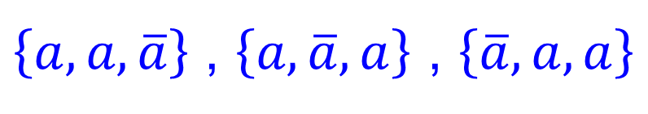

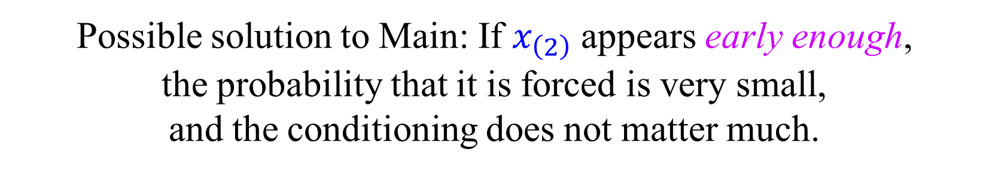
Bias in NAE-3-SAT
$${\{x}_{1},x_{2},x_{3}\}$$
$\left\{a,a,\overline{a}\right\}$ , $\left\{a,\overline{a},a\right\}$ , $\left\{\overline{a},a,a\right\}$
In any NAE clause, two random literals differ w.p. $\frac{2}{3}$.
Let $x_{(1)}$, $x_{(2)}$, $x_{(3)}$ be the order in which $x_{1},x_{2},x_{3}$ arrive.
Suppose that $x_{(2)}$ is not forced.
“Clearly”, $x_{(2)}$ should be guessed with a bias towards ${\overline{x}}_{(1)}$.
Main difficulty: need to condition on $x_{(2)}$ not being forced.
Another difficulty: What if $x_{(2)}$ is second in several clauses?
Possible solution to Main: If $x_{\left(2\right)}$ appears early enough, the probability that it is forced is very small, and the conditioning does not matter much.

Slide 28
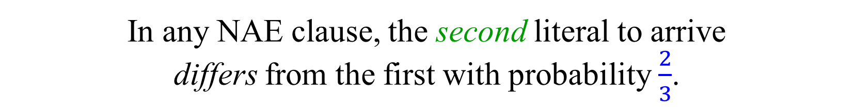
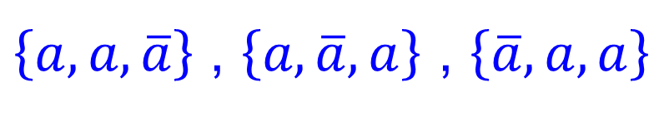

Bias in NAE-3-SAT
$${\{x}_{1},x_{2},x_{3}\}$$
$\left\{a,a,\overline{a}\right\}$ , $\left\{a,\overline{a},a\right\}$ , $\left\{\overline{a},a,a\right\}$
Suppose $x_{1}$, $x_{2}$, $x_{3}$ arrive in this order.
In any NAE clause, the second literal to arrive differs from the first with probability $\frac{2}{3}$.
Suppose that $x_{2}$ is not forced.
“Clearly”, $x_{2}$ should be guessed with a bias to ${\overline{x}}_{1}$.
Main difficulty: conditioning on $x_{2}$ not being forced.
What if $x_{2}$ is second to arrive in several clauses?

Slide 29







Maximal set of disjoint clauses
Used as a scaffolding to reduce dependencies. (Hopefully there would be a better solution.)
maximal collection of disjoint clauses.
All other clauses
$$x_{1}∨x_{2}∨x_{3}$$
$$x_{10}∨x_{2}∨{\overline{x}}_{11}$$
$$x_{4}∨x_{5}∨x_{6}$$
$$x_{12}∨x_{13}∨x_{6}$$
$$⋮$$
$${{\overline{x}}_{9}∨x}_{1}∨x_{5}$$
$$⋮$$
We may assume, w.l.o.g., that all literals in the disjoint collection of clauses are unnegated.

Slide 30




Maximal set of disjoint clauses
Used as a scaffolding to reduce dependencies. (Hopefully there would be a better solution.)
Let $𝒞$ be a maximal collection of disjoint clauses. (Can be found greedily.)
Let $cn=3|𝒞|$ be the number of variables in $𝒞$.
If $c<\lg{1.308}≃0.387$, we can in $o\left({1.307}^{n}\right)$ time enumerate over the values of all variables in $𝒞$.
As $𝒞$ is maximal, every clause not in $𝒞$ must intersect $𝒞$. We are thus left with a 2-SAT instance, solvable in poly. time.
We may thus assume that $c>0.387$, i.e., a substantial fraction of the variables are in $𝒞$.
We guess with bias only variables from $𝒞$.

Slide 31



Biased-PPSZ for NAE-3-SAT
Construct a maximal set $𝒟$ of disjoint clauses.
If $3\left|𝒟\right|<0.387n$ enumerate on the variables in $𝒟$ and solve the resulting 2-SAT instance.
Choose a (small) parameter $0<t<1$.
Run PPSZ with the following modification:
If a variable $x$ to be guessed is (1) contained in a clause $C∈𝒟$, (2) appears before time $t$, (3) and is the second variable to appear from $C$,
then guess $x$ with bias $\frac{2}{3}:\frac{1}{3}$ towards the opposite value of the first variable to appear from $C$.
Improvement: guess with a bias that depends on $t$.

Slide 32


Biased-PPSZ for NAE-3-SAT
Construct a maximal set $𝒞$of disjoint clauses.
Assume $3\left|𝒞\right|>0.387n.$ Otherwise, …
Choose a (small) parameter $0<t<1$.
Run PPSZ with the following modification:
If a variable $x$ to be guessed is contained in a clause $C$ from $𝒞$, appears before time $t$, and is the second variable to appear from $C$,
then guess $x$ with bias $\frac{2}{3}:\frac{1}{3}$ towards the opposite value of the first variable to appear from $C$.

Slide 33
Biased-PPSZ for NAE-3-SAT - analysis
Do we get a chance to guess, with a bias, the second variable to arrive from a clause?
Yes, at least if $σ\left(x\right)=p$ is small enough.
The probability that $x$ is second is $2p\left(1−p\right)≃2p$.
The probability that $x$ is forced is ${\left(\frac{p}{1−p}\right)}^{2}≃p^{2}$.
$ℙ\left[ \left.\begin{matrix} x is second \\ x is guessed \end{matrix}\right|σ\left(x\right)=p \right]=2p\left(1−p\right)−{\left(\frac{p}{1−p}\right)}^{2}≃2p$
Wait, but ${\left(\frac{p}{1−p}\right)}^{2}$ is only a lower bound?
If the forcing probability is higher, we also gain.
Can be made formal.

Slide 34



Bias in 3-SAT
As before, let $𝒟$ be a maximal collection of disjoint clauses.
The weight of a clause is the number of 1’s in it, under the unique satisfying assignment.
Let $w_{1},w_{2},w_{3}$ be the fraction of clauses in $𝒟$ of weight 1,2,3. Note that $w_{1}+w_{2}+w_{3}=1$. (For NAE-3-SAT, $w_{3}=0$.)
We may assume that $w_{1},w_{2},w_{3}$ are known to us.
If ${(w}_{1},w_{2},w_{3})≠\left(\frac{3}{4},0,\frac{1}{4}\right)$ there is bias on first or second variable, and the situation is very similar to NAE-3-SAT.
If ${(w}_{1},w_{2},w_{3})≈\left(\frac{3}{4},0,\frac{1}{4}\right)$ there is almost maximal bias on the third variable.
We show that either the third variable has a higher forcing probability, or we can sometimes guess it with bias and win.

Slide 35

Bias in 3-SAT
As before, let $𝒞$ be a maximal collection of disjoint clauses.
The weight of a clause is the number of 1’s in it, under the unique satisfying assignment.
Let $w_{1},w_{2},w_{3}$ be the fraction of clauses in $𝒞$ of weight 1,2,3.
Note that $w_{1}+w_{2}+w_{3}=1$. (For NAE-3-SAT, $w_{3}=0$.)
We may assume that $w_{1},w_{2},w_{3}$ are known to us.
Choose a random clause of $𝒞$ and a random order of its variables.
Let $p_{i}$ be the probability that the value of first variable is $i$.
Let $p_{i,j}$ be the probability that the value of first variable is $i$ and the value of the second variable is $j$.

Slide 36


Bias on first or second in 3-SAT
$p_{0}=\frac{2}{3}w_{1}+\frac{1}{3}w_{2}$ , $p_{1}=\frac{1}{3}w_{1}+\frac{2}{3}w_{2}+w_{3}$
$p_{00}=\frac{1}{3}w_{1}$ , $p_{01}=p_{10}=\frac{1}{3}w_{1}+\frac{1}{3}w_{2}$ , $p_{11}={\frac{1}{3}w}_{2}+w_{3}$
If $\left(p_{0},p_{1}\right)≠\left(\frac{1}{2},\frac{1}{2}\right)$, we get some bias on the first variable.
If ${(p}_{00},p_{01},p_{10},p_{11}) ≠\left(\frac{1}{4},\frac{1}{4},\frac{1}{4},\frac{1}{4}\right)$, we get some bias on the second variable.
If there is bias on first or second variable, a modification of the analysis of NAE-3-SAT applies.
No bias on first or second variable ➔ $w_{1}=\frac{3}{4} , w_{2}=0 , w_{3}=\frac{1}{4}$

Slide 37

Bias on third variable in 3-SAT
Suppose $\left(w_{1},w_{2},w_{3}\right)≈\left(\frac{3}{4},0,\frac{1}{4}\right)$.
Each clause is almost a linear equation $x_{1}⊕x_{2}⊕x_{3}=1$.
We have an almost maximal bias on the third variable.
In almost each clause of $𝒞$, every two variables determine the third.
What if the third variable is almost never guessed?
In that case, the forcing probabilities of many variables must be higher than what promised by the PPSZ analysis.

Slide 38



Related critical clauses
For simplicity, assume that $α≡1$.
Lemma 1:
Suppose that $x$ has a critical clause $x∨\overline{y}∨{\overline{z}}_{1}$, and that $y$ has a critical clause $y∨\overline{x}∨{\overline{z}}_{2}$.
then either $x$ or $y$ have a forcing probability of at least $μ+ε_{1}$, where $ε_{1}≥0.0035$,
where $μ=2−2\ln{2}=0.61370…$ is the forcing probability promised by the standard analysis of PPSZ

Slide 39


Non-clauses
For simplicity, assume that $α≡1$.
Lemma 2:
Suppose that the clause $x∨\overline{y}∨\overline{z}$ is not in the input formula.
then, the probability that $x$ is forced, or that of $x$ is guessed and appears after $y$ and $z$, is least $μ+ε_{2}$, where $ε_{2}>0$,
where $μ=2−2\ln{2}=0.61370…$ is the forcing probability promised by the standard analysis of PPSZ

Slide 40

Bias on third variable in 3-SAT
Assume that $α$, the unique satisfying assignment, is all-1.
In almost each clause of $𝒞$, every two variables determine the third.
Consider a “good” clause $x∨\overline{y}∨\overline{z}$ in $𝒞$.
The weight of the clause is 1.
Case 1: The input formula explicitly contains the critical clauses

Slide 41

Concluding remarks
Biased- PPSZ – a natural extension of PPSZ.
First improvement over PPSZ for $k$-SAT, for every $k>3$.
A noticeable improvement for 3-SAT.
Non-trivial analysis.
Potential for much larger improvement.

