Slide 1

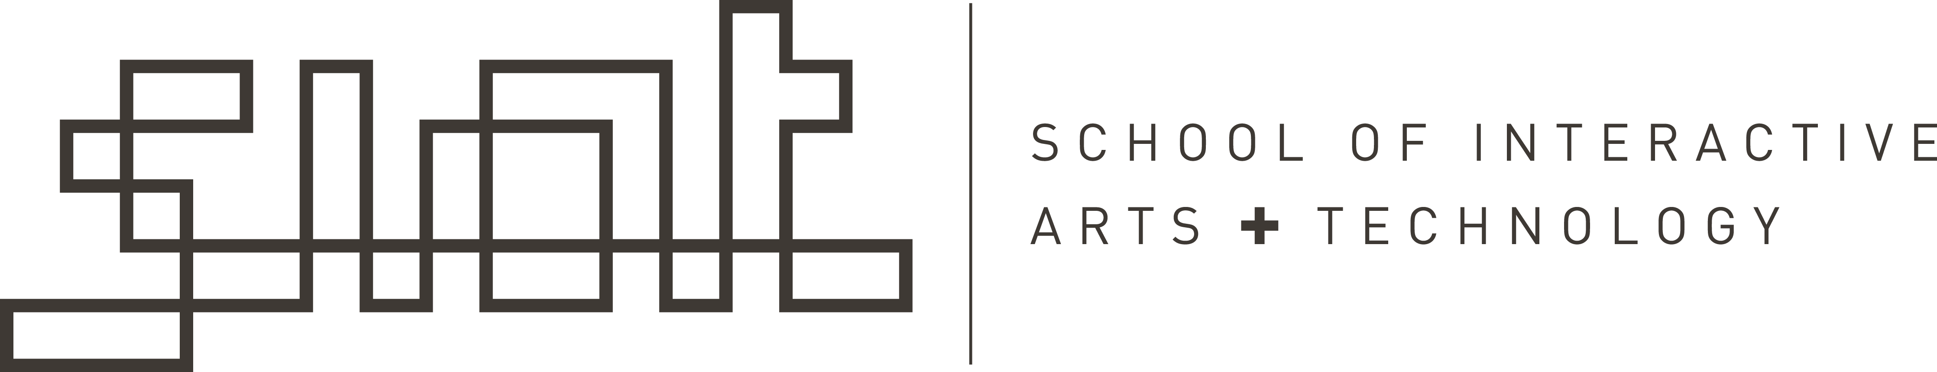
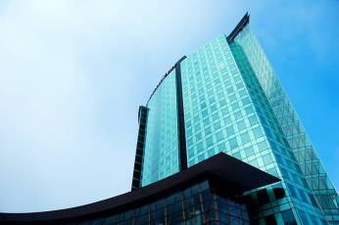
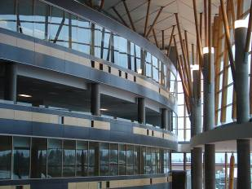

IAT 106
Spatial Thinking and Communicating
Spring 2021

Slide 2
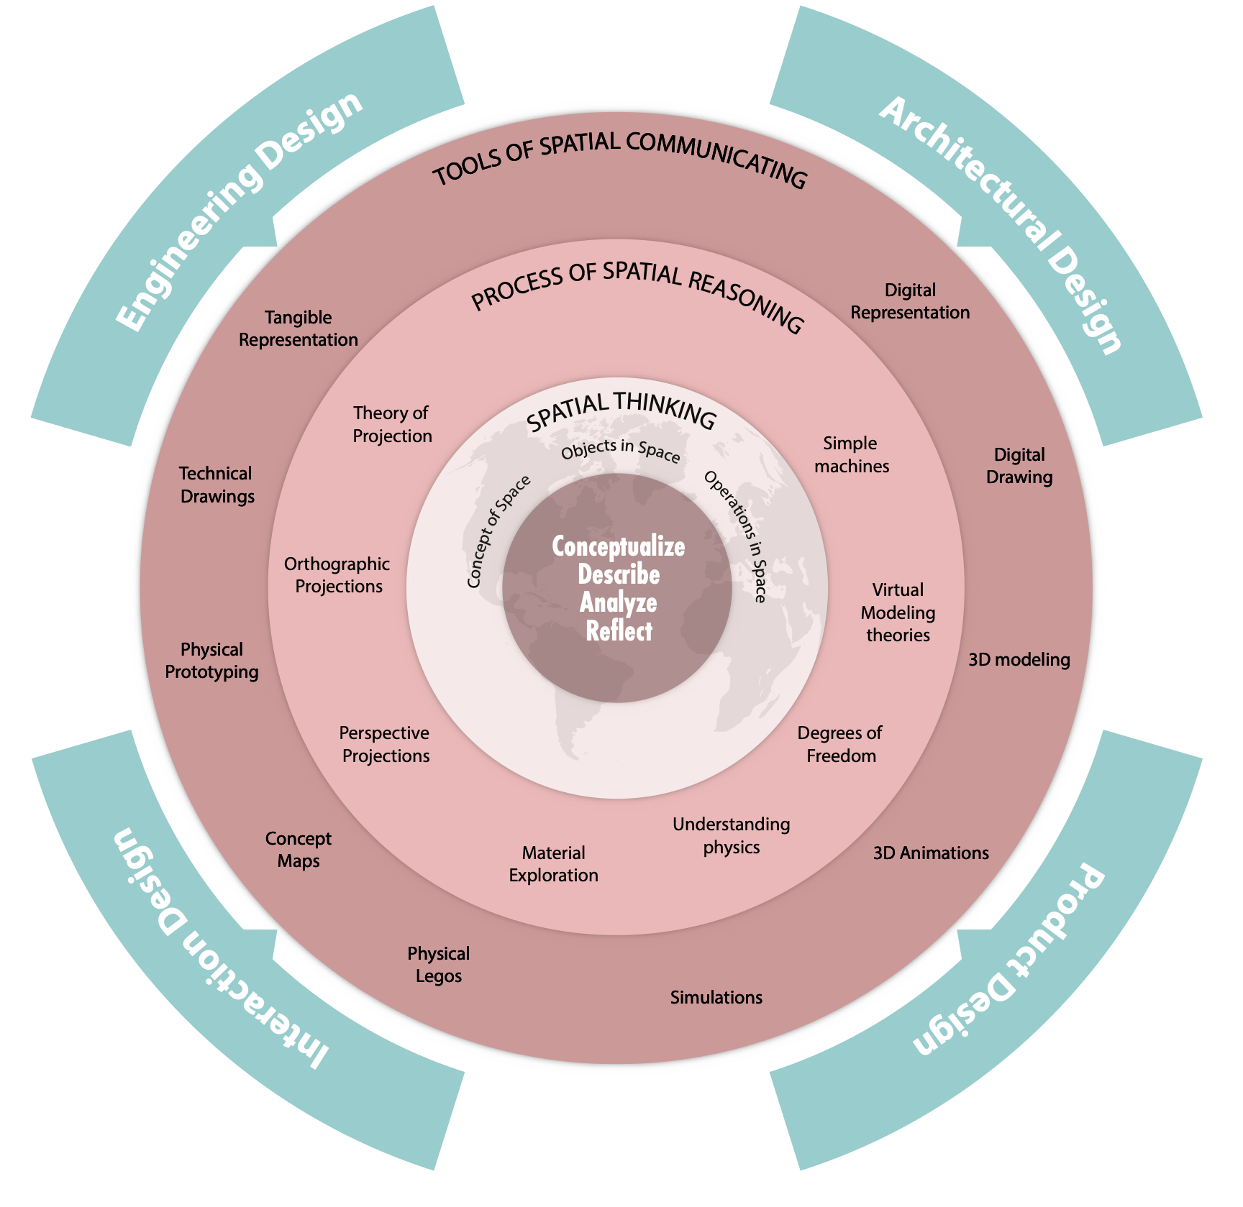
IAT106 Concept Map

Slide 3
Course Website Overview (www.sfu.ca/~t106)

Slide 4
Course Schedule Online Lecture (1 hr.) LIVE Session – every Fri @12:30 (1 hr.) LIVE Labs – every Monday @9:30AM, or @2:30PM (3 hrs.)

Slide 5
Polling Time What is your Major? Which year are you?

Slide 6
Lab this week - Concept Map - Digital Modelling using Lego

Slide 7
Concept Maps
A concept map is a diagram or graphical tool that visually represents relationships between concepts and ideas. Most concept maps depict ideas as boxes or circles (also called nodes), which are structured hierarchically and connected with lines or arrows (also called arcs). These lines are labeled with linking words and phrases to help explain the connections between concepts.
https://www.lucidchart.com/pages/concept-map

Slide 8
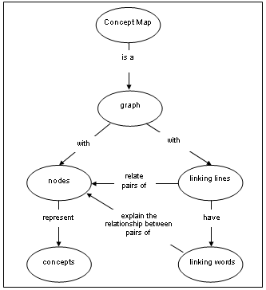

Slide 11
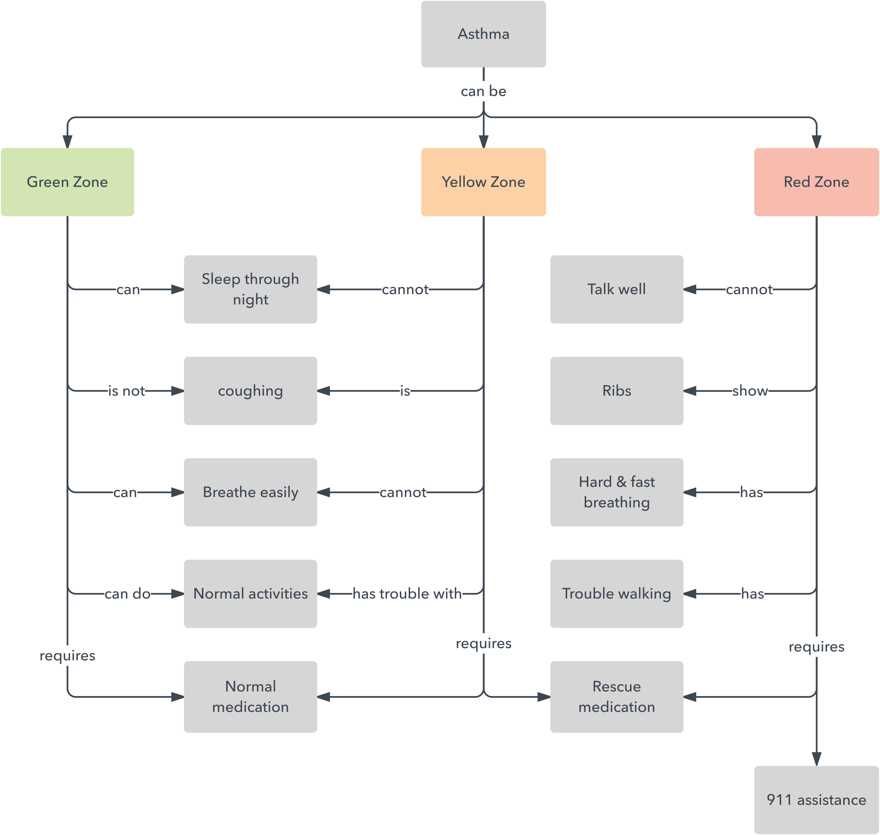

Slide 12
Concept Maps of a HOUSE After you are done, upload it on Canvas under Discussions

Slide 13
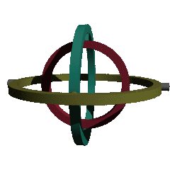
Gimbal Example
Objects: Pivot, Ring, Base, Support
Pivot: a support that enables an object attached to rotate about an axis
Ring: A circular structure that is supported by one or two pivots to either another ring or to the base.
Space:
Inner rings are smaller than the outer ring supporting them.
Rotations occur about axes in space.
The base sits on the XY plane.
Each object has a local coordinate system.
Operations change and move space and objects
If the outer ring rotates about X-axis, the inner ring rotates with it; and if the inner ring rotates about its Y-axis, the object on the inner ring can be rotated about X and Y axes simultaneously.
Two-Gimbal Mechanism

Slide 14
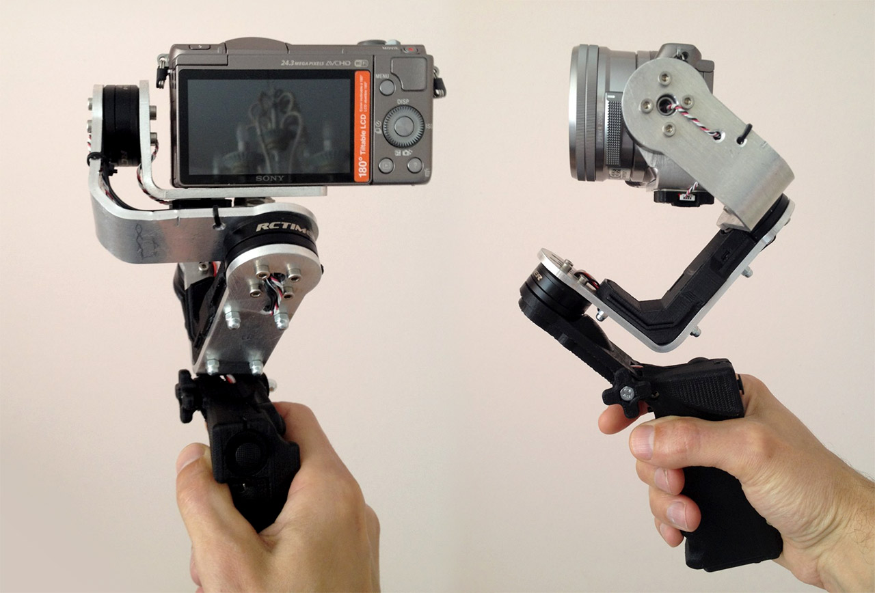
Notes:
a mechanism, typically consisting of rings pivoted at right angles, for keeping an instrument such as a compass or chronometer horizontal in a moving vessel or aircraft.

Slide 15
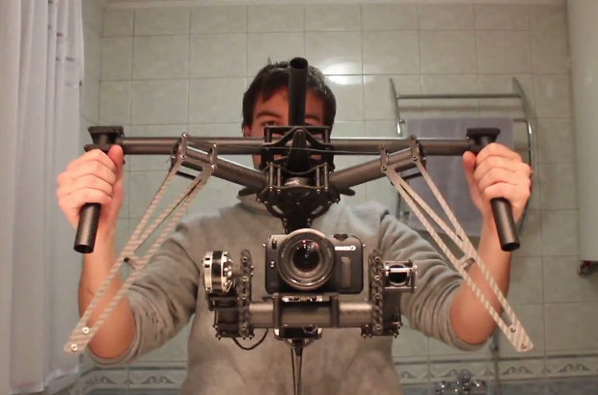

Slide 16
Digital Modeling using Legos Mecabricks Demo (https://www.mecabricks.com)

Slide 17
See you on Monday! Thank you!
☺

