Slide 1



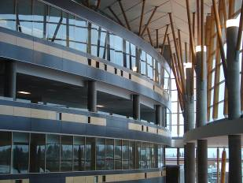

IAT 106
Spatial Thinking and Communicating
Spring 2021

Slide 2
Icebreaker - tell us your name - your major -if today was the end of this world, where would you wish to be?

Slide 3
Lab Content - Intro to GIMBAL mechanism - Intro to Concept Map - Developing a concept map of a Gimbal in groups of 4 (Break out sessions) - Intro to Mecabricks - Developing Digital Gimbals using Lego

Slide 4
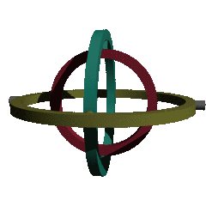
Gimbal Example
Objects: Pivot, Ring, Base, Support
Pivot: a support that enables an object attached to rotate about an axis
Ring: A circular structure that is supported by one or two pivots to either another ring or to the base.
Space:
Inner rings are smaller than the outer ring supporting them.
Rotations occur about axes in space.
The base sits on the XY plane.
Each object has a local coordinate system.
Operations change and move space and objects
If the outer ring rotates about X-axis, the inner ring rotates with it; and if the inner ring rotates about its Y-axis, the object on the inner ring can be rotated about X and Y axes simultaneously.
Two-Gimbal Mechanism

Slide 5
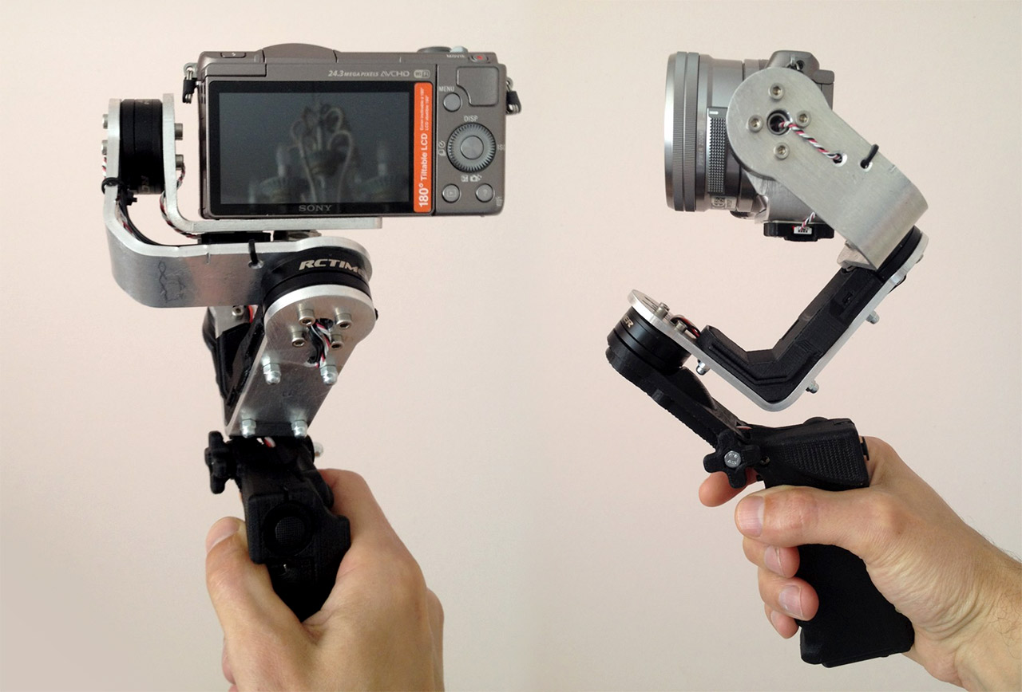
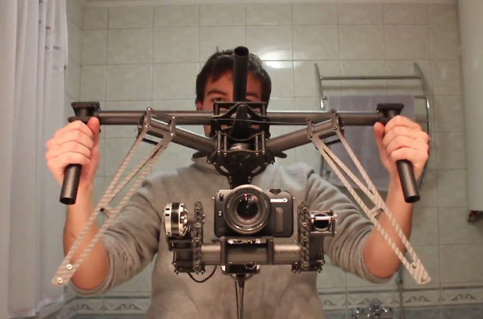
Notes:
a mechanism, typically consisting of rings pivoted at right angles, for keeping an instrument such as a compass or chronometer horizontal in a moving vessel or aircraft.

Slide 6
Concept Maps
A concept map is a diagram or graphical tool that visually represents relationships between concepts and ideas. Most concept maps depict ideas as boxes or circles (also called nodes), which are structured hierarchically and connected with lines or arrows (also called arcs). These lines are labeled with linking words and phrases to help explain the connections between concepts.
https://www.lucidchart.com/pages/concept-map

Slide 9
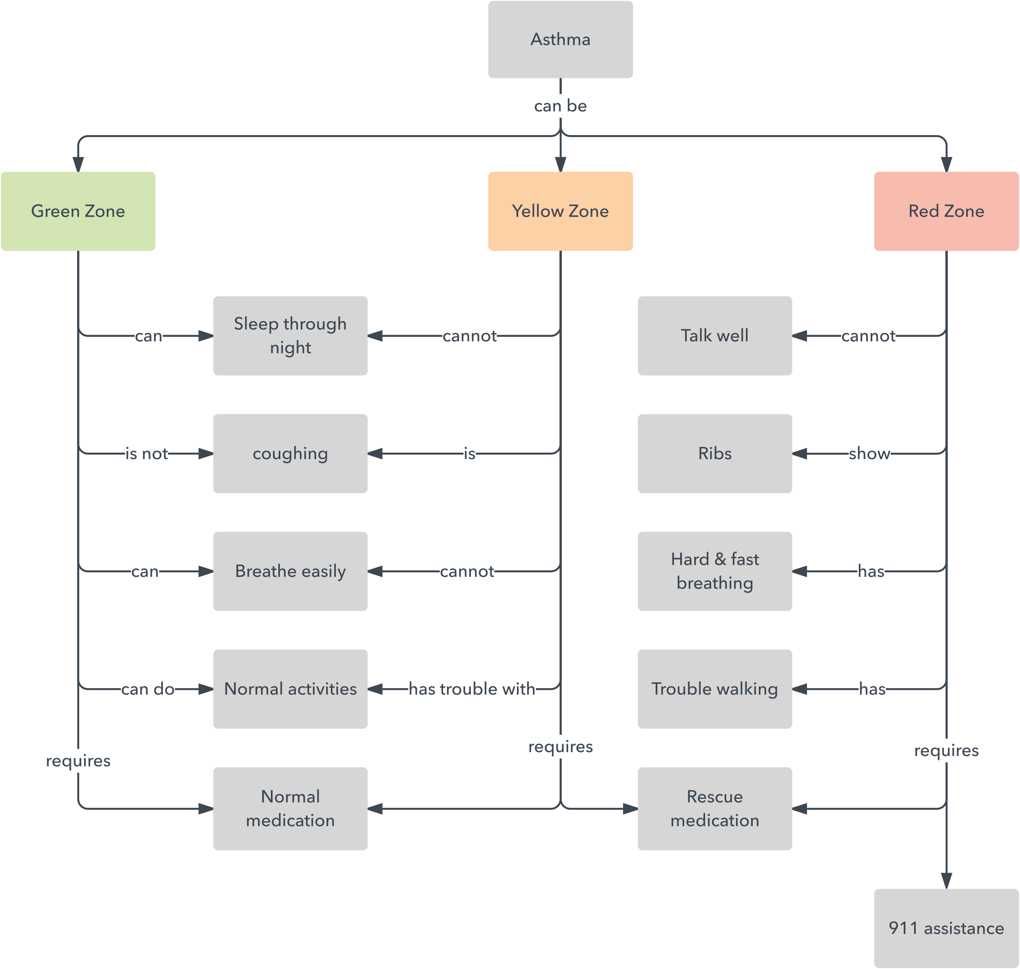

Slide 10
Concept Maps of a GIMBAL Let’s start BREAK OUT rooms in groups of 4. You will be randomly assigned into a group. You are expected to discuss with your group members how to develop a concept map of a Gimbal mechanism. Show each other your maps to learn from each other. TIME: 60 minutes

Slide 11
Digital Modeling using Legos Mecabricks Demo (https://www.mecabricks.com)

Slide 12
Digital Models of a GIMBAL Everyone is expected to start working on your digital model using Mecabricks individually. TIME: 60 minutes

Slide 13
Deliverables Next Week Sept. 21, 2020
Concept map uploaded on Canvas → Assignments
Digital Gimbal uploaded on Canvas → Assignments
Reflection on Gimbal project on Canvas → Assignments/Discussions. Reflection is on following 2 questions;
Describe one helpful and one unhelpful quality of each representation used on the labs (concept map and digital model) for the task of devising the gimbal assembly.
Imagine and list three differences and three similarities that you foresee to happen in developing a gimbal in digital environment vs. with physical Lego bricks, in terms of space, objects and operations.

Slide 14
See you on Monday! Thank you!
☺

